Slide 1
Programming Fundamentals 1

Slide 2
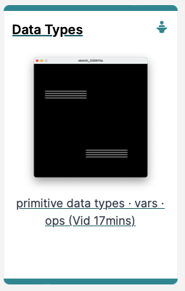
Introduction to Processing
Variables, Data Types &
Arithmetic Operators

Slide 3
Agenda
Variables
Assignment statement
Data Types
Java’s Primitive Data Types
Whole numbers
Decimal numbers
Others
Arithmetic operators

Slide 4

Variables

Slide 5
Variables
In Programming, variables:
are defined (created) in your programs
are used to store data (whose value can change over time)
have a data type.
have a name.
are a VERY important programming concept!

Slide 6
Variable names…
https://docs.oracle.com/javase/tutorial/java/nutsandbolts/variables.html
Are case-sensitive
Begin with either:
a letter (preferable),
the dollar sign "$", or
the underscore character "_"
Can contain letters, digits, "$", or "_" characters
Can be any length you choose
Cannot be a keyword or reserved word e.g. int, while, etc.
Cannot contain white spaces.
Notes:
We will name our variables beginning with a letter and typically containing only letters (no special characters).
CamelCase for variables and function names that have multiple words. We capitalize each word except the first

Slide 7
Variable names should be carefully chosen
Use full words instead of cryptic abbreviations e.g.
variables named speed and gear are much more intuitive than abbreviated versions, such as s and g.
If the name consists of:
only one word,
spell that word in all lowercase letters e.g. ratio.
more than one word,
capitalise the first letter of each subsequent word e.g. gearRatio and currentGear.
This is called camelCase
https://docs.oracle.com/javase/tutorial/java/nutsandbolts/variables.html

Slide 8
Assignment Statement

Slide 9
Assignment Statement
Values are stored in variables via assignment statements:
A variable stores a single value, so any previous value is lost
Assignment statements work by taking the value of what appears on the right-hand side of the operator and copying that value into a variable on the left-hand side
Syntax | variable = expression;
Example | diameter = 100;
Notes:
Animation is next

Slide 10
Assignment Statement
Values are stored in variables via assignment statements:
A variable stores a single value, so any previous value is lost
Assignment statements work by taking the value of what appears on the right-hand side of the operator and copying that value into a variable on the left-hand side
Syntax | variable = expression;
Example | diameter = 100;
Notes:
Animation is next

Slide 11
Assignment Statement
Values are stored in variables via assignment statements:
Syntax | variable = expression;
Example | diameter = 100;
diameter
100
100
Notes:
Animation is next

Slide 12
Data Types

Slide 13
Data Types
In Java, when we define (create) a variable, we have to give it a data type
The data type defines the kinds of values (data) that can be stored in the variable e.g.
-456
2
45.7897
I Love Programming
S
True
The data type also determines the operations that may be performed on it.
Notes:
Operations…e.g. I cannot divide “I Love Programming” by ‘S’.
E.g. Mathematical operations are only available on numeric types.
E.g. I cannot add ‘S’ to true.

Slide 14
Data Types
Java uses two kinds of data types:
Primitive types
Object types
We are only looking at Primitive types now; we will cover Object types later in the module

Slide 15
Java’s Primitive Data Types

Slide 16
Java’s Primitive Data Types
Java programming language supports eight primitive data types.
A primitive type is predefined by the language and is named by a reserved keyword.
A primitive type is highlighted red when it is typed into the PDE e.g.
int numberOfItems;
boolean bounceUp;
float lengthOfRectangle;

Slide 17
Java’s Primitive Data Types (Whole Numbers)

Slide 18
Java’s Primitive Data Types (whole numbers)
Type | Byte-size | Minimum value (inclusive) | Maximum value (inclusive) | Typical Use
byte | 8-bit | -128 | +127 | Useful in applications where memory savings apply
short | 16-bit | -32,768 | +32,767
int | 32-bit | -2,147,483,648 | +2,147,483,647 | Default choice
long | 64-bit | -9,223,372,036,854,775,808 | + 9,223,372,036,854,775,807 | Used when you need a data type with a range of values larger than that provided by int
Notes:
I usually show them how the minimum and max values for byte are calculated e.g.
8-bit is 2 to the power of 8 = 256
To spread this value over the negative/positive number range, divide by two = 128. so -128 range up to +127, with 0 being on the “positive size”.
Then they can always work out the min/max values for the other whole numbers.

Slide 19
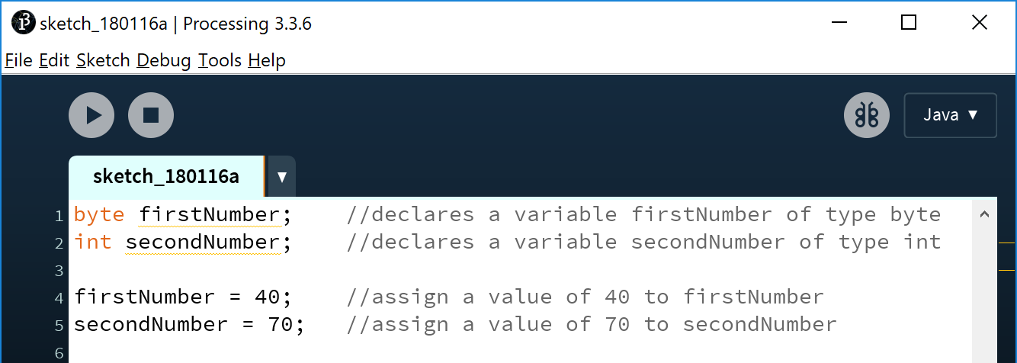
Declaring variables of a specific type
Notes:
Notice the yellow underline on both variable declarations. Yellow underlines are warnings and you can run your code with them. The PDE is just telling us that we haven’t meaningfully used the two variables further down the sketch; all we have done is assign a starting value. Meaningful use would be using the variable as the diameter of a circle, printing out the value of the variable, using it in a mathematical calculation, etc.
byte firstNumber; //declares a variable firstNumber of type byte
int secondNumber; //declares a variable secondNumber of type int
firstNumber = 40; //assign a value of 40 to firstNumber
secondNumber = 70; //assign a value of 70 to secondNumber

Slide 20
Declaring variables of a specific type
YELLOW underline – a warning message that indicates that the variable hasn’t been used meaningfully.
Notes:
Notice the yellow underline on both variable declarations. Yellow underlines are warnings and you can run your code with them. The PDE is just telling us that we haven’t meaningfully used the two variables further down the sketch; all we have done is assign a starting value. Meaningful use would be using the variable as the diameter of a circle, printing out the value of the variable, using it in a mathematical calculation, etc.
byte firstNumber; //declares a variable firstNumber of type byte
int secondNumber; //declares a variable secondNumber of type int
firstNumber = 40; //assign a value of 40 to firstNumber
secondNumber = 70; //assign a value of 70 to secondNumber

Slide 21
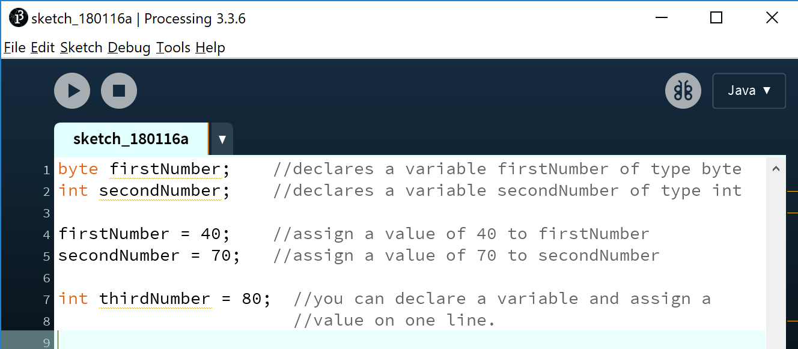
Declaring variables of a specific type
Notes:
byte firstNumber; //declares a variable firstNumber of type byte
int secondNumber; //declares a variable secondNumber of type int
firstNumber = 40; //assign a value of 40 to firstNumber
secondNumber = 70; //assign a value of 70 to secondNumber
int thirdNumber = 80; //you can declare a variable and assign a
//value on one line.

Slide 22
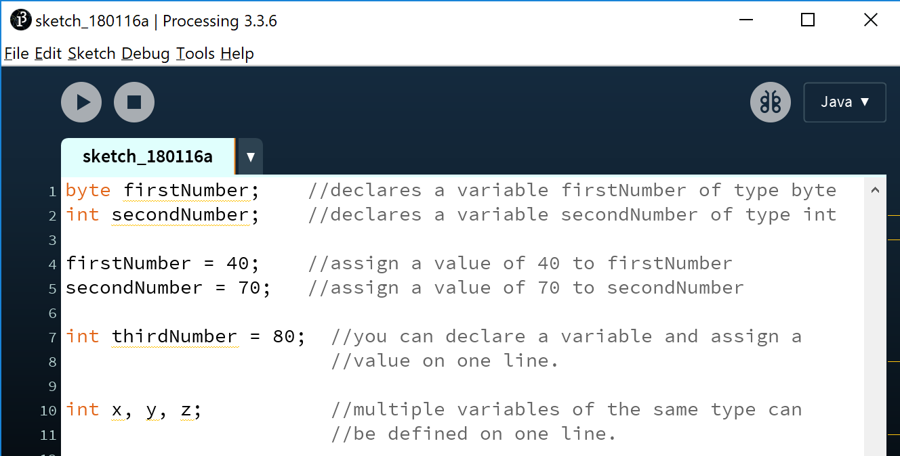
Declaring variables of a specific type
Notes:
byte firstNumber; //declares a variable firstNumber of type byte
int secondNumber; //declares a variable secondNumber of type int
firstNumber = 40; //assign a value of 40 to firstNumber
secondNumber = 70; //assign a value of 70 to secondNumber
int thirdNumber = 80; //you can declare a variable and assign a
//value on one line.
int x, y, z; //multiple variables of the same type can be defined
//on one line.

Slide 23
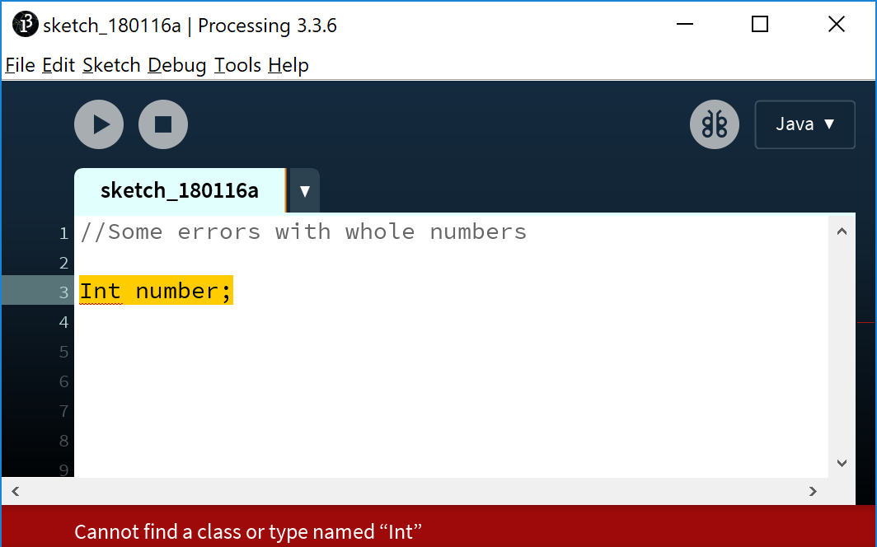
Declaring variables - some errors
Data types are case sensitive.
Int is not valid.
int is valid.
Notes:
Draw attention to the red underline…red means syntax errors and your program won’t run with them. Recall warnings are yellow and you can run with them.
//Some errors with whole numbers
Int number;

Slide 24
Declaring variables - some errors
Data types are case sensitive.
Int is not valid.
int is valid.
RED underline - indicates a type of syntax error
Notes:
Draw attention to the red underline…red means syntax errors and your program won’t run with them. Recall warnings are yellow and you can run with them.
//Some errors with whole numbers
Int number;

Slide 25
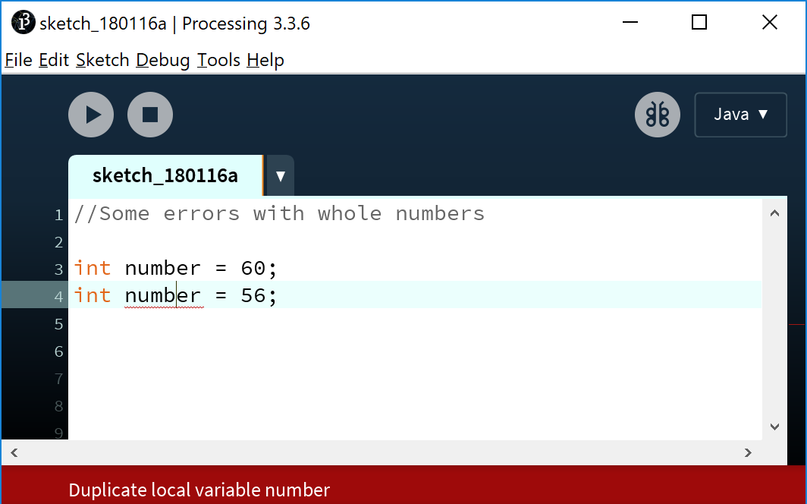
Declaring variables - some errors
Syntax error – you cannot define two variables with the same name.
Notes:
There is a “scoping” issue here…ie global and local scope…I would nearly not mention it until scope is covered…
//Some errors with whole numbers
int number = 60;
int number = 56;

Slide 26
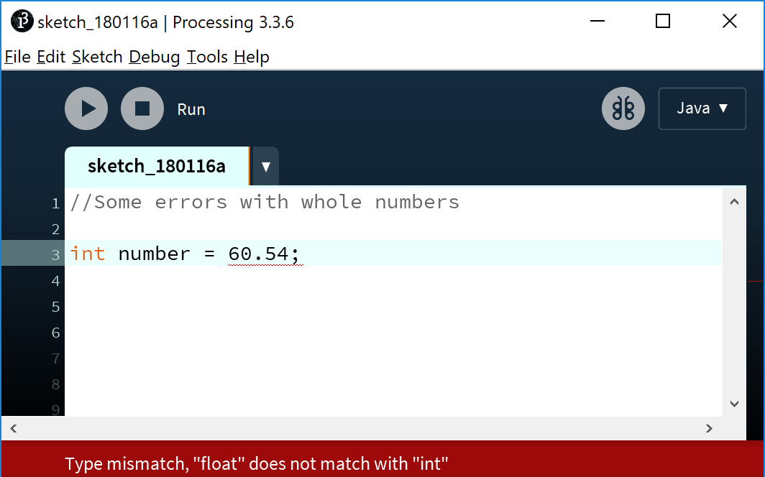
Declaring variables - some errors
Syntax error – you can only store whole numbers in an int variable.

Slide 27
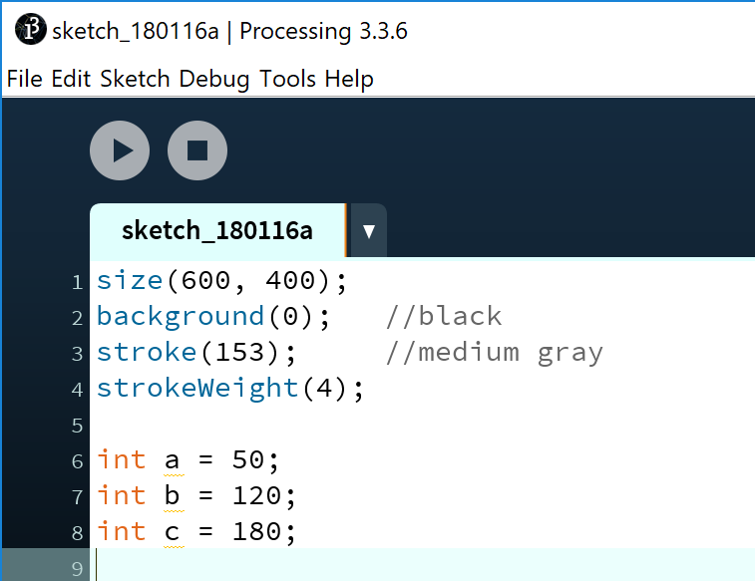
Java’s Primitive Data Types: int example
In this example, we have defined three variables (a, b and c) that:
can hold whole numbers (int).
are set with a starting value.
Based on the Processing Example: Basics → Data → Variables
Notes:
//NOTE: we used a, b, c here, which clearly violates our rules for declaring variables.
//However, we used these as we will be doing a lot of calculations on the variables in labs and if we had long variable names it would have been very hard to read. Our sketch only has a few lines of code, so it is kinda ok to do it here, but if our sketch was larger, we should definitely avoid this approach.
size(600, 400);
background(0); //black
stroke(153); //medium gray
strokeWeight(4);
int a = 50;
int b = 120;
int c = 180;

Slide 28
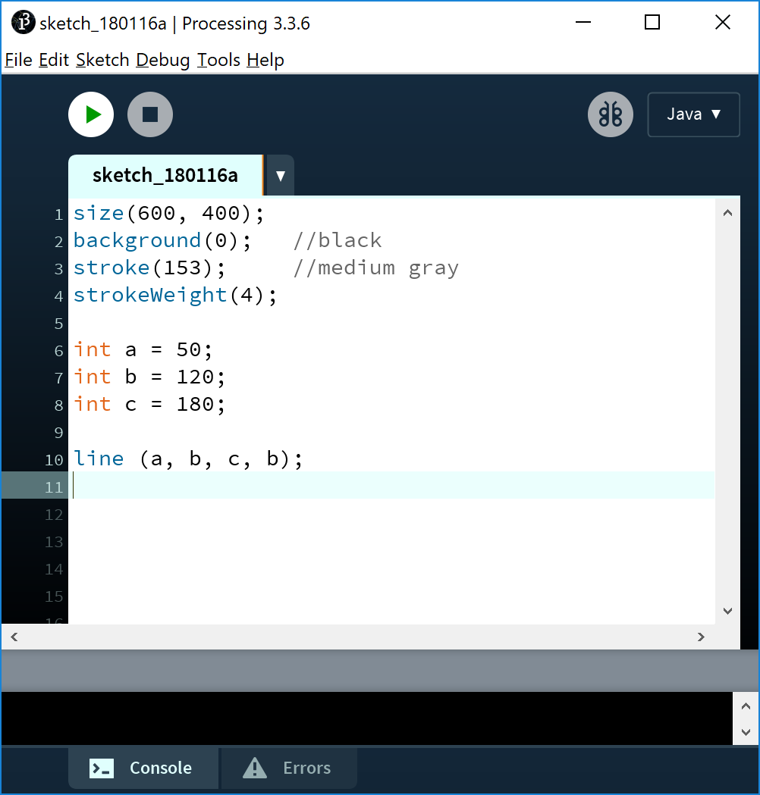
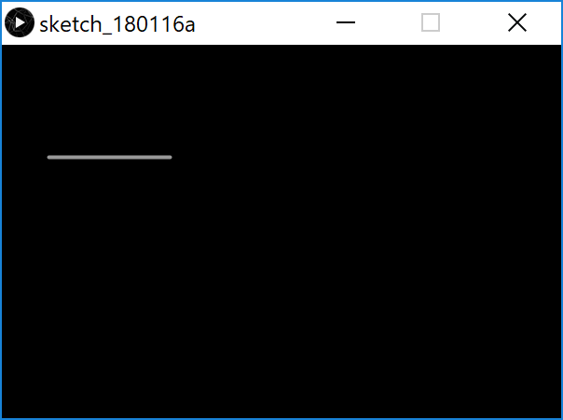
Java’s Primitive Data Types: int example
We can pass the defined variables as values to functions.
Based on the Processing Example: Basics → Data → Variables
Notes:
size(600, 400);
background(0); //black
stroke(153); //medium gray
strokeWeight(4);
int a = 50;
int b = 120;
int c = 180;
line (a, b, c, b);

Slide 29
Java’s Primitive Data Types: int example
Type | Minimum value (inclusive) | Maximum value (inclusive)
byte | -128 | 127
short | -32,768 | 32,767
int | -2,147,483,648 | 2,147,483,647
long | -9,223,372,036,854,775,808 | 9,223,372,036,854,775,807
Q: Could we have used the byte data type instead of int?
Based on the Processing Example: Basics → Data → Variables

Slide 30
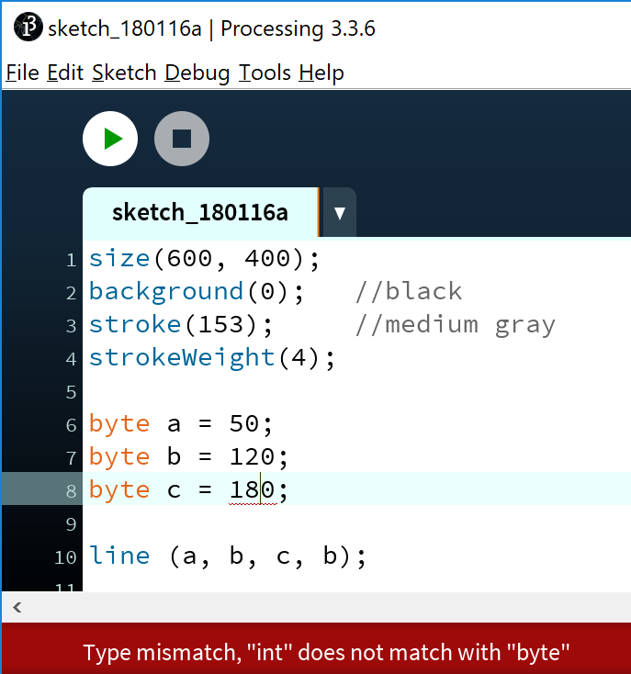
Java’s Primitive Data Types: int example
Type | Min value | Max value
byte | -128 | 127
short | -32,768 | 32,767
Q: Could we have used the byte data type instead of int?
A: For a and b we could have; 50 and 120 fall below the max value of 127. But c produces a syntax error; 180 cannot fit into a 127 capacity variable.
Based on the Processing Example: Basics → Data → Variables

Slide 31
Java’s Primitive Data Types (Decimal Numbers)

Slide 32
Java’s Primitive Data Types (decimal numbers)
Type | Byte-size | Minimum value (inclusive) | Maximum value (inclusive) | Typical Use
float | 32-bit | Beyond the scope of this lecture . There is also a loss of precision in this data-type that we will cover in later lectures. |  | Useful in applications where memory savings apply. Default choice when using Processing.
double | 64-bit |  |  | Default choice when programming Java apps.

Slide 33
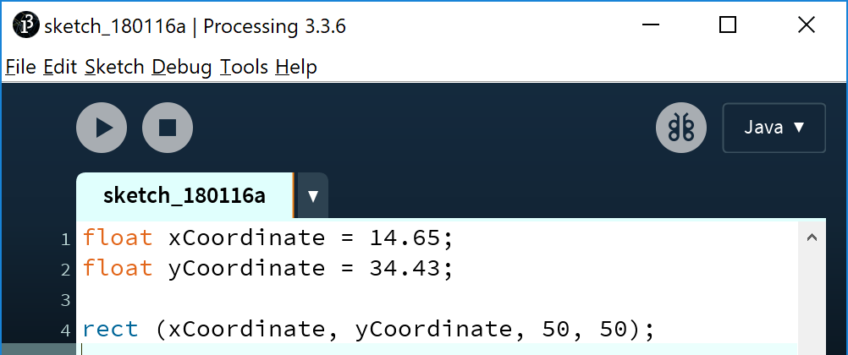
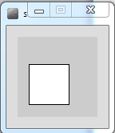
Java’s Primitive Data Types (decimal numbers)
We can pass the defined variables as values to functions.
Notes:
float xCoordinate = 14.65;
float yCoordinate = 34.43;
rect (xCoordinate, yCoordinate, 50, 50);

Slide 34
Java’s Primitive Data Types: float example
Whole numbers can be placed into a float variable.
Q: Why?
Notes:
float xCoordinate = 14;
float yCoordinate = 34;
rect (xCoordinate, yCoordinate, 50, 50);

Slide 35
Java’s Primitive Data Types: float example
Whole numbers can be placed into a float variable.
Q: Why?
A: There is no loss of precision. We are not losing any data.
Notes:
float xCoordinate = 14;
float yCoordinate = 34;
rect (xCoordinate, yCoordinate, 50, 50);

Slide 36
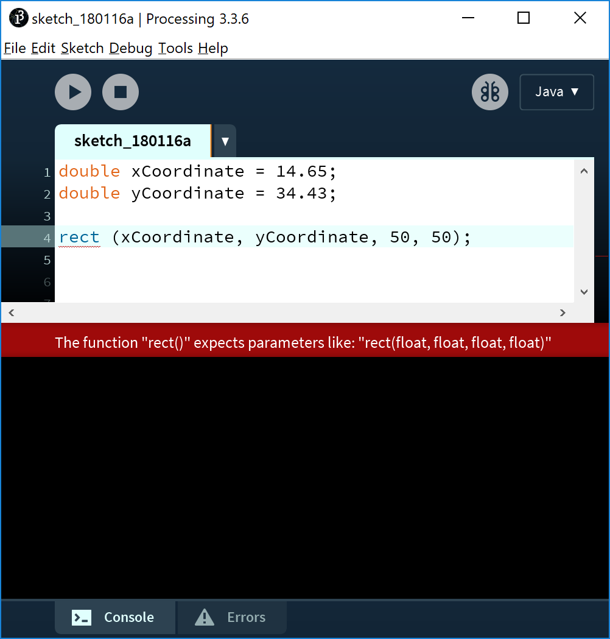
Passing variables as arguments: some errors
We changed the data type of our variables from float to double.
Q: Why are we getting this syntax error?
Notes:
double xCoordinate = 14.65;
double yCoordinate = 34.43;
rect (xCoordinate, yCoordinate, 50, 50);

Slide 37
Passing variables as arguments: some errors
We changed the data type of our variables from float to double.
Q: Why are we getting this syntax error?
A: a double variable has a larger capacity than a float. A float is required in the rect() method. The value stored in the double may not fit into the float.
Notes:
double xCoordinate = 14.65;
double yCoordinate = 34.43;
rect (xCoordinate, yCoordinate, 50, 50);

Slide 38
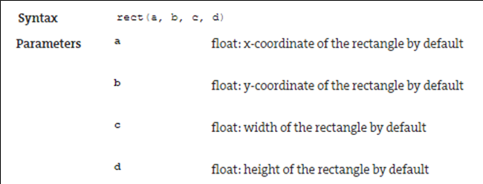
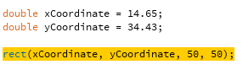
Passing variables as arguments: some errors
From: https://processing.org/reference/rect_.html

Slide 39
Java’s Primitive Data Types (Others)

Slide 40
Java’s Primitive Data Types (others)
We will go into more detail on these two data types in later lectures.
Type | Byte-size | Minimum value (inclusive) | Maximum value (inclusive) | Typical Use
char | 16-bit | '\u0000’ (or 0) | '\uffff' (or 65,535) | Represents a Unicode character
boolean | 1-bit | n/a |  | Holds either true or false and is typically used as a flag
http://en.wikipedia.org/wiki/List_of_Unicode_characters

Slide 41
Java’s Primitive Data Types (default values)
Data Type | Default Value
byte | 0
short | 0
int | 0
long | 0L
float | 0.0f
double | 0.0d
char | '\u0000'
boolean | false
http://docs.oracle.com/javase/tutorial/java/nutsandbolts/datatypes.html

Slide 42
Arithmetic operators

Slide 43
Arithmetic Operators
Arithmetic Operator | Explanation | Example(s)
+ | Addition | 6 + 2 amountOwed + 10
- | Subtraction | 6 – 2 amountOwed – 10
* | Multiplication | 6 * 2 amountOwed * 10
/ | Division | 6 / 2 amountOwed / 10

Slide 44
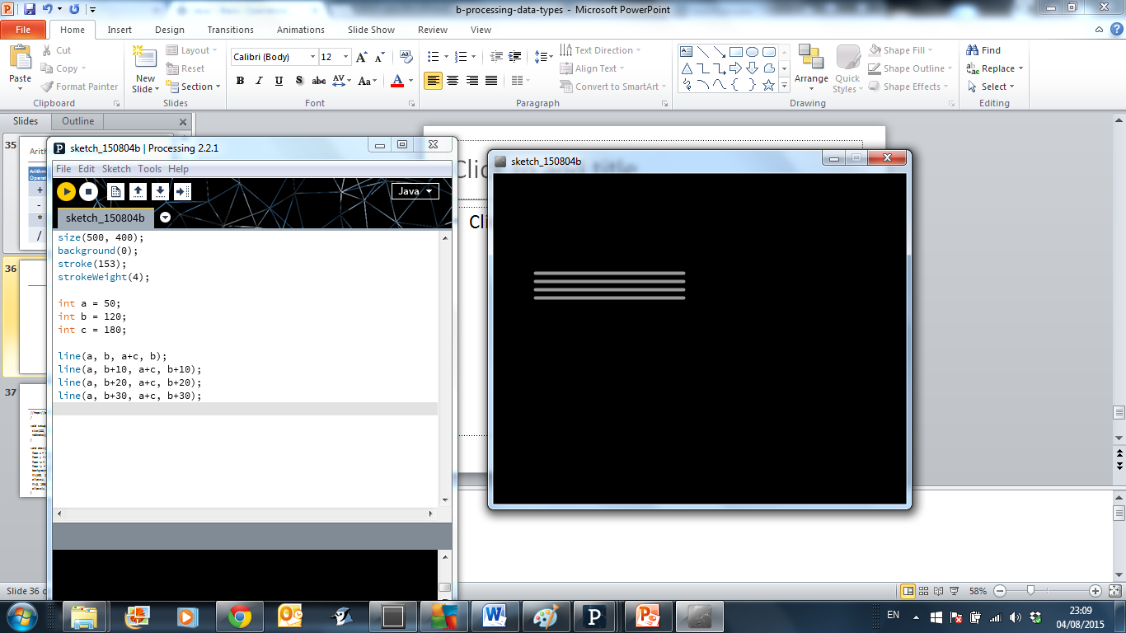
Arithmetic operators: example 1
Based on the Processing Example: Basics → Data → Variables
Notes:
size(500, 400);
background(0);
stroke(153);
strokeWeight(4);
int a = 50;
int b = 120;
int c = 180;
line(a, b, a+c, b);
line(a, b+10, a+c, b+10);
line(a, b+20, a+c, b+20);
line(a, b+30, a+c, b+30);

Slide 45
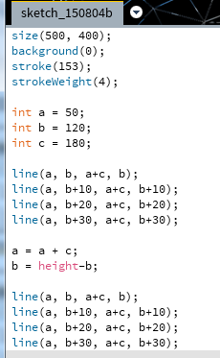
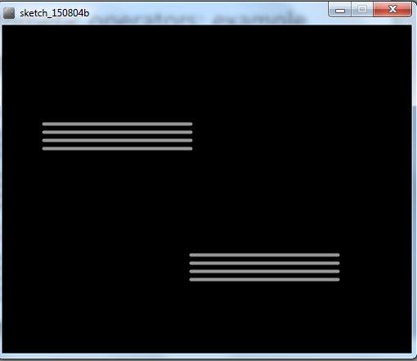
Arithmetic operators: example 2
Based on the Processing Example: Basics → Data → Variables
Notes:
size(500, 400);
background(0);
stroke(153);
strokeWeight(4);
int a = 50;
int b = 120;
int c = 180;
line(a, b, a+c, b);
line(a, b+10, a+c, b+10);
line(a, b+20, a+c, b+20);
line(a, b+30, a+c, b+30);
a = a + c;
b = height-b;
line(a, b, a+c, b);
line(a, b+10, a+c, b+10);
line(a, b+20, a+c, b+20);
line(a, b+30, a+c, b+30);

Slide 46
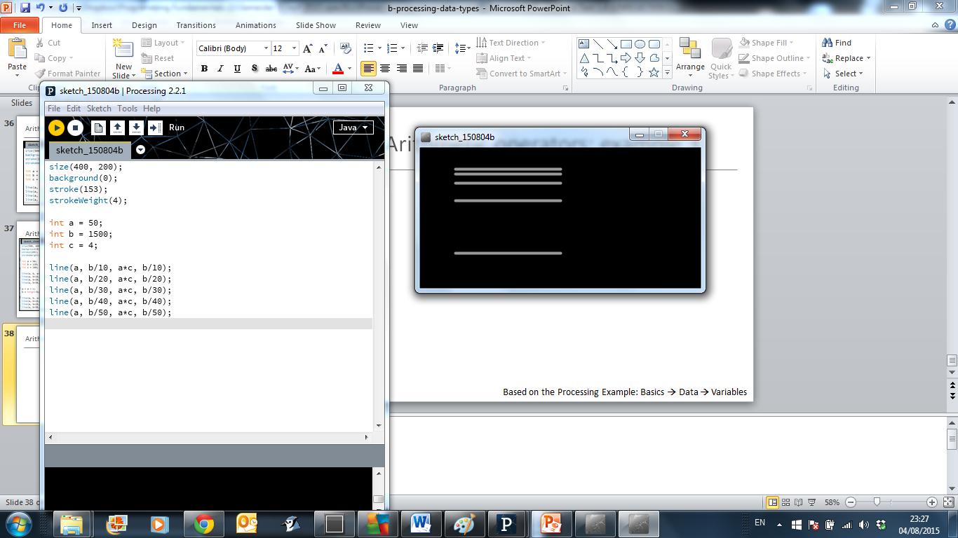
Arithmetic operators: example 3
Based on the Processing Example: Basics → Data → Variables
Notes:
size(400, 200);
background(0);
stroke(153);
strokeWeight(4);
int a = 50;
int b = 1500;
int c = 4;
line(a, b/10, a*c, b/10);
line(a, b/20, a*c, b/20);
line(a, b/30, a*c, b/30);
line(a, b/40, a*c, b/40);
line(a, b/50, a*c, b/50);

Slide 47

Questions?

Slide 48



