Slide 1
Programming Fundamentals 1

Slide 2
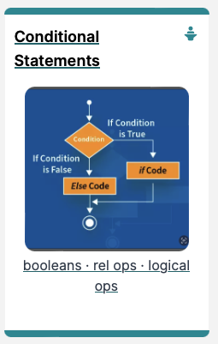
Introduction to Processing
Conditional Statements and Boolean Expressions

Slide 3
Agenda
Conditional Statements
Boolean Conditions & Relational Operators
Logical Operators

Slide 4

Conditional Statements

Slide 5
Conditional Statement Syntax (1)
if( perform some test )
{
Do these statements if the test gave a true result
}

Slide 6
Conditional Statement Syntax (1)
boolean condition to be tested
‘if’ keyword
actions if condition is true
if( perform some test )
{
Do these statements if the test gave a true result
}
curly braces
parentheses

Slide 7
Conditional Statement Syntax (2)
boolean condition to be tested
‘if’ keyword
actions if condition is true
if(perform some test) {
Do these statements if the test gave a true result
}
else {
Do these statements if the test gave a false result
}
actions if condition is false
‘else’ keyword

Slide 8
Conditional Statement Syntax (3)
if(condition1…perform some test)
{
Do these statements if condition1 gave a true result
}
else if(condition2…perform some test)
{
Do these statements if condition1 gave a false result and condition2 gave a true result
}
else
{
Do these statements if both condition1 and
condition2 gave a false result
}
Notes:
You can half multiple occurances of “else if”

Slide 9
Boolean Conditions & Relational Operators

Slide 10
Boolean conditions
A boolean condition is an expression that evaluates to either true or false e.g.
mouseX < 50
An if statement evaluates a boolean condition and its result will determine which portion of the if statement is executed.

Slide 11
Boolean conditions
// Do these statements before.
if (boolean condition)
{
// Perform this clause if the
// condition is true.
}
// Do these statements after.

Slide 12
Java Relational Operators
Operator | Use | Returns true if…
> | op1 > op2 | op1 is greater than op2
>= | op1 >= op2 | op1 is greater than or equal to op2
< | op1 < op2 | op1 is less than op2
<= | op1 <= op2 | op1 is less than or equal to op2
== | op1 == op2 | op1 and op2 are equal
!= | op1 != op2 | op1 and op2 are not equal
BEWARE = is an assignment operator.
It doesn’t test for equality. Use == to test for equality in primitive types
Source: http://www.freejavaguide.com/relational_operators.htm

Slide 13
Some notes on the if statement
An if statement IS a statement - it is only executed once
When your if statement only has one statement inside it, you do not need to use the curly braces
For example, both of these are the same:
if (mouseX < 50)
{
rect(0, 0, 50, 100);
}
if (mouseX < 50)
rect(0, 0, 50, 100);
Notes:
But I would advise to use use them to avoid errors when updating programs later.

Slide 14
Some notes on the if statement
The semi-colon (;) is a statement terminator.
if (mouseX < 50)
{
rect(0, 0, 50, 100) ;
}
Your if statement does not need a statement terminator.
Notes:
Why?
A simple statement ends in a semi colon
A compound statement is a collection of statement surround by curly braces
An if statement is the if keyword followed by a condition in brackets followed by compound statement

Slide 15
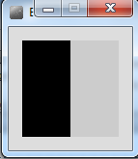
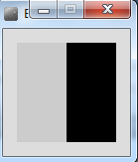
Conditional Example 3.1
Functionality:
If the x-coordinate of the mouse pointer is on the:
left half of the display window, draw a rectangle on the left hand side.
right half of the display window, draw a rectangle on the right hand side.

Slide 16
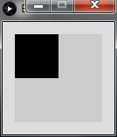
(0,0)
(100,0)
(0,100)
(100,100)
(50,50)

Slide 17
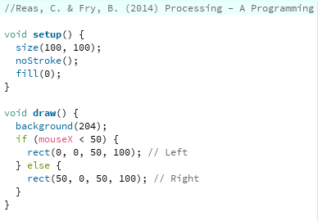
Conditional Example 3.1 - code
Notes:
QUESTION: Replace the x value in the rect() function call with a statement that calculates the width of the rectangle to draw
//Reas, C. & Fry, B. (2014) Processing – A Programming Handbook for Visual Designers and Artists, 2nd Edition, MIT Press, London.
void setup() {
size(100, 100);
noStroke();
fill(0);
}
void draw() {
background(204);
if (mouseX < 50) {
rect(0, 0, 50, 100); // Left
} else {
rect(50, 0, 50, 100); // Right
}
}

Slide 18
Conditional Example 3.1 - code
Notes:
QUESTION: Replace the x value in the rect() function call with a statement that calculates the width of the rectangle to draw
//Reas, C. & Fry, B. (2014) Processing – A Programming Handbook for Visual Designers and Artists, 2nd Edition, MIT Press, London.
void setup() {
size(100, 100);
noStroke();
fill(0);
}
void draw() {
background(204);
if (mouseX < 50) {
rect(0, 0, 50, 100); // Left
} else {
rect(50, 0, 50, 100); // Right
}
}

Slide 19
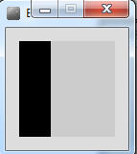
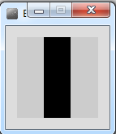
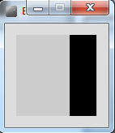
Conditional Example 3.2
Functionality:
If the x-coordinate of the mouse pointer is on the:
left third of the display window, draw a rectangle on the left third of the window.
middle third of the display window, draw a rectangle on the middle third of the window.
right third of the display window, draw a rectangle on the right third of the window.

Slide 20
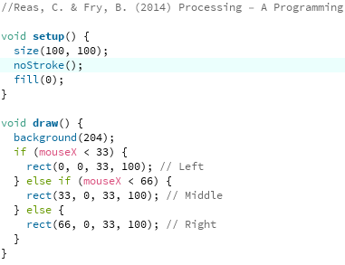
Conditional Example 3.2 - code
Notes:
QUESTION: Replace the x value in the rect() function call with a statement that calculates the width of the rectangle to draw
//Reas, C. & Fry, B. (2014) Processing – A Programming Handbook for Visual Designers and Artists, 2nd Edition, MIT Press, London.
void setup() {
size(100, 100);
noStroke();
fill(0);
}
void draw() {
background(204);
if (mouseX < 33) {
rect(0, 0, 33, 100); // Left
} else if (mouseX < 66) {
rect(33, 0, 33, 100); // Middle
} else {
rect(66, 0, 33, 100); // Right
}
}

Slide 21
Conditional Example 3.2 - code
Notes:
QUESTION: Replace the x value in the rect() function call with a statement that calculates the width of the rectangle to draw
//Reas, C. & Fry, B. (2014) Processing – A Programming Handbook for Visual Designers and Artists, 2nd Edition, MIT Press, London.
void setup() {
size(100, 100);
noStroke();
fill(0);
}
void draw() {
background(204);
if (mouseX < 33) {
rect(0, 0, 33, 100); // Left
} else if (mouseX < 66) {
rect(33, 0, 33, 100); // Middle
} else {
rect(66, 0, 33, 100); // Right
}
}

Slide 22
Logical Operators

Slide 23
Logical operators
Logic operators operate on boolean values.
They produce a new boolean value as a result.
The ones that we will use, so far, are:
&& (and)
|| (or)
! (not)

Slide 24
Logical operators - AND
a && b
This evaluates to true if both a and b are true.
It is false in all other cases.
a | b | a && b
0 | 0 | 0
0 | 1 | 0
1 | 0 | 0
1 | 1 | 1

Slide 25
Logical operators - OR
a || b
This evaluates to true if either a or b or both are true, and false if they are both false.
a | b | a II b
0 | 0 | 0
0 | 1 | 1
1 | 0 | 1
1 | 1 | 1

Slide 26
Logical operators - NOT
!a
This evaluates to true if a is false, and false if a is true.
a | !a
0 | 1
1 | 0

Slide 27
Logical operators - Quiz
int a = 5;
int b = 10;
int c = 7;
What is the result of each of these boolean expressions:
Q1 (a > b) && (a < c)
Q2 (a < b) || (c < a)
Q3 !(b < a) && (c > b)
Notes:
(a > b) && (a < c) = (5>10) is false. (5<7) is true. Overall FALSE
(a < b) || (c < a) = (5 < 10) is true. As we are using the “lazy” OR, we don’t have to evaluate the other side…overall answer is TRUE.
!(b < a) && (c > b) = !(10 < 5) is true. (7 > 10) is false. Overall FALSE.

Slide 28
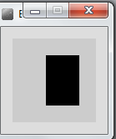
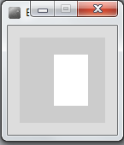
Conditional Example 3.3
Functionality:
If the mouse pointer is:
inside the rectangle coordinates, then fill the rectangle with white.
otherwise, fill with black.

Slide 29
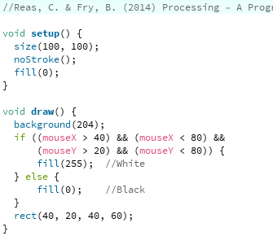
Conditional Example 3.3 - code
Notes:
//Reas, C. & Fry, B. (2014) Processing – A Programming Handbook for Visual Designers and Artists, 2nd Edition, MIT Press, London.
void setup() {
size(100, 100);
noStroke();
fill(0);
}
void draw() {
background(204);
if ((mouseX > 40) && (mouseX < 80) &&
(mouseY > 20) && (mouseY < 80)) {
fill(255); //White
} else {
fill(0); //Black
}
rect(40, 20, 40, 60);
}

Slide 30
Conditional Example 3.3 - code
Notes:
//Reas, C. & Fry, B. (2014) Processing – A Programming Handbook for Visual Designers and Artists, 2nd Edition, MIT Press, London.
void setup() {
size(100, 100);
noStroke();
fill(0);
}
void draw() {
background(204);
if ((mouseX > 40) && (mouseX < 80) &&
(mouseY > 20) && (mouseY < 80)) {
fill(255); //White
} else {
fill(0); //Black
}
rect(40, 20, 40, 60);
}

Slide 31
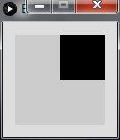
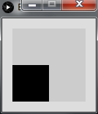
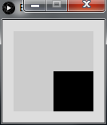
Conditional Example 3.4
Functionality:
If the mouse pointer is in the upper-left quadrant of the display window, draw a black rectangle covering the upper-left quadrant of the window.
Repeat this approach for upper-right, lower-left and lower-right quadrants.

Slide 32
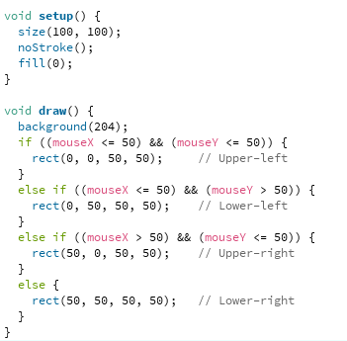
Conditional Example 3.4 - code
Notes:
//Reas, C. & Fry, B. (2014) Processing – A Programming Handbook for Visual Designers and Artists, 2nd Edition, MIT Press, London.
void setup() {
size(100, 100);
noStroke();
fill(0);
}
void draw() {
background(204);
if ((mouseX <= 50) && (mouseY <= 50)) {
rect(0, 0, 50, 50); // Upper-left
}
else if ((mouseX <= 50) && (mouseY > 50)) {
rect(0, 50, 50, 50); // Lower-left
}
else if ((mouseX > 50) && (mouseY <= 50)) {
rect(50, 0, 50, 50); // Upper-right
}
else {
rect(50, 50, 50, 50); // Lower-right
}
}

Slide 33
References
Reas, C. & Fry, B. (2014) Processing – A Programming Handbook for Visual Designers and Artists, 2nd Edition, MIT Press, London.

Slide 34

Questions?

Slide 35



