Slide 1
Programming Fundamentals 1

Slide 2
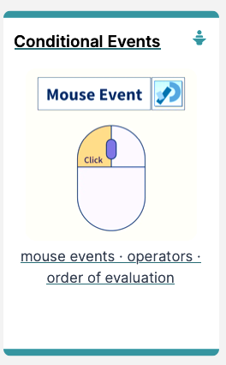
Introduction to Processing
Conditional Mouse Events &
Operators

Slide 3
Agenda
Mouse Events
Recap: Arithmetic Operators
Order of Evaluation

Slide 4

Mouse Events

Slide 5
What is an event?
“…an action such as
a key being pressed,
the mouse moving,
or a new piece of data
becoming available to read.”
(Reas & Fry, 2014)

Slide 6
What happens when an event is “fired”?
“An event interrupts
the normal flow
of a program
to run the code
within an event block”
(Reas & Fry, 2014)

Slide 7
Mouse Events
Mouse Variables | Description
mousePressed | true if any mouse button is pressed, false otherwise. Note: this variable reverts to false as soon as the button is released.
mouseButton | Can have the value LEFT, RIGHT and CENTER, depending on the mouse button most recently pressed. Note: this variable retains its value until a different mouse button is pressed.
Notes:
Draw attention to the spelling of CENTER…american spelling. We won’t be using the CENTER one, just left and right.

Slide 8
Mouse Events
Mouse and keyboard events only work when a program has draw()
Without draw(), the code is only run once and then stops “listening” for events
Source: https://processing.org/reference/

Slide 9
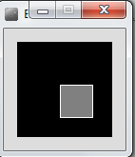
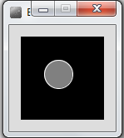
Processing Example 3.5
Functionality:
If the mouse is pressed:
draw a grey square with a white outline.
otherwise draw a grey circle with a white outline.

Slide 10
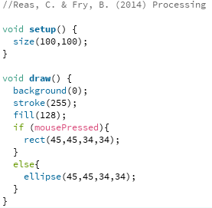
Processing Example 3.5 - Code
Notes:
//Reas, C. & Fry, B. (2014) Processing – A Programming Handbook for Visual Designers and Artists, 2nd Edition, MIT Press, London.
void setup() {
size(100,100);
}
void draw() {
background(0);
stroke(255);
fill(128);
if (mousePressed){
rect(45,45,34,34);
}
else{
ellipse(45,45,34,34);
}
}

Slide 11
Processing Example 3.5 - Code
Notes:
//Reas, C. & Fry, B. (2014) Processing – A Programming Handbook for Visual Designers and Artists, 2nd Edition, MIT Press, London.
void setup() {
size(100,100);
}
void draw() {
background(0);
stroke(255);
fill(128);
if (mousePressed){
rect(45,45,34,34);
}
else{
ellipse(45,45,34,34);
}
}

Slide 12
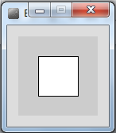
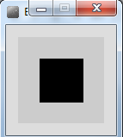
Processing Example 3.6
Functionality:
If the mouse is pressed:
set the fill to white and draw a square.
otherwise set the fill to black and draw a square.

Slide 13
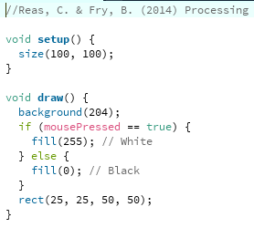
Processing Example 3.6
Notes:
//Reas, C. & Fry, B. (2014) Processing – A Programming Handbook for Visual Designers and Artists, 2nd Edition, MIT Press, London.
void setup() {
size(100, 100);
}
void draw() {
background(204);
if (mousePressed == true) {
fill(255); // White
} else {
fill(0); // Black
}
rect(25, 25, 50, 50);
}

Slide 14
Processing Example 3.6
Notes:
//Reas, C. & Fry, B. (2014) Processing – A Programming Handbook for Visual Designers and Artists, 2nd Edition, MIT Press, London.
void setup() {
size(100, 100);
}
void draw() {
background(204);
if (mousePressed == true) {
fill(255); // White
} else {
fill(0); // Black
}
rect(25, 25, 50, 50);
}

Slide 15
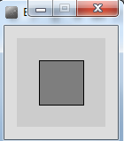
Processing Example 3.7
Functionality:
If the LEFT button on the mouse is pressed, set the fill to black and draw a square. As soon as the LEFT button is released, grey fill the square.
If the RIGHT button on the mouse is pressed, set the fill to white and draw a square. As soon as the RIGHT button is released, grey fill the square.
If no mouse button is pressed, set the fill to grey and draw a square.

Slide 16
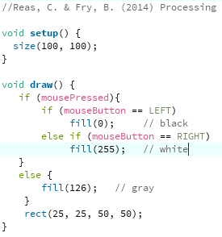
Processing Example 3.7
Notes:
Nested IF:
If statement inside and if statement
//Reas, C. & Fry, B. (2014) Processing – A Programming Handbook for Visual Designers and Artists, 2nd Edition, MIT Press, London.
void setup() {
size(100, 100);
}
void draw() {
if (mousePressed){
if (mouseButton == LEFT)
fill(0); // black
else if (mouseButton == RIGHT)
fill(255); // whit
}
else {
fill(126); // gray
}
rect(25, 25, 50, 50);
}

Slide 17
Processing Example 3.7
Nested
if
Notes:
Nested IF:
If statement inside and if statement
//Reas, C. & Fry, B. (2014) Processing – A Programming Handbook for Visual Designers and Artists, 2nd Edition, MIT Press, London.
void setup() {
size(100, 100);
}
void draw() {
if (mousePressed){
if (mouseButton == LEFT)
fill(0); // black
else if (mouseButton == RIGHT)
fill(255); // whit
}
else {
fill(126); // gray
}
rect(25, 25, 50, 50);
}

Slide 18
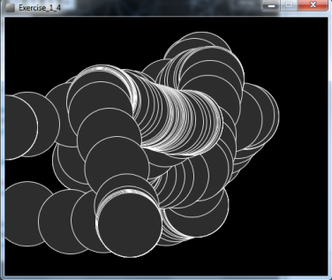
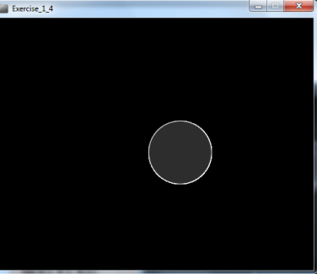
Processing Example 3.8
Functionality:
Draw a circle on the mouse (x,y) coordinates.
Each time you move the mouse, draw a new circle.
All the circles remain in the sketch until you press a mouse button.
When you press a mouse button, the sketch is cleared and a single circle is drawn at the mouse (x,y) coordinates.
Notes:
mouseX mouseY
put an ellipse() in the draw function
mousePressed
Background() // clears

Slide 19
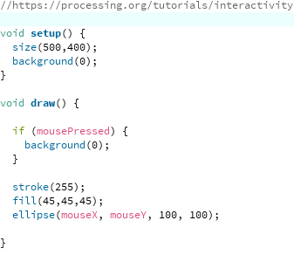
Processing Example 3.8
https://processing.org/tutorials/interactivity/
Notes:
//https://processing.org/tutorials/interactivity
void setup() {
size(500,400);
background(0);
}
void draw() {
if (mousePressed) {
background(0);
}
stroke(255);
fill(45,45,45);
ellipse(mouseX, mouseY, 100, 100);
}

Slide 20
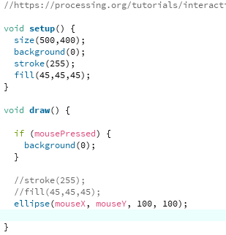
Processing Example 3.8
We moved the stroke and fill function calls to the setup() function.
Q: Does this change the functionality of our sketch?
Notes:
A: No…it just calls them once, in setup(); there was no need to call them repeatedly in draw().
//https://processing.org/tutorials/interactivity
void setup() {
size(500,400);
background(0);
stroke(255);
fill(45,45,45);
}
void draw() {
if (mousePressed) {
background(0);
}
//stroke(255);
//fill(45,45,45);
ellipse(mouseX, mouseY, 100, 100);
}

Slide 21
Recap : Arithmetic Operators

Slide 22
Recap: Arithmetic Operators
Arithmetic Operator | Explanation | Example(s)
+ | Addition | 6 + 2 amountOwed + 10
- | Subtraction | 6 – 2 amountOwed – 10
* | Multiplication | 6 * 2 amountOwed * 10
/ | Division | 6 / 2 amountOwed / 10

Slide 23
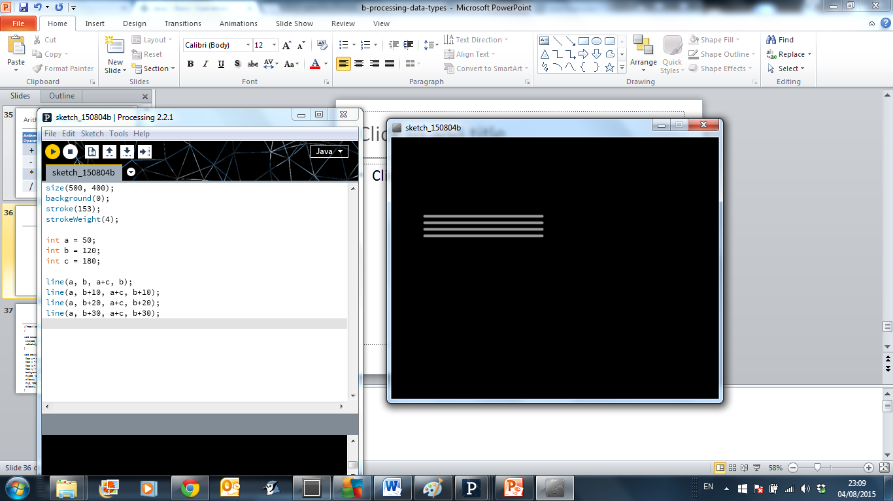
Recap: Arithmetic Operators
Based on the Processing Example: Basics → Data → Variables
Notes:
size(500, 400);
background(0);
stroke(153);
strokeWeight(4);
int a = 50;
int b = 120;
int c = 180;
line(a, b, a+c, b);
line(a, b+10, a+c, b+10);
line(a, b+20, a+c, b+20);
line(a, b+30, a+c, b+30);

Slide 24
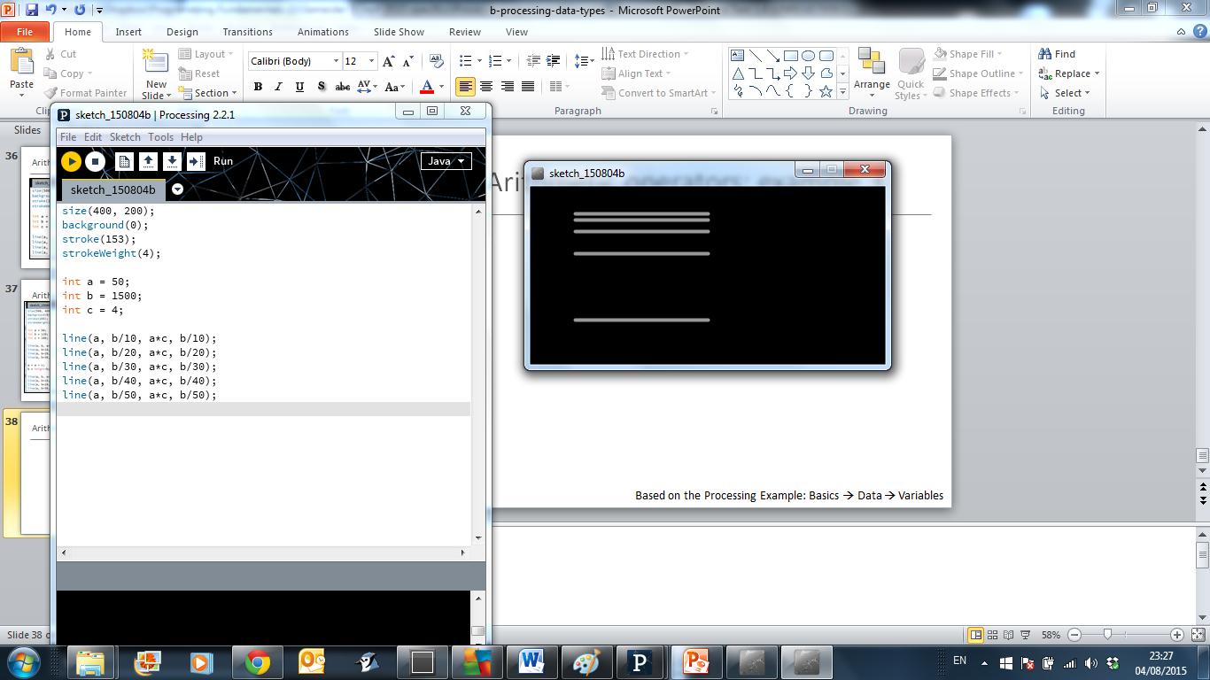
Recap: Arithmetic Operators
Based on the Processing Example: Basics → Data → Variables
Notes:
size(400, 200);
background(0);
stroke(153);
strokeWeight(4);
int a = 50;
int b = 1500;
int c = 4;
line(a, b/10, a*c, b/10);
line(a, b/20, a*c, b/20);
line(a, b/30, a*c, b/30);
line(a, b/40, a*c, b/40);
line(a, b/50, a*c, b/50);

Slide 25
Arithmetic Operators
If you want to keep track of how many times something happens, you are keeping a running total. For example
The number of times you drew a line on the computer screen
As each line is drawn, you add one to your counter variable

Slide 26
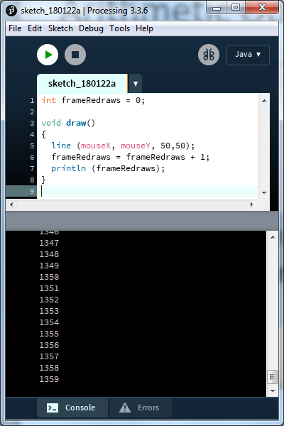
Arithmetic Operators
This code declares a new variable of type int called frameRedraws and initialises it to 0.
One is added to the frameRedraws variable each time the draw() method is called.
The value of frameRedraws is then printed to the console.
frameRedraws is a “running total” of the number of frame redraws.

Slide 27
Arithmetic Operators
These examples are straightforward uses of the arithmetic operators
However, we typically want to do more complex calculations involving many arithmetic operators
To do this, we need to understand the Order of Evaluation

Slide 28
Order of Evaluation

Slide 29
Order of Evaluation
Brackets ()
Multiplication (*)
Division (/)
Addition (+)
Subtraction (-)
BoMDAS
Buy Me Dimsum And Soup ☺

Slide 30
Order of Evaluation - Quiz
What are the results of these calculations?
Q1: 3+6*5-2
Q2: 3+6*(5-2)
Q3: (3+6)*5-2
Notes:
A1: 31
A2: 21
A3: 43

Slide 31

Questions?

Slide 32
References
Reas, C. & Fry, B. (2014) Processing – A Programming Handbook for Visual Designers and Artists, 2nd Edition, MIT Press, London.

Slide 33



