Slide 1
Programming Fundamentals 1

Slide 2
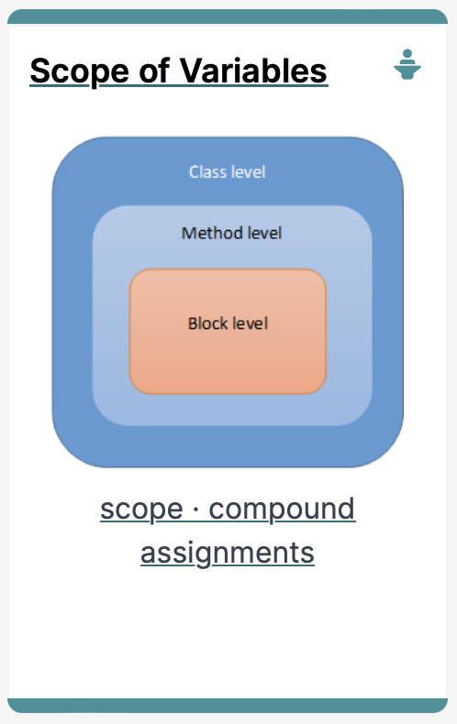
Introduction to Processing
Scope of variables, Printing and Compound Assignment Statements

Slide 3
Agenda
Use of println(), text() in Processing
Variable Scope
Compound Assignment Statements

Slide 4

Use of println(), text() in Processing

Slide 5
println() and text() in Processing
To print a message to the console in Processing, use:
print()
println()
Both take a String as input,
(more on this in later lectures).
To print onto the display window, use:
text()

Slide 6
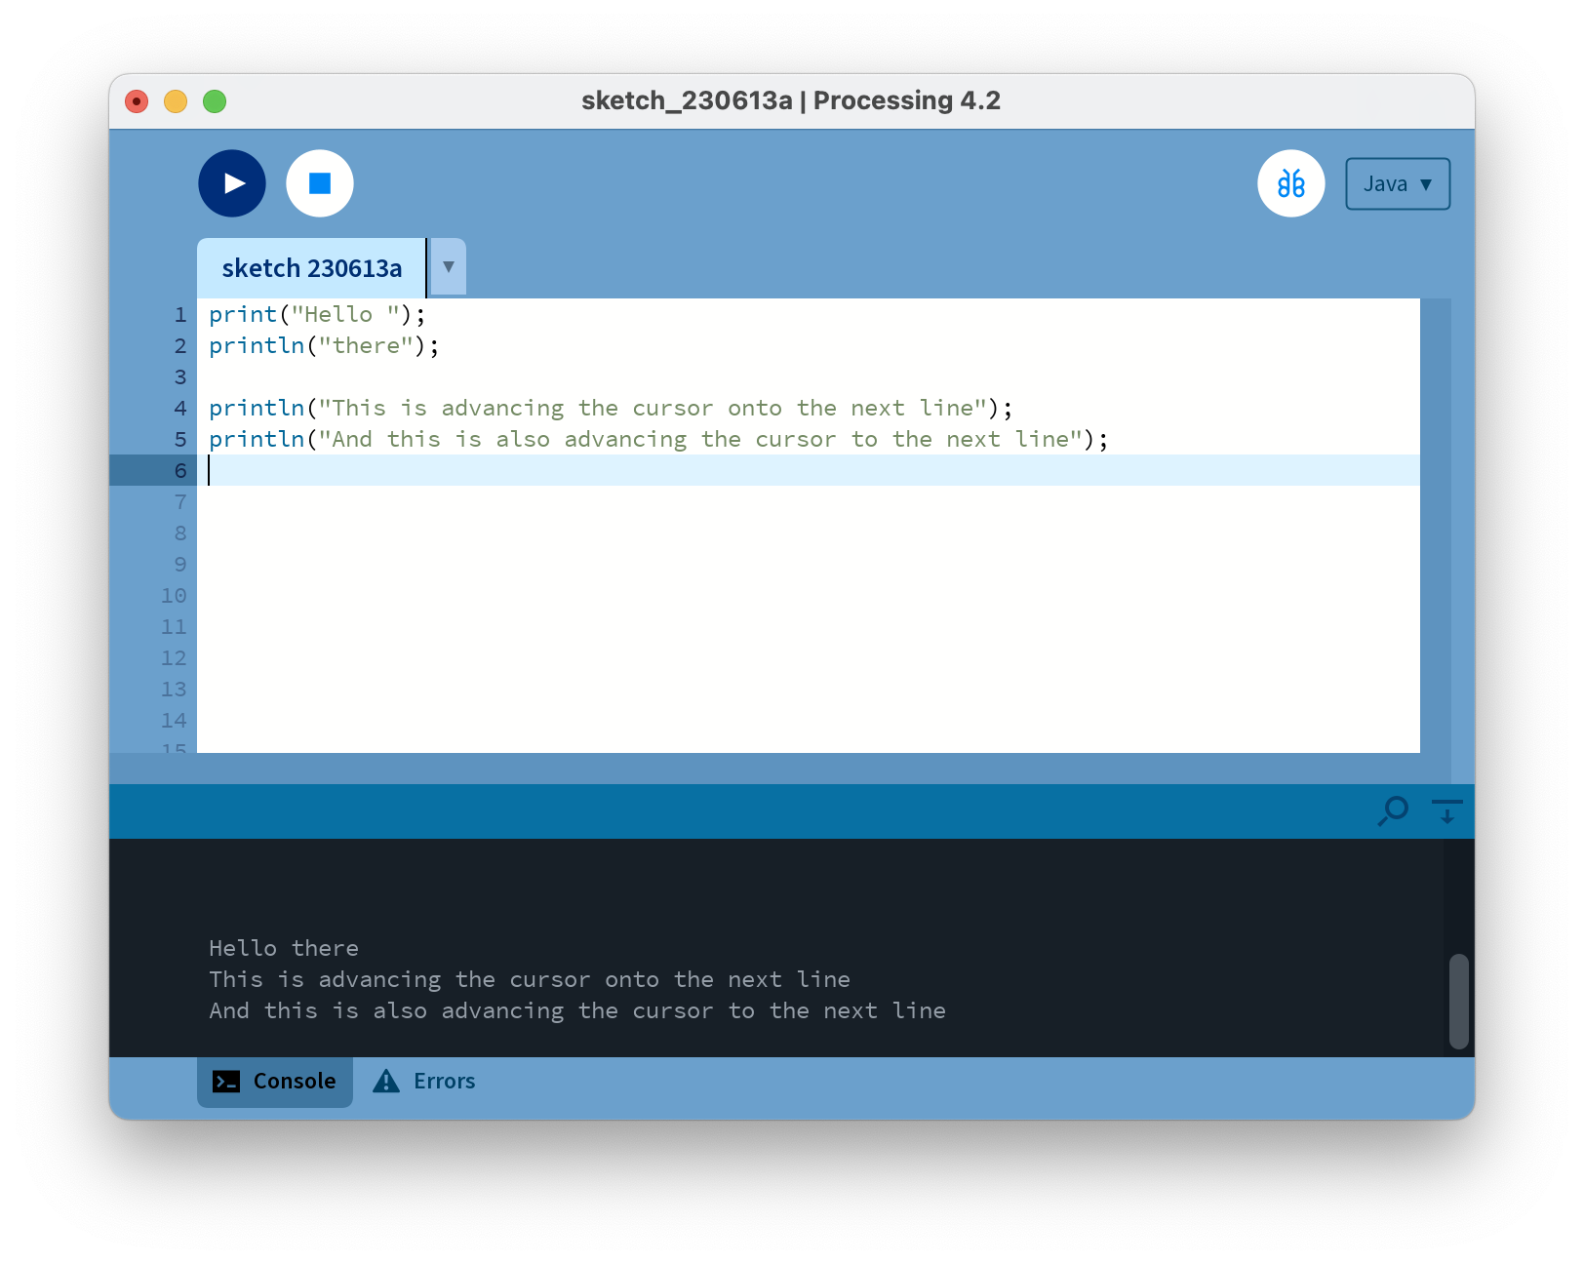
println() and text() in Processing
Notes:
print("Hello ");
println("there");
println("This is advancing the cursor onto the next line");
println("And this is also advancing the cursor to the next line");

Slide 7
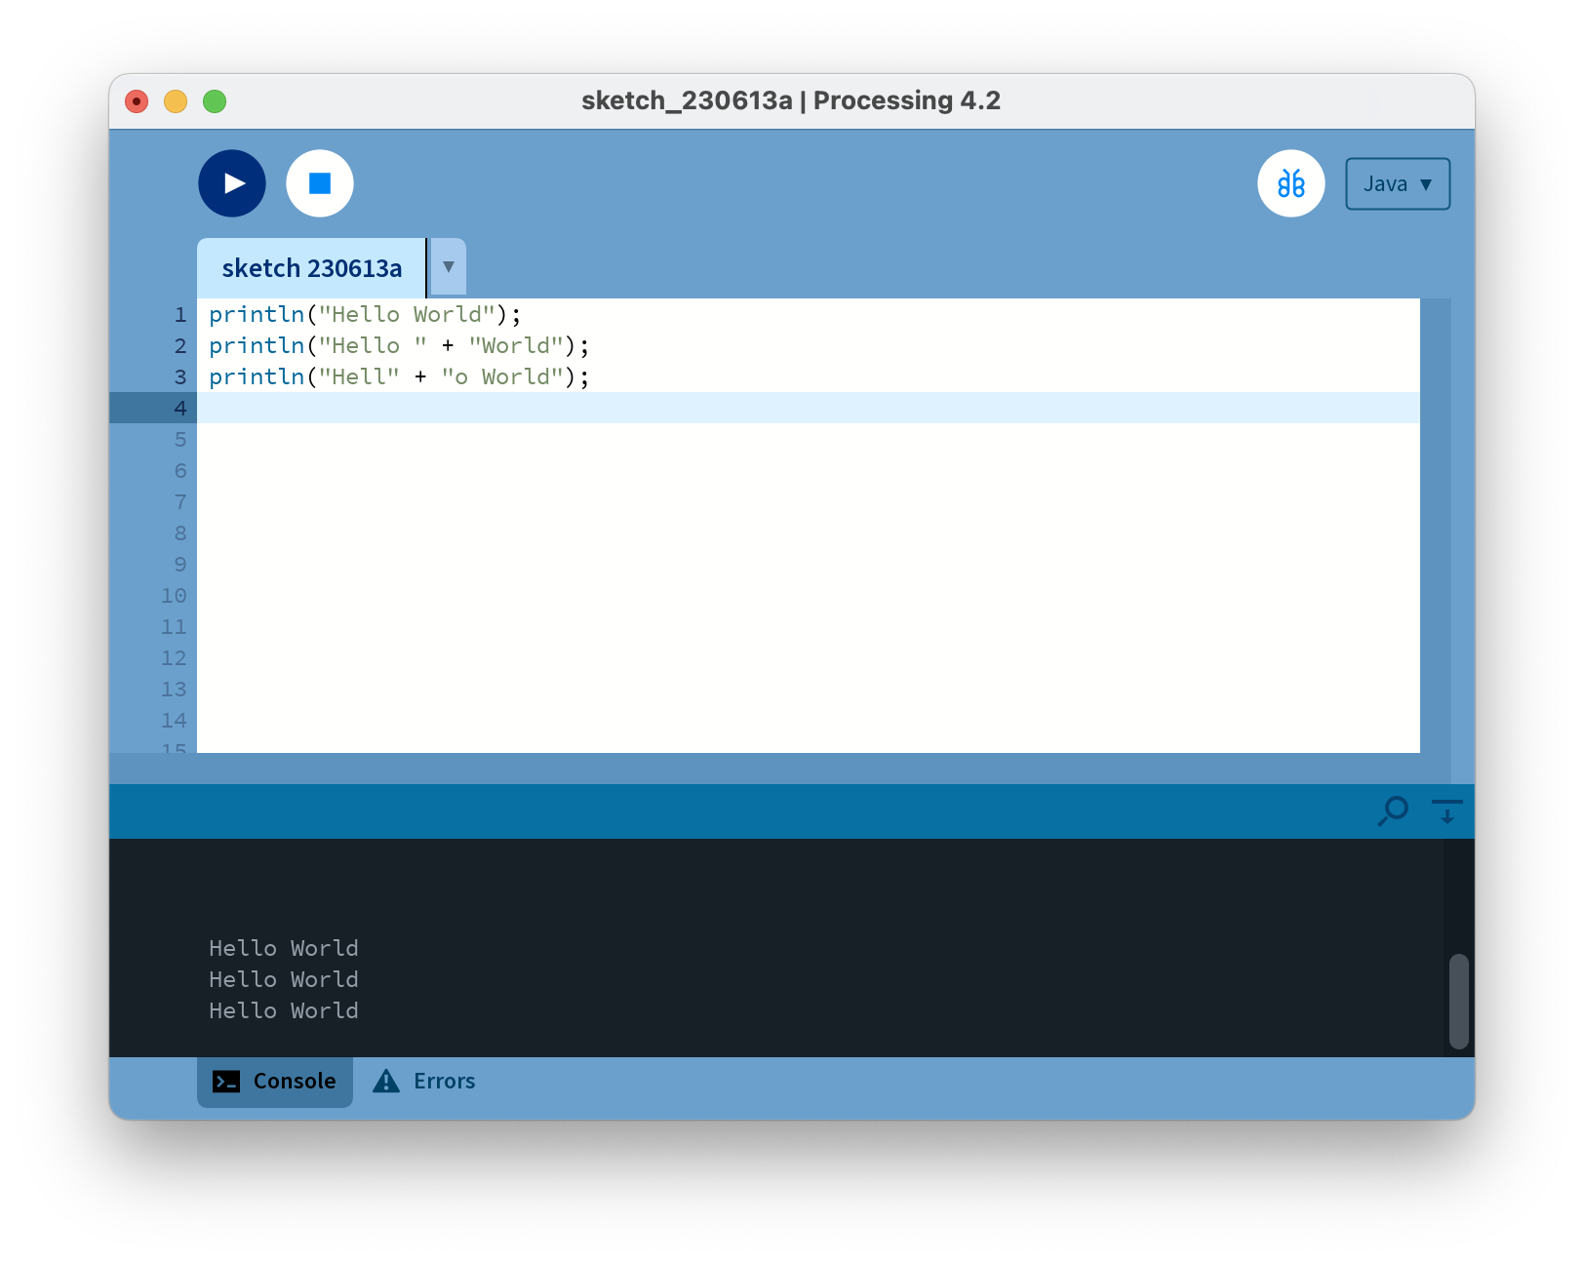
println()
Each statement prints the same output.
Notes:
println("Hello World");
println("Hello " + "World");
println("Hell" + "o World");

Slide 8
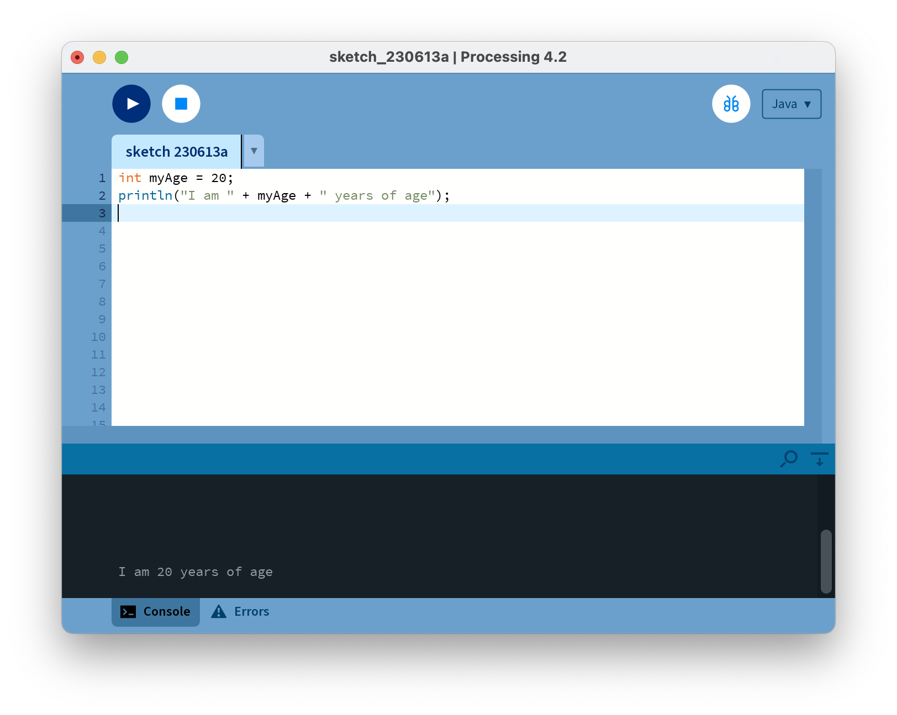
println()
We can use variables in the print statement.
Notes:
int myAge = 20;
println("I am " + myAge + " years of age");

Slide 9

text() in processing
text() is used to draw text on the display window.
textSize(32);
text("word", 10, 30);
fill(0, 102, 153);
text("word", 10, 60);
fill(0, 102, 153, 51);
text("word", 10, 90 );
Text to be written (also in String format)
x, y co-ordinates on screen

Slide 10
Variable Scope

Slide 11
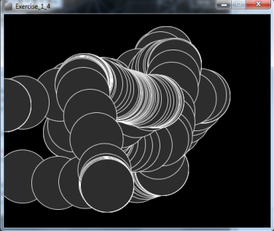
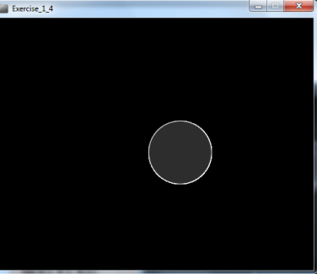
Recap: Processing Example 3.8
Functionality:
Draw a circle on the mouse (x,y) coordinates.
Each time you move the mouse, draw a new circle.
All the circles remain in the sketch until you press a mouse button.
When you press a mouse button, the sketch is cleared and a single circle is drawn at the mouse (x,y) coordinates.

Slide 12
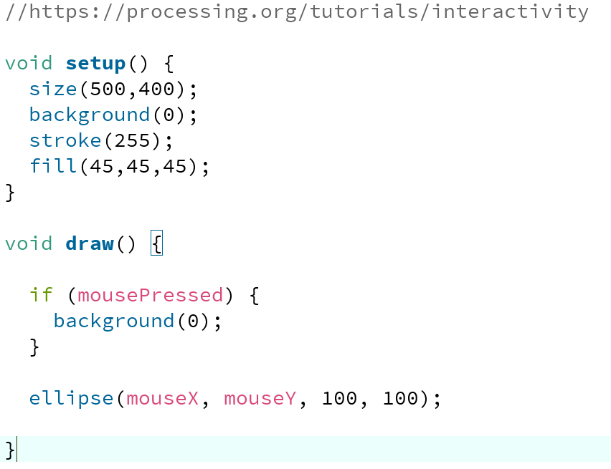
Recap: Processing Example 3.8
Notes:
//https://processing.org/tutorials/interactivity
void setup() {
size(500,400);
background(0);
}
void draw() {
if (mousePressed) {
background(0);
}
stroke(255);
fill(45,45,45);
ellipse(mouseX, mouseY, 100, 100);
}

Slide 13
Recap: Processing Example 3.8
In this example, we have “hard coded” the value of 100 for the diameter of the circle.
Notes:
//https://processing.org/tutorials/interactivity
void setup() {
size(500,400);
background(0);
}
void draw() {
if (mousePressed) {
background(0);
}
stroke(255);
fill(45,45,45);
ellipse(mouseX, mouseY, 100, 100);
}

Slide 14
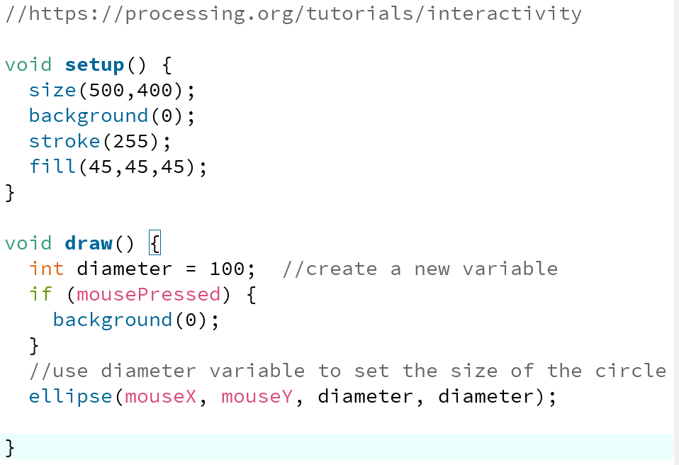
Processing Example 4.1
Here, we have replaced the “hard coded” 100 with a variable diameter, whose value is 100.
Notes:
//https://processing.org/tutorials/interactivity
void setup() {
size(500,400);
background(0);
stroke(255);
fill(45,45,45);
}
void draw() {
int diameter = 100; //create a new variable
if (mousePressed) {
background(0);
}
//use diameter variable to set the size of the circle
ellipse(mouseX, mouseY, diameter, diameter);
}

Slide 15
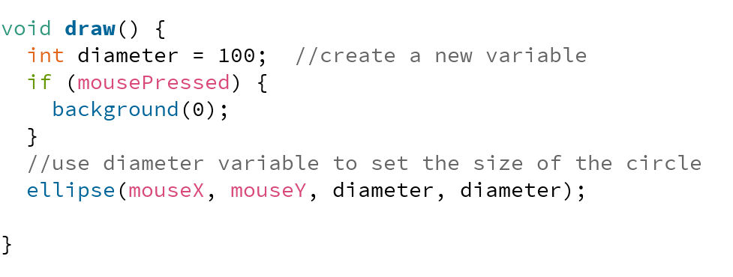
Local Scope – diameter variable
The diameter variable is declared in the draw() function i.e. it is a local variable.
It is only “alive” while the draw() function is running.

Slide 16
Local Scope – diameter variable
Each time the draw() function:
finishes running, the diameter variable is destroyed.
is called, the diameter variable is re-created.

Slide 17
Local variables – scope rules
The scope of a local variable is the block it is declared in. A block is delimited by the curly braces {}.
A program can have many nested blocks.
int number = int(random(40)); //This gives a random number between (and including) 0 and 39.
if (number < 10)
{
int j = 40;
println(“number is : " + number + " and j is : " + j);
}
else if (number >=10)
{
int x = 30;
println(“number is : " + number + " and x is : " + x);
}
Outer block – number is available here
Two inner blocks – number is available in both. Each has its own local variable too. First block has j, second block has x.
Notes:
Mention that a variable must be defined before it can be used.

Slide 18
Local variables – scope rules
The lifetime of a local variable is the time of execution of the block it is declared in.
Trying to access a local variable outside its scope will trigger a syntax error e.g.:
void draw()
{
if (mousePressed)
{
int diameter = 100;
background(0);
}
ellipse(mouseX, mouseY, diameter, diameter);
}
Syntax Error

Slide 19
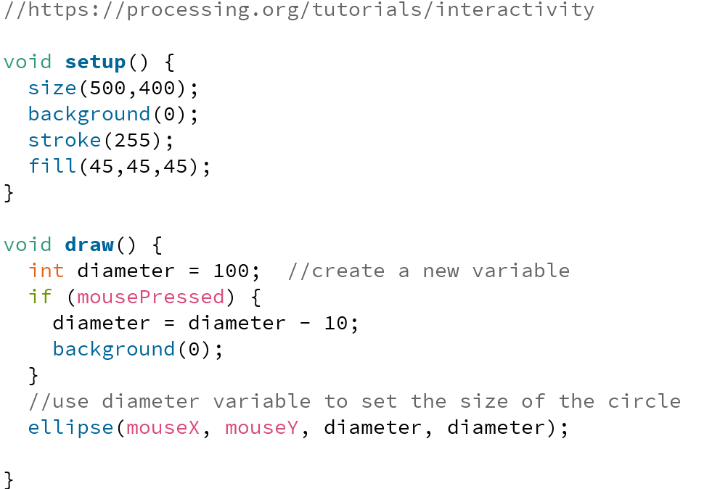
Processing Example 4.2
Using our 4.1 code, we now want to reduce the diameter size by 10 each time the mouse is pressed.
Q: Is this correct?
Notes:
//https://processing.org/tutorials/interactivity
void setup() {
size(500,400);
background(0);
stroke(255);
fill(45,45,45);
}
void draw() {
int diameter = 100; //create a new variable
if (mousePressed) {
diameter = diameter - 10;
background(0);
}
//use diameter variable to set the size of the circle
ellipse(mouseX, mouseY, diameter, diameter);
}

Slide 20
Processing Example 4.2
A: We have a bug in our logic.
As the diameter variable is re-created each time draw() is called, its value will be reset to 100 and will lose our previous decrement of 10. Our circle will keep resetting itself to a diameter of 100.
Notes:
//https://processing.org/tutorials/interactivity
void setup() {
size(500,400);
background(0);
stroke(255);
fill(45,45,45);
}
void draw() {
int diameter = 100; //create a new variable
if (mousePressed) {
diameter = diameter - 10;
background(0);
}
//use diameter variable to set the size of the circle
ellipse(mouseX, mouseY, diameter, diameter);
}

Slide 21
Global variables – scope rules
The scope of the diameter variable is too narrow;
as soon as draw() finishes running, the local variable is destroyed and we loose all data.
when draw() is called again, the diameter variable is recreated and its value is set to 100.
We need a diameter variable that lives for the lifetime of a sketch i.e.
a global variable.

Slide 22
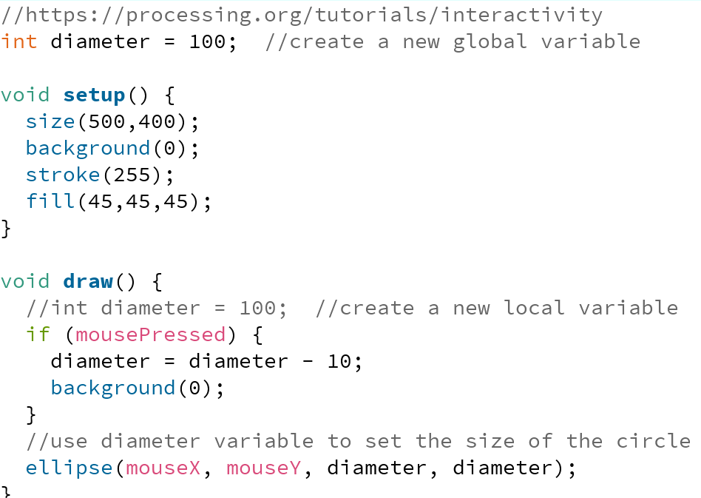
Processing Example 4.3
Let’s try fix the bug
We established that the scope of the local diameter variable was too narrow; diameter is recreated each time draw() is called and its value is set to 100.
Let’s try fix the bug
We established that the scope of the local diameter variable was too narrow; diameter is recreated each time draw() is called and its value is set to 100.
Comment out the local diameter variable and instead make it global scope.
Notes:
//https://processing.org/tutorials/interactivity
int diameter = 100; //create a new global variable
void setup() {
size(500,400);
background(0);
stroke(255);
fill(45,45,45);
}
void draw() {
//int diameter = 100; //create a new local variable
if (mousePressed) {
diameter = diameter - 10;
background(0);
}
//use diameter variable to set the size of the circle
ellipse(mouseX, mouseY, diameter, diameter);
}

Slide 23
Processing Example 4.3
But we still have a bug
The diameter variable is decreased each time we press the mouse. Correct?
Q: However, what happens when the mouse pressing reduces the value of diameter to zero?

Slide 24
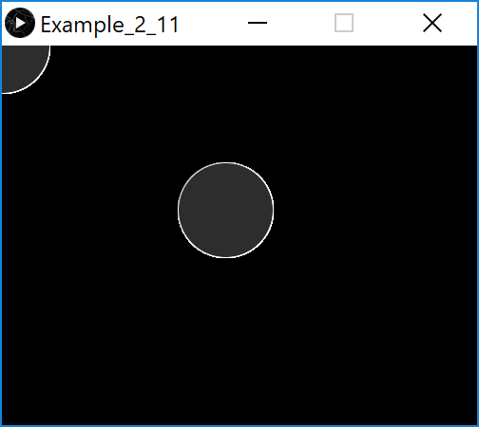
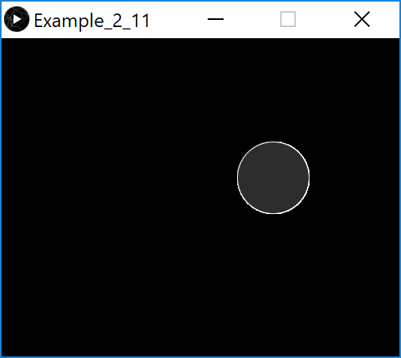
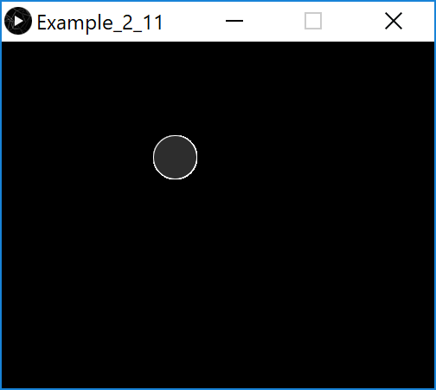
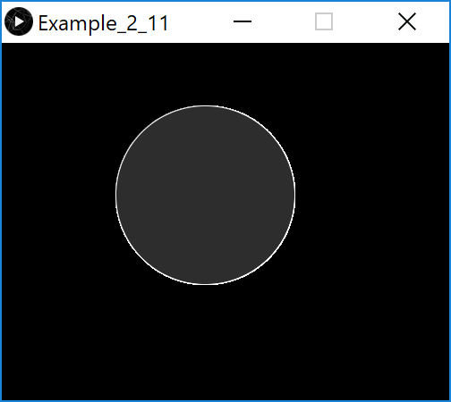
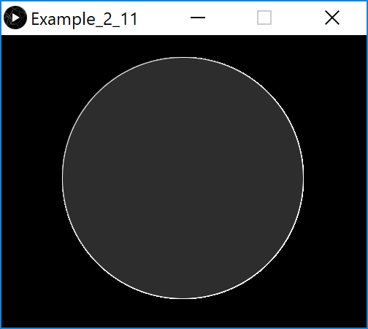
Processing Example 4.3
But we still have a bug
We can see that the diameter variable is decreased as we press the mouse…however, when it reaches zero, the diameter of the circle starts growing!
Mouse presses over time…

Slide 25
Processing Example 4.3
What is happening?
The width and height in the ellipse function are absolute values (negative sign is dropped).
So, even though diameter had a value of say, -50, the magnitude is all that is used when drawing the ellipse…i.e. 50.
Mouse presses over time…

Slide 26
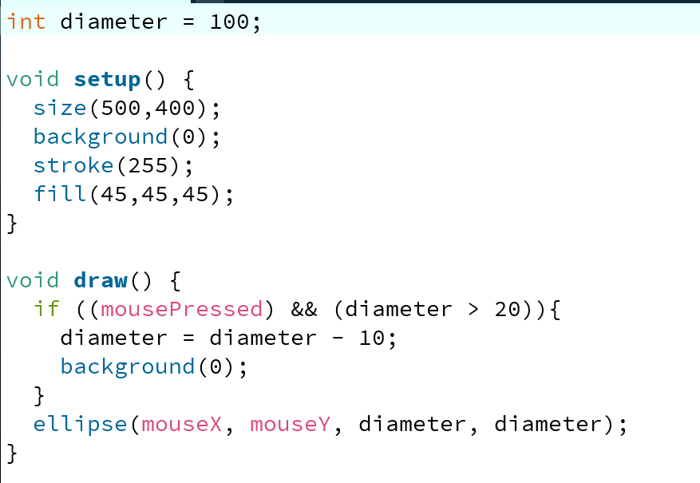
Processing Example 4.4
In the ellipse function, the width and height are absolute values (negative sign is dropped).
To handle this logic bug, we need to stop reducing the diameter by 10 when we reach a certain value, say 20.
Notes:
int diameter = 100;
void setup() {
size(500,400);
background(0);
stroke(255);
fill(45,45,45);
}
void draw() {
if ((mousePressed) && (diameter > 20)){
diameter = diameter - 10;
background(0);
}
ellipse(mouseX, mouseY, diameter, diameter);
}

Slide 27
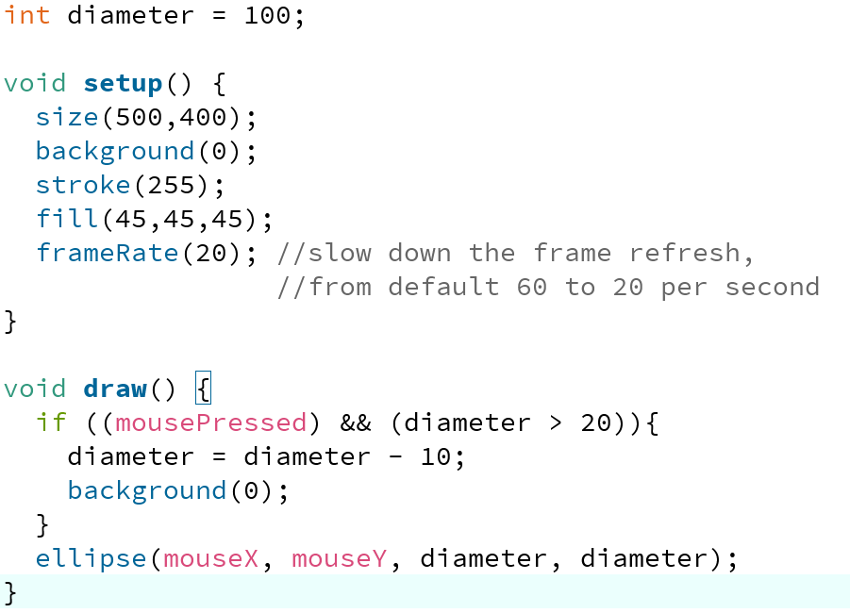
Processing Example 4.4
When you run this code, it appears the reduction is larger than 10 when we press the mouse?
Why? The default frame rate is 60 refreshes of the screen per second i.e. draw() is called 60 times per second.
You can change the frame rate by calling the frameRate() function.
Notes:
int diameter = 100;
void setup() {
size(500,400);
background(0);
stroke(255);
fill(45,45,45);
frameRate(20); //slow down the frame refresh,
//from default 60 to 20 per second
}
void draw() {
if ((mousePressed) && (diameter > 20)){
diameter = diameter - 10;
background(0);
}
ellipse(mouseX, mouseY, diameter, diameter);
}

Slide 28
Compound Assignment Statements

Slide 29
A note on i++
The post-body action in this for loop is i++.
This is called a compound assignment statement.
It is a shortcut for i = i + 1.
for(int i = 0; i < 4; i++)
{
rect(50, yCoordinate, 500, 10);
yCoordinate = yCoordinate + 20;
}
Notes:
We will cover loops in the next lecture.

Slide 30
Compound Assignment Statements
 | Full statement | Shortcut
Mathematical shortcuts | x = x + a; | x += a;
 | x = x - a; | x -= a;
 | x = x * a; | x *= a;
 | x = x/a; | x /= a;
Increment shortcut | x = x+1; | x++;
Decrement shortcut | x = x - 1; | x--;
Notes:
Objects First with Java
© David J. Barnes and Michael Kölling
30

Slide 31
Compound Assignment Statements
 | Full statement | Shortcut
Mathematical shortcuts | x = x + a; | x += a;
 | x = x - a; | x -= a;
 | x = x * a; | x *= a;
 | x = x/a; | x /= a;
Increment shortcut | x = x+1; | x++;
Decrement shortcut | x = x - 1; | x--;
Notes:
Objects First with Java
© David J. Barnes and Michael Kölling
31

Slide 32

Questions?

Slide 33
References
Reas, C. & Fry, B. (2014) Processing – A Programming Handbook for Visual Designers and Artists, 2nd Edition, MIT Press, London.

Slide 34



