Slide 1
Programming Fundamentals 1

Slide 2
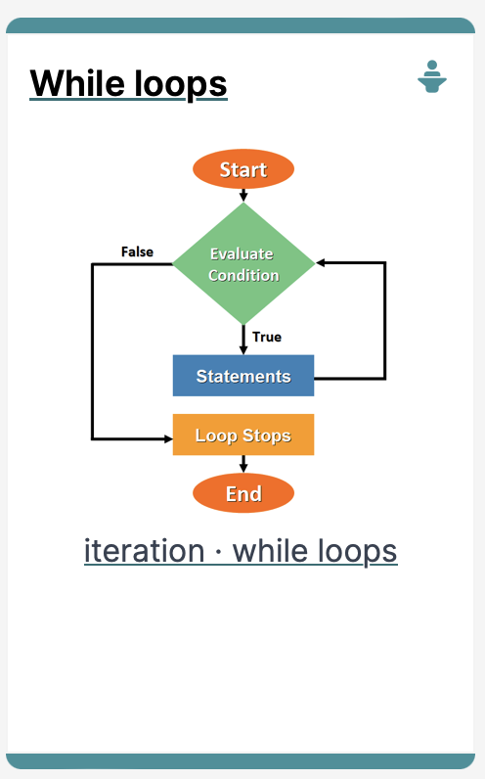
Introduction to Processing
Iteration in Programming – While Loops

Slide 3
Agenda
Repetition in Programming – Intro to looping
Use of loops (while loops)

Slide 4

Repetition in Programming – Intro to looping

Slide 5
Recap: Boolean conditions
A boolean condition is an expression that evaluates to either true or false e.g.
mouseX < 50
Boolean conditions can be used to control:
Selection i.e. if statements and
Iteration i.e. loops (we will look at these now).

Slide 6
Repetition in Programming
Computers are very good at repetition.
Example:
calculate pay for 1000 employees.
You should use the same calculate pay algorithm 1000 times.
You don’t write the calculate pay algorithm 1000 times; instead you include it in a loop.

Slide 7
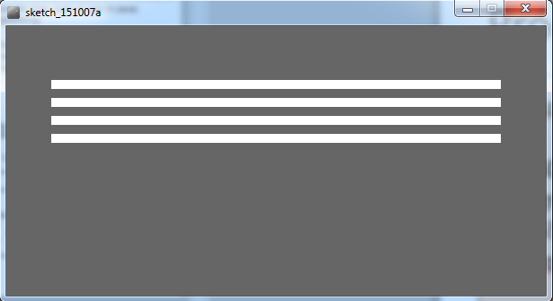
Form of loop
Draw a rectangle 4 times that has a gap of 10 pixels between each one.

Slide 8
Form of loop
Draw a rectangle 4 times that has a gap of 10 pixels between each one.
Without loop:
rect(50, 60, 500, 10);
rect(50, 80, 500, 10);
rect(50, 100, 500, 10);
rect(50, 120, 500, 10);

Slide 9
Form of loop
Draw a rectangle 4 times that has a gap of 10 pixels between each one.
With a loop:
do this 4 times (adding 20 onto the yCoordinate variable each time).
rect(50, yCoordinate, 500, 10);
Notes:
We add 20 because its 10 for the height of the rectangle +10 for the gap

Slide 10
Form of loop
Draw a rectangle 4 times that has a gap of 10 pixels between each one.
With a loop:
do this 4 times (adding 20 onto the yCoordinate variable each time).
rect(50, yCoordinate, 500, 10);
We will learn a little more about loops and then we will write the code to solve this problem.
Notes:
We add 20 because its 10 for the height of the rectangle +10 for the gap

Slide 11
Use of loops (while loops)

Slide 12
Loops in Programming
There are three types of loop in (Java) programming:
while loops
for loops
do while loops

Slide 13
while loop pseudo code
General form of a while loop
while keyword
boolean condition
while(loop condition) {
loop body }
Statements to be repeated
Pseudo-code expression of the actions of a while loop
while we wish to continue, do the things in the loop body

Slide 14
Construction of while loop
Declare and initialise loop control variable (LCV)
while(boolean condition based on LCV is true)
{
“do the job to be repeated”
“update the LCV”
}
This structure should always be used
Notes:
The “update the LCV” should always update it so that the Boolean condition will eventually evaluation to false.

Slide 15

while loop Flowchart
int yCoordinate = 60;
int i = 0; //i is the LCV
while(i < 4)
{
rect(50, yCoordinate, 500, 10);
yCoordinate += 20;
i++;
}
boolean
condition?
true
statement(s)
false

Slide 16
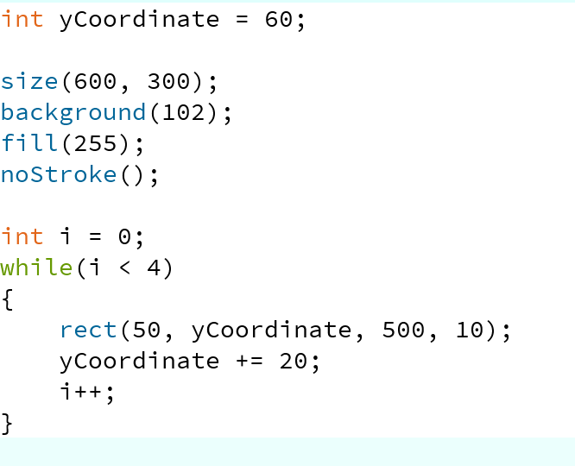
Processing Example 4.5
Notes:
int yCoordinate = 60;
size(600, 300);
background(102);
fill(255);
noStroke();
int i = 0;
while(i < 4)
{
rect(50, yCoordinate, 500, 10);
yCoordinate += 20;
i++;
}

Slide 17
Processing Example 4.5
Q: Could we remove the yCoordinate variable and rework the code to still produce the four lines using the while loop?
Notes:
int yCoordinate = 60;
size(600, 300);
background(102);
fill(255);
noStroke();
int i = 0;
while(i < 4)
{
rect(50, yCoordinate, 500, 10);
yCoordinate += 20;
i++;
}

Slide 18
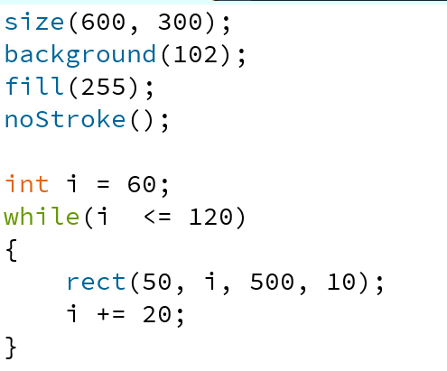
Processing Example 4.6
A: Yes. Here is the solution with no yCoordinate variable.
Notes:
size(600, 300);
background(102);
fill(255);
noStroke();
int i = 60;
while(i <= 120)
{
rect(50, i, 500, 10);
i += 20;
}

Slide 19
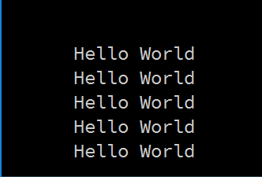
Some Study Exercises
This basic while loop, produces this output.
int i = 1;
while (i <=5)
{
println("Hello World");
i++;
}

Slide 20
Some Study Exercises
Change the code so that “Hello World” is printed out 10 times.
Change the code so that the numbers from 1 to 10 (inclusive) are printed out, one line at a time.
Change the code so that the numbers from 10 to 1 are printed out.

Slide 21

Questions?

Slide 22
References
Reas, C. & Fry, B. (2014) Processing – A Programming Handbook for Visual Designers and Artists, 2nd Edition, MIT Press, London.

Slide 23



