Slide 1
Programming Fundamentals 1

Slide 2
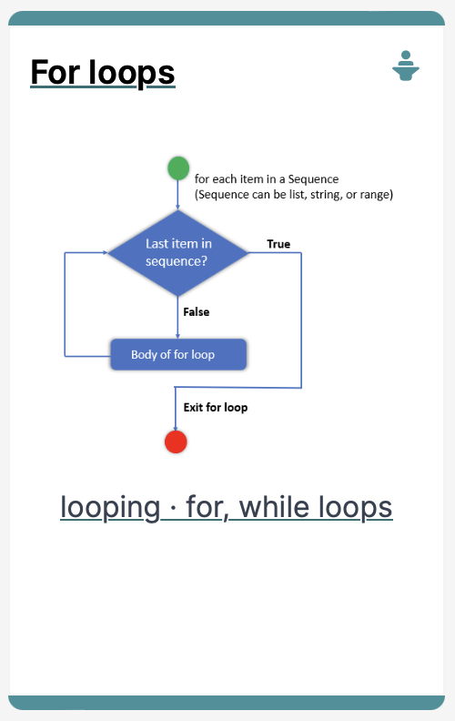
Introduction to Processing
Iteration in Programming – For Loops

Slide 3
Agenda
Use of loops (for loops)
Comparative use of while and for loops
Lab03 - Challenge 1
Lab03 - Challenge 3

Slide 4

Use of loops (for loops)

Slide 5
For loop pseudo-code
General form of a for loop
for(initialization ; boolean condition ; post-body action)
{
statements to be repeated
}

Slide 6
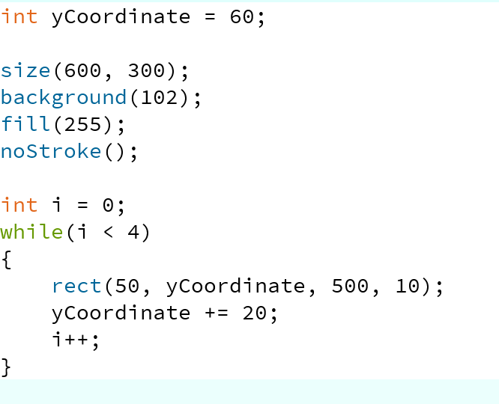
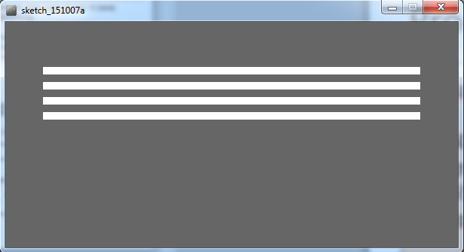
Recap: Processing Example 4.5
This was a slide from the previous talk. We used a while loop to repeatedly print the four rectangles to the display window.
Notes:
int yCoordinate = 60;
size(600, 300);
background(102);
fill(255);
noStroke();
int i = 0;
while(i < 4)
{
rect(50, yCoordinate, 500, 10);
yCoordinate += 20;
i++;
}

Slide 7
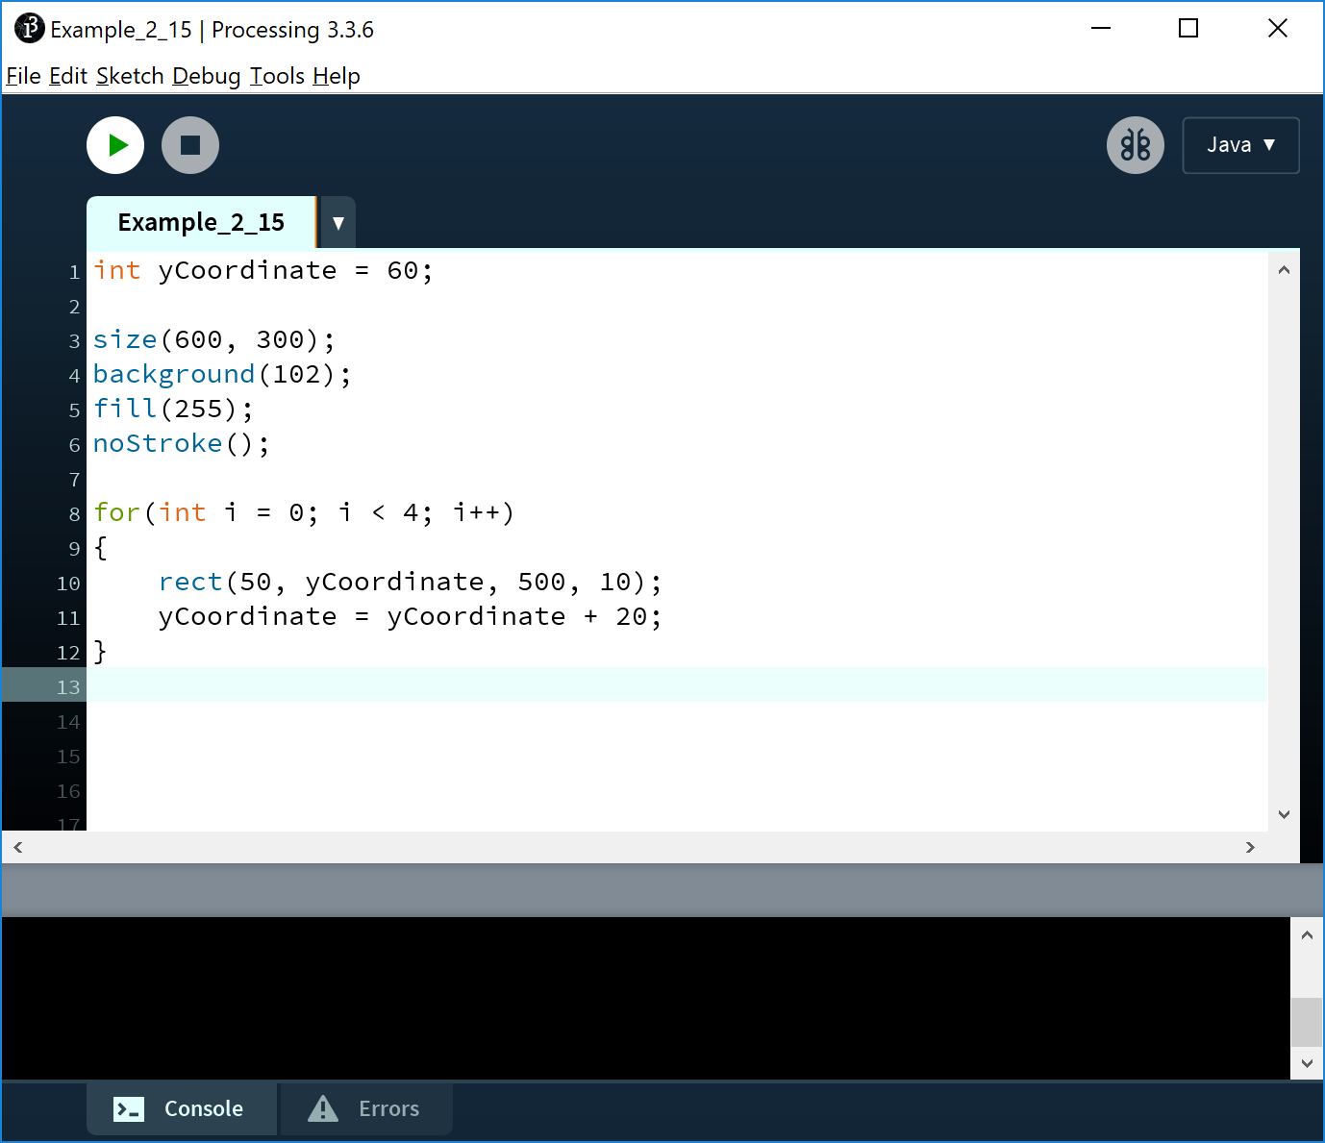
Processing Example 4.7
This code does the same as the previous slide, except that we use a different loop: for
Notes:
int yCoordinate = 60;
size(600, 300);
background(102);
fill(255);
noStroke();
for(int i = 0; i < 4; i++)
{
rect(50, yCoordinate, 500, 10);
yCoordinate = yCoordinate + 20;
}

Slide 8
For loop syntax
for(initialization; boolean condition; post-body action)
{
statements to be repeated
}

Slide 9
For loop syntax
for(initialization; boolean condition; post-body action)
{
statements to be repeated
}

Slide 10
For loop syntax
initialization | int i = 0; | Initialise a loop control variable (LCV) e.g. i. It can include a variable declaration.
boolean condition | i < 4; | Is a valid boolean condition that typically tests the loop control variable (LCV).
post-body action | i++ | A change to the loop control variable (LCV). Contains an assignment statement.

Slide 11

for Loop Flowchart
boolean
condition?
true
statement(s)
update
false
Notes:
for(int i = 0; i < 4; i++)
{
rect(50, yCoordinate, 500, 10);
yCoordinate = yCoordinate + 20;
}

Slide 12
Returning to: Processing Example 4.7
Q: Do we need the yCoordinate variable?
Can you think of a different approach using a for loop?
Notes:
int yCoordinate = 60;
size(600, 300);
background(102);
fill(255);
noStroke();
for(int i = 0; i < 4; i++)
{
rect(50, yCoordinate, 500, 10);
yCoordinate = yCoordinate + 20;
}

Slide 13
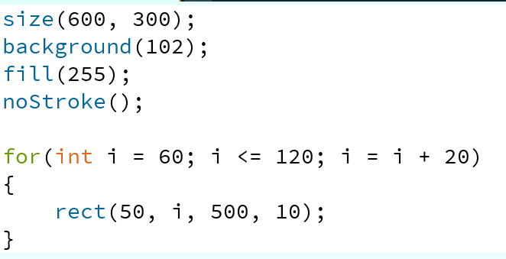
Processing Example 4.8
A: We can eliminate the yCoordinate variable by setting the i variable to 60 and incrementing it by 20.
Notes:
size(600, 300);
background(102);
fill(255);
noStroke();
for(int i = 60; i <= 120; i = i + 20)
{
rect(50, i, 500, 10);
}

Slide 14
For loop: all parts are optional
for ( ; ; )
{
// statements here
}
This is an infinite loop…

Slide 15
For loops can be nested
The value of i is: 0 and j is: 0
The value of i is: 0 and j is: 1
The value of i is: 0 and j is: 2
The value of i is: 0 and j is: 3
The value of i is: 1 and j is: 0
The value of i is: 1 and j is: 1
The value of i is: 1 and j is: 2
The value of i is: 1 and j is: 3
The value of i is: 2 and j is: 0
The value of i is: 2 and j is: 1
The value of i is: 2 and j is: 2
The value of i is: 2 and j is: 3
The value of i is: 3 and j is: 0
The value of i is: 3 and j is: 1
The value of i is: 3 and j is: 2
The value of i is: 3 and j is: 3
for (int i=0; i < 4; i++)
for (int j=0; j < 4; j++)
println("The value of i is: " + i + " and j is: " + j);

Slide 16
Comparative use of while and for loops

Slide 17
for versus while
Processing Example 4.7(for loop)
Variable i is the Loop Control Variable (LCV). It must be initialised, tested and changed.
for(int i = 0; i < 4; i++) {
rect(50, yCoordinate, 500, 10);
yCoordinate += 20;
}
Processing Example 4.5 (while loop)
int i = 0 is the initialisation.
i < 4 is the boolean condition i.e. the test
i++ is the post-body action
i.e. the change.
int i = 0;
while(i < 4) {
rect(50, yCoordinate, 500, 10);
yCoordinate += 20;
i++;
}

Slide 18
Lab03 - Challenge 1

Slide 19
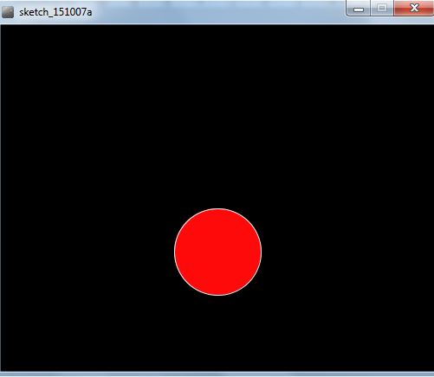
Lab03 - Challenge 1 – bouncing ball
Draw a continuously bouncing ball. (vertical only)
the xCoordinate remains the same value the yCoordinate will change.
Assumptions:
display window is 500 x 400
ball is 100 in diameter.
static xCoordinate is 250.
background is called in the draw() method.
starting yCoordinate is 300.

Slide 20
Lab03 - Challenge 1
float yCoordinate = 300;
void setup() {
size(500,400);
fill(255, 10, 10);
stroke(255);
}
Assumptions:
display window is 500 x 400
ball is 100 in diameter.
static xCoordinate is 250.
void draw() {
background(0);
ellipse(250, yCoordinate, 100, 100);
}

Slide 21
Lab03 - Challenge 1
float yCoordinate = 300;
void setup() {
size(500,400);
fill(255, 10, 10);
stroke(255);
}
Assumptions:
display window is 500 x 400
ball is 100 in diameter.
static xCoordinate is 250.
background is called in the draw() method.
starting yCoordinate is 300.
void draw() {
background(0);
ellipse(250, yCoordinate, 100, 100);
}

Slide 22
Lab03 - Challenge 1
float yCoordinate = 300;
boolean bounceUp = false;
void setup() {
size(500,400);
fill(255, 10, 10);
stroke(255);
}
We need to track whether the ball is bouncing up or falling.
To do this, we will use a boolean variable bounceUp. It will be:
true if the ball is bouncing up
false if the ball is falling and
void draw() {
background(0);
ellipse(250, yCoordinate, 100, 100);
if (bounceUp)
// code to bounce the ball up
if (!bounceUp)
// code when ball is falling
}

Slide 23
float yCoordinate = 300;
boolean bounceUp = false;
void setup() {
size(500,400);
fill(255, 10, 10);
stroke(255);
}
void draw() {
background(0);
ellipse(250, yCoordinate, 100, 100);
//ball is bouncing up
if (bounceUp){
if (yCoordinate > 100)
yCoordinate = yCoordinate - 1;
else
bounceUp = false;
}
//ball is falling down
if (!bounceUp){
if (yCoordinate <= 350)
yCoordinate = yCoordinate + 1;
else
bounceUp = true;
}
}

Slide 24
Lab03 - Challenge 3

Slide 25
Lab03 - Challenge 3 – Moving Line
In a new sketch, draw a vertical line that is the height of your display window.
It starts in the left most position of your display window and moves right, pixel by pixel, until it reaches the right hand side of your display window.

Slide 26
Lab03 - Challenge 3 – Moving Line
Upon reaching the right hand side, the vertical line should reverse direction and return, pixel by pixel, to the left hand side of the display window.
As your vertical line is continually traversing the display window, your grayscale background should be varying very slightly in colour.

Slide 27
Lab03 - Challenge 3 – Moving Line
Assumptions:
Window size 300x400.
Background is initially set to 120.
Stroke weight is 4
float background = 120;
void setup(){
size(300,400);
background(background);
strokeWeight(4);
}

Slide 28
Lab03 - Challenge 3 – Moving Line
float background = 120;
float xCoordinate = 0.0;
void setup(){
size(300,400);
background(background);
strokeWeight(4);
}
Draw a vertical line that is the height of your display window.
Call background to clear the previously drawn line.
void draw()
{
background(background);
line (xCoordinate, 0, xCoordinate, height);
}

Slide 29
Lab03 - Challenge 3 – Moving Line
This vertical line should start in the left most position of your display window and move right, pixel by pixel, until it reaches the right hand side of your display window.
void draw(){
xCoordinate = xCoordinate + 1;
background(background);
line (xCoordinate, 0, xCoordinate, height);
}

Slide 30
Lab03 - Challenge 3 – Moving Line
As your vertical line is continually traversing the display window, your grayscale background should be varying very slightly in colour.
void draw(){
xCoordinate = xCoordinate + 1;
background = background + 0.5;
background(background);
line (xCoordinate, 0, xCoordinate, height);
}

Slide 31
Lab03 - Challenge 3 – Moving Line
Upon reaching the right hand side, the vertical line should reverse direction and return, pixel by pixel, to the left hand side of the display window.
We need to keep track of the direction that the line should be moving i.e. is it going left-to-right, or has it reversed direction and is going from right-to-left?
We will use a boolean variable to do this:
boolean reverseDirection will be initially set to false. indicating a left-to-right direction.
false indicates a left-to-right direction
true indicates a right-to-left direction.

Slide 32
Lab03 - Challenge 3 – Moving Line
void draw()
{
if (!reverseDirection){
background = background + 0.5;
xCoordinate = xCoordinate + 1;
}
else{
background = background - 0.5;
xCoordinate = xCoordinate - 1;
}
background(background);
line (xCoordinate, 0, xCoordinate, height);
}
float background = 120;
float xCoordinate = 0.0;
boolean reverseDirection = false;
void setup(){
size(300,400);
background(background);
strokeWeight(4);
}

Slide 33
Lab03 - Challenge 3 – Moving Line
But, we have no code written that will set the flag to true e.g.
reverseDirection = true;
Under what circumstances should the flag be set to true?
And when should it be set back to false?
Notes:
Question

Slide 34
Lab03 - Challenge 3 – Moving Line
void draw(){
if (xCoordinate == width)
reverseDirection = true;
if (xCoordinate == 0)
reverseDirection = false;
if (!reverseDirection){
background = background + 0.5;
xCoordinate = xCoordinate + 1;
}
else{
background = background - 0.5;
xCoordinate = xCoordinate - 1;
}
background(background);
line (xCoordinate, 0, xCoordinate, height);
}
float background = 120;
float xCoordinate = 0.0;
boolean reverseDirection = false;
void setup(){
size(300,400);
background(background);
strokeWeight(4);
}

Slide 35

Questions?

Slide 36
References
Reas, C. & Fry, B. (2014) Processing – A Programming Handbook for Visual Designers and Artists, 2nd Edition, MIT Press, London.

Slide 37



