Slide 1
Programming Fundamentals 1

Slide 2
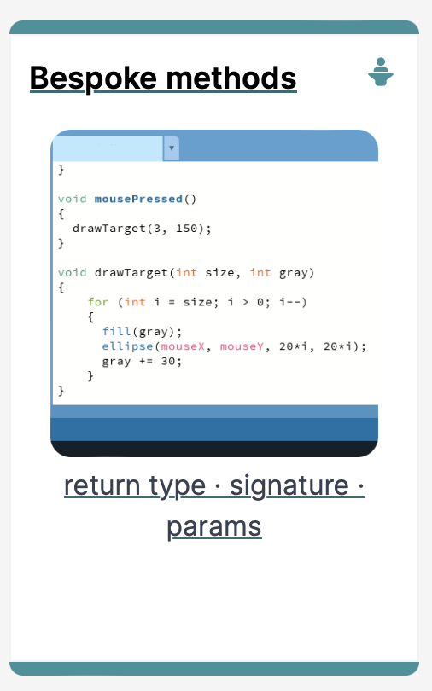
Introduction to Processing
Writing your own Methods

Slide 3
Agenda
Recap Method terminology:
Return type
Method names
Parameter list
Writing your own methods:
With no parameters
With parameters
That return data

Slide 4

Recap : Method Terminology

Slide 5
Recap: Methods in Processing
A method comprises a set of instructions that performs some task.
When we invoke the method, it performs the task.
Some methods that we have used are:
rect, ellipse, stroke, line, fill, etc.
void mousePressed()
void setup(), void draw()

Slide 6
Recap : Method terminology
Method signature
void setup()
{
size(640, 360);
background(120);
}
Method body

Slide 7
Recap : Method signature
Return type
Method name
Parameter list
void setup()

Slide 8
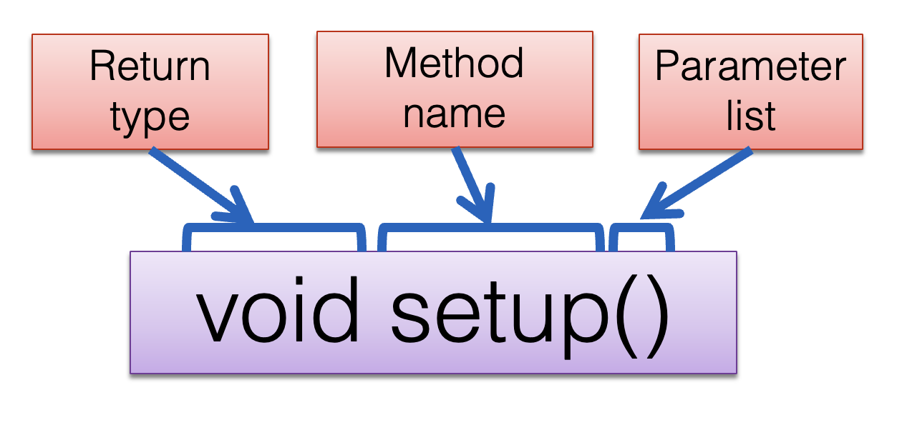
Recap : Return Types
Methods can return information.
The void keyword means that nothing is returned from the method.
When a data type (e.g. int) appears before the method name, this means that something is returned from the method.
Within the body of the method, you use the return statement to return the value.
You can only have one return type per method.
Methods can return any type of data e.g. boolean, byte, char, int, float, String, etc.

Slide 9
Recap : Return Types
int val = 30;
void draw()
{
int result = timestwo(val);
println(result);
}
int timestwo(int number)
{
number = number * 2;
return number;
}
// The red int in the function declaration
// specifies the type of data to be returned.
https://processing.org/reference/return.html
Notes:
Draw attention to the naming of the variables in the parameter list. The actual name of the variable does not matter…the type is all java is interested in. To demonstrate this concept, val and number are used.

Slide 10
Recap : Method name
Method names should:
Use verbs (i.e. actions) to describe what the method does e.g.
calculateTax
printResults
Be mixed case (camelCase) with the first letter lowercase and the first letter of each subsequent internal word capitalised.

Slide 11
Recap : Parameter list
Methods take in data via their parameters.
Methods do not have to pass parameters. These methods don’t need any additional information to do their tasks.
void noStroke()
void setup()
void noCursor()

Slide 12
Recap : Parameter list
Methods take in data via their parameters.
Methods do not have to pass parameters. These methods don’t need any additional information to do their tasks.
If a method needs additional information to execute, we provide a parameter so that the information can be passed into it. A method can have any number of parameters.
void strokeWeight (float weight)
void size (int width, int height)

Slide 13
Writing your own Methods

Slide 14
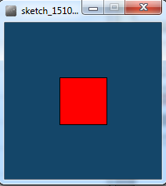
Writing methods with NO parameters
Draw a red square at certain (x, y) coordinates.

Slide 15
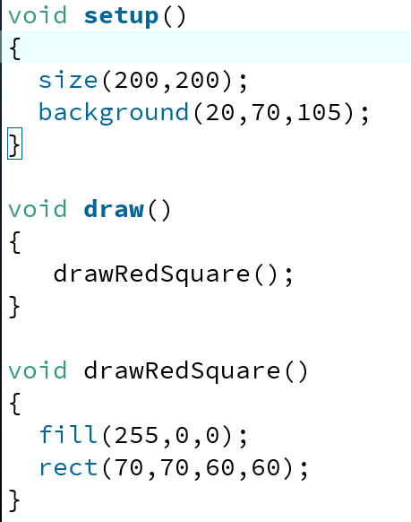
Processing Example 5.2
Notes:
void setup()
{
size(200,200);
background(20,70,105);
}
void draw()
{
drawRedSquare();
}
void drawRedSquare()
{
fill(255,0,0);
rect(70,70,60,60);
}

Slide 16
Writing methods with parameters
Now update the code so that you can: pass in the length of the square into the method, drawRedSquare.

Slide 17
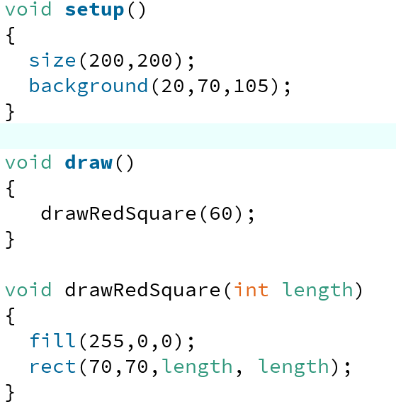
Processing Example 5.3
Notes:
void setup()
{
size(200,200);
background(20,70,105);
}
void draw()
{
drawRedSquare(60);
}
void drawRedSquare(int length)
{
fill(255,0,0);
rect(70,70,length, length);
}

Slide 18
Writing methods with parameters
Now update the code so that you can pass in the:
length of the square
xCoordinate of the square
yCoordinate of the square
into the method, drawRedSquare

Slide 19
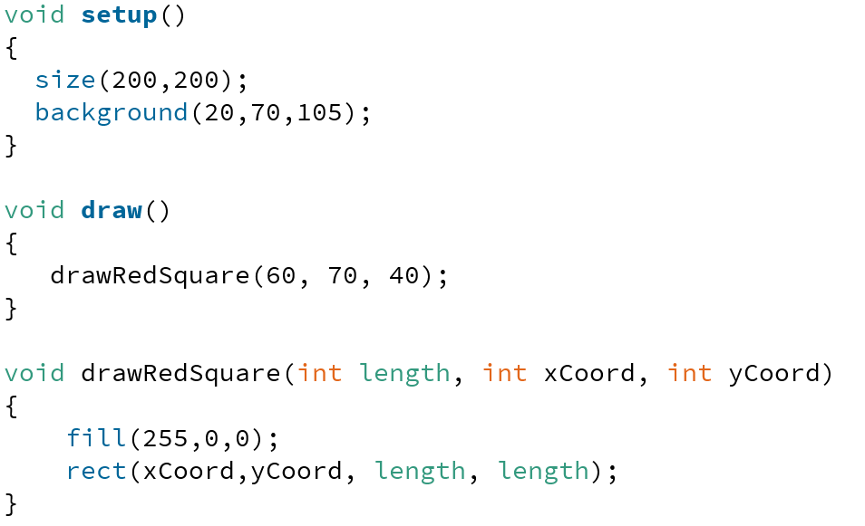
Processing Example 5.4
Notes:
void setup()
{
size(200,200);
background(20,70,105);
}
void draw()
{
drawRedSquare(60, 70, 40);
}
void drawRedSquare(int length, int xCoord, int yCoord)
{
fill(255,0,0);
rect(xCoord,yCoord, length, length);
}

Slide 20
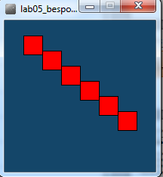
Writing methods with parameters
Now update the code so that you can call the drawRedSquare multiple times (using a loop)

Slide 21
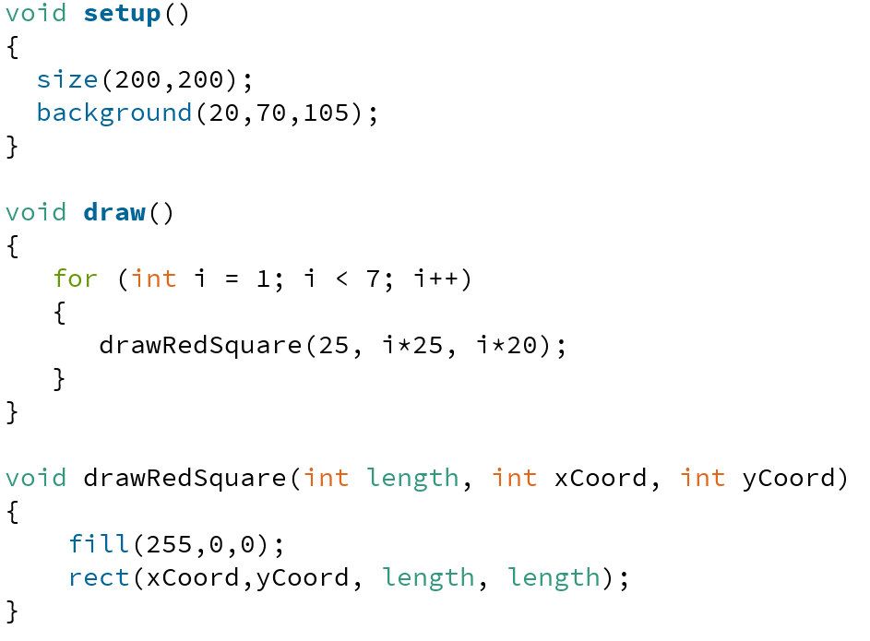
Processing Example 5.5
Notes:
void setup()
{
size(200,200);
background(20,70,105);
}
void draw()
{
for (int i = 1; i < 7; i++)
{
drawRedSquare(25, i*25, i*20);
}
}
void drawRedSquare(int length, int xCoord, int yCoord)
{
fill(255,0,0);
rect(xCoord,yCoord, length, length);
}

Slide 22
Writing methods that return data
Write a method called timesTwo
This method should
take in one int parameter
multiply this int by 2 and
return it back to where the timesTwo method was called from
The returned value should be printed to the console

Slide 23
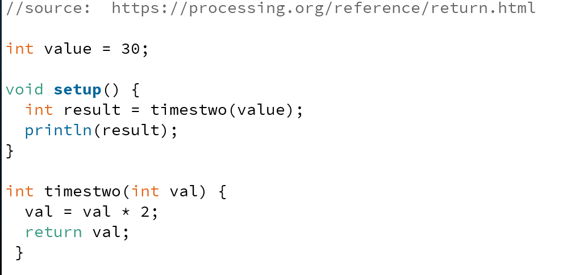
Processing Example 5.6

Slide 24
Summary
Recap of method terminology:
Return type
Method names
Parameter list
Writing your own methods:
With no parameters
With parameters
That return data

Slide 25

Questions?

Slide 26
References
Reas, C. & Fry, B. (2014) Processing – A Programming Handbook for Visual Designers and Artists, 2nd Edition, MIT Press, London.

Slide 27



