Slide 1

Classes and Objects
Recap of Spot (Processing)
Produced
by:
Dr. Siobhán Drohan
Ms. Mairead Meagher
Department of Computing and Mathematics
http://www.setu.ie/

Slide 2
Topics list
Recap: Classes and Objects
Recap on the Spot class:
v1.0 (default constructor)
v2.0 (constructor with parameters)
v3.0 (overloading constructors)

Slide 3
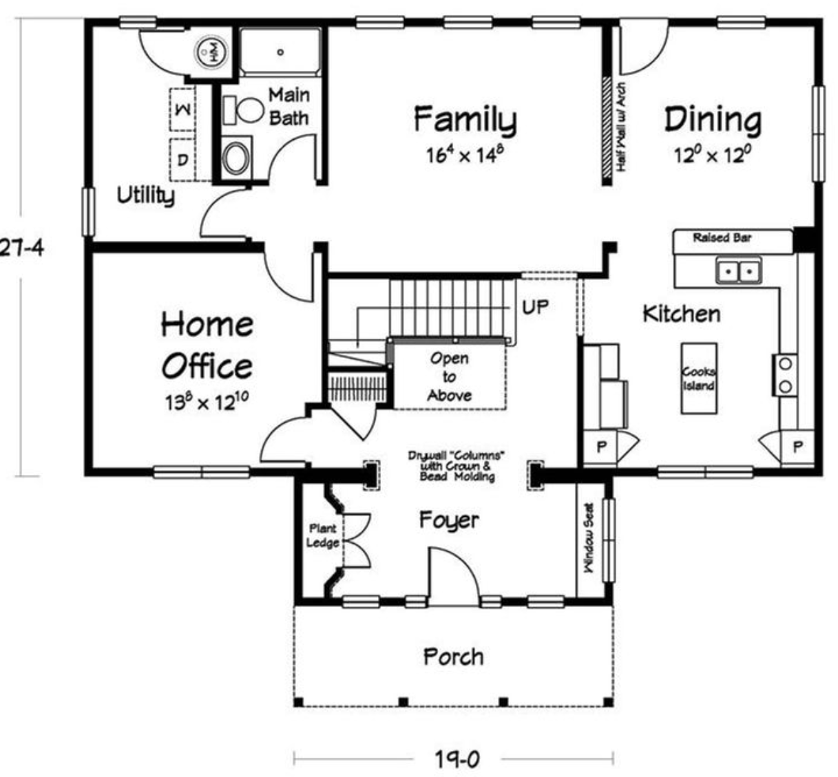
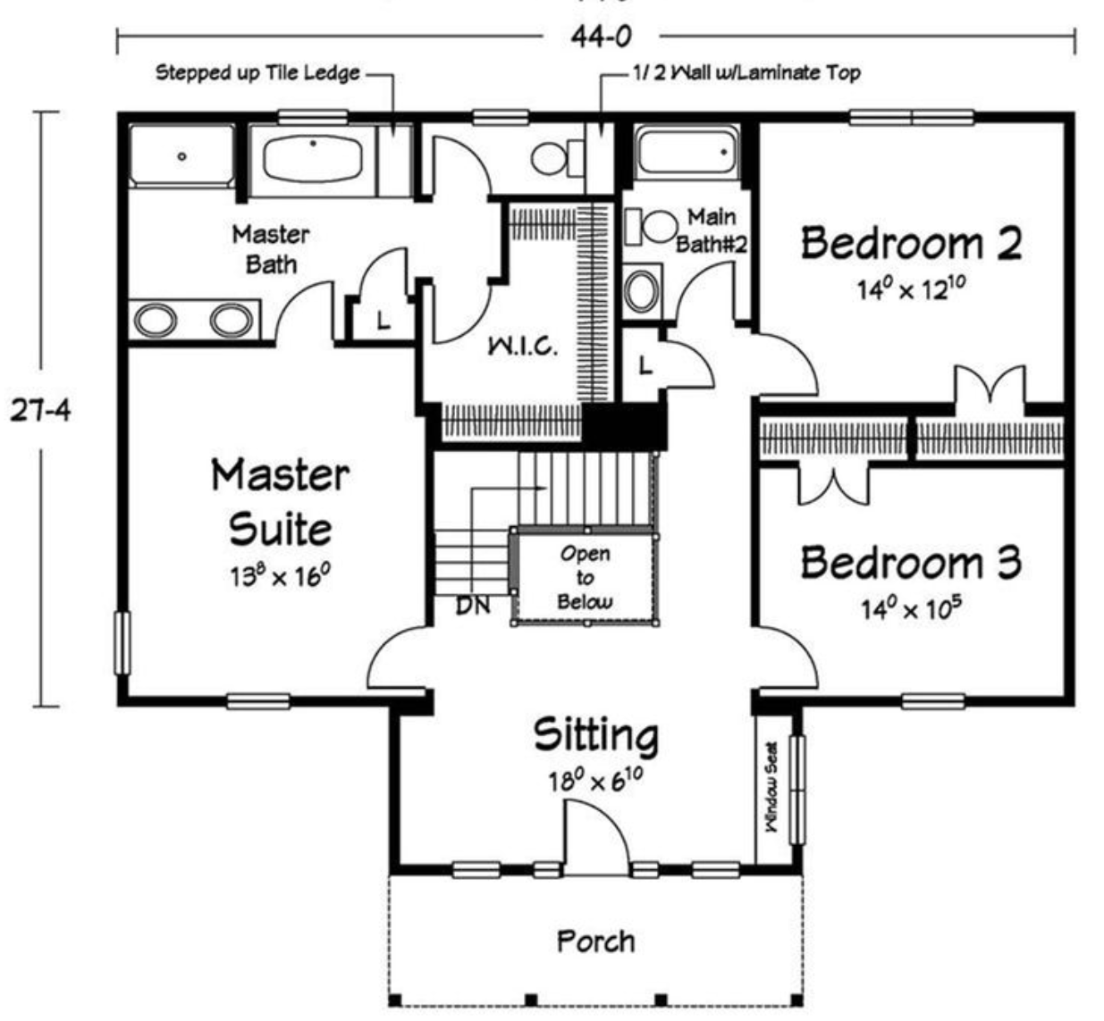
Building Analogy
A class is like a blueprint for a building.

Slide 4
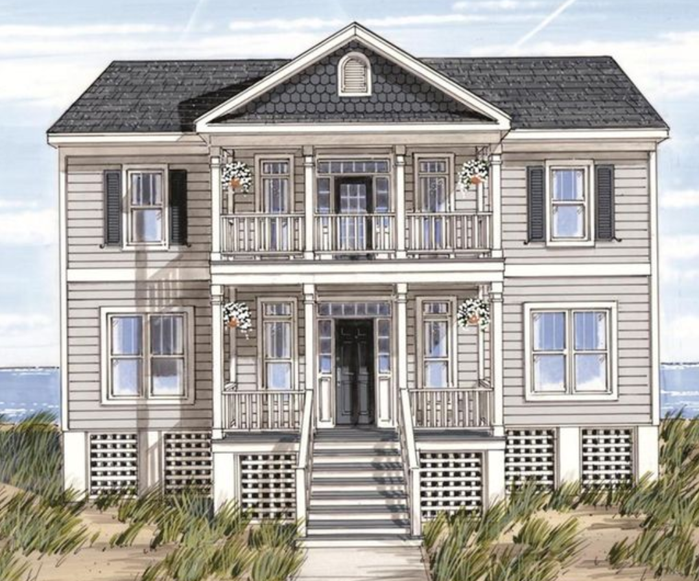
Building Analogy
An object is a building constructed from that blueprint.

Slide 5
Building Analogy
You can build lots of (buildings) objects from a single blueprint.
Notes:
http://momchuri.com/blueprint-house-plans/best-25-house-blueprints-ideas-on-pinterest-floor-plans-blueprint-small-b2b36c37890dbaeb4ef896380f4312f5-minecraft-building-h/

Slide 6
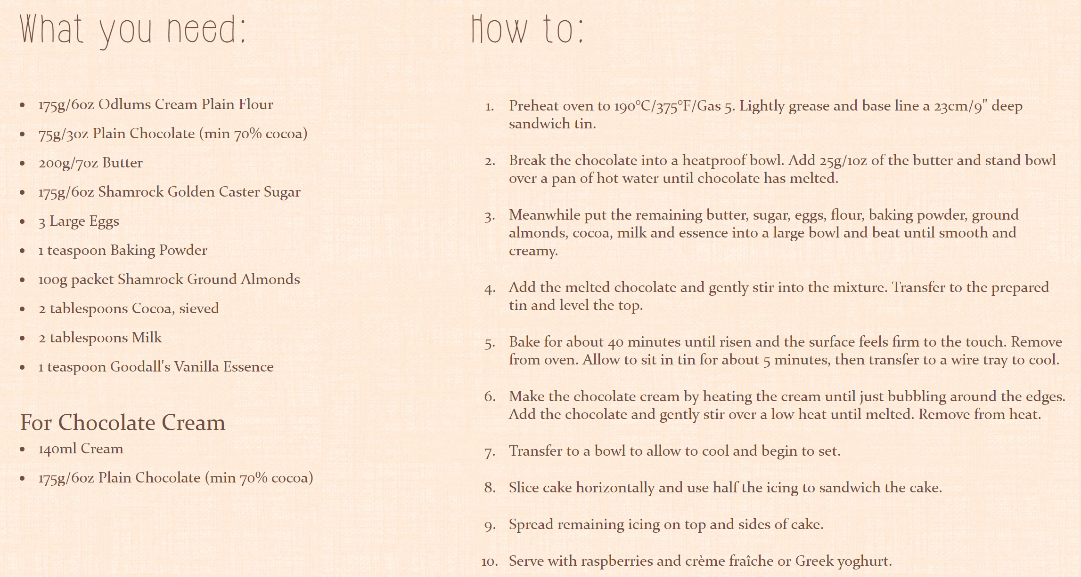
Cake Analogy
A class is like a recipe for a cake.

Slide 7
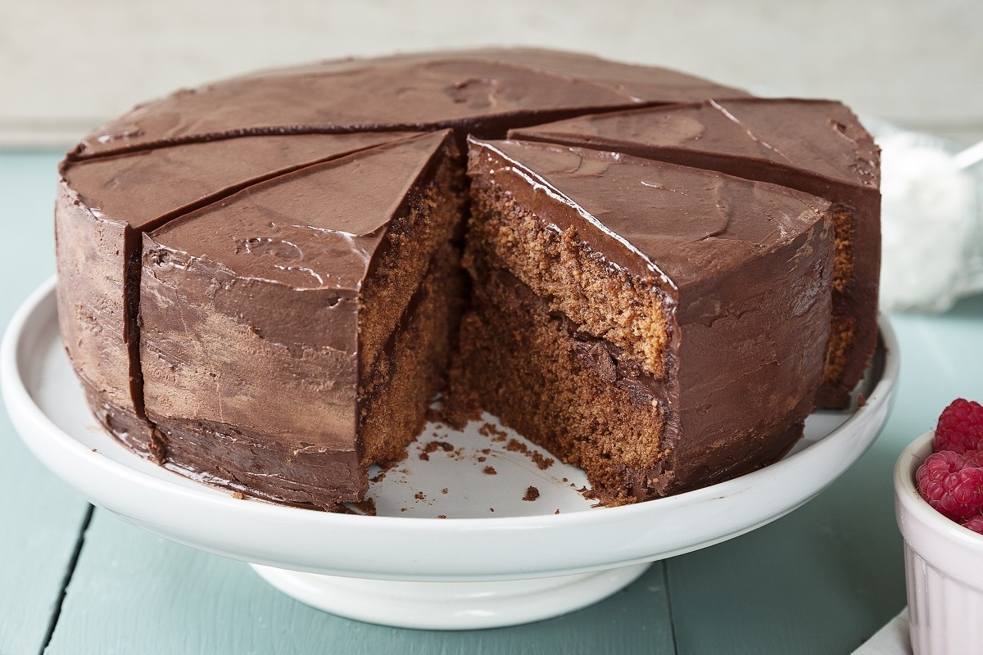
Cake Analogy
An object is the cake baked from that recipe.
Notes:
http://www.odlums.ie/recipes/decadent-chocolate-cake/

Slide 8


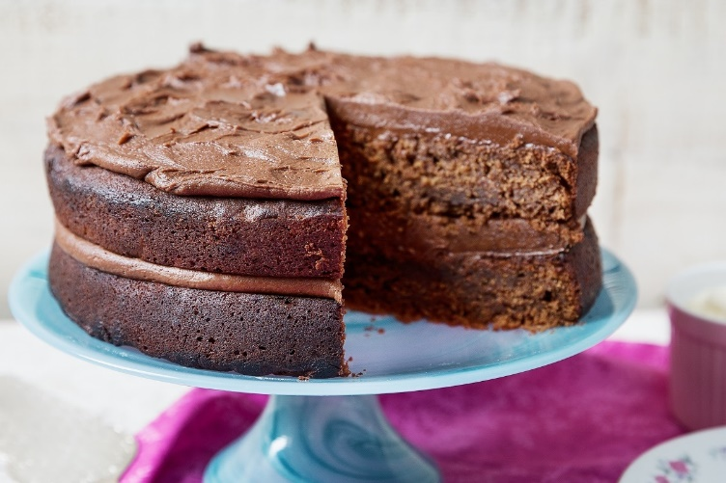
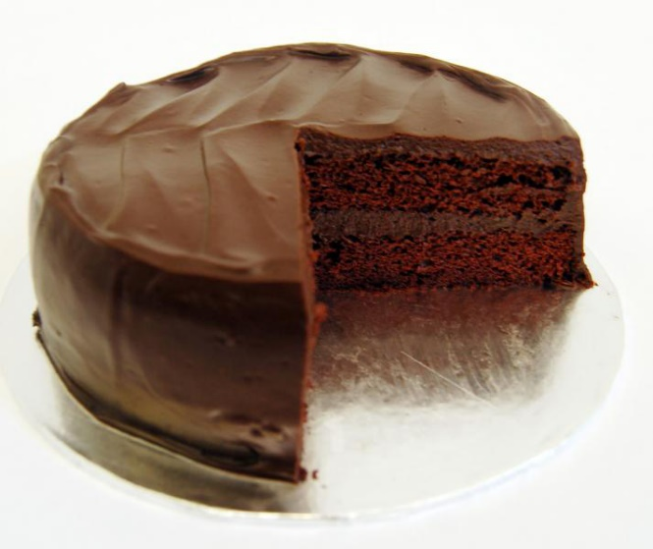
Cake Analogy
You can bake lots of (cakes) objects from a single recipe.

Slide 9
Cake Analogy
Each (cake) object has its own
object state
(each cake looks different here!).

Slide 10
Class names:
should match its purpose.
can be any word or combination of words e.g.:
Account
CurrentAccount
Should begin with a Capital letter and not be pluralised e.g.:
Spot
Product
Source: Reas & Fry (2014)

Slide 11
Spot – classes and objects
class Spot
{
float xCoord;
float yCoord;
float diameter;
Spot()
{
}
}
A class defines a group of related methods (functions) and fields (variables / properties).

Slide 12
Spot – classes and objects
class Spot
{
float xCoord;
float yCoord;
float diameter;
Spot()
{
}
}
Class Name | Spot
Fields (variables, properties) | xCoord yCoord diameter
Methods (functions) | Spot()

Slide 13
Spot – classes and objects
Class Type
class Spot
{
float xCoord;
float yCoord;
float diameter;
Spot()
{
}
}
Class Name | Spot
Fields (variables, properties) | xCoord yCoord diameter
Methods (functions) | Spot()

Slide 14
Spot – classes and objects
class Spot
{
float xCoord;
float yCoord;
float diameter;
Spot()
{
}
}
Class Name | Spot
Fields (variables, properties) | xCoord yCoord diameter
Methods (functions) | Spot()
Properties / Attributes

Slide 15
Spot – classes and objects
class Spot
{
float xCoord;
float yCoord;
float diameter;
Spot()
{
}
}
Class Name | Spot
Fields (variables, properties) | xCoord yCoord diameter
Methods (functions) | Spot()
Behaviours

Slide 16
Spot – classes and objects
sp
An object
is a single instance of a class
i.e. an object is created (instantiated) from a class.
sp
xCoord
0.0
yCoord
0.0
diameter
0.0

Slide 17
Spot – classes and objects
Many objects can be constructed from a single class definition.
spot1
spot2
spot1
spot2
xCoord
30.0
xCoord
10.0
yCoord
60.0
yCoord
20.0
diameter
30.0
diameter
60.0
Source: Reas & Fry (2014)

Slide 18
Spot – classes and objects
Many objects can be constructed from a single class definition.
spot1
spot2
spot1
spot2
xCoord
30.0
xCoord
10.0
Two objects.
Each has a unique name, spot1 and spot2.
Each has it’s own copy (values) of the fields.
yCoord
60.0
yCoord
20.0
diameter
30.0
diameter
60.0
Source: Reas & Fry (2014)

Slide 19
Topics list
Recap: Classes and Objects
Recap on the Spot class:
v1.0 (default constructor)
v2.0 (constructor with parameters)
v3.0 (overloading constructors)

Slide 20
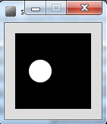
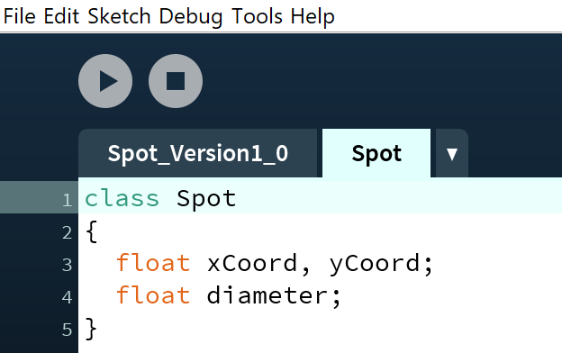
Spot Class – Version 1.0
Defining the class
class Spot
{
float xCoord, yCoord;
float diameter;
}
Declaring the
fields in the
class
In the PDE, place this code in a new tab, called Spot
Source: Reas & Fry (2014)

Slide 21
Spot Class – Version 1.0
class Spot
{
float xCoord, yCoord;
float diameter;
}
Declaring an object sp, of type Spot.
Spot sp;
void setup(){
size (100,100);
noStroke();
sp = new Spot();
sp.xCoord = 33;
sp.yCoord = 50;
sp.diameter = 30;
}
void draw(){
background(0);
ellipse(sp.xCoord, sp.yCoord, sp.diameter, sp.diameter);
}
Calling the Spot() constructor to build the sp object in memory.
Initialising the fields in the sp object with a starting value.
Calling the ellipse method, using the fields in the sp object as arguments.
Source: Reas & Fry (2014)

Slide 22
Constructors
Spot sp;
sp = new Spot();
The sp object is constructed with the keyword new.
Spot() is the default constructor that is called to build the sp object in memory.

Slide 23
Constructors
Spot sp;
sp = new Spot();
The sp object is constructed with the keyword new.
Spot() is the default constructor that is called to build the sp object in memory.
A CONSTRUCTOR is a method that has the same name as the class but has no return type.
Spot()
{
}

Slide 24
Default Constructor
sp
class Spot
{
float xCoord;
float yCoord;
float diameter;
//Default Constructor
Spot()
{
}
}
sp
xCoord
0.0
yCoord
0.0
diameter
0.0
The constructor stores initial values in the fields.

Slide 25
Topics list
Recap: Classes and Objects
Recap on the Spot class:
v1.0 (default constructor)
v2.0 (constructor with parameters)
v3.0 (overloading constructors)

Slide 26
Spot Class – Version 2.0
class Spot
{
float xCoord, yCoord;
float diameter;
Spot (float xPos, float yPos, float diamtr)
{
xCoord = xPos;
yCoord = yPos;
diameter = diamtr;
}
}
Spot sp;
void setup()
{
size (100,100);
noStroke();
sp = new Spot (33, 50, 30);
}
void draw()
{
background(0);
ellipse(sp.xCoord, sp.yCoord, sp.diameter, sp.diameter);
}
Source: Reas & Fry (2014)

Slide 27
Topics list
Recap: Classes and Objects
Recap on the Spot class:
v1.0 (default constructor)
v2.0 (constructor with parameters)
v3.0 (overloading constructors)

Slide 28
Overloading Constructors
We can have as many constructors as our design requires, ONCE they have unique parameter lists.
We are overloading our constructors in Version 3.0…

Slide 29
Spot Class – Version 3.0
class Spot{
float xCoord, yCoord;
float diameter;
Spot() {
}
Spot (float xPos, float yPos, float diamtr){
xCoord = xPos;
yCoord = yPos;
diameter = diamtr;
}
}
Default Constructor with NO parameters
overloading
A second Constructor with a (float, float, float) parameter list
Source: Reas & Fry (2014)

Slide 30
Class Diagram for Spot Version 3.0
Object Type/ Class Name
Spot
xCoord yCoord diameter
Spot() Spot(float, float, float)
Fields i.e. the attributes of the class
Methods i.e. the behaviours of the class
Source: Reas & Fry (2014)

Slide 31
Class Diagram for Spot Version 3.0
So far, we only have overloaded constructors for our class (they create the objects of our class).
We have not defined any behaviours for our class e.g.
display the spot,
colour the spot,
move the spot,
and so on.
As it stands, the Spot class is not very useful!
Spot
xCoord yCoord diameter
Spot() Spot(float, float, float)
Source: Reas & Fry (2014)

Slide 32

Questions?

Slide 33
References
Reas, C. & Fry, B. (2014) Processing – A Programming Handbook for Visual Designers and Artists, 2nd Edition, MIT Press, London.

