Slide 1
Programming Fundamentals 1

Slide 2
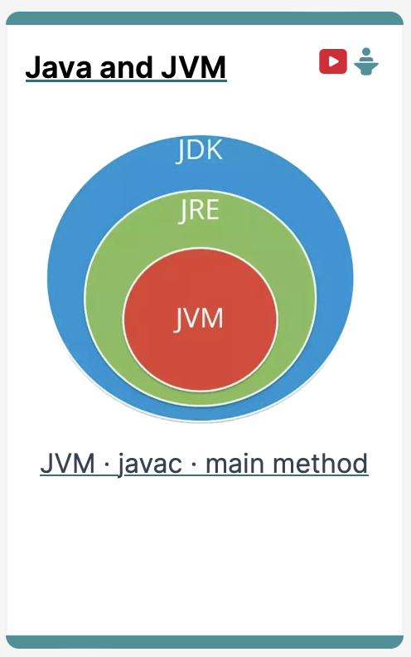
Introduction to the JVM
The Java Virtual Machine and the main method

Slide 3
Agenda
Files in Java
Java Virtual Machine (JVM)
main() method

Slide 4
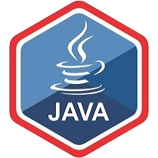
Files in Java

Slide 5
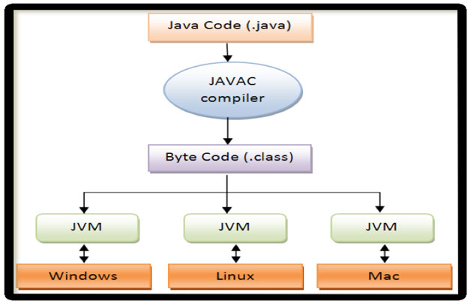
Files in Java
http://viralpatel.net/blogs/java-virtual-machine-an-inside-story/
Platform
independent
Platform
specific
Notes:
http://viralpatel.net/blogs/java-virtual-machine-an-inside-story/

Slide 6
Files in Java
http://viralpatel.net/blogs/java-virtual-machine-an-inside-story/
Java code is written in .java file
code contains one or more Java language constructs e.g. Classes, Methods, Variable, Objects etc.
Compiling this code generates a .class file
A .class file
“byte code”
the input to Java Virtual Machine (JVM)
The JVM (for a specific platform) reads this byte code, interprets it as machine code instructions (for that platform) and executes the program (on that platform)

Slide 7
Java Virtual Machine (JVM)

Slide 8
Java Virtual Machine (JVM)
http://viralpatel.net/blogs/java-virtual-machine-an-inside-story/
A “virtual” computer that resides in the “real” computer as a software process
Gives Java the flexibility of platform independence.
The .class files can be run on any OS, once a JVM has been installed
(NB: JVM is installed when you install the JDK).

Slide 9
main() method

Slide 10
main() method
When you want to run a java project, the Java Virtual Machine (JVM) invokes the main() method in the project
For the JVM to recognise it, the main() method must have a specific method signature
public static void main(String[] args) {
... }

Slide 11
main() method - signature
“main” must exist
“main” must be public
“main” must be static (class method)
“main” must have a String array parameter
Only “main” can be invoked automatically
public static void main(String[] args) {
... }

Slide 12
The main() method typically…
public static void main(String[] args)
{
Driver driver = new Driver();
driver.runMenu();
}
Creates an object
Calls the first method

Slide 13

Questions?

Slide 14



