Slide 1
Programming Fundamentals 1

Slide 2
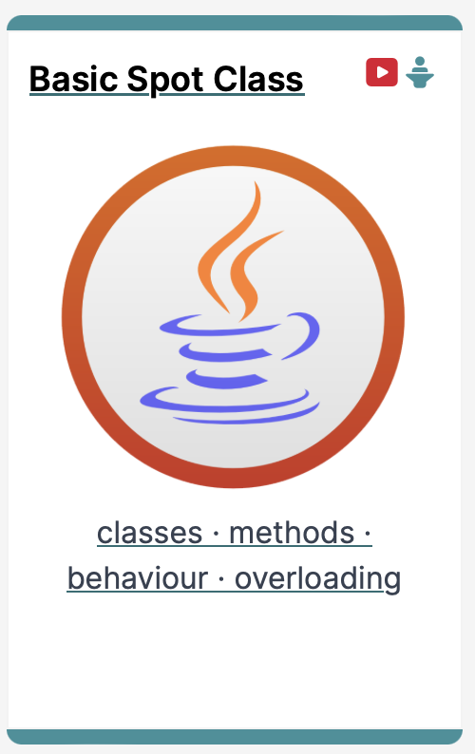
IntelliJ and Spot
Basic Spot Class in our new IDE

Slide 3
Agenda
The IntelliJ IDE
New Project Setup
Basic Spot Class

Slide 4

The IntelliJ IDE

Slide 5
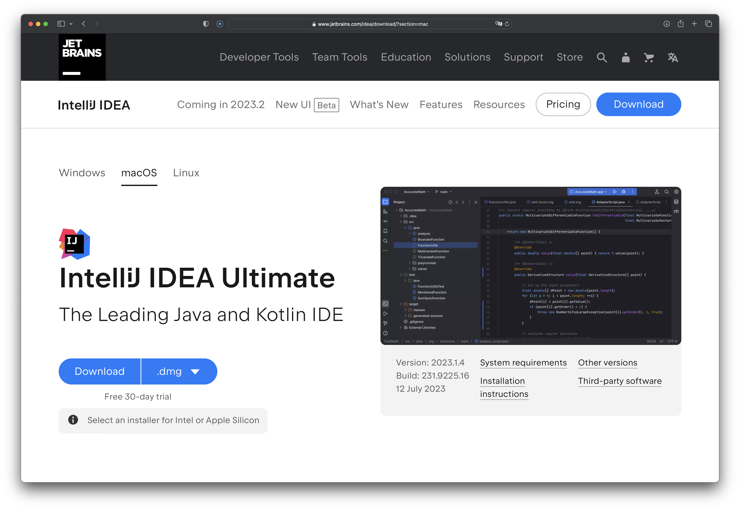
IntelliJ - An industry standard IDE

Slide 6
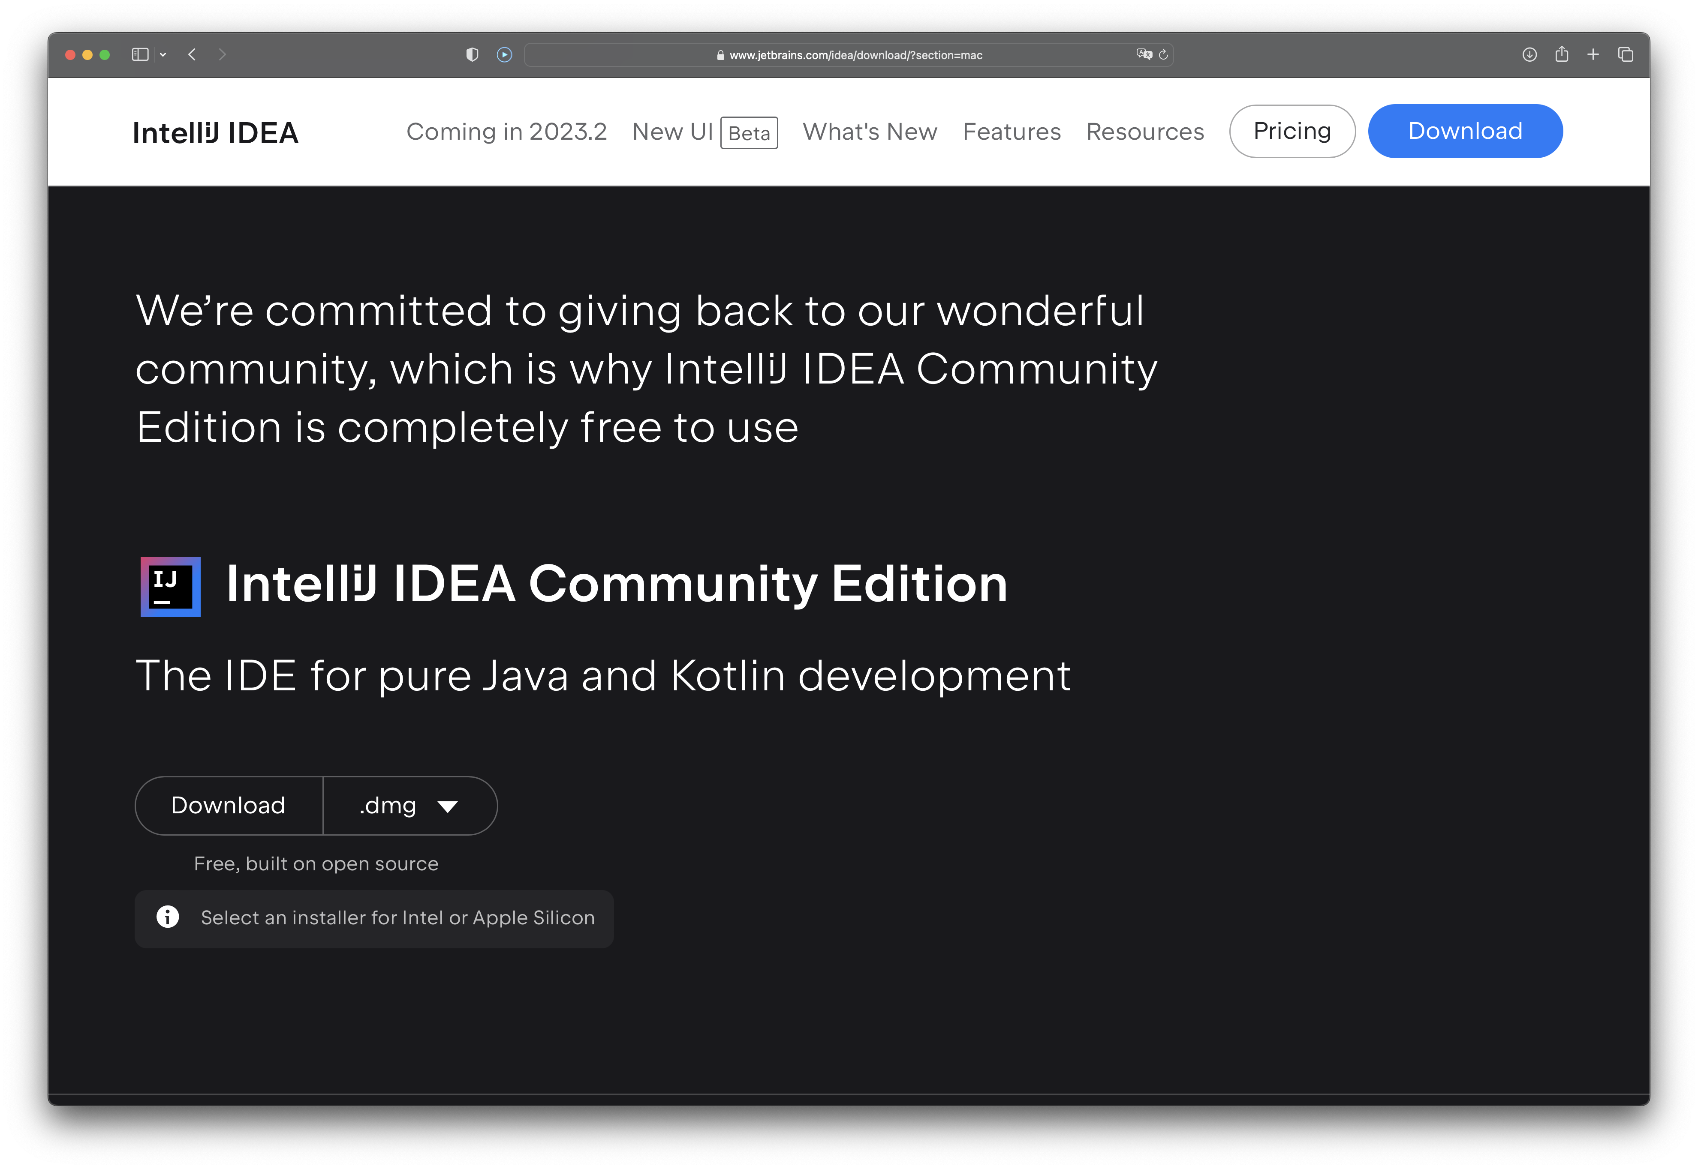
IntelliJ - An industry standard IDE

Slide 7
New Project Setup

Slide 8
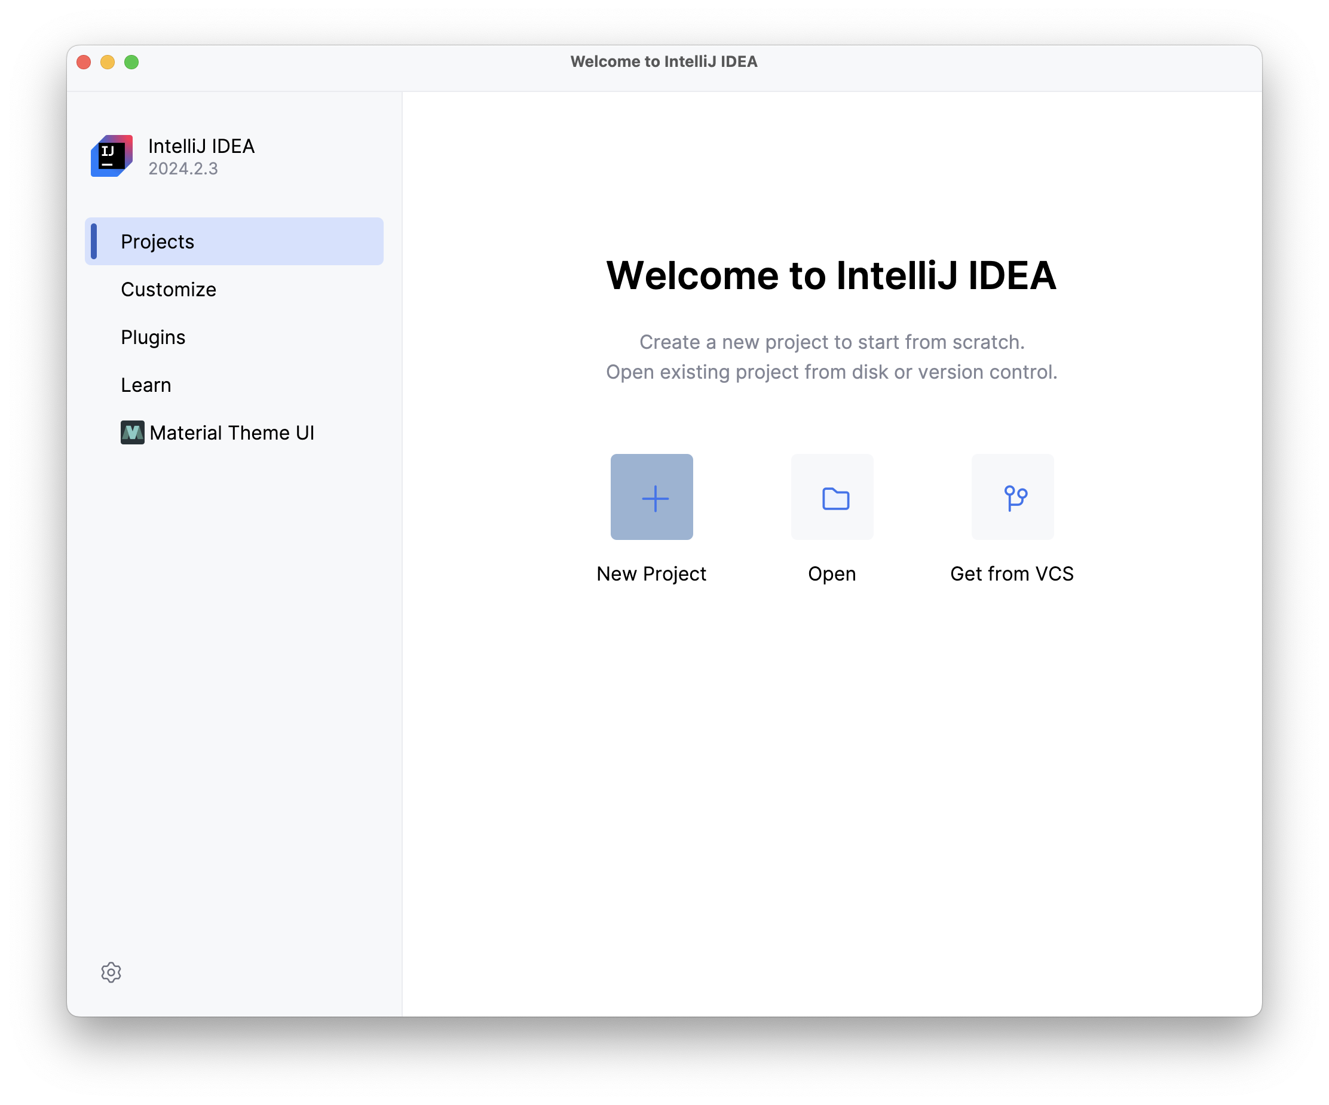
Launch IntelliJ

Slide 9
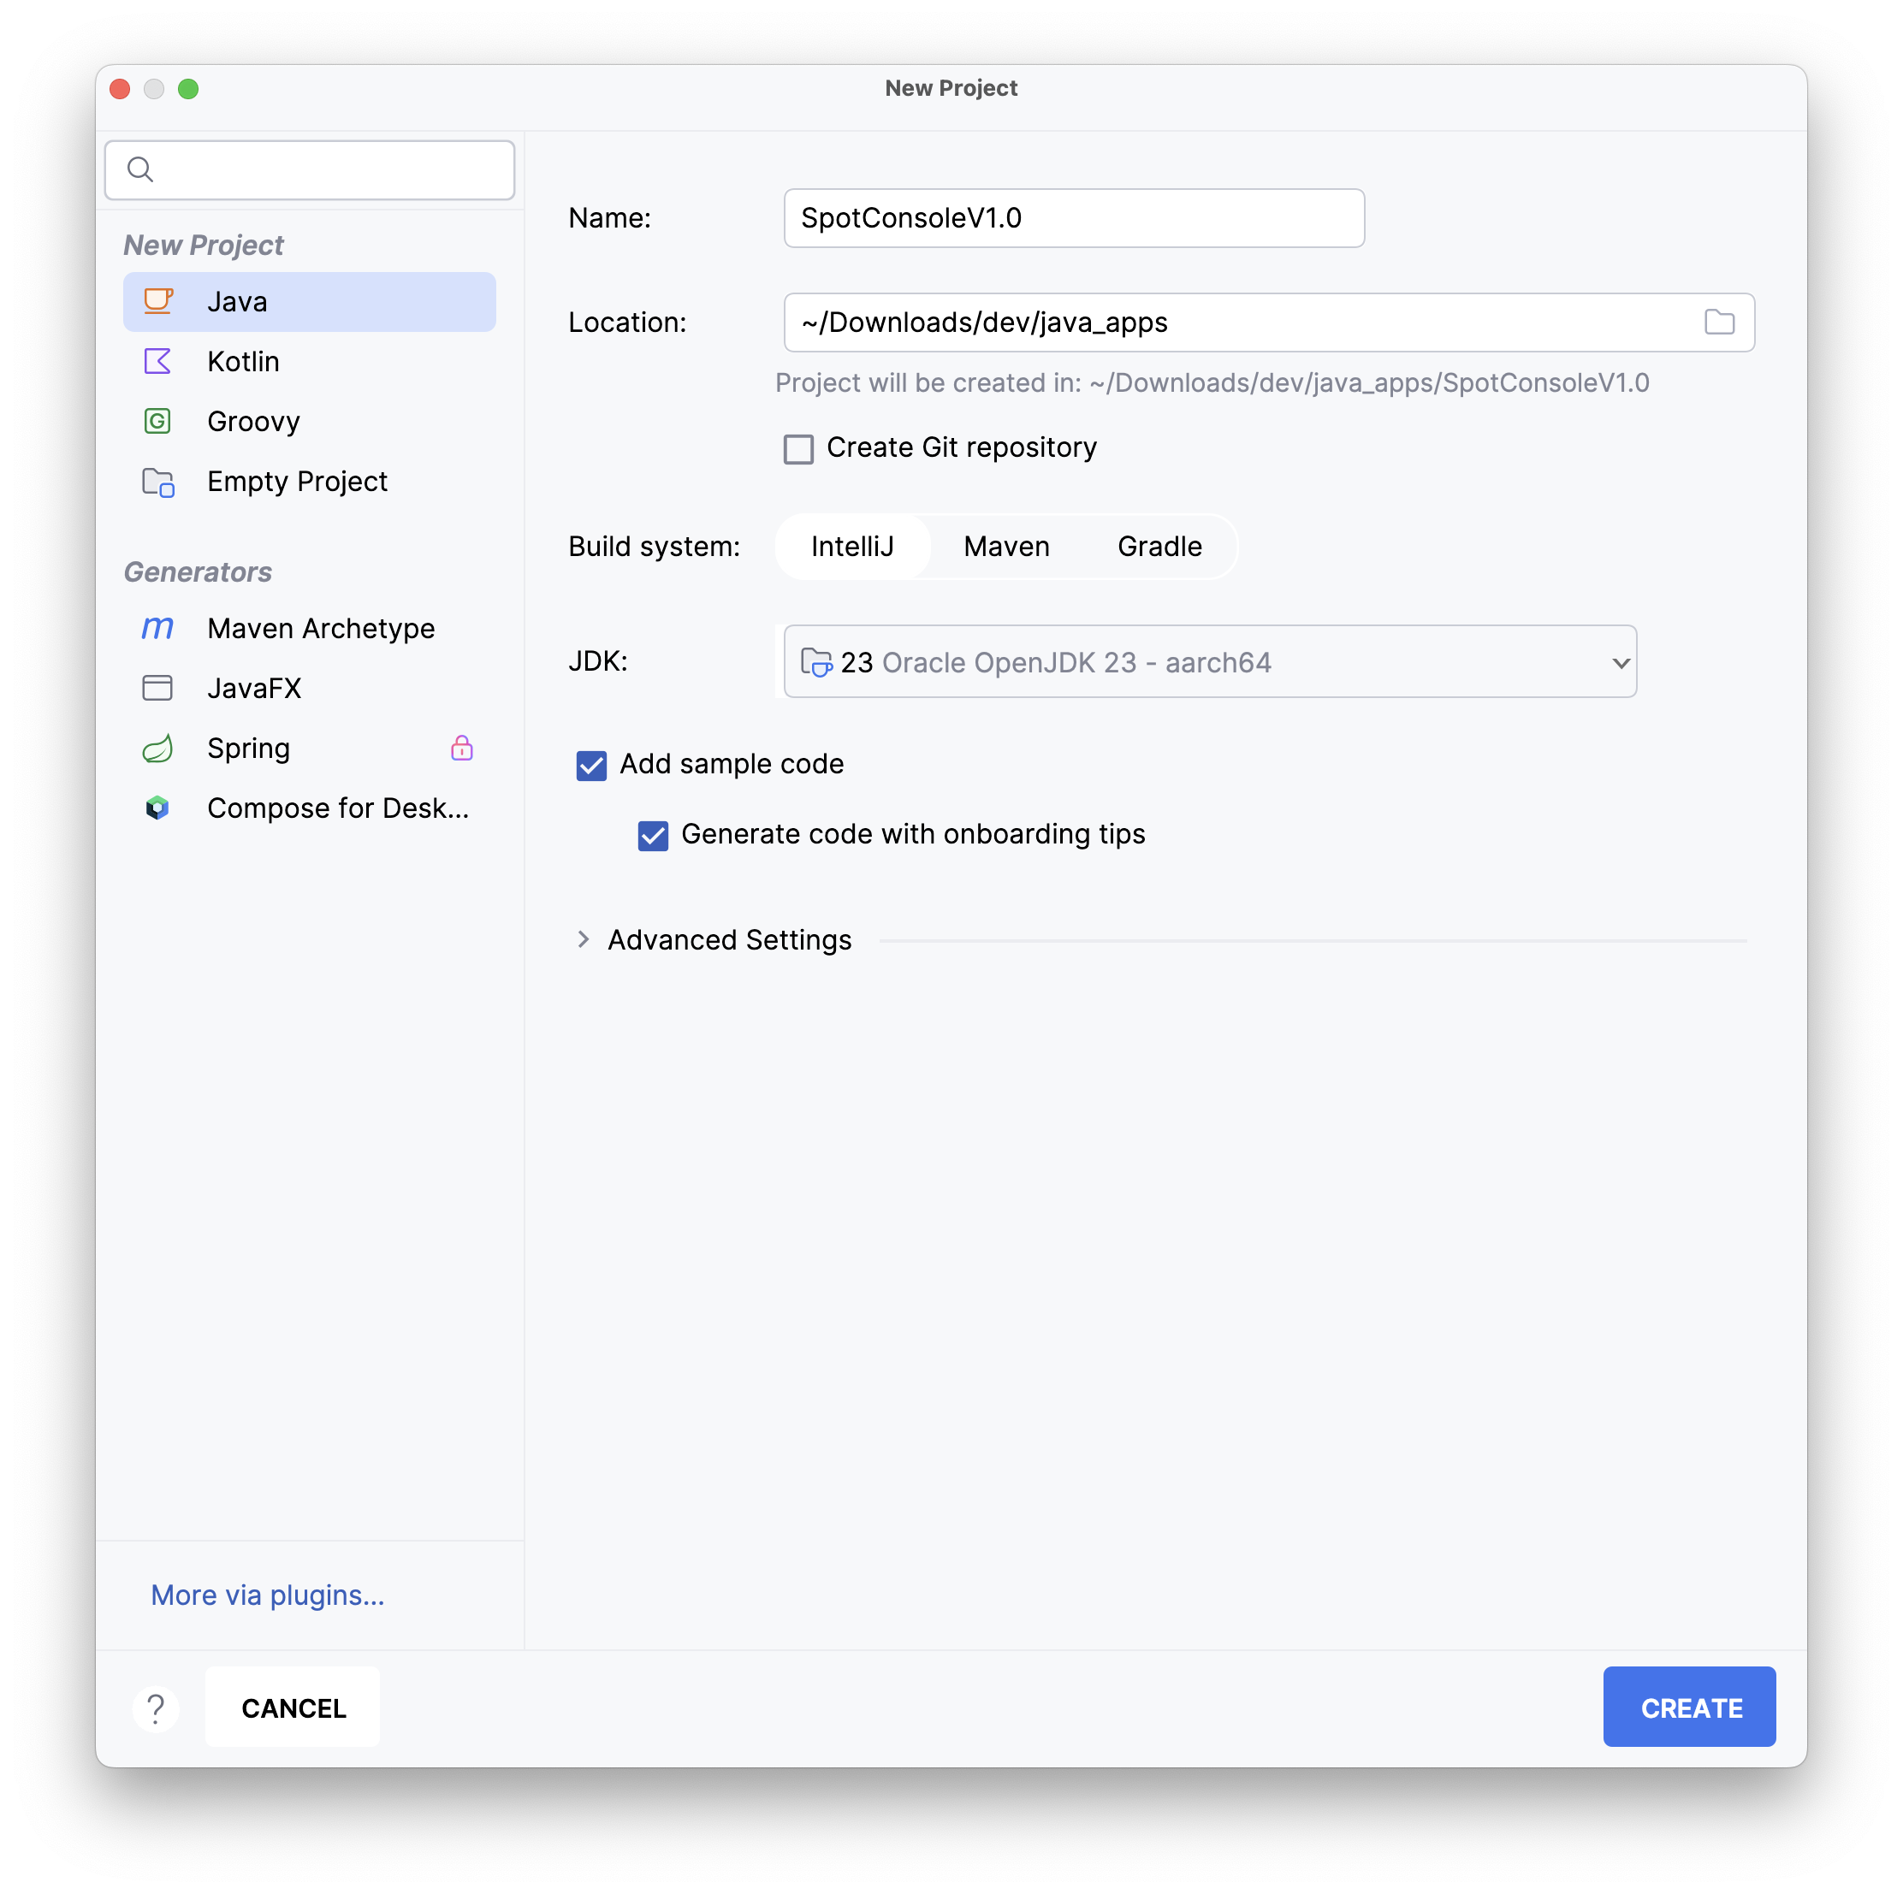
New Java Project

Slide 10
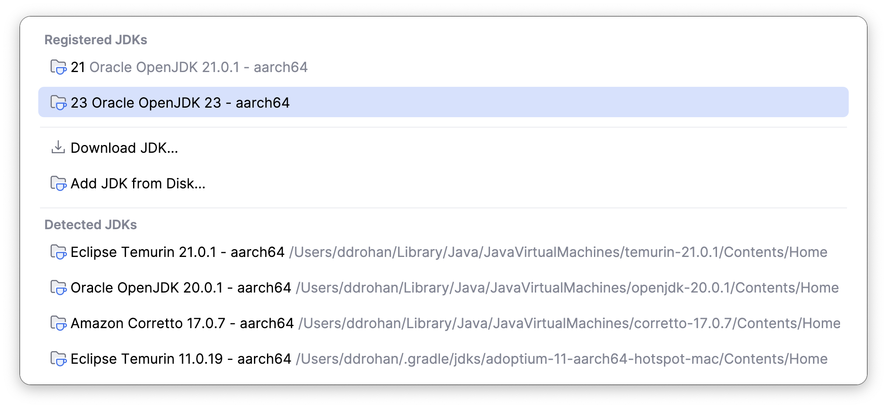
New Java Project

Slide 11
New Java Project

Slide 12
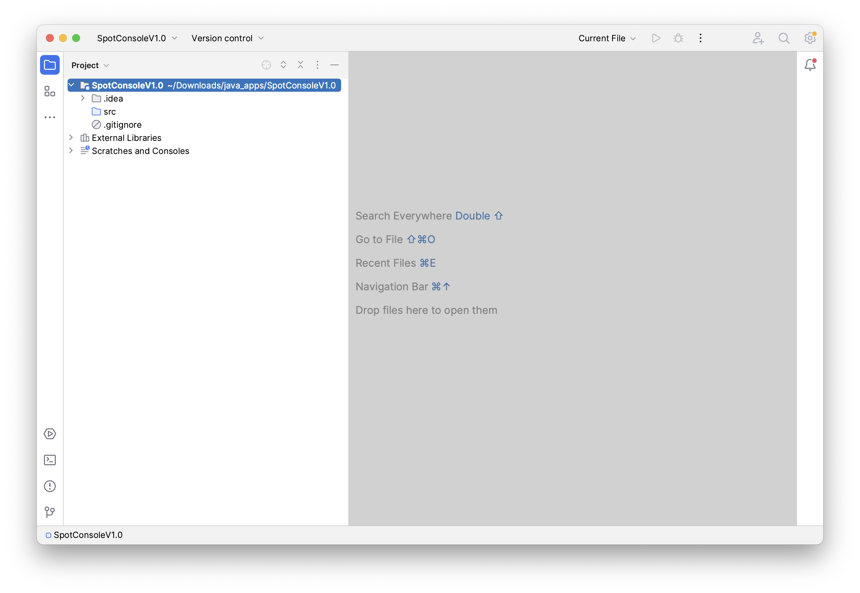
New Project

Slide 13
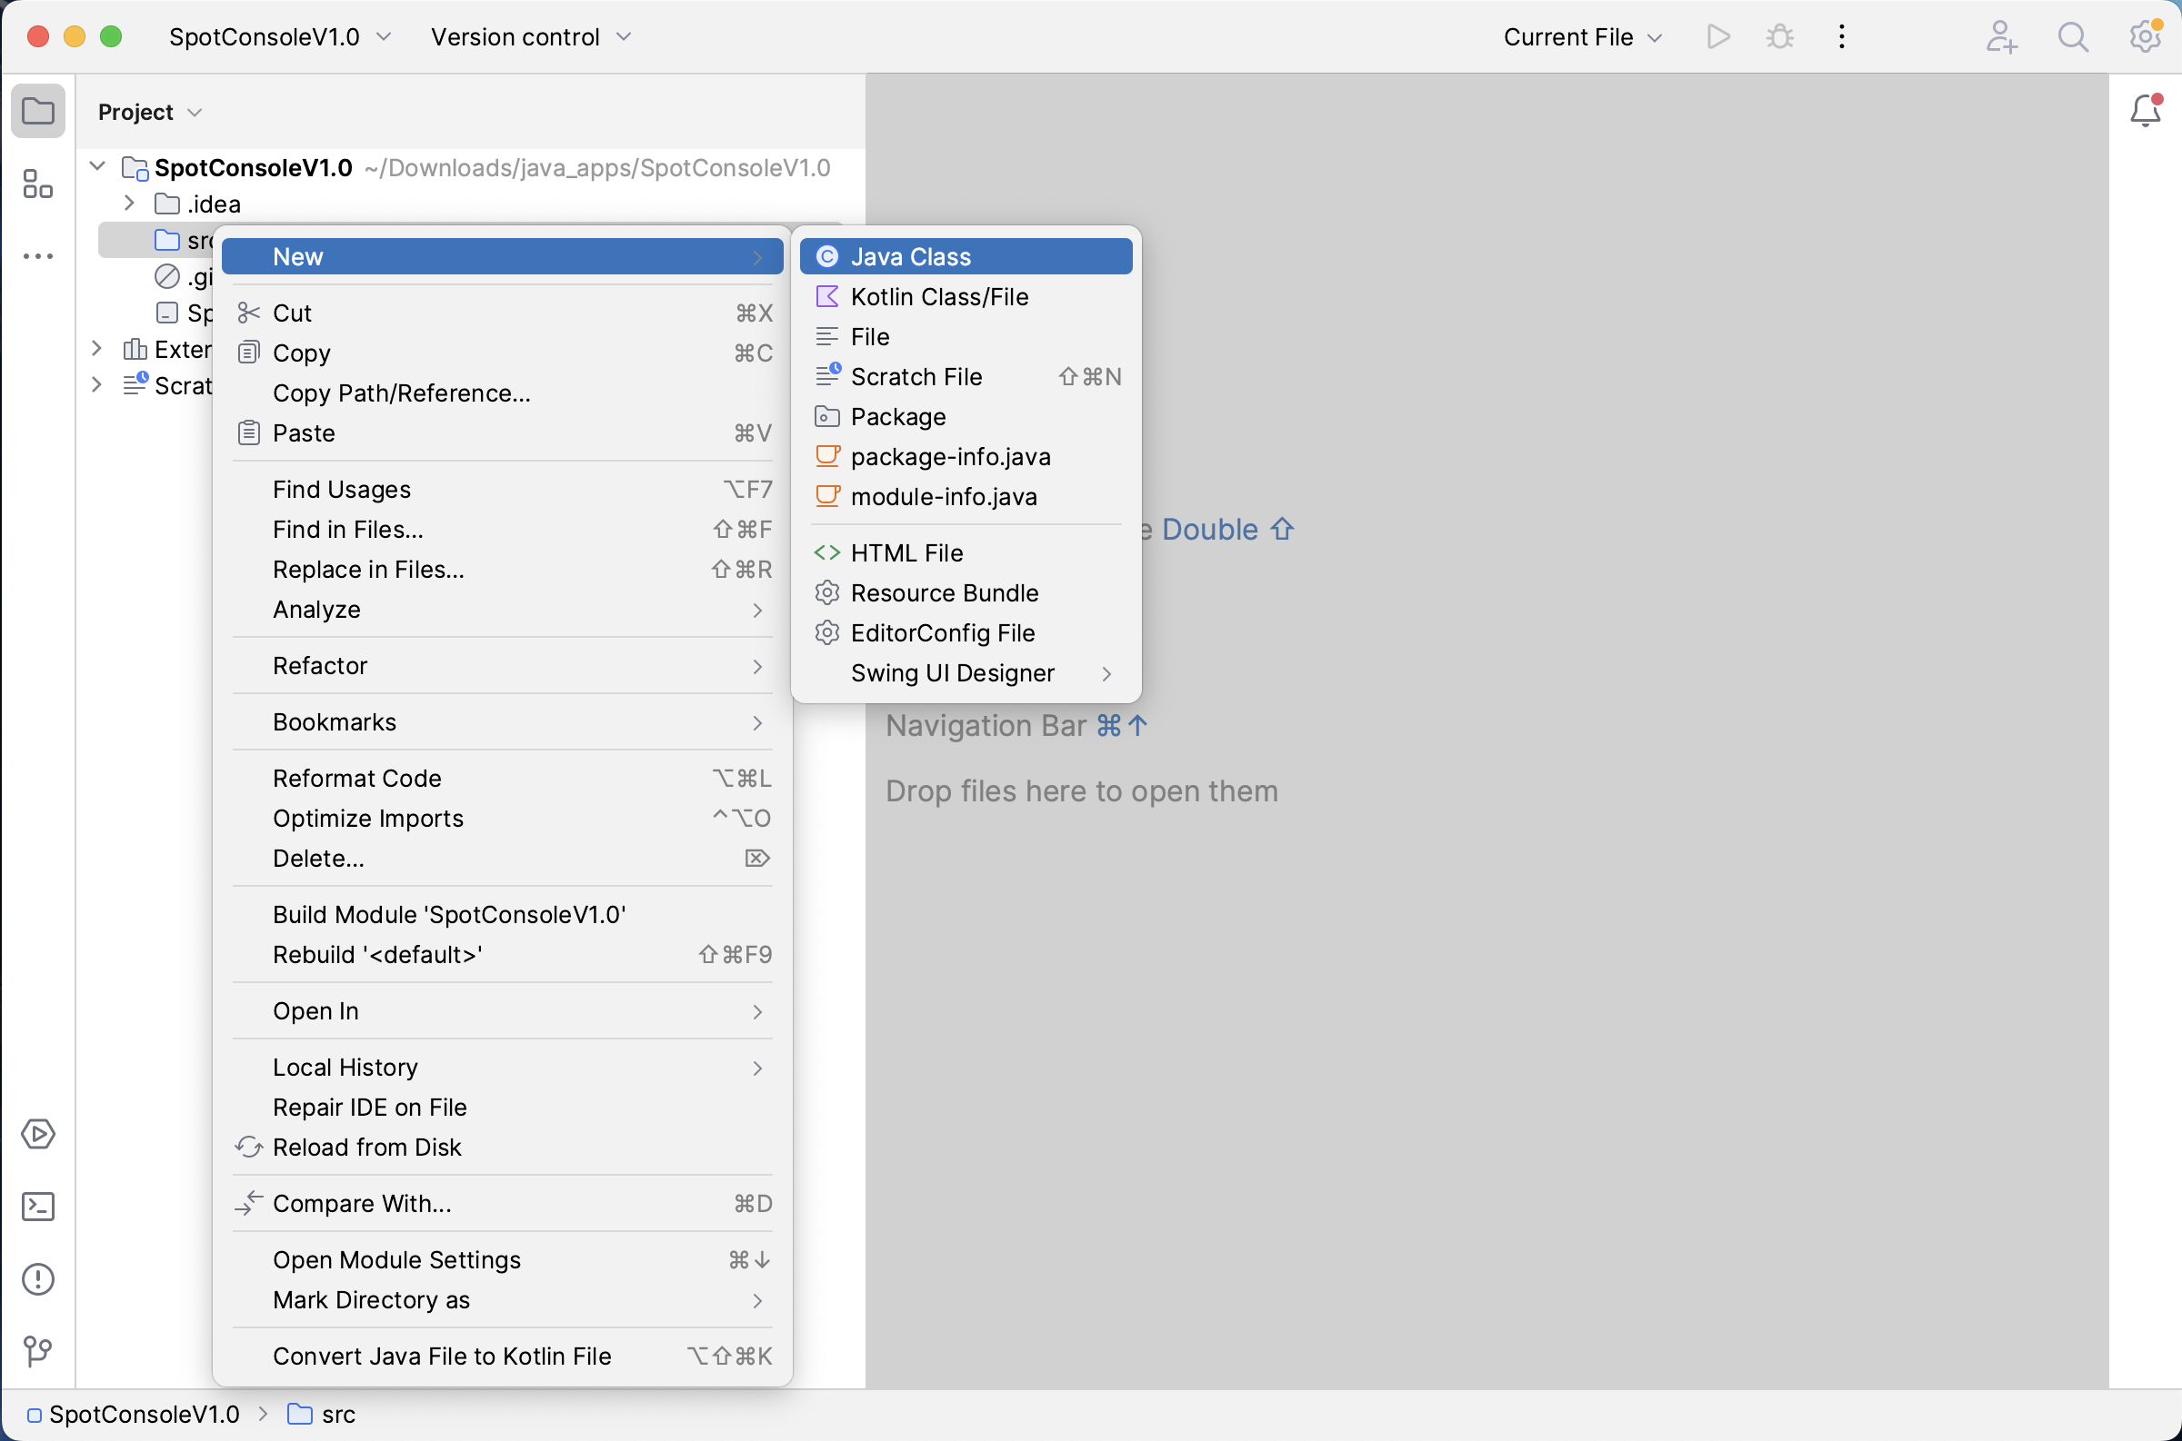
Create New Class

Slide 14
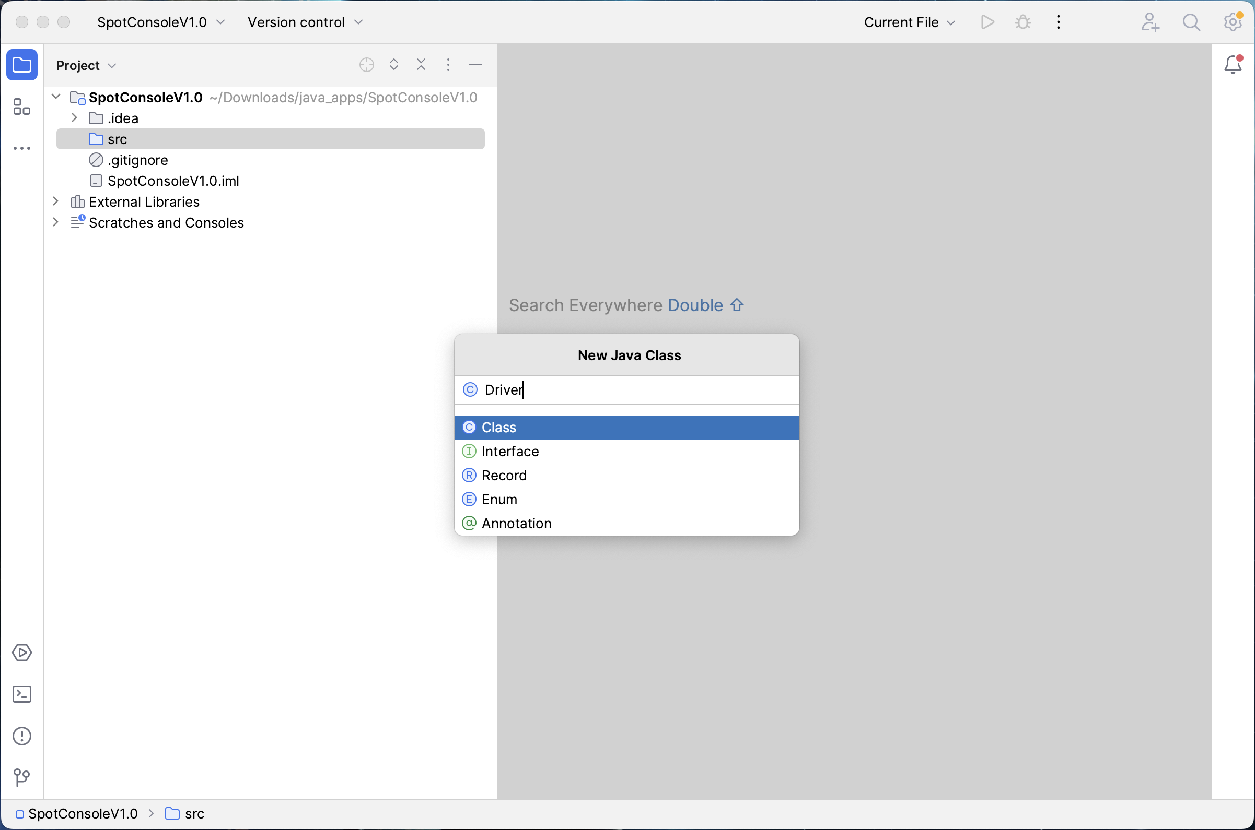
Create New Class Driver

Slide 15
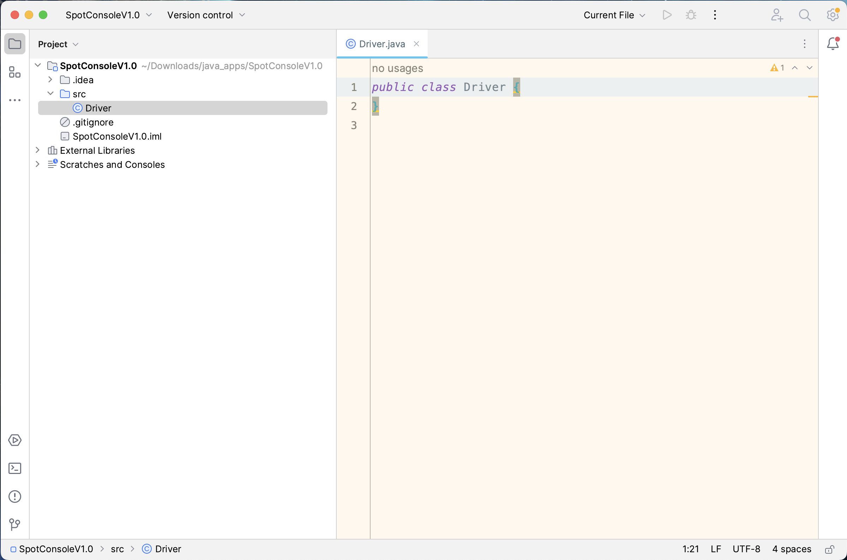
Create New Class Driver

Slide 16
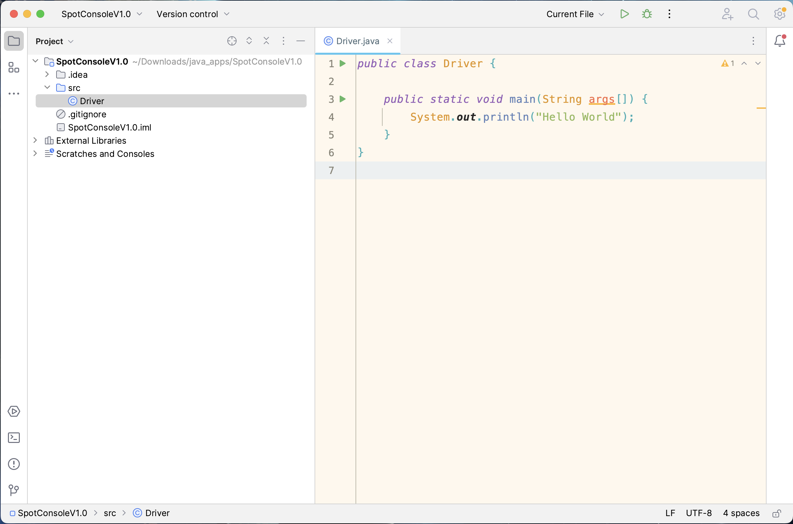
main() method

Slide 17
Run App

Slide 18
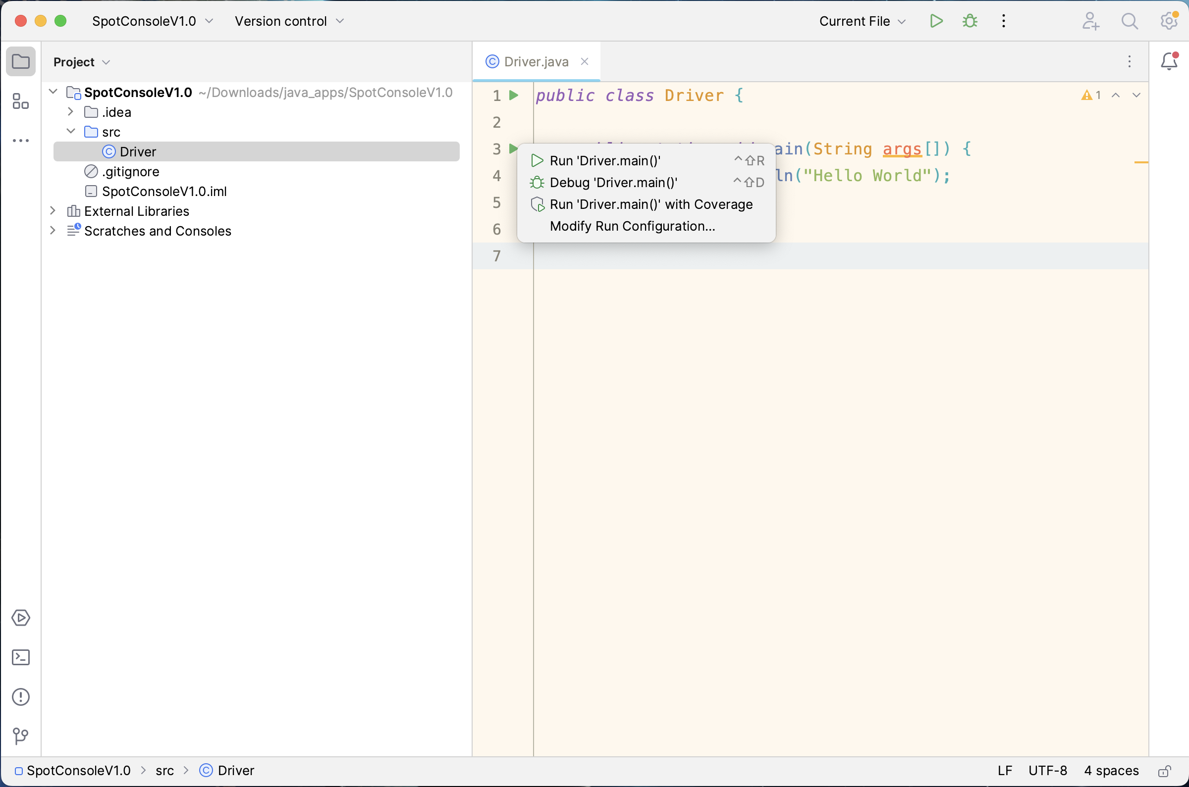
Run App

Slide 19
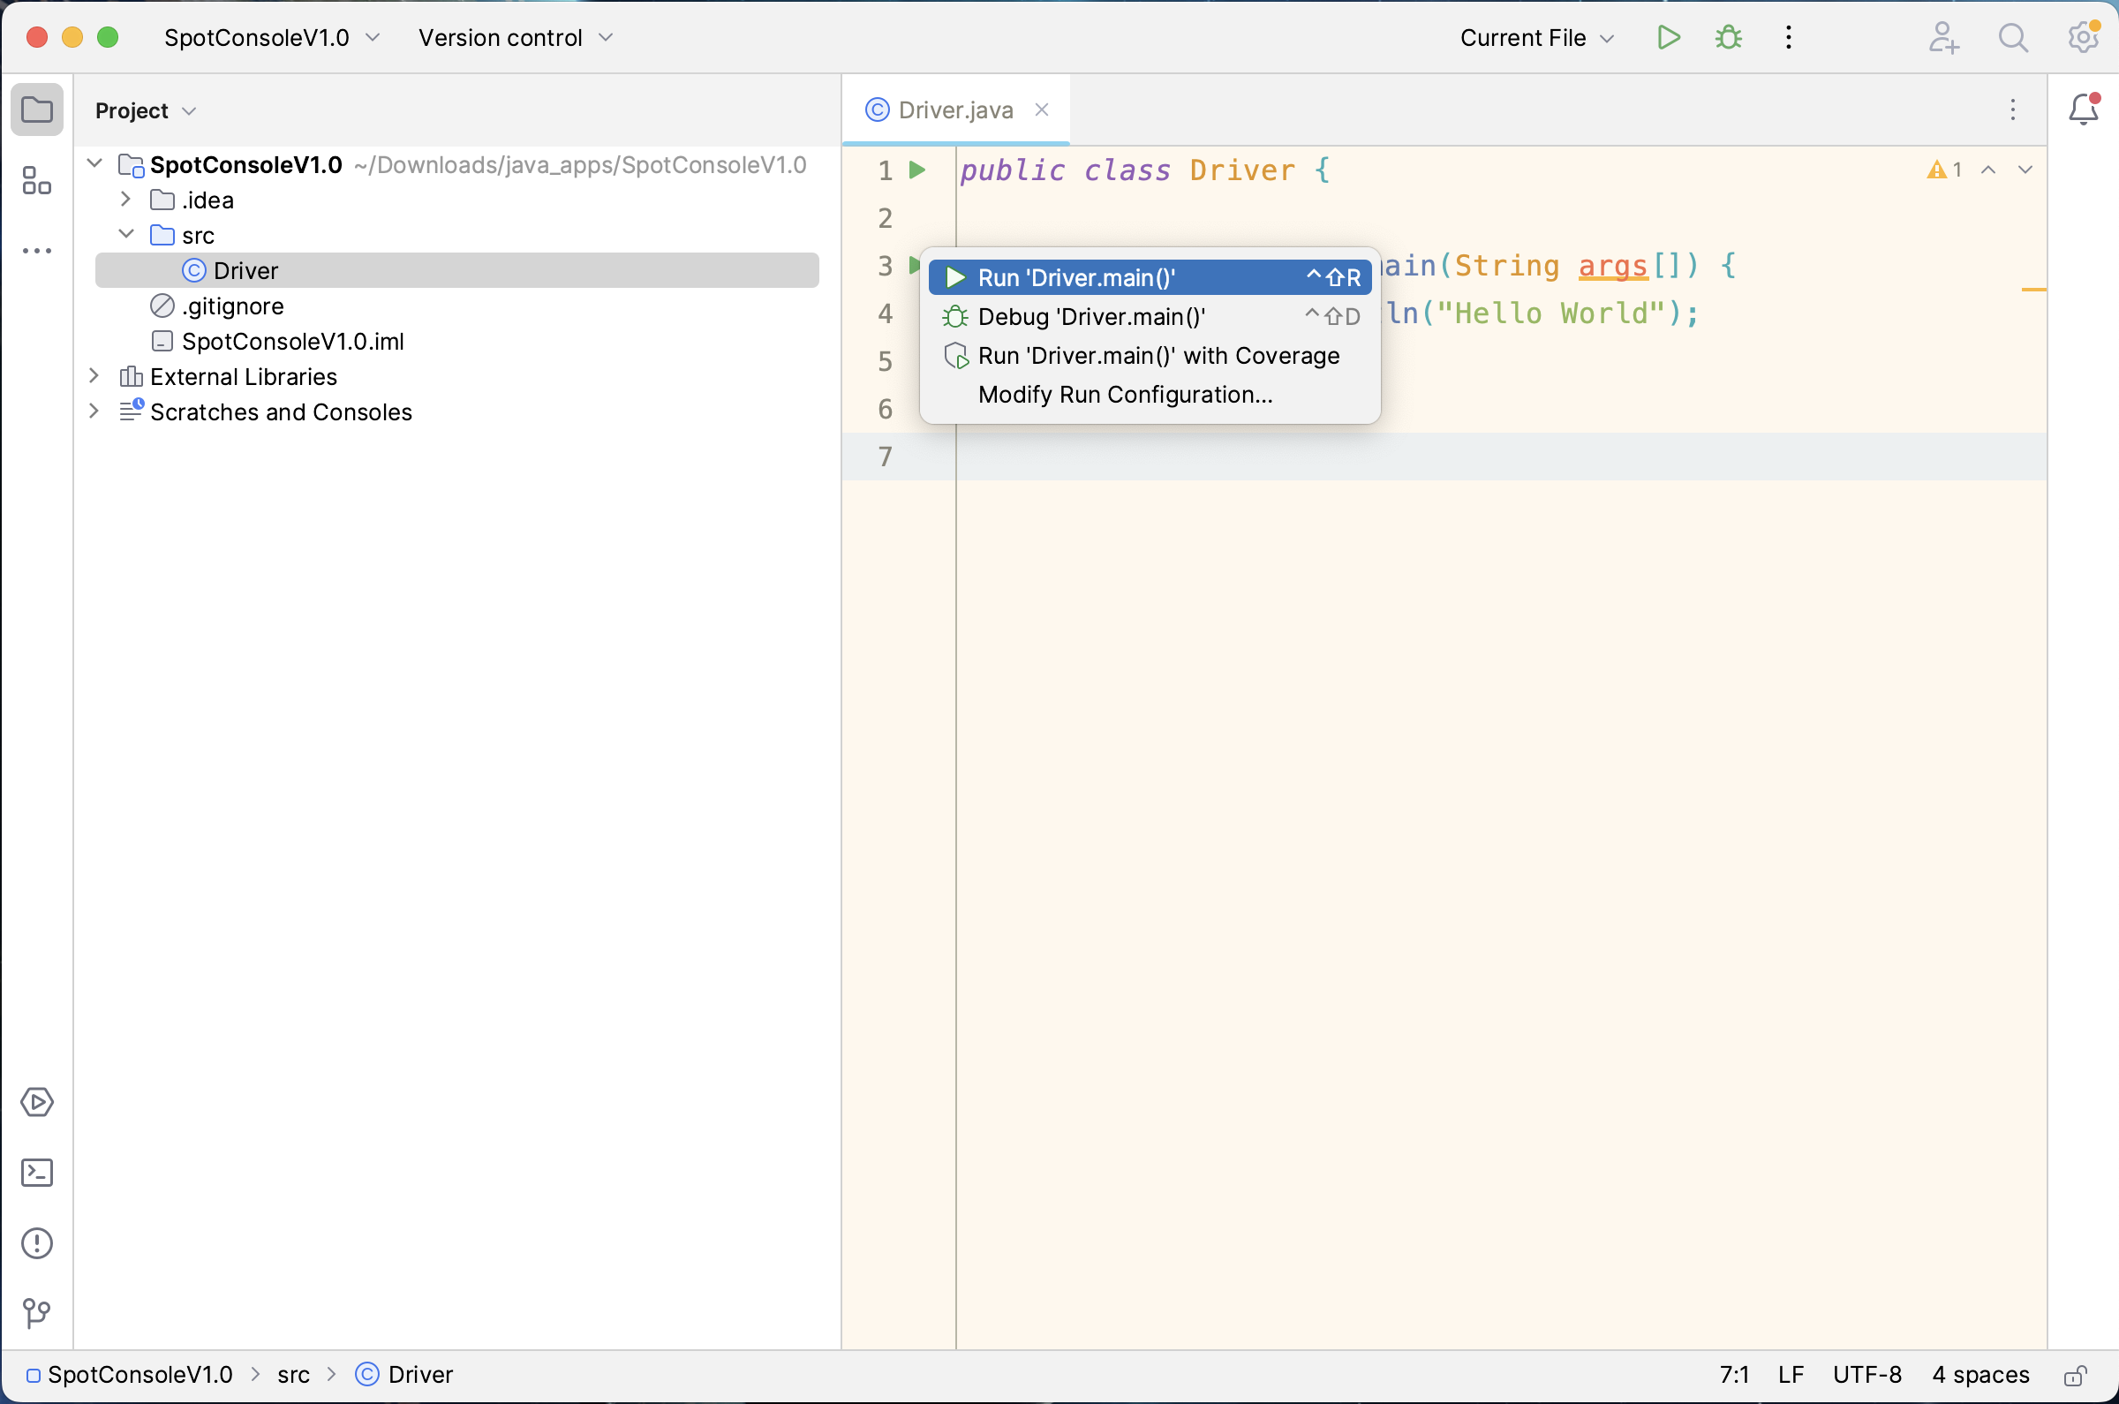
Run App

Slide 20
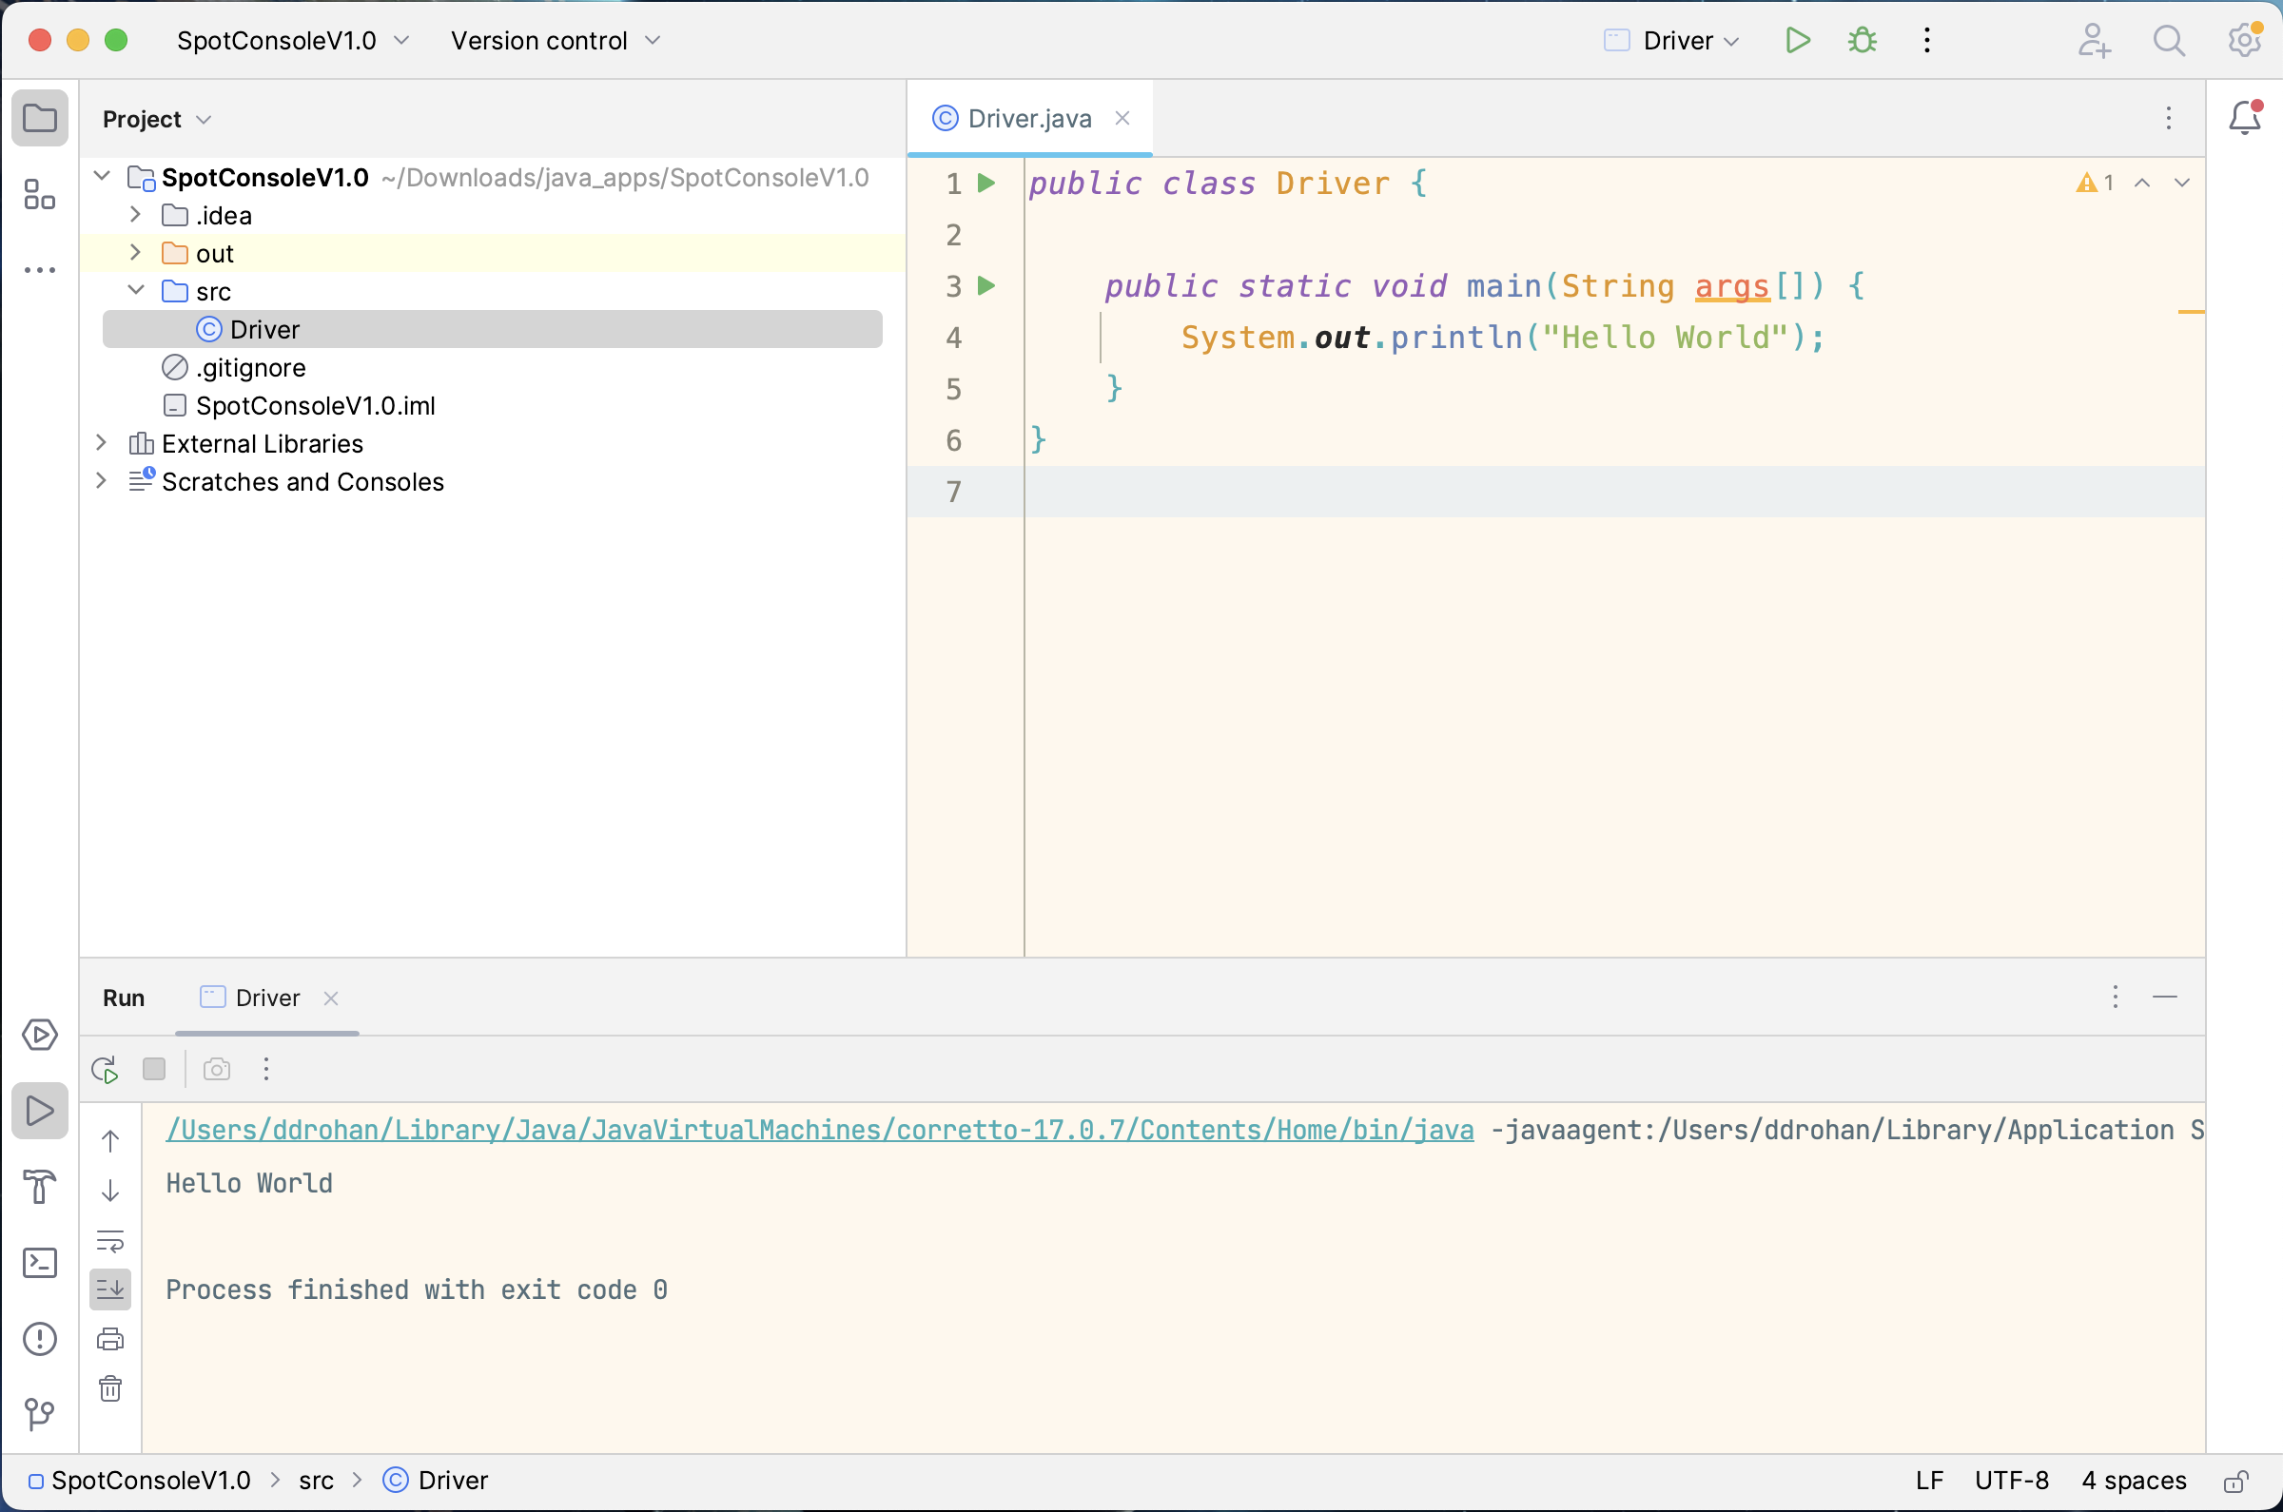
Run App
Console Output

Slide 21
Basic Spot Class

Slide 22
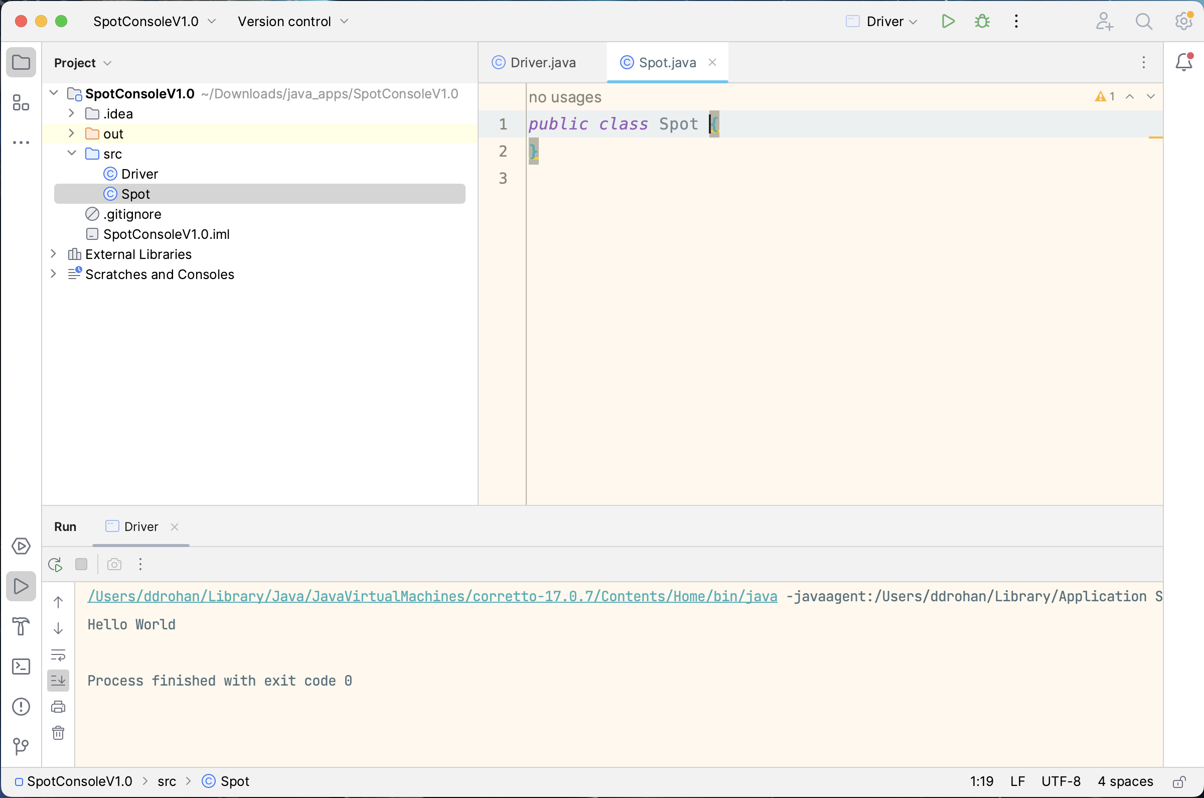
New Spot Class

Slide 23
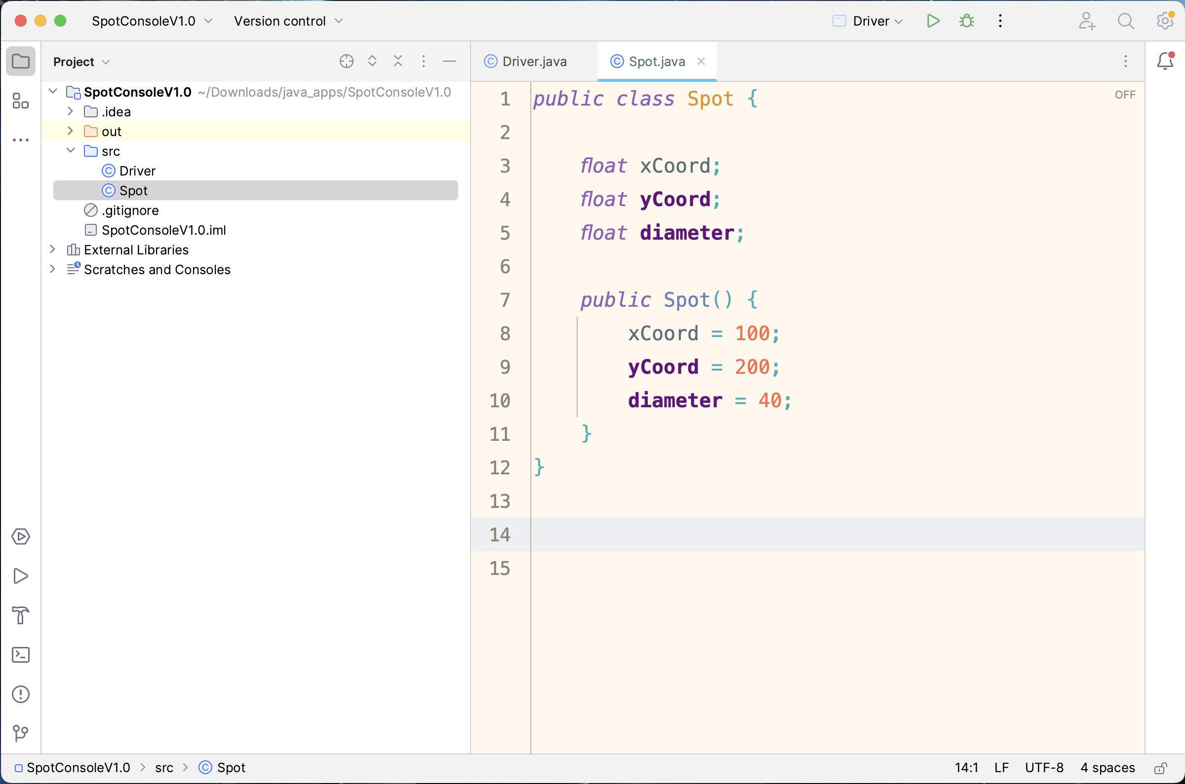
Three fields:
xCoord
yCoord
diameter
Default constructor to initialise the fields with starting data

Slide 24
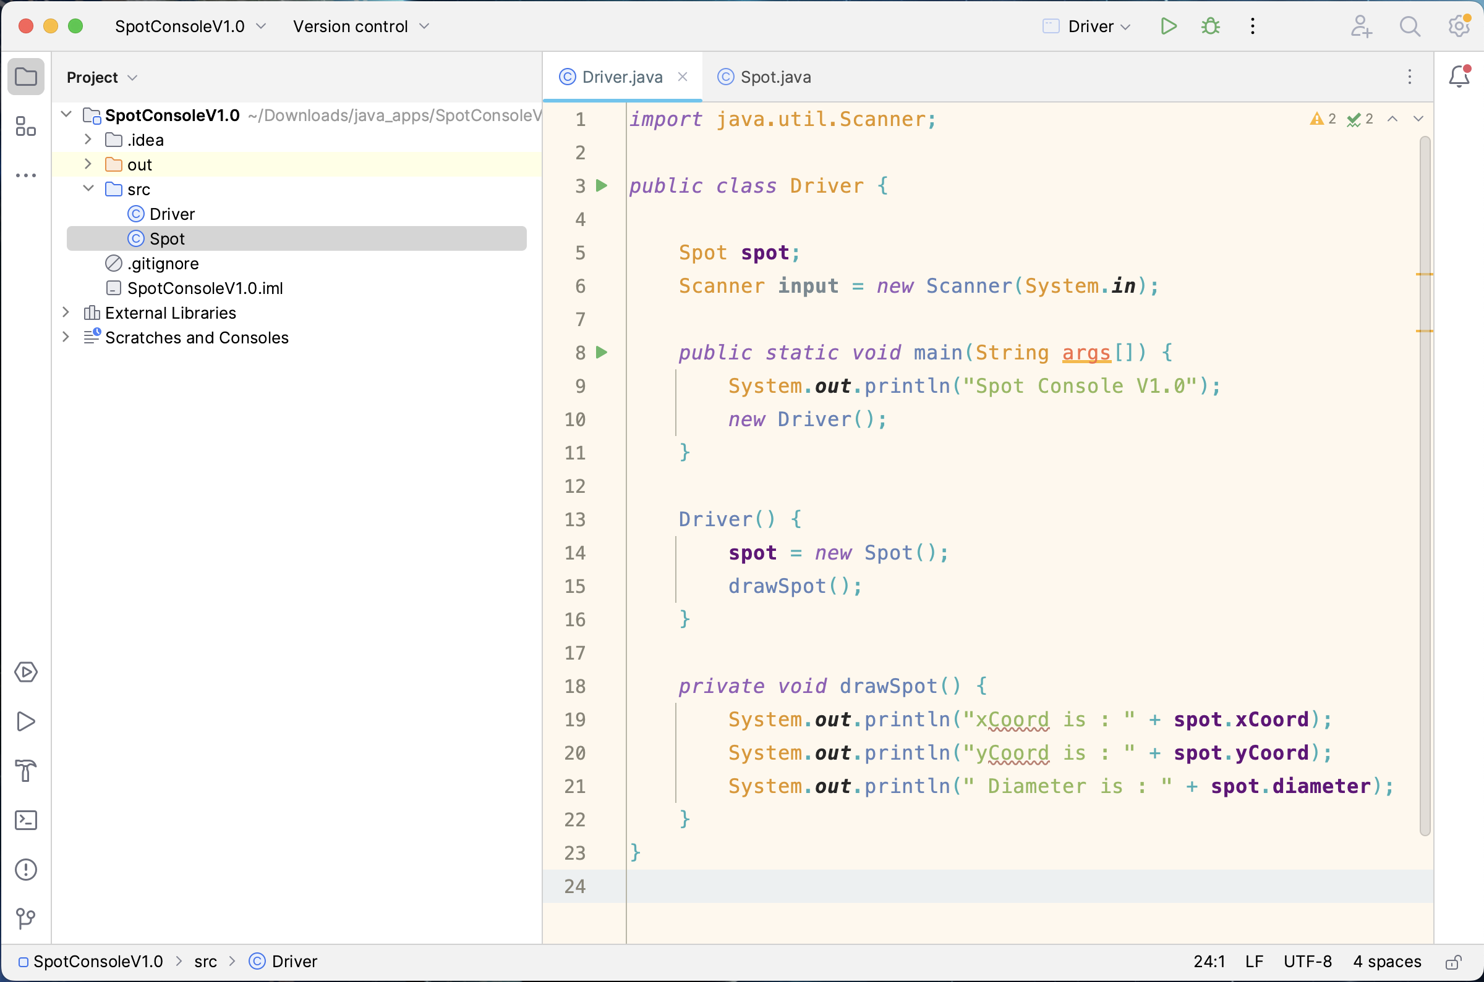
New Driver Class
Includes the main() method
main() method calls the Driver constructor

Slide 25
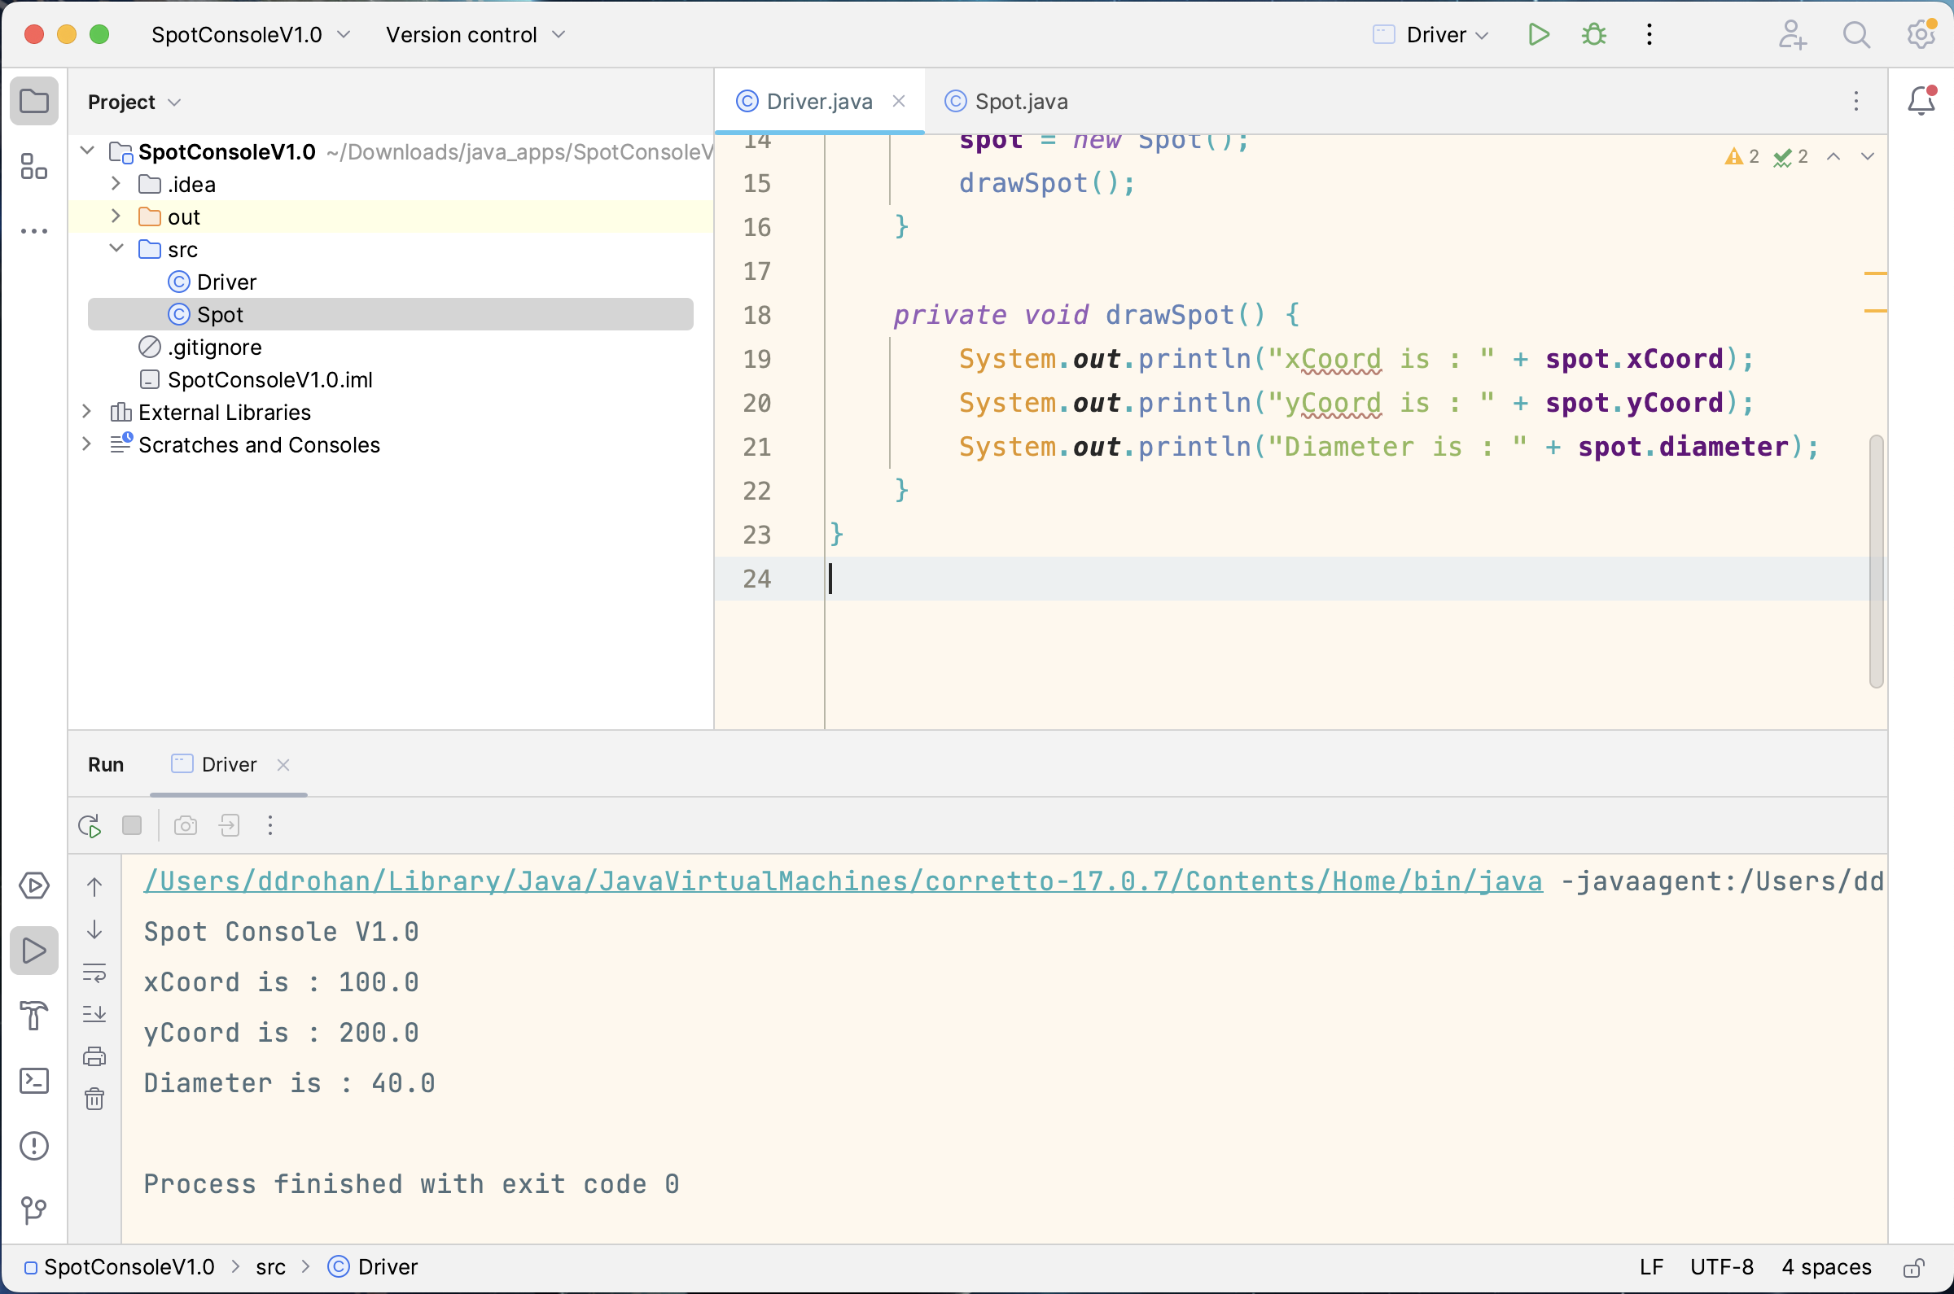
New Driver Class
Console Output

Slide 26

Questions?

Slide 27



