Slide 1
Programming Fundamentals 1

Slide 2
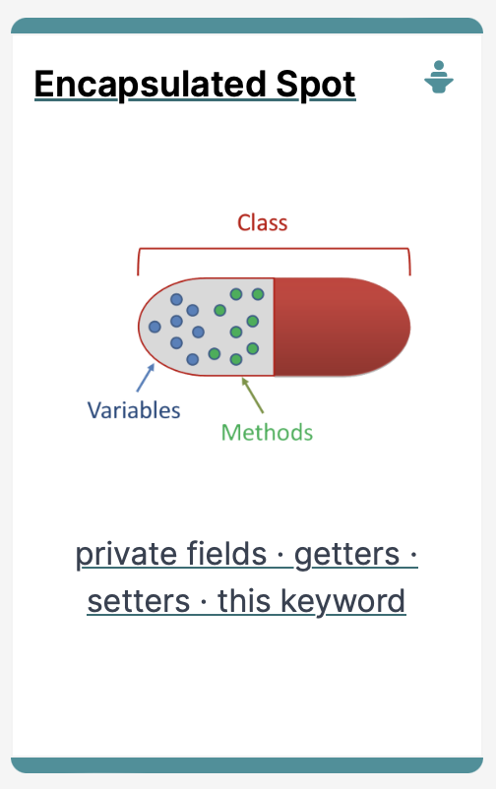
IntelliJ and Spot
Encapsulation and Spot

Slide 3
Agenda
What is Encapsulation?
Spot and Encapsulation
Basic Spot Class
The this keyword

Slide 4

What is Encapsulation?

Slide 5
Class
Variables
Methods

Slide 6
Encapsulation
http://www.tutorialspoint.com/java/java_encapsulation.htm
Encapsulation (data hiding) is a fundamental Object Oriented concept
How to achieve encapsulation?
wrap the data (fields) and code acting on the data (methods) together as single unit
hide the fields from other classes
access the fields only through the methods of their current class

Slide 7
Encapsulation in Java – steps 1-3
Encapsulation Step | Approach in Java
1. Wrap the data (fields) and code acting on the data (methods) together as single unit | public class ClassName { Fields Constructors Methods }
2. Hide the fields from other classes | Declare the fields of a class as private
3. Access the fields only through the methods of their current class | Provide public getter and setter methods to modify and view the fields values

Slide 8
Access Modifiers
Java provides a number of access modifiers to set access levels for classes, fields, methods and constructors.
The four access levels are:
Visible to the package, the default. No modifiers needed
Visible to the class only (private)
Visible to the world (public)
Visible to the package and all subclasses (protected)

Slide 9
Access Modifiers
Java provides a number of access modifiers to set access levels for classes, fields, methods and constructors.
The four access levels are:
Visible to the package, the default. No modifiers needed.
Visible to the class only (private)
Visible to the world (public)
Visible to the package and all subclasses (protected)
We will focus on these this semester

Slide 10
Spot and Encapsulation

Slide 11
Spot and Encapsulation
Step 1 Wrap the data (fields) and code acting on the data (methods) together as single unit

Slide 12
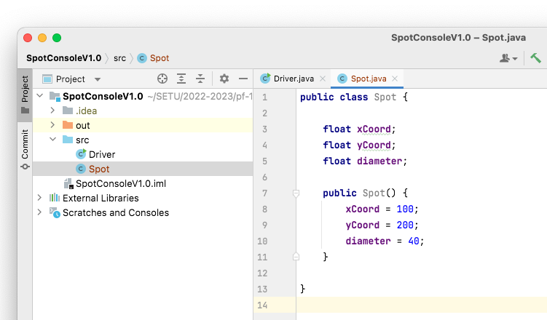
Encapsulation Step | Approach in Java
1. Wrap the data (fields) and code acting on the data (methods) together as single unit | public class ClassName { Fields Constructors Methods }
Encapsulation step 1 is complete; all fields, constructors and methods are all in a single unit, called Spot.

Slide 13
Spot and Encapsulation
Step 2 Hide the data (fields) from other Classes

Slide 14
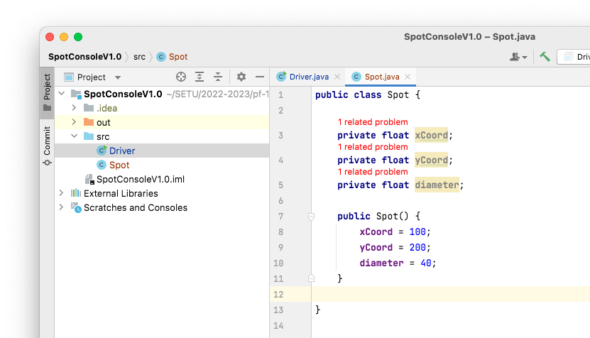
Encapsulation Step | Approach in Java
2. Hide the fields from other classes | Declare the fields of a class as private
Encapsulation step 2
We have made our fields private, however our app is no longer compiling!

Slide 15
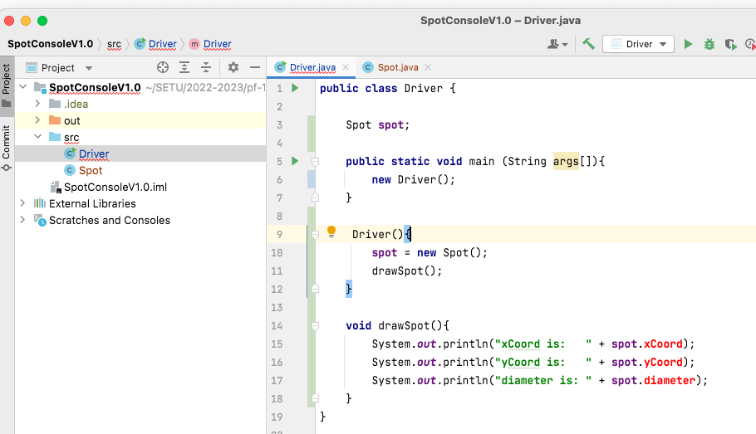
Encapsulation Step | Approach in Java
2. Hide the fields from other classes | Declare the fields of a class as private
Encapsulation step 2
The problem lies in the Driver class:
We are trying to directly access fields that are now private.
These fields are no longer visible in Driver.

Slide 16
Encapsulation Step | Approach in Java
2. Hide the fields from other classes | Declare the fields of a class as private
The private fields are not viewable or updatable outside the class Spot. Other classes don’t know these exist.
Notes:
Mention here that there is a bug in processing where it (incorrectly) allows classes outside of Spot to access private fields. This bug is there because of how Processing builds the final code before running (it puts many classes in one *.java file). This doesn’t happen in “real” IDEs.

Slide 17
Spot and Encapsulation
Step 3 Access the data (fields) only through the methods of their current class

Slide 18
Solution: Getters and Setters
Encapsulation Step 3 Provide public getter and setter methods to modify and view the fields values.

Slide 19
Getters (Accessor Methods)
Accessor methods
return information about the state of an object i.e. the values stored in the fields
A ‘getter’ method
is a specific type of accessor method and typically:
contains a return statement (as the last executable statement in the method)
defines a return type
does NOT change the object state

Slide 20
Getters
return type
visibility modifier
method name
parameter list (empty)
public float getDiameter()
{
return diameter;
}
return statement
start and end of method body (block)

Slide 21
Setters (Mutator methods)
Mutator methods
change (i.e. mutate) an object’s state
A ‘setter’ method
is a specific type of mutator method and typically:
contains an assignment statement
takes in a parameter
changes the object state.

Slide 22
Setters
return type
visibility modifier
method name
parameter
public void setDiameter(float diameter)
{
this.diameter = diameter;
}
field being mutated
assignment
statement
Value passed
as a parameter

Slide 23
Getters/Setters
For each instance field in a class, you are normally asked to write:
A getter
Return statement
A setter
Assignment statement
Encapsulation Step | Approach in Java
3. Access the fields only through the methods of their current class. | Provide public getter and setter methods to modify and view the fields values.

Slide 24
Spot and Encapsulation
Step 3 Getters

Slide 25
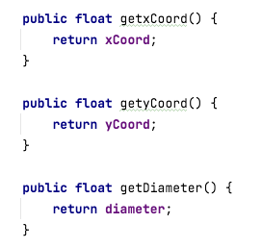
Encapsulation Step 3: Provide public getter methods to view the fields values.
Spot class
Spot
xCoord yCoord diameter
Spot() getxCoord() getyCoord() getDiameter()

Slide 26
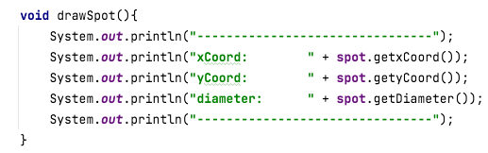
Encapsulation Step 3:
Use these new getter methods to view the fields values.
Driver class

Slide 27
Spot and Encapsulation
Step 3 Setters

Slide 28
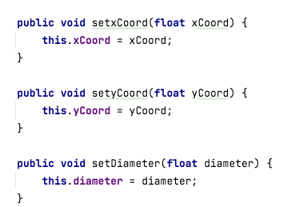
Encapsulation Step 3: Provide public setter methods to update the fields values.
Spot class
Spot
xCoord yCoord diameter
Spot() getxCoord() getyCoord() getDiameter() setxCoord(float) setyCoord(float) setDiameter(float)

Slide 29
New values for xCoord, yCoord, diameter…
To demonstrate the use of these mutator/setter methods, we need to update the Spot variables with new values.
The easiest way to get new values is to ask the user to enter them on the console.
To do this, we will use the Scanner class (which we will cover in more detail next week).
Spot class

Slide 30
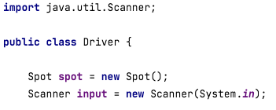
Driver class
Scanner Class to read from the console

Slide 31
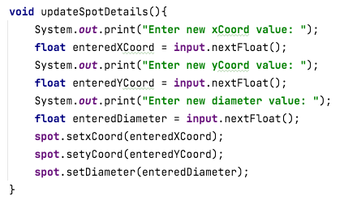
Driver class
Method to ask the user to enter new values for the three fields.
The setters are then called to update the values in the spot object.

Slide 32
The this Keyword

Slide 33
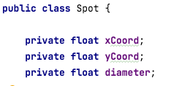
In Spot, there are three private instance fields:

Slide 34
In Spot, there are three private instance fields:
In Spot, there is a setter for each of these fields:

Slide 35
In Spot, there are three private instance fields:
In Spot, there is a setter for each of these fields:
The instance fields (global) are named the same as the parameters for the setters (which are local fields).

Slide 36
In Spot, there are three private instance fields:
In Spot, there is a setter for each of these fields:
This is called name overloading.
We use this. to distinguish between local and global variables.

Slide 37
In Spot, there are three private instance fields:
In Spot, there is a setter for each of these fields:
this. refers to the current objects fields i.e. the global ones.

Slide 38
In Spot, there are three private instance fields:
In Spot, there is a setter for each of these fields:
The variables without the this. are the local ones that are destroyed when the method is finished running i.e. the local variables.

Slide 39
In Spot, there are three private instance fields:
In Spot, there is a setter for each of these fields:
The variables without the this. are the local ones that are destroyed when the method is finished running i.e. the local ones.

Slide 40

Questions?

Slide 41



