Slide 1
Programming Fundamentals 1

Slide 2
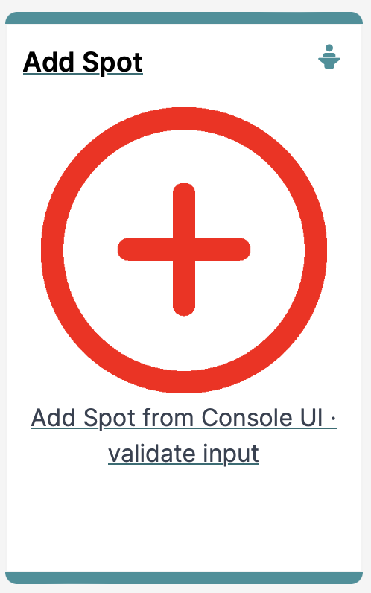
IntelliJ and Spot
Add Spot (and Validate Input)

Slide 3
Agenda
RECAP
Spot Constructors
Add a Spot
User Input Validation

Slide 4

RECAP

Slide 5
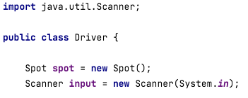
RECAP: Scanner class
Driver class
Scanner Class to read from the console

Slide 6
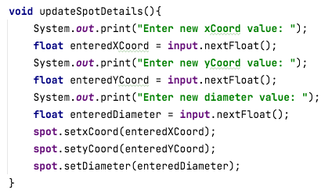
RECAP: Driver class
Method to ask the user to enter new values for the three fields.
Driver class

Slide 7
Spot Constructors

Slide 8
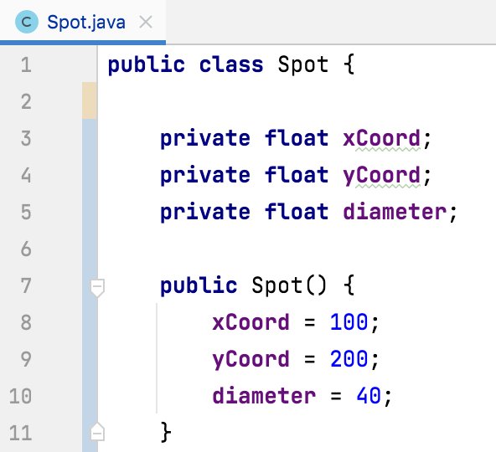
Spot Constructor
Currently, the Spot class only has one constructor
It is the default constructor as it has no parameters
This constructor sets default values for each field

Slide 9
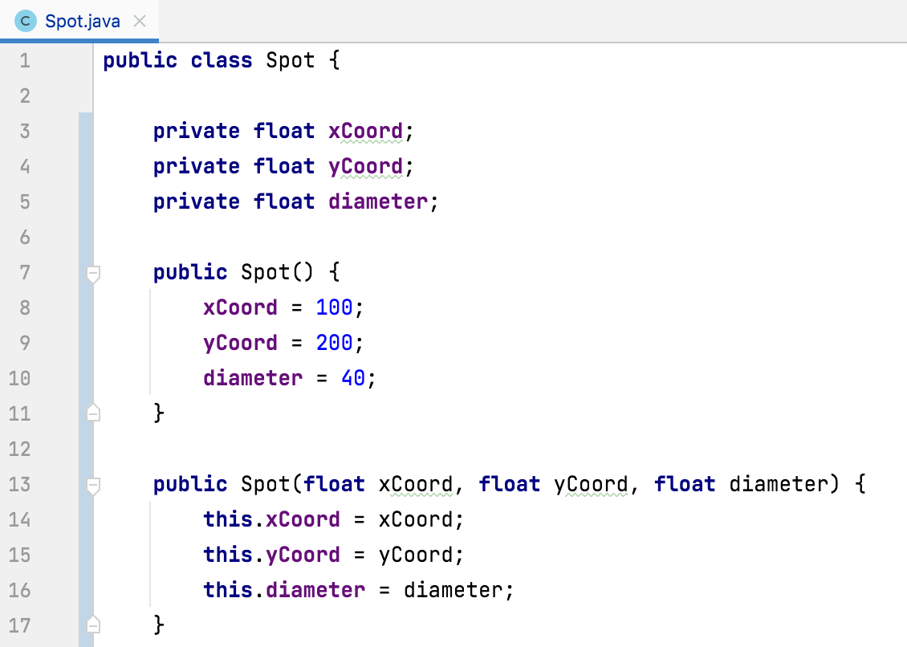
Spot Constructor – adding a second one
If we want to allow the user to add a new Spot with their own data (read from the console), then we need to provide a second constructor that will allow this

Slide 10
Spot Constructor – overloading
We now have two constructors, both called Spot, with different parameter lists in our class
This is called constructor overloading

Slide 11
Spot Constructor – overloading
Why would we need two different constructors?

Slide 12
Spot Constructor – overloading
Why would we need two different constructors?
It gives us different options for creating a Spot object:
When we have no values for the fields
When we have values for the fields (from the user, maybe)

Slide 13
Spot Constructor – this keyword
Instance fields (global)
Both the local and global variables have the same name.
This is called name overloading.
We use this. to distinguish between local and global variables.
Parameters (local)

Slide 14
Spot Constructor – this keyword
Instance fields (global)
Both the local and global variables have the same name.
This is called name overloading.
We use this. to distinguish between local and global variables.

Slide 15
Spot Constructor – this keyword
Both the local and global variables have the same name.
This is called name overloading.
We use this. to distinguish between local and global variables.
Parameters (local)

Slide 16
Add a Spot

Slide 17
Adding a New Spot
Driver class
1
We defined a Scanner object, called input, when writing the code to Update a Spot.

Slide 18
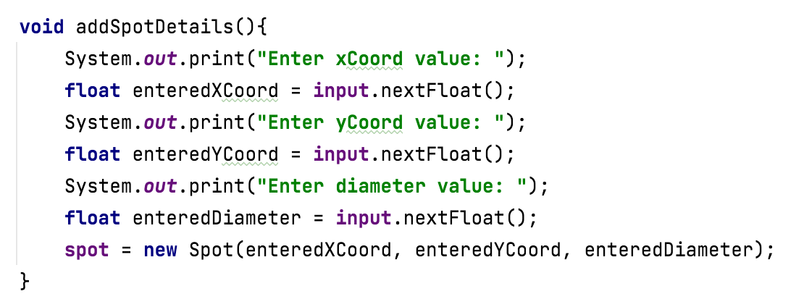
Adding a New Spot
2
Driver class
Now write a new method that will ask the user for the values for the three Spot fields and then use our new constructor to create a new Spot object.

Slide 19
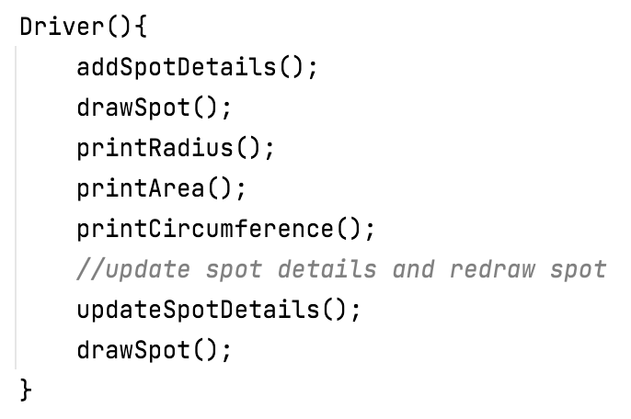
Adding a New Spot
Driver class
3
Now call this new method from the Driver() constructor

Slide 20
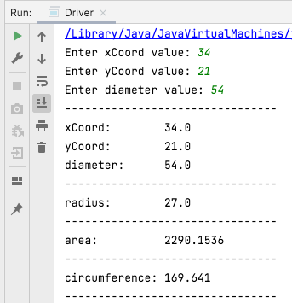
Adding a New Spot
4
Driver class
When you run the app, you should now be asked to enter in any details you wish for each of the fields

Slide 21
User Input Validation

Slide 22
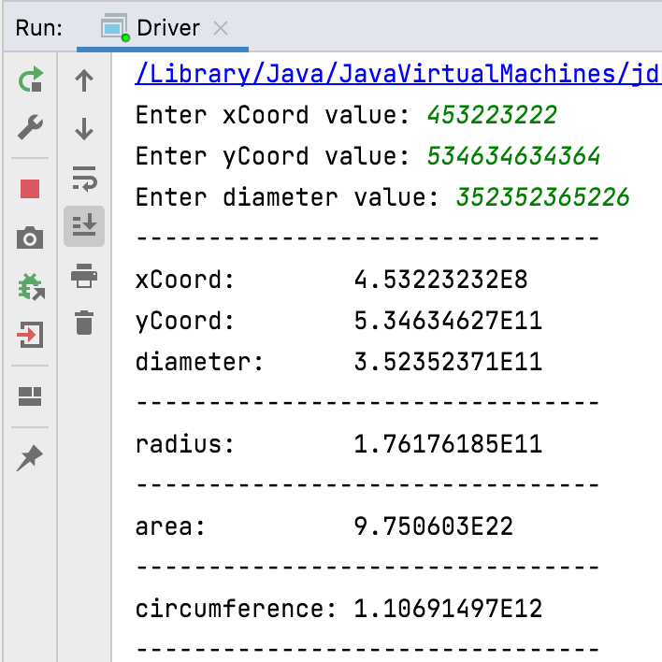
No Validation
The purpose of this app is to do calculations on a Spot that can be drawn on a monitor.
Do you, for either the add or the update, try enter absurd values for any of the fields?

Slide 23
No Validation
Clearly we need to put some restrictions in place for each field i.e.:
min and max permitted values
default value if the min and max are breached.

Slide 24
Validation Rules
Field | Min Value | Max Value | Default Value
xCoord | Greater than or equal to 0 | Less than or equal to 800 | 400
yCoord | Greater than or equal to 0 | Less than or equal to 700 | 350
diameter | Greater than 0 | Less than 600 | 100

Slide 25
User Input Validation
Implementing Validation Rules Default Values

Slide 26
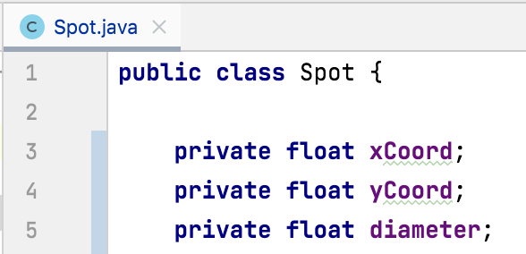
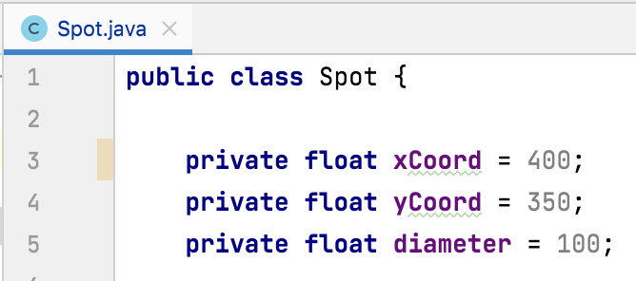
Validation Rules – Default Values
Field | Default Value
xCoord | 400
yCoord | 350
diameter | 100
becomes

Slide 27
User Input Validation
Implementing Validation Rules xCoord

Slide 28
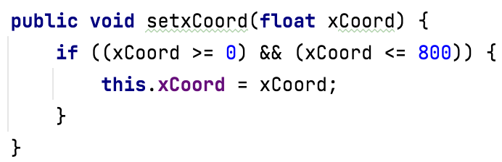
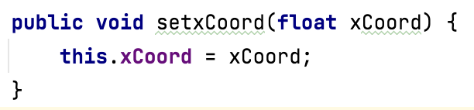
xCoord – mutator changes
Field | Min Value | Max Value
xCoord | Greater than or equal to 0 | Less than or equal to 800
becomes

Slide 29
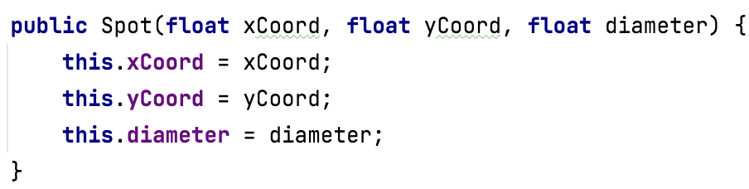
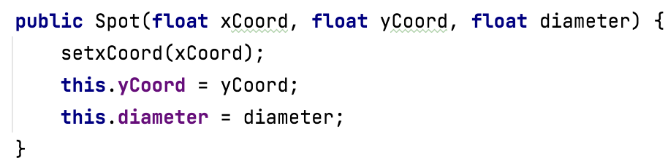
xCoord – constructor changes
Field | Min Value | Max Value
xCoord | Greater than or equal to 0 | Less than or equal to 800
becomes

Slide 30
User Input Validation
Implementing Validation Rules yCoord

Slide 31
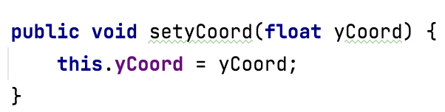
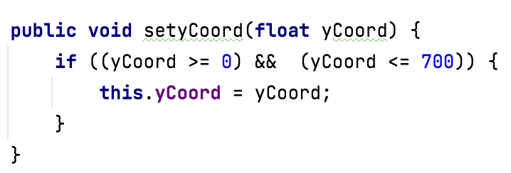
yCoord – mutator changes
Field | Min Value | Max Value
yCoord | Greater than or equal to 0 | Less than or equal to 700
becomes

Slide 32
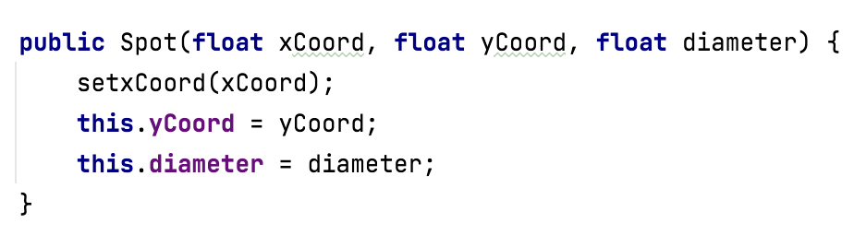
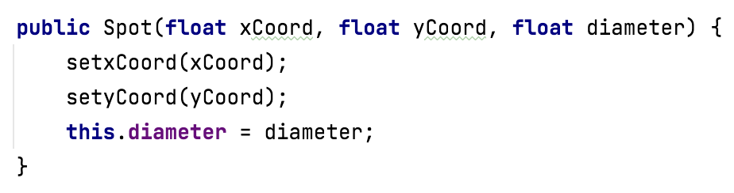
yCoord – constructor changes
Field | Min Value | Max Value
yCoord | Greater than or equal to 0 | Less than or equal to 700
becomes

Slide 33
User Input Validation
Implementing Validation Rules diameter

Slide 34
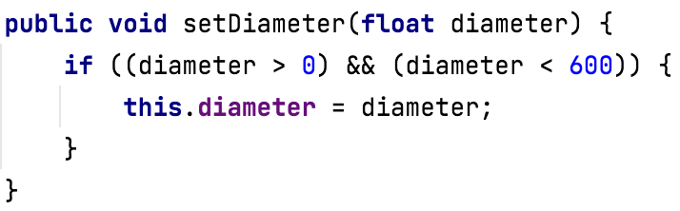
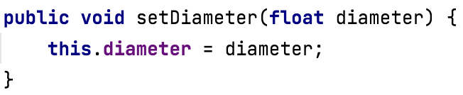
diameter – mutator changes
Field | Min Value | Max Value
diameter | Greater than 0 | Less than 600
becomes

Slide 35
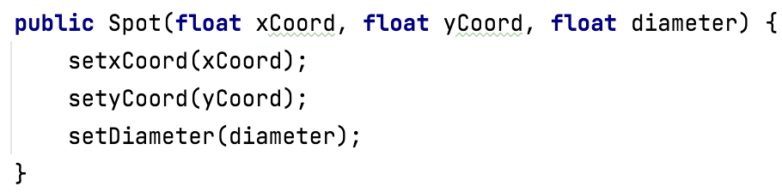
diameter – constructor changes
Field | Min Value | Max Value
diameter | Greater than 0 | Less than 600
becomes

Slide 36
User Input Validation
Boundary Testing the Validation Rules for Add and Update

Slide 37
What is Boundary Testing?
Boundary Testing is when you input test data that is:
Just inside
Just outside
the boundary values in your Boolean expressions.
Inputting the following values for xCoord would test the ‘boundaries’ of this if statement:
[-1, 0, 1, 799, 800, 801]

Slide 38
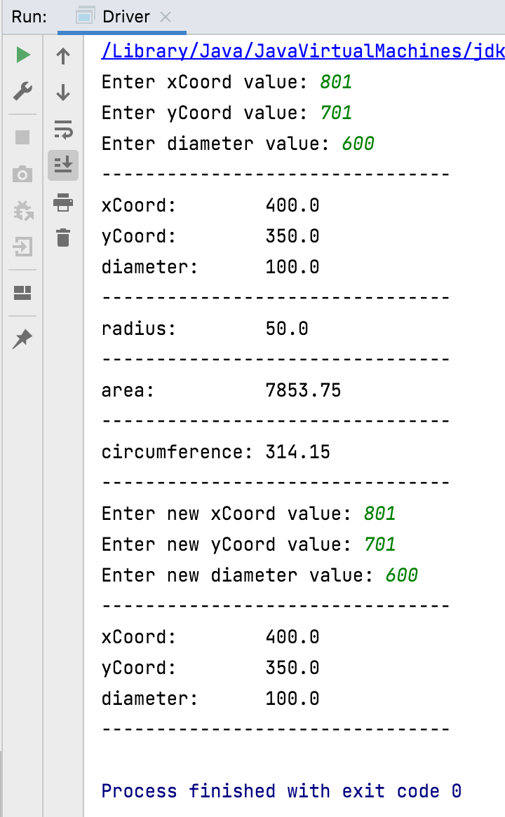
Example Boundary Test
Just-Outside Upper Boundary Test:
default values are correctly used when adding and updating

Slide 39
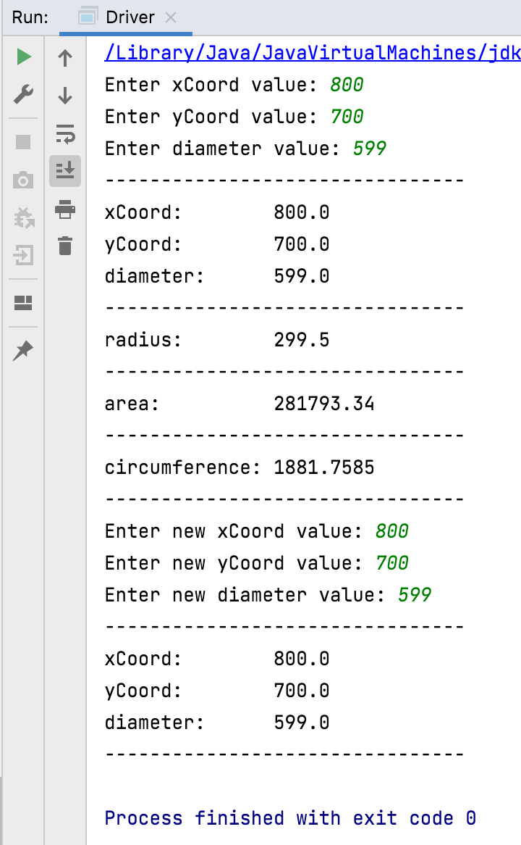
Example Boundary Test
Just-Inside Upper Boundary Test:
all values are accepted for both add and update

Slide 40
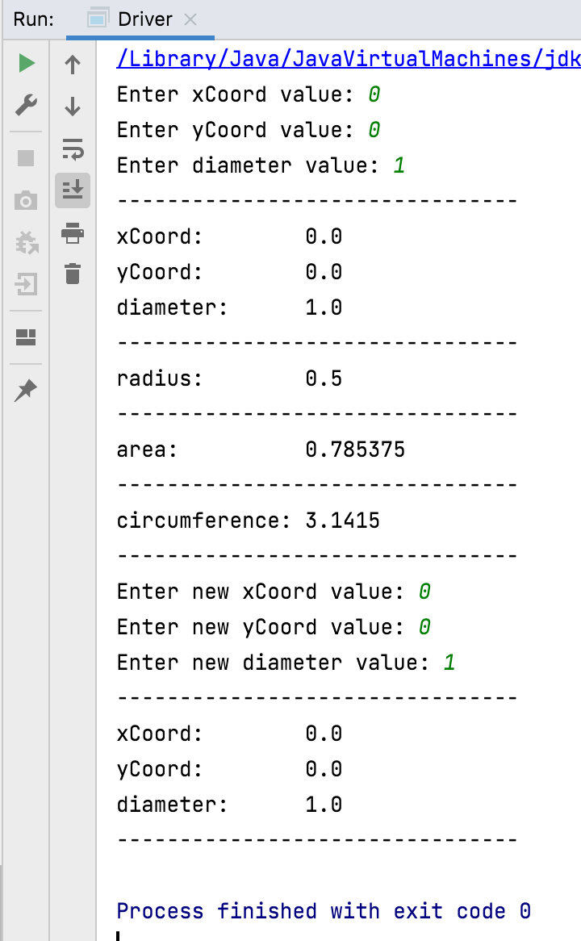
Example Boundary Test
Just-Inside Lower Boundary Test:
all values are accepted for both add and update

Slide 41

Questions?

Slide 42



