Slide 1
Programming Fundamentals 1

Slide 2
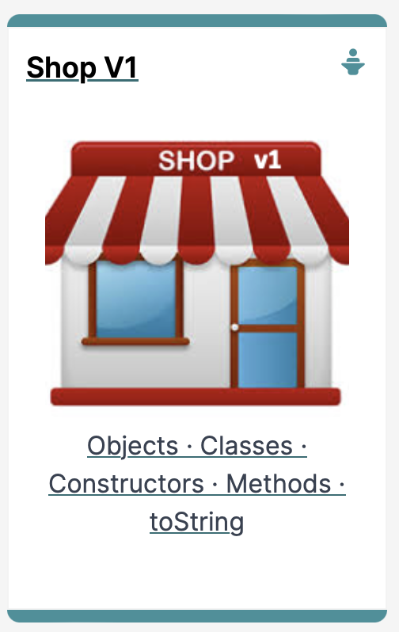
Recap of OO Concepts
Objects, classes, methods
and more

Slide 3
RECAP Agenda
Classes & Objects
SHOP Version 1.0
A Product Class
Setters/Getters/Encapsulation…

Slide 4

Classes & Objects

Slide 5
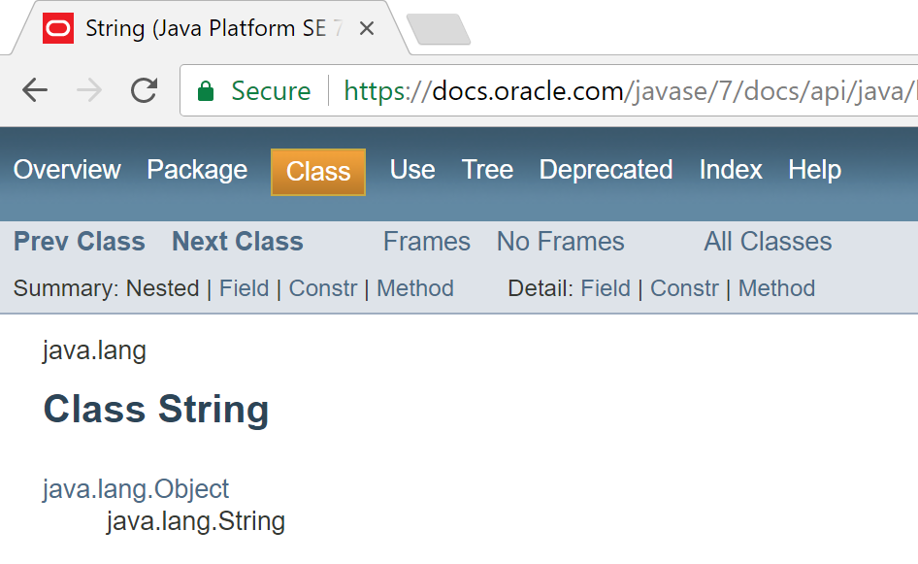
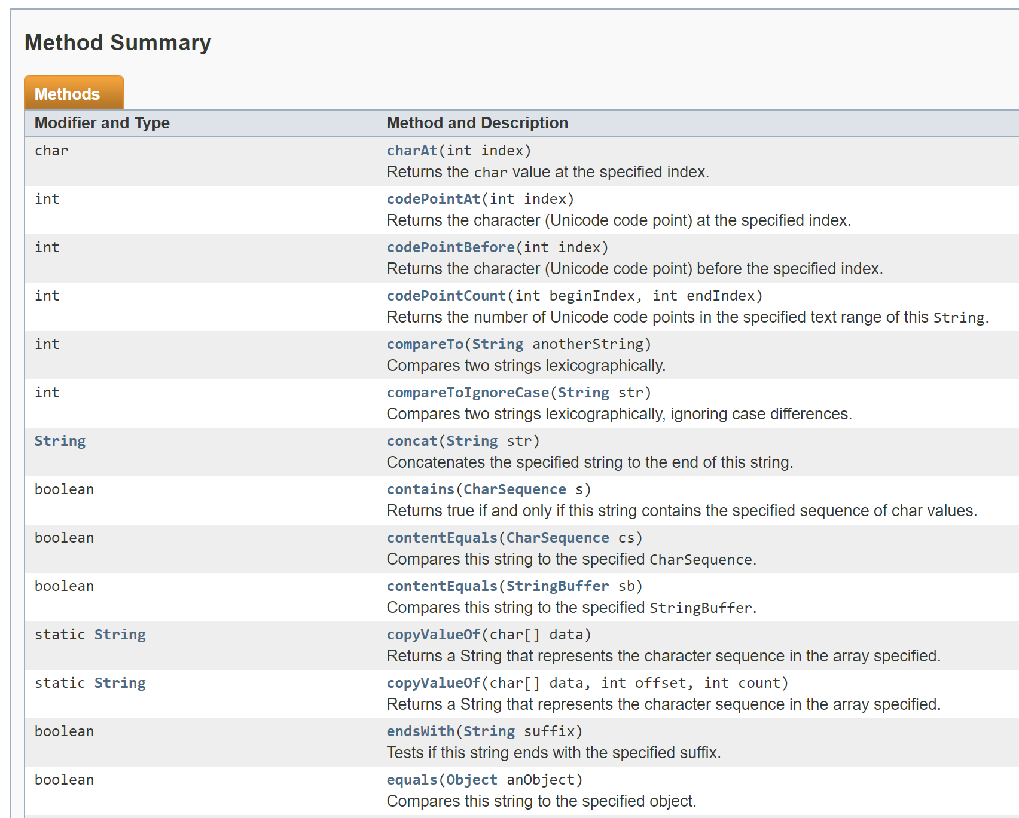
Classes and Objects
A class
defines a group of related methods (functions) and fields (variables / properties).

Slide 6
Classes and Objects
An object
is a single instance of a class
i.e. an object is created (instantiated) from a class.
String is the Class
String a = new String();
&FFCC
a is the Object, which contains “Hello”
&FFCC
“Hello”

Slide 7
Classes and Objects – Many Objects
Many objects can be constructed from a single class definition
Each object must have a unique name within the program

Slide 8
Shop Version 1.0

Slide 9

Shop V1.0 - Product
We will recap object oriented concepts through the study of a new class called Product
Driver
Product

Slide 10
Shop V1.0 - Product
The Product class stores details about a product, e.g. name, code, unit cost, in the current product line or not?
Driver
Product

Slide 11
Shop V1.0 - Driver
Driver
The Driver class
has the main() method.
reads the product details from the user (via the console)
creates a new Product object
prints the product object (to the console)
Driver is covered in the next lecture
Product

Slide 12
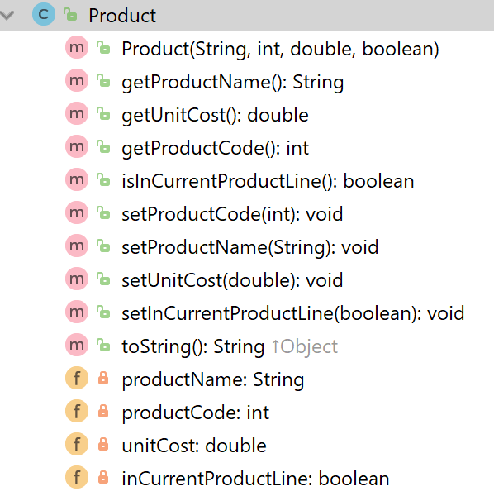
A Product Class…
Object Type/ Class Name
i.e. Product
The C icon means it is a Class.
The open padlock means it is public.

Slide 13
A Product Class…fields
The f icon means it is a field.
Fields i.e. the attributes / properties of the class

Slide 14
A Product Class…fields
field type
field name
The closed padlock means it is private.
The f icon means it is a field.
Fields i.e. the attributes / properties of the class

Slide 15
A Product Class…constructor
Constructor i.e. for building objects.
The m icon means it is a method.
The open padlock means it is public.
Constructors have same name as the class
Four parameters; one for each field.

Slide 16
A Product Class…fields & constructor
public class Product { private String productName; private int productCode; private double unitCost; private boolean inCurrentProductLine; public Product (String productName, int productCode, double unitCost, boolean inCurrentProductLine){
this.productName = productName; this.productCode = productCode; this.unitCost = unitCost; this.inCurrentProductLine = inCurrentProductLine; }

Slide 17
A Product Class… methods
The open padlock means it is public.
The m icon means it is a method.
Methods i.e. the behaviours of the class

Slide 18
A Product Class… methods
Return type
Method name

Slide 19
A Product Class… getters
getters

Slide 20
Getters (Accessor Methods)
Accessor methods
return information about the state of an object
i.e. the values stored in the fields.
A ‘getter’ method
is a specific type of accessor method and typically:
contains a return statement (as the last executable statement in the method).
defines a return type.
does NOT change the object state.

Slide 21
Getters
return type
visibility modifier
method name
parameter list (empty)
public double getUnitCost()
{
return unitCost;
}
return statement
start and end of method body (block)

Slide 22
A Product Class… getters
public String getProductName(){ return productName; } public double getUnitCost(){ return unitCost; } public int getProductCode() { return productCode; } public boolean isInCurrentProductLine() { return inCurrentProductLine; }

Slide 23
A Product Class… setters
setters

Slide 24
Setters (Mutator methods)
Mutator methods
change (i.e. mutate) an object’s state.
A ‘setter’ method
is a specific type of mutator method and typically:
contains an assignment statement
takes in a parameter
changes the object state.

Slide 25
Setters
return type
visibility modifier
method name
parameter
public void setUnitCost(double unitCost)
{
this.unitCost = unitCost;
}
field being mutated
assignment
statement
Value passed
as a parameter

Slide 26
A Product Class… setters
public void setProductCode(int productCode) { this.productCode = productCode; } public void setProductName(String productName) { this.productName = productName; } public void setUnitCost(double unitCost) { this.unitCost = unitCost; } public void setInCurrentProductLine(boolean inCurrentProductLine) { this.inCurrentProductLine = inCurrentProductLine; }

Slide 27
Getters/Setters
For each instance field in a class, you are normally asked to write:
A getter
Return statement
A setter
Assignment statement

Slide 28
A Product Class… toString()
toString():
Builds and returns a String containing a user-friendly representation of the object state.

Slide 29
A Product Class… toString()
public String toString() { return "Product description: " + productName + ", product code: " + productCode + ", unit cost: " + unitCost + ", currently in product line: " + inCurrentProductLine; }
Sample Console Output if we printed a Product Object:
Product description: 24 Inch TV, product code: 23432, unit cost: 399.99, currently in product line: true

Slide 30
toString()
This is a useful method and you will write a toString() method for most of your classes.
When you print an object, Java automatically calls the toString() method e.g.
Product product = new Product();
//both of these lines of code do the same thing
System.out.println(product);
System.out.println(product.toString());

Slide 31
Encapsulation in Java – steps 1-3
Encapsulation Step | Approach in Java
1. Wrap the data (fields) and code acting on the data (methods) together as single unit. | public class ClassName { Fields Constructors Methods }
2. Hide the fields from other classes. | Declare the fields of a class as private.
3. Access the fields only through the methods of their current class. | Provide public setter and getter methods to modify and view the fields values.

Slide 32
A Product Class… An Encapsulated Class
1. Product class wraps the data (fields) and code acting on the data (methods) together as single unit.

Slide 33
A Product Class… An Encapsulated Class
1. Product class wraps the data (fields) and code acting on the data (methods) together as single unit.
2. Fields are hidden from other classes.

Slide 34
A Product Class… An Encapsulated Class
1. Product class wraps the data (fields) and code acting on the data (methods) together as single unit.
2. Fields are hidden from other classes.
3. Access the fields only through the methods of Product (e.g. getter and setter methods).

Slide 35
Using the Product Class
1
private Product product;
product
Declaring an object product, of type Product
null

Slide 36
Using the Product Class
1
private Product product;
product
Declaring an object product, of type Product
2
product = new Product(“TV”, 1234, 149.99, true);
product
Calls the Product constructor to build the product object in memory.
productName
“TV”
productCode
1234
unitCost
149.99
inCurrentProductLine
true

Slide 37
Multiple Product objects
private Product product = new Product(“TV”, 1234, 149.99, true);
product
product
productName
“TV”
productCode
1234
unitCost
149.99
inCurrentProductLine
true

Slide 38
Multiple Product objects
private Product product = new Product(“TV”, 1234, 149.99, true);
private Product phone = new Product(“iPhone8”, 1001, 349.99, false);
product
phone
product
phone
productName
“TV”
productName
“iPhone8”
productCode
1234
productCode
1001
unitCost
149.99
unitCost
349.99
inCurrentProductLine
true
inCurrentProductLine
false

Slide 39

Questions?

Slide 40



