Slide 1
Programming Fundamentals 1

Slide 2
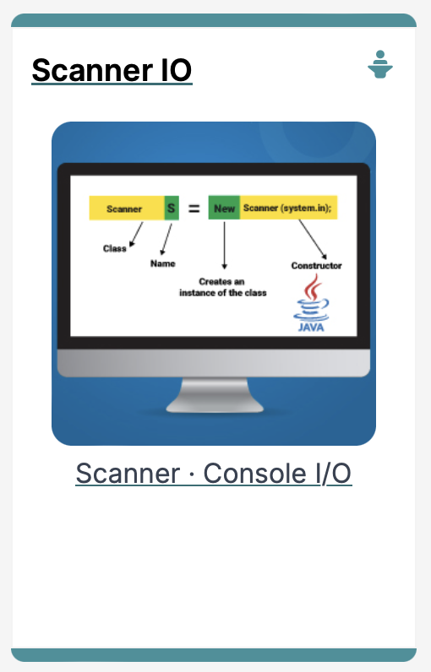
Input / Output
The Scanner class

Slide 3
Agenda
The Scanner class
RECAP :
SHOP Version 1.0
Product Class
Driver Class
Input / Output in SHOP

Slide 4

The Scanner Class

Slide 5
Input in Java: the Scanner Class
The Scanner class is part of Java
It allows us to take in data from the console / terminal window
It is part of the java.util package in the Java Application Programming Interfaces (APIs)

Slide 6
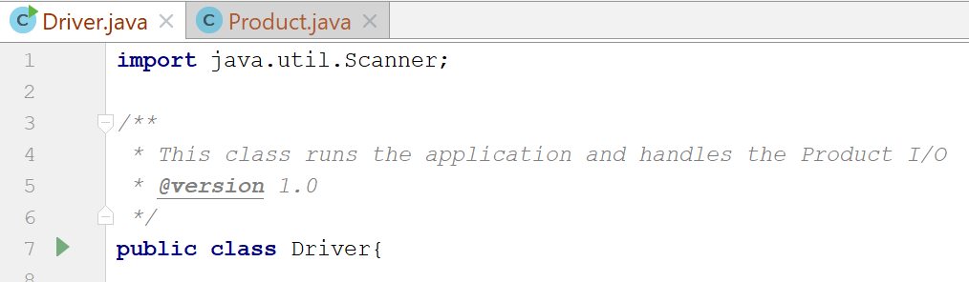
Input in Java: the Scanner Class
In order to use the Scanner class, place the following line as the first line of code in your file (i.e. before class declaration):
import java.util.Scanner;

Slide 7
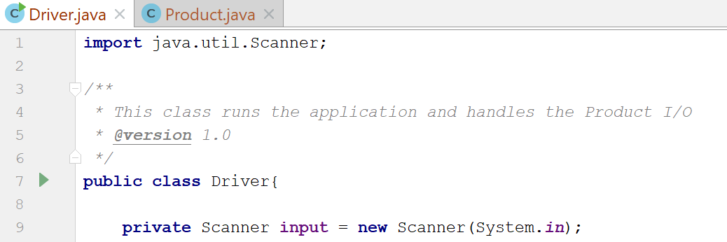
Input in Java: the Scanner Class
Having imported the util package, you will need to write the following instruction in your program.
Scanner input = new Scanner(System.in);

Slide 8
Input in Java: the Scanner Class
This declares a Scanner object called input (you can name this object anything you wish).
You must have this instruction to be able to call the methods in the Scanner class.

Slide 9
Input in Java: the Scanner Class
Now that a Scanner object is set up, we can use all the input methods that have been defined in the Scanner class.
There are methods to take in:
ints | .nextInt()
doubles | .nextDouble()
Strings | .nextLine()
chars | .next().charAt(0)
etc… | See API docs for more

Slide 10
RECAP : SHOP V1.0

Slide 11

Shop V1.0 - Product
The Product class stores details about a product, e.g. name, code, unit cost, in the current product line or not?
Driver
Product

Slide 12
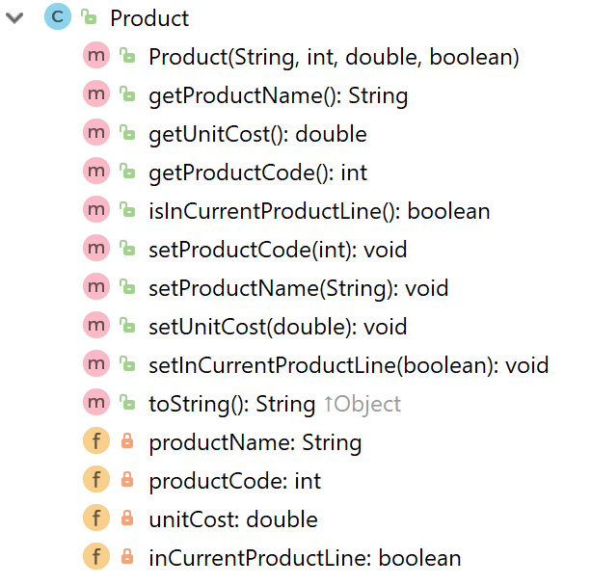
RECAP : Shop V1.0 - Product
constructor
getters
setters
toString
fields
Notes:
We will use the constructor from Driver to build an object with user input stored in the instance fields.

Slide 13
Shop V1.0 - Driver
Driver
The Driver class
has the main() method.
reads the product details from the user (via the console)
creates a new Product object
prints the product object (to the console)
Product

Slide 14
Shop V1.0 - Driver
Driver
We want to use Scanner to read in product details from the console
We will then store these details in a Product object
And then print these details back to the console
Product

Slide 15
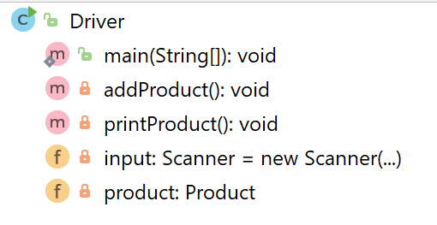
Shop V1.0 - Driver
main()
methods
fields

Slide 16
I/O in SHOP V1.0

Slide 17
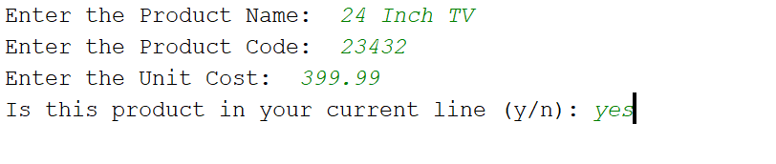
What the program will look like…
Console Output
String
int
double
boolean

Slide 18
public class Driver{ private Scanner input = new Scanner(System.in); private Product product; public static void main(String[] args) {
Driver driver = new Driver(); driver.addProduct(); driver.printProduct(); } //gather the product data from the user and create a new product. private void addProduct(){ System.out.print("Enter the Product Name: "); String productName = input.nextLine();
System.out.print("Enter the Product Code: "); int productCode = input.nextInt();
System.out.print("Enter the Unit Cost: "); double unitCost = input.nextDouble();
System.out.print("Is this product in your current line (y/n): "); char currentProduct = input.next().charAt(0);
boolean inCurrentProductLine = false; if ((currentProduct == 'y') || (currentProduct == 'Y')) inCurrentProductLine = true; product = new Product(productName, productCode, unitCost, inCurrentProductLine); } //print the product (the toString method is automatically called). private void printProduct(){ System.out.println(product); } }

Slide 19
public class Driver{ private Scanner input = new Scanner(System.in); private Product product; public static void main(String[] args) {
Driver driver = new Driver(); driver.addProduct(); driver.printProduct(); } //gather the product data from the user and create a new product. private void addProduct(){ System.out.print("Enter the Product Name: "); String productName = input.nextLine();
System.out.print("Enter the Product Code: "); int productCode = input.nextInt();
System.out.print("Enter the Unit Cost: "); double unitCost = input.nextDouble();
System.out.print("Is this product in your current line (y/n): "); char currentProduct = input.next().charAt(0);
boolean inCurrentProductLine = false; if ((currentProduct == 'y') || (currentProduct == 'Y')) inCurrentProductLine = true; product = new Product(productName, productCode, unitCost, inCurrentProductLine); } //print the product (the toString method is automatically called). private void printProduct(){ System.out.println(product); } }

Slide 20
public class Driver{ private Scanner input = new Scanner(System.in); private Product product; public static void main(String[] args) {
Driver driver = new Driver(); driver.addProduct(); driver.printProduct(); } //gather the product data from the user and create a new product. private void addProduct(){ System.out.print("Enter the Product Name: "); String productName = input.nextLine();
System.out.print("Enter the Product Code: "); int productCode = input.nextInt();
System.out.print("Enter the Unit Cost: "); double unitCost = input.nextDouble();
System.out.print("Is this product in your current line (y/n): "); char currentProduct = input.next().charAt(0);
boolean inCurrentProductLine = false; if ((currentProduct == 'y') || (currentProduct == 'Y')) inCurrentProductLine = true; product = new Product(productName, productCode, unitCost, inCurrentProductLine); } //print the product (the toString method is automatically called). private void printProduct(){ System.out.println(product); } }

Slide 21
public class Driver{ private Scanner input = new Scanner(System.in); private Product product; public static void main(String[] args) {
Driver driver = new Driver(); driver.addProduct(); driver.printProduct(); } //gather the product data from the user and create a new product. private void addProduct(){ System.out.print("Enter the Product Name: "); String productName = input.nextLine();
System.out.print("Enter the Product Code: "); int productCode = input.nextInt();
System.out.print("Enter the Unit Cost: "); double unitCost = input.nextDouble();
System.out.print("Is this product in your current line (y/n): "); char currentProduct = input.next().charAt(0);
boolean inCurrentProductLine = false; if ((currentProduct == 'y') || (currentProduct == 'Y')) inCurrentProductLine = true; product = new Product(productName, productCode, unitCost, inCurrentProductLine); } //print the product (the toString method is automatically called). private void printProduct(){ System.out.println(product); } }

Slide 22
The addProduct() console output…
Console Output
String
int
double
boolean
Now, Let’s Look at how this is done…

Slide 23
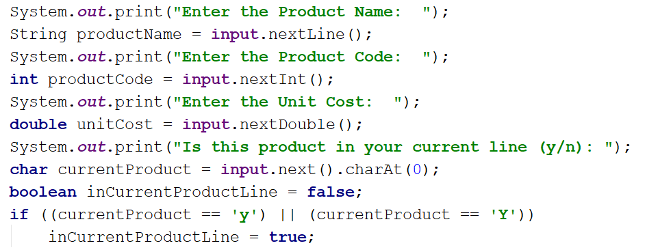
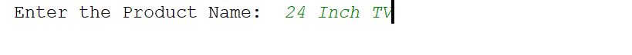
ShopV1.0 – read Product Name (String)
Console Output

Slide 24
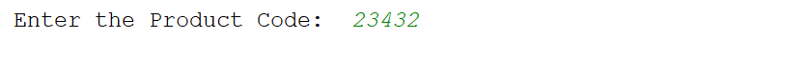
ShopV1.0 – read Product Code (int)
Console Output

Slide 25
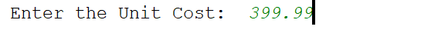
ShopV1.0 – read Unit Cost (double)
Console Output

Slide 26
ShopV1.0 – In Current Product Line? (boolean)
For booleans, take in a character first, then test it
Console Output

Slide 27
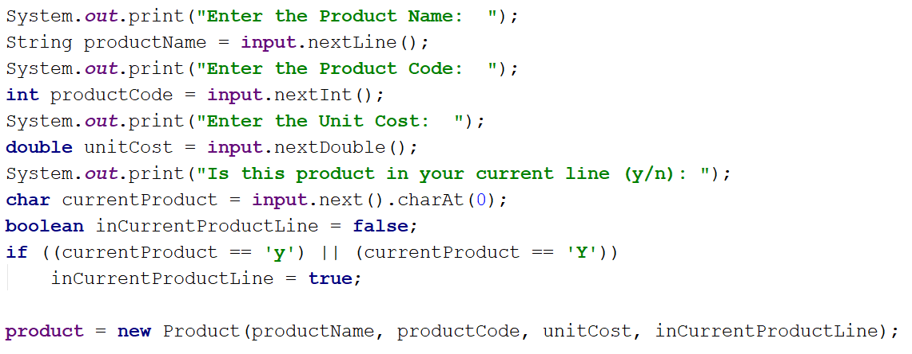
ShopV1.0 – Create Product Object
Using the values taken in pass them to the Product constructor

Slide 28
public class Driver{ private Scanner input = new Scanner(System.in); private Product product; public static void main(String[] args) {
Driver c = new Driver(); c.addProduct(); c.printProduct(); } //gather the product data from the user and create a new product. private void addProduct(){ System.out.print("Enter the Product Name: "); String productName = input.nextLine();
System.out.print("Enter the Product Code: "); int productCode = input.nextInt();
System.out.print("Enter the Unit Cost: "); double unitCost = input.nextDouble();
System.out.print("Is this product in your current line (y/n): "); char currentProduct = input.next().charAt(0);
boolean inCurrentProductLine = false; if ((currentProduct == 'y') || (currentProduct == 'Y')) inCurrentProductLine = true; product = new Product(productName, productCode, unitCost, inCurrentProductLine); } //print the product (the toString method is automatically called). private void printProduct(){ System.out.println(product); } }

Slide 29

Questions?

Slide 30



