Slide 1
Programming Fundamentals 1

Slide 2
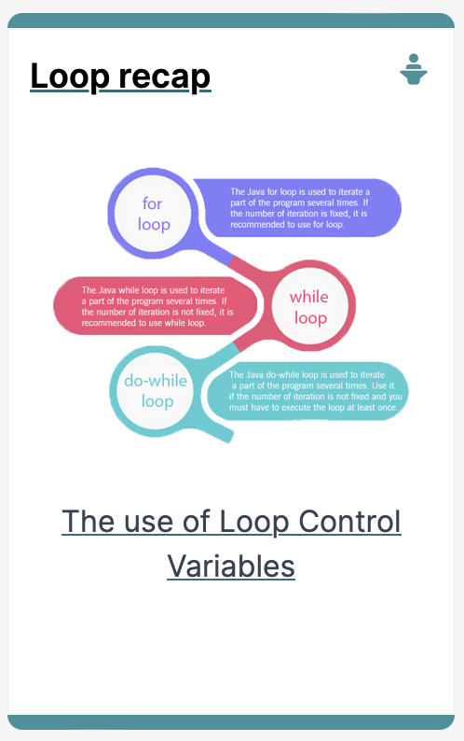
Iteration in Programming
while loops & loop control variables

Slide 3
Agenda
Repetition in Programming – Intro to looping
Use of loops (while loops)

Slide 4

Repetition in Programming Intro to looping

Slide 5
Recap: Boolean conditions
A boolean condition is an expression that evaluates to either true or false e.g.
x<50
Boolean conditions can be used to control:
Selection i.e. if statements and
Iteration i.e. loops (we will look at these now)

Slide 6
Repetition in Programming
Computers are very good at repetition
Example:
calculate pay for 1000 employees
You should use the same calculate pay algorithm 1000 times
You don’t write the calculate pay algorithm 1000 times; instead you include it in a loop

Slide 7
Form of loop
Write the all the numbers between 1 and 5 inclusive
Without loop:
System.out.println(1);
System.out.println(2);
System.out.println(3);
System.out.println(4);
System.out.println(5);

Slide 8
Form of loop
Write the all the numbers between 1 and 5 inclusive
With a loop:
do this 5 times
System.out.println(i);
With the value of i going from 1 to 5

Slide 9
Use of loops (while loops)

Slide 10
Loops in Programming
There are three types of loop in (Java) programming:
while loops
for loops
do while loops

Slide 11
while loop pseudo code
General form of a while loop
while keyword
boolean condition
while(loop condition) {
loop body
}
Statements to be repeated
Pseudo-code expression of the actions of a while loop
while we wish to continue, do the things in the loop body

Slide 12
Construction of while loop
Declare and initialise loop control variable (LCV)
while(boolean condition based on LCV is true)
{
“do the job to be repeated”
“update the LCV”
}
This structure should always be used
Notes:
The “update the LCV” should always update it so that the Boolean condition will eventually evaluation to false.

Slide 13
while loop Flowchart
int i = 1; //i is the LCV
while(i <= 5)
{
System.out.println(i);
i++;
}
boolean
condition?
true
statement(s)
false

Slide 14

Processing Example 4.5
Declare and initialise loop control variable (LCV)
while(boolean condition based on LCV is true)
{
“do the job to be repeated”
“update the LCV”
}
int i = 1; //i is the LCV while(i <=5) { System.out.println(i); i++; }
Notes:
int yCoordinate = 60;
size(600, 300);
background(102);
fill(255);
noStroke();
int i = 0;
while(i < 4)
{
rect(50, yCoordinate, 500, 10);
yCoordinate += 20;
i++;
}

Slide 15
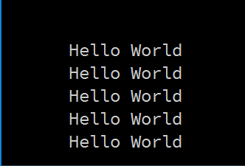
Some Study Exercises
This basic while loop, produces this output.
int i = 1;
while (i <=5)
{
println("Hello World");
i++;
}

Slide 16
Some Study Exercises
Change the code so that “Hello World” is printed out 10 times.
Change the code so that the numbers from 1 to 10 (inclusive) are printed out, one line at a time.
Change the code so that the numbers from 10 to 1 are printed out.

Slide 17

Questions?

Slide 18
Questions?

Slide 19



