Slide 1
Programming Fundamentals 1

Slide 2
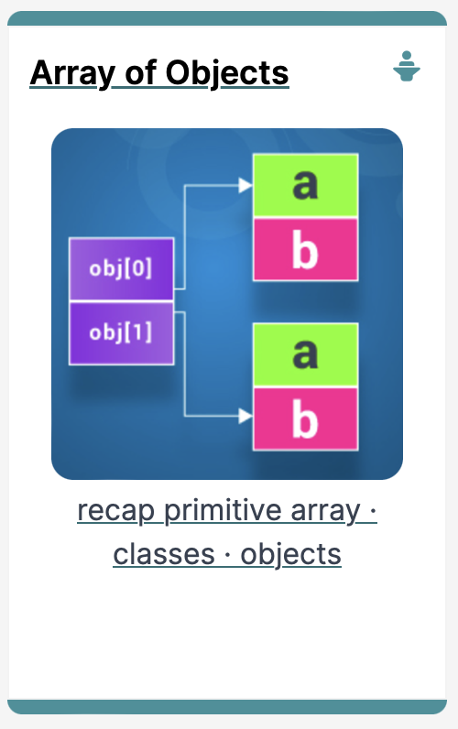
Arrays, Classes & Objects
A look at arrays of objects

Slide 3
Agenda
RECAP : Primitive Arrays
String Arrays
Arrays of Objects - Product

Slide 4
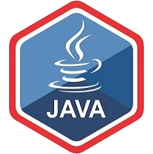
RECAP : Primitive Arrays

Slide 5
An array can store any type of data.
Primitive Types
int numbers[] = new int[10];
byte smallNumbers[] = new byte[4];
char characters[] = new char[26];
Object Types
String[] words = new String[4];
Product products[] = new Product[10];

Slide 6
Structure of an int primitive array
int[] numbers;
numbers
null

Slide 7
Structure of an int primitive array
int[] numbers;
numbers
numbers = new int[4];
0 | 0
1 | 0
2 | 0
3 | 0

Slide 8
Structure of an int primitive array
int[] numbers;
numbers
numbers = new int[4];
numbers[2] = 18;
0 | 0
1 | 0
2 | 18
3 | 0
We are directly accessing the element at index 2 and setting it to a value of 18.

Slide 9
Structure of an int primitive array
int[] numbers;
numbers
numbers = new int[4];
numbers[2] = 18;
0 | 12
1 | 0
2 | 18
3 | 0
numbers[0] = 12;
We are setting the element at index 0 to a value of 12.

Slide 10
Structure of an int primitive array
int[] numbers;
numbers
numbers = new int[4];
numbers[2] = 18;
0 | 12
1 | 0
2 | 18
3 | 0
numbers[0] = 12;
print(numbers[2]);
Here we are printing the contents of index location 2 i.e. 18 will be printed to the console.

Slide 11
String Arrays

Slide 12
An array can store any type of data.
Primitive Types
int numbers[] = new int[10];
byte smallNumbers[] = new byte[4];
char characters[] = new char[26];
Object Types
String[] words = new String[4];
Product products[] = new Product[10];

Slide 13
Structure of a String object array
String[] words;
words
null

Slide 14
Structure of a String object array
String[] words;
words
words = new String[4];
0 | null
1 | null
2 | null
3 | null

Slide 15
Structure of a String object array
String[] words;
words
words = new String[4];
0 | null
1
2 | null
3 | null
words[1] = “Dog”;
“Dog”

Slide 16
Structure of a String object array
String[] words;
words
words = new String[4];
0 | null
1
2 | null
3 | null
words[1] = “Dog”;
“Dog”
We are directly accessing the element at index 1 and setting it to a value of “Dog”.

Slide 17
Structure of a String object array
String[] words;
words
words = new String[4];
0 | null
1
2 | null
3
words[1] = “Dog”;
“Dog”
words[3] = “Cat”;
“Cat”

Slide 18
Structure of a String object array
String[] words;
words
words = new String[4];
0 | null
1
2 | null
3
words[1] = “Dog”;
“Dog”
words[3] = “Cat”;
“Cat”
The element at index 3 is set to “Cat”.

Slide 19
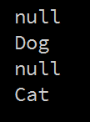
Structure of a String object array
String words[];
words = new String[4];
words[1] = "Dog";
words[3] = "Cat";
for (int i=0; i < words.length; i++)
{
System.out.println(words[i]);
}
Notes:
Should this be string object array

Slide 20
Arrays of Objects - Product

Slide 21
An array can store any type of data.
Primitive Types
int numbers[] = new int[10];
byte smallNumbers[] = new byte[4];
char characters[] = new char[26];
Object Types
String[] words = new String[4];
Product products[] = new Product[10];

Slide 22
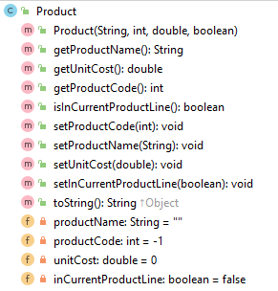
Product Class
Object Type/ Class Name
Methods i.e. the behaviours of the class
Fields i.e. the attributes of the class

Slide 23
Structure of a Product Object array
Product[] products;
products
null

Slide 24
Structure of a Product Object array
Product[] products;
products
products = new Product[4];
0 | null
1 | null
2 | null
3 | null

Slide 25
Structure of a Product Object array
Product[] products;
products
productName
“TV”
productCode
123
products = new Product[4];
unitCost
12.99
inCurrentProductLine
true
0 | null
1
2 | null
3 | null
products[1] = new Product(“TV”, 123, 12.99, true);

Slide 26
Example using a Product Object array
public String listProducts() {
String listOfProducts = "";
for (int i = 0; i < total; i++) { listOfProducts += i + ": " + products[i].toString() + "\n"; }
return listOfProducts; } }
Returns a String containing all the products stored in the primitive array.

Slide 27

Questions?

Slide 28



