Slide 1
Programming Fundamentals 1

Slide 2
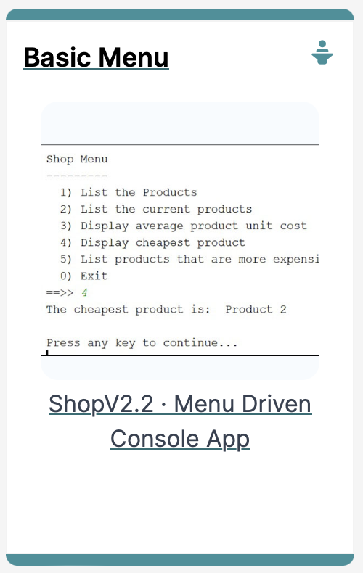
SHOP V2.2
An Array of Products + a Menu

Slide 3
Agenda
RECAP : SHOP V2.0
SHOP V2.1
SHOP V2.2

Slide 4

RECAP : SHOP V2.0

Slide 5
Recap - Shop V2.0 - Product
The Product class stores details about a product
name, code, unit cost, in the current product line
Driver
Store
Product

Slide 6
Recap - Shop V2.0
New Store class is responsible for maintaining a collection of Products
i.e. an array of Products.
Driver will now allow the user to decide how many product details they want to store.
Driver
Store
Product

Slide 7
SHOP V2.1
Version Developed in Lab Exercises

Slide 8
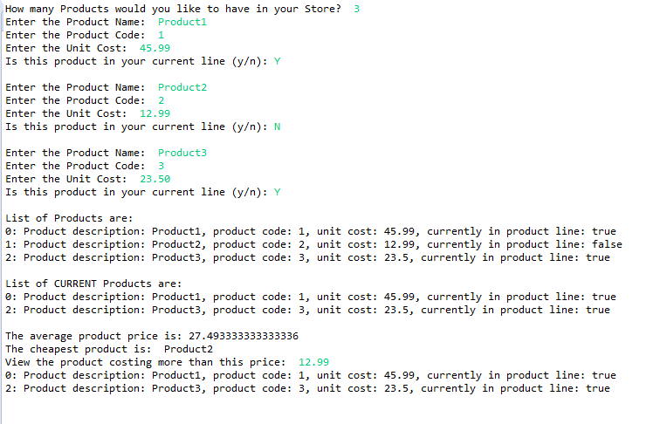
Shop V2.1 – Lab Exercises

Slide 9
Shop V2.1 – Lab Exercises
public class Driver{
//code omitted
public static void main(String[] args) { Driver driver = new Driver(); driver.processOrder(); driver.printProducts(); driver.printCurrentProducts(); driver.printAverageProductPrice(); driver.printCheapestProduct(); driver.printProductsAboveAPrice(); } //code omitted }

Slide 10
Shop V2.1 – Lab Exercises
Our users have no control of the system; they cannot choose to do anything!
public class Driver{
//code omitted
public static void main(String[] args) { Driver driver = new Driver(); driver.processOrder(); driver.printProducts(); driver.printCurrentProducts(); driver.printAverageProductPrice(); driver.printCheapestProduct(); driver.printProductsAboveAPrice(); } //code omitted }

Slide 11
SHOP V2.2
Adding a Menu System

Slide 12
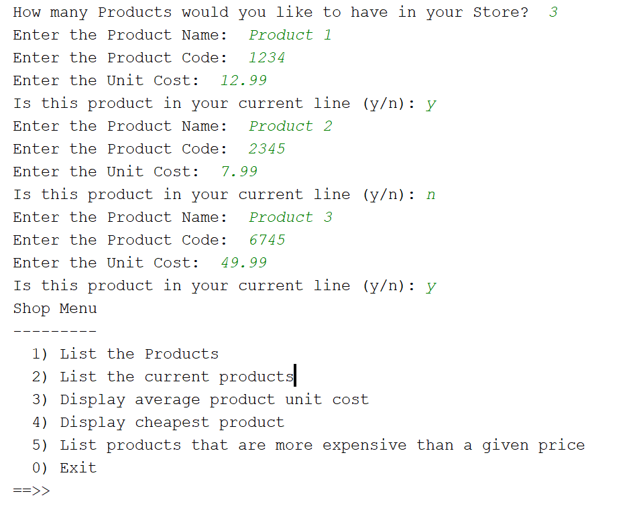
Shop V2.2 – Control with menu
We are going to add a simple menu that will allow us to view details about the entered products.

Slide 13
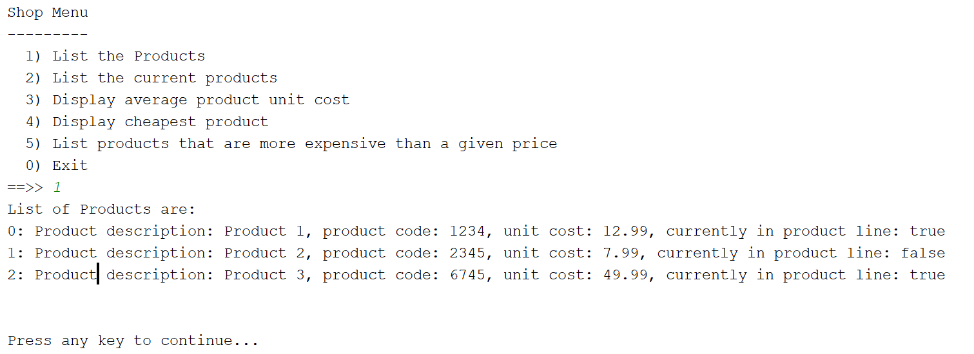
Shop V2.2 – Control with menu
Option 1:
List the products

Slide 14
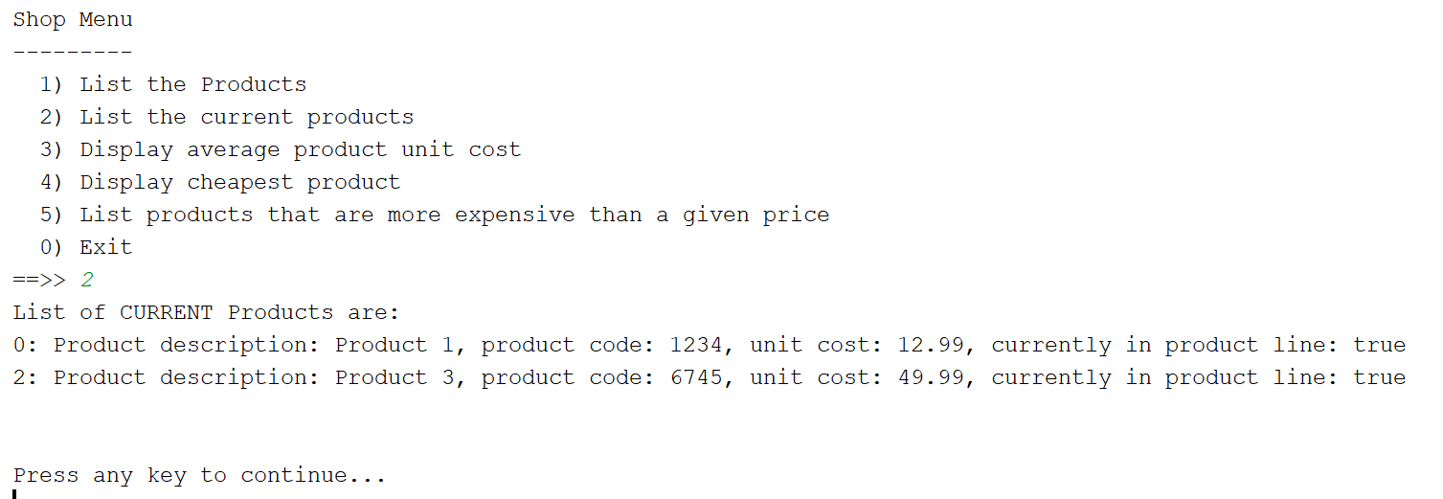
Shop V2.2 – Control with menu
Option 2:
List the current products

Slide 15
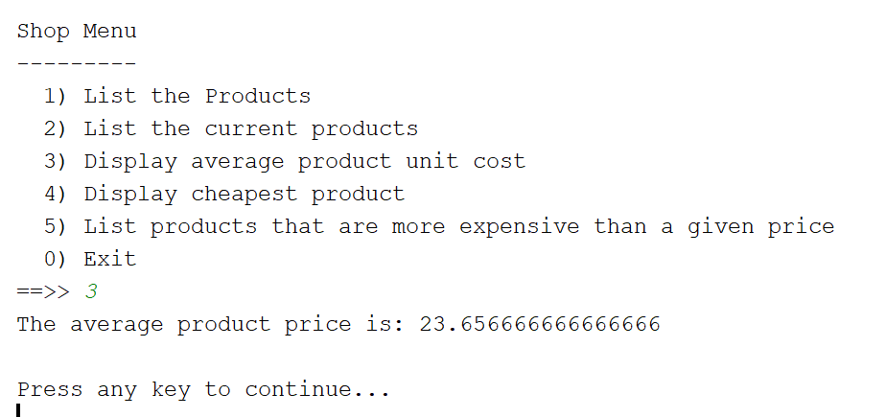
Shop V2.2 – Control with menu
Option 3:
Display average cost

Slide 16
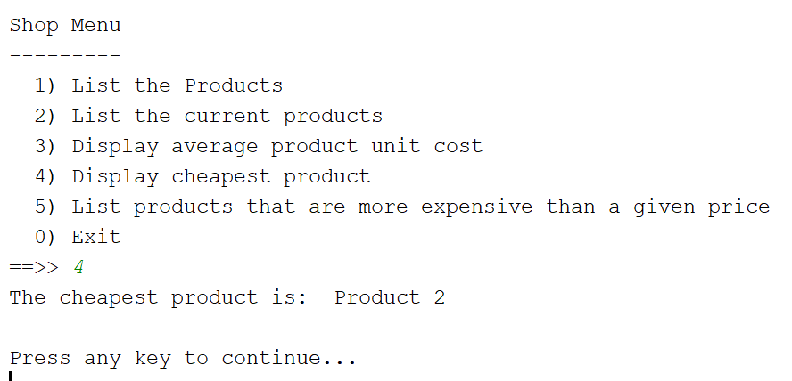
Shop V2.2 – Control with menu
Option 4:
Display cheapest product

Slide 17
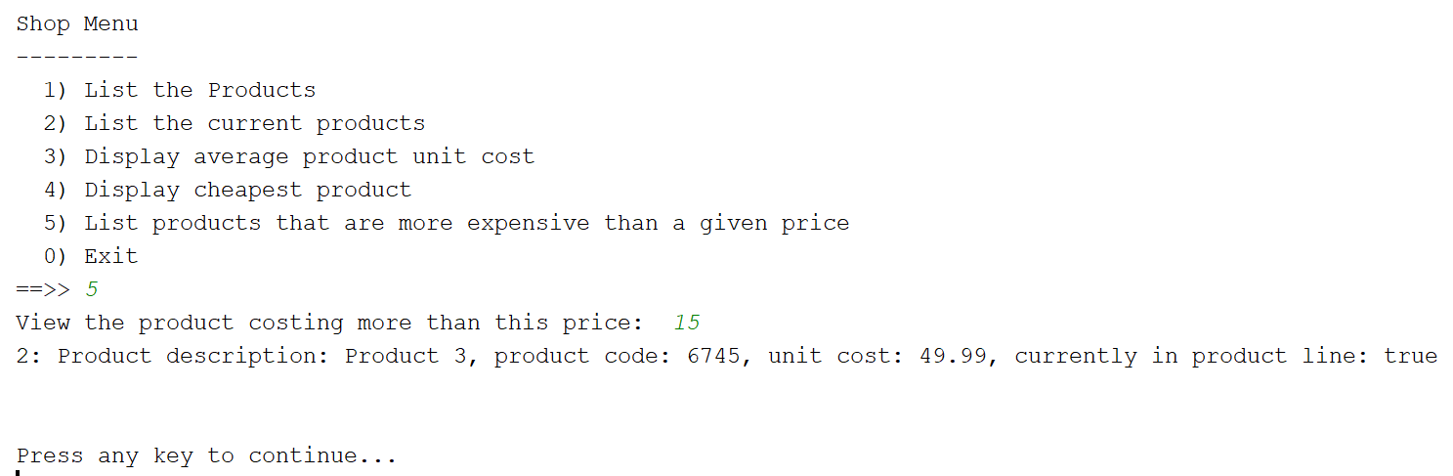
Shop V2.2 – Control with menu
Option 5:
List products that are more expensive than a given price

Slide 18
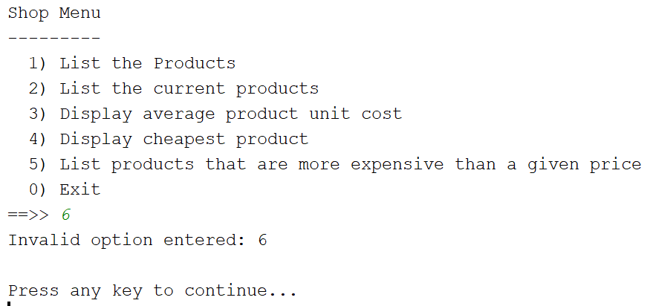
Shop V2.2 – Control with menu
Invalid Option
Menu is redisplayed once you press the enter key.

Slide 19
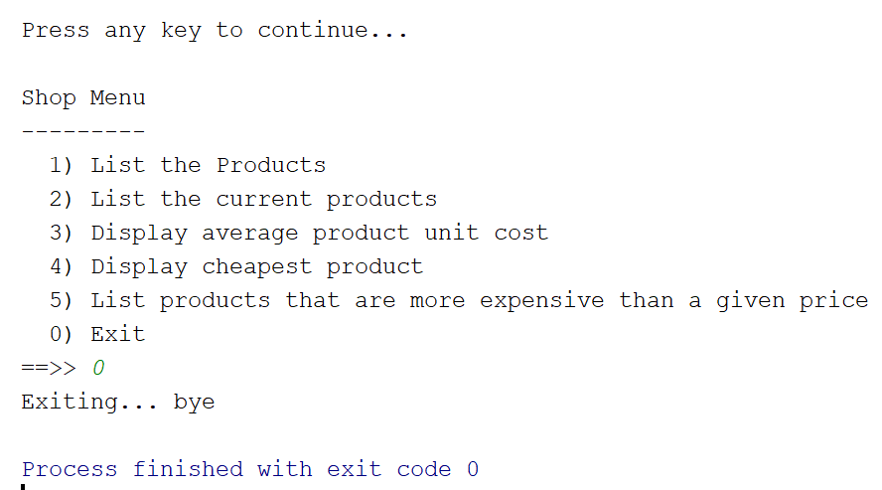
Shop V2.2 – Control with menu
Option 0:
Exit the system

Slide 20
The Switch Statement
A brief introduction (more later..)

Slide 21
The switch statement
The switch statement works in exactly the same way as a set of if statements, but is more compact and readable
The switch statement switches on a single value to one of an arbitrary number of cases

Slide 22
The switch statement

Slide 23
The switch statement
A switch statement can have any number of case labels.
The default case is optional; if no default is given, it may happen that no case is executed.
Can switch on int, char or String.
Let’s use this now in ShopV2.2

Slide 24
SHOP V2.2
Adding the Menu System

Slide 25
SHOP V2.2
Product – no changes
Store – no changes
Driver will be changed to allow the user to choose options from a menu.
Driver
Store
Product

Slide 26
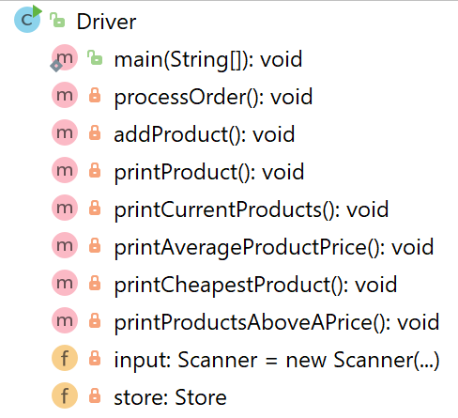
Shop V2.1 Shop V2.2

Slide 27
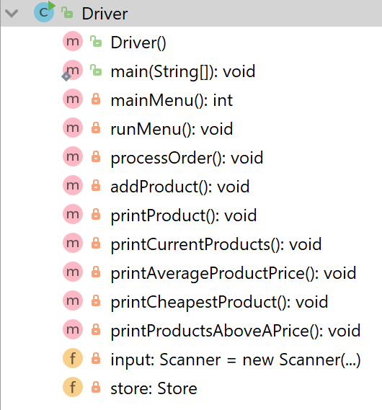
Shop V2.1 Shop V2.2

Slide 28
Shop V2.1 – main method
public static void main(String[] args) { Driver driver = new Driver(); driver.processOrder(); driver.printProducts(); driver.printCurrentProducts(); driver.printAverageProductPrice(); driver.printCheapestProduct(); driver.printProductsAboveAPrice(); }

Slide 29
Shop V2.1 – main method
public static void main(String[] args) { Driver driver = new Driver(); driver.processOrder(); driver.printProducts(); driver.printCurrentProducts(); driver.printAverageProductPrice(); driver.printCheapestProduct(); driver.printProductsAboveAPrice(); }
Console Output

Slide 30
Shop V2.1 – main method
public static void main(String[] args) { Driver driver = new Driver(); driver.processOrder(); driver.printProducts(); driver.printCurrentProducts(); driver.printAverageProductPrice(); driver.printCheapestProduct(); driver.printProductsAboveAPrice(); }
These methods will be in a menu system in V2.2

Slide 31
Shop V2.2: - changes to the main method
public static void main(String[] args) { Driver driver = new Driver();
driver.processOrder();
driver.runMenu(); }
1

Slide 32
private int mainMenu(){ System.out.print(""" Shop Menu --------- 1) List the Products 2) List the current products 3) Display average product unit cost 4) Display cheapest product 5) List products that are more expensive than a given price 0) Exit ==>> """); int option = input.nextInt(); return option; }
Shop V2.2 – new mainMenu method
2

Slide 33
V2.2
private void runMenu(){ int option = mainMenu(); while (option != 0){ switch (option){ case 1 -> printProducts(); case 2 -> printCurrentProducts(); case 3 -> printAverageProductPrice(); case 4 -> printCheapestProduct(); case 5 -> printProductsAboveAPrice(); default -> System.out.println("Invalid option entered: " + option); } //pause the program so that the user can read what we just printed to the terminal window System.out.println("\nPress enter key to continue..."); input.nextLine(); input.nextLine(); //second read is required - bug in Scanner class; a String read is ignored straight after reading an int. //display the main menu again option = mainMenu(); } //the user chose option 0, so exit the program System.out.println("Exiting...bye"); System.exit(0); }
3
Shop V2.2 – new runMenu method

Slide 34
V2.2
private void runMenu(){ int option = mainMenu(); while (option != 0){ switch (option){ case 1 -> printProducts(); case 2 -> printCurrentProducts(); case 3 -> printAverageProductPrice(); case 4 -> printCheapestProduct(); case 5 -> printProductsAboveAPrice(); default -> System.out.println("Invalid option entered: " + option); } //pause the program so that the user can read what we just printed to the terminal window System.out.println("\nPress enter key to continue..."); input.nextLine(); input.nextLine(); //second read is required - bug in Scanner class; a String read is ignored straight after reading an int. //display the main menu again option = mainMenu(); } //the user chose option 0, so exit the program System.out.println("Exiting...bye"); System.exit(0); }
LCV initialised
LCV tested
LCV changed
Loop Control Variable is option

Slide 35
V2.2
private void runMenu(){ int option = mainMenu(); while (option != 0){ switch (option){ case 1 -> printProducts(); case 2 -> printCurrentProducts(); case 3 -> printAverageProductPrice(); case 4 -> printCheapestProduct(); case 5 -> printProductsAboveAPrice(); default -> System.out.println("Invalid option entered: " + option); } //pause the program so that the user can read what we just printed to the terminal window System.out.println("\nPress enter key to continue..."); input.nextLine(); input.nextLine(); //second read is required - bug in Scanner class; a String read is ignored straight after reading an int. //display the main menu again option = mainMenu(); } //the user chose option 0, so exit the program System.out.println("Exiting...bye"); System.exit(0); }
public static void main(String[] args) { Driver driver = new Driver(); driver.processOrder(); driver.printProducts(); driver.printCurrentProducts(); driver.printAverageProductPrice(); driver.printCheapestProduct(); driver.printProductsAboveAPrice(); }
V2.1
Note the methods in the switch statement are those that were in the main method in V2.1

Slide 36

Questions?

Slide 37



