Slide 1
Programming Fundamentals 1

Slide 2
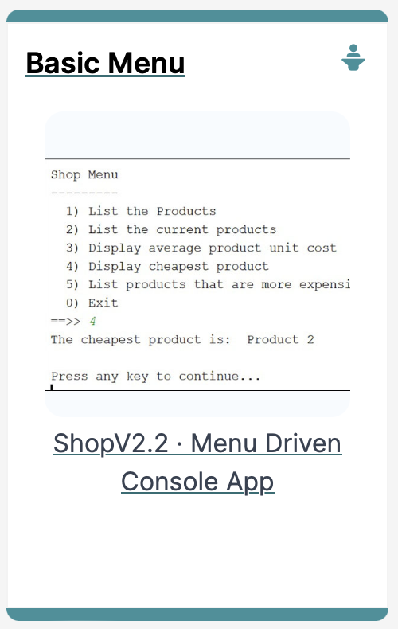
The this Keyword in Java
Why and How we use it

Slide 3
this keyword
Examine a class called Spot – it contains many fields e.g.:
xCoord, yCoord, diameter
class Spot{
float xCoord, yCoord;
float diameter;
int red, green, blue;
Spot(float xPos, float yPos, float diamtr)
{
xCoord = xPos;
yCoord = yPos;
diameter = diamtr;
}

Slide 4
this keyword
One of the Spot constructors takes three parameters:
xPos, yPos, diamtr
class Spot{
float xCoord, yCoord;
float diameter;
int red, green, blue;
Spot (float xPos, float yPos, float diamtr)
{
xCoord = xPos;
yCoord = yPos;
diameter = diamtr;
}

Slide 5
this keyword
It would be nice to name the parameters passed into the Spot constructor the same names as the instance fields
This is called name overloading
But how will Java know which variable we are referring to?
class Spot{
float xCoord, yCoord;
float diameter;
int red, green, blue;
Spot(float xPos, float yPos, float diamtr)
{
xCoord = xPos;
yCoord = yPos;
diameter = diamtr;
}

Slide 6
this keyword
We can use the this keyword to distinguish between them
class Spot{
float xCoord, yCoord;
float diameter;
int red, green, blue;
Spot(float xCoord, float yCoord, float diameter)
{
this.xCoord = xCoord;
this.yCoord = yCoord;
this.diameter = diameter;
}

Slide 7
this keyword
this refers to the current object fields.
class Spot{
float xCoord, yCoord;
float diameter;
int red, green, blue;
Spot(float xCoord, float yCoord, float diameter)
{
this.xCoord = xCoord;
this.yCoord = yCoord;
this.diameter = diameter;
}

Slide 8
this keyword
These are local fields that are destroyed as soon as the Spot constructor finishes executing
class Spot{
float xCoord, yCoord;
float diameter;
int red, green, blue;
Spot(float xCoord, float yCoord, float diameter)
{
this.xCoord = xCoord;
this.yCoord = yCoord;
this.diameter = diameter;
}

Slide 9
this keyword – other examples
To clairfy, in the statement: this.x = x;
Where this.x refers to the object’s property / field
and x on it’s own is the parameter passed in to the method substitute x for any property/field
This describes name overloading
void colour (int red, int green, int blue)
{
this.red = red;
this.green = green;
this.blue = blue;
fill (red, green, blue);
}
void colour (int gray){
this.gray = gray;
fill (this.gray);
}

Slide 10

Questions?

Slide 11
References
Reas, C. & Fry, B. (2014) Processing – A Programming Handbook for Visual Designers and Artists, 2nd Edition, MIT Press, London.

Slide 12



