Slide 1
Programming Fundamentals 1

Slide 2
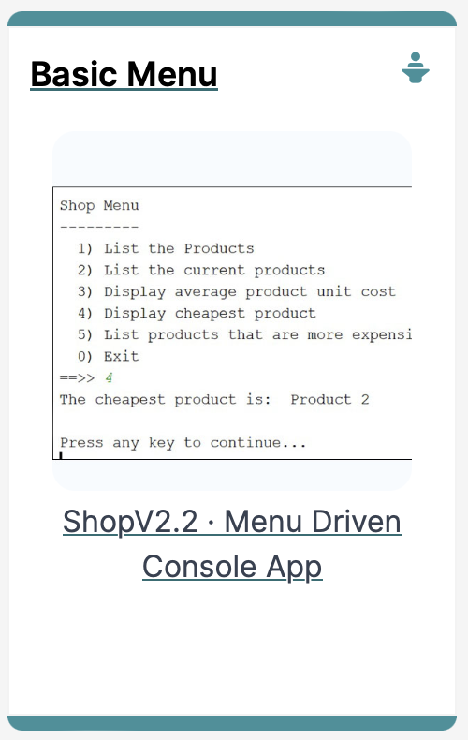
The toString() method
Why and How to use it

Slide 3
Why toString()
What if we wish to print out the contents of an object?
We could just use getters wherever we need to access the values?
We have a better way…
toString()

Slide 4
toString()
We will start to write a toString() method for each class.
It will be public
It can be basic or complicated
Then other classes can get a ’string’ version of the object at any time.
This is useful if we wish to
Examine an object’s value
Print out an object for reporting purposes.

Slide 5
toString()
We will firstly write a toString() for a simple class (Spot)
Then we will develop a class (Spots) whose main function is to have an array of Spot.
We will write a toString() for this collection
This toString() uses the Spot toString()..

Slide 6
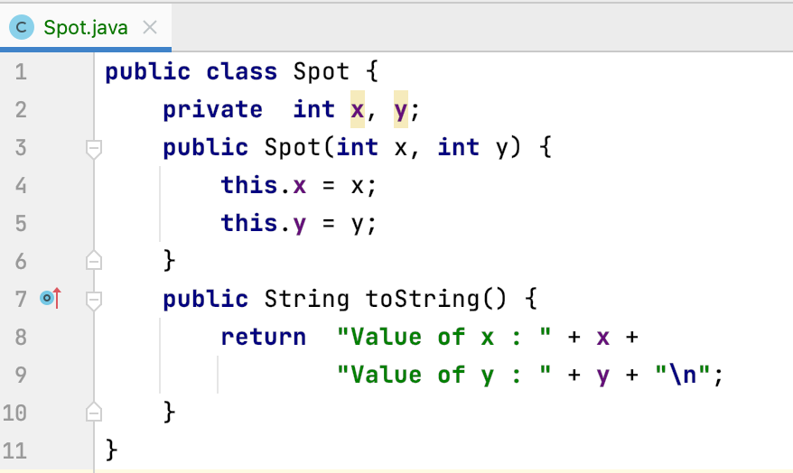
Ex 1. Example of toString() in Spot
Simple Spot Class – Note the toString()

Slide 7
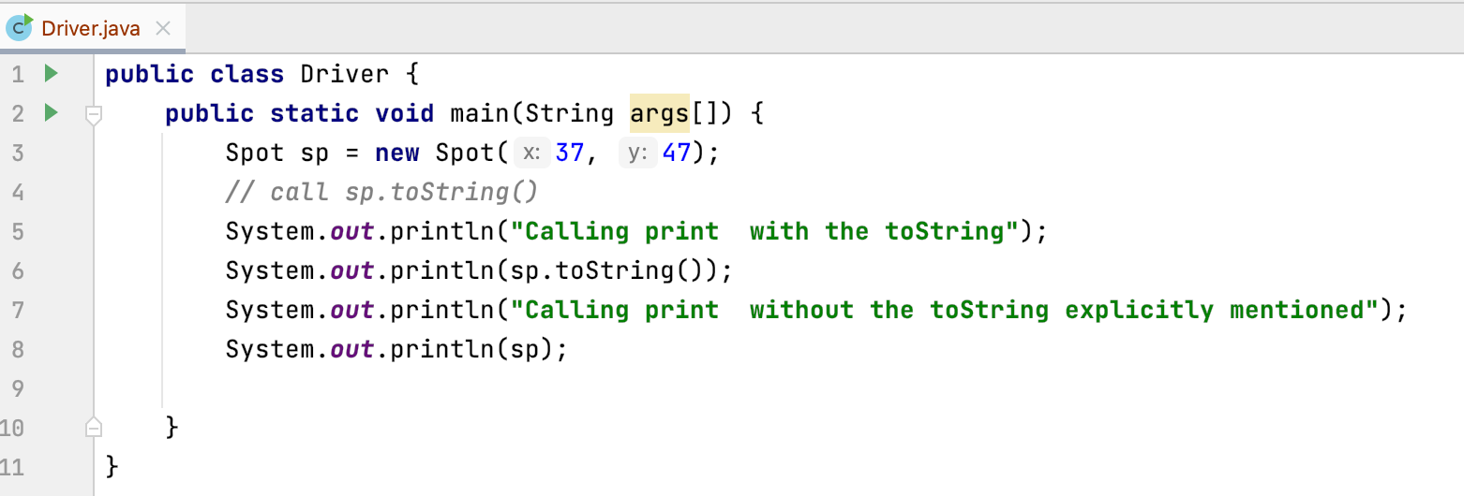
Ex 1. Using toString()
Driver Class using toString()

Slide 8
Ex 2. toString() for a collection of Spots
Simple Spot Class – Note the toString() (no change)

Slide 9
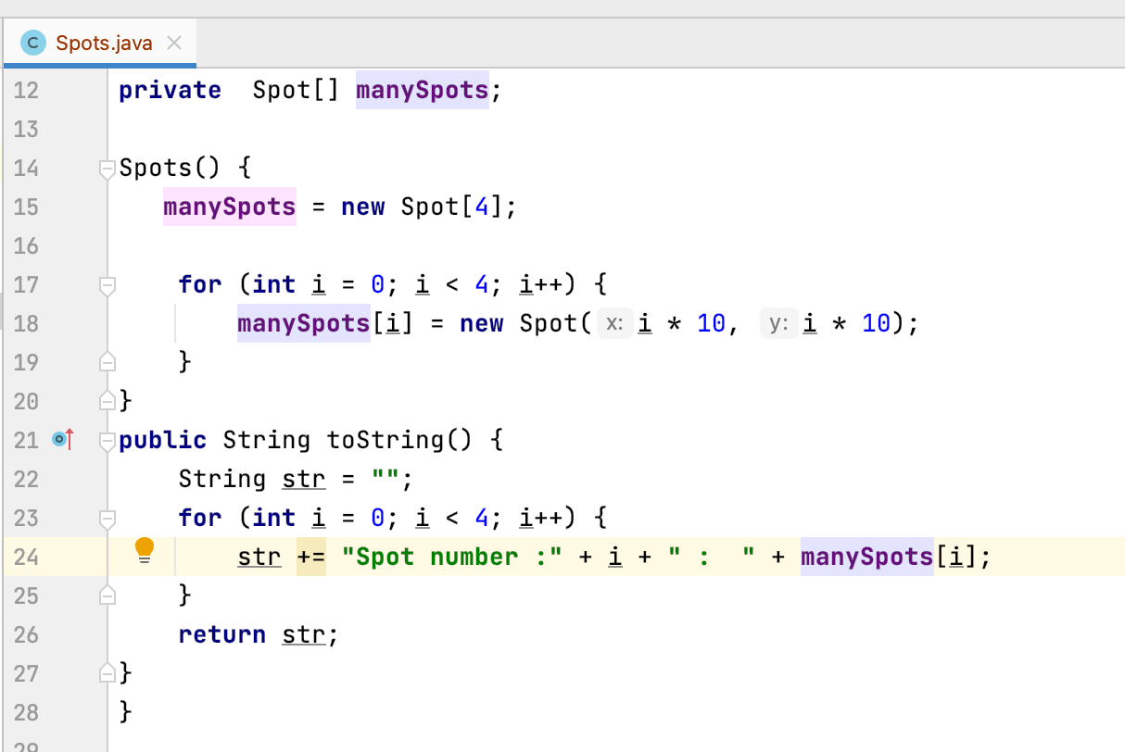
Ex 2. introduce Spots with an array of Spot
Spots Class – Note the toString() – needs a loop)

Slide 10
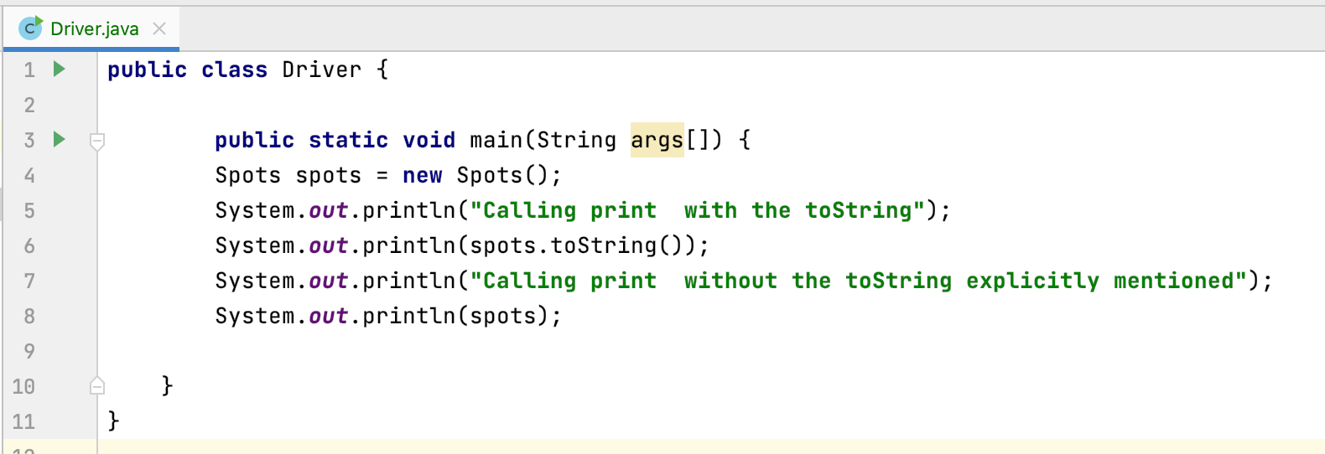
Using toString()
Driver Class using toString() on spots – note similarity

Slide 11

Questions?

Slide 12



