Slide 1

Public and private access
Why do we need private fields and public methods?
Produced
by:
Ms. Mairead Meagher
Dr. Siobhán Drohan
Department of Computing and Mathematics
http://www.wit.ie/

Slide 2
Class Diagram for Spot Version 2
Object Type/ Class Name
Spot
xCoord yCoord diameter red green blue gray
Spot() Spot(float, float, float) Spot(float, float, float, int) Spot(float, float, float, int, int, int) display() colour(int, int, int) colour(int) move(float, float)
Fields i.e. the attributes of the class
Overloaded Constructor
Methods i.e. the behaviours of the class
Overloaded Methods

Slide 3
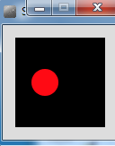
Spot Class – Version 2
class Spot{
float xCoord, yCoord;
float diameter;
int red, green, blue;
Spot()
{
}
Spot (float xCoord, float yCoord, float diameter)
{
this.xCoord = xCoord;
this.yCoord = yCoord;
this.diameter = diameter;
}
// colour methods…
// display method…
// move method…
}
Source: Reas & Fry (2014)

Slide 4
Spot Class – Version 2
class Spot{
// fields and constructors…
void display ()
{
ellipse(xCoord, yCoord, diameter, diameter);
}
void colour (int red, int green, int blue)
{
this.red = red;
this.green = green;
this.blue = blue;
fill (red, green, blue);
}
void colour (int gray){
this.gray = gray;
fill (this.gray);
}
}
Source: Reas & Fry (2014)

Slide 5
Spot Class – Version 2
class Spot{
float xCoord, yCoord;
float diameter;
int red, green, blue;
// constructors…
void display(){
ellipse(xCoord, yCoord, diameter, diameter);
}
void colour(int red, int green, int blue)
{
this.red = red;
this.green = green;
this.blue = blue;
fill (red, green, blue);
}
// move methods…
}
Spot sp;
void setup()
{
size (100,100);
noStroke();
sp = new Spot(33, 50, 30);
}
void draw()
{
background(0);
sp.colour(255, 0, 0);
sp.diameter = 30000;
sp.display();
}
Source: Reas & Fry (2014)

Slide 6
Our Our design smells!
We can directly access the diameter field (and all other fields) in the Spot class from another class, and set it to a value that is completely preposterous!
Also, when we directly access a field in a class, we are applying a “behaviour” to that field i.e. resizing the circle.
But, aren’t methods supposed to be the “behaviour” for a class???????

Slide 7
Our design smells!
Our design violates one of the basic principles of object-oriented design:
Encapsulation!

Slide 8
Encapsulation
Encapsulation (data hiding) is a fundamental Object Oriented concept.
How to achieve encapsulation?
wrap the data (fields) and code acting on the data (methods) together as single unit.
hide the fields from other classes.
access the fields only through the methods of their current class.
http://www.tutorialspoint.com/java/java_encapsulation.htm

Slide 9
Encapsulation in Java – steps 1-3
Encapsulation Step | Approach in Java
1. Wrap the data (fields) and code acting on the data (methods) together as single unit. | public class ClassName { Fields Constructors Methods }
2. Hide the fields from other classes. | Declare the fields of a class as private.
3. Access the fields only through the methods of their current class. | Provide public setter and getter methods to modify and view the fields values.
http://www.tutorialspoint.com/java/java_encapsulation.htm

Slide 10
Refactoring Spot: Access Modifiers
Java provides a number of access modifiers to set access levels for classes, fields, methods and constructors.
The four access levels are:
Visible to the package, the default. No modifiers needed.
Visible to the class only (private).
Visible to the world (public).
Visible to the package and all subclasses (protected).
http://www.tutorialspoint.com/java/java_modifier_types.htm

Slide 11
Refactoring Spot: Access Modifiers
Java provides a number of access modifiers to set access levels for classes, fields, methods and constructors.
The four access levels are:
Visible to the package, the default. No modifiers needed.
Visible to the class only (private).
Visible to the world (public).
Visible to the package and all subclasses (protected).
We will focus on public and private.
http://www.tutorialspoint.com/java/java_modifier_types.htm

Slide 12
Refactoring Spot : Access Modifiers
public class Spot{
float xCoord, yCoord;
float diameter;
int red, green, blue;
Spot()
{
}
// other constructor
void display(){
ellipse(xCoord, yCoord, diameter, diameter);
}
// move method…
// colour methods…
}
Encapsulation step 1 is complete; all fields, constructors and methods are all in a single unit, called Spot.
We just changed the class access level to public (default is package).
Filename: Spot

Slide 13
Refactoring Spot : Access Modifiers
public class Spot{
float xCoord, yCoord;
float diameter;
int red, green, blue;
Spot()
{
}
// other constructor
void display(){
ellipse(xCoord, yCoord, diameter, diameter);
}
// move method…
// colour methods…
}
However, as the default access level is package
→ our methods and fields are all package level access.
Problem: this breaks Encapsulation step 2 i.e. the fields of a class should be private.

Slide 14
Refactoring Spot: Access Modifiers
public class Spot{
private float xCoord, yCoord;
private float diameter;
private int red, green, blue;
Spot()
{
}
// other constructor
void display(){
ellipse(xCoord, yCoord, diameter, diameter);
}
// move method…
// colour methods…
}
To fix Encapsulation step 2, we declare all the fields with private access.

Slide 15
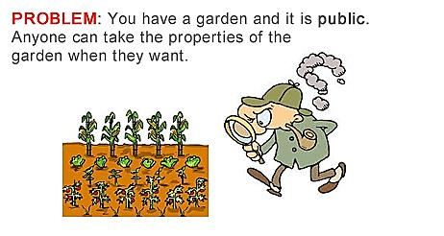
Access Modifiers
http://www.evinw.com/w/

Slide 16
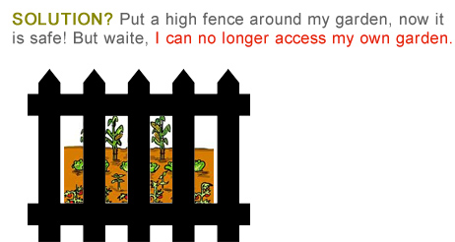
Access Modifiers
http://www.evinw.com/w/

Slide 17
Refactoring Spot 7.0: Access Modifiers
The private fields are not viewable or updatable outside the class Spot. Other classes don’t know these exist.
public class Spot{
private float xCoord, yCoord;
private float diameter;
private int red, green, blue;
//constructors…
//display method…
// move method…
// colour methods…
}
http://www.evinw.com/w/
Notes:
Mention here that there is a bug in processing where it (incorrectly) allows classes outside of Spot to access private fields. This bug is there because of how Processing builds the final code before running (it puts many classes in one *.java file). This doesn’t happen in “real” IDEs.

Slide 18
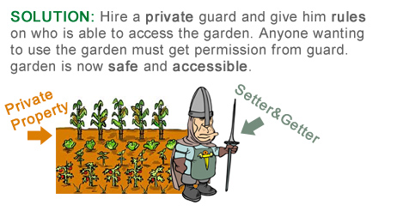
Refactoring Spot : Setters and Getters
http://www.evinw.com/w/

Slide 19
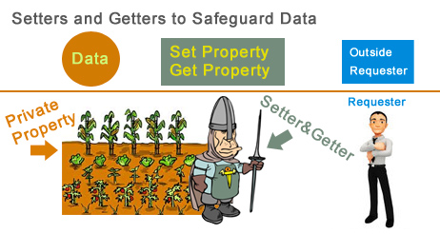
Refactoring Spot 2: Setters and Getters
http://www.evinw.com/w/

Slide 20
Refactoring Spot 2: Setters and Getters
Encapsulation Step 3: Provide public setter and getter methods to modify and view the fields values.
http://www.evinw.com/w/

Slide 21
Refactoring Spot 2: Getters
public float getXCoord(){
return xCoord;
}
public float getYCoord(){
return yCoord;
}
public int getRed(){
return red;
}
public class Spot{
private float xCoord, yCoord;
private float diameter;
private int red, green, blue;
//constructors…
//display method…
// move method…
// colour methods…
public float getDiameter(){
return diameter;
}
public int getGreen(){
return green;
}
public int getBlue(){
return blue;
}
} //end Spot class

Slide 22
Refactoring Spot 2: Setters
public void setXCoord (float xCoord){
this.xCoord = xCoord;
}
public void setYCoord (float yCoord){
this.yCoord = yCoord;
}
public void setRed (int red){
this.red = red;
}
public class Spot{
private float xCoord, yCoord;
private float diameter;
private int red, green, blue;
//constructors…
//display method…
// move method…
// colour methods…
// assessor methods…
public void setDiameter (float diameter){
this.diameter = diameter;
}
public void setGreen (int green){
this.green = green;
}
public void setBlue (int blue){
this.blue = blue;
}
public void setGray (int gray){
this.gray = gray;
}
}

Slide 23
Spot Class – Version 2
Spot sp;
void setup()
{
size (100,100);
noStroke();
sp = new Spot(33, 50, 30);
}
void draw()
{
background(0);
sp.colour(255, 0, 0);
sp.diameter = 30000;
sp.display();
}
class Spot{
float xCoord, yCoord;
float diameter;
int red, green, blue;
// constructors…
// display method…
// colour methods…
// move methods…
}
Before refactoring, we directly accessed the diameter field… this broke Encapsulation rules.
Source: Reas & Fry (2014)

Slide 24
Refactoring Spot 2 – getters and setters
public class Spot{
private float xCoord, yCoord;
private float diameter;
private int red, green, blue;
// constructors…
// display method…
// colour methods…
// move methods…
//getter methods…
//setter methods…
public void setDiameter (float diameter) {
this.diameter = diameter;
}
}
Spot sp;
void setup()
{
size (100,100);
noStroke();
sp = new Spot(33, 50, 30);
}
void draw()
{
background(0);
sp.colour(255, 0, 0);
sp.setDiameter(30000);
sp.display();
}
Now we update via the appropriate setter

Slide 25

Questions?

Slide 26
References
Reas, C. & Fry, B. (2014) Processing – A Programming Handbook for Visual Designers and Artists, 2nd Edition, MIT Press, London.

