Slide 1

Validation
Validation in constructors, setters.
Produced
by:
Ms. Mairead Meagher
Dr. Siobhán Drohan
Department of Computing and Mathematics
http://www.wit.ie/

Slide 2
Topics list
Recap: Version 6.1
Our design smells!
Encapsulation
Refactoring Spot:
Access Modifiers
Accessors and Mutators
Validation

Slide 3
Class Diagram for Spot Version 2
Object Type/ Class Name
Spot
xCoord yCoord diameter red green blue gray
Spot() Spot(float, float, float) Spot(float, float, float, int) Spot(float, float, float, int, int, int) display() colour(int, int, int) colour(int) move(float, float)
Fields i.e. the attributes of the class
Overloaded Constructor
Methods i.e. the behaviours of the class
Overloaded Methods

Slide 4
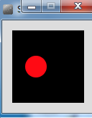
Spot Class – Version 2
class Spot{
float xCoord, yCoord;
float diameter;
int red, green, blue;
Spot()
{
}
Spot (float xCoord, float yCoord, float diameter)
{
this.xCoord = xCoord;
this.yCoord = yCoord;
this.diameter = diameter;
}
// colour methods…
// display method…
// move method…
}
Source: Reas & Fry (2014)

Slide 5
Spot Class – Version 2
class Spot{
// fields and constructors…
void display ()
{
ellipse(xCoord, yCoord, diameter, diameter);
}
void colour (int red, int green, int blue)
{
this.red = red;
this.green = green;
this.blue = blue;
fill (red, green, blue);
}
void colour (int gray){
this.gray = gray;
fill (this.gray);
}
}
Source: Reas & Fry (2014)

Slide 6
Spot Class – Version 7.0
class Spot{
float xCoord, yCoord;
float diameter;
int red, green, blue;
// constructors…
void display(){
ellipse(xCoord, yCoord, diameter, diameter);
}
void colour(int red, int green, int blue)
{
this.red = red;
this.green = green;
this.blue = blue;
fill (red, green, blue);
}
// move methods…
}
Spot sp;
void setup()
{
size (100,100);
noStroke();
sp = new Spot(33, 50, 30);
}
void draw()
{
background(0);
sp.colour(255, 0, 0);
sp.diameter = 30000;
sp.display();
}
Source: Reas & Fry (2014)

Slide 7
Topics list
Recap: Version 6.1
Our design smells!
Encapsulation
Refactoring Spot:
Access Modifiers
Accessors and Mutators
Validation

Slide 8
Our Our design smells!
We can directly access the diameter field (and all other fields) in the Spot class from another class, and set it to a value that is completely preposterous!
Also, when we directly access a field in a class, we are applying a “behaviour” to that field i.e. resizing the circle.
But, aren’t methods supposed to be the “behaviour” for a class???????

Slide 9
Our Our design smells!
Our design violates one of the basic principles of object-oriented design:
Encapsulation!

Slide 10
Topics list
Recap: Version 6.1
Our design smells!
Encapsulation
Refactoring Spot:
Access Modifiers
Accessors and Mutators
Validation

Slide 11
Encapsulation
Encapsulation (data hiding) is a fundamental Object Oriented concept.
How to achieve encapsulation?
wrap the data (fields) and code acting on the data (methods) together as single unit.
hide the fields from other classes.
access the fields only through the methods of their current class.
http://www.tutorialspoint.com/java/java_encapsulation.htm

Slide 12
Encapsulation in Java – steps 1-3
Encapsulation Step | Approach in Java
1. Wrap the data (fields) and code acting on the data (methods) together as single unit. | public class ClassName { Fields Constructors Methods }
2. Hide the fields from other classes. | Declare the fields of a class as private.
3. Access the fields only through the methods of their current class. | Provide public setter and getter methods to modify and view the fields values.
http://www.tutorialspoint.com/java/java_encapsulation.htm

Slide 13
Topics list
Recap: Version 6.1
Our design smells!
Encapsulation
Refactoring Spot:
Access Modifiers
Accessors and Mutators
Validation

Slide 14
Refactoring Spot: Access Modifiers
Java provides a number of access modifiers to set access levels for classes, fields, methods and constructors.
The four access levels are:
Visible to the package, the default. No modifiers needed.
Visible to the class only (private).
Visible to the world (public).
Visible to the package and all subclasses (protected).
http://www.tutorialspoint.com/java/java_modifier_types.htm

Slide 15
Refactoring Spot: Access Modifiers
Java provides a number of access modifiers to set access levels for classes, fields, methods and constructors.
The four access levels are:
Visible to the package, the default. No modifiers needed.
Visible to the class only (private).
Visible to the world (public).
Visible to the package and all subclasses (protected).
In Processing, we will focus on public and private.
http://www.tutorialspoint.com/java/java_modifier_types.htm

Slide 16
Refactoring Spot 7.0: Access Modifiers
public class Spot{
float xCoord, yCoord;
float diameter;
int red, green, blue;
Spot()
{
}
// other constructor
void display(){
ellipse(xCoord, yCoord, diameter, diameter);
}
// move method…
// colour methods…
}
Encapsulation step 1 is complete; all fields, constructors and methods are all in a single unit, called Spot.
We just changed the class access level to public (default is package).
Filename: Spot

Slide 17
Refactoring Spot 7.0: Access Modifiers
public class Spot{
float xCoord, yCoord;
float diameter;
int red, green, blue;
Spot()
{
}
// other constructor
void display(){
ellipse(xCoord, yCoord, diameter, diameter);
}
// move method…
// colour methods…
}
However, as the default access level is package
→ our methods and fields are all package level access.
Problem: this breaks Encapsulation step 2 i.e. the fields of a class should be private.

Slide 18
Refactoring Spot 7.0: Access Modifiers
public class Spot{
private float xCoord, yCoord;
private float diameter;
private int red, green, blue;
Spot()
{
}
// other constructor
void display(){
ellipse(xCoord, yCoord, diameter, diameter);
}
// move method…
// colour methods…
}
To fix Encapsulation step 2, we declare all the fields with private access.

Slide 19
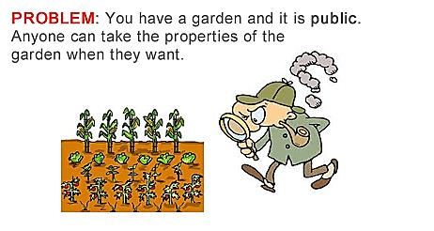
Refactoring Spot 7.0: Access Modifiers
http://www.evinw.com/w/

Slide 20
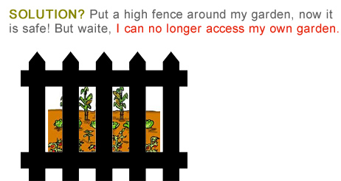
Refactoring Spot 7.0: Access Modifiers
http://www.evinw.com/w/

Slide 21
Refactoring Spot 7.0: Access Modifiers
The private fields are not viewable or updatable outside the class Spot. Other classes don’t know these exist.
public class Spot{
private float xCoord, yCoord;
private float diameter;
private int red, green, blue;
//constructors…
//display method…
// move method…
// colour methods…
}
http://www.evinw.com/w/
Notes:
Mention here that there is a bug in processing where it (incorrectly) allows classes outside of Spot to access private fields. This bug is there because of how Processing builds the final code before running (it puts many classes in one *.java file). This doesn’t happen in “real” IDEs.

Slide 22
Topics list
Recap: Version 6.1
Our design smells!
Encapsulation
Refactoring Spot:
Access Modifiers
Accessors and Mutators (getters & setters)
Validation

Slide 23
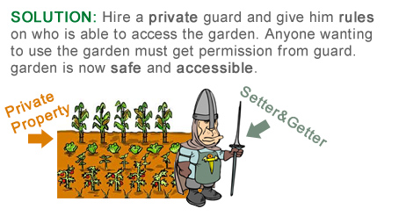
Refactoring Spot 7.0: Setters and Getters
http://www.evinw.com/w/

Slide 24
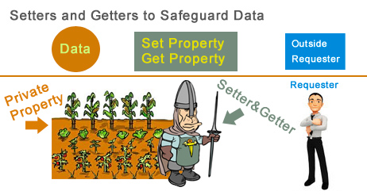
Refactoring Spot 7.0: Setters and Getters
http://www.evinw.com/w/

Slide 25
Refactoring Spot 7.0: Setters and Getters
Encapsulation Step 3: Provide public setter and getter methods to modify and view the fields values.
http://www.evinw.com/w/

Slide 26
Getters (Accessor Methods)
Accessor methods
return information about the state of an object
i.e. the values stored in the fields.
A ‘getter’ method
is a specific type of accessor method and typically:
contains a return statement (as the last executable statement in the method).
defines a return type.
does NOT change the object state.

Slide 27
Getters
return type
visibility modifier
method name
parameter list (empty)
public float getDiameter()
{
return diameter;
}
return statement
start and end of method body (block)

Slide 28
Setters (Mutator methods)
Mutator methods
change (i.e. mutate!) an object’s state.
A ‘setter’ method
is a specific type of mutator method and typically:
contains an assignment statement
takes in a parameter
changes the object state.

Slide 29
Setters
return type
visibility modifier
method name
parameter
public void setDiameter(float diameter)
{
this.diameter = diameter;
}
field being mutated
assignment
statement
Value passed
as a parameter

Slide 30
Getters/Setters
For each instance field in a class, you are normally asked to write:
A getter
Return statement
A setter
Assignment statement

Slide 31
Refactoring Spot 7.0: Getters
public float getXCoord(){
return xCoord;
}
public float getYCoord(){
return yCoord;
}
public int getRed(){
return red;
}
public class Spot{
private float xCoord, yCoord;
private float diameter;
private int red, green, blue;
//constructors…
//display method…
// move method…
// colour methods…
public float getDiameter(){
return diameter;
}
public int getGreen(){
return green;
}
public int getBlue(){
return blue;
}
} //end Spot class

Slide 32
Refactoring Spot 7.0: Setters
public void setXCoord (float xCoord){
this.xCoord = xCoord;
}
public void setYCoord (float yCoord){
this.yCoord = yCoord;
}
public void setRed (int red){
this.red = red;
}
public class Spot{
private float xCoord, yCoord;
private float diameter;
private int red, green, blue;
//constructors…
//display method…
// move method…
// colour methods…
// assessor methods…
public void setDiameter (float diameter){
this.diameter = diameter;
}
public void setGreen (int green){
this.green = green;
}
public void setBlue (int blue){
this.blue = blue;
}
public void setGray (int gray){
this.gray = gray;
}
}

Slide 33
Spot Class – Version 7.0
Spot sp;
void setup()
{
size (100,100);
noStroke();
sp = new Spot(33, 50, 30);
}
void draw()
{
background(0);
sp.colour(255, 0, 0);
sp.diameter = 30000;
sp.display();
}
class Spot{
float xCoord, yCoord;
float diameter;
int red, green, blue;
// constructors…
// display method…
// colour methods…
// move methods…
}
Before refactoring, we directly accessed the diameter field… this broke Encapsulation rules.
Source: Reas & Fry (2014)

Slide 34
Refactoring Spot 7.0 – getters and setters
public class Spot{
private float xCoord, yCoord;
private float diameter;
private int red, green, blue;
// constructors…
// display method…
// colour methods…
// move methods…
//getter methods…
//setter methods…
public void setDiameter (float diameter) {
this.diameter = diameter;
}
}
Spot sp;
void setup()
{
size (100,100);
noStroke();
sp = new Spot(33, 50, 30);
}
void draw()
{
background(0);
sp.colour(255, 0, 0);
sp.setDiameter(30000);
sp.display();
}
Now we update via the appropriate setter

Slide 35
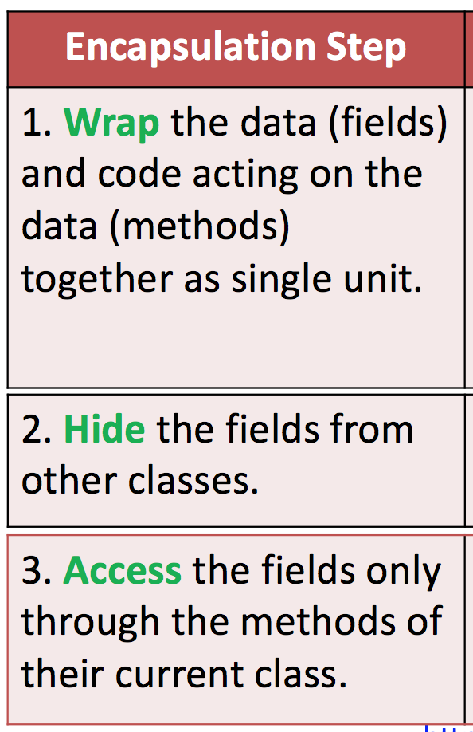
Review – Encapsulation steps
We have:
Wrapped the fields & methods into a single unit
Hidden our fields (they are private)
Implemented getter and setter methods
to view/update the fields.
Enforced the Encapsulation rules

Slide 36
But Our Design Still Smells!
BECAUSE
While we can no longer directly access the field/property, we can still set the field values to undesirable values by passing in a parameter … e.g. 30000
→ We need validation!

Slide 37
Topics list
Recap: Version 6.1
Our design smells!
Encapsulation
Refactoring Spot:
Access Modifiers
Accessors and Mutators
Validation

Slide 38
Improving the constructor
Spot(float xCoord, float yCoord, float diameter)
{
this.xCoord = xCoord;
this.yCoord = yCoord;
this.diameter = diameter;
}
Current constructor with no validation.

Slide 39
Improving the constructor
Spot(float xCoord, float yCoord, float diameter)
{
this.xCoord = xCoord;
this.yCoord = yCoord;
if ((diameter >= 20) && (diameter <= 50)){
this.diameter = diameter;
}
else{
this.diameter = 20;
}
}
Updated constructor with some validation.
Note: in the constructor, you typically set the field to a default value if invalid data was entered.

Slide 40
Improving the setter / mutator
public void setDiameter (float diameter){
if ((diameter >= 20) && (diameter <= 50)){
this.diameter = diameter;
}
}
Note: The validation done at constructor level must be repeated at setter level for that field → data integrity!
However, in setter methods, you typically do not update the field’s value if invalid data was entered (no “else” branch).

Slide 41
Summary - Encapsulation (data hiding)
Hide fields
Access them only through methods of the class e.g. getters & setters
Make the
class public
and the fields private
4 Access Levels (2 for processing)
package
private
public
Protected
Accessors
get
Mutators
set
Write a getter & setter for each each field
Validation
Test min / max values
in constructor
Apply default if value fails
in setter
Ignore the update if value fails

Slide 42
Summary continued
Encapsulation – Steps
Wrap Fields & Methods in single file
Hide the fields from other classes using private
Access only through getter & setters
Apply validation in constructors & setters

Slide 43
CAVEAT…
Processing PDE is not a software development environment.
Therefore, it doesn’t follow the strict rules of encapsulation…it allows you to directly access a private field.
This WILL NOT happen in a proper development environment i.e. IntelliJ, which we will be using after Christmas.

Slide 44

Questions?

Slide 45
References
Reas, C. & Fry, B. (2014) Processing – A Programming Handbook for Visual Designers and Artists, 2nd Edition, MIT Press, London.

