Slide 1
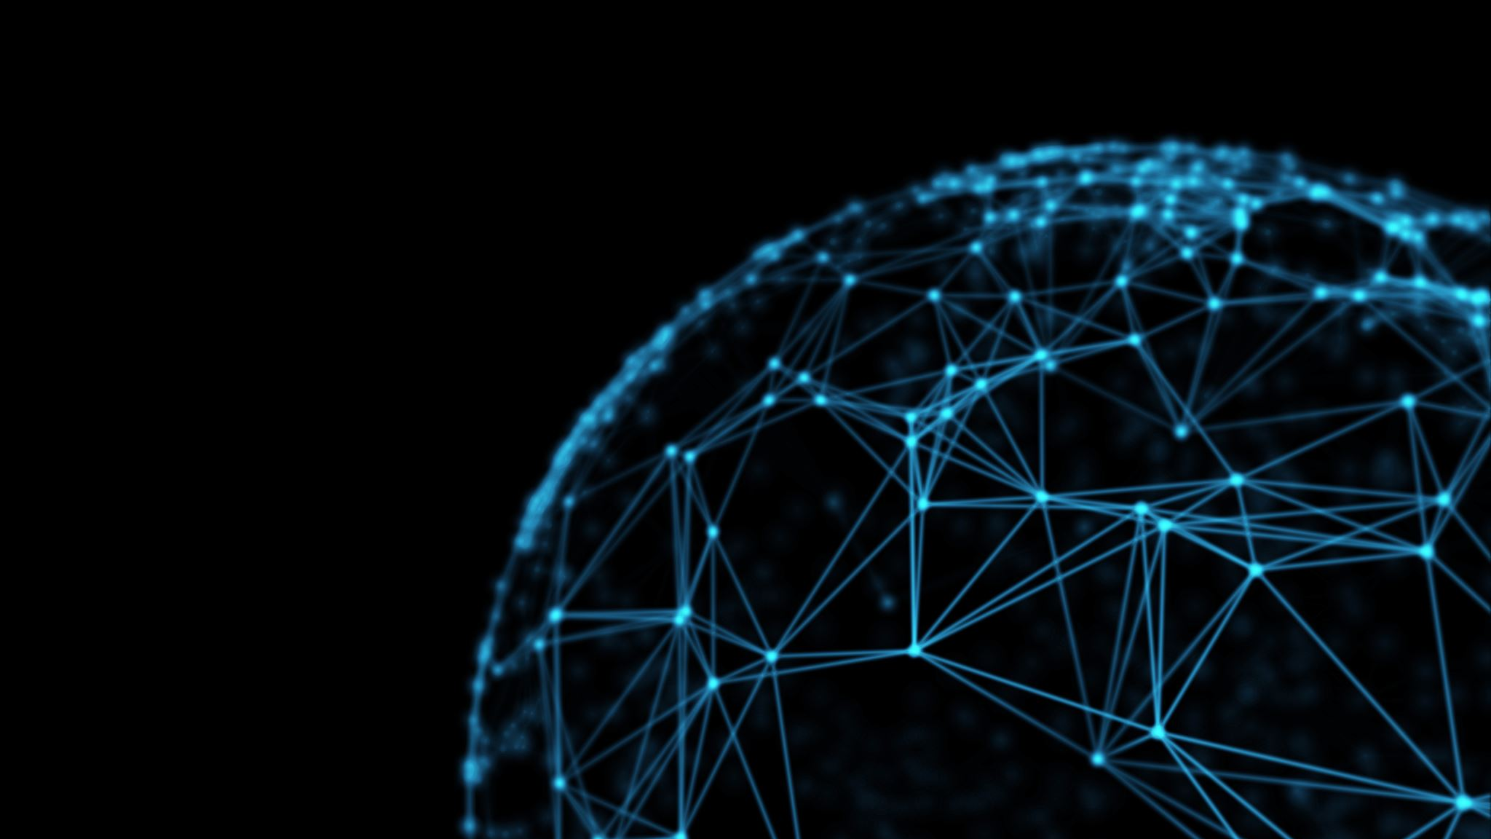
AI / ML overview
by the beginner for the beginners
Intuition, Inspiration, Ideas

Slide 2
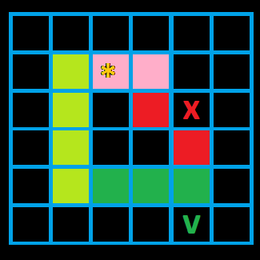
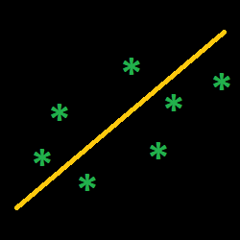
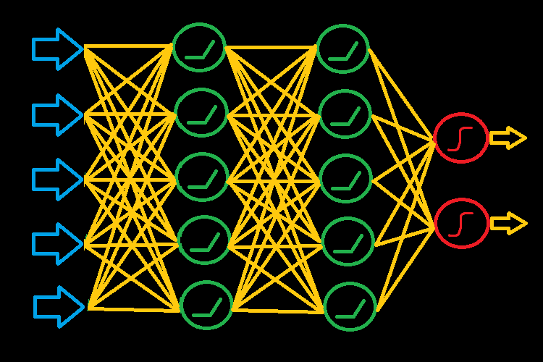
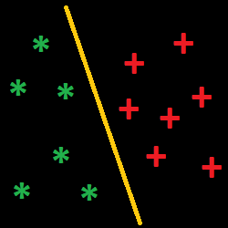
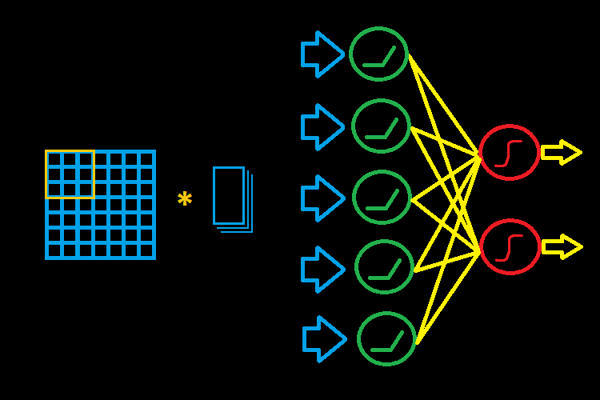
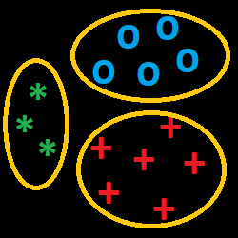
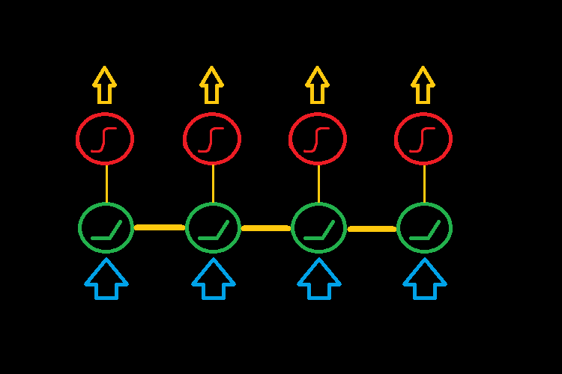
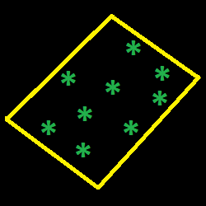
Classic ML
Deep Learning
Reinforcement Learning
Regression
Artificial Neural Network
X
Y
Z
Case: ??
Feature engineering
Loss function
Regularization
Gradient Descend
Case: Estimates ?
Activation function
Back-propagation
Optimizer
Hyper-parameters
Transfer Learning
Case: ?
Classification
Logistic regression
Decision Trees
Support Vector Machine
Confusion matrix
Case: ??
Convolutional NN
Convolution
Pooling
Flattening
Case: Screenshots
Deep Reinforcement Learning
X
Y
Z
Case: ??
Clustering
K-means clustering
Hierarchical clustering
Cluster metrics
Anomaly detection
Case: Regression testing
Recurrent NN
X
Y
Z
Case: Status reports
Dimensionality reduction
Principal Components
Case: Performance analysis

