Slide 1
Using ChatGPT 4.0 To Migrate a VB.NET Windows Forms Application to a C# Blazor Web Application An Application Modernization Experiment For Gap Mobilize
Prepared by Gregory Leake For Gap Mobilize
March 1, 2024

Slide 2
Pre-Notes: To Resolve For This Dry Run [This slide to be removed for final ppt]
Need Dee Dee and Robert Git Usernames, to add
For read access to checked in repositories, to clone/own
Feedback of course
I can add some discrete examples of key interactions
Including Context Setting in ChatGTP, how long lasts
And some specific migration samples (from master doc), illustrative
Are my timings right?
Assume 10-15 mins demos total for both apps (source, target)
With discussion
Slides/number/visual feedback, other feedback etc.
QA (how much time to leave—though will be interactive invite any/all questions during)
Need resources slide w/ links to Git, which includes two projects
Source WindowsTradeApp
Target TradeBlazorApp
Note TradeBlazor target app already includes download links for both docs
Main Word Doc/Step by/Step/Notes
This PPT

Slide 3
Project Goals and Methodology
Project Goals
Test the effectiveness of using generative AI to economically do code migrations
Motivate product team to start seriously using gen AI for product development
Methodology
Start with a simple VB.NET WinForms Application (.NET 4.8)
Application demonstrates a typical VB.NET legacy application
Migrate using ChatGTP 4.0 to a modern Blazor Web application in C# (.NET 8.0)
Capture each ChatGTP interaction in a separate document, with notes
Get to a completely faithful new target application in repeatable steps recommended by ChatGTP 4
Refactor to make more modern and clean, faithful to a decently-coded Blazor Web App
Summarize key learnings in this presentation
Project Outputs
Summary Presentation
Word Document with all ChatGTP Interactions by migration phase, with notes for each
ChatGTP 4 Input, ChatGTP 4 Output, Notes for each interaction
VB.NET Source Project
Blazor C# Migrated Project
Project scoped to 3 weeks, including creation of VB target application

Slide 4
My Background
A Technical Marketing Professional (30 years)
L. Gregory Leake | LinkedIn
Familiar with C# coding, ASP.NET, SQL Server, but not expert
Have not done any coding since 2012
Last use of Visual Studio was version 2012
A good “proxy” for a low/medium-experience corporate developer
With no concept of Blazor, new Web App constructs
Hardly any experience with VB.NET for WinForms applications
There have been a ton of changes in 12 years
New databinding technologies (e.g. MS Entity Framework)
.NET and C# advances
Modern, async Web applications
Many new versions/evolution of Visual Studio
Blazor itself

Slide 5
Summary of Key Learnings with ChatGTP 4
The Good
It worked! 74 total ChatGTP Interactions, 45 hours
Provided all-up advice on migration steps
Consistently made good recommendations
Time savings: 75% vs manual redo (est)
It provided me a serious skills upgrade
Taught me Entity Framework from scratch
Taught me Blazor concepts
Helped with a cleaner refactor
Strong at “pure” code translations
Helped with HTML formatting/CSS generation
Great database model classes from DDL
Migrated from EntityFramework 6.4.4 to 8.0.2
Helped tremendously in DEBUG/runtime fixing (never had to use an external help forum)
Presumably, could migrate this to Python, or an Angular/Node.JS app, or pick your target! HUGE!
The Bad
Too time consuming, with piecemeal interactions and cut/pastes
Cannot get holistic view of project—lead to many manual fixups (examples: using statements, namespaces, exact class property names)
Advice on order of steps wrong: start with DB tier/model classes!
Must consistently reset context to target queries to precise versions of .NET, Blazor and EntityFramework targets
Cannot read VB.NET properties for UI colors, fonts etc.
Cannot “just generate” new VS Solutions/Projects (text only)
Mix of “steps to follow” and pure code migration
Not understanding (well) nature of Async calls in EF 8.0.2
I needed to take time to go through MS Learn Blazor tutorials, before starting migration (failed first attempt at pure ChatGTP start, 2 days)
Meaning: You must have some understanding of target platform concepts/project structure first

Slide 6
Migration Phases
General Steps/Advice
Business Logic Migration
Database Migration
UI (WinForms) Migration
Integrated Testing/Debug
HTML/CSS Stylesheet generation/UI formatting

Slide 7
Summary Of ChatGTP Interaction Types
Interaction Type | Number of ChatGTP 4 Interactions
Starting Steps/Arch Guidance | 2
Direct Code Migration Config | 2
Output Code Optimization/Fixup Config | 3
Direct Code Migrations Business Logic Tier | 5
Output Code Optimization/Fixup Business Logic Tier | 7
Direct Code Migrations/Generation DB Tier | 4
Output Code Optimization/Fixup DB Tier | 5
Direct Code Migrations UI Tier | 9
Output Code Optimization/Fixup UI Tier | 18
HTML/CSS Formatting Generation | 4
Other | 15
Total | 74
Note: First 2 Interactions on Guidance Excluded from Chart

Slide 8
ChatGTP Interaction Types

Slide 9
Time Spent on Just Migration: Start to Finish
Not Included Here Building VB.NET App – Required time learning Entity Framework as Well SQL Server Install/DB Creations/Setup Time spent on Blazor MS Learn Tutorials Documentation
Other (VS 2022 setup, git, status meetings, etc.)

Slide 10
The Source VB.NET Application
7 Forms total
Simple application
3923 lines of source
Has business logic and database logic
Two SQL Server databases
Five tables total
Uses mix of MS EntityFramework 6.4.4 and ADO.NET for illustrative purposes
Not well factored
Used drag/drop EF databinding via VS EF Wizard
Some pure ADO.NET (Account Form)
Database logic mixed in with VB.NET form logic, with 4 separate “logic classes”
No separation of tiers (UI, Business Layer, Database Layer)
Limited VB controls, but UI has some formatting
Background images, colors, fonts, etc.

Slide 11
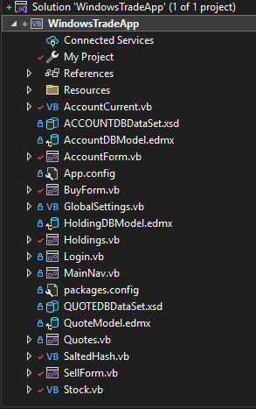
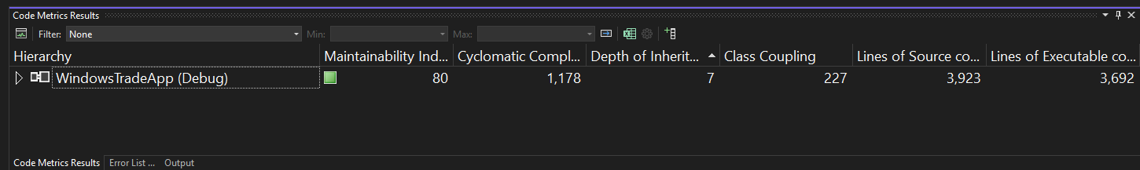
Source VB.NET WinForm Application Metrics

Slide 12
Demo: The Source .NET 4.8 VB.NET WinForms Application

Slide 13
The Target Blazor C# .NET 8 Web Application
Blazor Server Application for pure thin-clients
Faithful to the latest Microsoft technologies
Refactoring to a cleaner/modern app via ChatGTP directions
Migrating
From MS EntityFramework 6.4.4 to MS EntityFrameworkCore 8.0.2
Migrating from ADO.NET, to MS EntityFrameworkCore 8.0.2 (Account Form)
Clean UI, Business Logic and Data Tiers with ChatGTP help
A brand new, better app, modernized as a C# Blazor Web Application!

Slide 14
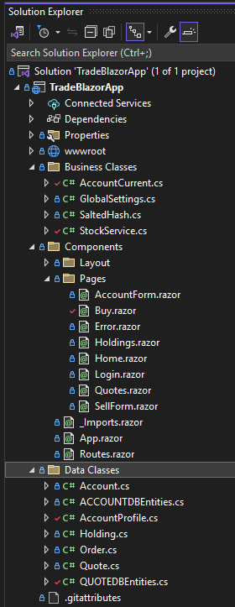
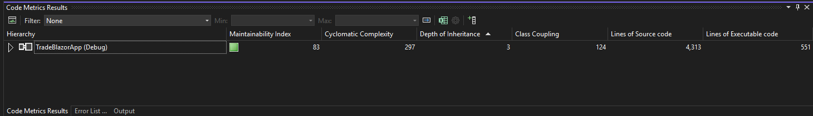
Source VB.NET WinForm Application Metrics
Code Metric | VB.NET Win Form App | Blazor C# Web App
Maintainability Index | 80 | 83
Cyclomatic Complexity | 1178 | 297
Depth of Inheritance | 7 | 3
Class Coupling | 227 | 124
Lines of Source | 3923 | 4313
Lines of Executable Code | 3692 | 551
Notes: Source code counts seem to include blank lines and comments
Blazor app has many more comments, which document ChatGTP interactions/manual fixups

Slide 15
Demo: The Target .NET 8 Blazor C# Web Application

Slide 16
Appendix

Slide 17
Resources
Git Projects and Docs
Link
UID/Password

Slide 18
Notes on Approach
Output
Documenting the process I follow will be primary output
Provide feedback to product team to help them understand the possibilities
Working code samples/VS projects showing the starting points and the results
Approach
Progressively migrate a VB.NET WinForms Application to Blazor/Razor
Start with simple application to document learning process via ChatGTP (is possible using ChatGTP alone, learning the basics of Blazor?)
Progressively add to application, more sophisticated layout, forms, business logic, data binding logic
Using ChatGTP to help me optimize the code
Document every ChatGPT interaction I have, and why, even those unproductive ones/dead ends (with explanation)
Document my learning process—how I, as a .NET developer, used ChatGTP to both learn Blazor, and use to migrate the application
My stumbling blocks, areas of confusion and how ChatGTP did/did not help me overcome them
Areas where I needed to go outside of ChatGTP to find answers or augment my learning
Document the time spent in each phase, including learning phase (how ChatGTP teaches me Blazor/Razor)
Document the automatics, and manual steps I needed where ChatGTP could not just “fill in the blanks”

Slide 19
Comments/Status for 2/21/2024
I have migrated Data Tier
I have migrated Business Tier
I am working on UI Tier (30% done)
I am refactoring, per ChatGTP Instructions
Lots of learnings
Really need to qualify each ChatGTP interaction with details of target app (Entity Framework version number, Blazor .NET 8, Server App, etc.
Can set context up front, but ChatGTP loses this after time, so need to reset.
The recommended Repeatable Steps from ChatGTP needed re-ordering
In retrospect: Start with DB layer, then Business Logic, then UI/Forms
ChatGTP recommended Business layer, then DB layer, then UI
It has trouble generating the right @using statements/imports
It has trouble with some simple directives such as InteractiveRenderMode = Server, required in all Razor components for event firing
It has trouble generating DB model classes that include composite keys
However, this might be fixed with better ChatGTP input to qualify
Overall:
It’s great.
It helped me learn both Entity Framework and Blazor, modernized my skills
It’s good at both Migration and Help with Debugging
I never had to use an external support forum like StackOverflow
I did find I needed several hours of MSLearn tutorials on Blazor
To get concepts down
Before blindly trying to start with a WinForm code migration
Once I did, things went pretty well, and this was a first app/migration experience
It cannot generate VS Solution or Project Files.
Requires a lot of individual interactions and cut/paste
This makes it less productive than a “complete” migration tool

