Slide 1
Cluster Analysis of Indianapolis neighborhood’s
dAne Dudley
Nov 2019

Slide 2
Background & Goal
A small family owned brewery located in the suburbs of Indianapolis is expanding and wants to relocate closer to the downtown area – specifically near Lucas Oil Stadium – home of the Indianapolis Colts.
This study identifies the neighborhoods of Indianapolis and their location to extract the venues and types of venues in each neighborhood.
The venue information per neighborhood is used in a Kmeans Cluster analysis to see what neighborhood and venues are near Lucas Oil Stadium.
The ultimate goal of this study is to analyze what type of competition the family will face if they decide to relocate near Lucas Oil Stadium.

Slide 3
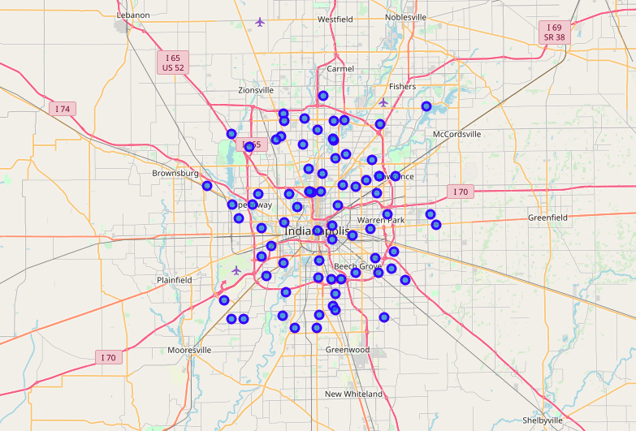
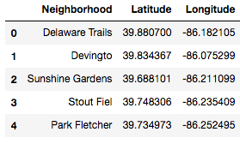
Datasets for Analysis
Snapshot of 5 Indianapolis Neighborhoods used in Study of 77 Total
Plotting All Indianapolis Neighborhoods

Slide 4
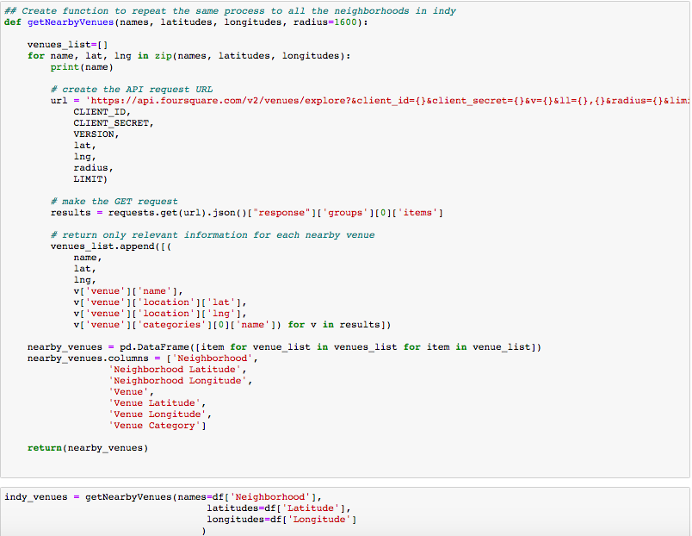
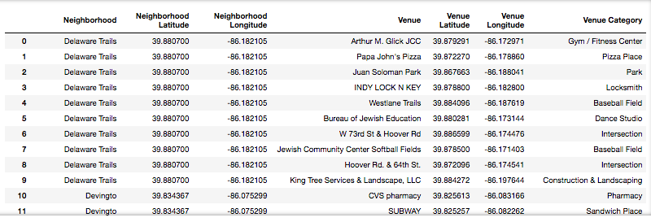
Using Foursquare Api to extract venue information in each neighborhood
Extracting data from Foursquare API
Example of first 12 venues extracted

Slide 5
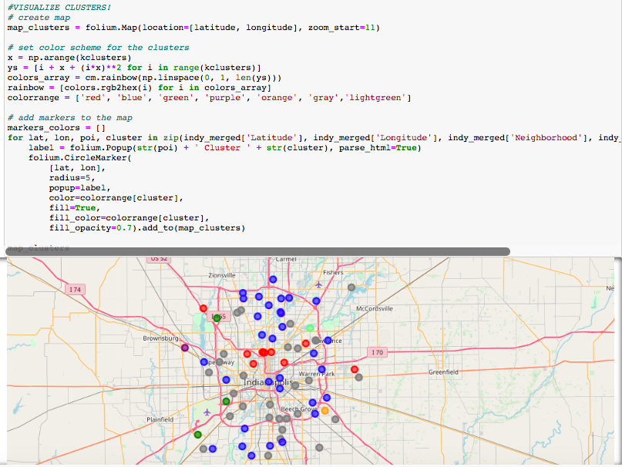
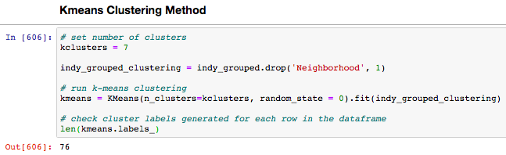
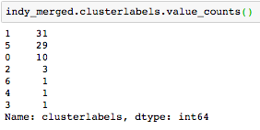
Results of Kmeans clustering
Each color represents a cluster (7 total)
Using Kmeans Clustering Algorithm to group neighborhoods into clusters based on venue cateorgry information
Count of Neighborhoods per cluster

Slide 6
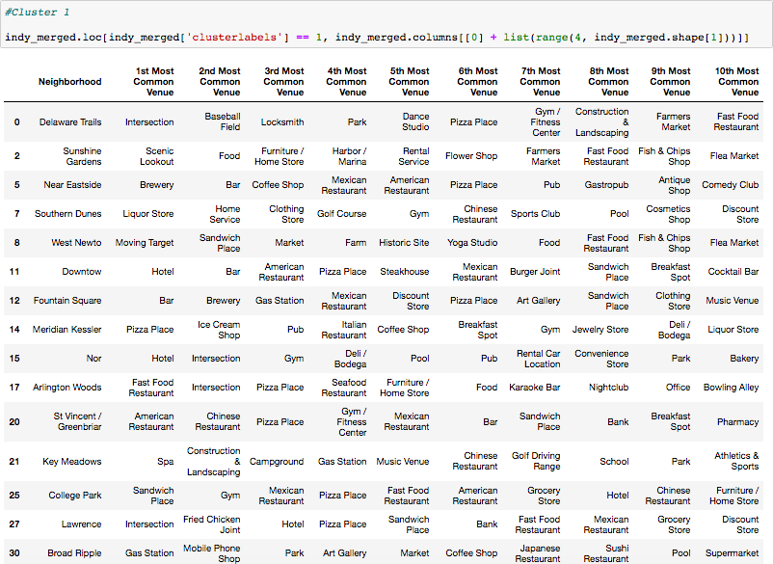
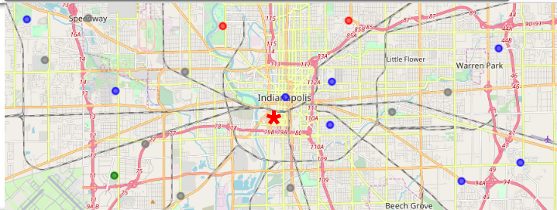
Lucas Oil Stadium would most likely in cluster #1 (blue color)
Dataframe of all neighborhoods in Cluster 1.
Red star: ~Lucas Oil Stadium location
3 closest neighborhoods: Near Eastside(a), Downtown (b), and Fountain Square(c)
a
b
c

Slide 7
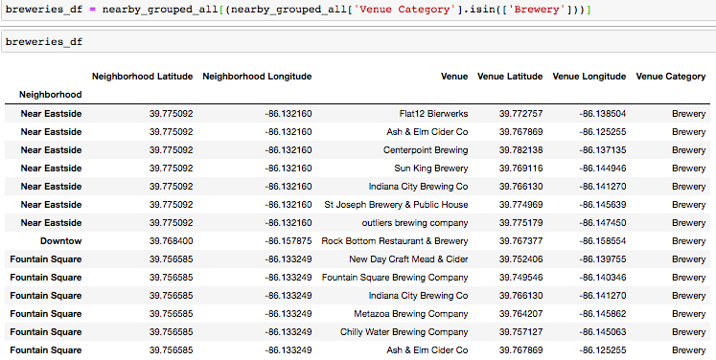
Analyzing the breweries in the 3 neighborhoods in the cluster near lucas oil stadium
*14 breweries extracted from Foursquare API
*All breweries within a 3 mile radius of Lucas Oil Stadium

Slide 8
Discussion Points
If family relocates brewery near Lucas Oil Stadium, it’ll most likely fall into Cluster 1
The three closest neighborhoods that are used to analyze nearby competition are Downtown, Near Eastside, and Fountain Square
Results show that there are at least 14 breweries in those neighborhoods combined. I limited the Foursquare API search to 1 mile, thus there could be more breweries extracted if the radius of search was increased.
The 14 breweries are within a 3 mile radius of Lucas Oil Stadium
The results show only one brewery in the Downtown Neighborhood
If the family decides to relocate near the stadium, they will face competiton from several of breweries. However, the Downtown Neighborhood offers a location of the least amount of breweries (one)

