Slide 1

Cathco Inventory Management System
David Dugan

Slide 2
System Objectives
The Cathco Inventory Management System will help retail store owners manage and track their product inventory
Managers will be able to create and remove items, and edit item information
Managers can create and delete employee accounts to login to the system
Employees can either be general – allowing for viewing only, or inventory – allowing for quantity adjustments
All changes to inventory quantity are logged with the employee’s ID and a timestamp for managers to view

Slide 3
Use Cases

Slide 4
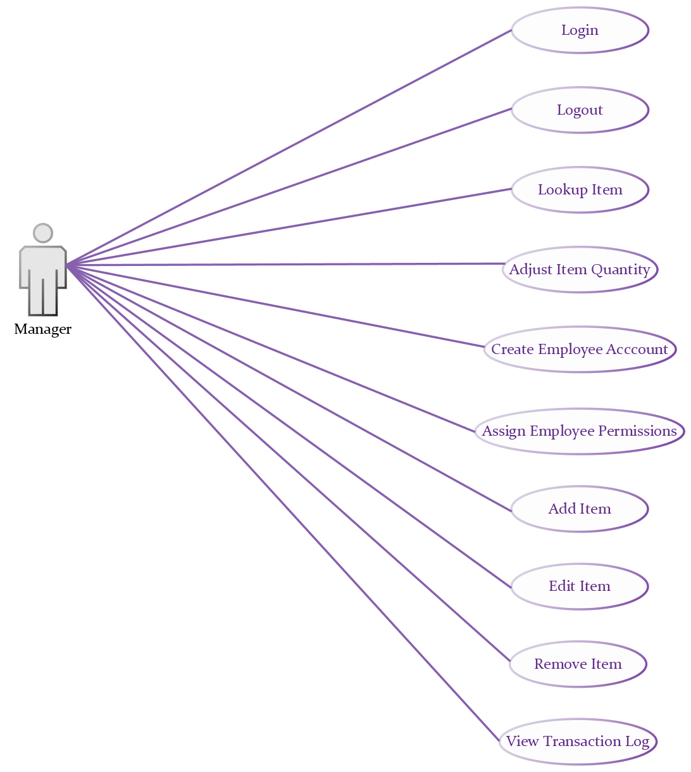

Slide 5
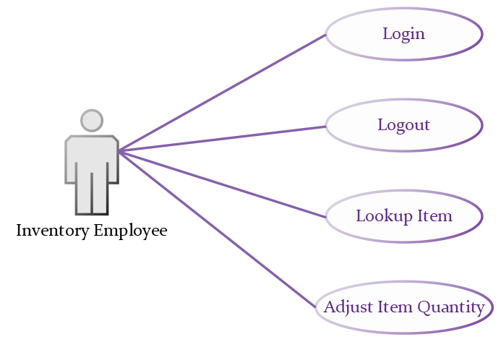

Slide 6
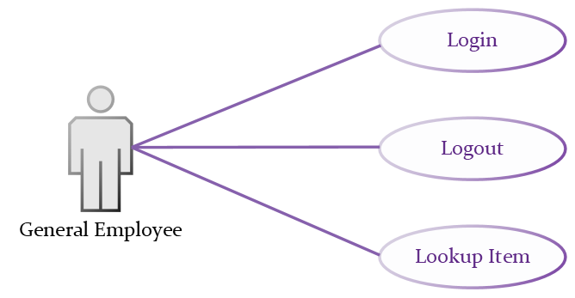

Slide 7

Test Cases

Slide 8
User | Case # | Description | Expected Results | Actual Results
Manager | 1.1 | Create Employee | New Employee account appears on list, employee can log into the system with the set ID and password
 | 1.2 | Change Employee Permissions | The employee gains or loses the ability to change inventory quantity
 | 1.3 | Remove Employee | Employee removed from list and login credentials no longer work
 | 1.4 | View Employees | A list of employees appears. Each employee name is clickable.
 | 1.5 | View Employee | The employee’s information appears, including a log of recent transactions made if any. Editing and removal options appear.

Slide 9
User | Case # | Description | Expected Result | Actual Result
Manager | 1.6 | Add Item | New Item appears in the system and can be searched for
 | 1.7 | Remove Item | Item is removed from the system and no longer appears
 | 1.8 | Edit Item | New Item information overrides previous in all searches
 | 1.9 | View Log | A log showing all inventory changes, who they were made by, and when they were made appears

Slide 10
User | Case # | Description | Expected Result | Actual Result
Inventory Employee | 2.1 | Adjust Item Quantity | New quantity appears in all searches. Transaction is added to the log with employee # and timestamp
 | 2.2 | View Item Screen | The ability to add, remove, and edit item information should not be available
 | 2.3 | Employee Screen | Should not have the ability to view the employee screen

Slide 11
User | Case # | Description | Expected Result | Actual Result
General Employee | 3.1 | Login | Grants access to the system with correct credentials
 | 3.2 | Item Search | All items matching the given search term appears in a list.
 | 3.3 | View Item | Item name and quantity on hand appear. Adjustment and editing options should not appear.
 | 3.4 | Employee Screen | Employee screen should not be accessible

Slide 12
Tools
Front End
Java
JavaFX
Database
MySQL
Development
Eclipse IDE
MySQL Workbench
GitHub

Slide 13
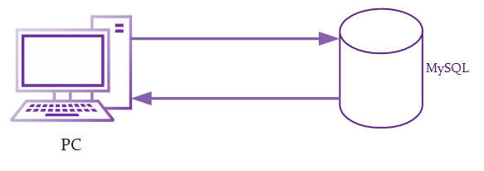
System Architecture

Slide 14
Data Flow

Slide 15
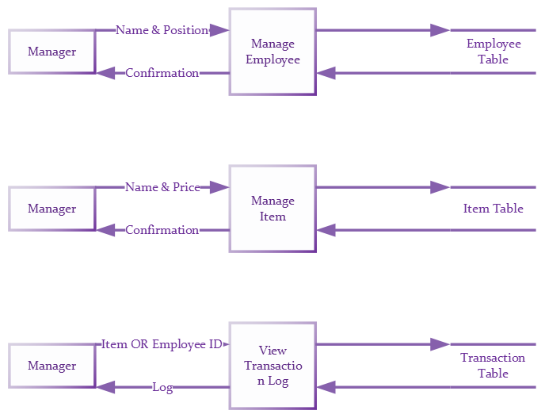

Slide 16
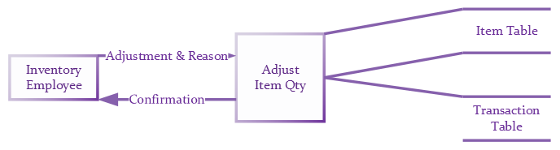

Slide 17


Slide 18
User Flow

Slide 19
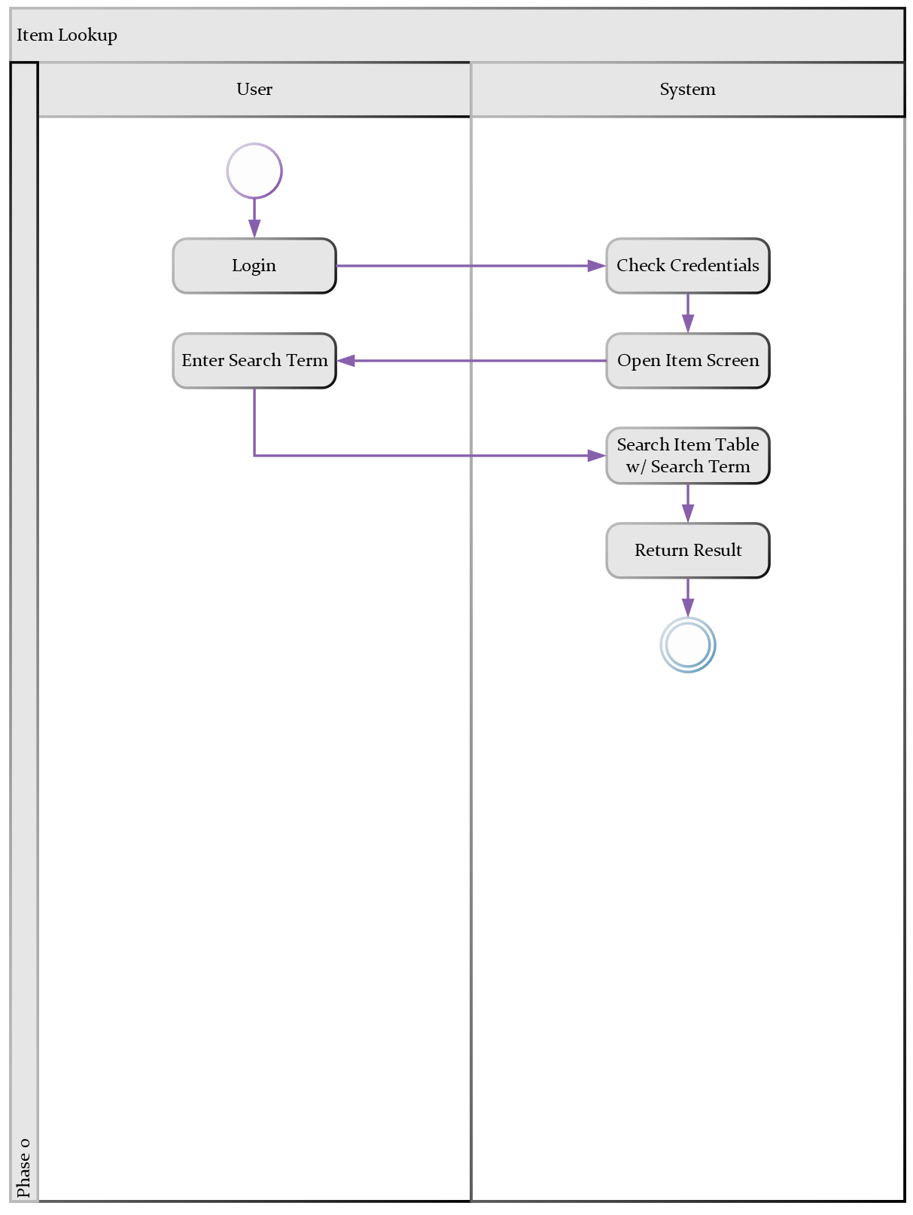

Slide 20
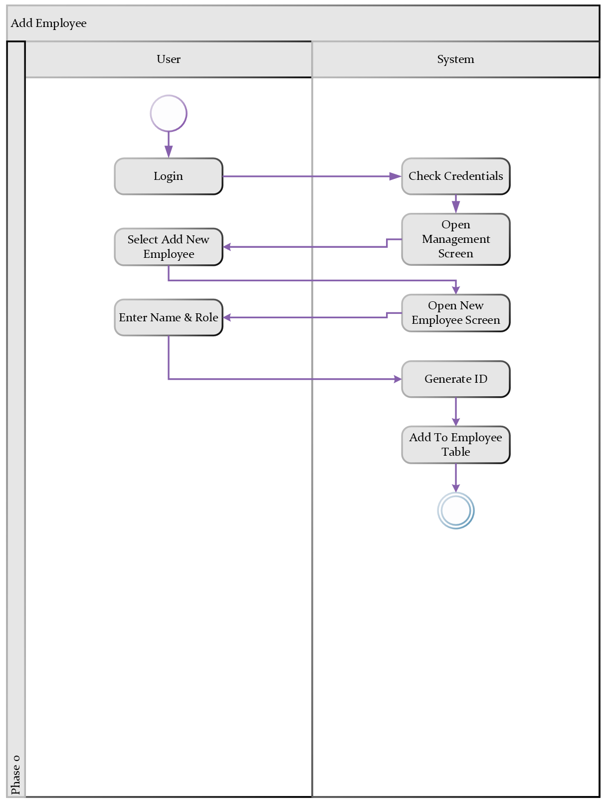

Slide 21
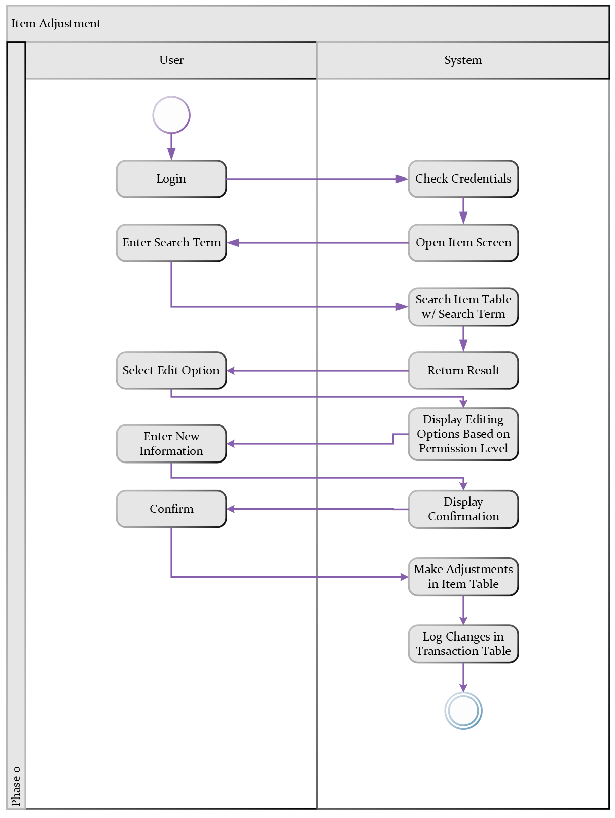

Slide 22
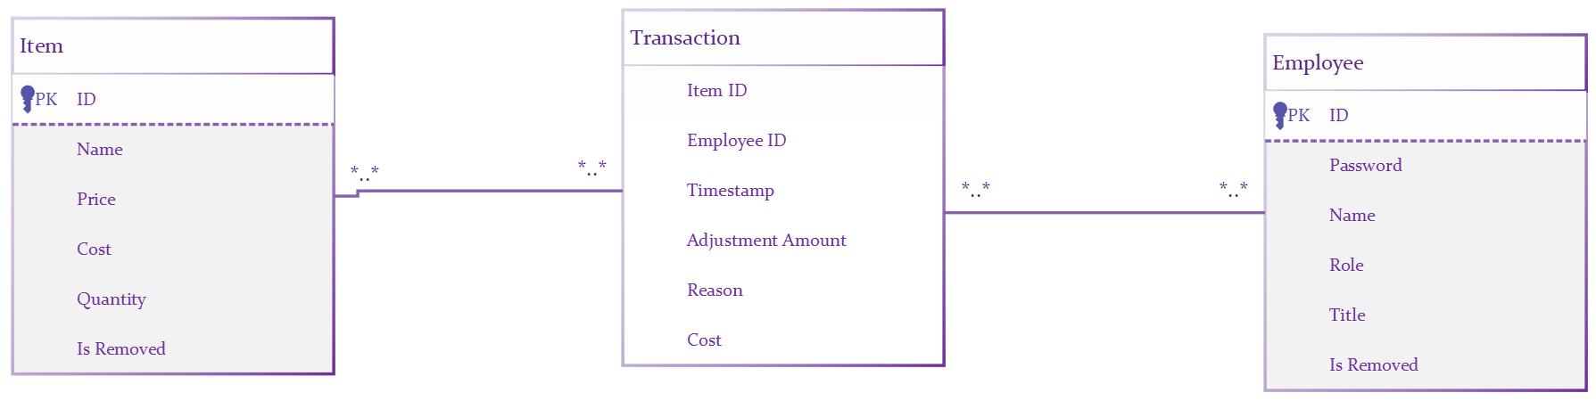
Database Design
Notes:
Add objects section after this.

Slide 23
Objects

Slide 24
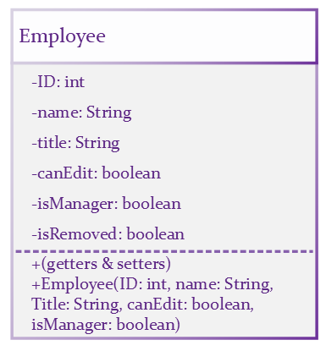

Slide 25
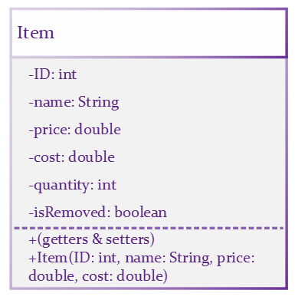

Slide 26
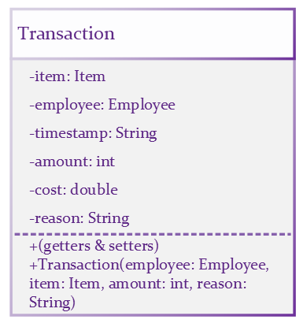

Slide 27
Screen Layouts

Slide 28
Employee ID
1924426
Password
********
Log In

Slide 29
Items
Management
Welcome, User!
Log Out
Lookup
Details
History
22345
Name
ID
Include Removed
Search

Slide 30
Items
Management
Welcome, User!
Log Out
Lookup
Details
History
Name: Lays Original Snack Bag
Item #: 22345
Price: $1.99
Cost: $0.90
On Hand: 24
Edit Item
Transaction History

Slide 31
Items
Management
Welcome, User!
Log Out
Lookup
Details
History
Employee ID | Employee Name | Reason | Quantity | Cost | Time
4154 | Ken Morgan | Shrink | -2 | -$1.80 | 11/17/23 11:21 AM
4548 | Nate Kent | Delivery | +24 | +$21.60 | 11/17/23 9:33 AM
4548 | Nate Kent | Damaged Return | -1 | -$0.90 | 11/17/23 7:52 AM

Slide 32
Items
Management
Welcome, User!
Log Out
Employees
Audit
ID | Name | Title | Can Adjust? | Manager
4154 | Ken Morgan | Cashier | No | No
3125 | Kristen Ford | Shift Supervisor | Yes | No
2717 | Ben Nichols | Customer Service Associate | No | No
2555 | Shannon May | Tech Desk Associate | No | No
Add Employee
Edit Employee
Remove Employee
Audit Log
Former Employees

Slide 33
Items
Management
Welcome, User!
Log Out
Employees
Audit
Transaction History for Kristen Ford (3125)
Item # | Item Name | Adjustment | Cost | Reason | Timestamp
07230 | Red File Folders | -1 | -$2.42 | Damaged | 11/17/23 11:27 AM
52151 | Logitech Wireless Mouse | +12 | +$67.54 | Delivery | 11/15/23 9:10 AM
55522 | Johnson Signature Office Chair | +1 | +$121.67 | Return | 11/15/23 4:39 PM
112112 | Lays BBQ Chips | -3 | -$3.07 | Expired | 11/14/23 10:02 AM

Slide 34

Project Plan

Slide 35
Phase | Task | Due Date | Status
1 | Build Database | 7/7 | COMPLETE
 | Create Template Pages | 7/7
 | Connect Database | 7/7 | COMPLETE
2 | Create Login Page | 7/7 | COMPLETE
 | Implement Login Functionality | 7/7
3 | Create Employee Management Screen | 7/14
 | Implement Employee Management Screen Population | 7/14
 | Implement Employee Add/Remove/Edit | 7/14
4 | Create Item Search Screen | 7/21

Slide 36
Phase | Task | Due Date | Status
4 | Implement Item Detail Population | 7/21
 | Implement Item Search Function | 7/21
 | Implement Item Add/Remove/Edit | 7/21
5 | Create and Populate Former Employees Screen | 7/28
 | Create and Populate Former Items Screen | 7/28
6 | Create Item Audit Table Screen | 7/28
 | Implement Item Audit Table Population | 7/28
 | Create Employee Audit Table Screen | 7/28
 | Implement Employee Audit Population | 7/28

Slide 37
Phase | Task | Due Date | Status
7 | Beautify Screens | 8/4
 | Implement Table Sorting Functionality | 8/4
 | Implement Clickable Employee & Item IDs | 8/4
8 | Submit Test Cases | 8/11
 | Submit Source Code | 8/11
 | Submit Finalized Deliverables | 8/11

