Slide 1

Conversational Wikipedia RAG
Duncan Earl / Capstone Design Review / October 15, 2026
Notes:
TARGET: 15 seconds | 0:00–0:15 of 7:00
SPEAKER SCRIPT
My project is a conversational chatbot for a local collection of Wikipedia articles. I’ll explain the problem, how the system works, and how four versions improved performance. My main focus was accuracy, followed by cost and response time.
REFERENCE NOTES — NOT PART OF THE SPOKEN SCRIPT
Sources: evaluation_results_v1.zip / v1_20261014_124445_598187/report.json; evaluation_results_v2.zip / v2_20261014_124852_253335/report.json; evaluation_results_v3.zip / v3_20261014_130348_329735/report.json; report(3).json for V4 (pricing timestamp 2026-10-14T18:58:36Z). All four runs use the same 50 test questions and corpus fingerprint. V1–V3 use the measured editions of the original programs; V4 uses Capstone_Project_Final_v4.py. Program hashes verified. This deck supersedes older V2/V3 results: current scores are 78%, 86%, 92%, 94%. No manual score overrides.

Slide 2
Project Overview
Develop a production-level chat bot for users to query a corpus of approximately 2,400 Wikipedia articles covering numerous topics
Design priorities, in order
1. Accuracy 2. Cost 3. Latency
Notes:
The goal was to move toward a production-level chatbot that lets someone ask questions across approximately 2,400 articles. I ranked the priorities deliberately: accuracy first, cost second, and latency third. Once the answers became more reliable, I looked for ways to reduce the cost of producing them.

Slide 3
The Problem
Finding answers across 2,400 Wikipedia articles is time-consuming, especially when questions require connecting facts across multiple articles.
Intended user
Example questions
Someone exploring the local collection
without manually reading every article.
“Who played Phoebe in Friends?”
“When was she born?”
“Which series costarred Lisa Kudrow and Jennifer Aniston?”
Why is this important? Getting a relevant, supported answer - or a clear statement of missing evidence - in a short period of time improves human productivity.
Notes:
The problem is the time required to find and connect information across a large collection. For example, a simple question like who played Phoebe in Friends could take a long time to answer if you have to read all 2400 pages. The RAG AI solution basically condenses that down to a few seconds to improve productivity.

Slide 4
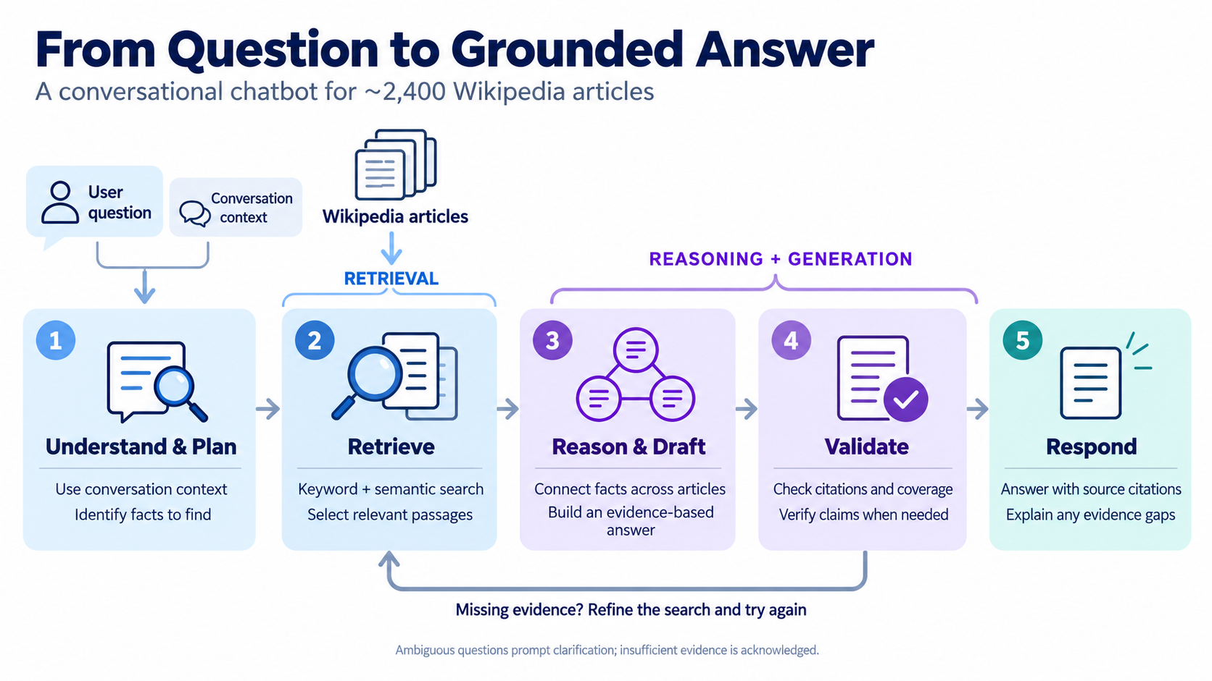
The Solution (high level)
Decomposition
Notes:
Here is the workflow at a high level. The chatbot first interprets the question using conversation context. For a question with several parts, it breaks the question into separate facts that need to be found, a step called decomposition. It then searches the articles using both BM25 keywords and semantic search. The model uses the selected passages to connect facts and draft an answer. The program checks the response and, when needed, uses another model call to verify its support. If something is missing, it can search again. Finally, it responds with citations or explains what it could not establish.

Slide 5
Solution Evolution (Checkpoint 8.1)
Model families stayed the same. Workflow and evidence handling changed from version 1 to 4.
Version | What changed | Why it helps
V1 | Search articles and answer with checked citations (basically 7.2) | Build the basic chatbot with links to evidence
V2 | Track context and needed facts; add checks of answer support | Check whether the evidence really supports the answer
V3 | Improved routing between simple and advanced model; keep facts already supported | Stay focused on the question; keep useful partial answers
V4 | Select better passages; check for missing answer parts | Find evidence for each part of a multipart question
Notes:
In a nutshell, the progression is basic answering, stronger checks, better planning, and better evidence selection.
That basic workflow was improved across four versions. I started with version 1, which was just the final program after checkpoint 7.2 and then I started making improvements.
Version one established the basic process: search the articles, generate an answer, and check its citations.
Version two better identified the list of facts list of facts needed to answer a question. It also added a separate check, when needed, of whether the retrieved passages actually supported the answer.
Version three improved planning by doing a better job of routing the questions to the simpler versus stronger model and keeping the plan focused on what the user actually asked. It connected each requested fact to an answer claim and could retain supported facts when a later step failed.
Version four continued to improve on partial answers. It had added verification steps to ensure evidence for all parts were found before submitting a final answer.

Slide 6
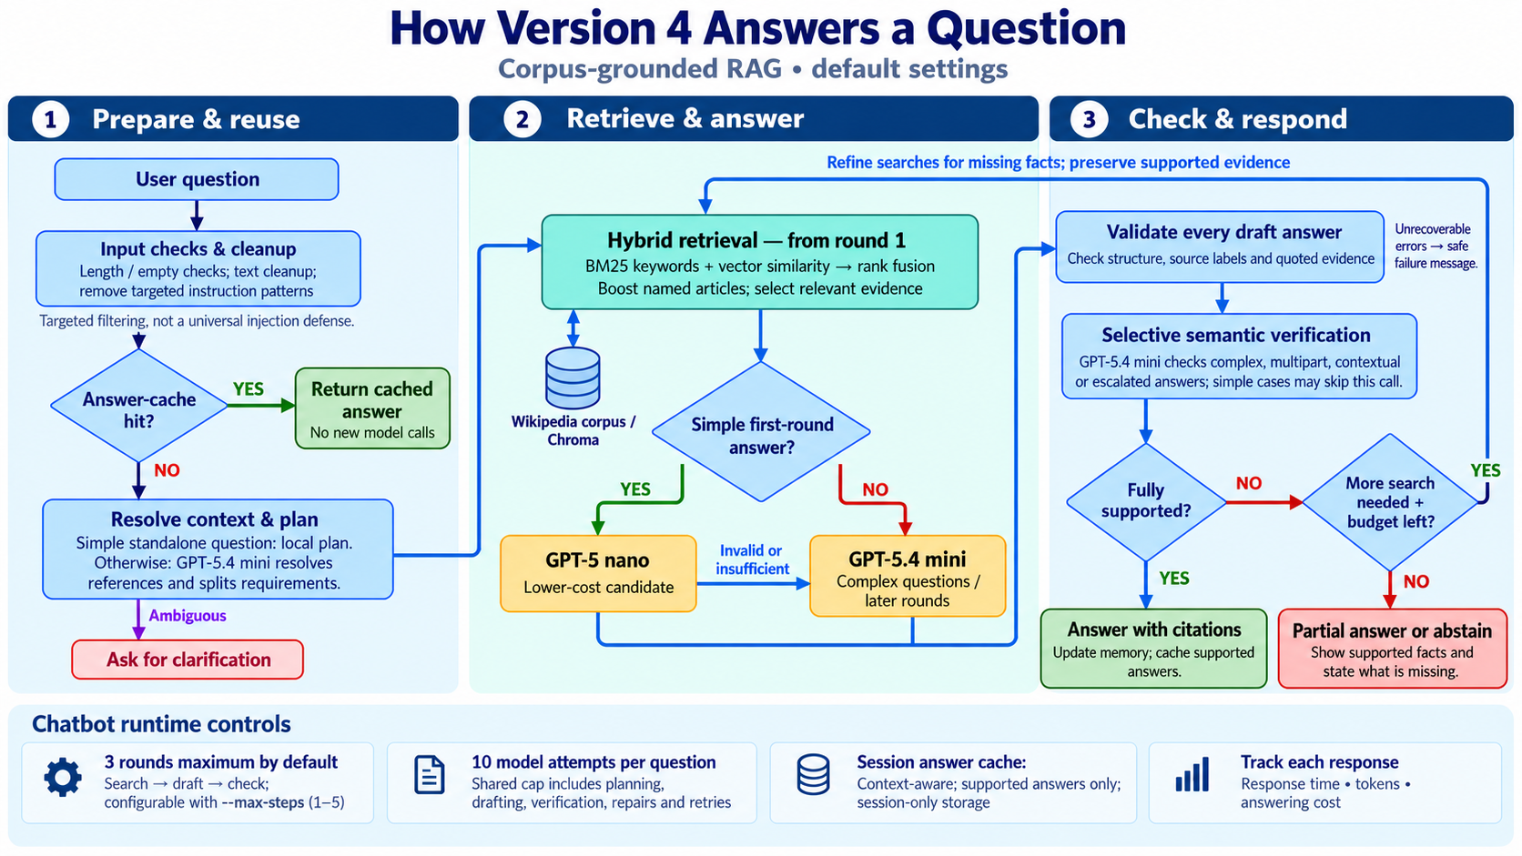
Retrieval and Evaluation (Final version: v4)
Notes:
With that said, here is a more detailed look at version 4 – the final version. This is broken into three boxes. On the left, the system checks the input and strips out problematic text, looks for cached answers, handles conversation context and history, etc. In the middle, it retrieves passages and chooses an answering model. Simple questions can start with the smaller model, while more demanding cases use the stronger model. On the right, it validates the draft and can request another search. Limits on search rounds and model calls keep the process bounded.

Slide 7
Evaluation Method and Built-In Reporting
Same 50 questions and corpus fingerprint across all four versions
Component | How the evaluation works
Test set | 33 single-article, 16 multi-article, 1 unanswerable
LLM judge | GPT-5.4-mini compares answers with references and evidence
Metrics | Correctness, grounding, source recall, latency, tokens, USD
Saved outputs | report.json, results.csv and human_review.json
Notes:
I compared all four versions using the same 50 questions and the same corpus. Thirty-three questions used one article, sixteen required multiple articles, and one tested whether the system would acknowledge missing information. A separate language model judged answers against reference answers and retrieved evidence. Answer caching was disabled during evaluation so repeated answers could not bypass the work. This gives a consistent comparison, although a model judge is imperfect and the small test set limits what we can conclude.

Slide 8
Accuracy Across Four Versions
Same 50 questions across four workflow versions
Version 4 had best accuracy.
Notes:
Accuracy improved from 78 percent in version one to 94 percent in version 4. The difference between versions three and four is just one additional passing question, but version 4 was the most accurate given the test set.

Slide 9
Cost and Latency Across Four Versions
Mean cost (US cents per question)
Median answer latency (seconds)
Design tradeoff: Version 4 traded slower responses for lower cost (and higher accuracy)
Aligned with priority order: accuracy first, cost second, latency third
Notes:
The cost and timing results show why the priority order matters. Version one was the cheapest and fastest, but it also had the lowest accuracy. Versions three and four then brought cost down. Compared with version three, version four cost about 2.5 percent less per question, while median response time increased from about 7.3 to 10.4 seconds. I preferred version four because accuracy came first and cost came second. This is an observed tradeoff. These runs do not prove that reducing cost caused the slower response.

Slide 10
More Details on Performance
Measured across 50 questions | V1 | V2 | V3 | V4
Answering LLM calls | 60 | 188 | 159 | 151
Mean calls per question | 1.20 | 3.76 | 3.18 | 3.02
LLM input tokens | 191,545 | 936,516 | 788,451 | 759,462
LLM output tokens | 12,509 | 43,973 | 16,075 | 15,808
Query embedding tokens | 1,267 | 2,778 | 3,001 | 2,943
Expected-article recall | 94.2% | 98.5% | 100.0% | 100.0%
Processing errors | 3 | 1 | 0 | 0
Best performance given stated priorities
Notes:
The detailed metrics help explain the overall pattern. From version two to version four, answering model calls fell from 188 to 151, and input tokens also declined. Processing errors dropped to zero in versions three and four. Both versions retrieved the expected articles in all scored cases. But finding the right article is only one step. The system still needs the relevant passage and must use it correctly to produce a complete answer.

Slide 11
Accuracy by Question Type
Question type | V1 | V2 | V3 | V4
Single article (33) | 29 / 33 | 31 / 33 | 29 / 33 | 31 / 33
Multiple articles (16) | 9 / 16 | 11 / 16 | 16 / 16 | 15 / 16
Unanswerable (1) | 1 / 1 | 1 / 1 | 1 / 1 | 1 / 1
Total (50) | 39 / 50 | 43 / 50 | 46 / 50 | 47 / 50
Notes:
Breaking the results down shows that progress was uneven. Version three answered all sixteen multiple-article questions correctly. Version four answered fifteen, but improved the single-article result from 29 to 31. This is a reminder to look beyond the headline percentage and check for regressions. All versions passed the unanswerable question, but one example is far too little to establish reliable behavior whenever evidence is missing.

Slide 12
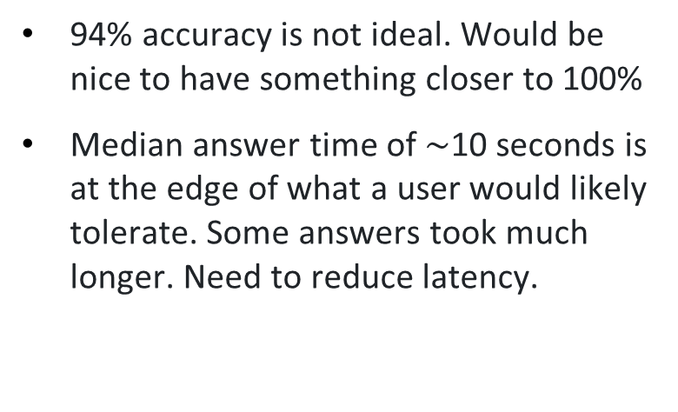
Limitations and Future Improvements
Observed gaps
Limits of this benchmark
94% accuracy is not ideal. Would be nice to have something closer to 100%
Median answer time of $\sim$10 seconds is at the edge of what a user would likely tolerate. Some answers took much longer. Need to reduce latency.
Only 50 questions informed development.
Improving accuracy for limited, static number of questions was like “teaching to the test.” Pointless to optimize further without a larger question set.
Cost of testing was high and this limited extent of testing.
Judge model should probably be higher than ChatGPT 5.4-mini
Notes:
There are still clear gaps. Ninety-four percent leaves incorrect answers, and response times around ten seconds may be too slow for some users. The bigger limitation is the evaluation itself. I repeatedly developed against the same 50 questions, which creates a risk of teaching to the test. My next step would be a larger, independently written test set with human-reviewed answers, more conversation tests, and more unanswerable questions. Repeated runs would also help separate consistent improvements from normal model and provider variability.
REFERENCE NOTES — NOT PART OF THE SPOKEN SCRIPT
Sources: evaluation_results_v1.zip / v1_20261014_124445_598187/report.json; evaluation_results_v2.zip / v2_20261014_124852_253335/report.json; evaluation_results_v3.zip / v3_20261014_130348_329735/report.json; report(3).json for V4 (pricing timestamp 2026-10-14T18:58:36Z). All four runs use the same 50 test questions and corpus fingerprint. V1–V3 use the measured editions of the original programs; V4 uses Capstone_Project_Final_v4.py. Program hashes verified. This deck supersedes older V2/V3 results: current scores are 78%, 86%, 92%, 94%. No manual score overrides.
Qufu wiki_025 and Pittsburgh wiki_026 are nonpasses in all four versions. Current V4 other failure: wiki_054, an inadequately grounded presidency-time relation. V3 other failures: wiki_013 and wiki_039. A correct-article hit does not guarantee the answer-bearing passage. Uploaded human review files contain unfilled human verdict fields. Corpus freshness is legacy_unknown in V2–V4. Scores rely on a model judge and an iterated development set; unseen questions and repeated matched runs are needed to estimate generalization and stability.

Slide 13
Questions
Thank you!
Notes:
TARGET: 10 seconds | 6:50–7:00 of 7:00
SPEAKER SCRIPT
The main lesson is that better planning and evidence handling can improve a chatbot without changing model families. Thank you. I’m happy to take questions.
REFERENCE NOTES — NOT PART OF THE SPOKEN SCRIPT

