Slide 1
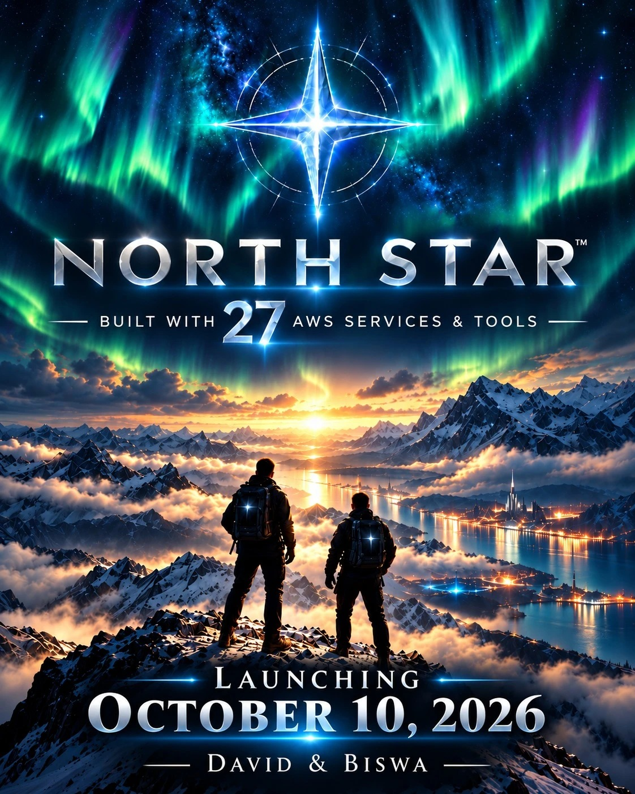

NORTH STAR
Your workday.
On course.
An employee assistant built with AI agents on AWS
David Dunmeyer and Biswa Samal
Agentic AI | IT Expert System
October 10, 2026
Notes:
DAVID. Good morning. This is North Star. Biswa built the agents and the data layer; I built the interface, the cloud deployment and the testing. By the end of this talk you will be using it on your own phones.

Slide 2





One simple question, four different systems
MONDAY, 8:55 AM
Can I take Friday off?
It should take ten seconds. It takes four systems, three logins and a 40-page PDF.
LOGIN 1
40 PAGES
LOGIN 2
LOGIN 3
HR system
The handbook
Task board
IT portal
your time-off balance
the rules, somewhere inside
what is due this week
the access you are still waiting for
The answers exist. Nobody has the map.
Notes:
DAVID. It's Monday, 8:55. I've got one question: can I take Friday off? To answer it I need the HR system for my balance, the handbook for the rules, and my task board to see what's due. Then I find out I can't start my task anyway, because I don't have VPN access, which is a fourth system and a form I've never filled in. None of that is hard. It's just scattered. Every company has the answers; nobody has the map. So we built one.

Slide 3








North Star: ask once, get one answer
A coordinator agent reads your question and hands it to the right specialists. They check your records and the handbook, then come back with one answer and show their work.
1
2
The model never does the maths
No answer without a source
Totals are added up in code, to the cent.
Policy answers name the document and section.
HR specialist
Developer specialist
3
4
Coordinator
IT specialist
Agents draft, people confirm
Your records only
Nothing is submitted until you click Confirm.
The app decides who you are, not the chat.
Built with Strands Agents and Amazon Nova 2 Lite on Amazon Bedrock
Notes:
BISWA. North Star isn't one chatbot. It's a team. A coordinator agent listens to the request and decides who should handle it. Behind it are three specialists: HR, developer work, and IT. Each can only touch its own tools, and each can only see the signed-in employee's records. Four rules shaped every decision, and these are them. The first and third matter most: the model never does the maths, and an agent can draft but only a person can confirm.

Slide 4





How it works
Employee
phone or laptop
Coordinator agent
decides which specialists to ask
Streamlit app
on Amazon EC2; sets who you are
IT specialist
incidents, access, changes; drafts only
Developer specialist
projects and tasks
HR specialist
PTO, expenses, jobs, policy
Dashboard and Confirm
app code: reads the tiles, writes confirmed requests
Amazon DynamoDB
employee records and confirmed requests
Bedrock Knowledge Base
policies, with citations
All four agents are Strands agents running Amazon Nova 2 Lite on Amazon Bedrock. Each reaches only its own tools and the signed-in employee's records.
Notes:
BISWA. Here is the path a question takes. The employee types into the Streamlit app, which runs on EC2 and decides who they are. The coordinator picks the specialists. All four are separate Strands agents, and each one calls Amazon Nova 2 Lite on Bedrock. IT and Developer read DynamoDB. HR reads DynamoDB and searches the Bedrock Knowledge Base for policy. Look at the box on the bottom left: that is plain application code, not an agent. It reads the numbers for the dashboard tiles straight from DynamoDB, and it is the only thing that writes a request. Confirm uses a conditional write, so one draft can only ever become one record.

Slide 5





Built with 27 AWS tools and services
AI AND AGENTS
DATA AND STORAGE
HOSTING
Amazon Bedrock
Amazon Nova 2 Lite
Amazon DynamoDB
Amazon S3
Amazon EC2
Amazon Linux 2023
Bedrock Knowledge Bases
Amazon S3 Vectors
Amazon EBS
Elastic IP
Titan Text Embeddings V2
Strands Agents
VPC security group
OPERATIONS, FROM OUR LAST PROJECT
SECURITY AND ACCESS
DEVELOPER TOOLS
EventBridge Scheduler
AWS Lambda
AWS IAM
AWS STS
AWS Systems Manager
AWS CLI v2
SDK for Python (Boto3)
Amazon SNS
Amazon SQS
Management Console
AWS CloudShell
CloudWatch Logs
CloudFormation and SAM
AWS Budgets
Notes:
BISWA. Twenty-seven AWS tools and services in six groups. Don't read them all out. Point at three: Bedrock with Nova 2 Lite is the brain of every agent; DynamoDB holds every record; and the whole operations group on the bottom left came from our previous project.

Slide 6
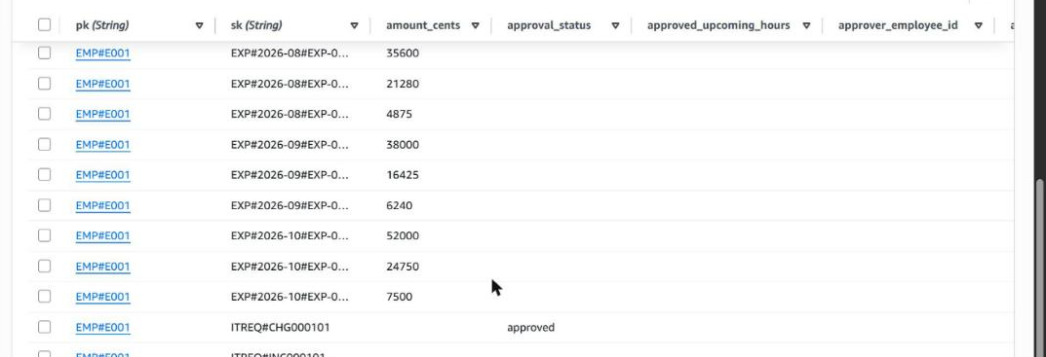
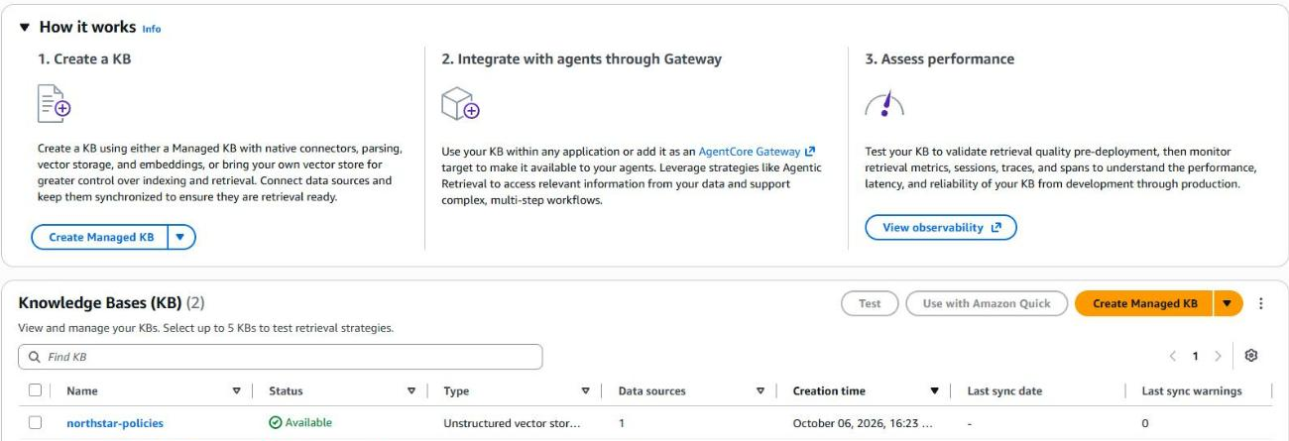
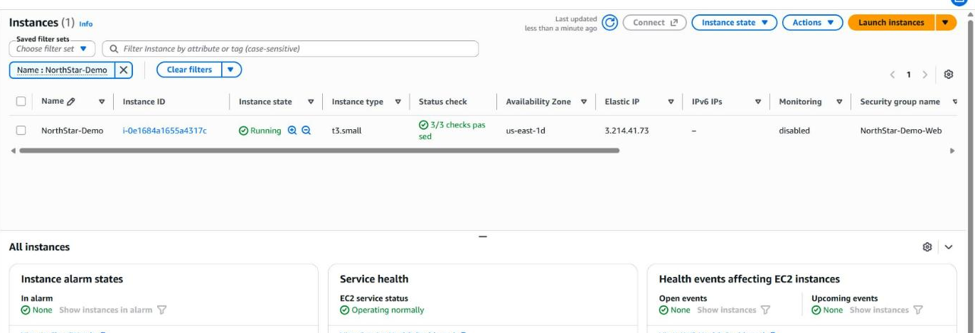
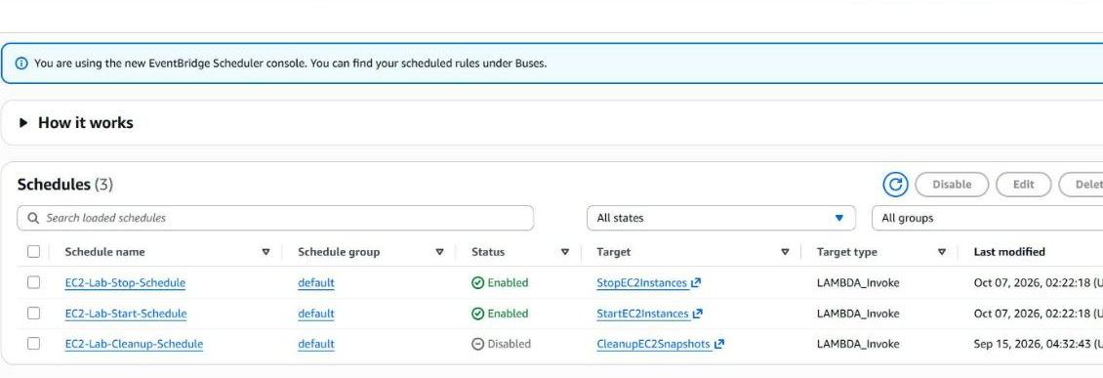
Inside our AWS account
AMAZON DYNAMODB one employee's records, one query
BEDROCK KNOWLEDGE BASE the policy documents, available
AMAZON EC2 the demo server, running, 3 of 3 checks
EVENTBRIDGE SCHEDULER from our last project
Our last project runs this one: its scheduler starts the server at 8:00 AM and stops it at 6:00 PM, and every start pulls the latest code from GitHub.
Notes:
DAVID. This is the real thing in the AWS console, not a diagram. Top left: one DynamoDB query returns all of David's records, because every item for an employee shares a partition key. Top right: the Bedrock Knowledge Base that holds the policy documents. Bottom left: the EC2 server running the site you are about to use. Bottom right: the schedules. That last one is the part I like most. For our last AWS project we built an EC2 scheduler. For North Star we didn't start over: the demo server carries the same tag, so that automation powered it on at 8 this morning and will shut it down at 6 tonight. It also became our deployment process, because the app pulls the latest code from GitHub every time it starts.

Slide 7


Live demo
LIVE
How much PTO do I have, and what can I carry over?
two sources, one answer, with a citation
1
WATCH FOR
Summarize my October expenses.
exact totals, calculated in code
The line under each answer: who was asked, and how long it took
2
Give me my PTO, check my projects, and look for my open tickets.
all three specialists
The policy citation chip
3
The hand-offs panel
I need AWS sandbox access through October 30 for load testing.
a draft, then Confirm
4
Nothing is sent until Confirm is clicked
Show me Kush's expenses. What is our parental leave entitlement?
the limits it keeps
5
Notes:
DAVID drives, BISWA narrates. Switch to the browser now. Sign in as David FIRST so the conversation is fresh. Ask the five questions in order. After question 3, pause on the line under the answer and open 'How North Star answered' to show the three hand-offs. For question 4, show the draft card, click Confirm, then click it again to show nothing new is created. Say the rule before each one. If Bedrock is slow, keep talking through what the audience should see; do not wait in silence. Close the demo by saying the numbers out loud, since there is no results slide: we tested it with 30 cases written before the agents existed; the first run passed 24 and found a wrong dollar figure and a missing refusal; after fixes it passed all 30, with a typical answer in under three seconds.

Slide 8

What it cost us, and what it would cost a corporation
WHAT IT COST US
A LARGE COMPANY, OUR ESTIMATE
$1.91
$300K to $500K
of AWS usage, October 6 to 9. We paid $0: AWS credits covered it.
for a first production release: about 6 people for 3 to 6 months.
Amazon Bedrock (the model):
$0.74
Live connections to the real HR, project and IT systems
Amazon EC2 server:
$0.66
Single sign-on, security and privacy review
Disk and public address:
$0.51
Testing, support and rollout to every employee
DynamoDB and S3:
under 1 cent
Then under $3,000 a month in model usage for 5,000 employees
Two people; the core was built in one day
Left: actual figures from AWS Cost Explorer for the hosting account. Right: our estimate, assuming loaded staff cost near $85 an hour, 5 questions per employee per working day, and under half a cent per question.
Notes:
DAVID. Here is what it really cost. On the left are actual figures from AWS Cost Explorer for the hosting account, October 6 through 9: a dollar ninety-one of usage, mostly the model and the server, and all of it covered by AWS credits, so we paid nothing. On the right is our own estimate, not a quote, of what a large company would spend to put the same idea into production. The agents are not the expensive part. The money goes on connecting to the real HR, project and IT systems, on single sign-on, on security and privacy review, and on testing and support. Say clearly that the right-hand side is an estimate and the assumptions are on the slide. The point: the technology is now cheap enough for two students to build in a day; what a company pays for is trust and integration.

Slide 9




Your turn: try it
1
2
3
Scan the code
Enter your first name
Ask it about your workday
TRY ASKING
“What's on my plate this week, and can I take Friday off?”
“Can I wear jeans to a client meeting on Friday?”
“Summarize my September expenses.”
3.214.41.73
Everything in it is fictional. The server is on until 6:00 PM Central.
Notes:
DAVID. Now it's your turn. Scan the code, type your first name, and ask it anything about your workday. Each of you has your own profile with your own numbers. The three questions on the slide are good ones to start with. Leave this slide up while people try it, then move to questions.

Slide 10

Questions?
David Dunmeyer and Biswa Samal
github.com/ddunmeyer/NorthStar
Still open: scan to try it
Your workday. On course.
Notes:
BOTH. Take questions. Likely ones: Is the data real? (No, all fictional.) Could it connect to real Workday or Jira? (Yes, through MCP; that is the main next step, along with real sign-in and running the agents on Bedrock AgentCore.) How did you use AI? (Biswa to learn step by step, David to build while keeping the decisions; both checked its work with a real phone and a 30-case test run.) Where does the corporate estimate come from? (Our own assumptions, shown on the cost slide; it is not a quote.)

