Slide 1

Machine Learning
Is Distracting

Slide 2

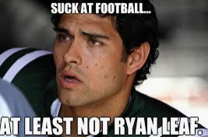
Maybe we should study why college football Quarterbacks succeed in college, but not in college?
Heath Shuler
Tim Couch
Jamarcus Russell
Baker Mayfield
Ryan Leaf
Johnny Manziel
Todd Marinovich

Slide 3
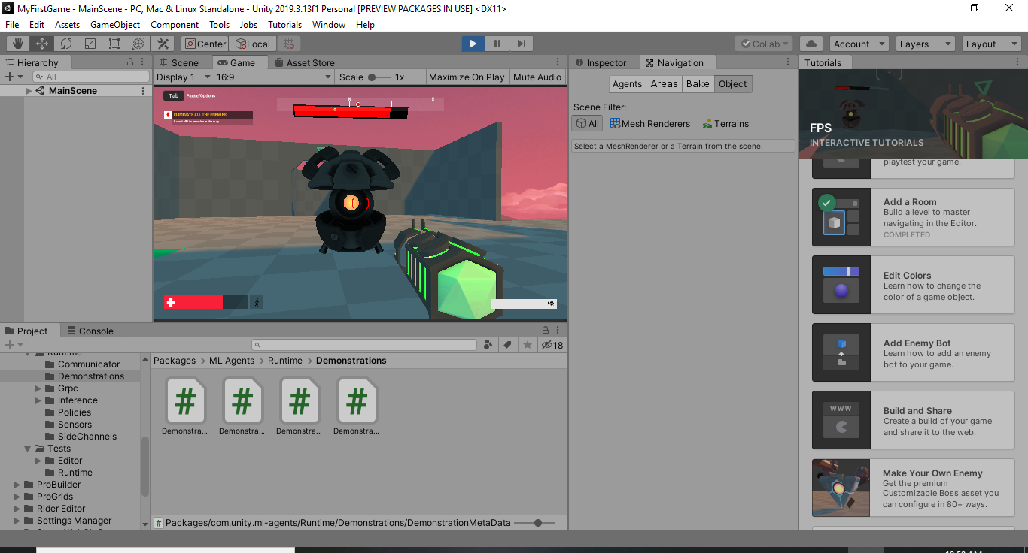
Maybe we should add ML to a 3D game? Unity is pretty cool

Slide 4
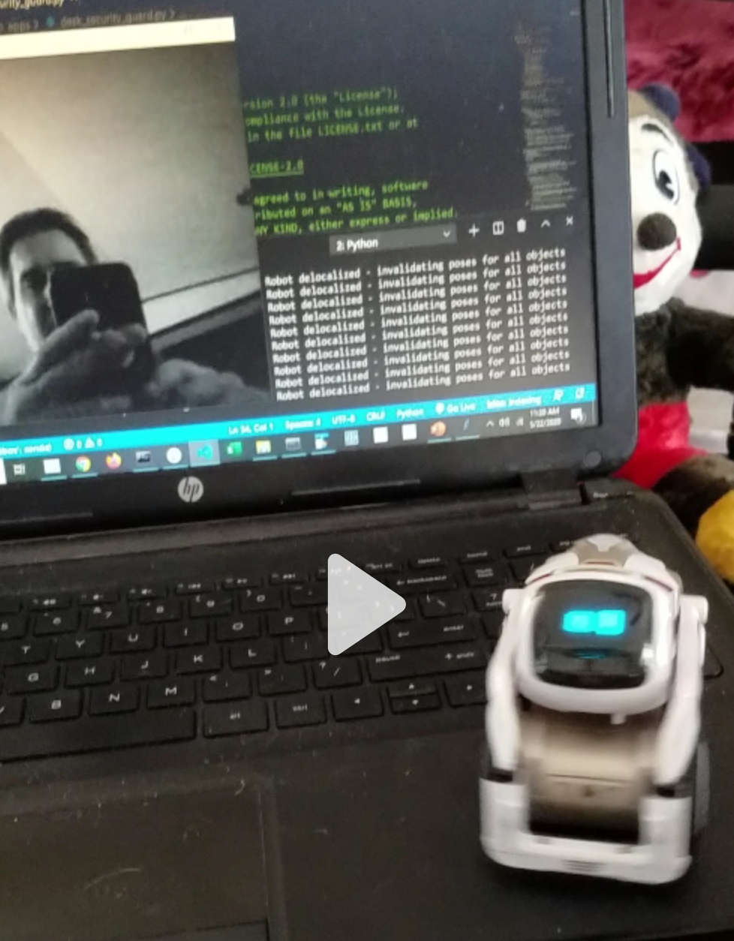
Maybe we should study Convolutional Neural Networks and figure out how my robot can see me?

Slide 5
Maybe we should start small and look at how CNN does vs. a flat NN?
Simply understood: CNNs glide over an image, learning as it goes instead of processing the whole image as it learns. Is that better? It certainly allows for processing larger images.
The important part is not the training but how the model reacts to the real world.
Let’s try out some user input with MNIST.

