Slide 1
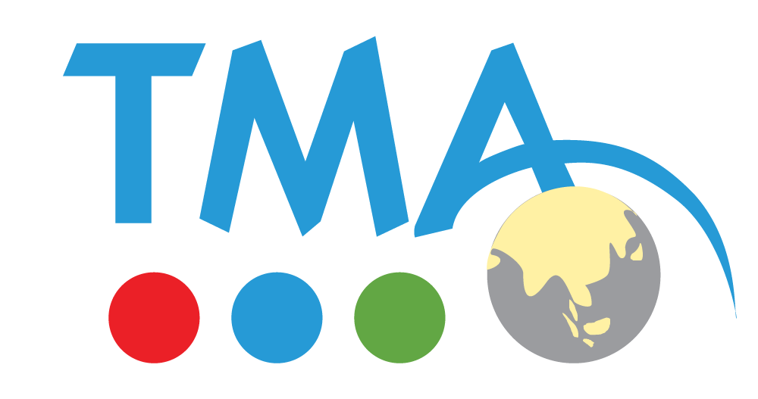
Final Project Report
TMA Internship
Topic: Healthcare Chatbot

Slide 2
Table of contents
01
02
04
05
03
Overview
Project Requirements and Objectives
Technology Analysis and Selection
System Architecture and Product
Product Demo and Future Development

Slide 3
01
Overview

Slide 4
Project Background and Motivation
Chatbots are potential tools for reducing workload and providing 24/7 operational capabilities.
This project aims to apply chatbots to automate customer service at clinics, enhance user experience, and optimize operational efficiency.

Slide 5



Chatbots in Healthcare
Quickly provide information about appointment schedules, services, and doctors.
Reduce workload for customer support staff.
Support data management and send reminders to patients via automated notifications.

Slide 6
02
Project Requirements

Slide 7
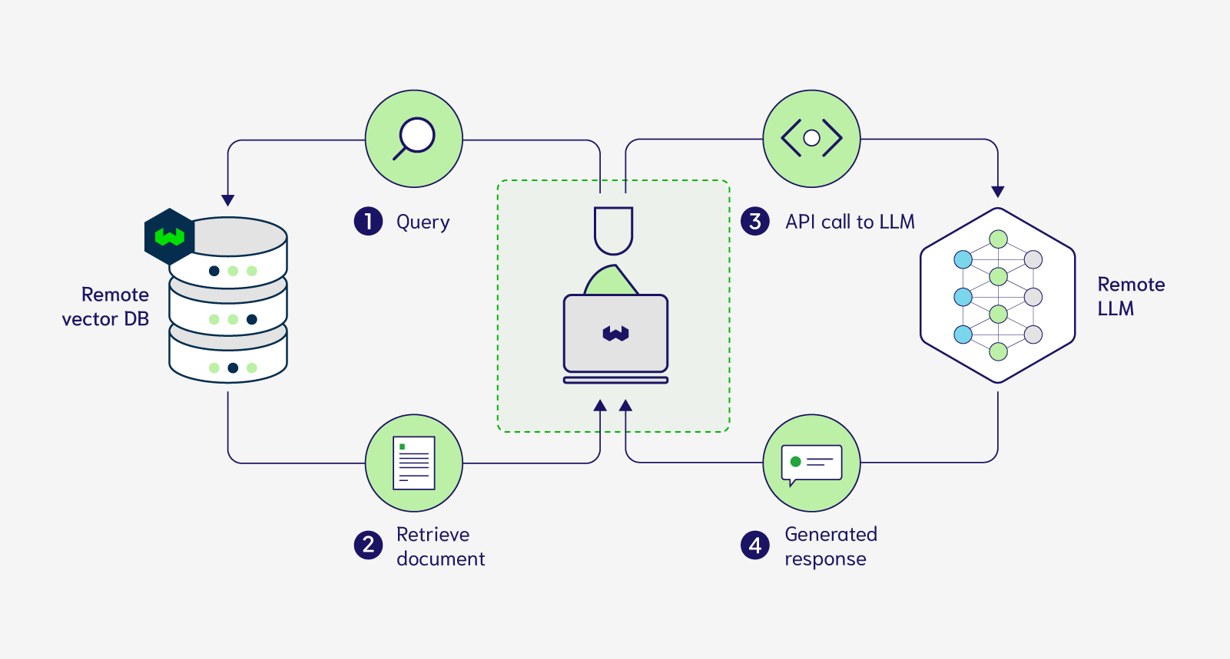
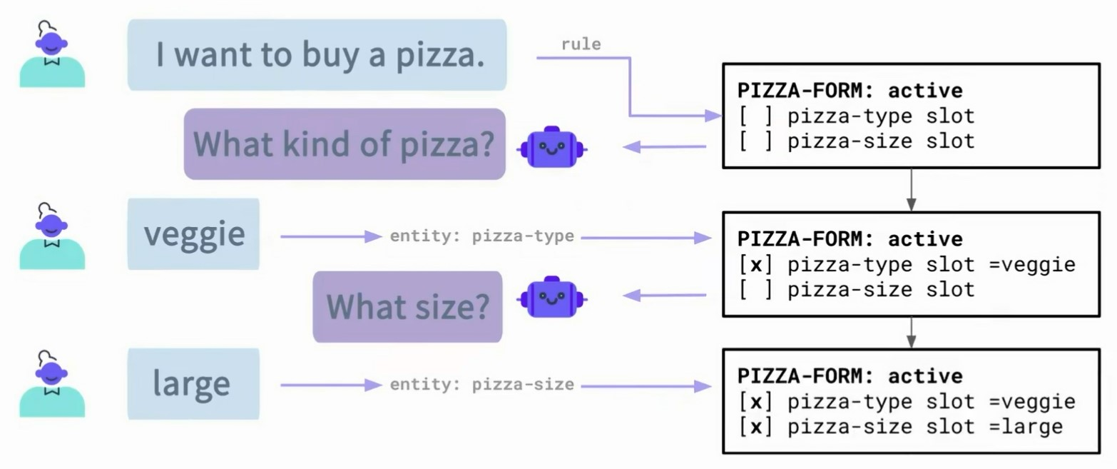
Detailed Problem Description
Develop a chatbot capable of automatic responses based on available documents.
Manage conversation content easily with flexible customization.

Slide 8
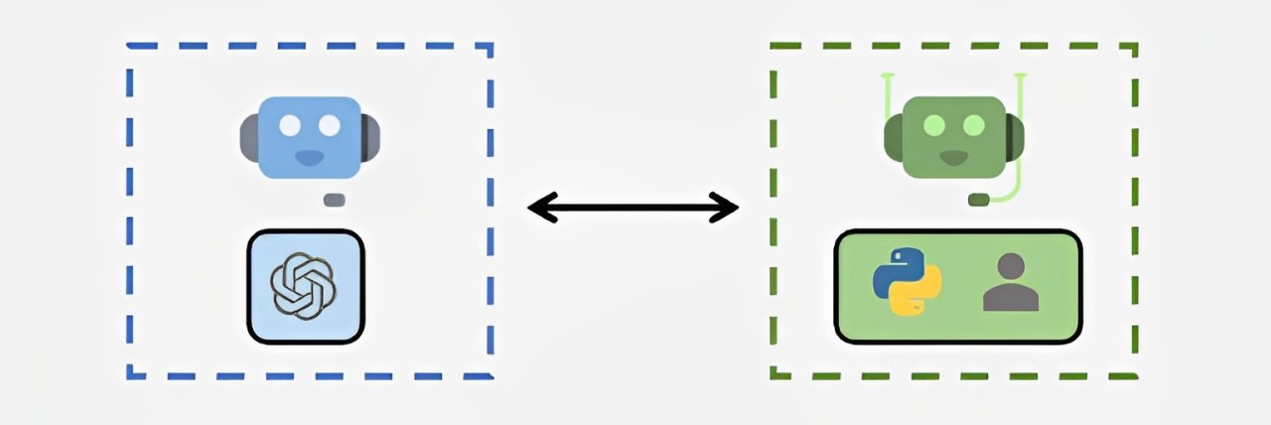
Detailed Problem Description
Integrate AI models to improve accuracy in answering questions.
Support appointment scheduling and SMS notifications.
Store and manage relevant data in a database.

Slide 9
Final Objectives
Improve customer experience through fast and accurate responses.
Reduce operational costs by automating support processes.
Effectively integrate AI technologies into the healthcare sector.

Slide 10
03
Technology Analysis and Selection

Slide 11
Overview of Frameworks and Platforms
Langflow: A framework supporting visual design, suitable for simple chatbots.
Vector Shift: A powerful no-code platform, easy to deploy and integrate with APIs.
Rasa Open Source: A coding-intensive framework but robust for multi-channel chatbots and complex context management.

Slide 12
Reason for Choosing Rasa Open Source
Effectively meets project requirements in context management, AI integration, and scalability.
Supports deploying complex chatbots and multi-channel integration.
Easy to integrate with other APIs.

Slide 13
04
System Architecture and Product

Slide 14

Context and Application
The product is an automated appointment booking solution designed for clinics. It streamlines scheduling, reduces staff workload, and improves patient experience through chatbot technology.

Slide 15
Overall Architecture Description
The system is designed to optimize customer interactions, appointment management, and AI integration. It consists of the following key components:
Rasa Open Source Agent: Handles customer requests based on pre-trained data.
RAG Application: Processes inquiries using clinic documents.
Database: Stores and retrieves appointment-related information.
SMS Notification: Sends updates about appointment statuses to patients.

Slide 16
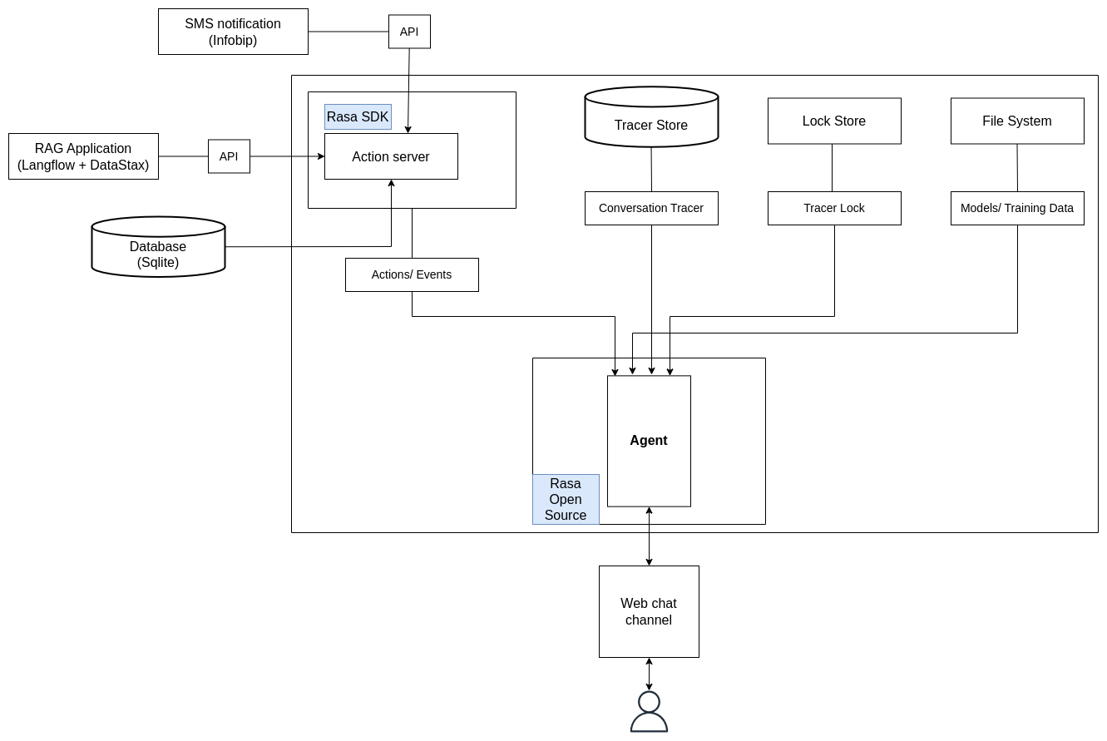
Overall Architecture Description
Chatbot architecture

Slide 17
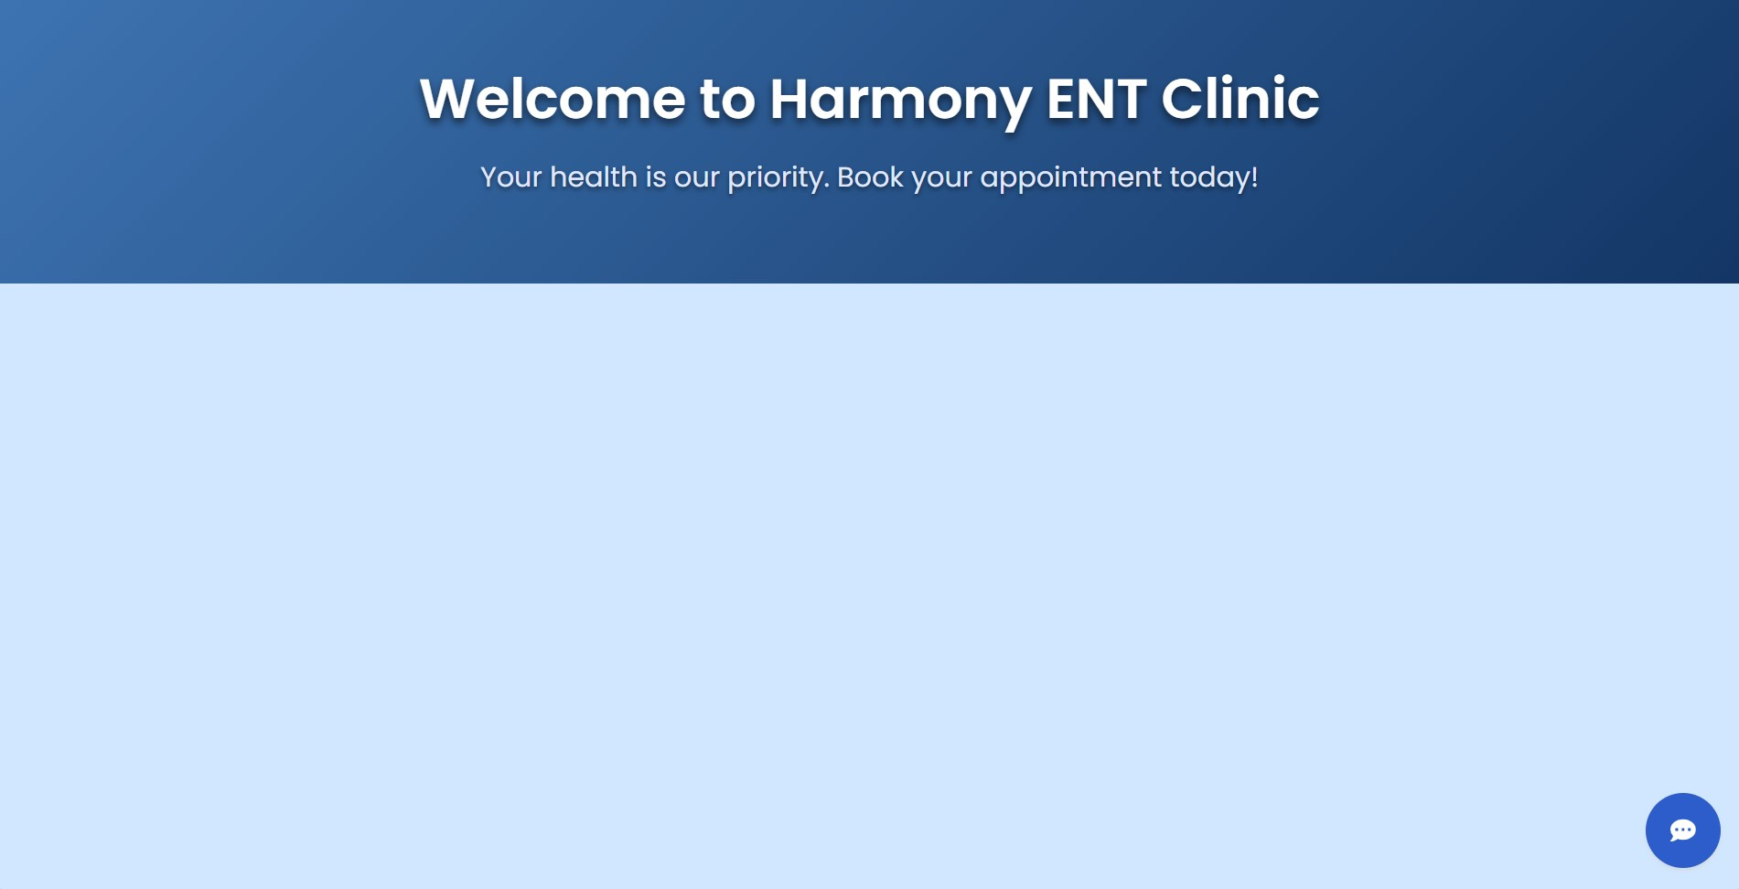
Key Features
Interface: A simple, user-friendly website that displays clinic information and supports appointment scheduling.

Slide 18
Key Features
Answer customer questions about clinic services, working hours, and doctors.
Schedule/ Search/ Cancel appointments and send SMS notifications.
Store appointment information in the database for easy management.

Slide 19
05
Product Demo and Future Development

Slide 20
Demo Highlights
Demonstration of key features:
Booking an appointment.
Searching for appointment details.
Deleting an appointment.
Answer questions about the clinic.
Basic conversation.

Slide 21
Demo Highlights
Video showcasing the chatbot’s functionality: link.

Slide 22
Future Development Directions
Enhance the scheduling system to detect and resolve conflicts, such as overlapping appointment times or bookings outside working hours.
Enhance the ability to recommend specialists for specific medical conditions.

Slide 23
Thanks for your listening!

