Slide 1
Kidney Cancer Classification Model Using Deep Learning
Joseph Neumann, Dr. Binlin Wu, Dr. Yulei Pang

Slide 2
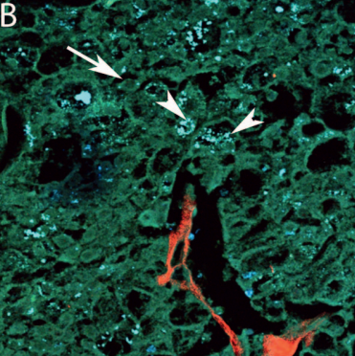
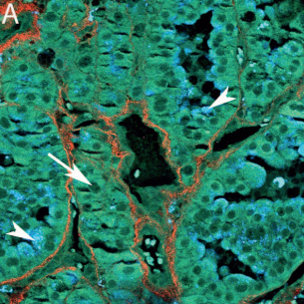
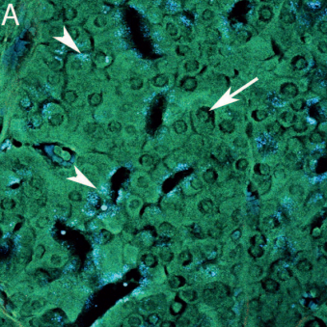
Kidney Cancer: A Primer
Either benign or malignant
Benign:
oncocytoma
Malignant:
chrCC
Eosinophilic cytoplasm variant is the main problem

Slide 3
Data Collection
Additional transformations
tensor([[[0.0314, 0.0353, 0.0431, ..., 0.0314, 0.0314, 0.0353], [0.0314, 0.0471, 0.0353, ..., 0.0353, 0.0392, 0.0353], [0.0353, 0.0314, 0.0314, ..., 0.0353, 0.0314, 0.0314], ..., [0.0314, 0.0627, 0.0392, ..., 0.0314, 0.0314, 0.0353], [0.0314, 0.0627, 0.0392, ..., ]
Tumor is benign
… *
0
Source: Exploring Multiphoton Microscopy as a Novel Tool to Differentiate
Chromophobe Renal Cell Carcinoma From Oncocytoma in Fixed Tissue Sections

Slide 4
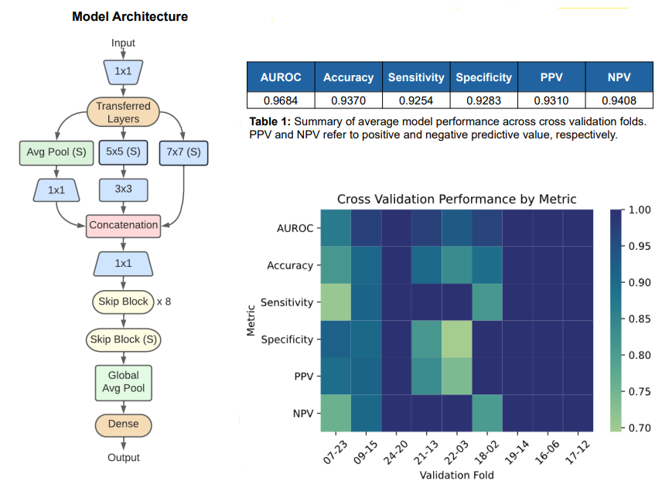
Data Visualization Goals
Demonstrate strengths and weaknesses of current model
Accuracy and performance metrics
Relative performance

