Slide 1
Introduction of ETL Automation
Version 2.5
By Jet Wu, Consultant
NCR Copyright© 2001-2002

Slide 2
What is ETL Automation?
In Data Warehouse, ETL means Extraction, Transformation, Loading
  Extraction
    Extract data from the source database into a flat data file.
    It occurs in external source environment.
  Transformation
    Transform data from flat data file to different format or from one table to another table in different data type.
    It may occur in external source or in DW, usually in DW environment.
  Loading
    Load the data from flat data file into Data Warehouse.
    It occurs in DW environment.
  Sometimes, it is called ELT.
Automation Scheme for ETL
  How do we make it automatically?

Slide 3
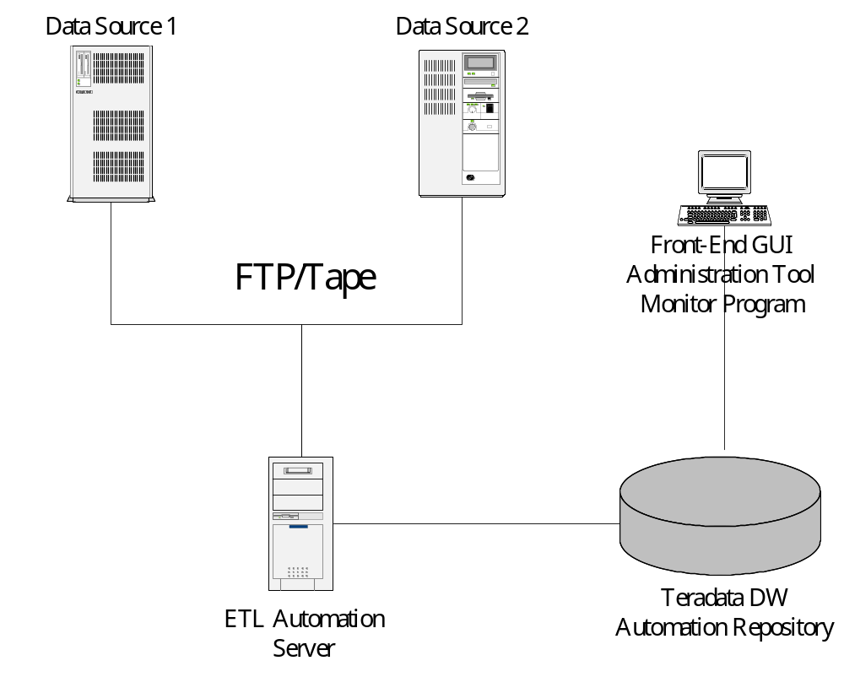
ETL Automation Structure

Slide 4
ETL Automation – Multiple Servers Support
Jobs at one server can trigger jobs at another server.
  For example, once a group of data loading jobs were done at loading server, the cube job will be triggered at another OLAP server by ETL Automation automatically.

Slide 5
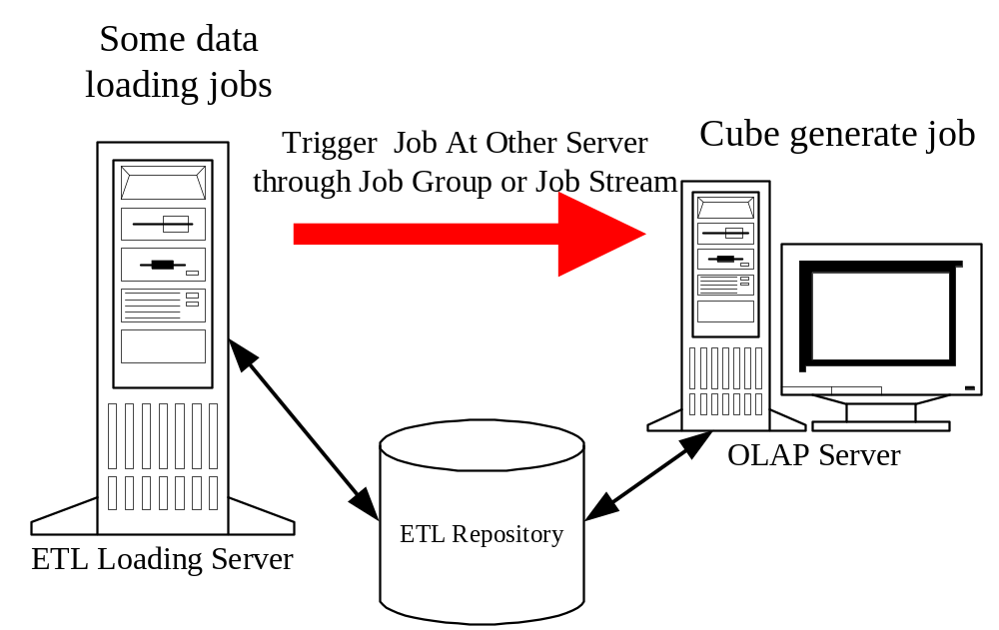
ETL Automation – Multiple Servers Support

Slide 6
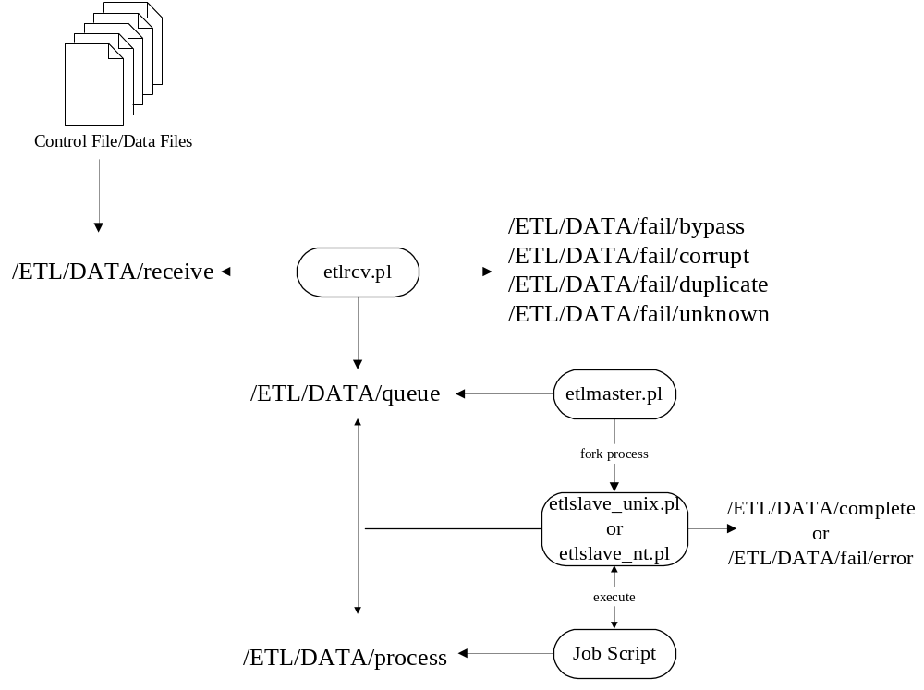
ETL Automation Process

Slide 7
Directory Tree in ETL Automation Server
  /ETL
  |--/APP
  |-----/$SYS
  |---------/$JOB
  |-------------/bin
  |-------------/ddl
  |--/DATA
  |-----/complete
  |-----/fail
  |--------/bypass
  |--------/corrupt
  |--------/duplicate
  |--------/error
  |--------/unknown
  |-----/process
  |-----/queue
  |-----/receive
  |--/LOG
  |-----/$SYS
  |--------/$DATE
  |--/bin
  |--/etc
  |--/lock
  |--/tmp

Slide 8
ETL Automation Server Program
ETL Automation Server Programs are written in Perl
  etlagent.pl
  etlclean.pl
  etlmaster.pl
  etlmsg.pl
  etlrcv.pl
  etlslave_unix.pl/etlslave_nt.pl
  etl_unix.pm/etl_nt.pm

Slide 9
Daemon Program in ETL Automation
etlagent.pl
etlclean.pl
etlmaster.pl
etlmsg.pl
etlrcv.pl

Slide 10
Daemon Program – etlagent.pl
This daemon program will listen to a socket port to service the requests from GUI front-end administration program.
  Get Log File
  Get Script File
  Put Script File
  Invoke Job
  Force Start Job
  Query Status

Slide 11
Daemon Program – etlclean.pl
This daemon program will do the house keeping job for ETL Automation.
  Clean up each system’s data files.
  Clean up each system work log files.
  Clean up each system repository log records information.
  Clean up ETL Automation system log file.

Slide 12
Daemon Program – etlmaster.pl
This program will monitor the /ETL/DATA/queue directory to see if there is any control file coming. For each control file, it will fork a process, which will invoke the etlslave_unix.pl or etlslave_nt.pl in order to execute the ETL Job. The control file also will be passed as parameter.

Slide 13
Daemon Program – etlmsg.pl
This daemon program will send message notification to specified users if it is needed.
  Message notification will be sent out via email or mobile short message if customer can provide the short message interface.

Slide 14
Daemon Program – etlrcv.pl
This program will monitor the /ETL/DATA/receive directory to see if there is any control file coming. If it finds that a control file has been put into this directory, it will do some necessary work and move the control file and data files to the /ETL/DATA/queue directory, which is monitored by the etlmaster.pl daemon.

Slide 15
What the etlrcv.pl does for ETL Automation
Check received (many) file sizes & duplicates.
Check whether the file has been defined at automation or not.
Check the job is enabled or not.
Check job frequency and data calendar.
Convert control file name to automation format. (System + Convert Source + TxDate + .dir)
Record received file information into repository.
Move files to queue directory.

Slide 16
What the etlmaster.pl does for ETL Automation
Check the job is enabled or not.
Check the dependency of job.
Check the job batch window time is meet.
If the number of running job is within the limit, then move files to process directory and invoke etlslave_unix.pl or etlslave_nt.pl for executing ETL Job.

Slide 17
What the etlslave_unix.pl or etlslave_nt.pl does for ETL Automation
Find the specified ETL Job’s script files and execute those script files by sequence of script file name.
Log start time, end time and return status of each script into repository.
Log start time, end time and return status of a whole job into repository.
If the job is upstream job or meet the criteria of job group, send control file to invoke other job.

Slide 18
How to trigger ETL Job?
An ETL Job is triggerd by control file.
  Control File
    A plain text file which contains source data file information.
    A control file can contain multiple source data files.
  Control File Name Convention
    dir.XXXXXYYYYMMDD
    dir.XXXXXXXX.YYYYMMDD/DIR.XXXXXXXX.YYYYMMDD
    DXXXXXMMDD
  What is the content of control file?
    Data Source File Name
    Data Source File Size
    Expected Record Count (Optional)

Slide 19
Where will the file go?
/ETL/DATA/receive
  All data files and control files will come at this directory first.
  If the job source is undefined, it goes to /ETL/DATA/fail/unknown.
  If the job’s frequency or data calendar is not match, it goes to /ETL/DATA/fail/bypass.
  If the data file is duplicate, it goes to /ETL/DATA/fail/duplicate.
  If the data file’s size is not match with the size in control file, it goes to /ETL/DATA/fail/corrupt.
/ETL/DATA/queue
  The data files and converted control files will come at this directory.
/ETL/DATA/process
  The data files and converted control files will come at this directory if the jobs are running.
  If the job is done, those files will go to /ETL/DATA/complete.
  If the job is failed, those files will go to /ETL/DATA/fail/error.

Slide 20
How does ETL Automation locate the job’s script?
ETL System + ETL Job
  Automation will locate the system directory under /ETL/APP, for example, if a job belongs to ‘TST’ system, it will look for /ETL/APP/TST directory.
  Then, Automation will locate the job directory under system directory. For example, if a job name is ‘CUST_MASTER’, it will look for /ETL/APP/TST/CUST_MASTER directory.
  bin and ddl directory
    /ETL/APP/TST/CUST_MASTER/bin
    /ETL/APP/TST/CUST_MASTER/ddl

Slide 21
What is the name of job script file?
<job>????.sh
  Unix platform only.
  <job> is the same name as the ETL Job name but it has to be in lower-case (letter).
  ???? is the four-digits sequence number. 0100 is the loading script.
<job>????.pl
  Unix or NT/2000 platform.
  <job> is the same name as the ETL Job name but is has to be in lower-case (letter).
  ???? is four digits sequence number. 0100 is the loading script.

Slide 22
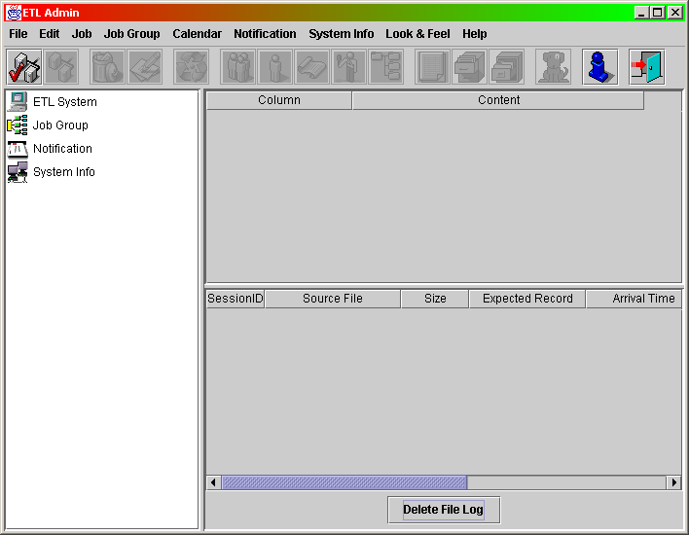
ETL Automation Administration

Slide 23
ETL Automation Administration
A GUI administration program, which is written in Java
  On left, there is a tree view named “System Panel”.
  On top of right, there is a table view named “Info Panel”.
  On bottom of right, there is a table view named “File Log Panel”.

Slide 24
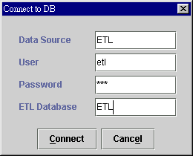
ETL Automation Administration - Connect to Automation Repository
Before you can do some administration work, you need to connect to automation repository first
  Select menu “File” - “Connect”.

Slide 25
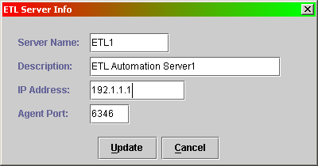
ETL Automation Administration – Add ETL Server
Add ETL Server
  A ETL Server is host name which running ETL Automation Service.
  You select “System Info” tree item at System Panel first. Select menu “System Info” then “Add Automation Server”

Slide 26
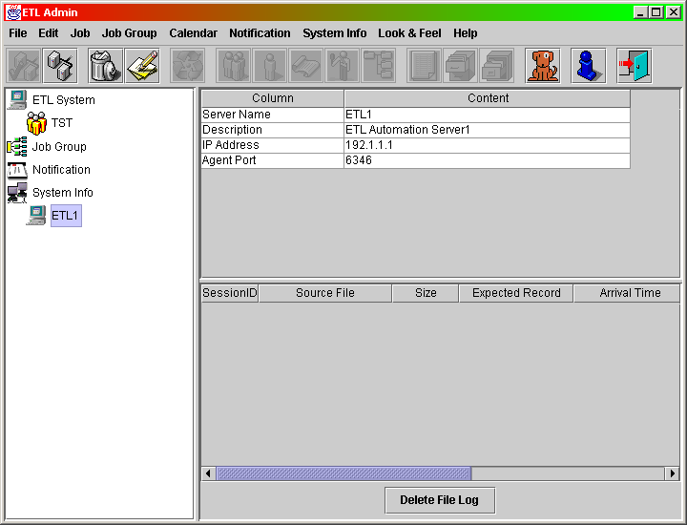
ETL Automation Administration – Add ETL Server

Slide 27
ETL Automation Administration - ETL System
What is ETL System
  An ETL System is a logical group of ETL Jobs.
  It groups jobs together and helps administrator to manage jobs.

Slide 28
ETL Automation Administration - Add ETL System
First, you need add a subsystem into ETL Automation
  You select ETL system tree item at System Panel first. Select menu “Job” then “Add ETL System”.

Slide 29
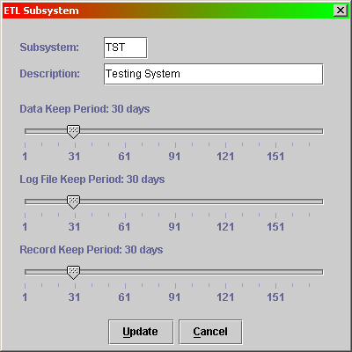
ETL Automation Administration - Add ETL System

Slide 30
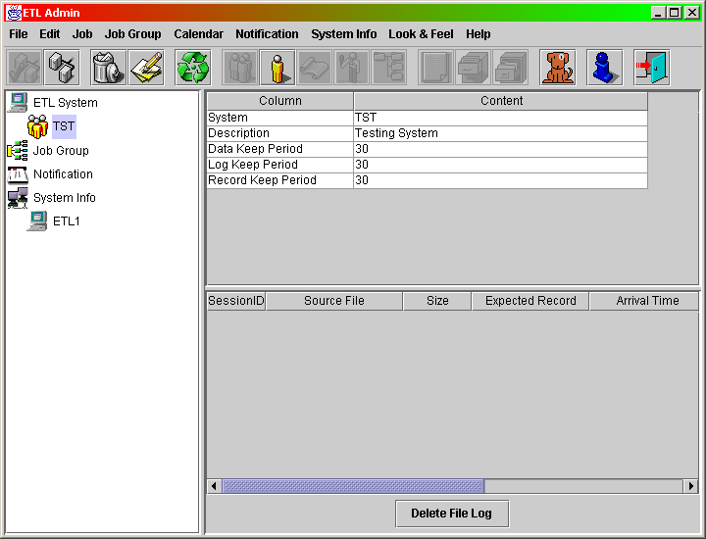
ETL Automation Administration - Add ETL System

Slide 31
ETL Automation Administration - ETL Job
What is ETL Job
  An ETL Job is a logical unit of one or several script files.
  An ETL Job is considered as successful when all of its scripts are done, otherwise, it should be considered as failure.
  Usually, an ETL Job is mapping to real data process job (loading or transformation, for example) but sometimes it can be a virtual job (uses when a job need to be putting in multiple job groups).

Slide 32
ETL Automation Administration - Add ETL Job
Before adding an new ETL Job, you select ETL system tree item at System Panel first
  Select menu “Job” - “Add ETL Job”.

Slide 33
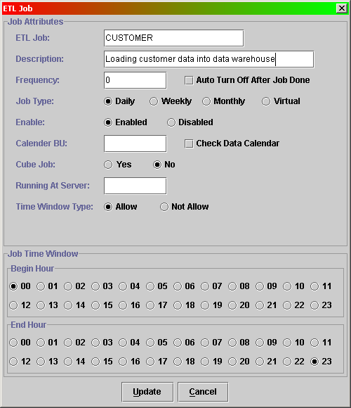
ETL Automation Administration - Add ETL Job

Slide 34
ETL Automation Administration - ETL Job Attributes
Frequency
  0 means every day, -1 means the last day of month, 1 to 31 means the day number in a month, 41 to 47 means the day number in a week.
Auto Turn Off
  After job was done, the job will be disabled automatically by Automation.
  A job can be auto turn on in a job group.

Slide 35
ETL Automation Administration - ETL Job Attributes
Enable Status
  A job only will be running by ETL Automation if it is enabled.
Data Calendar
  Calendar BU
    The business unit of Job. While your defining data calendar, you can copy a data calendar to all of jobs in the same Calendar BU.
  Check with Data Calendar
    Whether or not to check the data date with data calendar before invoking a job.

Slide 36
ETL Automation Administration - ETL Job Attributes
Running At Server
  Specify which server will run this job.
    Multiple server support
Time Window
  A time interval that allow or not allow job to be running.

Slide 37
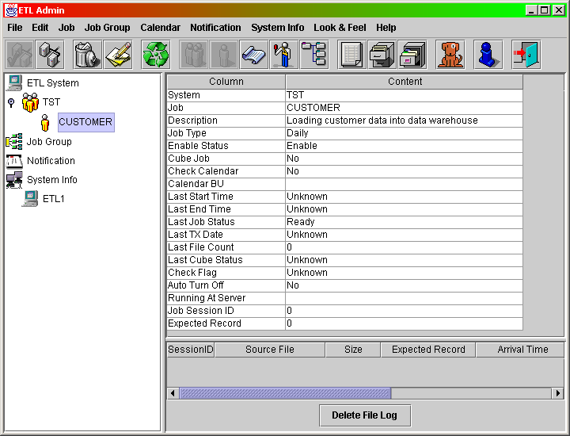
ETL Automation Administration - Add ETL Job

Slide 38
ETL Automation Administration - Job Source
What is Job Source
  The job source means the file name of control file.
  Each Job need to define at least one Job Source.

Slide 39
ETL Automation Administration - Add Job Source
You have to select one ETL Job tree item at System Panel first
  Select menu “Job” - “Add Job Source”.
You can let ETL Automation alert you if the job source did not come after the time you specified.

Slide 40
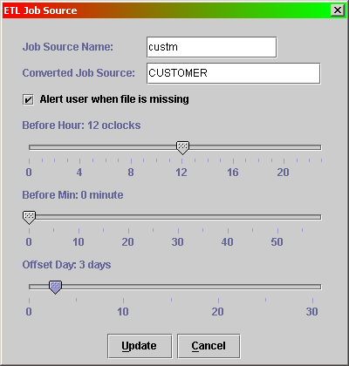
ETL Automation Administration - Add Job Source

Slide 41
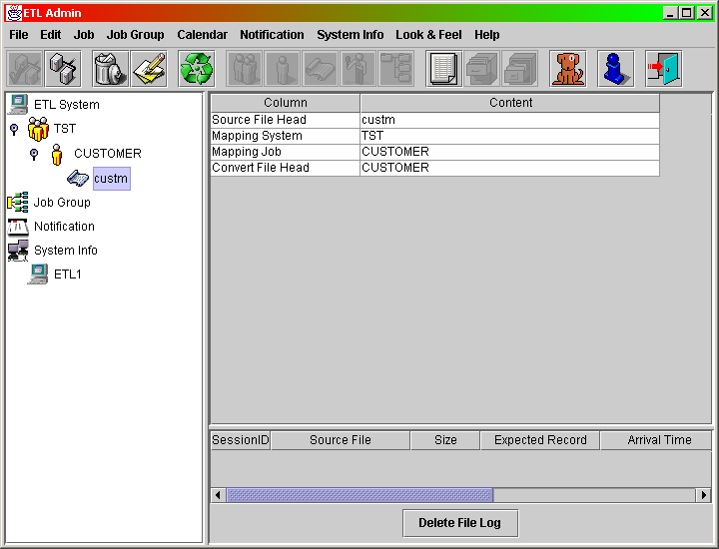
ETL Automation Administration - Add Job Source

Slide 42
ETL Automation Administration - Add Data Calendar
What is Data Calendar?
  For some business, the data must conform to a mandatory date sequence. We call it Data Calendar.
What is the benefit of Data Calendar in job process?
  It can prevent the source data problem in wrong time interval.
    If the date of data is not defined at Data Calendar, the Automation will move source to /ETL/DATA/fail/bypass.
    If the date of date is defined at Data Calendar but the sequence is wrong (the prior date is not marked), the Automation will move source to /ETL/DATA/fail/bypass.

Slide 43
ETL Automation Administration - Add Data Calendar
You have to select one ETL Job tree item at System Panel first
  Select menu “Calendar” - “Add Data Calendar”.

Slide 44
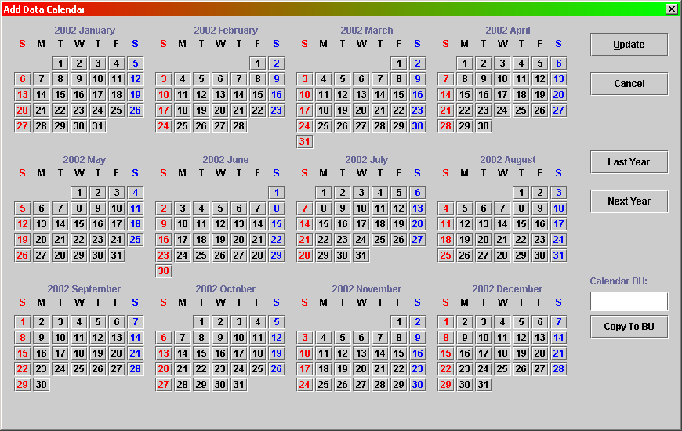
ETL Automation Administration - Add Data Calendar

Slide 45
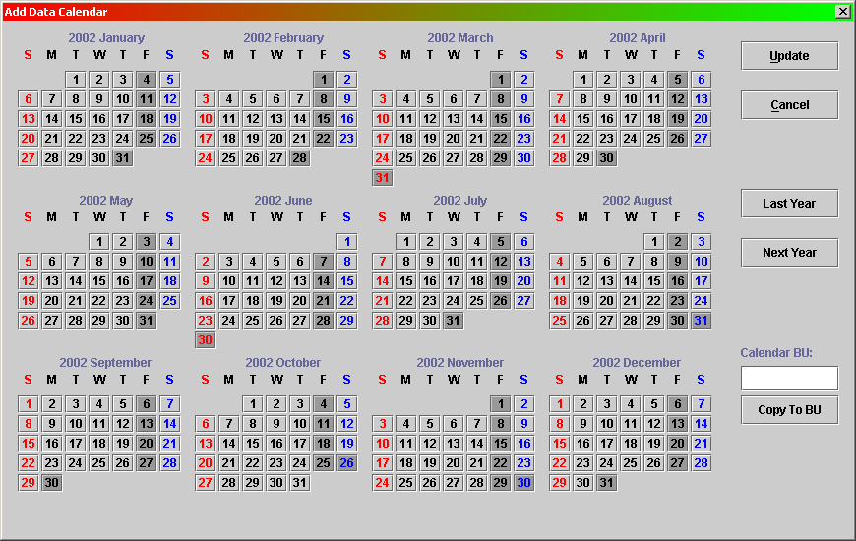
ETL Automation Administration - Add Data Calendar

Slide 46
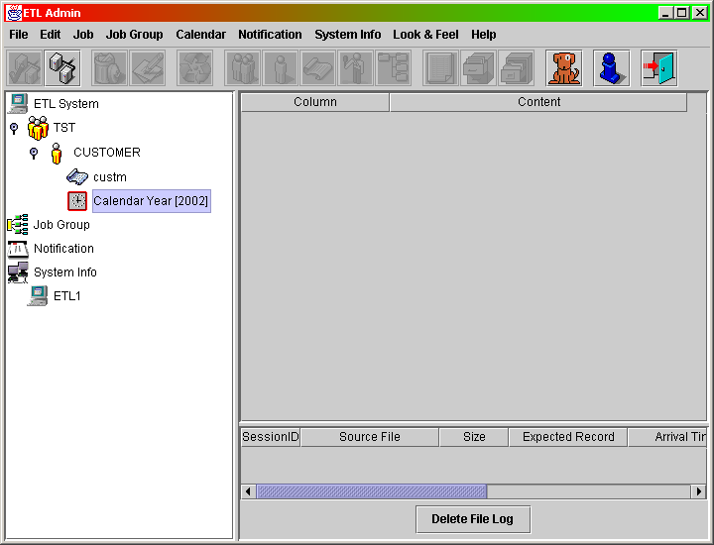
ETL Automation Administration - Add Data Calendar

Slide 47
ETL Automation Administration - Set Data Calendar
For some reason, you have to manually mark some particular date in Data Calendar. You need the “Set Data Calendar”.
  Every time Automation receive the source data for a job that needs to check the Data Calendar, it will check the prior date is marked or not.
  Some time you have to manually mark Data Calendar in order to let the job run.
You have to select one ETL Job tree item at System Panel first
  Select menu “Calendar” - “Set Data Calendar”.

Slide 48
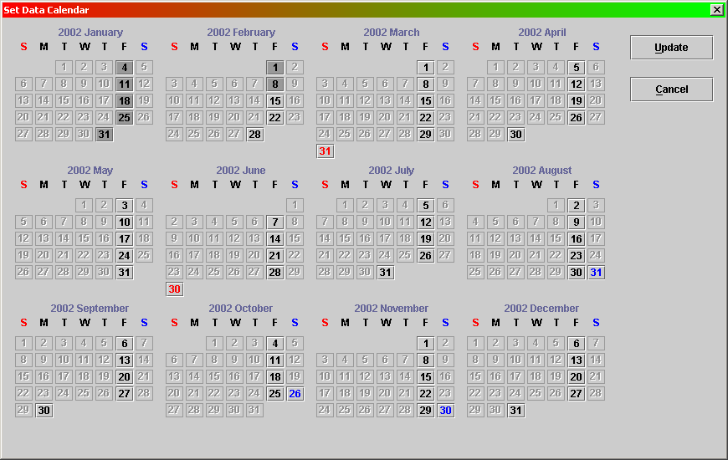
ETL Automation Administration - Set Data Calendar

Slide 49
ETL Automation Administration - Job Dependency
What is Job Dependency
  If Job A has to wait for the completion of Job B in order to meet the criteria of executing Job A, then we said those two jobs have dependency relationship. Job A depends on Job B and Job B is the dependent job of Job A.
  Job dependency is according to the same data extraction date on control file.
  One job can depend on one or several other jobs.

Slide 50
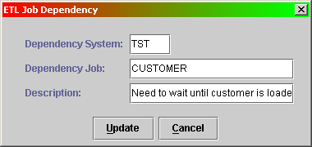
ETL Automation Administration - Add Job Dependency
You have to select one ETL Job tree item at System Panel first
  Select menu “Job” - “Add Job Dependency”.

Slide 51
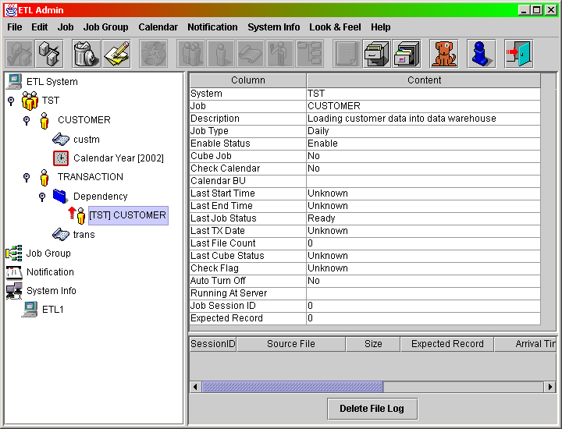
ETL Automation Administration - Add Job Dependency

Slide 52
ETL Automation Administration - Job Stream
What is Job Stream
  Job Stream is the a way to trigger other job after a job is done.
  Upstream Job is the job which will trigger other jobs after it is done.
  Downstream Job is the job which will be triggered by upstream job.
  One upstream job can have multiple downstream jobs in its job stream.

Slide 53
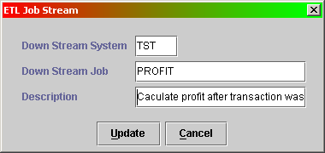
ETL Automation Administration - Add Job Stream
You have to select one ETL Job tree item at System Panel first
  Select menu “Job” - “Add Job Stream”.

Slide 54
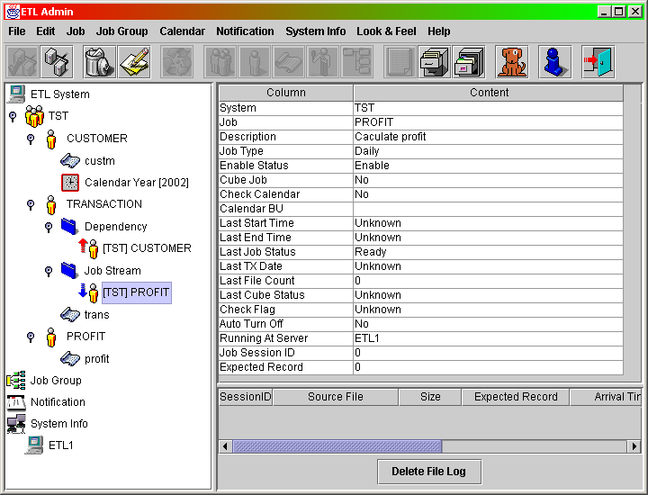
ETL Automation Administration - Add Job Stream

Slide 55
ETL Automation Administration - Job Group
What is Job Group
  A Job group is collection of one or several jobs.
  A Job Group has a associated job, named “head job”.
  Those jobs under a Job Group are the group child jobs.
  The head job will be invoked automatically once all of its group child jobs are done.
  After head job is done, the group child job can be enabled automatically (auto turn on).
  One Job can only be assigned at one Job Group.

Slide 56
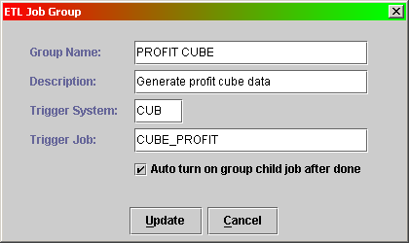
ETL Automation Administration - Add Job Group
You have to select “Job Group” tree item at System Panel first
  Select menu “Group” - “Add Group”.

Slide 57
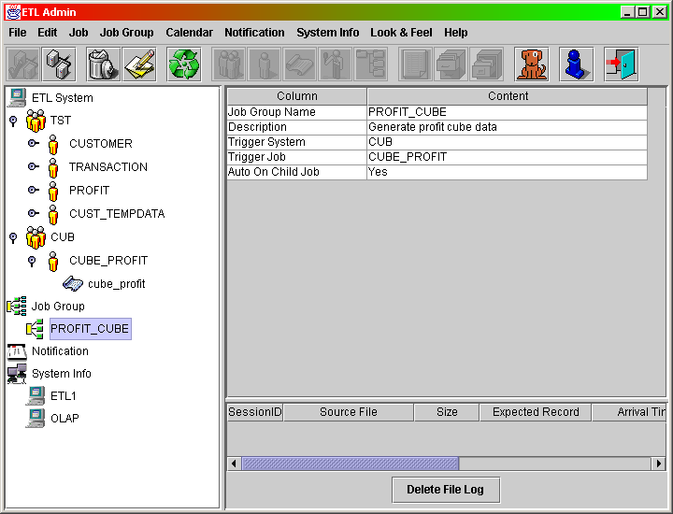
ETL Automation Administration - Add Job Group

Slide 58
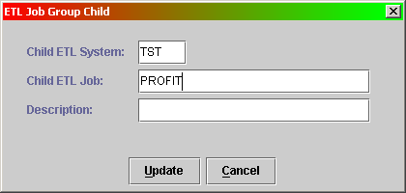
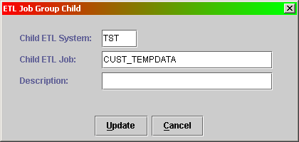
ETL Automation Administration - Add Group Child Job
You have to select job group tree item at System Panel first
  Select menu “Group” - “Add Group Child Job”.

Slide 59
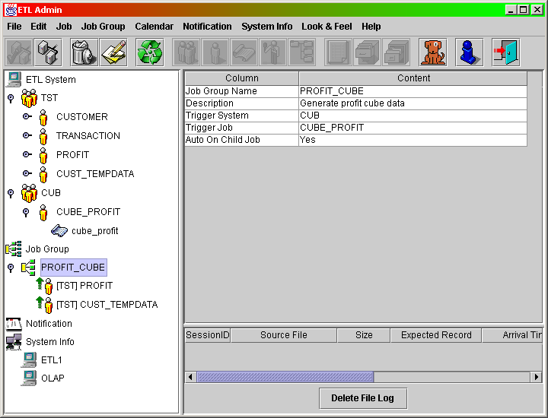
ETL Automation Administration - Add Group Child Job

Slide 60
ETL Automation Administration – Reset Job Status
Job Status
  Ready -> Pending -> Running -> Done/Failed
The etlrcv.pl daemon only process control file when job is ‘Ready’ or ‘Done’.
The etlmaster.pl daemon only process control file when job is ‘Pending’.
The job dependency will also check dependant job status (‘Done’ and same TxDate).

Slide 61
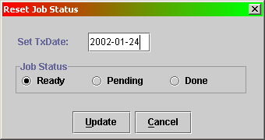
ETL Automation Administration – Reset Job Status
Select the job tree item at System Panel first.
Select menu “Job” then “Reset Job Status”.

Slide 62
ETL Automation Administration – Set Related Job
What is related job?
  If two jobs have relationship that each one has to check the other job’s previous return status in order to meet the criteria of executing itself, we call they are related jobs.
It usually comes with data calendar.
  When one job receive its control file, it will check other related job to see if the prior date’s status is allow the job to execute.

Slide 63
ETL Automation Administration - View Received File Log
All received data files will be recorded at Automation repository
  Select one ETL Job tree item at System Panel first.
  Select menu “Job” - “View File Log”.

Slide 64
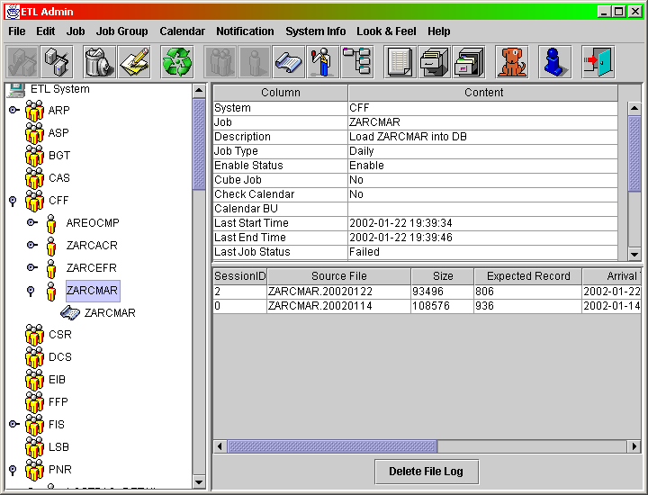
ETL Automation Administration - View Received File Log

Slide 65
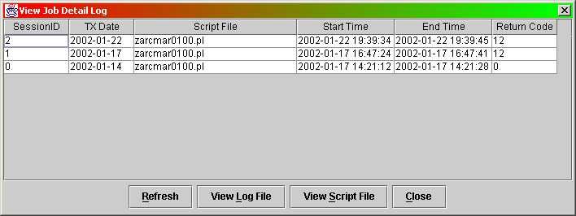
ETL Automation Administration - View Job Detail Log
An ETL Job may have multiple script files, we can see the detail log of each job.
  Select one ETL Job tree item at System Panel first.
  Select menu “Job” - “View Job Detail Log”.

Slide 66
ETL Automation Administration - View Job Script Working Log File
On the View Job Detail Log Window, you can get the job script working log file at server and view the working log.

Slide 67
ETL Automation Administration – View/Modify Job Script File
On the View Job Detail Log Window, you can get the job script file from server and view/modify the job script.

Slide 68
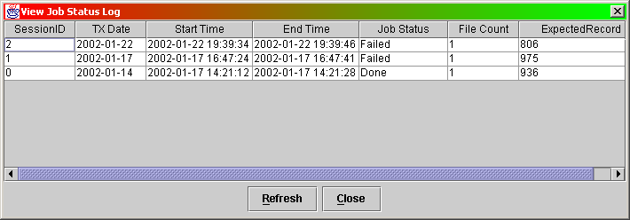
ETL Automation Administration - View Job Status History Log
Automation will keep Job’s status history log
  Select one ETL Job tree item at System Panel first.
  Select menu “Job” - “View Job Status Log”.

Slide 69
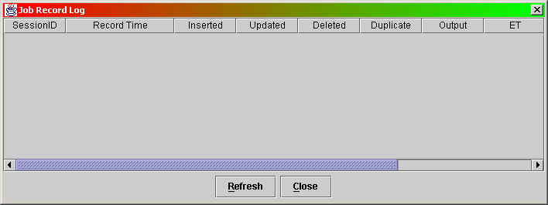
ETL Automation Administration - View Job Record Log
Automation will log Job’s record information if it has data loading job (Fastload or Multiload)
  Select one ETL Job tree item at System Panel first.
  Select menu “Job” - “View Job Status Log”.

Slide 70
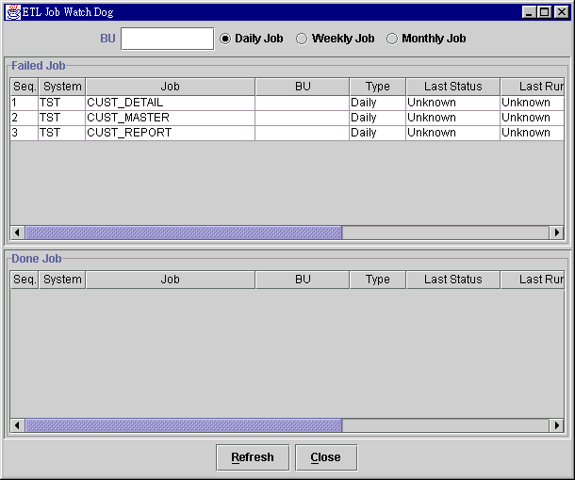
ETL Automation Administration - Job Watch Dog

Slide 71
ETL Automation Administration - Message Notification
Send email to notify the user when job is failed or done or job source missing.
It can attach a log file as an attached file in email.
A notification can send to multiple users or user groups.

Slide 72
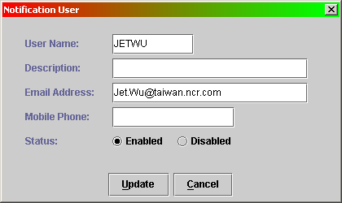
ETL Automation Administration - Message Notification
For adding a new user who want to be notified. You have to select “User List” tree item at System Panel first
  Select menu “Notification” - “Add User”.

Slide 73
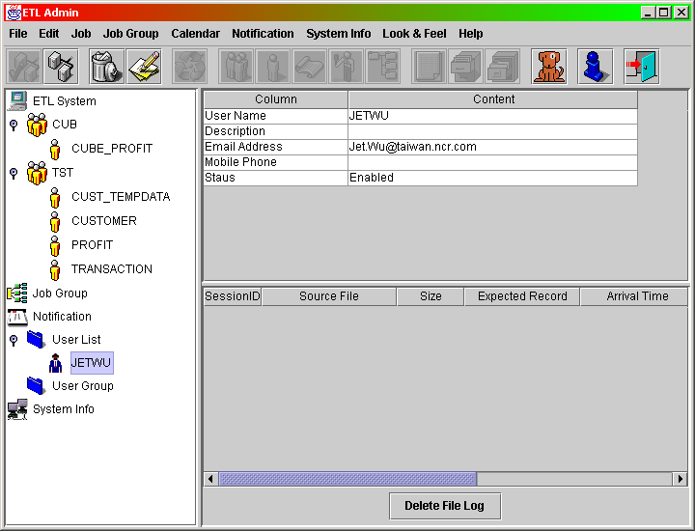
ETL Automation Administration - Message Notification

Slide 74
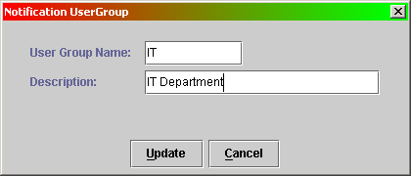
ETL Automation Administration - Message Notification
For adding a new user group for message notification. You have to select “User Group” tree item at System Panel first
  Select menu “Notification” - “Add User Group”.

Slide 75
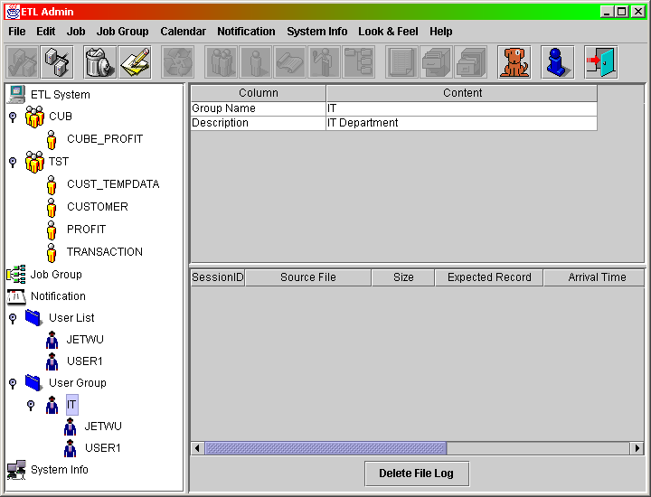
ETL Automation Administration - Message Notification

Slide 76
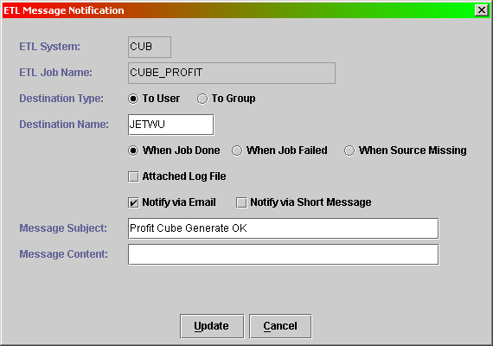
ETL Automation Administration - Message Notification
For adding a job want to notify user. You have to select “Job” tree item at System Panel first
  Select menu “Notification” - “Add Message Notification”.

Slide 77
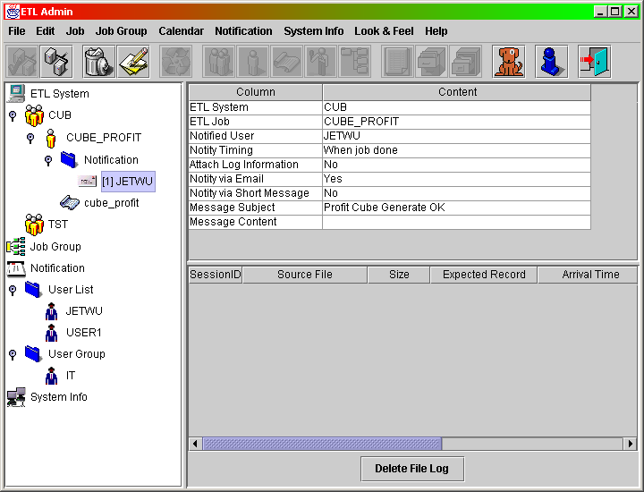
ETL Automation Administration - Message Notification

Slide 78
ETL Automation Administration – Invoke Job
You can invoke a specified job from ETLAdmin program.
Select the job item in System Panel first. Select menu ‘Job’ then ‘Invoke Job’.
Invoked Job will be put into /ETL/DATA/queue, in which is monitoring by etlmatser.pl, therefore, the job still need to meet the criteria (Dependency, Time Window) in order to execute.

Slide 79
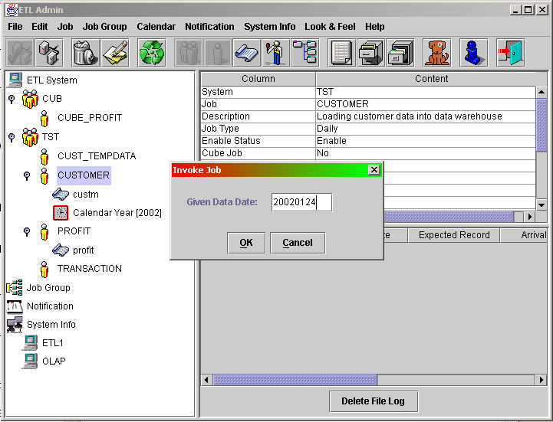
ETL Automation Administration – Invoke Job

Slide 80
ETL Automation Administration – Force Start Job
You can force start a specified job from ETLAdmin program.
Select the job item in System Panel first. Select menu ‘Job’ then ‘Force Start Job’.
Force Start Job will start job immediately.

Slide 81
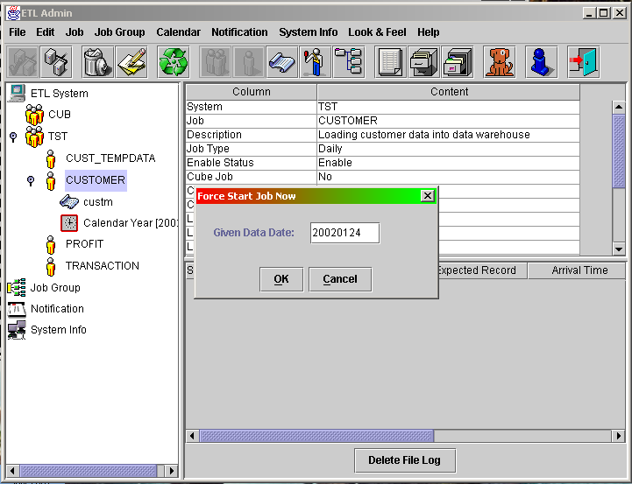
ETL Automation Administration – Force Start Job

Slide 82
ETL Automation Administration - Invoke Group Head Job
You can invoke a specified group head job from ETLAdmin program.
Select the job group item in System Panel first. Select menu ‘Job Group’ then ‘Invoke Group Head Job’.
Invoked Group Head Job will be put into /ETL/DATA/queue, in which is monitoring by etlmatser.pl, therefore, the group head job still need to meet the criteria (Dependency, Time Window) in order to execute.

Slide 83
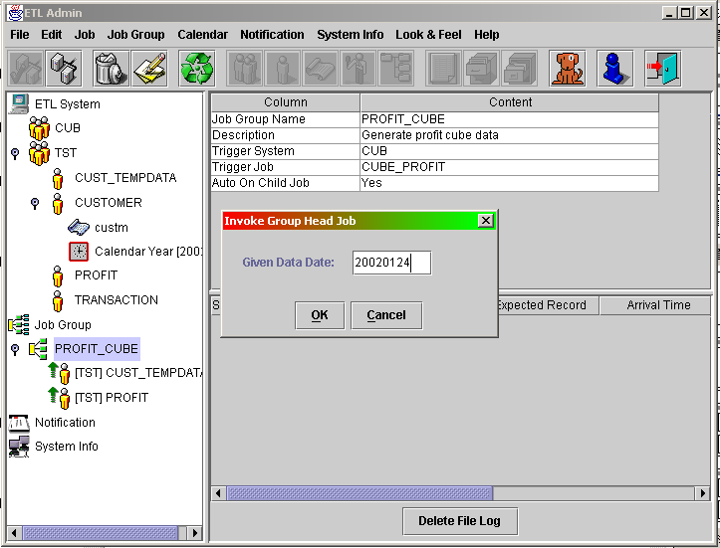
ETL Automation Administration - Invoke Group Head Job

Slide 84
ETL Automation Administration – Force Start Group Head Job
You can force start a specified group head job from ETLAdmin program.
Select the job group item in System Panel first. Select menu ‘Job Group’ then ‘Force Start Group Head Job’.
Force Start Group Head Job will start group head job immediately.

Slide 85

ETL Automation Administration – Force Start Group Head Job

Slide 86
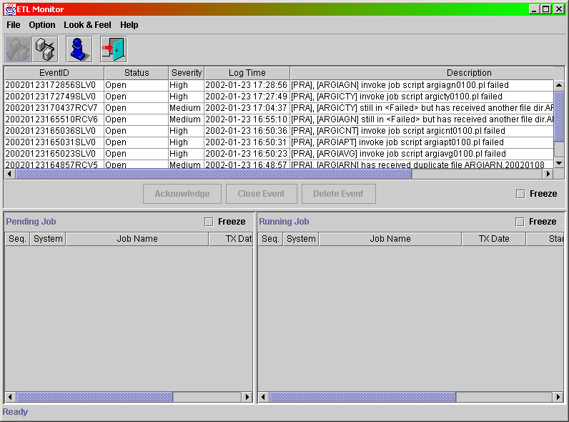
ETL Automation – Monitor Program

Slide 87
ETL Automation – Monitor Program
Event
  The exception cause by abnormal case.
  Severity: High, Medium, Low.
  Status: Open, Acknowledge, Closed.
Pending Job
  The job already received control file but waiting to run by Automation.
Running Job
  The current running job.
  Current running script name.

Slide 88
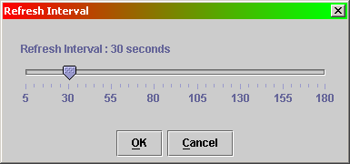
ETL Automation – Monitor Program
Set refresh interval
  How many second will refresh the event in the screen.

Slide 89
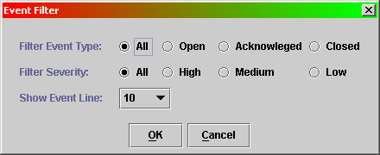
ETL Automation – Monitor Program
Set Event Filter
  What type of event you want to see.
  What severity of event you want to see.
  How many line of event you want to see

Slide 90
ETL Automation - Helper Utility
scriptwz.pl
  Script automatic generate utility.
  It can generate Fastload, Multiload in Perl, Shell or utility itself format.

Slide 91
ETL Automation – Helper Utility
EncodeLogon.pl – Password Encryption
  For maintenance issue, we keep the logon string in individual file. However, we need to protect the password in order to prevent malicious user from outside.
.LOGON etl,503399cf75d04df2;

Slide 92
What you should prepare for Automation
Identify the data source
  What is the source database?
  How the source will feed in?
    FTP, Tape, Directly Access Source.
Identify the job in DW
  What are your target tables in DW?
  How is the update frequency for target table?
    Daily, Weekly, Monthly
    Refresh, Incremental
  What are the derived jobs?
    End of Day, End of Week, End of Month...

Slide 93
Question?

