Slide 1
– adjective, Spry
active; nimble; agile; energetic; brisk

Slide 2
Brendan Neva
Doug Penner
Steffen L. Norgren
Edison Zhang

Slide 3
- Develop a performance based browser
- Usable on an embedded system (TPC-43)
- Use the GTK port of Webkit
- Command line configurable
Objectives

Slide 4
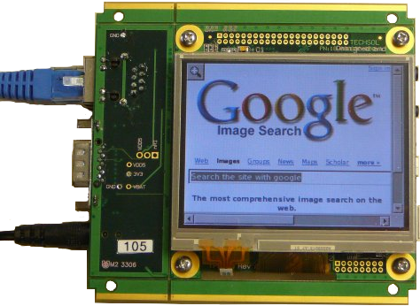
The Idea

Slide 5
WebKit + Gtk+ or WebKitGtk+

Slide 6
WebKit + Gtk+

Slide 7
Advantages:
- Firmly established development base
- Simple API
- Seamless Gtk+ integration
Disadvantages:
- Difficult to bypass features
WebKitGtk+

Slide 8
Initial Prototype

Slide 9
Regular Mode

Slide 10
Context Menu

Slide 11
Full-Screen

Slide 12
- Different Flavours & Versions of Linux
- Benchmarking
- WebKitGtk+ Compiler Flags
- Very Little Online Support
(WebKit Documentation is Objective-C)
- Bypassing WebKitGtk+ Features
Problems... Challenges

Slide 13
Thanks
for the opportunity
to work with you!

