Slide 1
Arduino-based model railroad controller:
Turnout Control: position sensor, polarity reversal, position change
Control Panel: turnout position indicators, position change buttons
Train detection and signal control
Control Panel Reader
Control Panel Indicators
Turnout State Reader
Turnout State Controller
Track sense and signal controller
Address Decoder
Arduino Controller
Power Supply
Architecture Overview
11-05-2018
1.0

Slide 2
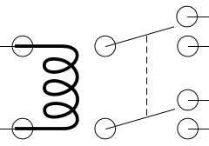
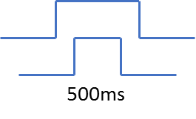


Switch
PWR
Supply
Data i/o
Arduino
Controller
[ R6 ]
12
[ RA2-1 ]
SwPwrReverse
[ R7 ]
[ R5 ]
9
Relay
PWR
Supply
[ RA1-1 ]
8
7
6
5
4
3
2
ItemAddr0
Sw1
x4, 1 each per switch
ItemAddr1
ItemAddr2
+5
PWR
Supply
[ R1 ]
SwState1
ClkAddr0
ClkAddr1
ClkAddr2
Sw2
ClkAction
[ R2 ]
SwState2
Turnout Indicator x
HIGH – engages relay, above is
simplified schematic
LOW = switch in
turnout position
Sw3
Switch Controller
[ R3 ]
SwState3
Sw x
[ R4 ]
SwState4
[ RA1-4 ]
Main Controller
1.1

Slide 3
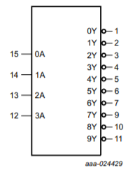
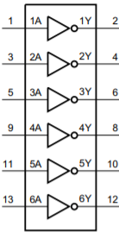
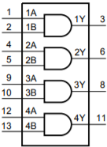
S1-A3
S1-B3
7442
ItemSelect1
[ S1 ]
[ A2 ]
ItemAddr0
ItemSelect2
[ S2 ]
[ A3 ]
ItemAddr1
[ S3 ]
[ A4 ]
ItemAddr2
ItemSelect3
13
12
ItemSelect4
[ S4 ]
7408
S1-B1
9
8
[ O 1 ]
Switch Ctrl 1
Switch Ctrl 2
[ O2 ]
Switch Ctrl 3
[ O3 ]
Switch Ctrl 4
[ O4 ]
S1-C2
7408
( To relay assembly )
CLK_READCTRLPANEL
[ S5 ]
S1-B2
[ A8 ]
ClkAction
CLK_CHANGESWITCH
S1-A2
7404
CLK_READSWITCHSTATE
[ S6 ]
7442
[ A5 ]
ClkAddr0
CLK_READTRACKSENSORS
[ S7 ]
[ A6 ]
ClkAddr1
[ A7 ]
ClkAddr2
CLK_WRITESIGNALSTATE
[ S8 ]
13
12
9
8
7404
S1-C3
Address & Clock Decoding
1.2

Slide 4
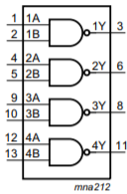
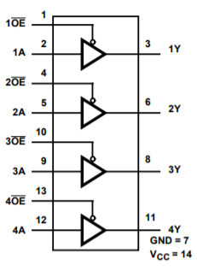
ItemSelect1
ItemSelect1
[ S1 ]
ItemSelect2
ItemSelect2
[ S2 ]
ItemSelect3
ItemSelect3
[ S3 ]
ItemSelect4
ItemSelect4
[ S4 ]
7400
S2-A3
[ O9 ]
Turnout Sense 1
[ O10 ]
Turnout Sense 2
CLK_READSWITCHSTATE
[ S6 ]
Sensor Read Enable
[ O11 ]
S2-A2
Turnout Sense 3
[ O12 ]
Turnout Sense 4
Data i/o
Data pin as input while reading switch states
[ A12 ]
Turnout Sense x (to control panel)
Connections on top shield
Turnout Sense x (from turnout)
Read Switch Machine State
1.1

Slide 5
ItemSelect1
ItemSelect1
[ S1 ]
ItemSelect2
ItemSelect2
[ S2 ]
ItemSelect3
ItemSelect3
[ S3 ]
ItemSelect4
ItemSelect4
[ S4 ]
S2-B3
7400
[ O5 ]
ButtonSense1
CLK_READCTRLPANEL
Sensor Read Enable
[ O6 ]
ButtonSense2
[ S5 ]
S2-B2
[ O7 ]
ButtonSense3
[ O8 ]
ButtonSense4
Data i/o
( All From control panel )
Data pin as input while reading switch states
[ A12 ]
Read Control Panel State
1.1

Slide 6
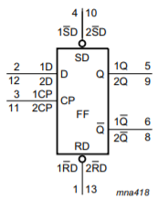
ItemSelect1
+5
ItemSelect1
[ S1 ]
(To RA2-4)
ItemSelect2
ItemSelect2
[ S2 ]
SignalChange1
ItemSelect3
ItemSelect3
[ S3 ]
[ O13 ]
ItemSelect4
ItemSelect4
[ S4 ]
7400
News Stand
[ O14 ]
S2-C1
CLK_WRITESIGNALSTATE
[ S8 ]
S3-B1
CLK_READTRACKSENSORS
[ S7 ]
Data i/o
S2-C2
S2-C3
[ A12 ]
[ O15 ]
TrackSense1
[ O16 ]
News Stand
Notes
1.3 expands to include news stand control
1.4 provides pin assignments – finding need for power up reset on FF’s
Track Sense & Signal Control
1.4

Slide 7
Switch Ctrl 1 [ O1 ]
Switch Ctrl 1 [ O2 ]
Switch Ctrl 1 [ O3 ]
Switch Ctrl 1 [ O4 ]
Reverse Polarity1 [ A9 ]
Sig Sen 1 [ O13 ]
News Stand [ O14 ]
Signal 1 [ O15 ]
News Stand [ O16 ]
Button Sense 1 [ O5 ]
Button Sense 2 [ O6 ]
Button Sense 3 [ O7 ]
Button Sense 4 [ O8 ]
Turnout Sense 1 [ O9 ]
Turnout Sense 2 [ O10 ]
Turnout Sense 3 [ O11 ]
Turnout Sense 4 [ O12 ]
Data Pin[ A12 ]
10k
10 x 1K
+5 [ Axx ]
J4 – 1
J4 – 2
J4 – 3
J4 – 4
J4 – 5
J4 – 6
J4 – 7
J4 – 8
330 x 7
330
Power Wiring
Ground [ Axx ]
Ground [ Axx ]
Test Harness Shield
Ground [ Axx ]
1.1

Slide 8
Notes
* Might need to use C1 for additional bus connections between boards, so S3 is only with connectors to layout or control panel
1.1
Shield 1 Assembly

Slide 9
Notes
* Going to drive LED’s through 1 signal, with inverter and drivers up in control panel… reduces connections by ½
1.1
Shield 2 Assembly

Slide 10
