Slide 1
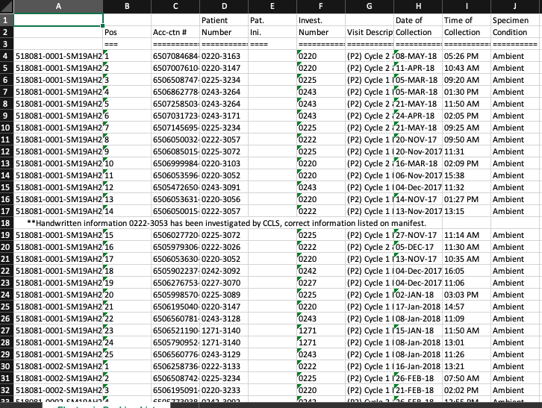
1. Samples Receipt

Slide 2
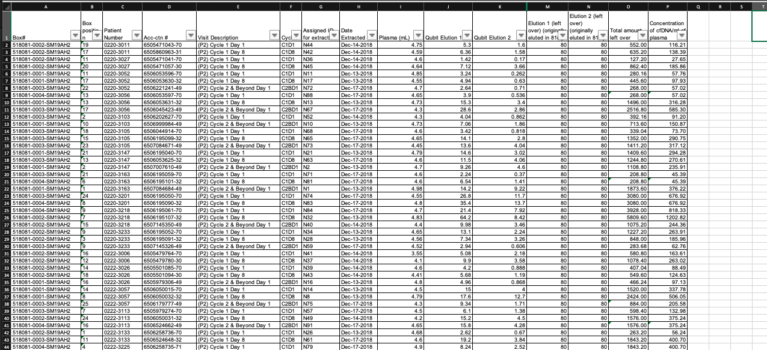
2. Processing Samples
2. Processing of Samples

Slide 3
2. Subsequent workflow for samples

Slide 4
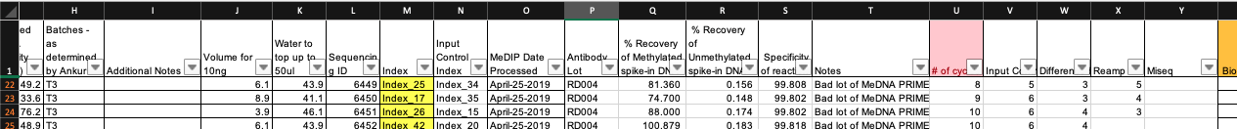
4. Updating sample information

Slide 5
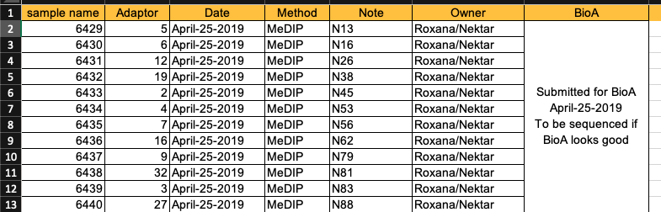
5. Submission to PMGC - BioA

Slide 6
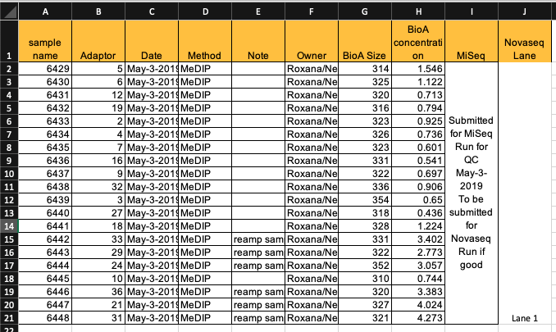
6. Submission to PMGC - Sequencing

Slide 7
7. Information provided to Bioinformatician
https://www.dropbox.com/s/79k01tlr46y4irc/Nektar_Sample_Information.xlsx?dl=0

Slide 8
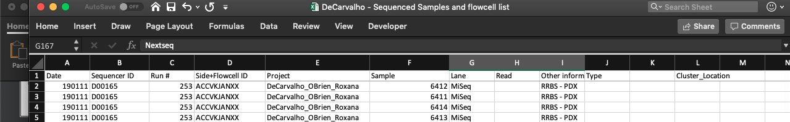
8. Receiving data

Slide 9
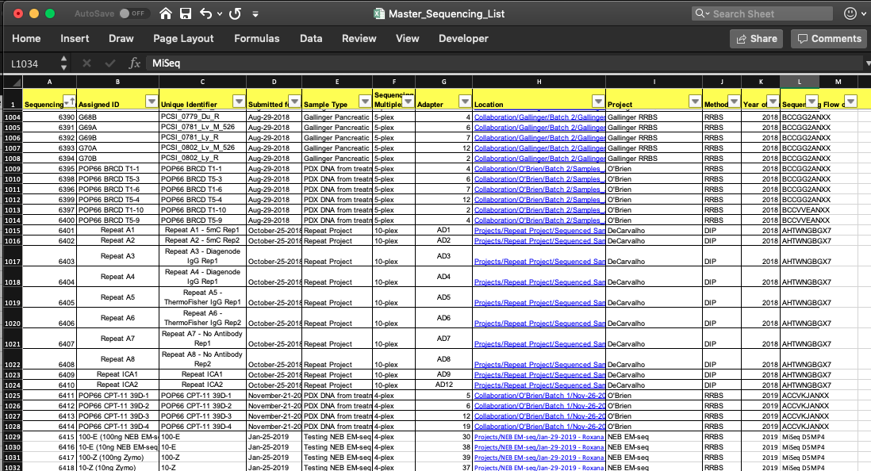
9. Updating Master sequencing list

Slide 10
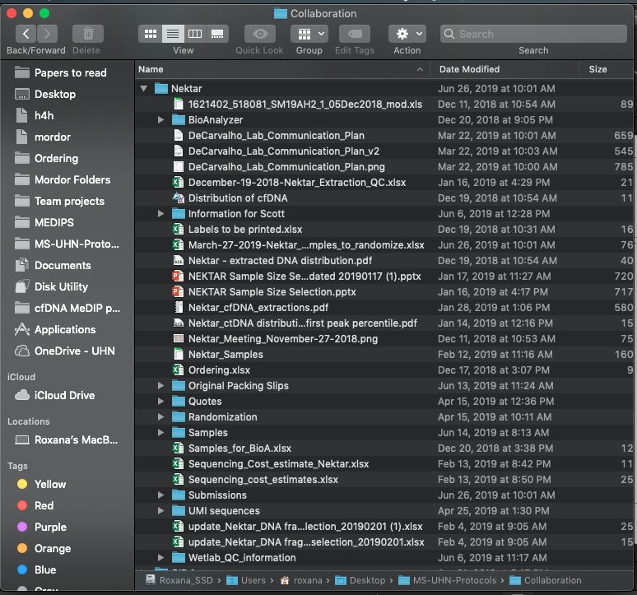
10. Organizing files from project

