Slide 1

Heart Rate Extraction from Around-The-Ear EEG
for Live Biofeedback Applications
Bachelor Thesis Dennis Stroh | Supervisor: Dr. Michael Knierim

Slide 2

Agenda
Motivation
Related Work
Objective & Research Questions
Methodology
Evaluation Procedures
Results & Key Findings
Limitations

Slide 3
Agenda
Motivation / Appetizer (1min)
Related Work (1min)
Problem Analysis / RQ (2min)
Methodology (3min)
Evaluation Procedures (3min)
Key Findings (1/2) (3min)
Results (1/2) (3min)
Limitations (2min)
Conclusion (1min)
Future Research (1min)

Slide 4
Motivation / Appetizer
Why Flow?
Why Interoceptive Biofeedback (cardiac, auditory)?
(see Potential Application Context)
Why simultaneous EEG and ECG?
(Research Gaps / Needs in that regard?)
(Necessary Definitions and Concept Explanation?)
Notes:
Why Topic Interesting? -> Application Context / Use Case
Warum Flow?
Warum (auditory cardiac) Interoceptive Biofeedback?
Warum simultaneous EEG and ECG so attractive?
Research Need & Gap in that regard?
What definitions necessary for understanding the präsi?

Slide 5
Related Work
Ear-centered ECG vs/and Wearable EEG systems
(for simultaneous ECG and EEG)
-> Research Gap / Need in that regard?
Why ExG Headphones?

Slide 6
Objective and Research Questions
Utilizing ATE-EEG for live cardiac biofeedback by extracting heartbeat via ICA
Feasibility Assessment
Requirements resulting from envisioned application context (explicit/implicit)
Temporal delay threshold of 200 ms between heartbeat and feedback [B] [C]
RQ 1: How robustly can recorded ATE-EEG be used, to extract ECG or heartbeat by means of ICA?
RQ 2: How feasible is the utilization of unobtrusive ATE-EEG recordings for the online extraction of R-peaks by means of ICA?

Slide 7
Objective and Research Questions (2)
Feasibility was operationalized in terms of
Computational Complexity (“costs”), using algorithmic execution time as indicator
ICA Result Quality / R-peak Detection Performance (“benefit”), using specific quality (pTp-SNR) and accuracy (JF score) measures as indicator

Slide 8
Independent Component Analysis
Probabilistic method for separating multivariate data (e.g., multichannel EEG data) into maximally independent subcomponents / sources
Assuming independence and non-gaussianity (unlike, e.g., PCA)
Special case of Blind Source Separation (BSS)
Separate a set of sources from a mixture of signals without knowing the original sources or mixing process
Commonly, model estimation is derived in two steps:
Linear transformation (“whitening”) and dimension reduction of data first, to simplify problem (e.g., using PCA or SVD)
Actual iterative ICA estimation afterwards (using prior obtained PCs)

Slide 9
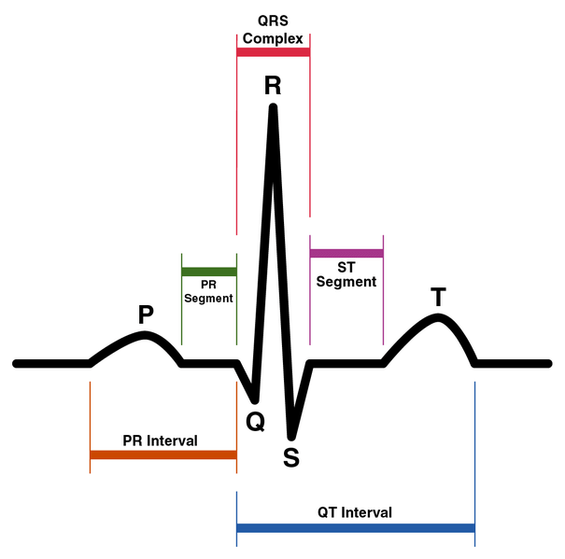
Sinus Rhythm of Healthy Individual
Figure taken from [A]

Slide 10
Overview: Proof of Concept Pipeline
ATE-EEG
ICA
ECG-related IC
R-peak Detection (R-PD)
Recording & Amplification of ATE-EEG
Selection of ECG-related IC
Application of R-peak Detection
Application of ICA on multichannel EEG Data
OpenBCI Cyton biosensing board
MNE (python) package
NeuroKit2 (python) package
Headphone prototype
BrainFlow library
3 ICA algorithms with various subvariants
15 R-peak detection algorithms (“ecg_peaks()”)
“mne.preprocessing.ICA” class
“neurokit2.ecg” class
Using signal similarity (abs correlation) with synchronized reference chest ECG (ground truth)
Notes:
Overview: Necessary Steps of a proof-of-concept pipeline
Overview: Used Hard- and Software (+ justification)

Slide 11
Methodology
Hardware used:
Cyton bio-amplifier (OpenBCI, NY, USA) for 8 channel ExG recordings with 250 Hz sampling frequency
Headphone prototype for unobtrusive ATE-EEG recording, based on Open ExG Headphones [D] with 16 dry electrodes integrated into each earpad
Software packages (python) used:
MNE (v1.5.1) for ICA, in total 8 (sub-) variants investigated
NeuroKit2 (v0.2.7) for R-PD, in total 16 R-peak detection variants investigated (some algorithms provide own pre-cleaning routine – “ecg_clean()”)
Notes:
[TODO]: Insert picture of used hardware !!!

Slide 12
Methodology (2)
Data Collection
ATE-EEG recordings from 5 study participants (3 males & 2 females with different hair length, 22-28 years old)
For each, simultaneous reference chest-ECG recording for ground truth, with conventional wet (pre-gelled adhesive Ag/AgCl) electrodes (bipolar)
Each recording yielded 13 observation segments of 60 s length, 104 ICA results and 1,664 possible R-PD results
Preliminary Hardware Configuration evaluated with “Proband 01”
Selection of 7 promising recording electrodes around the ear for unipolar ATE-EEG channels (8th channel for bipolar chest ECG - ground truth)
Suitability evaluation based on skin-electrode impedance (in kΩ) [E]
Notes:
[TODO]: Insert pictures of Preliminary Hardware Configuration Results

Slide 13
Quality and Performance Measures
Performance measures used:
Skin-electrode impedance (in kΩ) as proxy for ATE-EEG signal quality to expect
Peak-to-peak SNR (pTp-SNR) to assess quality of extracted ECG-related ICs regarding subsequent R-peak detection
JF score, to assess the (sample-wise) accuracy of R-peak detection algorithms on the ECG-related ICs
Notes:
OVERVIEW:
WHAT? Performance measures used?
WHY? Are these used (for what?) ?
Afterwards:
- HOW are they calculated?

Slide 14
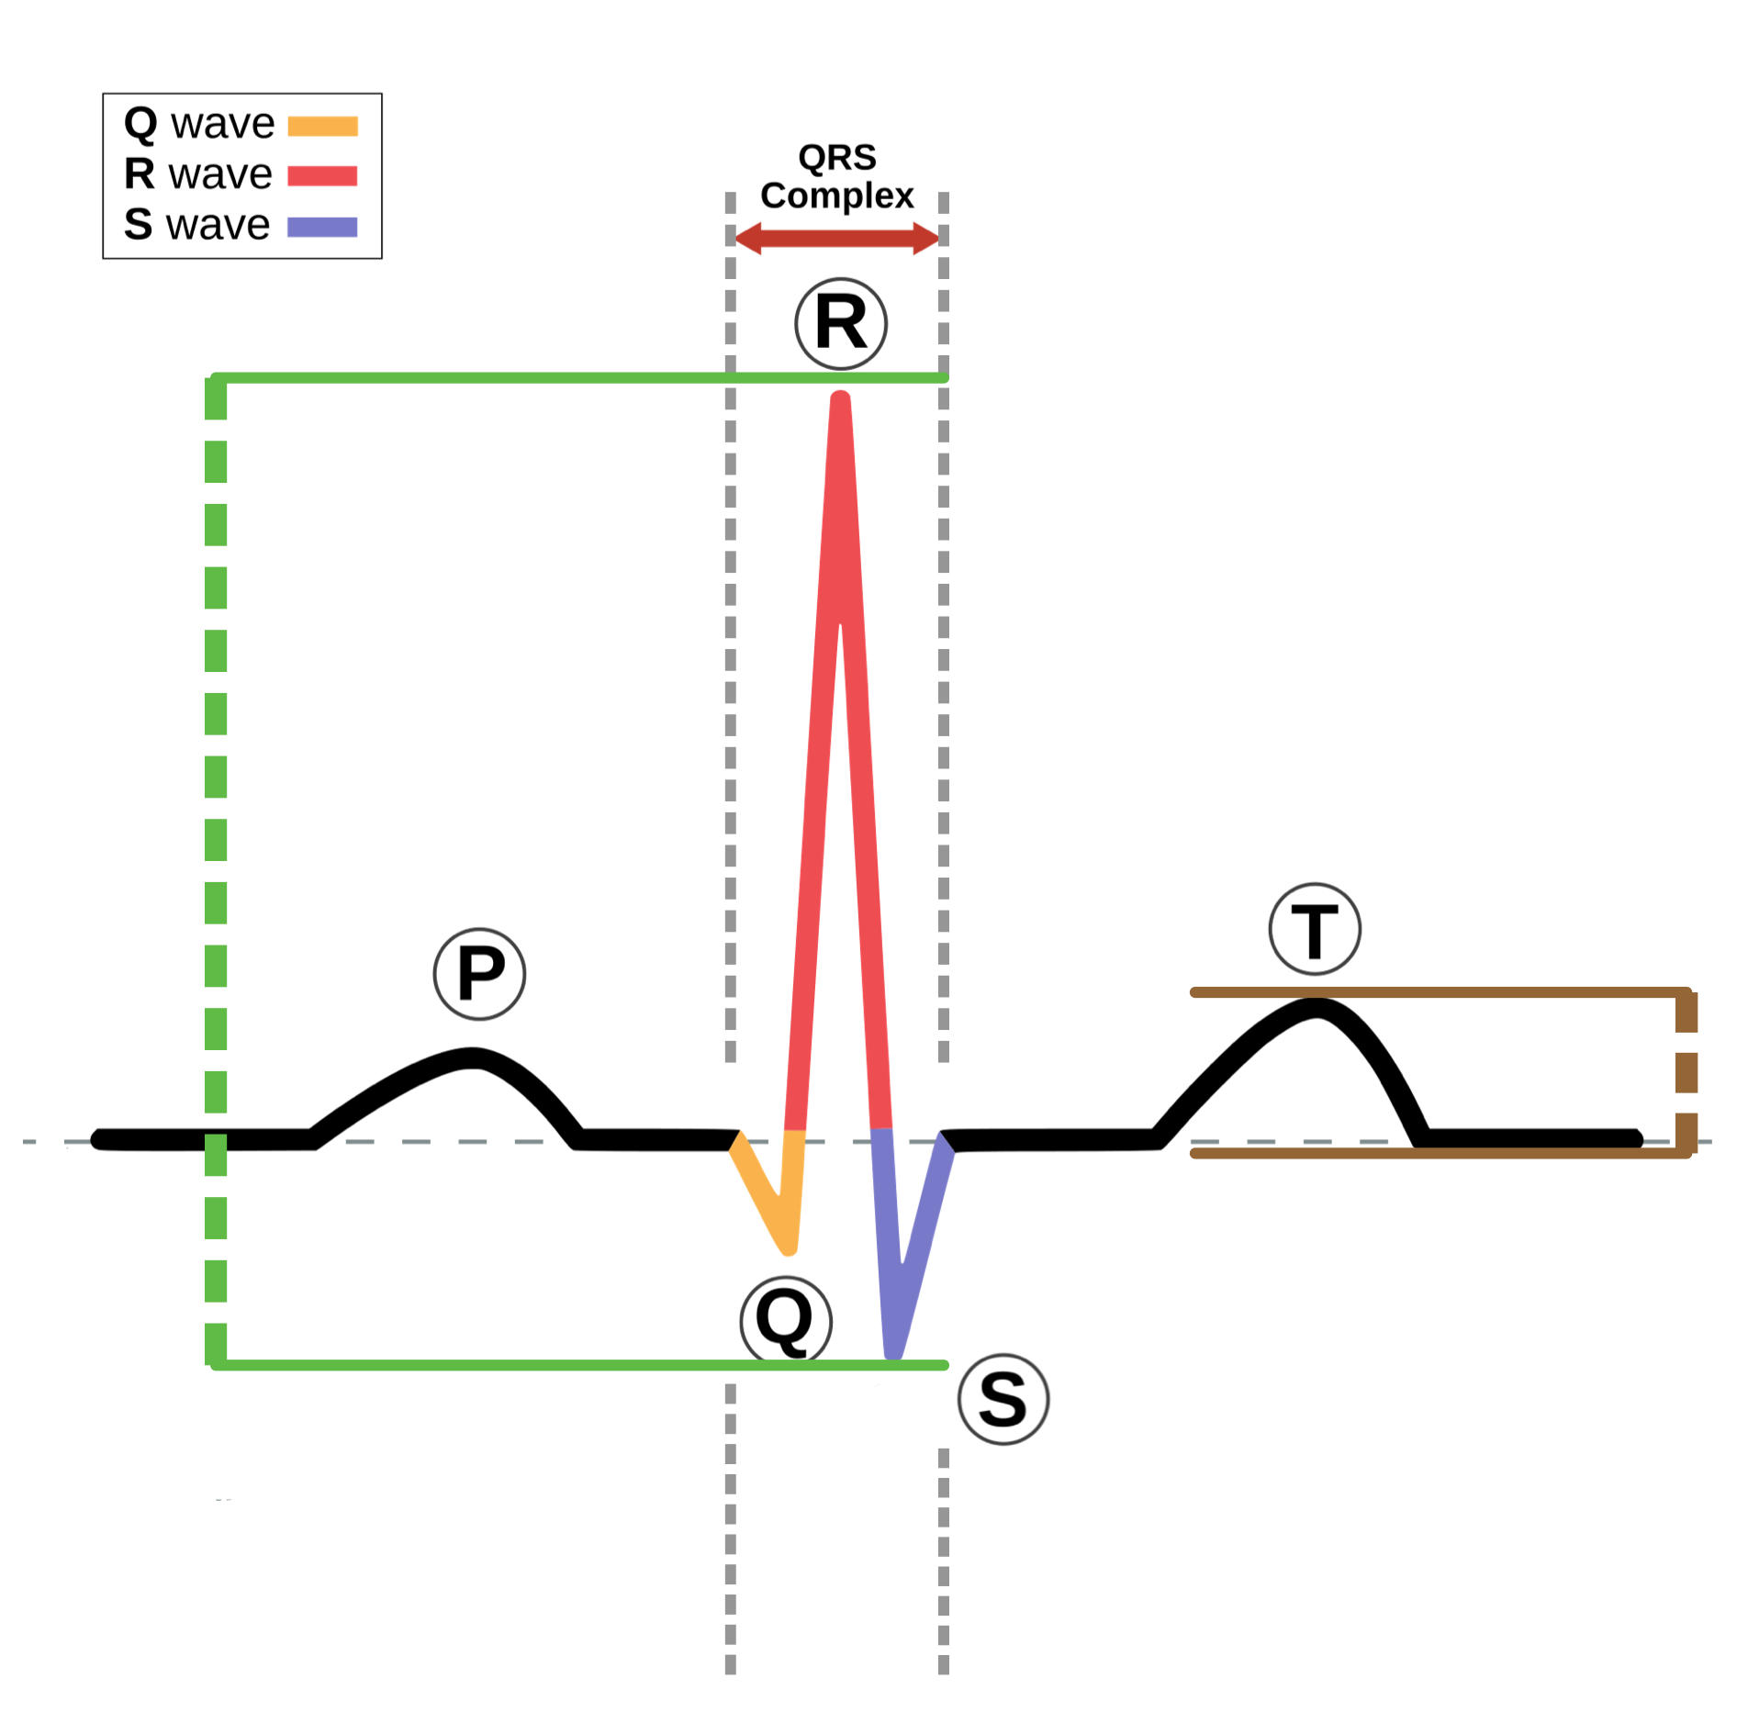
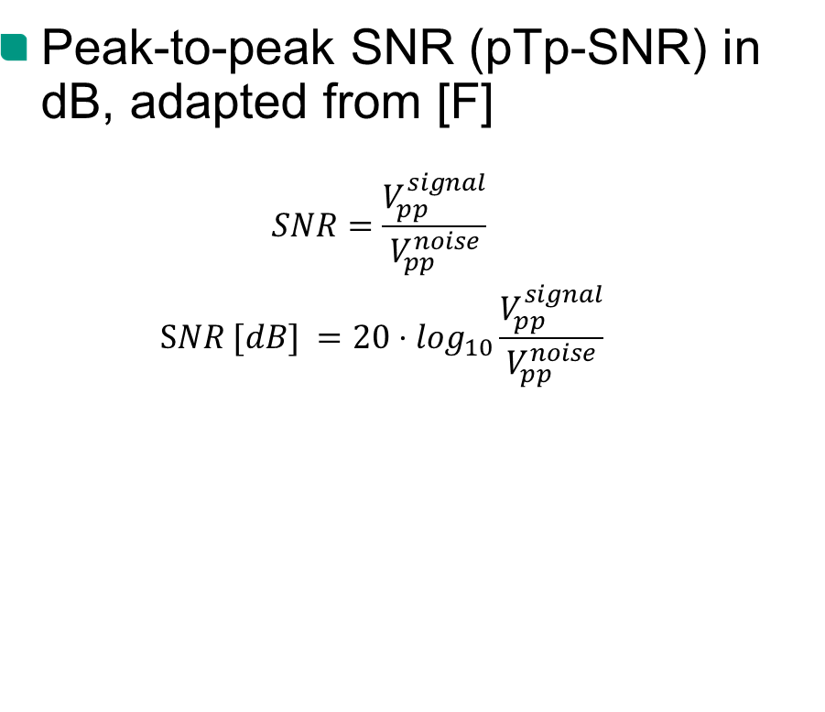
ICA Quality Measure
Peak-to-peak SNR (pTp-SNR) in dB, adapted from [F]
$$SNR=\frac{V_{pp}^{signal}}{V_{pp}^{noise}}$$
$$\text{S}NR [dB] =20⋅\log_{10}\frac{V_{pp}^{signal}}{V_{pp}^{noise}}$$
Notes:
TODO: Insert performance measure of pTp-SNR picture with ANIMATIONS

Slide 15
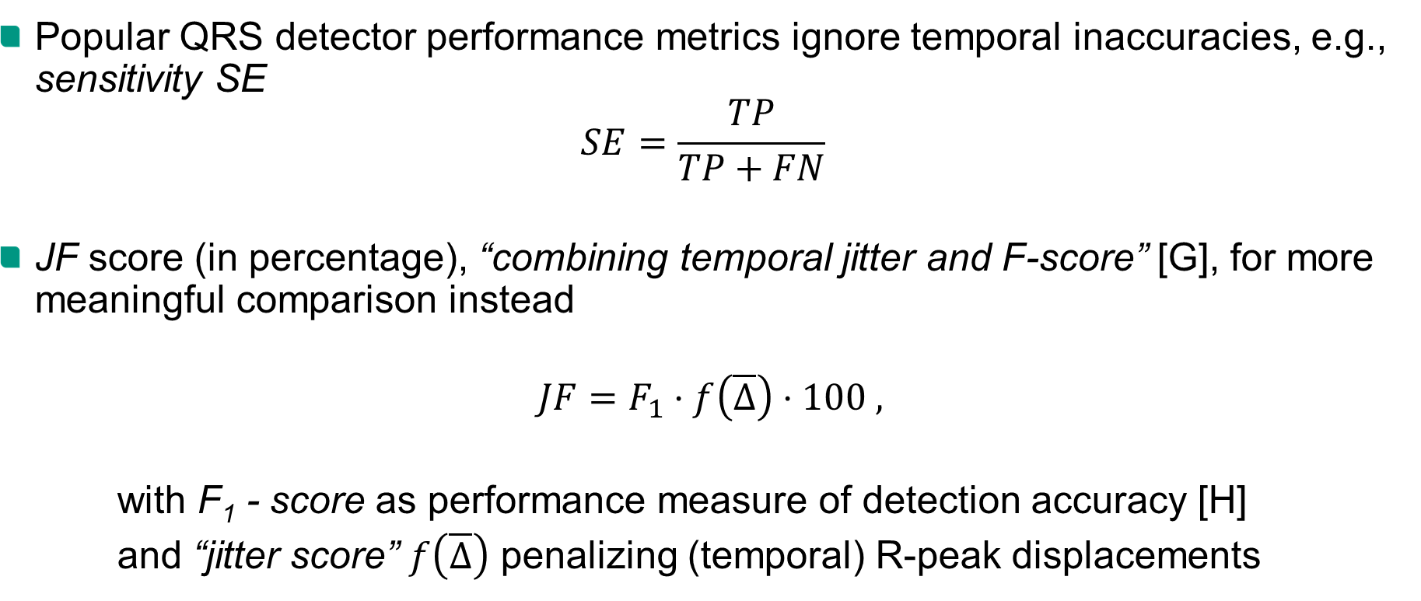
R-peak Detection Performance Measure
Popular QRS detector performance metrics ignore temporal inaccuracies, e.g., sensitivity SE
$$SE=\frac{TP}{TP+FN}$$
JF score (in percentage), “combining temporal jitter and F-score” [G], for more meaningful comparison instead
$$JF=F_{1}⋅f\left(\overline{Δ}\right)⋅100 ,$$
with F₁ - score as performance measure of detection accuracy [H]
and “jitter score” $f\left(\overline{Δ}\right)$ penalizing (temporal) R-peak displacements
Notes:
The F₁ score is the harmonic mean of the precision (How many retrieved items are relevant?) and recall (How many relevant items are retrieved?)
Das F-Maß kombiniert Genauigkeit (precision, 𝑃) und Trefferquote (recall, 𝑅) mittels des gewichteten harmonischen Mittels:
𝐹=2 ⋅ ( (𝑃⋅𝑅) / (𝑃+𝑅) )

Slide 16
Methodology
Present used Hard- and Software in more detail (inclusive configuration/parameterization)
Explain Validation of each pipeline step / used quality and performance measures

Slide 17
Methodology
Overview: Necessary Steps of a proof-of-concept pipeline
Overview: Used Hard- and Software (+ justification)
Present used Hard- and Software in more detail (inclusive configuration/parameterization)
Necessary Explanation for ICA and R-peak detection?
Overview: Performance Measures for ICA Quality and R-Peak Detection Accuracy
(Brief explanation and justification)
Explain Validation of each pipeline step / used quality and performance measures
Data Collection and Preliminary Hardware Configuration

Slide 18
Overview: Evaluation Procedures
ICA Evaluation
R-Peak Detection Evaluation
Combined Evaluation
Preliminary Hardware Evaluation
- Appy ICA algorithms on ATE-EEG recordings, with ICA
1) allowed for convergence
2) allowed for single iteration
Estimate upper bound of ICA quality
- Employ R-peak detection algorithms on all converged ECG-related ICs
(regardless of ICA variant used)
Investigate JF score compared to other metric (sensitivity)
- Separately investigate performance of all 128 ICA x R-PD combinations, with ICA
1) allowed for convergence
2) allowed for single iteration
Estimate lower bound of ICA execution time
Assess influence of preliminary hardware configuration (Good Case vs Bad Case)
Estimate lower bound of combined execution time
- Investigate skin-electrode impedance changes for various recording configurations
Why?
Cyton Board only offers 8 ExG recording channels
Minimize possible signal quality impairment, e.g., due to (facial) hair, bones etc.
Why?
Why?
Why?
Estimate upper bound of combined (R-PD) performance
Find promising recording configurations
Provide performance reference for every R-PD algorithm (Best Case for R-PD performance) independent of ICA variant used
Narrow down most promising combinations for use in live biofeedback pipeline
Notes:
- Separately investigate performance of all 128 ICA x R-PD combinations, with ICA
1) allowed for convergence
2) allowed for single iteration

Slide 19
Overview: Evaluation Procedures
ICA Evaluation
R-Peak Detection Evaluation
Combined Evaluation
Preliminary Hardware Evaluation
What?
- Investigate skin-electrode impedance changes for various recording configurations
Why?
What?
- Appy ICA algorithms on ATE-EEG recordings, with ICA
1) allowed for convergence
2) allowed for single iteration
Why?
What?
- Employ R-peak detection algorithms on all converged ECG-related ICs
(regardless of ICA variant used)
Why?
Cyton Board only offers 8 ExG recording channels
Identify promising recording configurations
Minimize possible signal quality impairments, e.g., due to (facial) hair, bones etc.
Estimate upper bound of ICA quality
Estimate lower bound of ICA execution time
Assess influence of preliminary hardware configuration (Good Case vs Bad Case)
Investigate JF score compared to other popular metric (sensitivity)
Provide performance reference for every R-PD algorithm (Best Case for R-PD performance), independent of ICA variant used
What?
- Separately investigate performance of all 128 ICA x R-PD combinations, with ICA
1) allowed for convergence
2) allowed for single iteration
Why?
Estimate upper bound of combined (R-PD) performance
Estimate lower bound of combined execution time
Narrow down most promising combinations for use in live biofeedback pipeline
Answer RQ 1
Answer RQ 2
Notes:
TODO: Unten weißen block einfügen!!

Slide 20
Key Findings (1)
RQ 1: How robustly can recorded ATE-EEG (with presented prototype) be used, to extract ECG or heartbeat by means of ICA?

Slide 21
Key Findings (2)
RQ 2: How feasible is the utilization of unobtrusive ATE-EEG recordings (with presented prototype) for the online extraction of R-peaks by means of ICA?

Slide 22
Results (2.1)
Single Evaluation R-Peak Detection (on converged ICA results)
JF score is better suited performance measure than, e.g., sensitivity
Mean temporal jitter of R-peak Detection across ICA variants between 7 and 75ms
Execution Time of R-peak detection mostly below 65 ms (promising compared to ICA exec time, therefore no further exec time minimization conducted for R-PD)
5 are most promising variants (having JF above 90%)

Slide 23
Results (2.2)
Combined Performance Evaluation
When ICA allowed for convergence, combined exec above 200ms threshold (-> employ “naïve” runtime minimization)
Elimination of combinations with combined exec time above 200ms, almost all of the remaining stayed even under 125ms

Slide 24
Limitations
Small Sample Size
Ground truth for R-peak detection not manually annotated
Automatic RT selection of ECG-related IC for live biofeedback pipeline

Slide 25
Conclusion
What are the key findings?
What are my own contributions?

Slide 26
Future Research
Study with bigger sample size and automatic (RT) selection of ECG-related IC to generalize the results / feasibility
Create annotated data set with fusion of ATE-EEG and ECG data (synchronized) for ground truth in further investigation
Further hardware development to improve recorded signal quality
More extensive hardware configuration and software parameterization for optimal trade-off between quality and execution time using expert domain knowledge (also investigate other performance measures for ICA/PD)

Slide 27
References
[A]: Srinivas, M., Basil, T., & Mohan, C. K. (2015). Adaptive learning based heartbeat classification. Bio-medical materials and engineering, 26 (1-2), 49–55.
[B]: Brener, J., Ring, C., & Liu, X. (1994). Effects of data limitations on heartbeat detection in the method of constant stimuli. Psychophysiology, 31 (3), 309–312.
[C]: Meyerholz, L., Irzinger, J., Witthöft, M., Gerlach, A. L., & Pohl, A. (2019). Contingent biofeedback outperforms other methods to enhance the accuracy of cardiac interoception: A comparison of short interventions. Journal of behavior therapy and experimental psychiatry, 63 , 12–20.
[D]: Knierim, M. T., Puhl, D., Ivucic, G., & R ̈oddiger, T. (2023, April). OpenBCI + 3D-Printed Headphones = Open ExG Headphones – An Open-Source Research Platform for Biopotential Earable Applications. In Extended Abstracts of the 2023 CHI Conference on Human Factors in Computing Systems (pp. 1–7). New York, NY, USA: Association for Computing Machinery.
[E]: Guler, S., Golparvar, A., Ozturk, O., & Yapici, M. K. (2022, Sep.). Ear electrocardiography with soft graphene textiles for hearable applications. IEEE Sensors Letters, 6 (9), 1-4.

Slide 28
Appendix
JF-Score

Slide 29
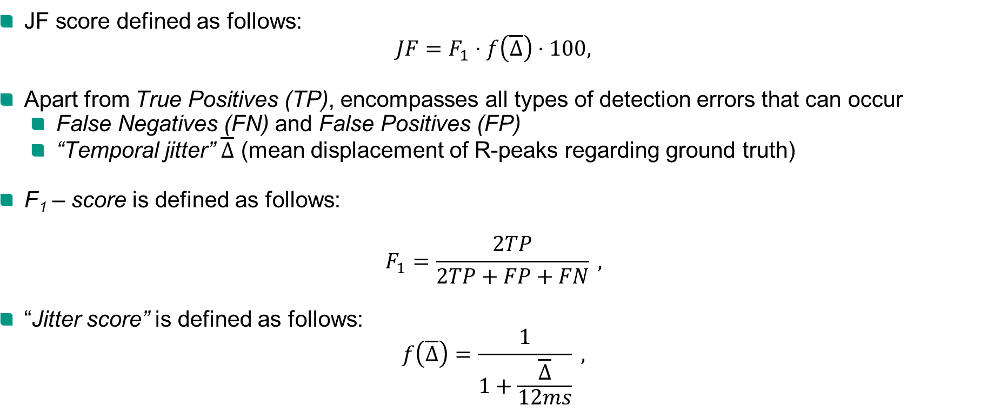
JF Score
JF score defined as follows:
$$JF=F_{1}⋅f\left(\overline{Δ}\right)⋅100,$$
Apart from True Positives (TP), encompasses all types of detection errors that can occur
False Negatives (FN) and False Positives (FP)
“Temporal jitter” $\overline{Δ}$ (mean displacement of R-peaks regarding ground truth)
F₁ – score is defined as follows:
$$F_{1}=\frac{2TP}{2TP+FP+FN} ,$$
“Jitter score” is defined as follows:
$$f\left(\overline{Δ}\right)=\frac{1}{1+\frac{\overline{Δ}}{12ms}} ,$$
Notes:
The proposed JF performance measure encompasses all types of detection errors that can occur, equally weights them and allows for direct and meaningful comparison between QRS-detectors
Temporal jitter meaning that an average R-peak displacement of 12 ms results in a penalty, reducing the JF score by 50\%.
This was compared by the authors, to the large temporal tolerance windows w, e.g., of ten times the sampling rate
w = 10 / (f_s) with f_s being sampling rate
widely used in QRS-detector implementations and masking temporal inaccuracies.
If inside such window w, a peak would be considered a true positive, and a false negative if outside w (in our case, with a sampling rate of f_s = 250 Hz, this would mean a tolerance window of 40 ms).
JF Score therefore resulting in a normalised measure that reaches 100\% if the average jitter is zero and there are no false negative or positive detections.
###########
For the calculation of the JF-score in this work, each peak detection algorithm was employed on the reference chest-ECG with the detected R-peaks serving as ground truth for subsequent peak detection on the ECG-related IC (with both signals being synchronized in time).
Additionally, a basic sample-wise R-peak placement correction was implemented (checking for higher values in samples surrounding the R-peak in a range of $\pm$ 40 ms, similar to the size of a tolerance window), in order to eliminate peak displacements in the ground truth.
The peak detection algorithms were then employed on the ECG-related IC and a sample-wise comparison of detected R-peaks was conducted, in order to determine the amount of all peak detection errors made on the ECG-related IC and calculate the JF score accordingly.

Slide 30
JF Score vs Sensitivity SE
TODOooo
Notes:
TODO: Insert comparing figure (bar chart) with JF performance and sensitity reported in
SINGLE R-PEAK DETECTION EVALUATION

