Slide 1
Sonarqube
Quick setup guide

Slide 2
Installation of SonarQube in Windows
1. Download & extract sonarqube-6.2.zip
https://www.sonarqube.org/downloads/
1.1 Launch SonarQube server using the appropriate batch file.
<<SONARQUBE_HOME>>\bin\windows-x86-64\StartSonar.bat
1.2 Once started, Sonar server shall be accessible using http://localhost:9000/
1.3 To login use admin/admin as user name & password
2. Download & extract sonar-scanner-2.8.zip
https://sonarsource.bintray.com/Distribution/sonar-scanner-cli/sonar-scanner-2.8.zip
2.1 Add the Sonar scanner bin folder to PATH variable
<<SONARSCANNER_HOME>>\bin
2.2 Update the sonar.host.url to http://localhost:9000 in the sonar-scanner.properties under <<SONARSCANNER_HOME>>\conf folder

Slide 3
Running the analysis
2.3 Create the sonar-project.properties file as follows under the root directory of your project (inside project folder)
# must be unique in a given SonarQube instance
sonar.projectKey=my:project
# this is the name and version displayed in the SonarQube UI. Was mandatory prior to SonarQube 6.1.
sonar.projectName=My project
sonar.projectVersion=1.0
# Path is relative to the sonar-project.properties file. Replace "\" by "/" on Windows.
# Since SonarQube 4.2, this property is optional if sonar.modules is set.
# If not set, SonarQube starts looking for source code from the directory containing
# the sonar-project.properties file.
sonar.sources=.
# Encoding of the source code. Default is default system encoding
#sonar.sourceEncoding=UTF-8
2.4 Go to the command prompt where the project is present & run the command sonar-scanner
This will run the analysis and the results will be available in the http://localhost:9000

Slide 4
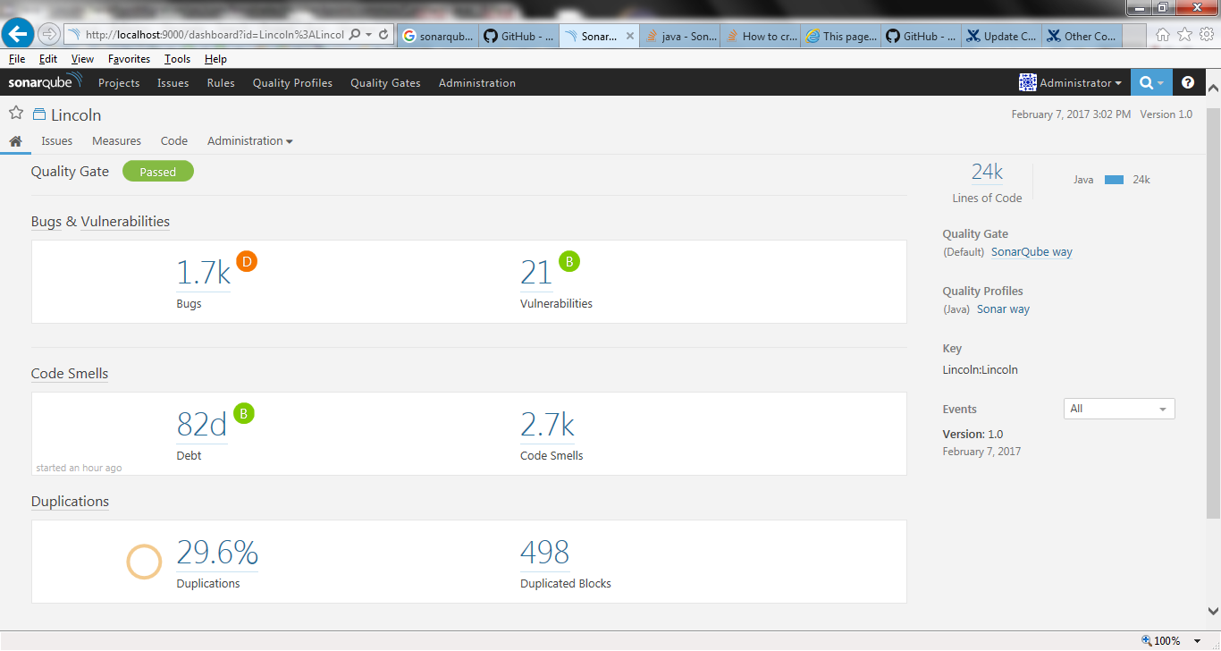
Dashboard

Slide 5
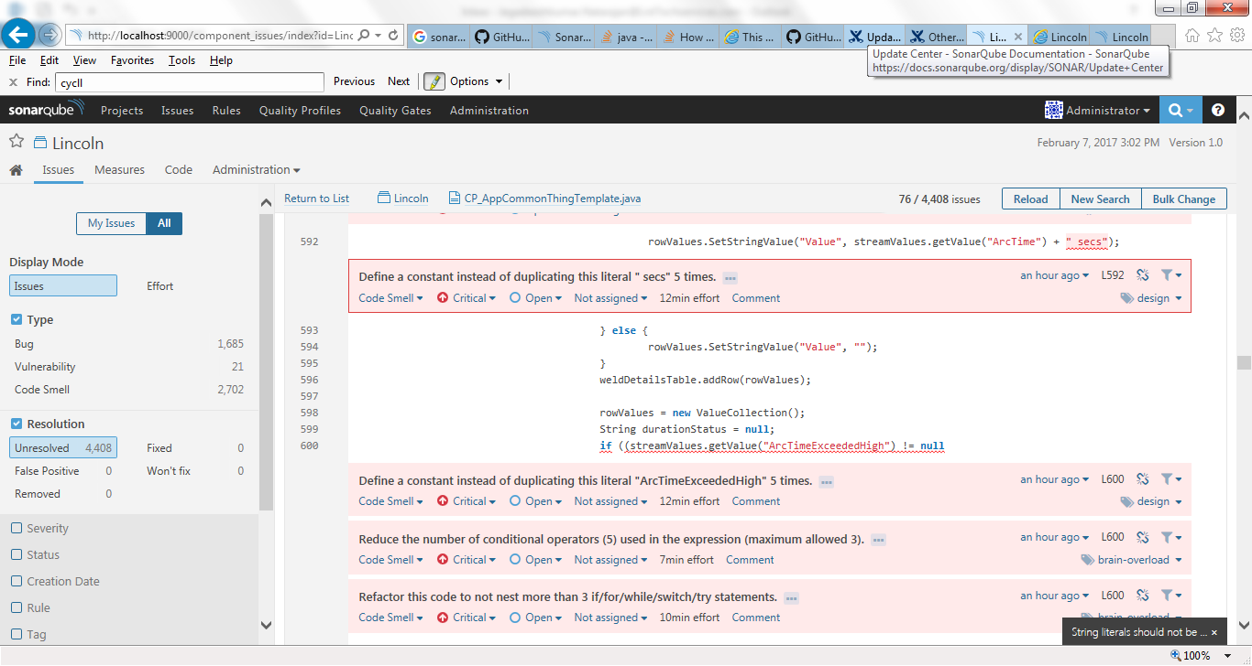
Bugs list

Slide 6
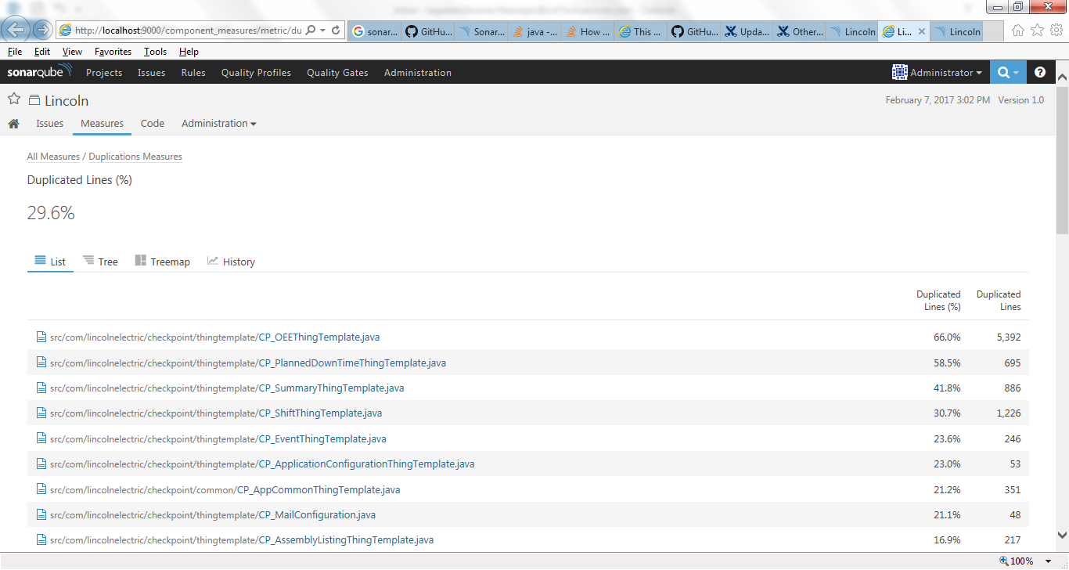
Duplicate code

Slide 7
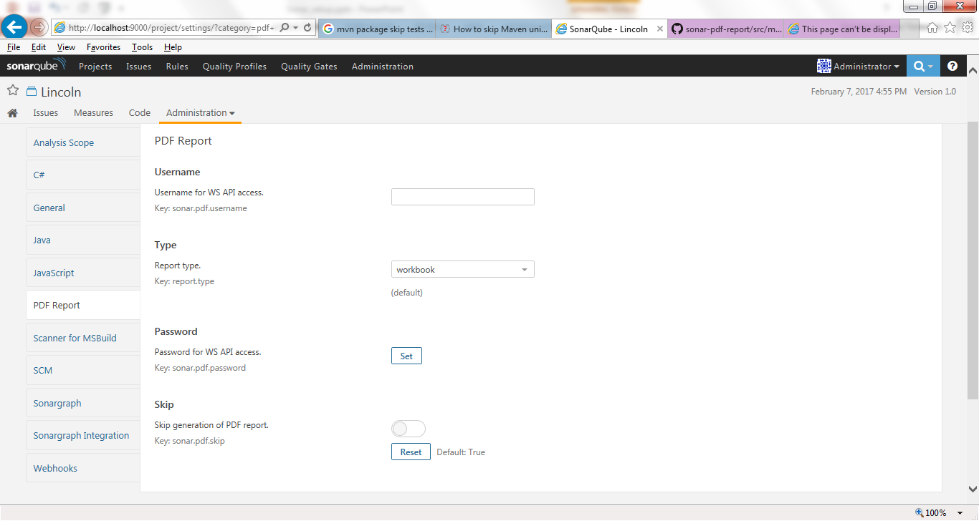

Slide 8
Thank You

