Slide 1


Test Driven Development and You
Introduction to Automated Testing

Slide 2
The Basics: User Stories and Acceptance Criteria
A user story is ideally the smallest unit of work that can be delivered that adds value to a stakeholder
When planning user stories, acceptance criteria (AC) is written to scope the work being done
Good AC should be specific in its outcomes, allowing for rigid tests

Slide 3


Testing Basics
Testing usually occurs when reviewing a feature for a pull request/ release, and checks for two things:
The new feature works as intended
Acceptance Testing
It hasn’t broken any existing functionality
Smoke Testing

Slide 4
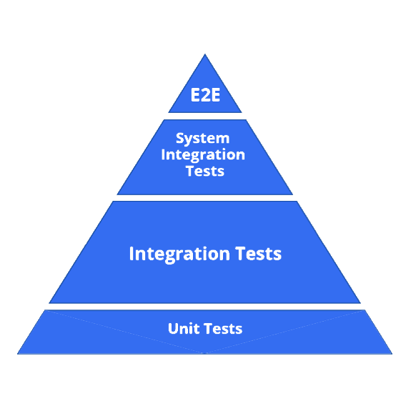
Testing Frameworks
Manual
______________
Integration
_________________________
Unit
Automated testing takes AC and runs code that confirms the feature is working as expected
There are various kinds of tests, with increasing complexity and in turn closer to a real users experience.
As there should be more low complexity tests than high, a pyramid is formed
Automated tests can be run manually or put into a CI/CD pipeline
Almost every language/ framework has testing modules available. We will be using Python’s Django framework for tonight’s example.

Slide 5
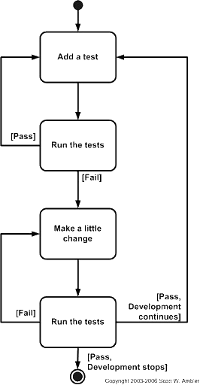
TDD Principals
If testing is needed before release, and the AC a test is based off of is already created, why not write the tests first?
It is expected your tests will fail at first
Your tests can act like a checklist of a user stories AC
Helps validate the feasibility of a story
Helps set up the necessary functions/ interfaces the final solution will need
Notes:
Diagram source: http://agiledata.org/essays/tdd.html

Slide 6
Practical Exercise: Unit Tests
Unit tests are simple input/output tests
Ideally only check a single functionality
Provide the most coverage quickly
Made by directly calling functions/ requests
We’ll be testing an example project
https://github.com/utsprogsoc/testdrivendevelopment

Slide 7
Integration Tests
Integration tests look at how multiple pieces fit together
More complex to write and can break with UI changes
Simulate what a real user sees
Selenium is a primary tool in creating integration tests for web

Slide 8
Stability Over Coverage
As with all methodologies, it can have potential downside if implemented haphazardly:
Can add unnecessary overhead to a project
Can cause tunnel vision of quantitative over qualitative AC
Can limit explorative/ discovery focused work
“When all you have is a hammer, everything looks like a nail”
Nothing in agile is a silver bullet:
Know when to maintain tests, and when to let them go
Testing should never be the only metric to success
Value the projects stability over test coverage

Slide 9
