Slide 1

LOAN ELIGIBILITY PREDICTION
Akshat Sharma
PGA 03

Slide 2





Introduction
Loan
Application
Loans constitute the fundamental business of banks, with the primary source of profit being the interest accrued on loans. Before granting a loan, financial institutions engage in a thorough process of verification and validation. Despite this, there remains uncertainty regarding whether the applicant possesses the capability to repay the loan without encountering difficulties. In this I construct a predictive model aimed at determining whether an applicant is likely to repay the loan to the lending company.
Document
Submission
Document
Verification
Loan
Approval

Slide 3
Problem Statement
Dream Housing Finance company specializes in providing all types of loans across urban, semi-urban, and rural areas. Upon receiving a loan application, the company undertakes a validation process to determine the customer's eligibility. This validation process is based on various customer details provided during the online application, including age, house ownership, working experience, intent of loan, income, loan amount, credit history, among others. To streamline and automate this loan eligibility process in real-time, the company aims to identify specific customer segments that qualify for loan amounts. By targeting these eligible customer segments, the company can optimize its loan offerings and better serve its clientele.

Slide 4











Way of Solving Problem
Data Cleaning
Data Visualization
Data Preprocessing
Dataset
Best Model
Training
Data
Test
Data
Streamlit App
Predicting
Test Data
Hyperparameter Tuning
Model Training

Slide 5
About Loan Eligibility Prediction
Loan eligibility is defined as a set of criteria basis which a financial institution
Evaluates to decide the eligibility of a customer for a particular loan.
Criteria
Person Employment
Length
Loan Percent Income
Loan Interest Rate
Person Home Ownership
CB Person Default on File
CB Person Credit History Length
Person Income
Loan Intent
Person Age
Loan Amount
Loan Grade

Slide 6
Techniques Used In
Filling Null values
We employed the mean imputation technique to fill null values in the 'person_emp_length' and 'loan_int_rate' columns, leveraging the loan intent as a guiding factor. This method ensures the preservation of data integrity while addressing missing values in numerical features.
Handling Imbalanced Data
Given the significant class imbalance in our dataset, we have opted for the Synthetic Minority Over-sampling Technique (SMOTE) to rectify this disparity. With the current ratio standing at 78:22 between majority and minority classes, SMOTE is anticipated to rebalance the distribution to around 66:34, thus enhancing the model's performance and robustness.
Dropping Row
Removed several rows from the dataset to mitigate bias. Specifically, we excluded entries where the age exceeded 75 years, as they could potentially introduce bias into the analysis. Additionally, we identified and removed two erroneous rows where individuals aged 22 and 23 reported work experience of 123 years, indicating data entry errors

Slide 7
Top Insight
Age Distribution: Majority of borrowers are aged 20-35, indicating youthful loan applicants.
Housing Status: Half of our dataset resides in rented accommodations, while 40% have mortgaged homes.
Loan Preference: Educational loans are most popular, closely followed by medical loans. Personal and venture loans show similar demand.
Default Rates: While most borrowers have clean records, a small segment defaults 3-5 times.
Loan Grades: Grades A and B dominate, reflecting lower risk. Grades C-G signify higher risk, with fewer instances.
Loan Amounts: Loans of 5000−5000−10000 are most common, followed by 300−300−5000 loans. A significant group borrows over $15000.

Slide 8
Machine learning Models Used
Logistic Regression
Before applying SMOTE, the model achieved an accuracy of approximately 79.54% on the test data, with a precision of 0.53 for class 1 and 0.87 for class 0. However, after applying SMOTE, the accuracy increased to around 84.80% on the test data, with a precision of 0.68 for class 1 and 0.89 for class 0.
Additionally, the recall and F1-score for class 1 also improved after applying SMOTE, indicating better performance in identifying instances of the minority class.
Furthermore, when comparing the logistic regression model with hyperparameters and the logistic regression model with balanced class weights, we observe that the former achieved a higher accuracy on both the training and test data

Slide 9
Decision tree
The decision tree model shows clear signs of overfitting, as seen in its high accuracy on the training data but lower performance on the test data.
Even after addressing class imbalance with SMOTE, the overfitting issue persists.
Therefore, relying solely on the decision tree model may not be a suitable approach.
Random Forest
Random forest applied to the data before SMOTE exhibited overfitting on the training data.
After applying SMOTE, the random forest model showed improved performance compared to before SMOTE, with enhanced precision and recall metrics. However, the issue of overfitting persisted.
Utilizing hyperparameters with the random forest model on SMOTE-treated data yielded similar results to the previous scenario, with slightly reduced accuracy on the training data compared to the test data. However, overfitting remained a concern.

Slide 10
Support Vector Classifier
Before applying SMOTE, the Support Vector Machine (SVM) model showed relatively low accuracy on both train and test data, with limited precision, recall, and F1-score for the minority class (1).
After implementing SMOTE to address the data imbalance, the SVM model's accuracy on the test data significantly improved. However, its performance metrics for the minority class remained suboptimal, with zero precision and recall, indicating challenges in correctly identifying instances of the minority class.
Despite the improvements in overall accuracy post-SMOTE, the SVM model's inability to effectively predict the minority class suggests limitations in its suitability for this classification task. Hence, further consideration of alternative models may be warranted.

Slide 11
Extreme Gradient Boost Classifier
All variations of the XGBoost model demonstrate promising outcomes.
While some models show signs of overfitting on the training data, others exhibit commendable accuracy, precision, and recall.
The final model stands out with superior performance, boasting excellent accuracy, precision, recall, and a more favorable confusion matrix compared to its counterparts.
XGBoost with hyperparameter tuning achieved remarkable results, showcasing high accuracy on both the training (99.99%) and test data (93.69%). It also displayed robust precision, recall, and F1-score for both classes, indicating its efficacy in classification tasks.
Hence, the final XGBoost model will be chosen as the preferred option for constructing the pipeline and conducting predictions.

Slide 12
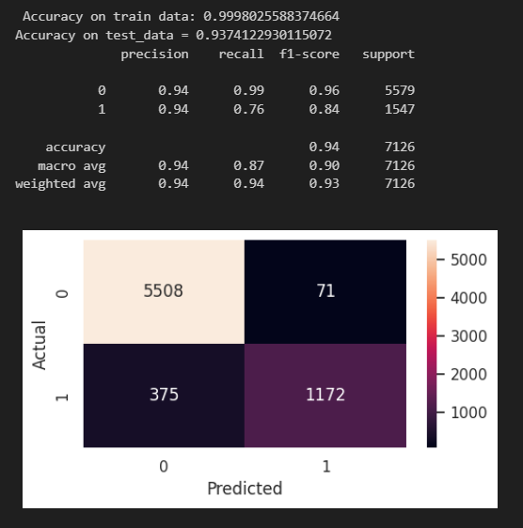
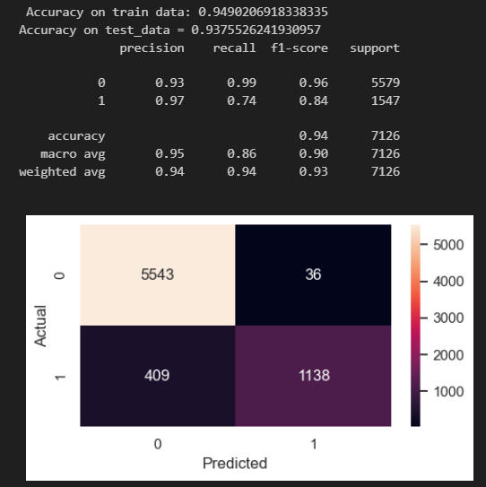
Results of Support Vector Classifier
After Smote (without parameter)
After Smote (with some parameter)

Slide 13

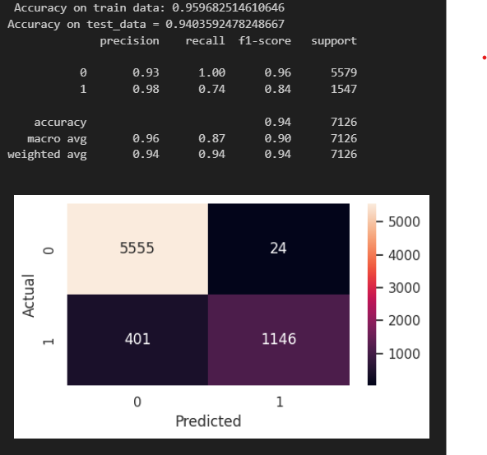
After Smote (with hyperparameter)
After Smote (with hyperparameter)

Slide 14

Streamlit App
Page 1

Slide 15

Page 2

Slide 16

Thank You

