Slide 1
Finance
Каширина Надежда

Slide 2
Initial data
Train data
0.5
Output
0
0
0
0
1
0
1
1
Company | Time | Financial Distress | x1 | x2 | x3 | x4 | x5 | x6 | x7 | … | x80 | …
1 | 1 | 0.010636 | 1.281 | 0.022934 | 0.87454 | 1.2164 | 0.06094 | 0.18827 | 0.5251 |  | 22
1 | 2 | -0.45597 | 1.27 | 0.006454 | 0.82067 | 1.0049 | -0.01408 | 0.18104 | 0.62288 |  | 22
1 | 3 | -0.32539 | 1.0529 | -0.059379 | 0.92242 | 0.72926 | 0.020476 | 0.044865 | 0.43292 |  | 22
1 | 4 | -0.56657 | 1.1131 | -0.015229 | 0.85888 | 0.80974 | 0.076037 | 0.091033 | 0.67546 |  | 22
2 | 1 | 1.3573 | 1.0623 | 0.10702 | 0.8146 | 0.83593 | 0.19996 | 0.0478 | 0.742 |  | 29
2 | 2 | 0.0071875 | 1.0558 | 0.081916 | 0.87949 | 0.68673 | 0.14263 | 0.043102 | 0.77198 |  | 29
2 | 3 | 1.2002 | 0.97059 | 0.076064 | 0.90677 | 0.8098 | 0.16592 | -0.024649 | 0.7366 |  | 29
2 | 4 | 2.2348 | 1.059 | 0.1302 | 0.81811 | 0.87599 | 0.23445 | 0.045576 | 0.78727 |  | 29
Категориальные
признаки
Числовые признаки
Катег. Пр.
Распределение классов
Class | TRAIN |  | TEST
0 | 111 | 3.8 % | 25 | 3.33 %
1 | 2810 | 96.8 % | 726 | 96.67 %

Slide 3
Models
Decision Tree | Random Forest | Logistic Regression | Grad Boost
max_depth = 5 | n_estimators=32 max_depth=5 | C=1 | n_estimators=64 depth=1
Metrics
Decision Tree
Train
Test
 | y=1 | y=0
a=1 | 2800 | 45
a=0 | 10 | 66
 | y=1 | y=0
a=1 | 716 | 21
a=0 | 10 | 4
TRAIN | TEST
ACC: 0.9812 | 0.9587
PREC: 0.8684 | 0.2857
RECALL: 0.5946 | 0.16
*for negative class
Recall for negative class

Slide 4
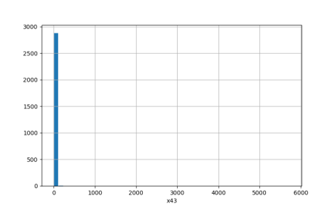
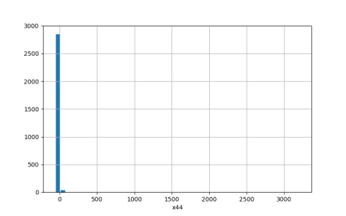
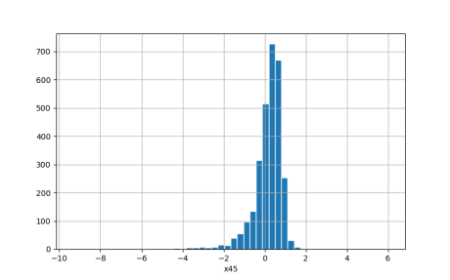
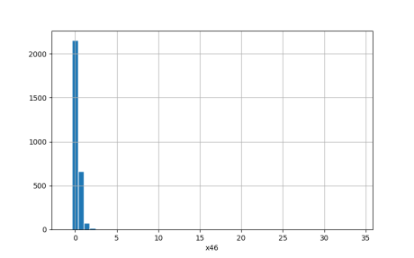
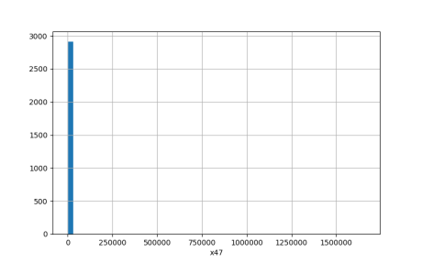
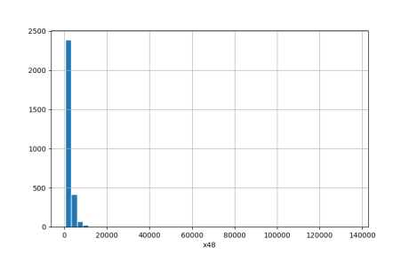
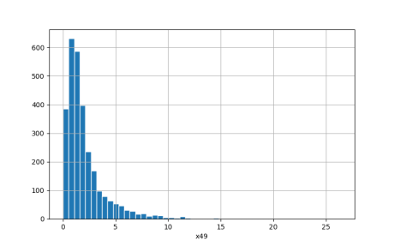
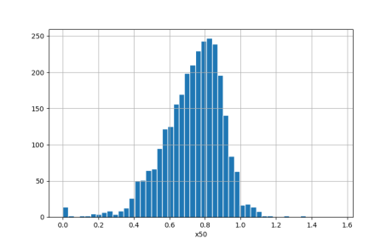
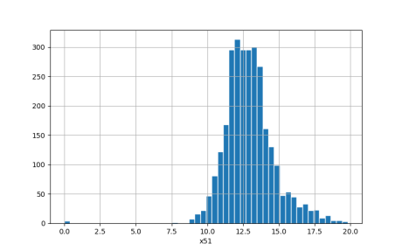
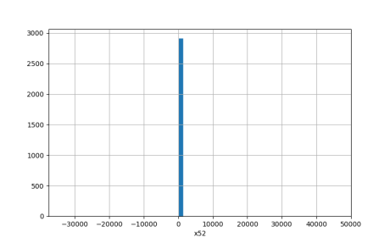
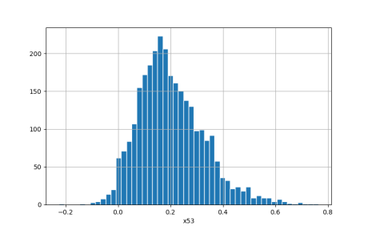
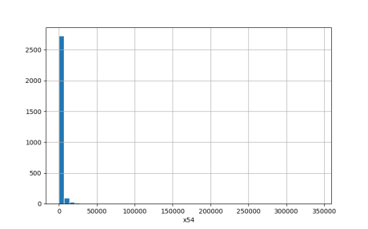
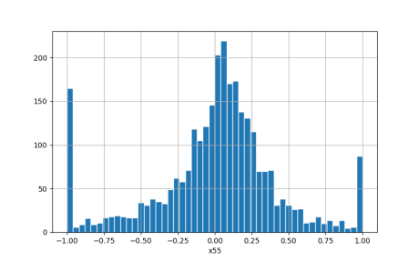
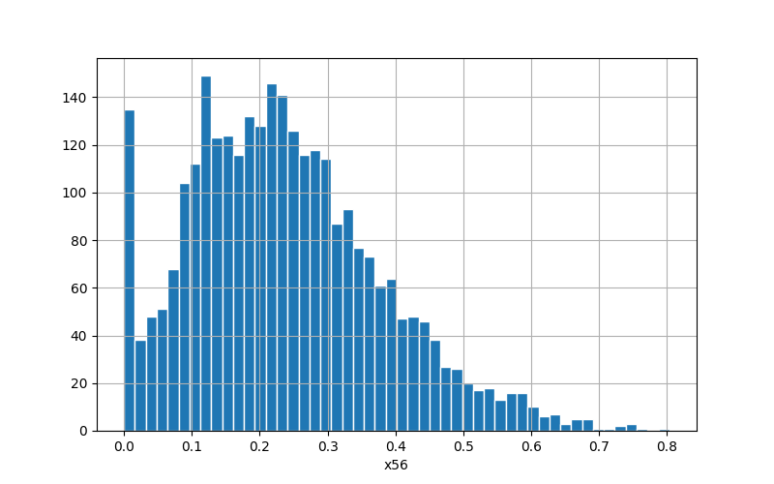
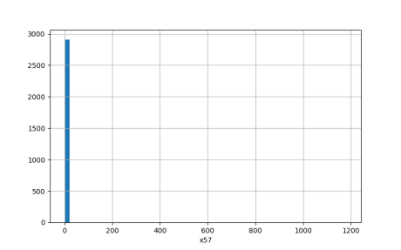
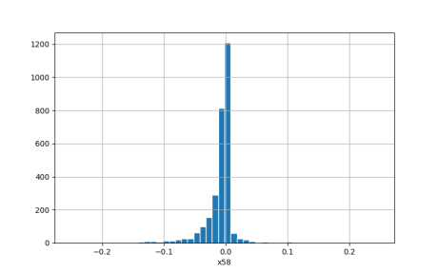
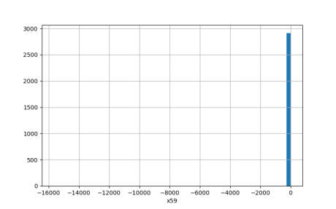
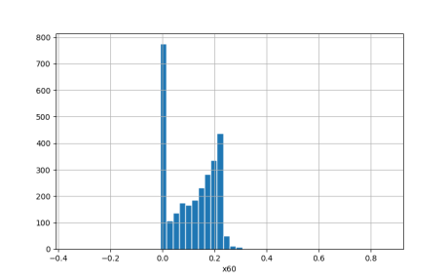
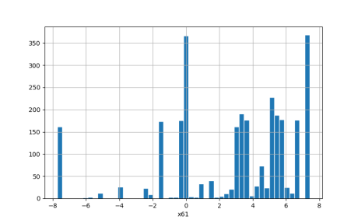
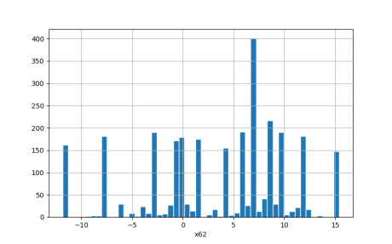
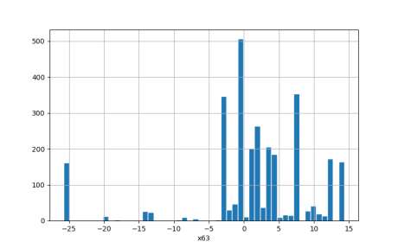
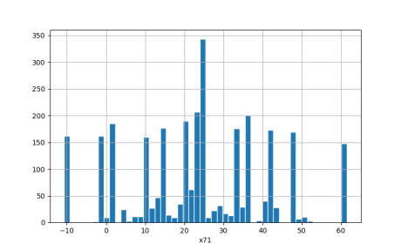
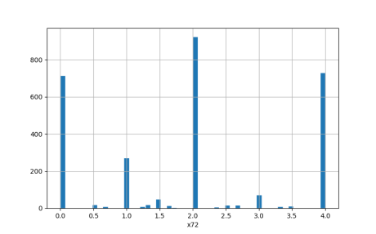
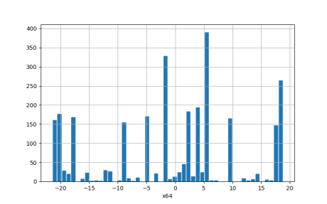
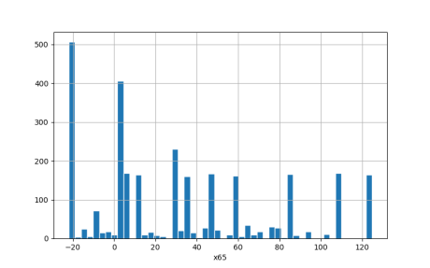
Real features
Real features

Slide 5

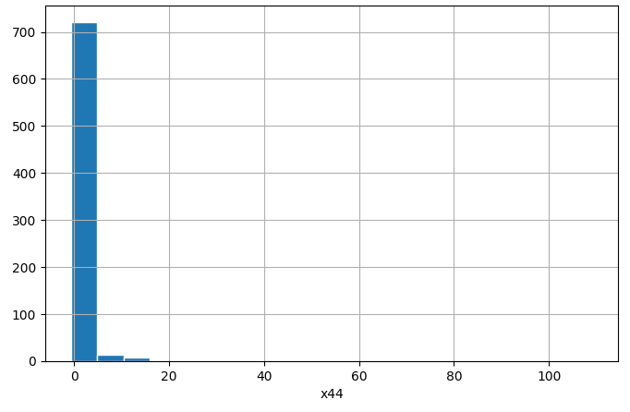
Real features
Before
After

Slide 6
Real features
Before
GB_ini = 40.5%
GB_cut = 43.2%
After
*using cross-val

Slide 7
Real features
Масштабирование
На среднее и дисперсию
На среднее и дисперсию
На 0 и 1
*using cross-val

Slide 8
Categorical features
*using cross-val
For TEST set

Slide 9
Categorical features
Add resampled algorithm – ADASYN(k_neighbors = 4)
*using cross-val

Slide 10
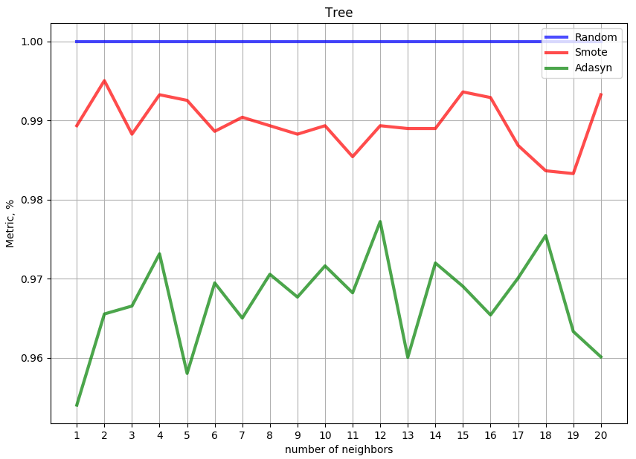
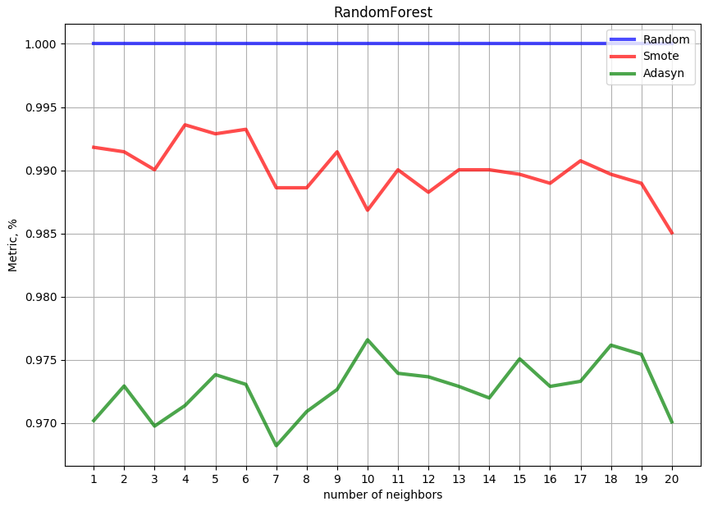
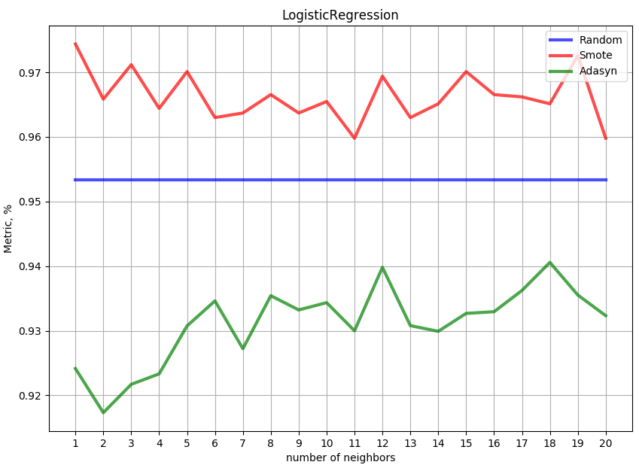
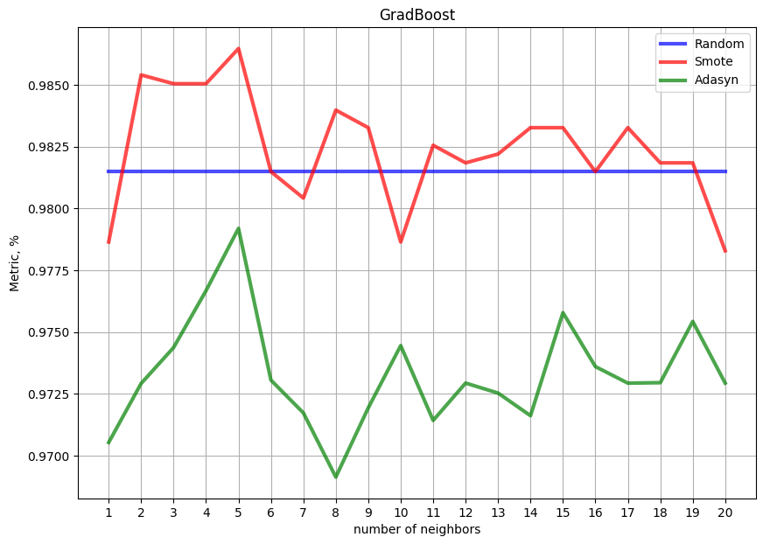
Resampled data
Not influence on test set
*using cross-val
SMOTE, N_neighbors = 5

Slide 11
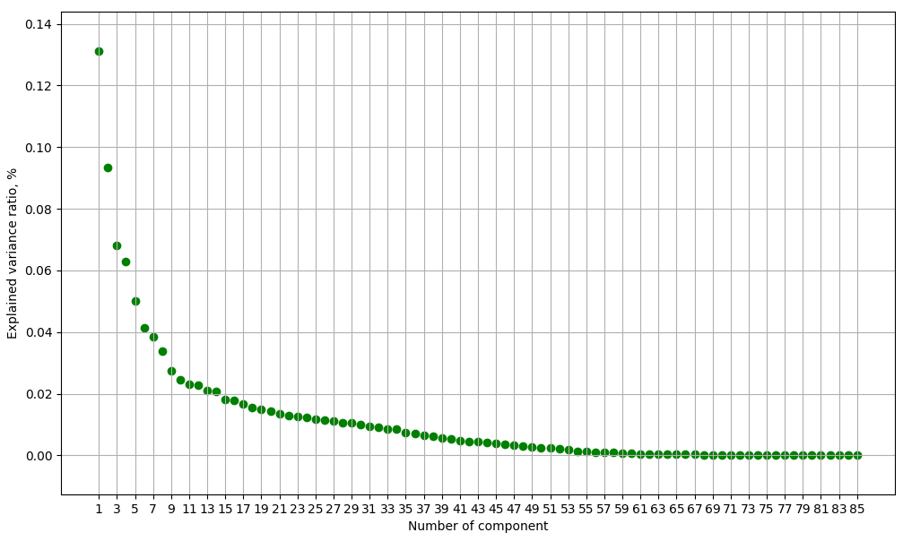
Selection features
PCA
n = 55
41 components : 95.08%

Slide 12
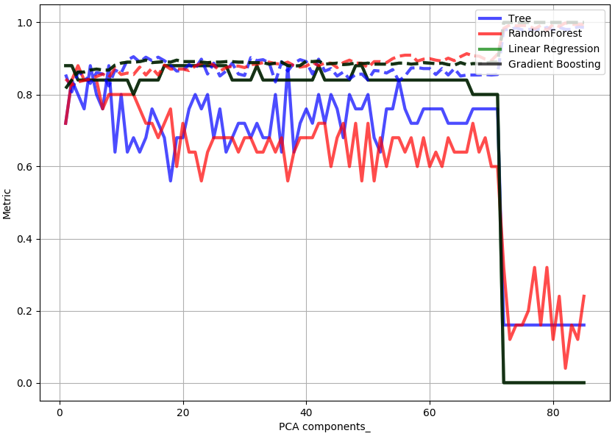
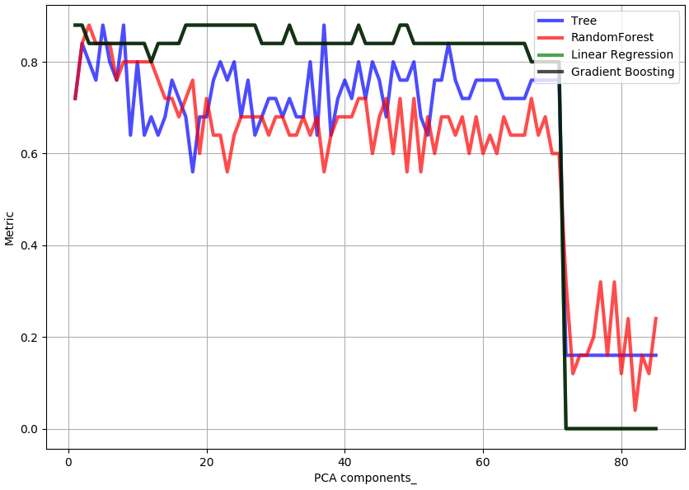
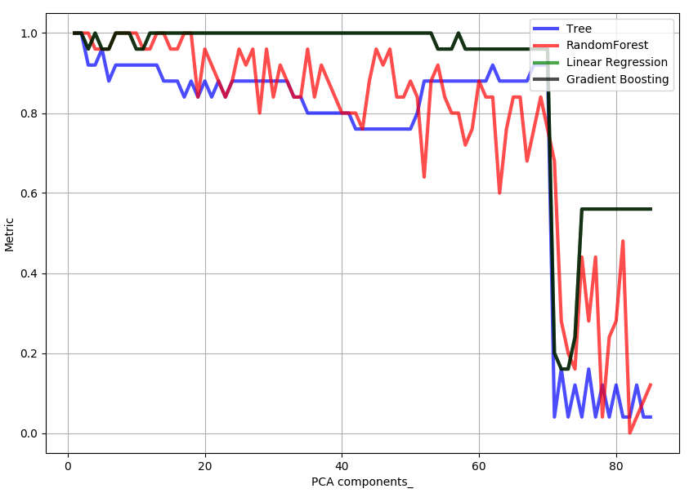
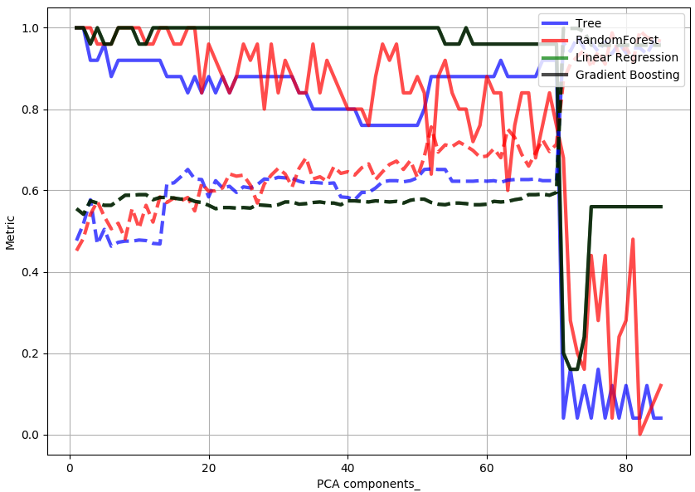
Selection features
PCA
Max = 88%
Max = 100%
Before
Before
After
After

Slide 13
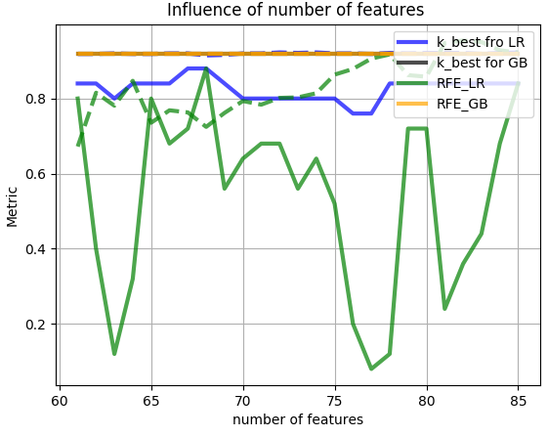
Selection features
Other methods
Одномерный отбор признаков
K_Best
Рекурсивное исключение признаков
RFE

Slide 14
Preprocessing - Result
1. Преобразование финансового благополучия компании к 0 или 1.
2. Удаление аутлайнеров из реальных признаков
3. Масштабирование реальных признаков на среднее и дисперсию
4. Преобразование категориальных признаков, используя счетчики
5. Добавление новых объектов для выравнивания классов – SMOTE (n_neighbors = 5)
6. Без преобразования признакового пространства

Slide 15
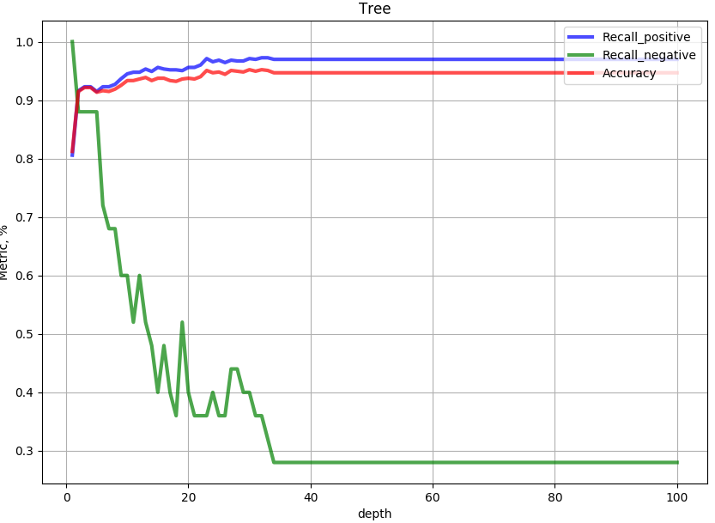
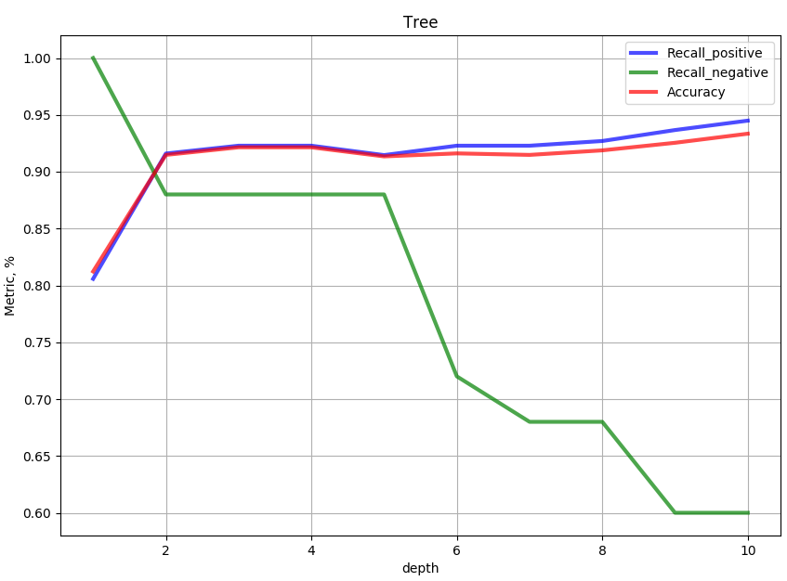
Decision Tree
Max_depth = 4

Slide 16
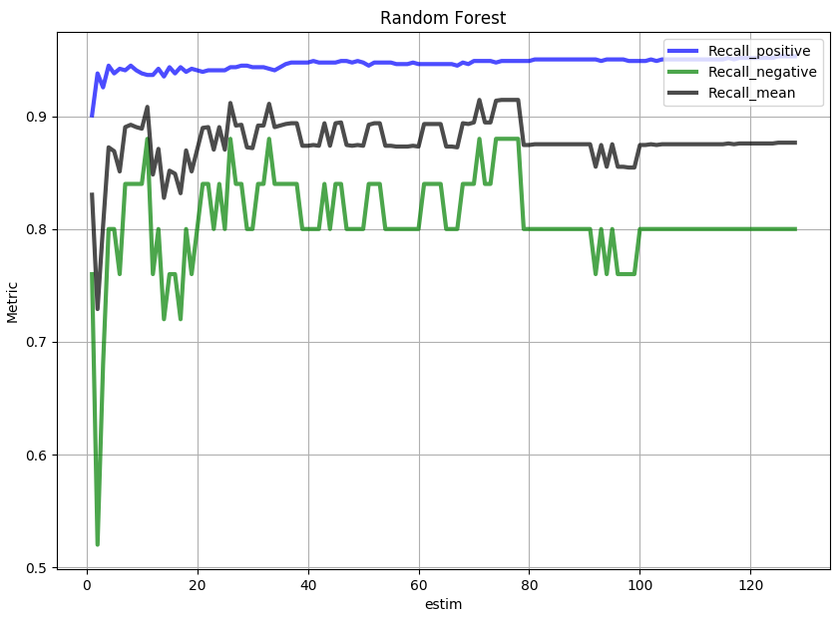
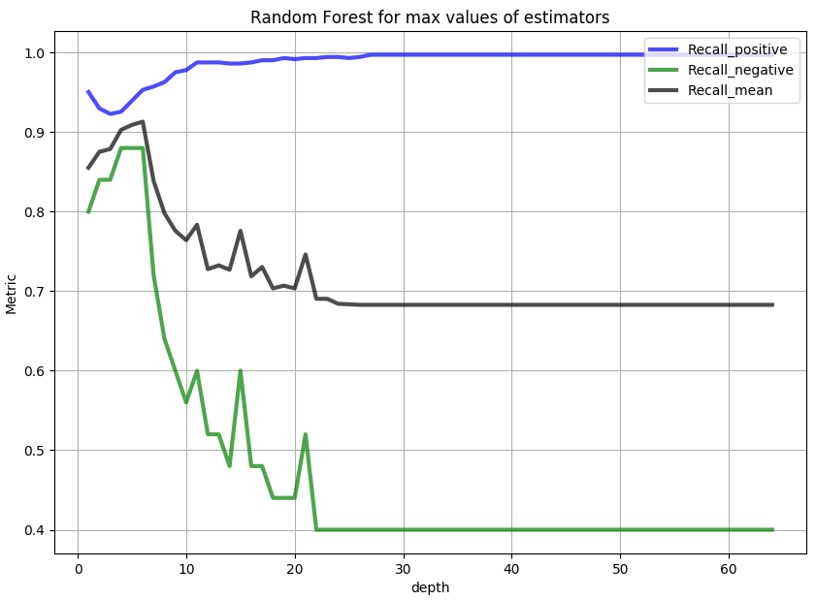
Random Forest
Fix depth – find n_estimators (1-128) for max recall
Max_depth = 7
N_estimators = 11
Max_depth = 7

Slide 17
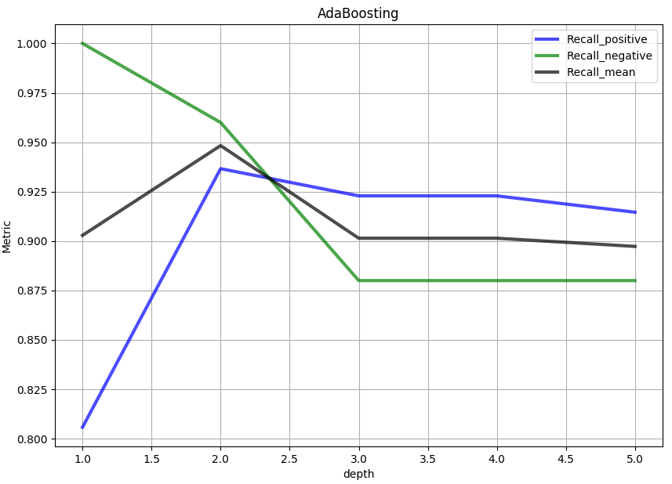
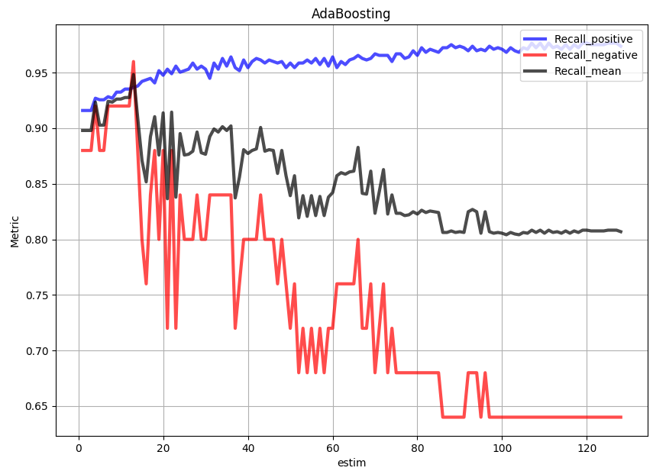
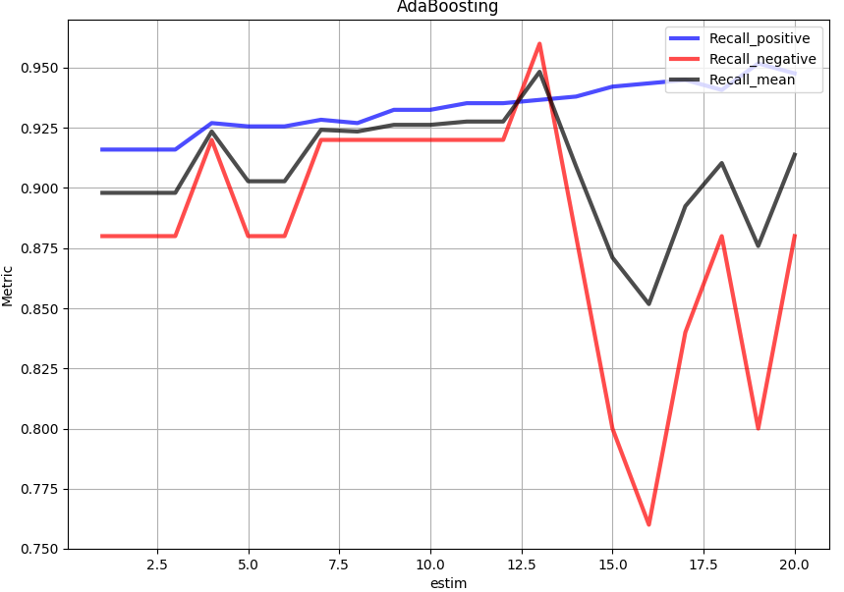
AdaBoost
SMOTE5
Fix depth – find n_estimators (1-60) for max recall
depth = 2
N_estimators = 13
Depth = 2

Slide 18
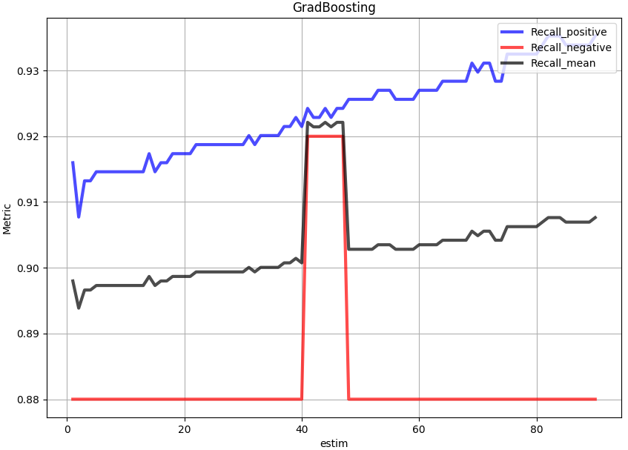
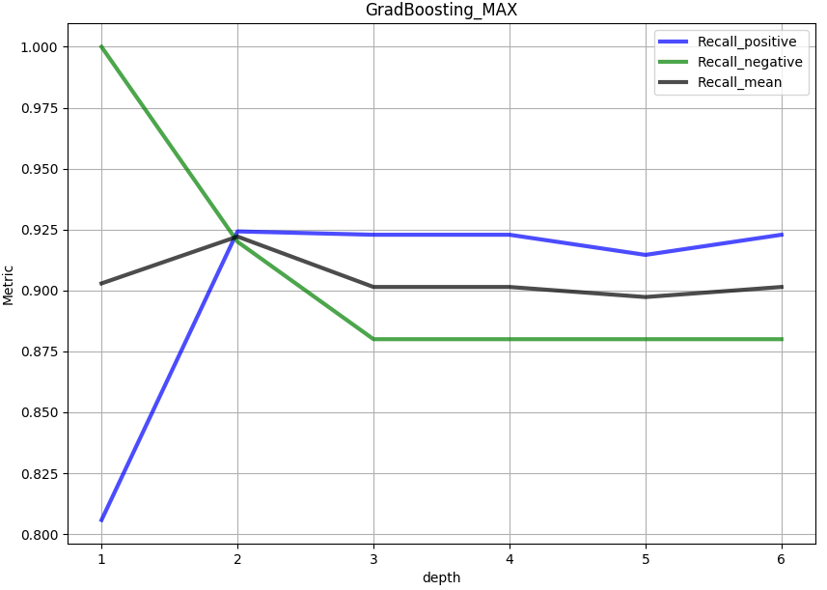
Gradient Boosting
SMOTE5
Fix depth – find n_estimators (1-90) for max recall
depth = 2
N_estimators = 42
Depth = 2

Slide 19
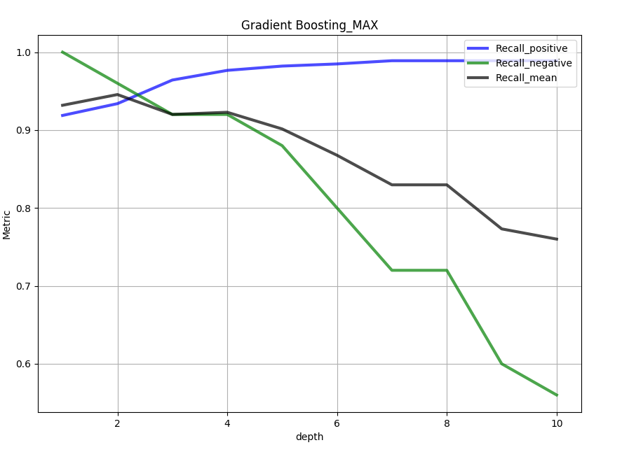
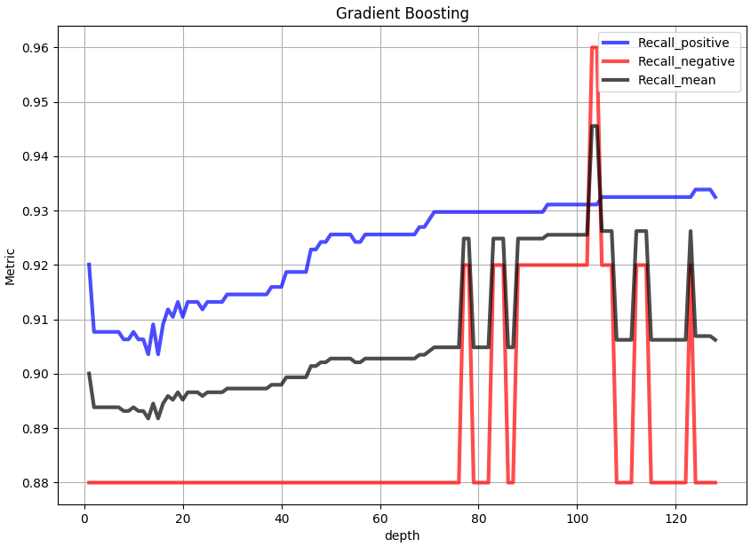
Gradient Boosting
Random
Fix depth – find n_estimators (1-128) for max recall
N_estimators = 103
Depth = 2
depth = 2

Slide 20
Results

