Slide 1



Kaiwa Sensei
Conversation Teacher
Team 16

Slide 2

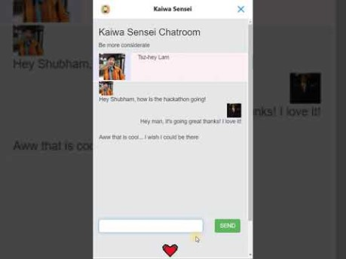
https://youtu.be/gtSHrm3yi8Y
Demo

Slide 3
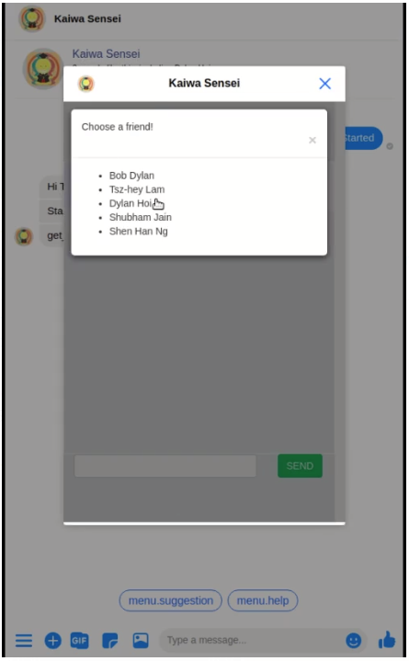





Architecture
Chat extension
Users send messages
User message
Chat Server
User
User Msgs
Sentiment Analysis

Slide 4
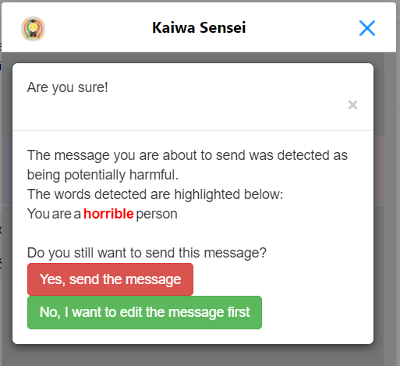
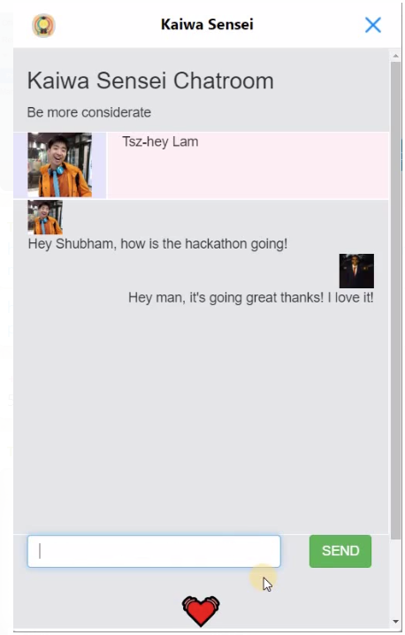
Impact
Think Twice
Transparent Conversations

Slide 5
Thank You!

