Slide 1
vizAI -Front and back end solution to visualizing explainable AI-
Systems Engineering Team 10 -
Julian Popovski-Jones, Dylan Hoi, James Chang

Slide 2
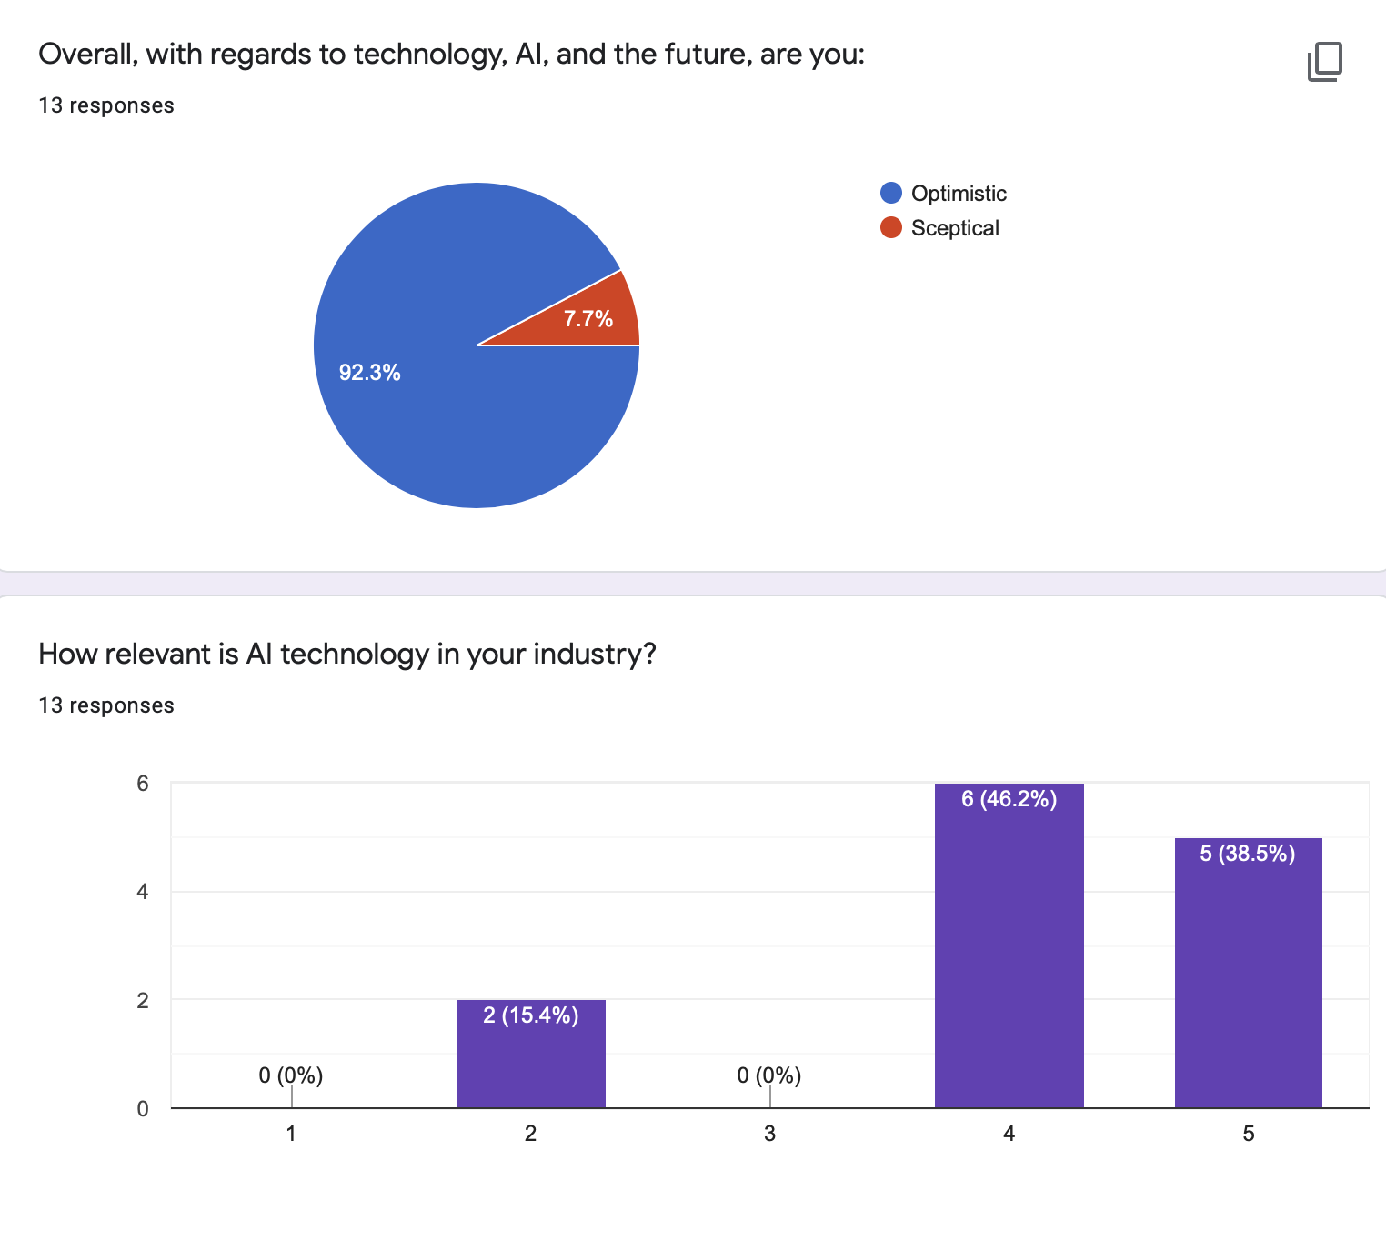
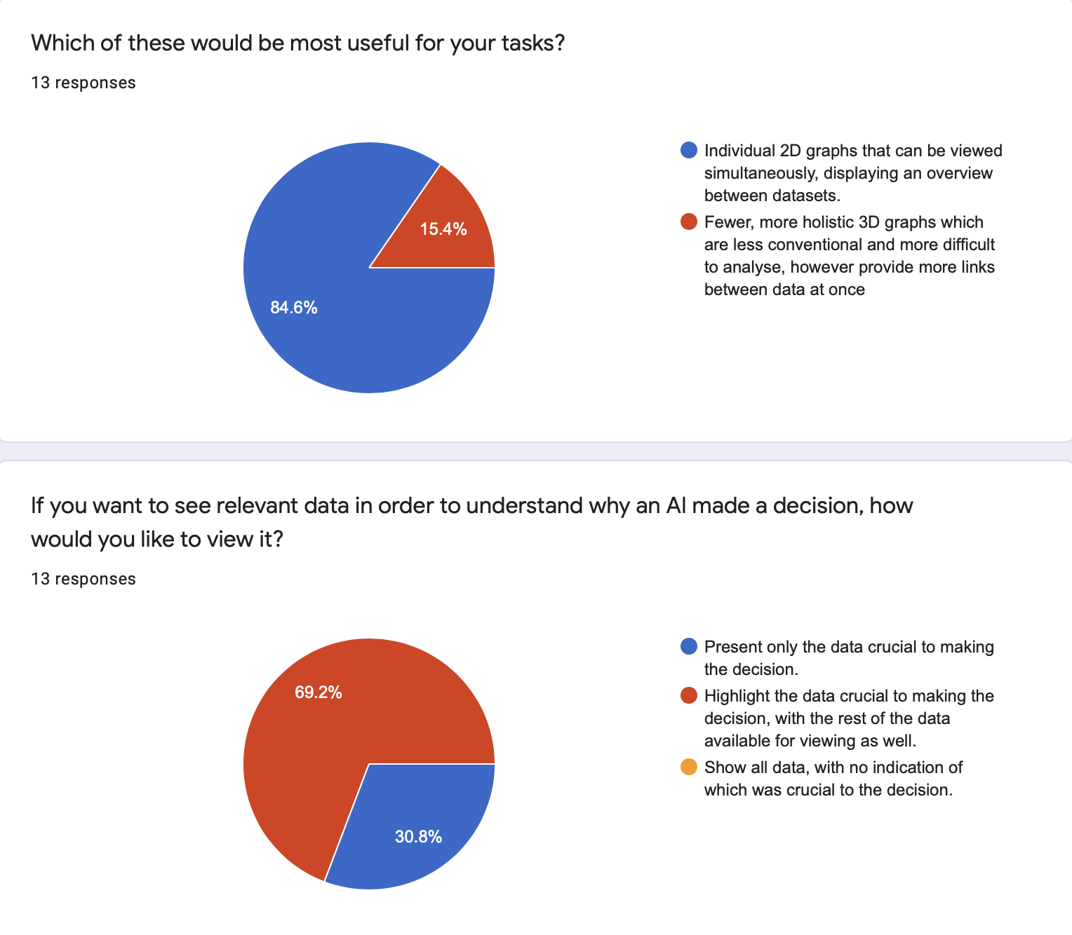
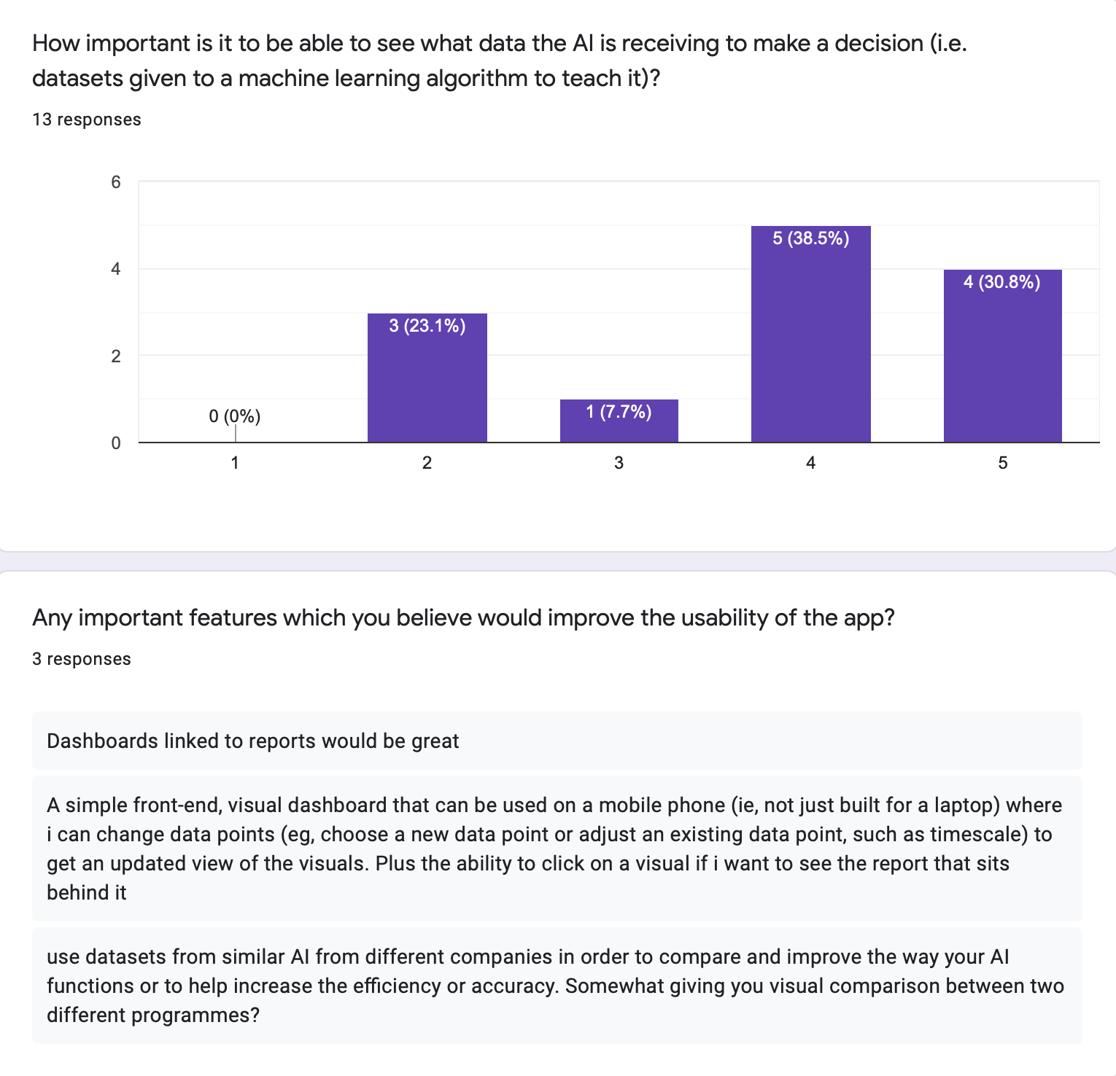
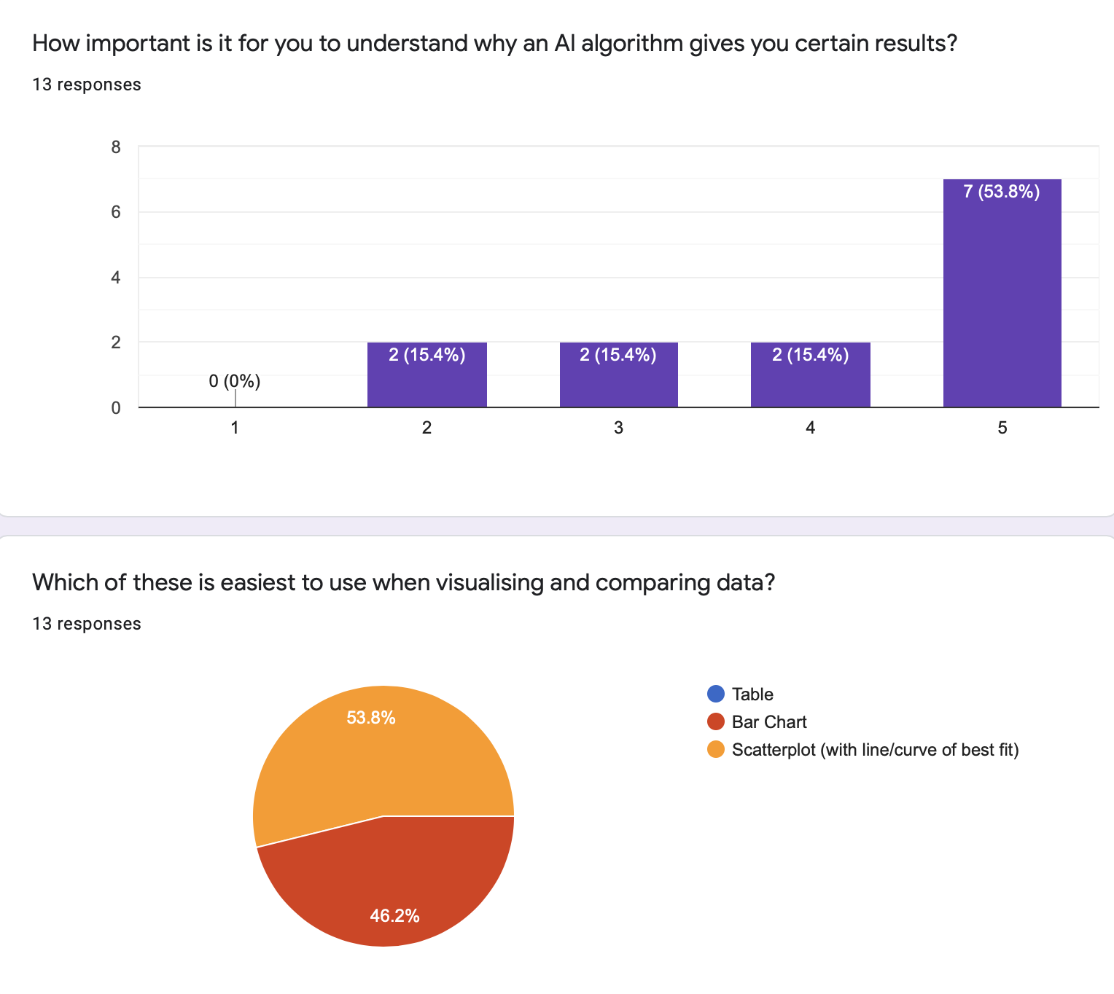
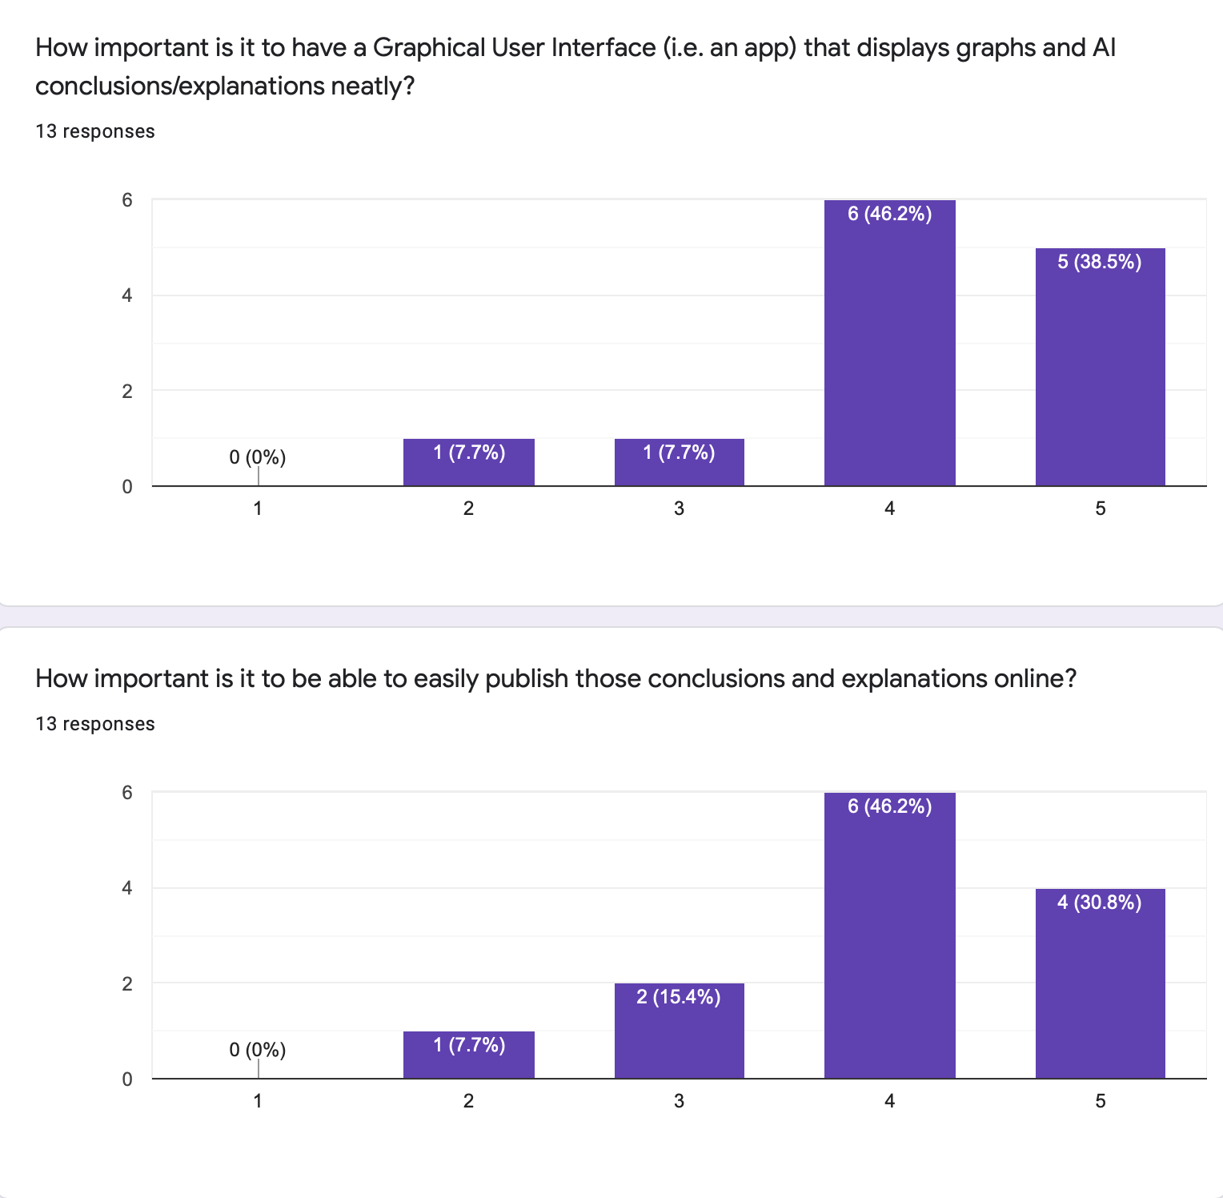
Gathering User Requirements

Slide 3
Personas & Scenarios From the results we collected we were able to create two distinct representations of our target users
Persona 1
Alan
34 years old
Senior manager of a financing company
Extensive statistical analysis experience
Expectations:
To increase the proportion of AI assistance and increase productivity without compromising validity of the analysis
To be able to trust certain constructive AI decisions that may be seen as irrational to a human analyser
To grip hold of AI algorithm’s bias and be able to determine whether it can be applied to certain types of data
Would like to have
An easy to interpret GUI for quick access i.e. a dashboard-style app
Data may be displayed in a variety of ways but must be conventional (bar charts, scatter plots)
All data should be available to view if desired, but the critical ones leading to certain AI decisions are highlighted
Wants to avoid:
Complex GUI with too many texts and tips
Too many options when involving data display
Unable to use the utility from both desktop and mobile clients.
Persona 2
Muhammad
28 years old
PhD, experienced AI developer
Comprehensive computer knowledge
Expectations:
Test his own machine learning algorithm with the aid of AI tool
To be able to see differences in behaviours of the algorithm before and after learning
To be able to spot in time whether the learning is going in an unexpected direction
Would like to have:
Any types of graph display, but only focused on the critical data points
More options to customise the tool to his needs
Open-source so he can contribute to the development if necessary
Wants to avoid:
Commercial licensing agreements that may jeopardise his research
Lack of cohesive and sound software design to easily expand and modify on
Redundant data being displayed on graph
Alan’s Scenario:
Alan is looking for an explainable AI tool that would enable him to view and evaluate the critical data points that resulted in a certain AI decision. Though unfamiliar with computer related subjects, Alan values AI’s potential and often uses it to assist his tasks, however in practice he is sometimes sceptical about its effectiveness and questions why it comes to certain conclusions.
Alan has extensive knowledge in statistical analysis and is confident with interpreting different types of graphs that are sometimes less obvious in terms of trend and relations. His goal is to use the AI tool to analyse the critical data points himself and decide whether the AI algorithm has made a sensible decision based on his experience.
He would like to have that data presented in conventional ways - he is quite traditional in the approach to data presentation, and would find it easier to deal with methods he’s more familiar with.
Having extensive knowledge and experience in statistical analysis, Alan is aware of how distracting additional information can be. He would like the tool to be able to filter out as much unnecessary data and technical complications as possible.
Muhammad’s Scenario:
Muhammad is a PhD student whose research direction is in machine learning. He is often frustrated by the fact that the training data he uses sometimes results in unpredictable behaviours. He is looking for an efficient way to visually inspect algorithm behaviours on critical data points, both before and after learning new training data.
Muhammad has completed both a BSc and an MEng degree in computer science and is thoroughly familiar with computer-related subjects. He understands the nuances of computing languages at all levels, and therefore is capable of expanding or tailoring AI tools to his own needs if the software is open-source.
Muhammad does not have a clear preference on data presentation, and is even willing to accept new ways of visualising data, such as a 3D plot. However, he does want the result to be focused on the critical data points only.
Muhammad is skilled in using all kinds of interfaces, including using a simple command prompt to execute applications. He does not have requirements towards GUI, although he does find it helpful to be able to have a command line version of the app so he can easily customise the software without worrying about GUI coding.

Slide 4
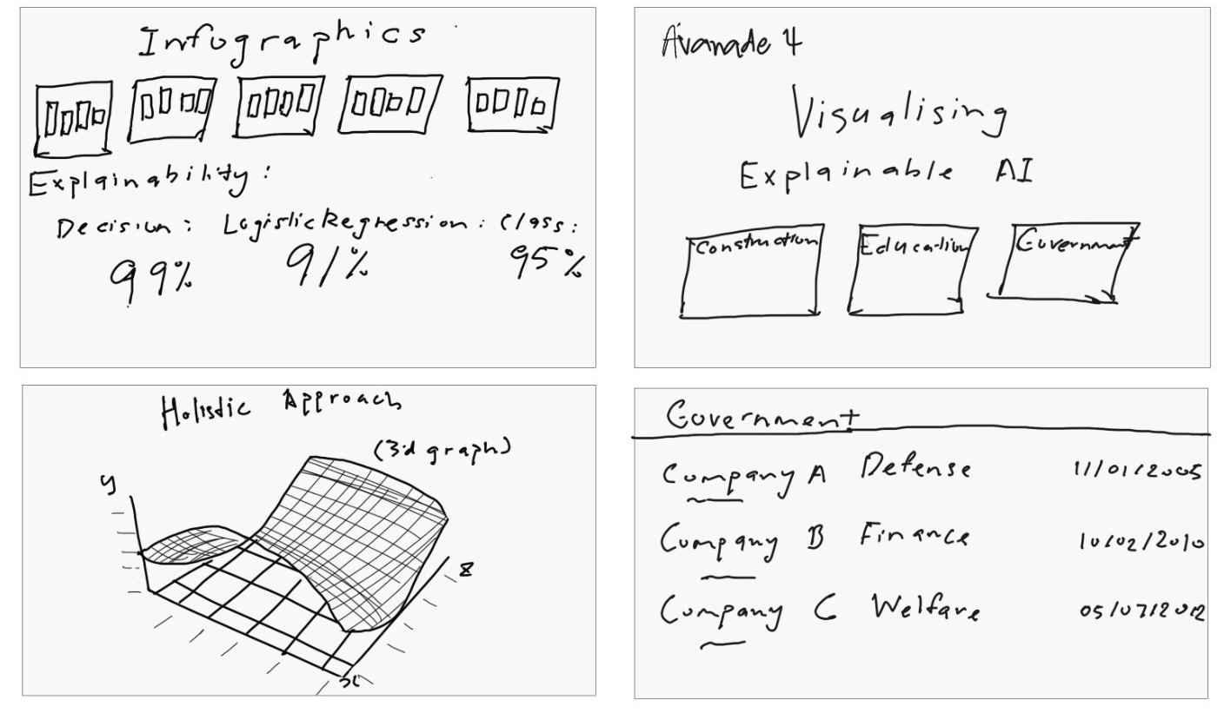
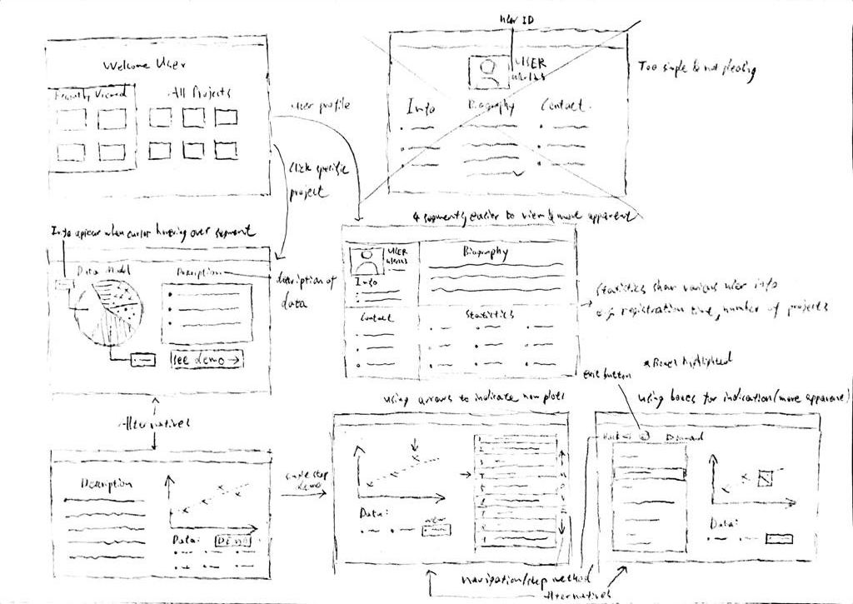
Sketches - Sketch 1 From studying our situations we concluded that two separate modes are needed for our software
We drew up several sketches as initial prototypes to explore ideas on how our web application would look like. They were drawn based on our initial assessment with our company regarding possible AR/VR 3d modelling graphs.
These serve as initial designs which we consult users with for feedback to improve.

Slide 5
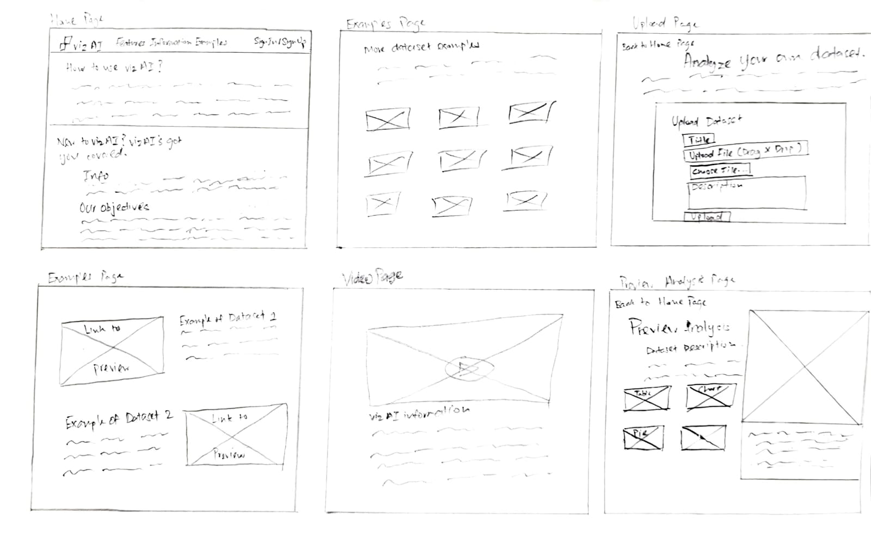
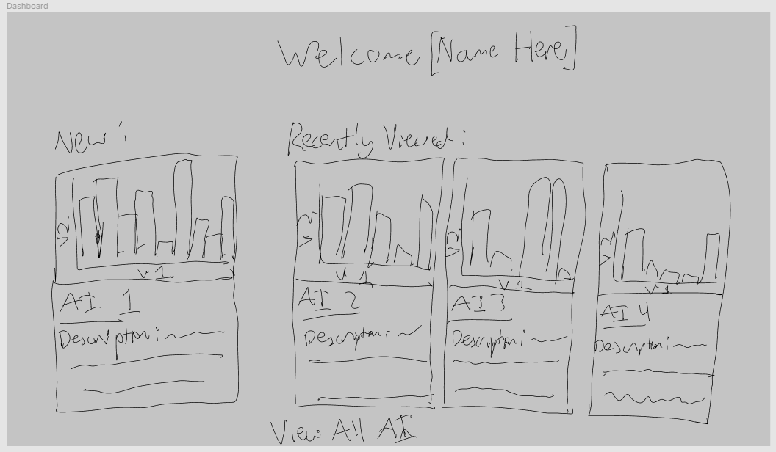
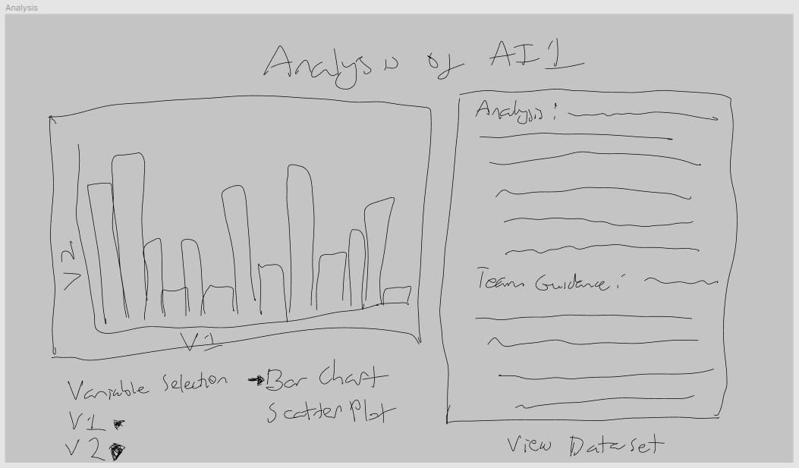
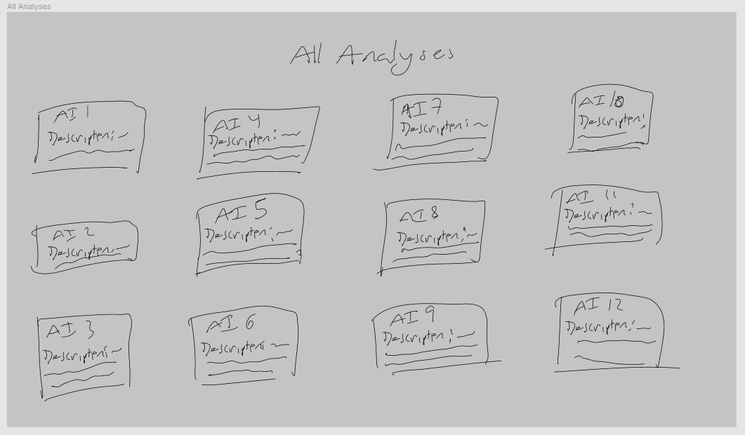
Sketches - Sketch 2
Home Page + Data Scientist Page Sketches
Management Page Sketches
The second set of sketches was made after we consulted with users, we found that most of them disliked the idea of using 3D graphs, and the constraints of “construction”, “education” and “government” on the homepage didn’t accurately encapsulate the user base, instead it limited the areas which our users may work in.
We decided it was best to split the page into 2 general sections, one on which the software engineers and data scientists would upload data, and one where more management focused employees would analyse the data.

Slide 6
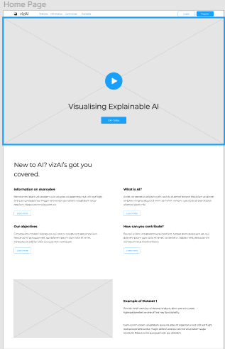
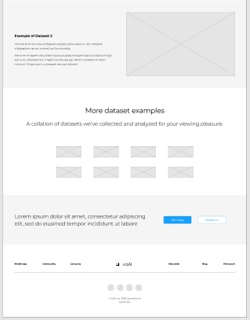
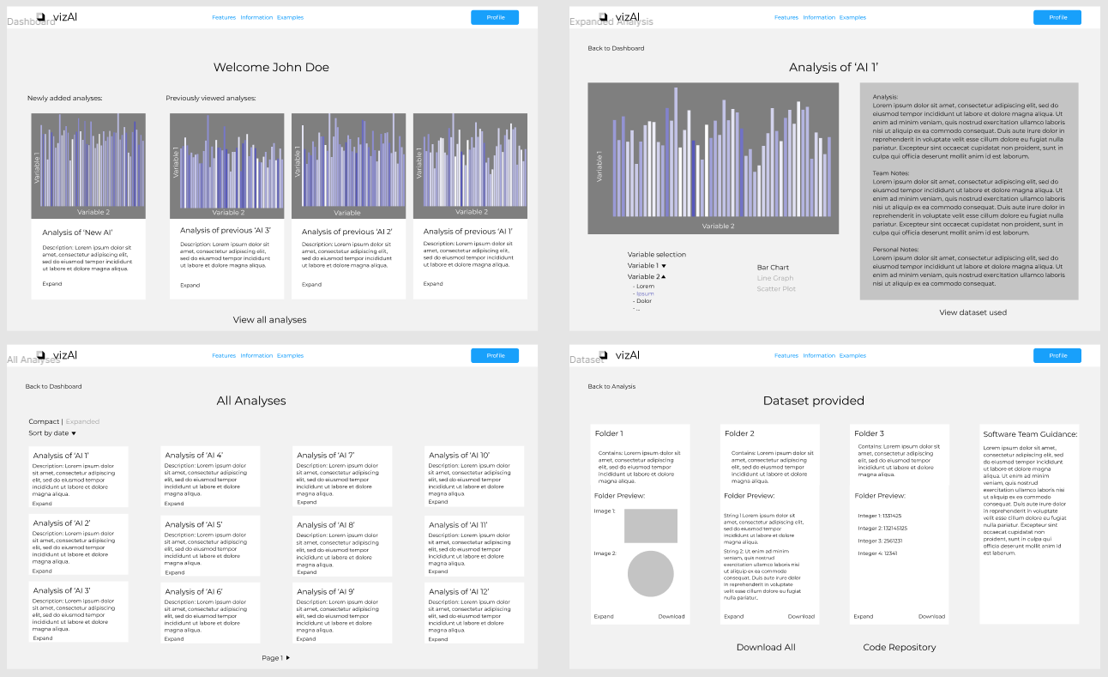
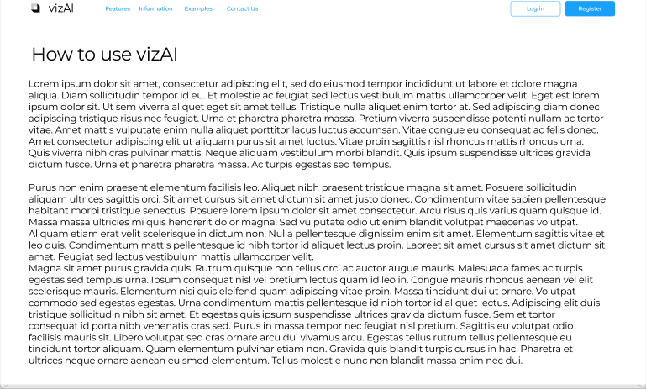
Home Page and Management/CEO Pages
Home Page w/ vizAI’s info, company motto and dataset examples
Dataset examples with clickable graphs to preview, as well as further dataset examples
Web page from the CEO/Management’s perspective

Slide 7
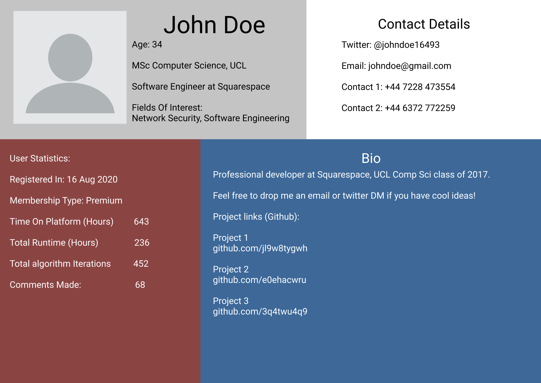
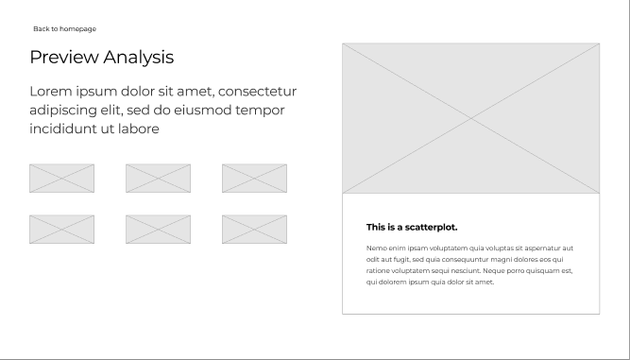
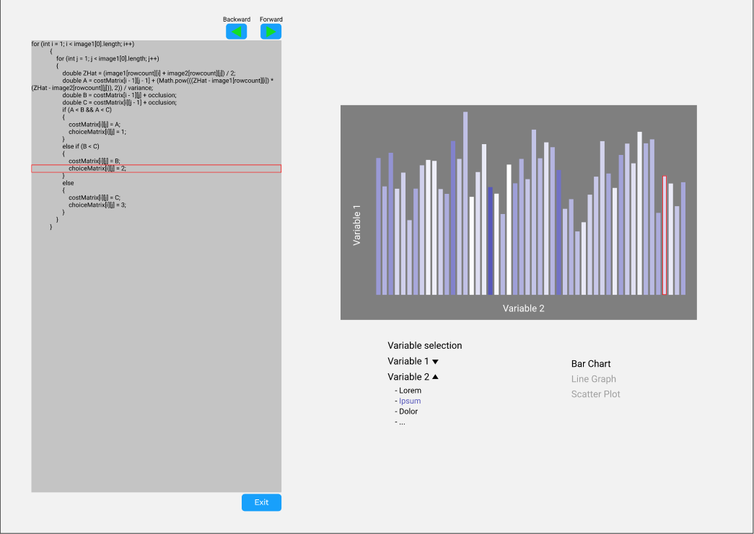
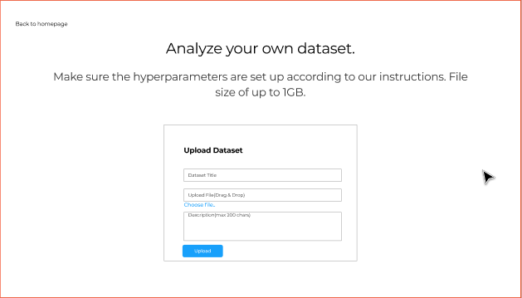
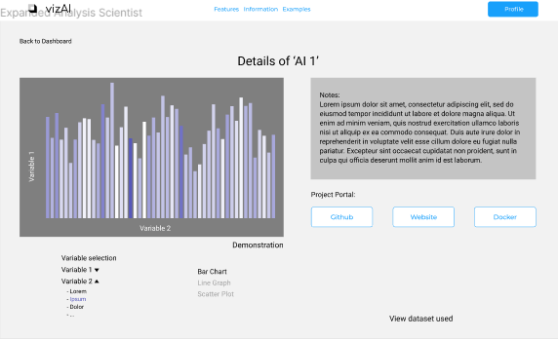
User Profile and Data Scientist Pages
Page is linked from Home Page from previous slide
User Profile page for users to view projects, descriptions and to add friends to work on similar projects.
Rough overview of dataset with different graph categories to choose from: scatterplot, tables, charts etc. Graphs are clickable and will lead to the analysis page for more information.
Page is linked from Home Page from previous slide
Red box indicates the current line of code being executed and the responding data point being changed
Upload page for users to choose their datasets, allow users to describe and name their projects
Analysis page with description and explanation of datasets, with links to GitHub, Website and Docker. Tweakable parameters to see graphical changes.

Slide 8
Evaluation of Prototype
Heuristics | Problem | Solution | Severity
Ease of Use | Home Page’s description was lengthy and unorganised | Replaced it with a introduction video for users to watch instead | 2
Readability | Dashboard was hard to view as the gray background and white text did not provide good contrast | Replaced it with a darker design for improved readability | 3
Consistency | Inconsistent page designs and fonts | Matched design fonts and colour palettes to improve consistency | 1
Fluidity | Pages had excessive buttons for users to click which were not made apparent | Made graphs clickable, buttons more apparent to improve fluidity of pages | 2

Slide 9
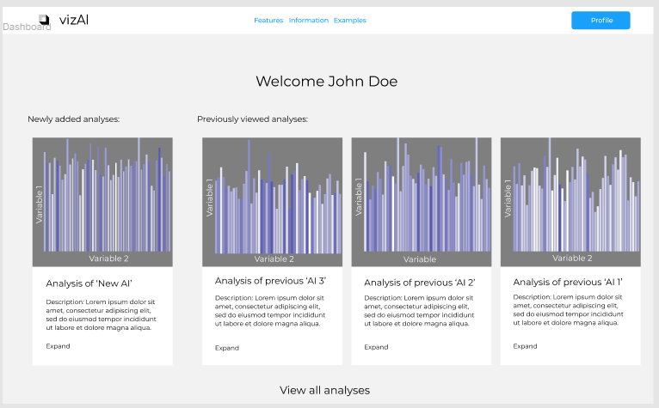
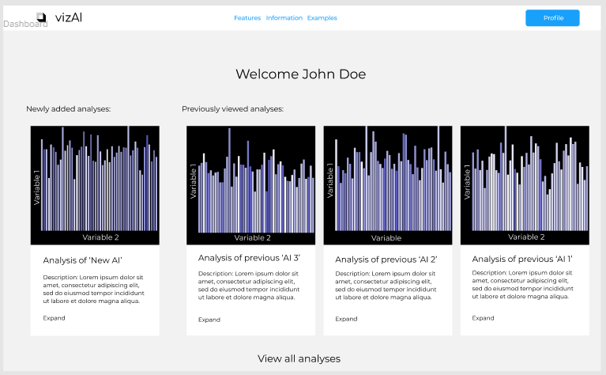
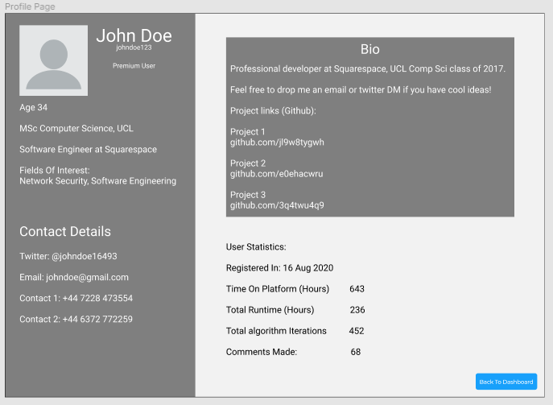
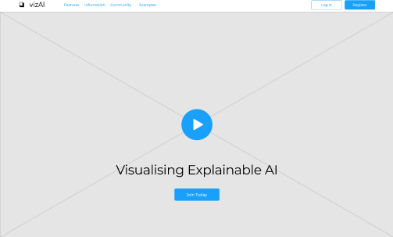
Improved Prototype
changing graph background to black, which users identified as easier to read
Changing design to fit overall style
Replacing wall of text with a more aesthetically pleasing and easy to understand video explanation

Slide 10
References
Amelia Wattenberger - Example graphs generator - https://www.figma.com/community/plugin/736737028247625415/Datavizer
Wireframing design template - https://www.figma.com/templates/wireframe-kits/
Preece, J., Sharp, H., & Rogers, Y. (2019). Interaction design: beyond human-computer interaction, Wiley, 5th Edition
Greenberg, S., Carpendale, S., Marquardt, N. and Buxton, B. 2012. Sketching User Experiences: The Workbook. San Francisco: Morgan Kaufmann.
Molich, R., & Nielsen, J. (1990). Improving a human-computer dialogue. Communications of the ACM, 33(3), 338-348.

