Slide 1
Java Methods
A method is a block of code which only runs when it is called.
You can pass data, known as parameters, into a method.
Methods are used to perform certain actions, and they are also known as functions.
Why use methods? To reuse code: define the code once, and use it many times.
Create a Method
A method must be declared within a class. It is defined with the name of the method, followed by parentheses (). Java provides some pre-defined methods, such as System.out.println(), but you can also create your own methods to perform certain actions:
Example
Create a method inside Main:
public class Main {
static void myMethod() {
// code to be executed
}
}
Notes:
Example Explained
myMethod() is the name of the method
static means that the method belongs to the Main class and not an object of the Main class. You will learn more about objects and how to access methods through objects later in this tutorial.
void means that this method does not have a return value. You will learn more about return values later in this chapter

Slide 2
Call a Method
To call a method in Java, write the method's name followed by two parentheses () and a semicolon;
In the following example, myMethod() is used to print a text (the action), when it is called:
Example
Inside main, call the myMethod() method:
public class Main {
static void myMethod() {
System.out.println("I just got executed!");
}
public static void main(String[] args) {
myMethod();
}
}
// Outputs "I just got executed!"
public class Main {
static void myMethod() {
System.out.println("I just got executed!");
}
public static void main(String[] args) {
myMethod();
myMethod();
myMethod();
}
}

Slide 3
Java Method Parameters
Parameters and Arguments
Information can be passed to methods as parameter. Parameters act as variables inside the method.
Parameters are specified after the method name, inside the parentheses. You can add as many parameters as you want, just separate them with a comma.
The following example has a method that takes a String called fname as parameter. When the method is called, we pass along a first name, which is used inside the method to print the full name:
Example
public class Main {
static void myMethod(String fname) {
System.out.println(fname + " Refsnes");
}
public static void main(String[] args) {
myMethod("Liam");
myMethod("Jenny");
myMethod("Anja");
}
}
// Liam Refsnes
// Jenny Refsnes
// Anja Refsnes

Slide 4
public class Main {
static void myMethod(String fname) {
System.out.println(fname + " Refsnes");
}
public static void main(String[] args) {
myMethod("Liam");
myMethod("Jenny");
myMethod("Anja");
}
}
When a parameter is passed to the method, it is called an argument. So, from the example above: fname is a parameter, while Liam, Jenny and Anja are arguments.

Slide 5
Java Method Overloading
Method Overloading
With method overloading, multiple methods can have the same name with different parameters:
Example
int myMethod(int x)
float myMethod(float x)
double myMethod(double x, double y)
Two methods that add numbers of different type:
Example
static int plusMethodInt(int x, int y) {
return x + y;
}
static double plusMethodDouble(double x, double y) {
return x + y;
}
public static void main(String[] args) {
int myNum1 = plusMethodInt(8, 5);
double myNum2 = plusMethodDouble(4.3, 6.26);
System.out.println("int: " + myNum1);
System.out.println("double: " + myNum2);
}

Slide 6
public class Main {
static int plusMethodInt(int x, int y) {
return x + y;
}
static double plusMethodDouble(double x, double y) {
return x + y;
}
public static void main(String[] args) {
int myNum1 = plusMethodInt(8, 5);
double myNum2 = plusMethodDouble(4.3, 6.26);
System.out.println("int: " + myNum1);
System.out.println("double: " + myNum2);
}
}
The return keyword stops the execution of a function and returns the desired output.

Slide 7
public class Main {
static int plusMethod(int x, int y) {
return x + y;
}
static double plusMethod(double x, double y) {
return x + y;
}
public static void main(String[] args) {
int myNum1 = plusMethod(8, 5);
double myNum2 = plusMethod(4.3, 6.26);
System.out.println("int: " + myNum1);
System.out.println("double: " + myNum2);
}
}

Slide 8
Java Scope
In Java, variables are only accessible inside the region they are created. This is called scope.
Method Scope
Variables declared directly inside a method are available anywhere in the method following the line of code in which they were declared:
public class Main {
public static void main(String[] args) {
// Code here cannot use x
int x = 100;
// Code here can use x
System.out.println(x);
}
}

Slide 9
Block Scope
A block of code refers to all of the code between curly braces {}.
Variables declared inside blocks of code are only accessible by the code between the curly braces, which follows the line in which the variable was declared:
public class Main {
public static void main(String[] args) {
// Code here CANNOT use x
{ // This is a block
// Code here CANNOT use x
int x = 100;
// Code here CAN use x
System.out.println(x);
} // The block ends here
// Code here CANNOT use x
}
}
A block of code may exist on its own or it can belong to an if, while or for statement. In the case of for statements, variables declared in the statement itself are also available inside the block's scope.

Slide 10
Java Recursion
Java Recursion
Recursion is the technique of making a function call itself. This technique provides a way to break complicated problems down into simple problems which are easier to solve.
Recursion may be a bit difficult to understand. The best way to figure out how it works is to experiment with it.
Recursion Example
Adding two numbers together is easy to do, but adding a range of numbers is more complicated. In the following example, recursion is used to add a range of numbers together by breaking it down into the simple task of adding two numbers:

Slide 11
public class Main {
public static void main(String[] args) {
int result = sum(10);
System.out.println(result);
}
public static int sum(int k) {
if (k > 0) {
return k + sum(k - 1);
} else {
return 0;
}
}
}
Notes:
Example Explained
When the sum() function is called, it adds parameter k to the sum of all numbers smaller than k and returns the result. When k becomes 0, the function just returns 0. When running, the program follows these steps:
10 + sum(9)
10 + ( 9 + sum(8) )
10 + ( 9 + ( 8 + sum(7) ) )
...
10 + 9 + 8 + 7 + 6 + 5 + 4 + 3 + 2 + 1 + sum(0)
10 + 9 + 8 + 7 + 6 + 5 + 4 + 3 + 2 + 1 + 0

Slide 12
Halting Condition
Just as loops can run into the problem of infinite looping, recursive functions can run into the problem of infinite recursion. Infinite recursion is when the function never stops calling itself. Every recursive function should have a halting condition, which is the condition where the function stops calling itself. In the previous example, the halting condition is when the parameter k becomes 0.
It is helpful to see a variety of different examples to better understand the concept. In this example, the function adds a range of numbers between a start and an end. The halting condition for this recursive function is when end is not greater than start:
Example
Use recursion to add all of the numbers between 5 to 10.

Slide 13
public class Main {
public static void main(String[] args) {
int result = sum(5, 10);
System.out.println(result);
}
public static int sum(int start, int end) {
if (end > start) {
return end + sum(start, end - 1);
} else {
return end;
}
}
}

Slide 14
Example 1: Java Methods
class Main {
// create a method
public int addNumbers(int a, int b) {
int sum = a + b;
// return value
return sum;
}
public static void main(String[] args) {
int num1 = 25;
int num2 = 15;
// create an object of Main
Main obj = new Main();
// calling method
int result = obj.addNumbers(num1, num2);
System.out.println("Sum is: " + result);
}
}
Example 2: Method Return Type
class Main {
// create a method
public static int square(int num) {
// return statement
return num * num;
}
public static void main(String[] args) {
int result;
// call the method
// store returned value to result
result = square(10);
System.out.println("Squared value of 10 is: " + result);
}
}

Slide 15
class Main {
// method with no parameter
public void display1() {
System.out.println("Method without parameter");
}
// method with single parameter
public void display2(int a) {
System.out.println("Method with a single parameter: " + a);
}
public static void main(String[] args) {
// create an object of Main
Main obj = new Main();
// calling method with no parameter
obj.display1();
// calling method with the single parameter
obj.display2(24);
}
}

Slide 16
Java - What is OOP?
OOP stands for Object-Oriented Programming.
Procedural programming is about writing procedures or methods that perform operations on the data, while object-oriented programming is about creating objects that contain both data and methods.
Object-oriented programming has several advantages over procedural programming:
OOP is faster and easier to execute
OOP provides a clear structure for the programs
OOP helps to keep the Java code DRY "Don't Repeat Yourself", and makes the code easier to maintain, modify and debug
OOP makes it possible to create full reusable applications with less code and shorter development time
Tip: The "Don't Repeat Yourself" (DRY) principle is about reducing the repetition of code. You should extract out the codes that are common for the application, and place them at a single place and reuse them instead of repeating it.

Slide 17
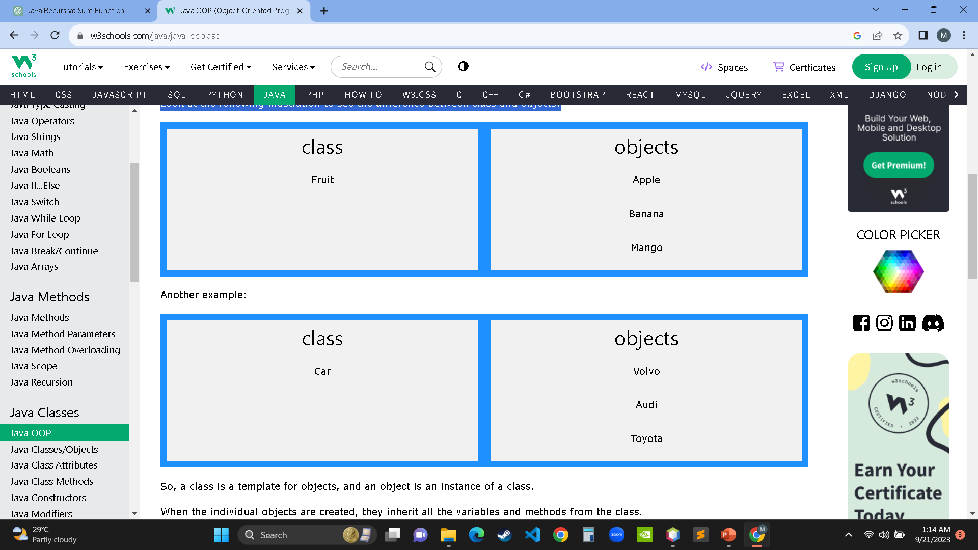

Java - What are Classes and Objects?
Classes and objects are the two main aspects of object-oriented programming.
Look at the following illustration to see the difference between class and objects:
EXAMPLE 1
So, a class is a template for objects, and an object is an instance of a class.
When the individual objects are created, they inherit all the variables and methods from the class.

Slide 18
Java Classes/Objects
Java is an object-oriented programming language.
Everything in Java is associated with classes and objects, along with its attributes and methods. For example: in real life, a car is an object. The car has attributes, such as weight and color, and methods, such as drive and brake.
A Class is like an object constructor, or a "blueprint" for creating objects.
Remember from the Java Syntax, that a class should always start with an uppercase first letter, and that the name of the java file should match the class name.
Create a Class
To create a class, use the keyword class:
Main.java
Create a class named "Main" with a variable x:
public class Main {
int x = 5;
}

Slide 19
Create an Object
In Java, an object is created from a class. We have already created the class named Main, so now we can use this to create objects.
To create an object of Main, specify the class name, followed by the object name, and use the keyword new:
Example
Create an object called "myObj" and print the value of x:
public class Main {
int x = 5;
public static void main(String[] args) {
Main myObj = new Main();
System.out.println(myObj.x);
}
}
public class Main {
int x = 5;
public static void main(String[] args) {
Main myObj = new Main();
System.out.println(myObj.x);
}
}

Slide 20
Multiple Objects
You can create multiple objects of one class:
public class Main {
int x = 5;
public static void main(String[] args) {
Main myObj1 = new Main();
Main myObj2 = new Main();
System.out.println(myObj1.x);
System.out.println(myObj2.x);
}
}
Example
Create two objects of Main:
public class Main {
int x = 5;
public static void main(String[] args) {
Main myObj1 = new Main(); // Object 1
Main myObj2 = new Main(); // Object 2
System.out.println(myObj1.x);
System.out.println(myObj2.x);
}
}

Slide 21
Using Multiple Classes
You can also create an object of a class and access it in another class. This is often used for better organization of classes (one class has all the attributes and methods, while the other class holds the main() method (code to be executed)).
Remember that the name of the java file should match the class name. In this example, we have created two files in the same directory/folder:
Main.java
Second.java
Main.java
public class Main {
int x = 5;
}
When both files have been compiled:
C:\Users\Your Name>javac Main.java
C:\Users\Your Name>javac Second.java
Run the Second.java file:
C:\Users\Your Name>java Second
And the output will be:
5
Second.java
class Second {
public static void main(String[] args) {
Main myObj = new Main();
System.out.println(myObj.x);
}
}

Slide 22


public class Main {
int x = 5;
}
class Second {
public static void main(String[] args) {
Main myObj = new Main();
System.out.println(myObj.x);
}
}
Accessing Attributes
You can access attributes by creating an object of the class, and by using the dot syntax (.):
The following example will create an object of the Main class, with the name myObj. We use the x attribute on the object to print its value:
Example
Create an object called "myObj" and print the value of x:
public class Main {
int x = 5;
public static void main(String[] args) {
Main myObj = new Main();
System.out.println(myObj.x);
}
}
Java Class Attributes
We used the term "variable" for x in the example (as shown below). It is actually an attribute of the class. Or you could say that class attributes are variables within a class:
Example
Create a class called "Main" with two attributes: x and y:
public class Main {
int x = 5;
int y = 3;
}
Another term for class attributes is fields.

Slide 23
public class Main {
int x;
public static void main(String[] args) {
Main myObj = new Main();
myObj.x = 40;
System.out.println(myObj.x);
}
}
public class Main {
int x = 10;
public static void main(String[] args) {
Main myObj = new Main();
myObj.x = 25; // x is now 25
System.out.println(myObj.x);
}
}
Or override existing values:
Example
Change the value of x to 25:
public class Main {
int x = 10;
public static void main(String[] args) {
Main myObj = new Main();
myObj.x = 25; // x is now 25
System.out.println(myObj.x);
}
}

Slide 24
If you don't want the ability to override existing values, declare the attribute as final:
Example
public class Main {
final int x = 10;
public static void main(String[] args) {
Main myObj = new Main();
myObj.x = 25; // will generate an error: cannot assign a value to a final variable
System.out.println(myObj.x);
}
}
public class Main {
final int x = 10;
public static void main(String[] args) {
Main myObj = new Main();
myObj.x = 25; // will generate an error
System.out.println(myObj.x);
}
}
The final keyword is useful when you want a variable to always store the same value, like PI (3.14159...).
The final keyword is called a "modifier”

Slide 25
Multiple Objects
If you create multiple objects of one class, you can change the attribute values in one object, without affecting the attribute values in the other:
Example
Change the value of x to 25 in myObj2, and leave x in myObj1 unchanged:
public class Main {
int x = 5;
public static void main(String[] args) {
Main myObj1 = new Main(); // Object 1
Main myObj2 = new Main(); // Object 2
myObj2.x = 25;
System.out.println(myObj1.x); // Outputs 5
System.out.println(myObj2.x); // Outputs 25
}
}
public class Main {
int x = 5;
public static void main(String[] args) {
Main myObj1 = new Main();
Main myObj2 = new Main();
myObj2.x = 25;
System.out.println(myObj1.x);
System.out.println(myObj2.x);
}
}

Slide 26
Multiple Attributes
You can specify as many attributes as you want:
Example
public class Main {
String fname = "John";
String lname = "Doe";
int age = 24;
public static void main(String[] args) {
Main myObj = new Main();
System.out.println("Name: " + myObj.fname + " " + myObj.lname);
System.out.println("Age: " + myObj.age);
}
}
public class Main {
String fname = "John";
String lname = "Doe";
int age = 24;
public static void main(String[] args) {
Main myObj = new Main();
System.out.println("Name: " + myObj.fname + " " + myObj.lname);
System.out.println("Age: " + myObj.age);
}
}

Slide 27
Java Class Methods
You learned from the Java Methods that methods are declared within a class, and that they are used to perform certain actions:
Example
Create a method named myMethod() in Main:
public class Main {
static void myMethod() {
System.out.println("Hello World!");
}
}
myMethod() prints a text (the action), when it is called. To call a method, write the method's name followed by two parentheses () and a semicolon;
Example
Inside main, call myMethod():
public class Main {
static void myMethod() {
System.out.println("Hello World!");
}
public static void main(String[] args) {
myMethod();
}
}
// Outputs "Hello World!"

Slide 28
public class Main {
static void myMethod() {
System.out.println("Hello World!");
}
public static void main(String[] args) {
myMethod();
}
}
Example
An example to demonstrate the differences between static and public methods:
public class Main {
// Static method
static void myStaticMethod() {
System.out.println("Static methods can be called without creating objects");
}
// Public method
public void myPublicMethod() {
System.out.println("Public methods must be called by creating objects");
}
// Main method
public static void main(String[] args) {
myStaticMethod(); // Call the static method
// myPublicMethod(); This would compile an error
Main myObj = new Main(); // Create an object of Main
myObj.myPublicMethod(); // Call the public method on the object
}
}
Static vs. Public
You will often see Java programs that have either static or public attributes and methods.
In the example above, we created a static method, which means that it can be accessed without creating an object of the class, unlike public, which can only be accessed by objects:

Slide 29
public class Main {
// Static method
static void myStaticMethod() {
System.out.println("Static methods can be called without creating objects");
}
// Public method
public void myPublicMethod() {
System.out.println("Public methods must be called by creating objects");
}
// Main method
public static void main(String[] args) {
myStaticMethod(); // Call the static method
Main myObj = new Main(); // Create an object of Main
myObj.myPublicMethod(); // Call the public method
}
}

Slide 30
Access Methods With an Object
Example
Create a Car object named myCar. Call the fullThrottle() and speed() methods on the myCar object, and run the program:
// Create a Main class
public class Main {
// Create a fullThrottle() method
public void fullThrottle() {
System.out.println("The car is going as fast as it can!");
}
// Create a speed() method and add a parameter
public void speed(int maxSpeed) {
System.out.println("Max speed is: " + maxSpeed);
}
// Inside main, call the methods on the myCar object
public static void main(String[] args) {
Main myCar = new Main(); // Create a myCar object
myCar.fullThrottle(); // Call the fullThrottle() method
myCar.speed(200); // Call the speed() method
}
}
// The car is going as fast as it can!
// Max speed is: 200

Slide 31
// Create a Main class
public class Main {
// Create a fullThrottle() method
public void fullThrottle() {
System.out.println("The car is going as fast as it can!");
}
// Create a speed() method and add a parameter
public void speed(int maxSpeed) {
System.out.println("Max speed is: " + maxSpeed);
}
// Inside main, call the methods on the myCar object
public static void main(String[] args) {
Main myCar = new Main(); // Create a myCar object
myCar.fullThrottle(); // Call the fullThrottle() method
myCar.speed(200); // Call the speed() method
}
}

Slide 32
Example explained
1) We created a custom Main class with the class keyword.
2) We created the fullThrottle() and speed() methods in the Main class.
3) The fullThrottle() method and the speed() method will print out some text, when they are called.
4) The speed() method accepts an int parameter called maxSpeed - we will use this in 8).
5) In order to use the Main class and its methods, we need to create an object of the Main Class.
6) Then, go to the main() method, which you know by now is a built-in Java method that runs your program (any code inside main is executed).
7) By using the new keyword we created an object with the name myCar.
8) Then, we call the fullThrottle() and speed() methods on the myCar object, and run the program using the name of the object (myCar), followed by a dot (.), followed by the name of the method (fullThrottle(); and speed(200);). Notice that we add an int parameter of 200 inside the speed() method.
Remember that..
The dot (.) is used to access the object's attributes and methods.
To call a method in Java, write the method name followed by a set of parentheses (), followed by a semicolon (;).
A class must have a matching filename (Main and Main.java).

Slide 33
Using Multiple Classes
Like we specified in the Classes, it is a good practice to create an object of a class and access it in another class.
Remember that the name of the java file should match the class name. In this example, we have created two files in the same directory:
Main.java
Second.java
Main.java
Second.java
public class Main {
public void fullThrottle() {
System.out.println("The car is going as fast as it can!");
}
public void speed(int maxSpeed) {
System.out.println("Max speed is: " + maxSpeed);
}
}
class Second {
public static void main(String[] args) {
Main myCar = new Main(); // Create a myCar object
myCar.fullThrottle(); // Call the fullThrottle() method
myCar.speed(200); // Call the speed() method
}
}

Slide 34
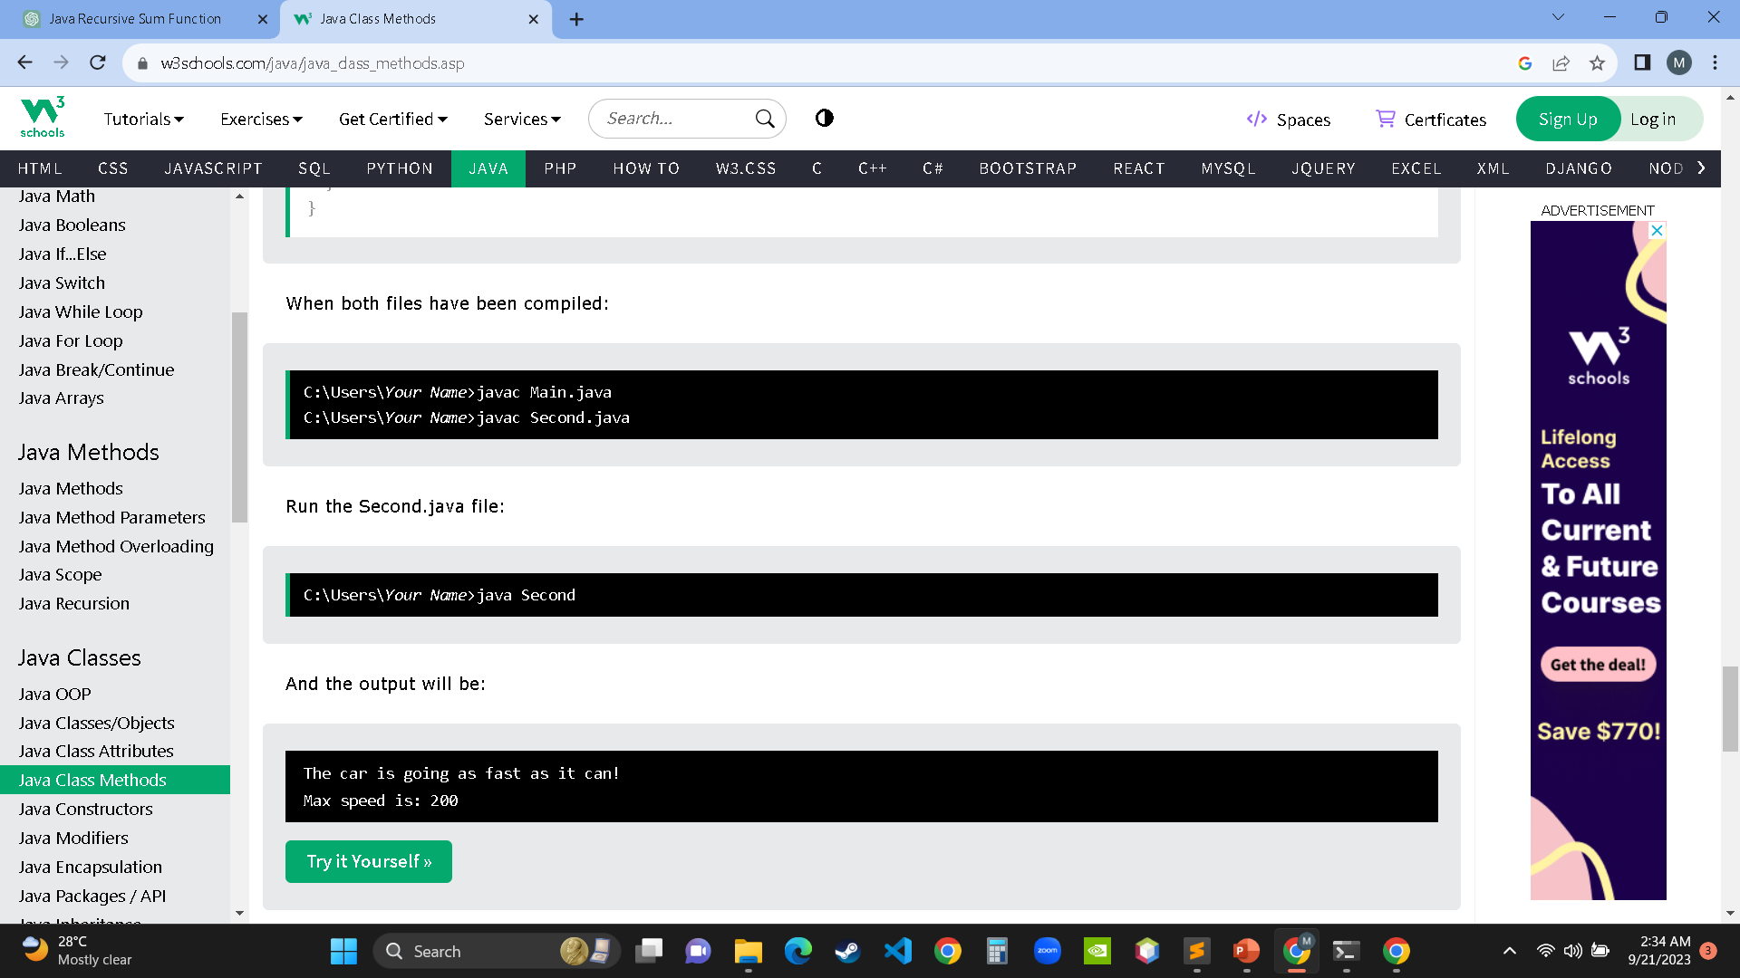

Slide 35
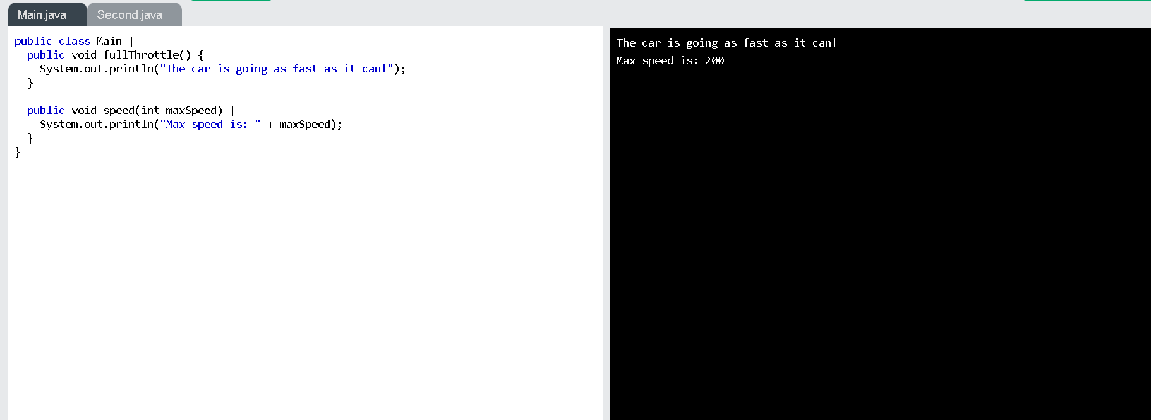

Slide 36
Java Constructors
A constructor in Java is a special method that is used to initialize objects. The constructor is called when an object of a class is created. It can be used to set initial values for object attributes:
Example
Create a constructor:
// Create a Main class
public class Main {
int x; // Create a class attribute
// Create a class constructor for the Main class
public Main() {
x = 5; // Set the initial value for the class attribute x
}
public static void main(String[] args) {
Main myObj = new Main(); // Create an object of class Main (This will call the constructor)
System.out.println(myObj.x); // Print the value of x
}
}
// Outputs 5

Slide 37
// Create a Main class
public class Main {
int x;
// Create a class constructor for the Main class
public Main() {
x = 5;
}
public static void main(String[] args) {
Main myObj = new Main();
System.out.println(myObj.x);
}
}
Note that the constructor name must match the class name, and it cannot have a return type (like void).
Also note that the constructor is called when the object is created.
All classes have constructors by default: if you do not create a class constructor yourself, Java creates one for you. However, then you are not able to set initial values for object attributes.

Slide 38
Constructor Parameters
Constructors can also take parameters, which is used to initialize attributes.
The following example adds an int y parameter to the constructor. Inside the constructor we set x to y (x=y). When we call the constructor, we pass a parameter to the constructor (5), which will set the value of x to 5:
Example
public class Main {
int x;
public Main(int y) {
x = y;
}
public static void main(String[] args) {
Main myObj = new Main(5);
System.out.println(myObj.x);
}
}
// Outputs 5
public class Main {
int x;
public Main(int y) {
x = y;
}
public static void main(String[] args) {
Main myObj = new Main(5);
System.out.println(myObj.x);
}
}

Slide 39
You can have as many parameters as you want:
Example
public class Main {
int modelYear;
String modelName;
public Main(int year, String name) {
modelYear = year;
modelName = name;
}
public static void main(String[] args) {
Main myCar = new Main(1969, "Mustang");
System.out.println(myCar.modelYear + " " + myCar.modelName);
}
}
// Outputs 1969 Mustang
//filename: Main.java
public class Main {
int modelYear;
String modelName;
public Main(int year, String name) {
modelYear = year;
modelName = name;
}
public static void main(String[] args) {
Main myCar = new Main(1969, "Mustang");
System.out.println(myCar.modelYear + " " + myCar.modelName);
}
}

Slide 40
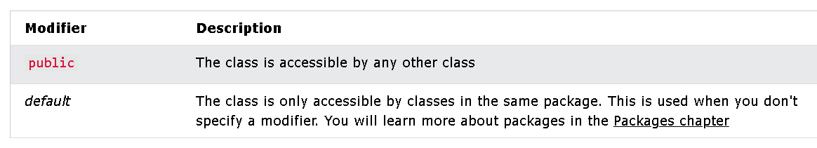
Modifiers
By now, you are quite familiar with the public keyword that appears in almost all of our examples:
public class Main
The public keyword is an access modifier, meaning that it is used to set the access level for classes, attributes, methods and constructors.
We divide modifiers into two groups:
Access Modifiers - controls the access level
Non-Access Modifiers - do not control access level, but provides other functionality.
Access Modifiers
For classes, you can use either public or default:

Slide 41
public | The class is accessible by any other class
public class Main {
public static void main(String[] args) {
System.out.println("Hello World");
}
}
default | The class is only accessible by classes in the same package. This is used when you don't specify a modifier.
class MyClass {
public static void main(String[] args) {
System.out.println("Hello World");
}
}

Slide 42
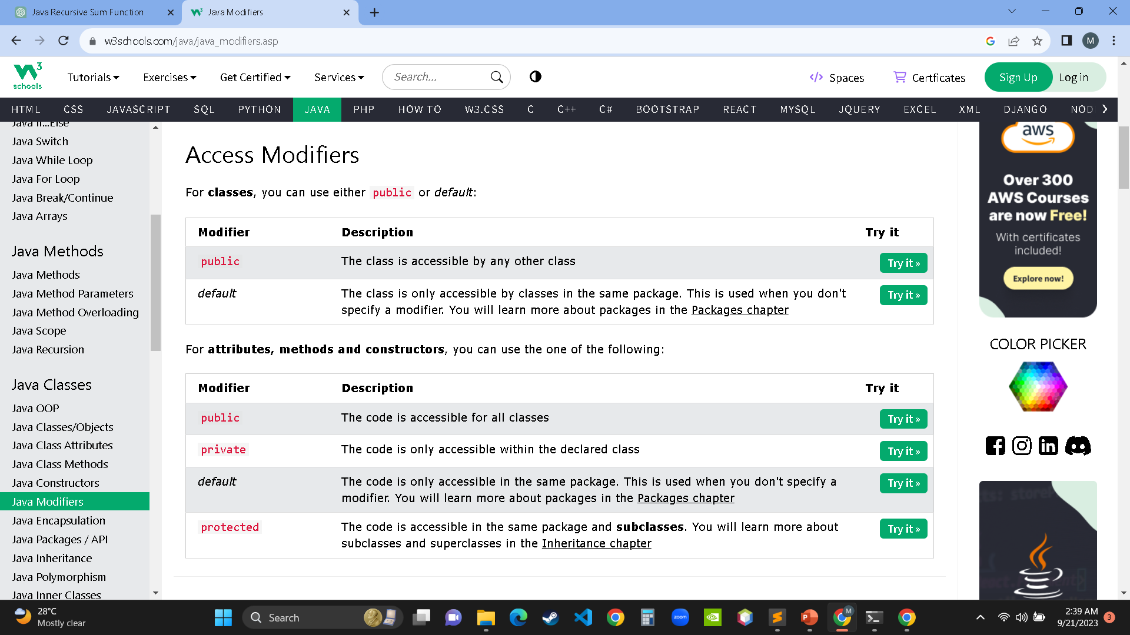
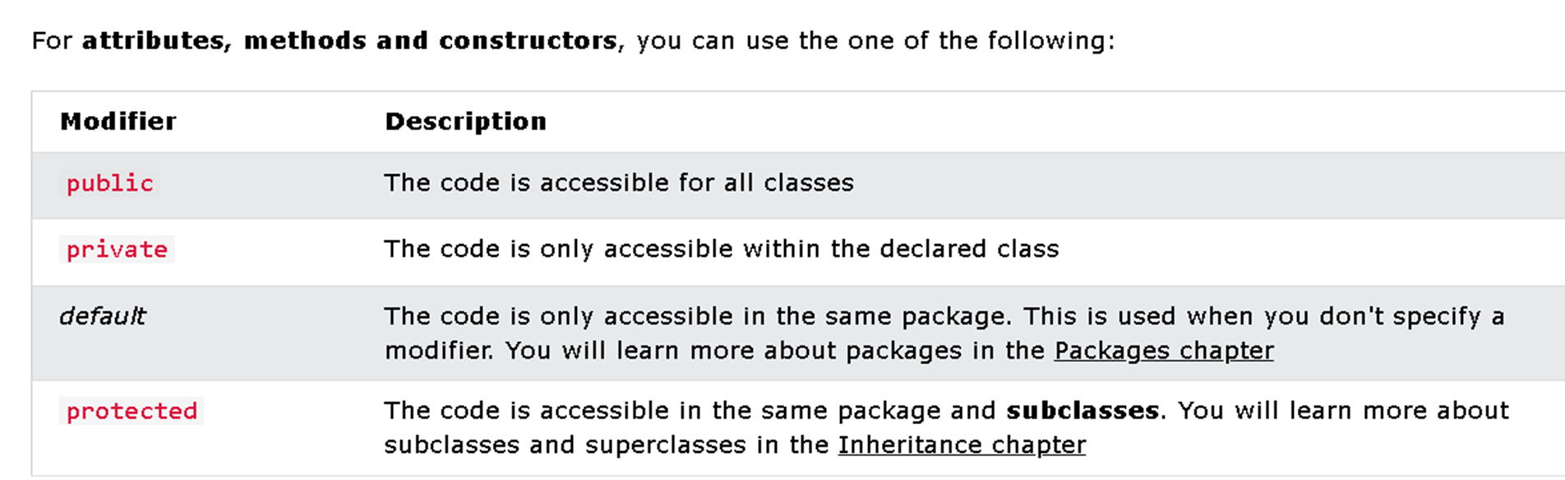

Slide 43
public | The code is accessible for all classes
private | The code is only accessible within the declared class
public class Main {
private String fname = "John";
private String lname = "Doe";
private String email = "john@doe.com";
private int age = 24;
public static void main(String[] args) {
Main myObj = new Main();
System.out.println("Name: " + myObj.fname + " " + myObj.lname);
System.out.println("Email: " + myObj.email);
System.out.println("Age: " + myObj.age);
}
}
public class Main {
public String fname = "John";
public String lname = "Doe";
public String email = "john@doe.com";
public int age = 24;
}
public static void main(String[] args) {
Main myObj = new Main();
System.out.println("Name: " + myObj.fname + " " + myObj.lname);
System.out.println("Email: " + myObj.email);
System.out.println("Age: " + myObj.age);
}
}

Slide 44
default | The code is only accessible in the same package. This is used when you don't specify a modifier.
class Person {
String fname = "John";
String lname = "Doe";
String email = "john@doe.com";
int age = 24;
public static void main(String[] args) {
Person myObj = new Person();
System.out.println("Name: " + myObj.fname + " " + myObj.lname);
System.out.println("Email: " + myObj.email);
System.out.println("Age: " + myObj.age);
}
}

Slide 45
protected | The code is accessible in the same package and subclasses.
class Person {
protected String fname = "John";
protected String lname = "Doe";
protected String email = "john@doe.com";
protected int age = 24;
}
class Student extends Person {
private int graduationYear = 2018;
public static void main(String[] args) {
Student myObj = new Student();
System.out.println("Name: " + myObj.fname + " " + myObj.lname);
System.out.println("Email: " + myObj.email);
System.out.println("Age: " + myObj.age);
System.out.println("Graduation Year: " + myObj.graduationYear);
}
}

Slide 46
Non-Access Modifiers
For classes, you can use either final or abstract:
Modifier | Description
final | The class cannot be inherited by other classes
abstract | The class cannot be used to create objects (To access an abstract class, it must be inherited from another class.
final class Vehicle {
protected String brand = "Ford";
public void honk() {
System.out.println("Tuut, tuut!");
}
}
class Main extends Vehicle {
private String modelName = "Mustang";
public static void main(String[] args) {
Main myFastCar = new Main();
myFastCar.honk();
System.out.println(myFastCar.brand + " " + myFastCar.modelName);
}
}
// abstract class
abstract class Main {
public String fname = "John";
public String lname = "Doe";
public String email = "john@doe.com";
public int age = 24;
public abstract void study(); // abstract method
}
// Subclass (inherit from Person)
class Student extends Main {
public int graduationYear = 2018;
public void study() {
System.out.println("Studying all day long");
}
}

Slide 47
For attributes and methods, you can use the one of the following:
Modifier | Description
final | Attributes and methods cannot be overridden/modified
static | Attributes and methods belongs to the class, rather than an object
abstract | Can only be used in an abstract class, and can only be used on methods. The method does not have a body, for example abstract void run();. The body is provided by the subclass (inherited from)
transient | Attributes and methods are skipped when serializing the object containing them
synchronized | Methods can only be accessed by one thread at a time
volatile | The value of an attribute is not cached thread-locally, and is always read from the "main memory"

Slide 48
Final
If you don't want the ability to override existing attribute values, declare attributes as final:
Example
public class Main {
final int x = 10;
final double PI = 3.14;
public static void main(String[] args) {
Main myObj = new Main();
myObj.x = 50; // will generate an error
myObj.PI = 25; // will generate an error
System.out.println(myObj.x);
}
}
public class Main {
final int x = 10;
final double PI = 3.14;
public static void main(String[] args) {
Main myObj = new Main();
myObj.x = 50; // will generate an error: cannot assign a value to a final variable
myObj.PI = 25; // will generate an error: cannot assign a value to a final variable
System.out.println(myObj.x);
}
}

Slide 49
Static
A static method means that it can be accessed without creating an object of the class, unlike public:
Example
An example to demonstrate the differences between static and public methods:
public class Main {
// Static method
static void myStaticMethod() {
System.out.println("Static methods can be called without creating objects");
}
// Public method
public void myPublicMethod() {
System.out.println("Public methods must be called by creating objects");
}
// Main method
public static void main(String[ ] args) {
myStaticMethod(); // Call the static method
// myPublicMethod(); This would output an error
Main myObj = new Main(); // Create an object of Main
myObj.myPublicMethod(); // Call the public method
}
}

Slide 50

Abstract
An abstract method belongs to an abstract class, and it does not have a body. The body is provided by the subclass:
Example
// Code from filename: Main.java
// abstract class
abstract class Main {
public String fname = "John";
public int age = 24;
public abstract void study(); // abstract method
}
// Subclass (inherit from Main)
class Student extends Main {
public int graduationYear = 2018;
public void study() { // the body of the abstract method is provided here
System.out.println("Studying all day long");
}
}
// End code from filename: Main.java
// Code from filename: Second.java
class Second {
public static void main(String[] args) {
// create an object of the Student class (which inherits attributes and methods from Main)
Student myObj = new Student();
System.out.println("Name: " + myObj.fname);
System.out.println("Age: " + myObj.age);
System.out.println("Graduation Year: " + myObj.graduationYear);
myObj.study(); // call abstract method
}
}
// abstract class
abstract class Main {
public String fname = "John";
public String lname = "Doe";
public String email = "john@doe.com";
public int age = 24;
public abstract void study(); // abstract method
}
// Subclass (inherit from Main)
class Student extends Main {
public int graduationYear = 2018;
public void study() {
System.out.println("Studying all day long");
}
}
class Second {
public static void main(String[] args) {
// create an object of the Student class (which inherits attributes and methods from Main)
Student myObj = new Student();
System.out.println("Name: " + myObj.fname + " " + myObj.lname);
System.out.println("Email: " + myObj.email);
System.out.println("Age: " + myObj.age);
System.out.println("Graduation Year: " + myObj.graduationYear);
myObj.study(); // call abstract method
}
}

Slide 51
Java Encapsulation
The meaning of Encapsulation, is to make sure that "sensitive" data is hidden from users. To achieve this, you must:
declare class variables/attributes as private
provide public get and set methods to access and update the value of a private variable
Get and Set
private variables can only be accessed within the same class (an outside class has no access to it). However, it is possible to access them if we provide public get and set methods.
The get method returns the variable value, and the set method sets the value.
Syntax for both is that they start with either get or set, followed by the name of the variable, with the first letter in upper case:
Example
public class Person { private String name; // private = restricted access
// Getter public String getName()
{ return name; }
// Setter public void setName(String newName)
{ this.name = newName; } }

Slide 52
Example
Example explained
The get method returns the value of the variable name.
The set method takes a parameter (newName) and assigns it to the name variable. The this keyword is used to refer to the current object.
However, as the name variable is declared as private, we cannot access it from outside this class:
public class Person {
private String name; // private = restricted access
// Getter
public String getName() {
return name;
}
// Setter
public void setName(String newName) {
this.name = newName;
}
}
public class Main {
public static void main(String[] args) {
Person myObj = new Person();
myObj.name = "John";
System.out.println(myObj.name);
}
}
However, as we try to access a private variable, we get an error:

Slide 53
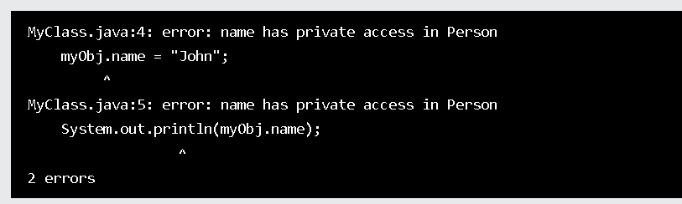

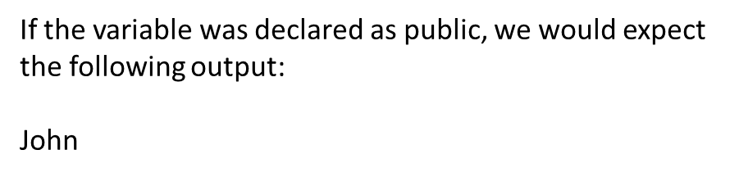
However, as we try to access a private variable, we get an error:
Example
public class Main {
public static void main(String[] args) {
Person myObj = new Person();
myObj.name = "John"; // error
System.out.println(myObj.name); // error
}
}
public class Main {
public static void main(String[] args) {
Person myObj = new Person();
myObj.name = "John";
System.out.println(myObj.name);
}
}
public class Person {
private String name;
// Getter
public String getName() {
return name;
}
// Setter
public void setName(String newName) {
this.name = newName;
}
}

Slide 54


Instead, we use the getName() and setName() methods to access and update the variable:
Example
public class Main {
public static void main(String[] args) {
Person myObj = new Person();
myObj.setName("John"); // Set the value of the name variable to "John"
System.out.println(myObj.getName());
}
}
// Outputs "John"
public class Person {
private String name;
// Getter
public String getName() {
return name;
}
// Setter
public void setName(String newName) {
this.name = newName;
}
}
public class Main {
public static void main(String[] args) {
Person myObj = new Person();
myObj.setName("John");
System.out.println(myObj.getName());
}
}

Slide 55
Why Encapsulation?
Better control of class attributes and methods
Class attributes can be made read-only (if you only use the get method), or write-only (if you only use the set method)
Flexible: the programmer can change one part of the code without affecting other parts
Increased security of data
Java Packages
Java Packages & API
A package in Java is used to group related classes. Think of it as a folder in a file directory. We use packages to avoid name conflicts, and to write a better maintainable code. Packages are divided into two categories:
Built-in Packages (packages from the Java API)
User-defined Packages (create your own packages)
Built-in Packages
The Java API is a library of prewritten classes, that are free to use, included in the Java Development Environment.
The library contains components for managing input, database programming, and much much more. The complete list can be found at Oracles website: https://docs.oracle.com/javase/8/docs/api/.
The library is divided into packages and classes. Meaning you can either import a single class (along with its methods and attributes), or a whole package that contain all the classes that belong to the specified package.
To use a class or a package from the library, you need to use the import keyword:

Slide 56
Syntax
import package.name.Class; // Import a single class
import package.name.*; // Import the whole package
Import a Class
If you find a class you want to use, for example, the Scanner class, which is used to get user input, write the following code:
Example
import java.util.Scanner;
In the example above, java.util is a package, while Scanner is a class of the java.util package.
To use the Scanner class, create an object of the class and use any of the available methods found in the Scanner class documentation. In our example, we will use the nextLine() method, which is used to read a complete line:

Slide 57
Example
Using the Scanner class to get user input:
import java.util.Scanner;
class MyClass {
public static void main(String[] args) {
Scanner myObj = new Scanner(System.in);
System.out.println("Enter username");
String userName = myObj.nextLine();
System.out.println("Username is: " + userName);
}
}
import java.util.Scanner; // import the Scanner class
class Main {
public static void main(String[] args) {
Scanner myObj = new Scanner(System.in);
String userName;
// Enter username and press Enter
System.out.println("Enter username");
userName = myObj.nextLine();
System.out.println("Username is: " + userName);
}
}

Slide 58
Import a Package
There are many packages to choose from. In the previous example, we used the Scanner class from the java.util package. This package also contains date and time facilities, random-number generator and other utility classes.
To import a whole package, end the sentence with an asterisk sign (*). The following example will import ALL the classes in the java.util package:
Example
import java.util.*;
import java.util.*; // import the java.util package
class Main {
public static void main(String[] args) {
Scanner myObj = new Scanner(System.in);
String userName;
// Enter username and press Enter
System.out.println("Enter username");
userName = myObj.nextLine();
System.out.println("Username is: " + userName);
}
}

Slide 59
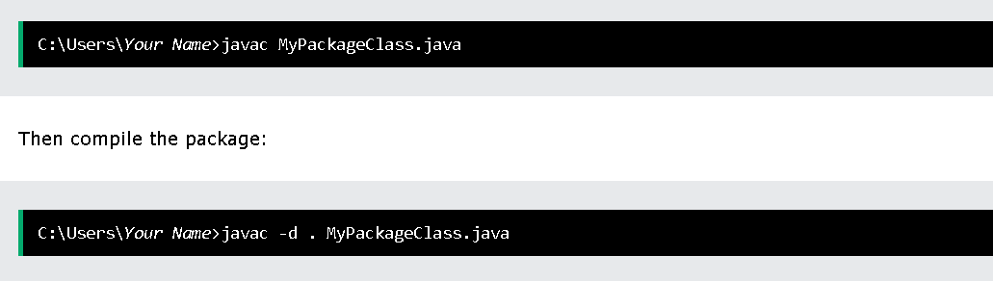
User-defined Packages
To create your own package, you need to understand that Java uses a file system directory to store them. Just like folders on your computer:
Example
└── root
└── mypack
└── MyPackageClass.java
To create a package, use the package keyword:
package mypack;
class MyPackageClass {
public static void main(String[] args) {
System.out.println("This is my package!");
}
}
Save the file as MyPackageClass.java, and compile it:
MyPackageClass.java
package mypack;
class MyPackageClass {
public static void main(String[] args) {
System.out.println("This is my package!");
}
}

Slide 60
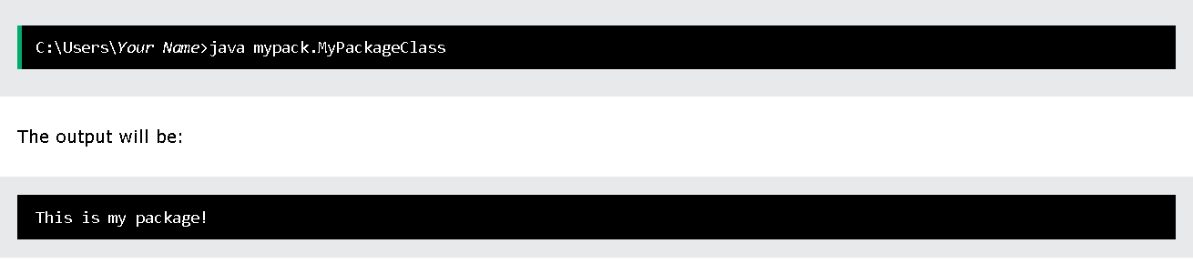
This forces the compiler to create the "mypack" package.
The -d keyword specifies the destination for where to save the class file. You can use any directory name, like c:/user (windows), or, if you want to keep the package within the same directory, you can use the dot sign ".", like in the example above.
Note: The package name should be written in lower case to avoid conflict with class names.
When we compiled the package in the example above, a new folder was created, called "mypack".
To run the MyPackageClass.java file, write the following:

Slide 61
Java Inheritance
Example
class Vehicle {
protected String brand = "Ford"; // Vehicle attribute
public void honk() { // Vehicle method
System.out.println("Tuut, tuut!");
}
}
class Car extends Vehicle {
private String modelName = "Mustang"; // Car attribute
public static void main(String[] args) {
// Create a myCar object
Car myCar = new Car();
// Call the honk() method (from the Vehicle class) on the myCar object
myCar.honk();
// Display the value of the brand attribute (from the Vehicle class) and the value of the modelName from the Car class
System.out.println(myCar.brand + " " + myCar.modelName);
}
}
Java Inheritance (Subclass and Superclass)
In Java, it is possible to inherit attributes and methods from one class to another. We group the "inheritance concept" into two categories:
subclass (child) - the class that inherits from another class
superclass (parent) - the class being inherited from
To inherit from a class, use the extends keyword.
In the example, the Car class (subclass) inherits the attributes and methods from the Vehicle class (superclass):

Slide 62
Did you notice the protected modifier in Vehicle?
We set the brand attribute in Vehicle to a protected access modifier. If it was set to private, the Car class would not be able to access it.
Why And When To Use "Inheritance"?
- It is useful for code reusability: reuse attributes and methods of an existing class when you create a new class.
class Vehicle {
protected String brand = "Ford";
public void honk() {
System.out.println("Tuut, tuut!");
}
}
class Car extends Vehicle {
private String modelName = "Mustang";
public static void main(String[] args) {
Car myFastCar = new Car();
myFastCar.honk();
System.out.println(myFastCar.brand + " " + myFastCar.modelName);
}
}
The final Keyword
If you don't want other classes to inherit from a class, use the final keyword:
If you try to access a final class, Java will generate an error:
final class Vehicle {
...
}
class Car extends Vehicle {
...
}

Slide 63
The output will be something like this:
Main.java:9: error: cannot inherit from final Vehicle
class Main extends Vehicle {
^
1 error)
final class Vehicle {
protected String brand = "Ford";
public void honk() {
System.out.println("Tuut, tuut!");
}
}
class Main extends Vehicle {
private String modelName = "Mustang";
public static void main(String[] args) {
Main myFastCar = new Main();
myFastCar.honk();
System.out.println(myFastCar.brand + " " + myFastCar.modelName);
}
}

Slide 64
Java Polymorphism
class Animal {
public void animalSound() {
System.out.println("The animal makes a sound");
}
}
class Pig extends Animal {
public void animalSound() {
System.out.println("The pig says: wee wee");
}
}
class Dog extends Animal {
public void animalSound() {
System.out.println("The dog says: bow wow");
}
}
Polymorphism means "many forms", and it occurs when we have many classes that are related to each other by inheritance.
Like we specified in the previously; Inheritance lets us inherit attributes and methods from another class. Polymorphism uses those methods to perform different tasks. This allows us to perform a single action in different ways.
For example, think of a superclass called Animal that has a method called animalSound(). Subclasses of Animals could be Pigs, Cats, Dogs, Birds - And they also have their own implementation of an animal sound (the pig oinks, and the cat meows, etc.):
Remember from the Inheritance topic that we use the extends keyword to inherit from a class.
Now we can create Pig and Dog objects and call the animalSound() method on both of them:

Slide 65
Why And When To Use "Inheritance" and "Polymorphism"?
- It is useful for code reusability: reuse attributes and methods of an existing class when you create a new class.
class Animal {
public void animalSound() {
System.out.println("The animal makes a sound");
}
}
class Pig extends Animal {
public void animalSound() {
System.out.println("The pig says: wee wee");
}
}
class Dog extends Animal {
public void animalSound() {
System.out.println("The dog says: bow wow");
}
}
class Main {
public static void main(String[] args) {
Animal myAnimal = new Animal();
Animal myPig = new Pig();
Animal myDog = new Dog();
myAnimal.animalSound();
myPig.animalSound();
myDog.animalSound();
}
}
Example
class Animal {
public void animalSound() { System.out.println("The animal makes a sound"); }
}
class Pig extends Animal {
public void animalSound(){
System.out.println("The pig says: wee wee");
}
}
class Dog extends Animal { public void animalSound() {
System.out.println("The dog says: bow wow");
}
}
class Main {
public static void main(String[] args) {
Animal myAnimal = new Animal(); // Create an Animal object
Animal myPig = new Pig(); // Create a Pig object
Animal myDog = new Dog(); // Create a Dog object
myAnimal.animalSound();
myPig.animalSound();
myDog.animalSound();
}
}

Slide 66
Java Inner Classes
In Java, it is also possible to nest classes (a class within a class). The purpose of nested classes is to group classes that belong together, which makes your code more readable and maintainable.
To access the inner class, create an object of the outer class, and then create an object of the inner class:
Example
class OuterClass {
int x = 10;
class InnerClass {
int y = 5;
}
}
public class Main {
public static void main(String[] args) {
OuterClass myOuter = new OuterClass();
OuterClass.InnerClass myInner = myOuter.new InnerClass();
System.out.println(myInner.y + myOuter.x);
}
}
// Outputs 15 (5 + 10)

Slide 67
Private Inner Class
Unlike a "regular" class, an inner class can be private or protected. If you don't want outside objects to access the inner class, declare the class as private:
Example
class OuterClass {
int x = 10;
private class InnerClass {
int y = 5;
}
}
public class Main {
public static void main(String[] args) {
OuterClass myOuter = new OuterClass();
OuterClass.InnerClass myInner = myOuter.new InnerClass();
System.out.println(myInner.y + myOuter.x);
}
}
If you try to access a private inner class from an outside class, an error occurs:
Main.java:13: error: OuterClass.InnerClass has private access in OuterClass
OuterClass.InnerClass myInner = myOuter.new InnerClass();

Slide 68
Static Inner Class
An inner class can also be static, which means that you can access it without creating an object of the outer class:
Example
class OuterClass {
int x = 10;
static class InnerClass {
int y = 5;
}
}
public class Main {
public static void main(String[] args) {
OuterClass.InnerClass myInner = new OuterClass.InnerClass();
System.out.println(myInner.y);
}
}
// Outputs 5
Note: just like static attributes and methods, a static inner class does not have access to members of the outer class.

Slide 69
Access Outer Class From Inner Class
One advantage of inner classes, is that they can access attributes and methods of the outer class:
class OuterClass {
int x = 10;
class InnerClass {
public int myInnerMethod() {
return x;
}
}
}
public class Main {
public static void main(String[] args) {
OuterClass myOuter = new OuterClass();
OuterClass.InnerClass myInner = myOuter.new InnerClass();
System.out.println(myInner.myInnerMethod());
}
}
// Outputs 10

Slide 70
Java Abstraction
Abstract Classes and Methods
Data abstraction is the process of hiding certain details and showing only essential information to the user.
Abstraction can be achieved with either abstract classes or interfaces.
The abstract keyword is a non-access modifier, used for classes and methods:
Abstract class: is a restricted class that cannot be used to create objects (to access it, it must be inherited from another class).
Abstract method: can only be used in an abstract class, and it does not have a body. The body is provided by the subclass (inherited from).
From the example, it is not possible to create an object of the Animal class:
An abstract class can have both abstract and regular methods:
abstract class Animal {
public abstract void animalSound();
public void sleep() {
System.out.println("Zzz");
}
}
Animal myObj = new Animal(); // will generate an error
To access the abstract class, it must be inherited from another class. Let's convert the Animal class we used in the Polymorphism topic to an abstract class:
Remember from the Inheritance topic that we use the extends keyword to inherit from a class.

Slide 71
Example
// Abstract class
abstract class Animal {
// Abstract method (does not have a body)
public abstract void animalSound();
// Regular method
public void sleep() {
System.out.println("Zzz");
}
}
// Subclass (inherit from Animal)
class Pig extends Animal {
public void animalSound() {
// The body of animalSound() is provided here
System.out.println("The pig says: wee wee");
}
}
class Main {
public static void main(String[] args) {
Pig myPig = new Pig(); // Create a Pig object
myPig.animalSound();
myPig.sleep();
}
}

Slide 72
// Abstract class
abstract class Animal {
// Abstract method (does not have a body)
public abstract void animalSound();
// Regular method
public void sleep() {
System.out.println("Zzz");
}
}
// Subclass (inherit from Animal)
class Pig extends Animal {
public void animalSound() {
// The body of animalSound() is provided here
System.out.println("The pig says: wee wee");
}
}
class Main {
public static void main(String[] args) {
Pig myPig = new Pig(); // Create a Pig object
myPig.animalSound();
myPig.sleep();
}
}
Why And When To Use Abstract Classes and Methods?
To achieve security - hide certain details and only show the important details of an object.
Note: Abstraction can also be achieved with Interfaces, which you will learn more about in the next chapter.

Slide 73
Java Interface
Interfaces
Another way to achieve abstraction in Java, is with interfaces.
An interface is a completely "abstract class" that is used to group related methods with empty bodies:
Example
// interface
interface Animal {
public void animalSound(); // interface method (does not have a body)
public void run(); // interface method (does not have a body)
}
ExampleGe
t
// interface interface Animal { public void animalSound(); // interface method (does not have a body) public void run(); // interface method (does not have a body) }
To access the interface methods, the interface must be "implemented" (kinda like inherited) by another class with the implements keyword (instead of extends). The body of the interface method is provided by the "implement" class:

Slide 74
To access the interface methods, the interface must be "implemented" (kind a like inherited) by another class with the implements keyword (instead of extends). The body of the interface method is provided by the "implement" class:
Example
// Interface
interface Animal {
public void animalSound(); // interface method (does not have a body)
public void sleep(); // interface method (does not have a body)
}
// Pig "implements" the Animal interface
class Pig implements Animal {
public void animalSound() {
// The body of animalSound() is provided here
System.out.println("The pig says: wee wee");
}
public void sleep() {
// The body of sleep() is provided here
System.out.println("Zzz");
}
}
class Main {
public static void main(String[] args) {
Pig myPig = new Pig(); // Create a Pig object
myPig.animalSound();
myPig.sleep();
}
}

Slide 75
interface Animal {
public void animalSound(); // interface method (does not have a body)
public void sleep(); // interface method (does not have a body)
}
class Pig implements Animal {
public void animalSound() {
System.out.println("The pig says: wee wee");
}
public void sleep() {
System.out.println("Zzz");
}
}
class Main {
public static void main(String[] args) {
Pig myPig = new Pig();
myPig.animalSound();
myPig.sleep();
}
}
Notes on Interfaces:
Like abstract classes, interfaces cannot be used to create objects (in the example above, it is not possible to create an "Animal" object in the MyMainClass)
Interface methods do not have a body - the body is provided by the "implement" class
On implementation of an interface, you must override all of its methods
Interface methods are by default abstract and public
Interface attributes are by default public, static and final
An interface cannot contain a constructor (as it cannot be used to create objects)
Why And When To Use Interfaces?
1) To achieve security - hide certain details and only show the important details of an object (interface).
2) Java does not support "multiple inheritance" (a class can only inherit from one superclass). However, it can be achieved with interfaces, because the class can implement multiple interfaces. Note: To implement multiple interfaces, separate them with a comma (see example below).

Slide 76
Multiple Interfaces
To implement multiple interfaces, separate them with a comma:
Example
interface FirstInterface {
public void myMethod(); // interface method
}
interface SecondInterface {
public void myOtherMethod(); // interface method
}
class DemoClass implements FirstInterface, SecondInterface {
public void myMethod() {
System.out.println("Some text..");
}
public void myOtherMethod() {
System.out.println("Some other text...");
}
}
class Main {
public static void main(String[] args) {
DemoClass myObj = new DemoClass();
myObj.myMethod();
myObj.myOtherMethod();
}
}
interface FirstInterface {
public void myMethod(); // interface method
}
interface SecondInterface {
public void myOtherMethod(); // interface method
}
// DemoClass "implements" FirstInterface and SecondInterface
class DemoClass implements FirstInterface, SecondInterface {
public void myMethod() {
System.out.println("Some text..");
}
public void myOtherMethod() {
System.out.println("Some other text...");
}
}
class Main {
public static void main(String[] args) {
DemoClass myObj = new DemoClass();
myObj.myMethod();
myObj.myOtherMethod();
}
}

Slide 77
Java Enums
Enums
An enum is a special "class" that represents a group of constants (unchangeable variables, like final variables).
To create an enum, use the enum keyword (instead of class or interface), and separate the constants with a comma. Note that they should be in uppercase letters:
enum Level {
LOW,
MEDIUM,
HIGH
}
public class Main {
public static void main(String[] args) {
Level myVar = Level.MEDIUM;
System.out.println(myVar);
}
}
ExampleGet
enum Level {
LOW,
MEDIUM,
HIGH }
You can access enum constants with the dot syntax:
Level myVar = Level.MEDIUM;

Slide 78
Java User Input (Scanner)
Java User Input
The Scanner class is used to get user input, and it is found in the java.util package.
To use the Scanner class, create an object of the class and use any of the available methods found in the Scanner class documentation. In our example, we will use the nextLine() method, which is used to read Strings:
Example
import java.util.Scanner; // Import the Scanner class
class Main {
public static void main(String[] args) {
Scanner myObj = new Scanner(System.in); // Create a Scanner object
System.out.println("Enter username");
String userName = myObj.nextLine(); // Read user input
System.out.println("Username is: " + userName); // Output user input
}
}
If you don't know what a package is, read our Java Packages Tutorial.
import java.util.Scanner; // import the Scanner class
class Main {
public static void main(String[] args) {
Scanner myObj = new Scanner(System.in);
String userName;
// Enter username and press Enter
System.out.println("Enter username");
userName = myObj.nextLine();
System.out.println("Username is: " + userName);
}
}

Slide 79
}
Enum in a Switch Statement
Enum is short for "enumerations", which means "specifically listed".
Enums are often used in switch statements to check for corresponding values:
Enum inside a Class
Example
You can also have an enum inside a class:
enum Level {
LOW,
MEDIUM,
HIGH
}
public class Main {
public static void main(String[] args) {
Level myVar = Level.MEDIUM;
switch(myVar) {
case LOW:
System.out.println("Low level");
break;
case MEDIUM:
System.out.println("Medium level");
break;
case HIGH:
System.out.println("High level");
break;
}
}
}
Example
public class Main {
enum Level {
LOW,
MEDIUM,
HIGH
} public static void main(String[] args) { Level myVar = Level.MEDIUM; System.out.println(myVar);
}
}

Slide 80
Loop Through an Enum
The enum type has a values() method, which returns an array of all enum constants. This method is useful when you want to loop through the constants of an enum:
Example
Difference between Enums and Classes
An enum can, just like a class, have attributes and methods. The only difference is that enum constants are public, static and final (unchangeable - cannot be overridden).
An enum cannot be used to create objects, and it cannot extend other classes (but it can implement interfaces).
Why And When To Use Enums?
Use enums when you have values that you know aren't going to change, like month days, days, colors, deck of cards, etc.
for (Level myVar : Level.values()) {
System.out.println(myVar);
enum Level {
LOW,
MEDIUM,
HIGH
}
public class Main {
public static void main(String[] args) {
for (Level myVar : Level.values()) {
System.out.println(myVar);
}
}
}

Slide 81
Java User Input (Scanner)Pr
import java.util.Scanner;
class Main {
public static void main(String[] args) {
Scanner myObj = new Scanner(System.in);
System.out.println("Enter name, age and salary:");
// String input
String name = myObj.nextLine();
// Numerical input
int age = myObj.nextInt();
double salary = myObj.nextDouble();
// Output input by user
System.out.println("Name: " + name);
System.out.println("Age: " + age);
System.out.println("Salary: " + salary);
}
}
Java User Input
The Scanner class is used to get user input, and it is found in the java.util package.
To use the Scanner class, create an object of the class and use any of the available methods found in the Scanner class documentation. In our example, we will use the nextLine() method, which is used to read Strings:
ExampleG\
import java.util.Scanner; // Import the Scanner class
class Main { public static void main(String[] args) { Scanner myObj = new Scanner(System.in); // Create a Scanner object System.out.println("Enter username"); String userName = myObj.nextLine(); // Read user input System.out.println("Username is: " + userName); // Output user input
}
}

Slide 82
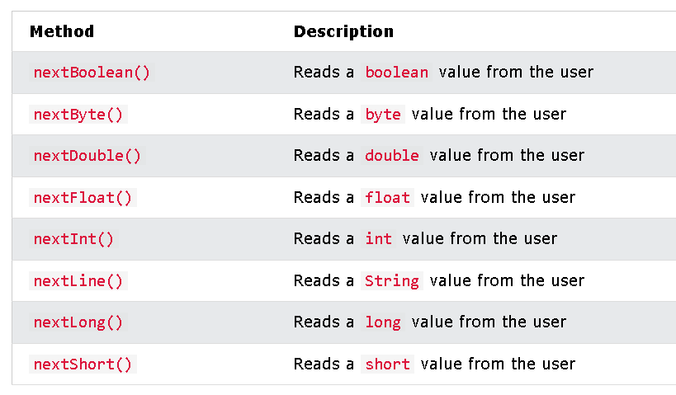
Input Types
In the example above, we used the nextLine() method, which is used to read Strings. To read other types, look at the table below:

Slide 83
import java.util.Scanner;
class Main {
public static void main(String[] args) {
Scanner myObj = new Scanner(System.in);
System.out.println("Enter name, age and salary:");
// String input
String name = myObj.nextLine();
// Numerical input
int age = myObj.nextInt();
double salary = myObj.nextDouble();
// Output input by user
System.out.println("Name: " + name);
System.out.println("Age: " + age);
System.out.println("Salary: " + salary);
}
}

Slide 84
In the example below, we use different methods to read data of various types:
import java.util.Scanner;
class Main {
public static void main(String[] args) {
Scanner myObj = new Scanner(System.in);
System.out.println("Enter name, age and salary:");
// String input
String name = myObj.nextLine();
// Numerical input
int age = myObj.nextInt();
double salary = myObj.nextDouble();
// Output input by user
System.out.println("Name: " + name);
System.out.println("Age: " + age);
System.out.println("Salary: " + salary);
}
}
Note: If you enter wrong input (e.g. text in a numerical input), you will get an exception/error message (like "InputMismatchException").

Slide 85
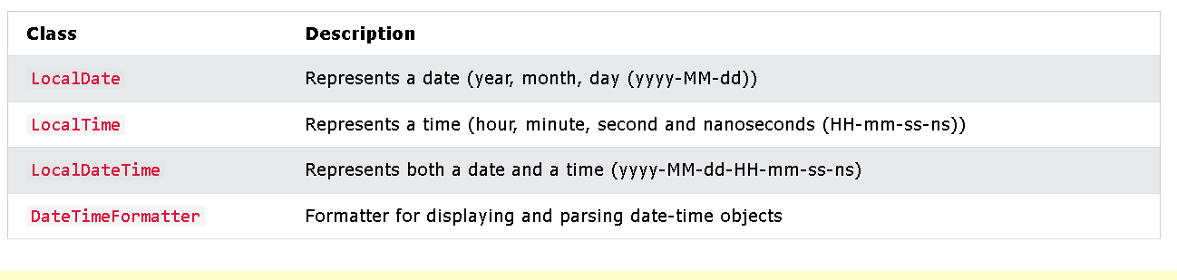
Java Date and Time
Java Dates
Java does not have a built-in Date class, but we can import the java.time package to work with the date and time API. The package includes many date and time classes. For example:

Slide 86


Display Current Date
To display the current date, import the java.time.LocalDate class, and use its now() method:
Display Current Time
To display the current time (hour, minute, second, and nanoseconds), import the java.time.LocalTime class, and use its now() method:
Example
Example
import java.time.LocalDate; // import the LocalDate class
public class Main {
public static void main(String[] args) {
LocalDate myObj = LocalDate.now(); // Create a date object
System.out.println(myObj); // Display the current date
}
}
import java.time.LocalTime; // import the LocalTime class
public class Main {
public static void main(String[] args) {
LocalTime myObj = LocalTime.now();
System.out.println(myObj);
}
}

Slide 87

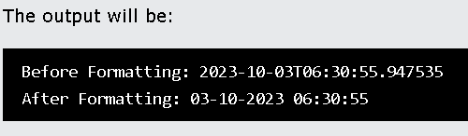
Formatting Date and Time
The "T" in the example above is used to separate the date from the time. You can use the DateTimeFormatter class with the ofPattern() method in the same package to format or parse date-time objects. The following example will remove both the "T" and nanoseconds from the date-time:
Example
import java.time.LocalDateTime; // Import the LocalDateTime class
import java.time.format.DateTimeFormatter; // Import the DateTimeFormatter class
public class Main {
public static void main(String[] args) {
LocalDateTime myDateObj = LocalDateTime.now();
System.out.println("Before formatting: " + myDateObj);
DateTimeFormatter myFormatObj = DateTimeFormatter.ofPattern("dd-MM-yyyy HH:mm:ss");
String formattedDate = myDateObj.format(myFormatObj);
System.out.println("After formatting: " + formattedDate);
}
}
Display Current Date and Time
To display the current date and time, import the java.time.LocalDateTime class, and use its now() method:
Example
import java.time.LocalDateTime; // import the LocalDateTime class
public class Main {
public static void main(String[] args) {
LocalDateTime myObj = LocalDateTime.now();
System.out.println(myObj);
}

Slide 88
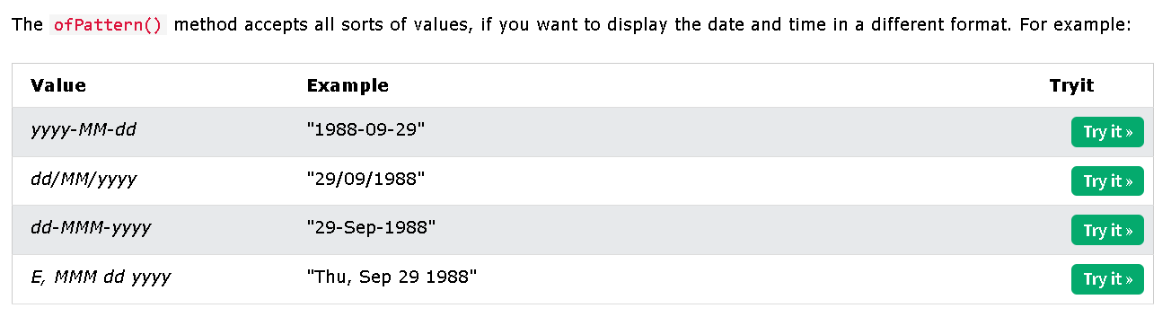

import java.time.LocalDateTime; // Import the LocalDateTime class
import java.time.format.DateTimeFormatter; // Import the DateTimeFormatter class
public class Main {
public static void main(String[] args) {
LocalDateTime myDateObj = LocalDateTime.now();
System.out.println("Before formatting: " + myDateObj);
DateTimeFormatter myFormatObj = DateTimeFormatter.ofPattern("dd-MM-yyyy HH:mm:ss");
String formattedDate = myDateObj.format(myFormatObj);
System.out.println("After formatting: " + formattedDate);
}
}

Slide 89


import java.time.LocalDateTime; // Import the LocalDateTime class
import java.time.format.DateTimeFormatter; // Import the DateTimeFormatter class
public class Main {
public static void main(String[] args) {
LocalDateTime myDateObj = LocalDateTime.now();
System.out.println("Before Formatting: " + myDateObj);
DateTimeFormatter myFormatObj = DateTimeFormatter.ofPattern("dd/MM/yyyy HH:mm:ss");
String formattedDate = myDateObj.format(myFormatObj);
System.out.println("After Formatting: " + formattedDate);
}
}
import java.time.LocalDateTime; // Import the LocalDateTime class
import java.time.format.DateTimeFormatter; // Import the DateTimeFormatter class
public class Main {
public static void main(String[] args) {
LocalDateTime myDateObj = LocalDateTime.now();
System.out.println("Before Formatting: " + myDateObj);
DateTimeFormatter myFormatObj = DateTimeFormatter.ofPattern("dd-MMM-yyyy HH:mm:ss");
String formattedDate = myDateObj.format(myFormatObj);
System.out.println("After Formatting: " + formattedDate);
}
}

Slide 90

import java.time.LocalDateTime; // Import the LocalDateTime class
import java.time.format.DateTimeFormatter; // Import the DateTimeFormatter class
public class Main {
public static void main(String[] args) {
LocalDateTime myDateObj = LocalDateTime.now();
System.out.println("Before Formatting: " + myDateObj);
DateTimeFormatter myFormatObj = DateTimeFormatter.ofPattern("E, MMM dd yyyy HH:mm:ss");
String formattedDate = myDateObj.format(myFormatObj);
System.out.println("After Formatting: " + formattedDate);
}
}

Slide 91
Java ArrayList
Java ArrayList
The ArrayList class is a resizable array, which can be found in the java.util package.
The difference between a built-in array and an ArrayList in Java, is that the size of an array cannot be modified (if you want to add or remove elements to/from an array, you have to create a new one). While elements can be added and removed from an ArrayList whenever you want. The syntax is also slightly different:
ExampleGet your own Java Server
Create an ArrayList object called cars that will store strings:
import java.util.ArrayList; // import the ArrayList class
ArrayList<String> cars = new ArrayList<String>(); // Create an ArrayList object
If you don't know what a package is, read our Java Packages Tutorial.
Add Items
The ArrayList class has many useful methods. For example, to add elements to the ArrayList, use the add() method:
Example
import java.util.ArrayList;
public class Main {
public static void main(String[] args) {
ArrayList<String> cars = new ArrayList<String>();
cars.add("Volvo");
cars.add("BMW");
cars.add("Ford");
cars.add("Mazda");
System.out.println(cars);
}
}

Slide 92
Access an Item
To access an element in the ArrayList, use the get() method and refer to the index number:
Example
cars.get(0);
import java.util.ArrayList;
public class Main {
public static void main(String[] args) {
ArrayList<String> cars = new ArrayList<String>();
cars.add("Volvo");
cars.add("BMW");
cars.add("Ford");
cars.add("Mazda");
System.out.println(cars.get(0));
}
}
Remember: Array indexes start with 0: [0] is the first element. [1] is the second element, etc.

Slide 93


Change an Item
To modify an element, use the set() method and refer to the index number:
Example
cars.set(0, "Opel");
Remove an Item
To remove an element, use the remove() method and refer to the index number:
Example
cars.remove(0);
import java.util.ArrayList;
public class Main {
public static void main(String[] args) {
ArrayList<String> cars = new ArrayList<String>();
cars.add("Volvo");
cars.add("BMW");
cars.add("Ford");
cars.add("Mazda");
cars.set(0, "Opel");
System.out.println(cars);
}
}
import java.util.ArrayList;
public class Main {
public static void main(String[] args) {
ArrayList<String> cars = new ArrayList<String>();
cars.add("Volvo");
cars.add("BMW");
cars.add("Ford");
cars.add("Mazda");
cars.remove(0);
System.out.println(cars);
}
}

Slide 94

To remove all the elements in the ArrayList, use the clear() method:
Example
cars.clear();
ArrayList Size
To find out how many elements an ArrayList have, use the size method:
Example
cars.size();
import java.util.ArrayList;
public class Main {
public static void main(String[] args) {
ArrayList<String> cars = new ArrayList<String>();
cars.add("Volvo");
cars.add("BMW");
cars.add("Ford");
cars.add("Mazda");
cars.clear();
System.out.println(cars);
}
}
import java.util.ArrayList;
public class Main {
public static void main(String[] args) {
ArrayList<String> cars = new ArrayList<String>();
cars.add("Volvo");
cars.add("BMW");
cars.add("Ford");
cars.add("Mazda");
System.out.println(cars.size());
}
}

Slide 95
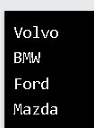
Loop Through an ArrayList
Loop through the elements of an ArrayList with a for loop, and use the size() method to specify how many times the loop should run:
Example
public class Main {
public static void main(String[] args) {
ArrayList<String> cars = new ArrayList<String>();
cars.add("Volvo");
cars.add("BMW");
cars.add("Ford");
cars.add("Mazda");
for (int i = 0; i < cars.size(); i++) {
System.out.println(cars.get(i));
}
}
}
import java.util.ArrayList;
public class Main {
public static void main(String[] args) {
ArrayList<String> cars = new ArrayList<String>();
cars.add("Volvo");
cars.add("BMW");
cars.add("Ford");
cars.add("Mazda");
for (int i = 0; i < cars.size(); i++) {
System.out.println(cars.get(i));
}
}
}

Slide 96
You can also loop through an ArrayList with the for-each loop:
Example
public class Main {
public static void main(String[] args) {
ArrayList<String> cars = new ArrayList<String>();
cars.add("Volvo");
cars.add("BMW");
cars.add("Ford");
cars.add("Mazda");
for (String i : cars) {
System.out.println(i);
}
}
}
import java.util.ArrayList;
public class Main {
public static void main(String[] args) {
ArrayList<String> cars = new ArrayList<String>();
cars.add("Volvo");
cars.add("BMW");
cars.add("Ford");
cars.add("Mazda");
for (String i : cars) {
System.out.println(i);
}
}
}

Slide 97
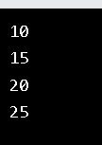
Other Types
Elements in an ArrayList are actually objects. In the examples above, we created elements (objects) of type "String". Remember that a String in Java is an object (not a primitive type). To use other types, such as int, you must specify an equivalent wrapper class: Integer. For other primitive types, use: Boolean for boolean, Character for char, Double for double, etc:
Example
Create an ArrayList to store numbers (add elements of type Integer):
import java.util.ArrayList;
public class Main {
public static void main(String[] args) {
ArrayList<Integer> myNumbers = new ArrayList<Integer>();
myNumbers.add(10);
myNumbers.add(15);
myNumbers.add(20);
myNumbers.add(25);
for (int i : myNumbers) {
System.out.println(i);
}
}
}
import java.util.ArrayList;
public class Main {
public static void main(String[] args) {
ArrayList<Integer> myNumbers = new ArrayList<Integer>();
myNumbers.add(10);
myNumbers.add(15);
myNumbers.add(20);
myNumbers.add(25);
for (int i : myNumbers) {
System.out.println(i);
}
}
}

Slide 98

Sort an ArrayList
Another useful class in the java.util package is the Collections class, which include the sort() method for sorting lists alphabetically or numerically:
Example
Sort an ArrayList of Strings:
import java.util.ArrayList;
import java.util.Collections; // Import the Collections class
public class Main {
public static void main(String[] args) {
ArrayList<String> cars = new ArrayList<String>();
cars.add("Volvo");
cars.add("BMW");
cars.add("Ford");
cars.add("Mazda");
Collections.sort(cars); // Sort cars
for (String i : cars) {
System.out.println(i);
}
}
}
import java.util.ArrayList;
import java.util.Collections;
public class Main {
public static void main(String[] args) {
ArrayList<String> cars = new ArrayList<String>();
cars.add("Volvo");
cars.add("BMW");
cars.add("Ford");
cars.add("Mazda");
Collections.sort(cars);
for (String i : cars) {
System.out.println(i);
}
}
}

Slide 99

Example
Sort an ArrayList of Integers:
import java.util.ArrayList;
import java.util.Collections; // Import the Collections class
public class Main {
public static void main(String[] args) {
ArrayList<Integer> myNumbers = new ArrayList<Integer>();
myNumbers.add(33);
myNumbers.add(15);
myNumbers.add(20);
myNumbers.add(34);
myNumbers.add(8);
myNumbers.add(12);
Collections.sort(myNumbers); // Sort myNumbers
for (int i : myNumbers) {
System.out.println(i);
}
}
}

Slide 100
Java LinkedList
Java LinkedList
In the previous chapter, you learned about the ArrayList class. The LinkedList class is almost identical to the ArrayList:
ExampleGet your own Java Server
// Import the LinkedList class
import java.util.LinkedList;
public class Main {
public static void main(String[] args) {
LinkedList<String> cars = new LinkedList<String>();
cars.add("Volvo");
cars.add("BMW");
cars.add("Ford");
cars.add("Mazda");
System.out.println(cars);
}
}
import java.util.LinkedList;
public class Main {
public static void main(String[] args) {
LinkedList<String> cars = new LinkedList<String>();
cars.add("Volvo");
cars.add("BMW");
cars.add("Ford");
cars.add("Mazda");
System.out.println(cars);
}
}

Slide 101
ArrayList vs. LinkedList
The LinkedList class is a collection which can contain many objects of the same type, just like the ArrayList.
The LinkedList class has all of the same methods as the ArrayList class because they both implement the List interface. This means that you can add items, change items, remove items and clear the list in the same way.
However, while the ArrayList class and the LinkedList class can be used in the same way, they are built very differently.
How the ArrayList works
The ArrayList class has a regular array inside it. When an element is added, it is placed into the array. If the array is not big enough, a new, larger array is created to replace the old one and the old one is removed.
How the LinkedList works
The LinkedList stores its items in "containers." The list has a link to the first container and each container has a link to the next container in the list. To add an element to the list, the element is placed into a new container and that container is linked to one of the other containers in the list.
When To Use
Use an ArrayList for storing and accessing data, and LinkedList to manipulate data.

Slide 102
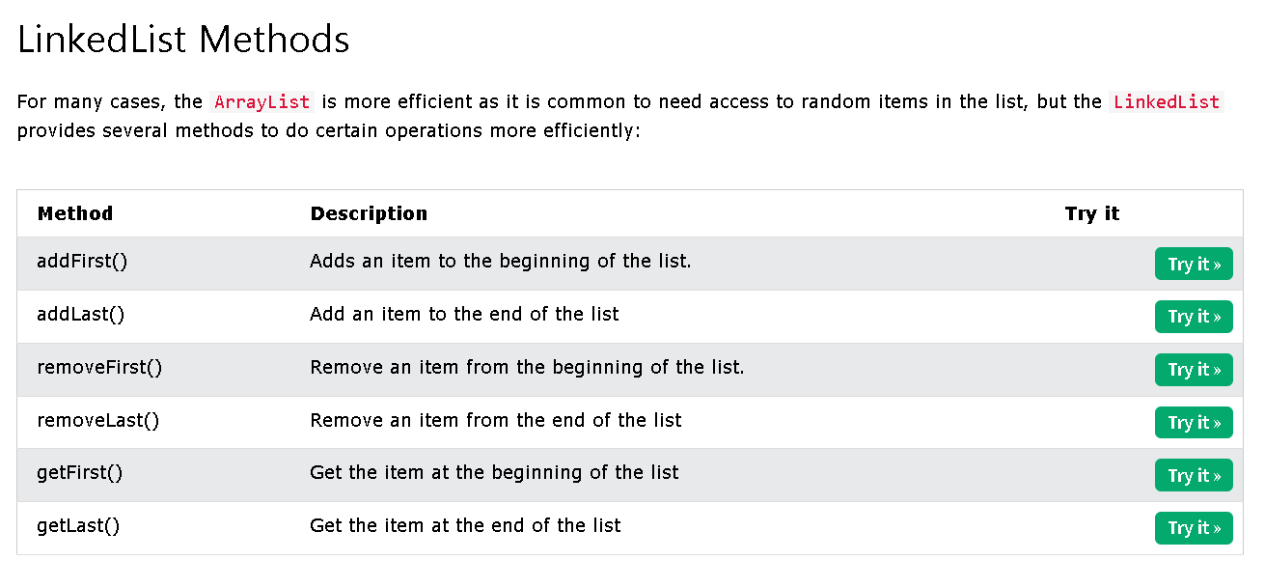

Slide 103


import java.util.LinkedList;
public class Main {
public static void main(String[] args) {
LinkedList<String> cars = new LinkedList<String>();
cars.add("Volvo");
cars.add("BMW");
cars.add("Ford");
// Use addFirst() to add the item to the beginning
cars.addFirst("Mazda");
System.out.println(cars);
}
}
import java.util.LinkedList;
public class Main {
public static void main(String[] args) {
LinkedList<String> cars = new LinkedList<String>();
cars.add("Volvo");
cars.add("BMW");
cars.add("Ford");
// Use addLast() to add the item to the end
cars.addLast("Mazda");
System.out.println(cars);
}
}

Slide 104


import java.util.LinkedList;
public class Main {
public static void main(String[] args) {
LinkedList<String> cars = new LinkedList<String>();
cars.add("Volvo");
cars.add("BMW");
cars.add("Ford");
cars.add("Mazda");
// Use removeFirst() remove the first item from the list
cars.removeFirst();
System.out.println(cars);
}
}
import java.util.LinkedList;
public class Main {
public static void main(String[] args) {
LinkedList<String> cars = new LinkedList<String>();
cars.add("Volvo");
cars.add("BMW");
cars.add("Ford");
cars.add("Mazda");
// Use removeLast() remove the last item from the list
cars.removeLast();
System.out.println(cars);
}
}

Slide 105


import java.util.LinkedList;
public class Main {
public static void main(String[] args) {
LinkedList<String> cars = new LinkedList<String>();
cars.add("Volvo");
cars.add("BMW");
cars.add("Ford");
cars.add("Mazda");
// Use getFirst() to display the first item in the list
System.out.println(cars.getFirst());
}
}
import java.util.LinkedList;
public class Main {
public static void main(String[] args) {
LinkedList<String> cars = new LinkedList<String>();
cars.add("Volvo");
cars.add("BMW");
cars.add("Ford");
cars.add("Mazda");
// Use getLast() to display the last item in the list
System.out.println(cars.getLast());
}
}

Slide 106
Java HashMap
Java HashMap
In the ArrayList chapter, you learned that Arrays store items as an ordered collection, and you have to access them with an index number (int type). A HashMap however, store items in "key/value" pairs, and you can access them by an index of another type (e.g. a String).
One object is used as a key (index) to another object (value). It can store different types: String keys and Integer values, or the same type, like: String keys and String values:

Slide 107
ExampleGet your own Java Server
Create a HashMap object called capitalCities that will store String keys and String values:
import java.util.HashMap; // import the HashMap class
HashMap<String, String> capitalCities = new HashMap<String, String>();

Slide 108

Add Items
The HashMap class has many useful methods. For example, to add items to it, use the put() method:
Example
// Import the HashMap class
import java.util.HashMap;
public class Main {
public static void main(String[] args) {
// Create a HashMap object called capitalCities
HashMap<String, String> capitalCities = new HashMap<String, String>();
// Add keys and values (Country, City)
capitalCities.put("England", "London");
capitalCities.put("Germany", "Berlin");
capitalCities.put("Norway", "Oslo");
capitalCities.put("USA", "Washington DC");
System.out.println(capitalCities);
}
}

Slide 109

Access an Item
To access a value in the HashMap, use the get() method and refer to its key:
Example
capitalCities.get("England");
import java.util.HashMap;
public class Main {
public static void main(String[] args) {
HashMap<String, String> capitalCities = new HashMap<String, String>();
capitalCities.put("England", "London");
capitalCities.put("Germany", "Berlin");
capitalCities.put("Norway", "Oslo");
capitalCities.put("USA", "Washington DC");
System.out.println(capitalCities.get("England"));
}
}
import java.util.HashMap;
public class Main {
public static void main(String[] args) {
HashMap<String, String> capitalCities = new HashMap<String, String>();
capitalCities.put("England", "London");
capitalCities.put("Germany", "Berlin");
capitalCities.put("Norway", "Oslo");
capitalCities.put("USA", "Washington DC");
System.out.println(capitalCities.get("England"));
}
}

Slide 110


Remove an Item
To remove an item, use the remove() method and refer to the key:
Example
capitalCities.remove("England");
To remove all items, use the clear() method:
Example
capitalCities.clear();
import java.util.HashMap;
public class Main {
public static void main(String[] args) {
HashMap<String, String> capitalCities = new HashMap<String, String>();
capitalCities.put("England", "London");
capitalCities.put("Germany", "Berlin");
capitalCities.put("Norway", "Oslo");
capitalCities.put("USA", "Washington DC");
capitalCities.clear();
System.out.println(capitalCities);
}
}
import java.util.HashMap;
public class Main {
public static void main(String[] args) {
HashMap<String, String> capitalCities = new HashMap<String, String>();
capitalCities.put("England", "London");
capitalCities.put("Germany", "Berlin");
capitalCities.put("Norway", "Oslo");
capitalCities.put("USA", "Washington DC");
capitalCities.remove("England");
System.out.println(capitalCities);
}
}

Slide 111


HashMap Size
To find out how many items there are, use the size() method:
Example
capitalCities.size();
Loop Through a HashMap
Loop through the items of a HashMap with a for-each loop.
Note: Use the keySet() method if you only want the keys, and use the values() method if you only want the values:
Example
// Print keys
for (String i : capitalCities.keySet()) {
System.out.println(i);
}
import java.util.HashMap;
public class Main {
public static void main(String[] args) {
HashMap<String, String> capitalCities = new HashMap<String, String>();
capitalCities.put("England", "London");
capitalCities.put("Germany", "Berlin");
capitalCities.put("Norway", "Oslo");
capitalCities.put("USA", "Washington DC");
System.out.println(capitalCities.size());
}
}
import java.util.HashMap;
public class Main {
public static void main(String[] args) {
HashMap<String, String> capitalCities = new HashMap<String, String>();
capitalCities.put("England", "London");
capitalCities.put("Germany", "Berlin");
capitalCities.put("Norway", "Oslo");
capitalCities.put("USA", "Washington DC");
for (String i : capitalCities.keySet()) {
System.out.println(i);
}
}
}

Slide 112

Example
// Print values
for (String i : capitalCities.values()) {
System.out.println(i);
}
import java.util.HashMap;
public class Main {
public static void main(String[] args) {
HashMap<String, String> capitalCities = new HashMap<String, String>();
capitalCities.put("England", "London");
capitalCities.put("Germany", "Berlin");
capitalCities.put("Norway", "Oslo");
capitalCities.put("USA", "Washington DC");
for (String i : capitalCities.values()) {
System.out.println(i);
}
}
}

Slide 113

Example
// Print keys and values
for (String i : capitalCities.keySet()) {
System.out.println("key: " + i + " value: " + capitalCities.get(i));
}
import java.util.HashMap;
public class Main {
public static void main(String[] args) {
HashMap<String, String> capitalCities = new HashMap<String, String>();
capitalCities.put("England", "London");
capitalCities.put("Germany", "Berlin");
capitalCities.put("Norway", "Oslo");
capitalCities.put("USA", "Washington DC");
for (String i : capitalCities.keySet()) {
System.out.println("key: " + i + " value: " + capitalCities.get(i));
}
}
}

Slide 114
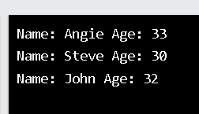
Other Types
Keys and values in a HashMap are actually objects. In the examples above, we used objects of type "String". Remember that a String in Java is an object (not a primitive type). To use other types, such as int, you must specify an equivalent wrapper class: Integer. For other primitive types, use: Boolean for boolean, Character for char, Double for double, etc:
Example
Create a HashMap object called people that will store String keys and Integer values:
// Import the HashMap class
import java.util.HashMap;
public class Main {
public static void main(String[] args) {
// Create a HashMap object called people
HashMap<String, Integer> people = new HashMap<String, Integer>();
// Add keys and values (Name, Age)
people.put("John", 32);
people.put("Steve", 30);
people.put("Angie", 33);
for (String i : people.keySet()) {
System.out.println("key: " + i + " value: " + people.get(i));
}
}
}
// Import the HashMap class
import java.util.HashMap;
public class Main {
public static void main(String[] args) {
// Create a HashMap object called people
HashMap<String, Integer> people = new HashMap<String, Integer>();
// Add keys and values (Name, Age)
people.put("John", 32);
people.put("Steve", 30);
people.put("Angie", 33);
for (String i : people.keySet()) {
System.out.println("Name: " + i + " Age: " + people.get(i));
}
}
}

Slide 115

Java HashSet
A HashSet is a collection of items where every item is unique, and it is found in the java.util package:
ExampleGet your own Java Server
Create a HashSet object called cars that will store strings:
import java.util.HashSet; // Import the HashSet class
HashSet<String> cars = new HashSet<String>();
/ Import the HashSet class
import java.util.HashSet;
public class Main {
public static void main(String[] args) {
HashSet<String> cars = new HashSet<String>();
cars.add("Volvo");
cars.add("BMW");
cars.add("Ford");
cars.add("BMW");
cars.add("Mazda");
System.out.println(cars);
}
}
Add Items
The HashSet class has many useful methods. For example, to add items to it, use the add() method:
Example
// Import the HashSet class
import java.util.HashSet;
public class Main {
public static void main(String[] args) {
HashSet<String> cars = new HashSet<String>();
cars.add("Volvo");
cars.add("BMW");
cars.add("Ford");
cars.add("BMW");
cars.add("Mazda");
System.out.println(cars);
}
}

Slide 116

Note: In the example above, even though BMW is added twice it only appears once in the set because every item in a set has to be unique.
Check If an Item Exists
To check whether an item exists in a HashSet, use the contains() method:
Example
cars.contains("Mazda");
// Import the HashSet class
import java.util.HashSet;
public class Main {
public static void main(String[] args) {
HashSet<String> cars = new HashSet<String>();
cars.add("Volvo");
cars.add("BMW");
cars.add("Ford");
cars.add("BMW");
cars.add("Mazda");
System.out.println(cars.contains("Mazda"));
}
}

Slide 117

Remove an Item
To remove an item, use the remove() method:
Example
cars.remove("Volvo");
// Import the HashSet class
import java.util.HashSet;
public class Main {
public static void main(String[] args) {
HashSet<String> cars = new HashSet<String>();
cars.add("Volvo");
cars.add("BMW");
cars.add("Ford");
cars.add("BMW");
cars.add("Mazda");
cars.remove("Volvo");
System.out.println(cars);
}
}

