Slide 1

Click through to see just how easy it is to integrate quotations within your business today
Many tubular manufacturers face a common problem…
Producing professional and accurate quotes for interested clients quickly, all while minimizing errors and inefficiencies.
Our software Quotations is a cloud-based tool powered by MicrosoftTM Azure platform, the world’s largest cloud-based hosting service.
Designed to simplify and streamline your quoting process, Quotations will boost your productivity while minimizing errors.
Notes:
QuickStarter has created an outline to help you get started on your presentation. Some slides include information here in the notes to provide additional topics for you to research.

Slide 2

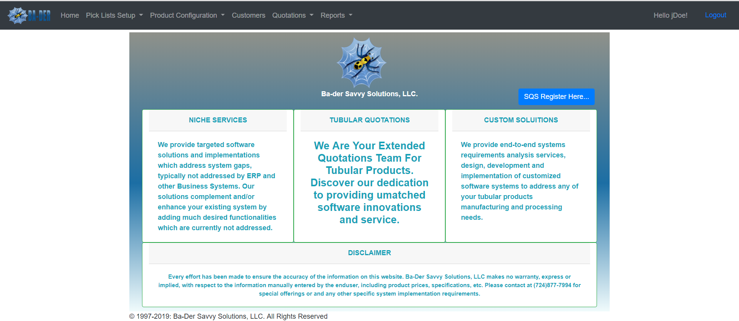
Quotations a Customized sqs solution for all your quoting needs
TO BEGIN, visit our SECURE SITE AT
https://quotations.azurewebsites.net
Access the site securely from any web-browser, anytime, anywhere!
Login with a unique user ID and password, created specifically for your companies needs.
You can create as many user ID’s as you’d like to accommodate any number of sales reps.
…Continue on to the ‘Pick lists setup’ tab ON THE NEXT PAGE

Slide 3
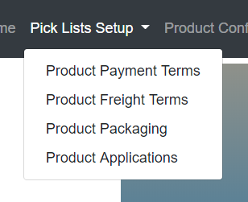
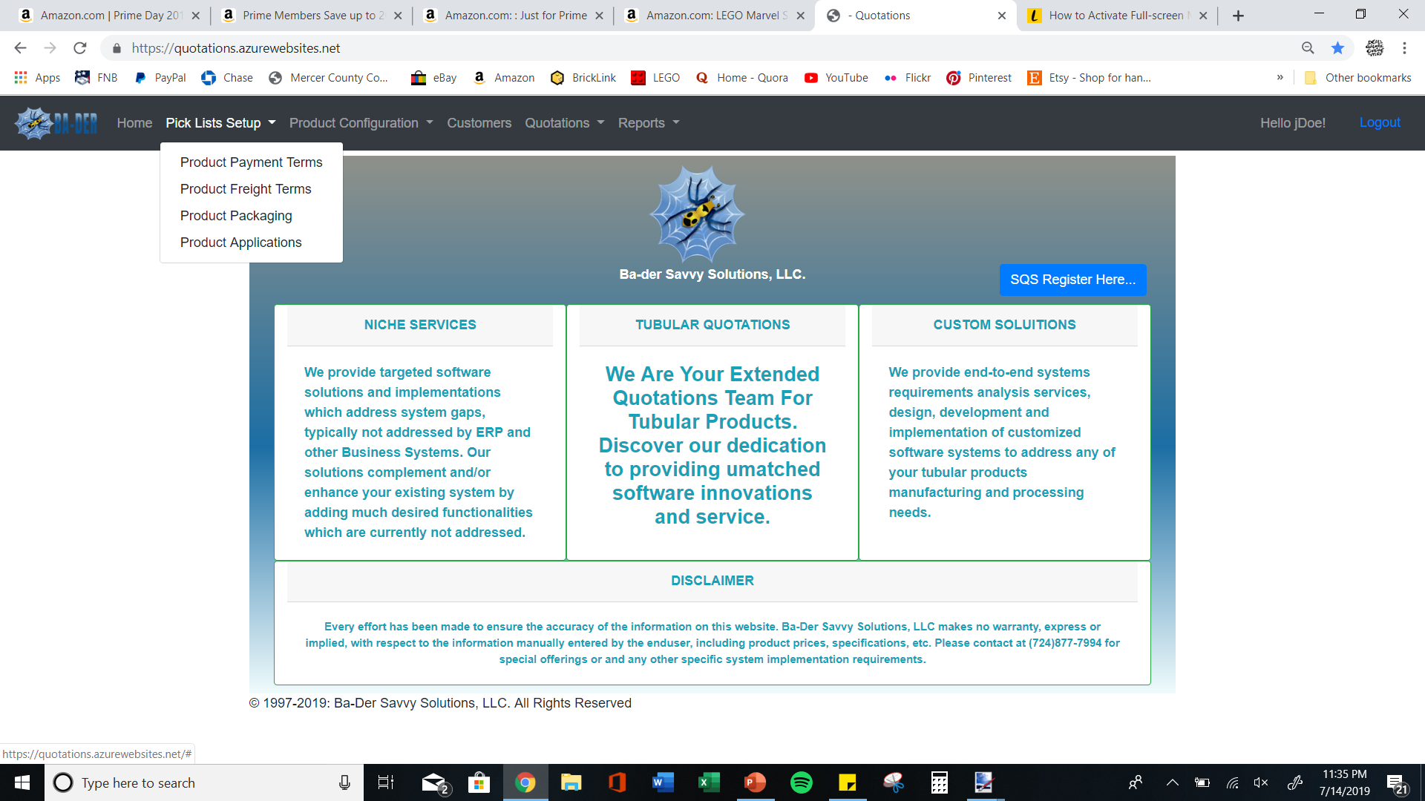
Pick lists setup
Step 1: company setup
Under “Pick Lists Setup”, you’ll begin to set-up your companies' standards. Set your desired product applications, packaging options, freight and payment terms.
Simply click on each of the options on the drop-down menu to quickly and easily set your unique standards.
These standards need only to be entered once and do not need to be entered again in the future (although you may revise and add to these terms at any time)
The information added to your Pick Lists Setup will be used when creating your quote.
…Continue on to the ‘PRODUCT CONFIGURATION’ tab ON THE NEXT PAGE

Slide 4
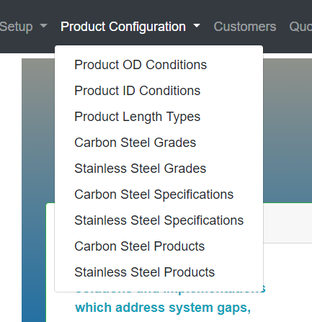
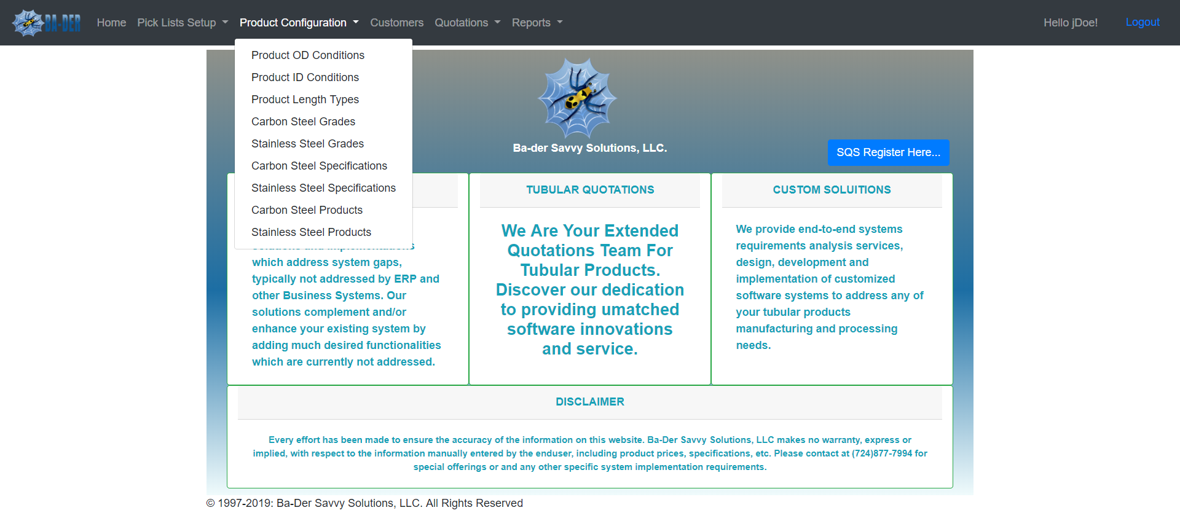
Step 1: company setup cont’d
Product configuration
Under “Product Configuration”, you’ll set-up your product standards. Currently we have grade and spec options for Carbon Steel and Stainless-Steel tube products, but we can work with your business to add any number of options depending on the product you supply.
Simply click on each of the options on the drop-down menu to set your own standards. Set your OD & ID conditions, units of length, product specifications and grades, and your list of products that your company offers.
Like the ‘Pick Lists Setup’, this information need only to be entered once and does NOT need to be entered again in the future (although you may edit these terms at any time, if necessary)
The information in the Product Configuration tab will be used when creating your quote.
…Continue on to the ‘customers’ tab ON THE NEXT PAGE

Slide 5
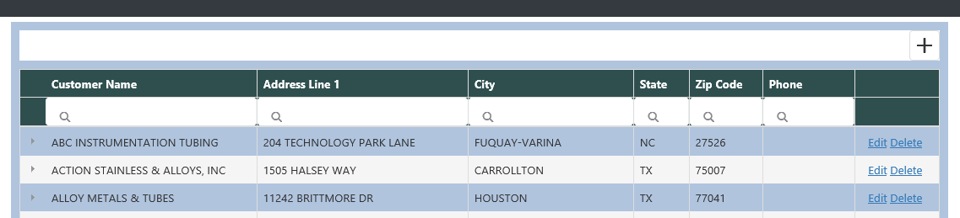
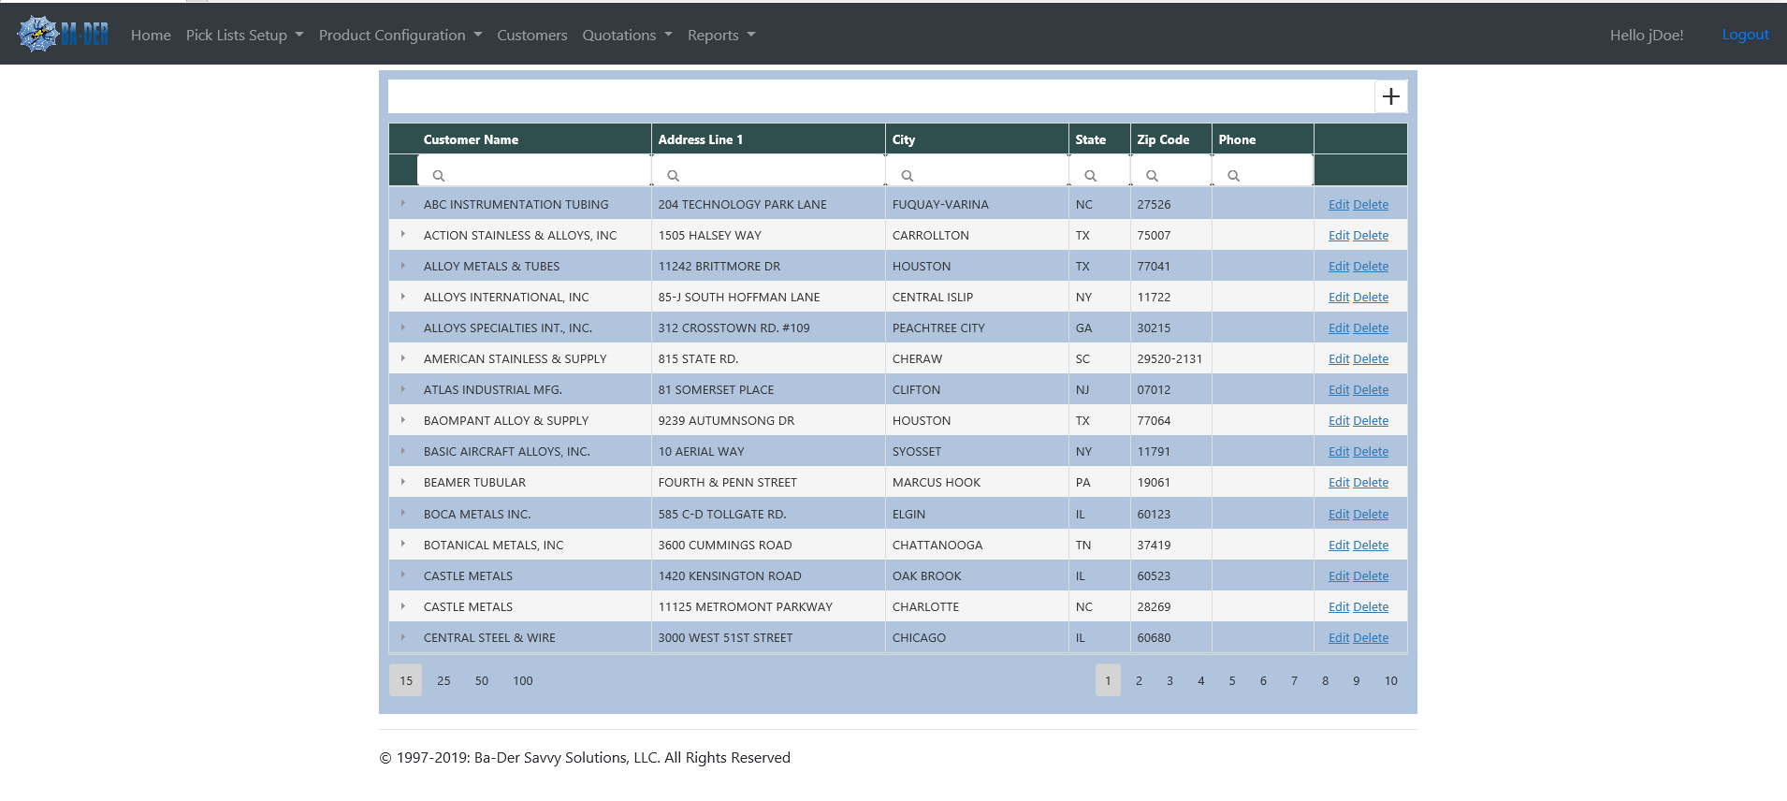
Sort any column alphabetically by clicking on the column header
Type to search in any category to quickly narrow down your results
Edit or delete customers from your address book
Click “+” to add new customers to your address book
Step 2: creating customer list
customers
The “Customers” tab is where you store all your customer. This comprehensive list is where you will pull your customer information from when you begin to create a new quote.
Quickly add, edit, delete, and sort customer addresses and contact information.
Once customer information is entered in the address book, you will NOT need to enter their information in again, minimizing and chances of error when generating a quote.
This comprehensive address book will hold the entirety of your customer list. Repeat customer quotes can now be completed very quickly and accurately, saving you time and money.
…now continue to the next page to begin creating a quote

Slide 6
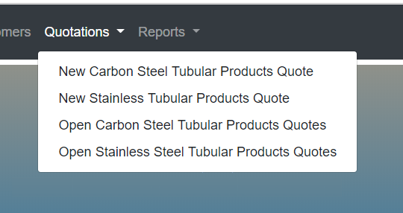
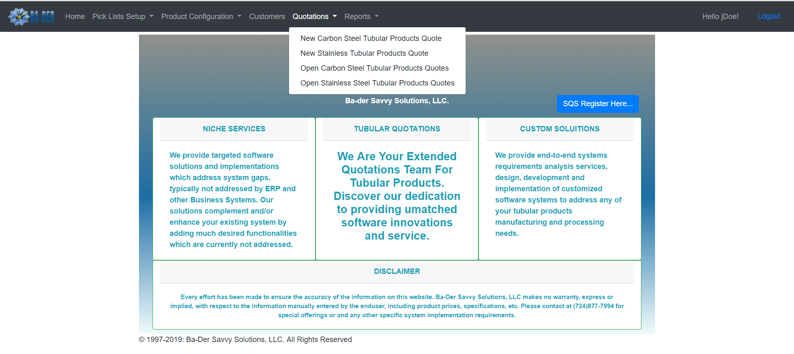

Step 3: creating quotes
quotations
The “Quotations” tab is where you can start a new quote or manage your existing open quotes.
The Quotations menu will bring up the options to either start a new quote or manage your open quotes (currently Carbon Steel and Stainless Steel options are available).
For this demonstration, we will be creating a “New Carbon Steel Tubular Products Quote”, and will begin by selecting this option from the drop down menu.
to begin creating your quote, select “new carbon steel tubular products quote” from the quotations menu

Slide 7
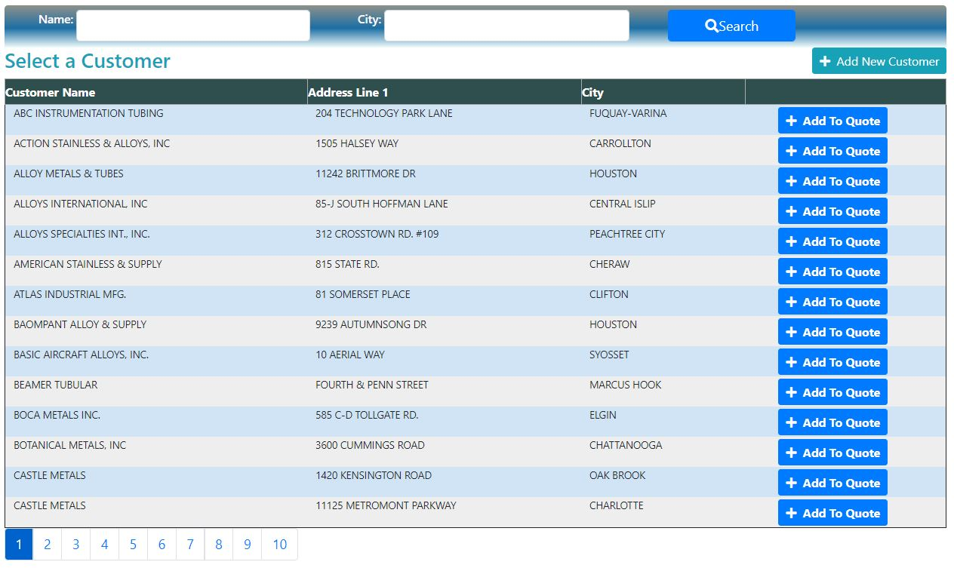

Step 3: creating quotes
Search for a specific customer by name or city
Easily add a new customer if they are not listed
quotations
Once you have selected “New Carbon Steel Tubular Products Quote” a new screen will appear that will let you “Select a Customer”.
From here you must select a customer from the customer list. Either search for a customer by name or city, or you can “Add a New Customer” if this is a new potential client.
For this demonstration, we will be selecting the already existing customer “Alloy Metals & Tubes”.
…when you’ve found the customer, add them to the quote by clicking
“+ aDD to quote” next to their name

Slide 8
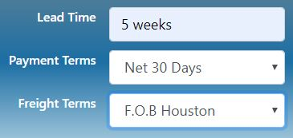
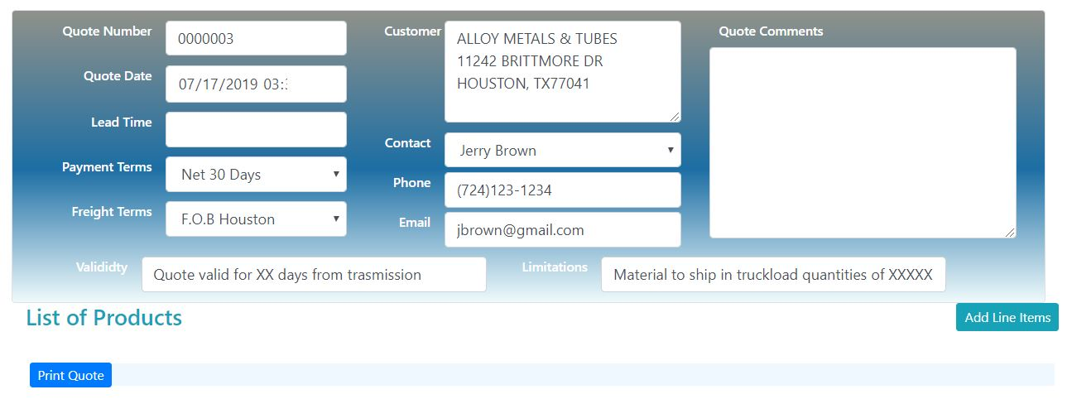




Step 3: creating quotes
Enter your desired lead time and select your payment / freight terms from the drop-down menus
quotations
Add any comments you’d like to include
After you have selected your customer, a window will appear that has any contact information for that customer already entered in the required fields.
From here you can make any changes to any of the fields, such as changing a customers name or phone number.
If all of the contact information is correct, you will then input a “Lead Time” and will select your “Payment Terms” and “Freight Terms” from their respective drop-down menus.
You can also add in any comments you’d like to include for the new quote, set “Validity” terms and any “Limitations”
Add specific validity terms or any limitations
…Once you are ready to add your products to the quote, click on the “aDD line items” box

Slide 9
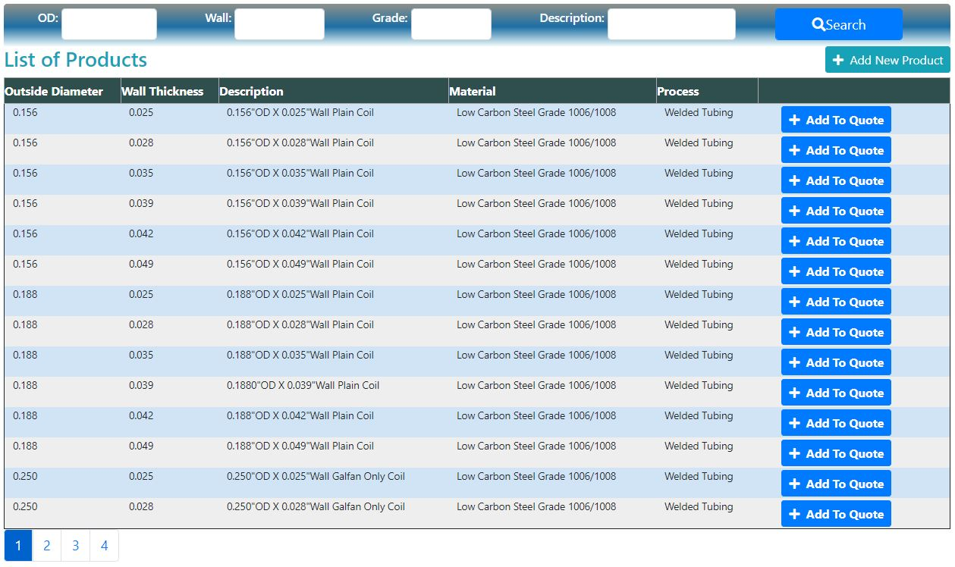
Step 3: creating quotes
quotations
Search for a specific product (by OD, Wall thickness, Grade or Description) using the available search boxes
Easily add a new product if your product isn’t listed
A new window will appear that allows you to select any number of products you would like to add to the quote.
Search for a specific product quickly with the search boxes. You can search by OD, Wall, Grade or Description, to efficiently narrow down your results.
You can add a single product or an assortment of products, depending on the customers requests. Simply click on the “+ Add To Quote” button next to any products you wish to add to the quote.
…After you have found your product, click on the “+ aDD to quote” box next to the products you would like to add

Slide 10
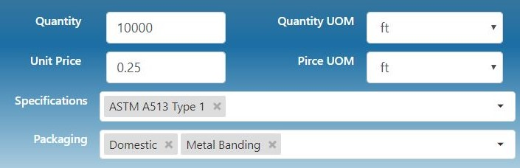
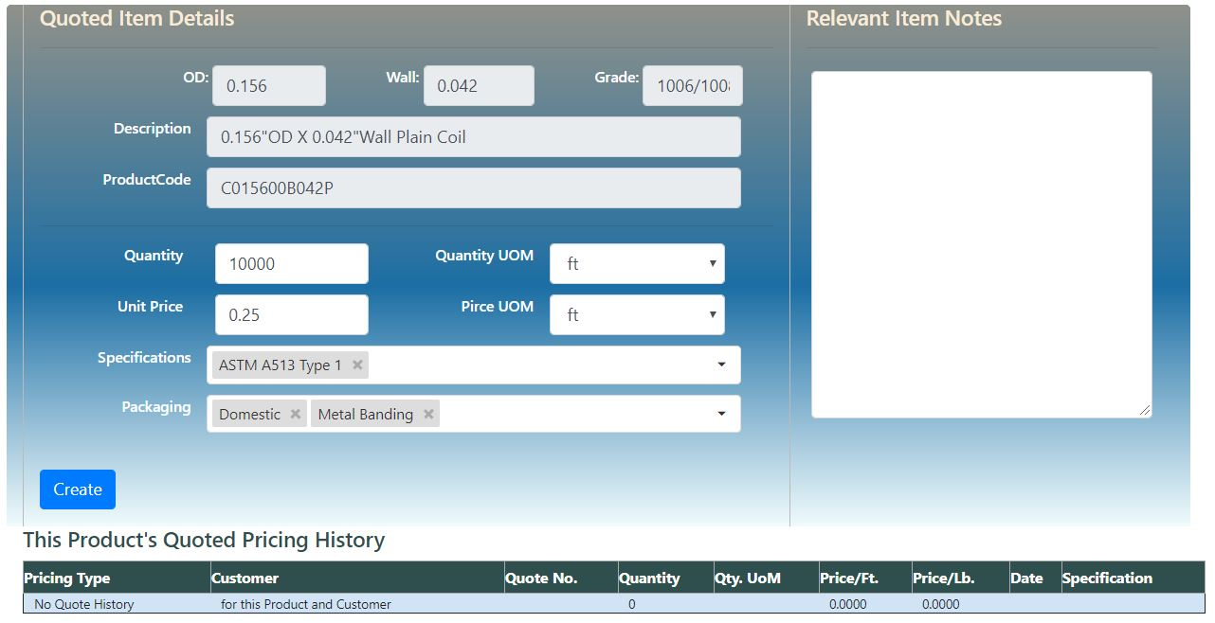

Enter your desired quantity and unit price, and select their respective units
Step 3: creating quotes
quotations
Choose your required Specifications and Package options
A window will appear that displays all of the “Quote Item Details”, such as the OD, wall and grade. You then add in your desired quantity and unit price, as well as the corresponding UOM units from the drop-down menus for each.
Secondly, you will select your required Specifications and Packaging options from their respective drop-down menus. You can add multiple items to each list. You can add in any relevant item notes you like in the text box to the right.
View any quoted pricing history from any previously completed quotes, so that you can effectively set unit prices and make accurate judgement callS.
…Once you’ve completed your quoted item details, click on the ”create” box to create the finished quote
View any relevant product pricing history to make better pricing decisions

Slide 11
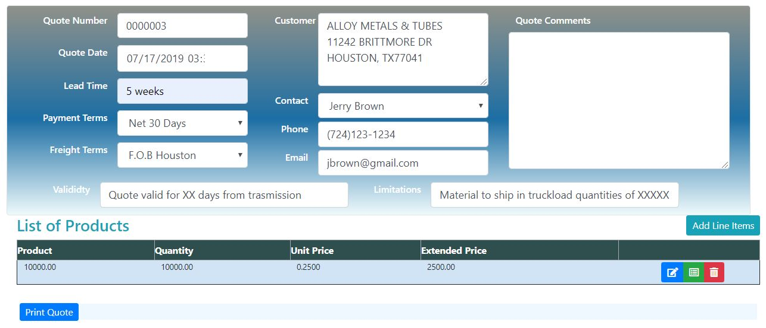

Step 3: creating quotes
quotations
A window will appear that summarizes all of your entered quote information for you to review. You can edit any of the information as required, and may add in any other products you would like to add by clicking the “Add Line Items” box at the bottom right of the window.
Your List of Products are displayed at the bottom of the window, summarizing your total products selected, their quantity, unit price and total price.
You can edit or delete products from your list by clicking one of the 3 colored boxes at the end of each product.
Add or edit any product by selecting the boxes at the end of each product
…When you have reviewed your quote, click on the ”print quote” box to generate a finished quote
Easily add more products to the quote by clicking “Add Line Items”

Slide 12
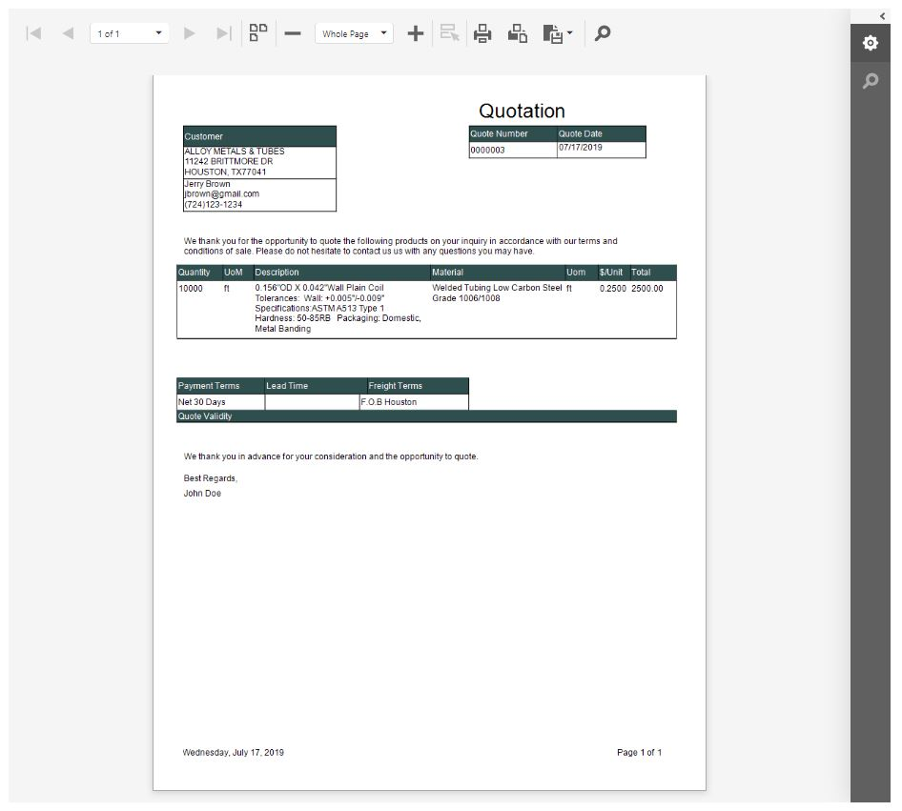
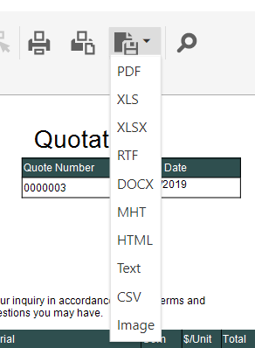
Your quote is complete!
PRINT OUT YOUR QUOTE OR EXPORT IT TO ANY NUMBER OF FORMATS, ready to send to your customer
You can choose to either print out the document as is or export it to a number of available formats, such as PDF, XLS and Text
continue to the next page for information on creating “reports”

Slide 13
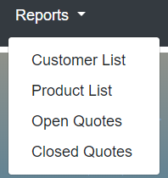
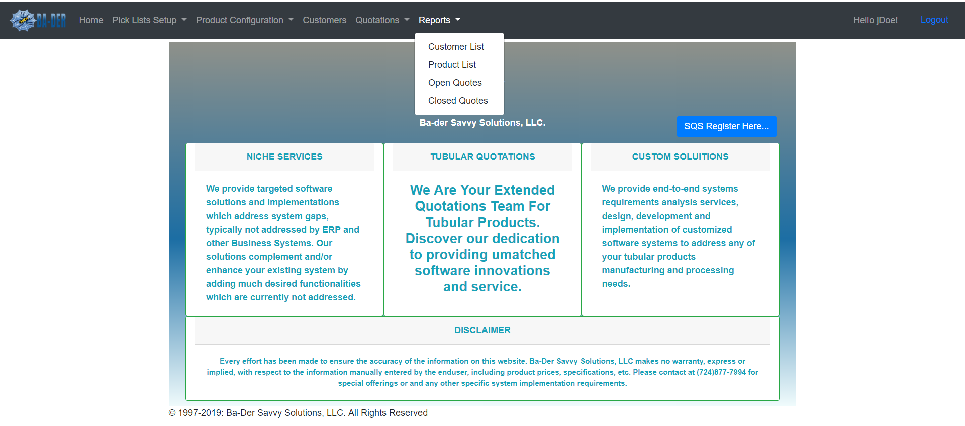
reports
Step 4: creating reports
The “Reports” tab is where you can view and print your Customer List, Product List, Open Quotes and Closed Quotes.
View your lists quickly by selecting them from the Reports drop-down menu.
You can choose to print your lists or export them to a numerous number of file types, such as PDF, Word document and Excel file.

Slide 14
BA-DER
SAVVY SOLUTIONS, LLC.
CUSTOMIZED SQS SOLUTIONS

