Slide 1
Game Controller for
Pupil-Labs Eyetracker
Nika Erzen
Anej Placer
Kevin Sedevcic
Notes:
This template can be used as a starter file for presenting training materials in a group setting.
Sections
Right-click on a slide to add sections. Sections can help to organize your slides or facilitate collaboration between multiple authors.
Notes
Use the Notes section for delivery notes or to provide additional details for the audience. View these notes in Presentation View during your presentation.
Keep in mind the font size (important for accessibility, visibility, videotaping, and online production)
Coordinated colors
Pay particular attention to the graphs, charts, and text boxes.
Consider that attendees will print in black and white or grayscale. Run a test print to make sure your colors work when printed in pure black and white and grayscale.
Graphics, tables, and graphs
Keep it simple: If possible, use consistent, non-distracting styles and colors.
Label all graphs and tables.

Slide 2
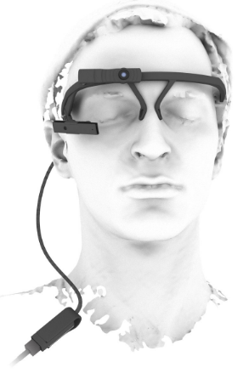
Goals
Creation of Pupil-Labs Eye Tracker plugin to play any game.
Recognition of simple and advanced commands and their execution.
Notes:
Give a brief overview of the presentation. Describe the major focus of the presentation and why it is important.
Introduce each of the major topics.
To provide a road map for the audience, you can repeat this Overview slide throughout the presentation, highlighting the particular topic you will discuss next.

Slide 3
The Plugin
Update gaze positions every frame.
Smoothing filter for less noise in the gaze path.
Gaze history for processing and recognition of actions.
XTE for keypress simulation.

Slide 4
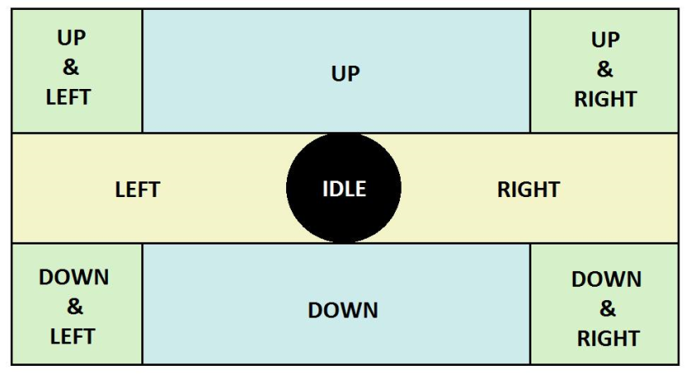
Simple Action Layout
Position history.
  Deleting (a portion of) history when an action is recognized.
Detection of actions.
  Localization parameter.

Slide 5
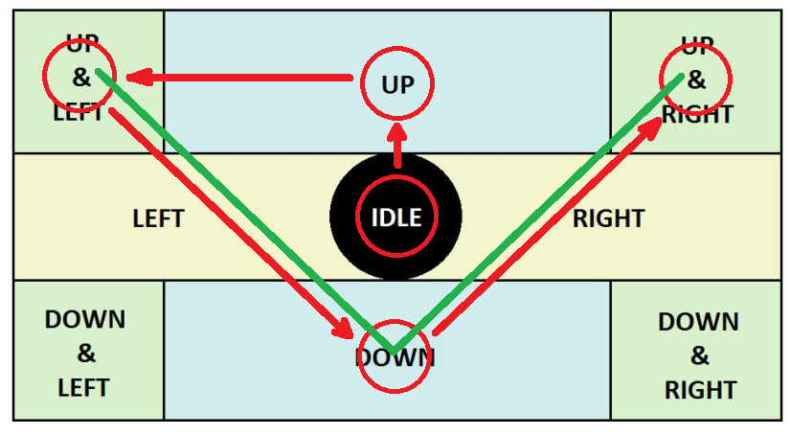
Special Actions

Slide 6
Problems
Eye-Tracker doesn't work reliably in different setups
  Eye camera doesn't work.
  Calibration doesn't work.
  No gaze detected.
Solution
  Simple calibration.
  Throw in the towel.

Slide 7
Thank you.

