Slide 1
Pupil position tracking for in-game implementation
Nika Erzen
Anej Placer
Kevin Sedevcic
8th June 2016
Notes:
This template can be used as a starter file for presenting training materials in a group setting.
Sections
Right-click on a slide to add sections. Sections can help to organize your slides or facilitate collaboration between multiple authors.
Notes
Use the Notes section for delivery notes or to provide additional details for the audience. View these notes in Presentation View during your presentation.
Keep in mind the font size (important for accessibility, visibility, videotaping, and online production)
Coordinated colors
Pay particular attention to the graphs, charts, and text boxes.
Consider that attendees will print in black and white or grayscale. Run a test print to make sure your colors work when printed in pure black and white and grayscale.
Graphics, tables, and graphs
Keep it simple: If possible, use consistent, non-distracting styles and colors.
Label all graphs and tables.

Slide 2
Summary
Pupil Labs eye tracker
Interface implementation
Positions and actions
Goals
Notes:
Give a brief overview of the presentation. Describe the major focus of the presentation and why it is important.
Introduce each of the major topics.
To provide a road map for the audience, you can repeat this Overview slide throughout the presentation, highlighting the particular topic you will discuss next.

Slide 3

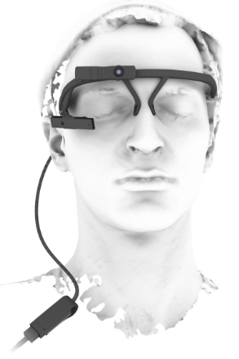
Pupil Labs Eye-tracker
Headset
Focus eye camera
Pupil capture software
World window
Eye window

Slide 4
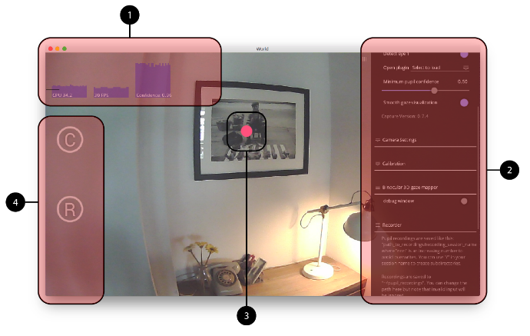
Eye-tracker-world window
3-Gaze dot

Slide 5
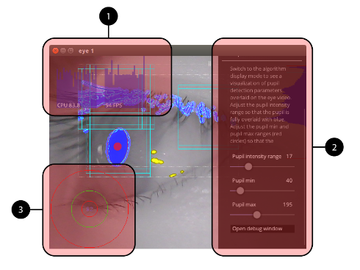
Eye-tracker-eye window
3-pupil stat

Slide 6
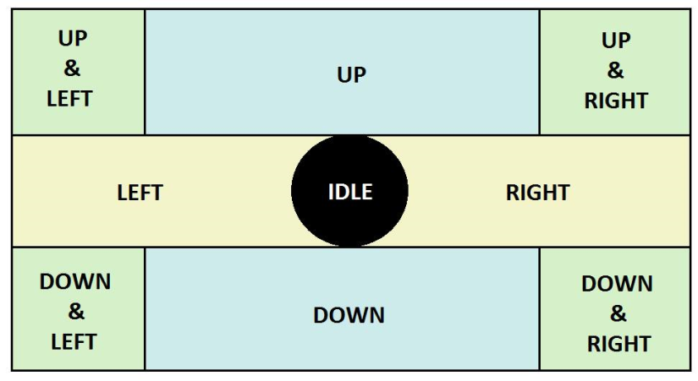
Positions and simple actions
Gaze dot position readings -> actions

Slide 7
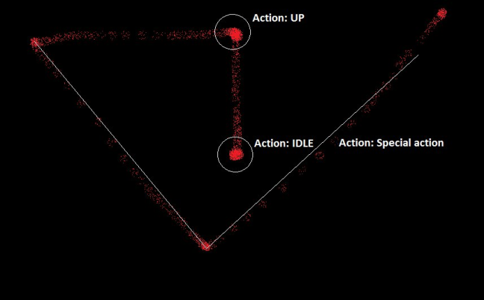
Special action
Gaze dot gesture detection

Slide 8
Goals
Pupil position -> actions
Avoiding errors
Simple interface:
Actions -> keyboard input
- Playing games with pupil movements

Slide 9
Work done so far

Slide 10
Questions?

