Slide 1
Megathon-2018: BoxRunner2D
Team No0one
Saksham Mittal
Harshit Patel
Om Sitapara
Adithya Hosapate

Slide 2
A multiplayer platformer game
OVERVIEW
Game Engine
Libraries used
Keypoints
Game BoxRunner2D
Libraries used
Concurrency (How multithreading is implemented)
Gameplay
Future Scope

Slide 3
Game Engine
Libraries used
Opengl
GLEW
SDL
Keypoints
Reusability
Efficiency

Slide 4
Game- BoxRunner2D
Libraries
Winsock
Concurrency
How it is used in the game?

Slide 5


Gameplay - The fun stuff!

Slide 6
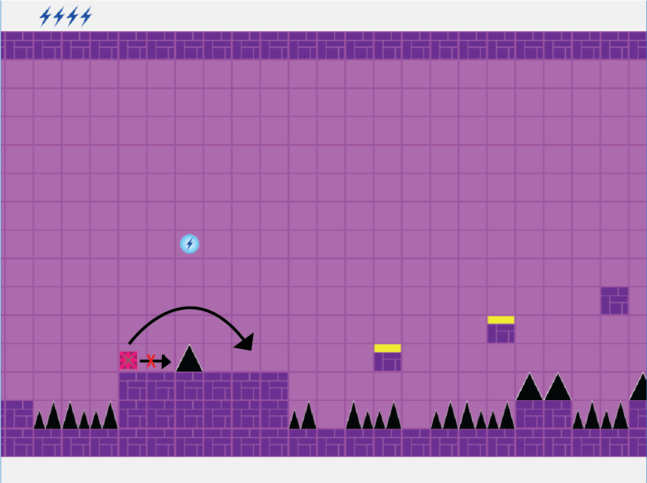
Gameplay - The fun stuff!

Slide 7
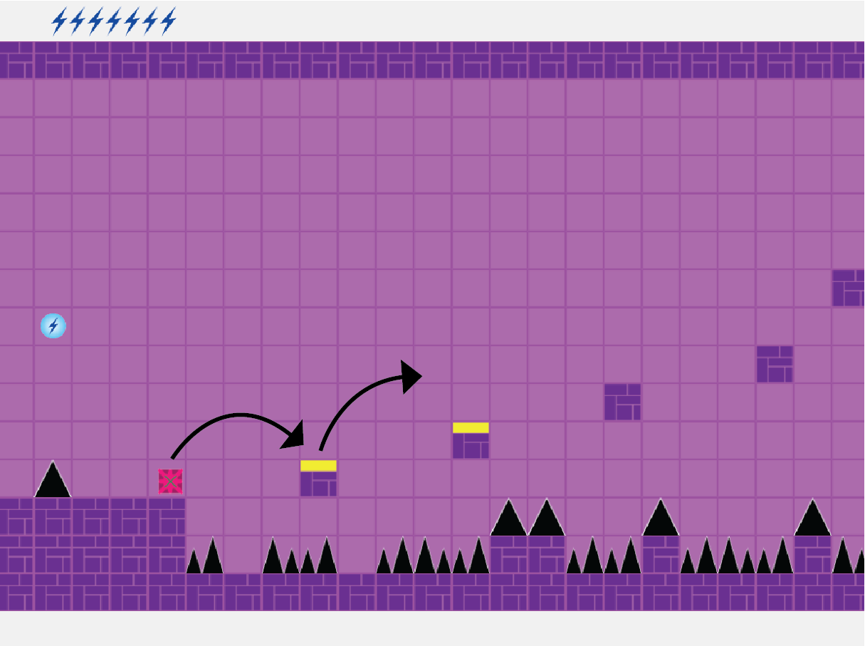

Slide 8
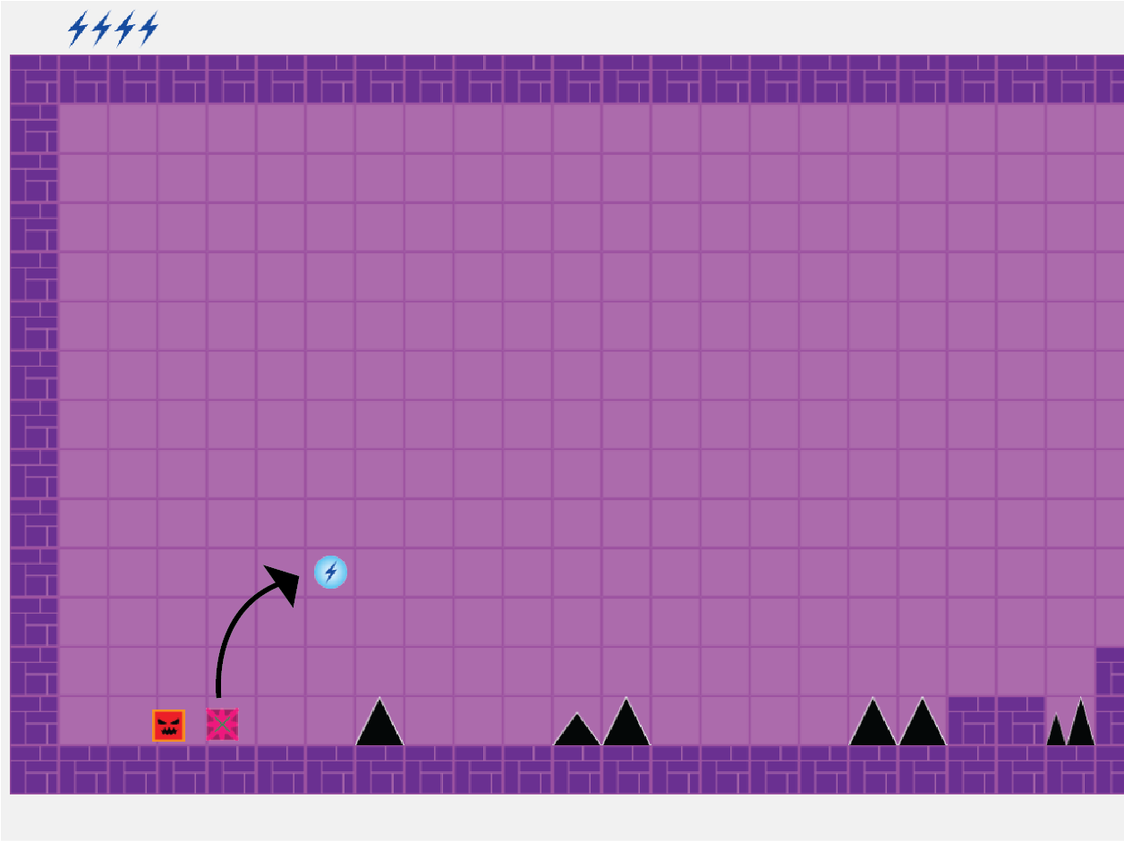

Slide 9
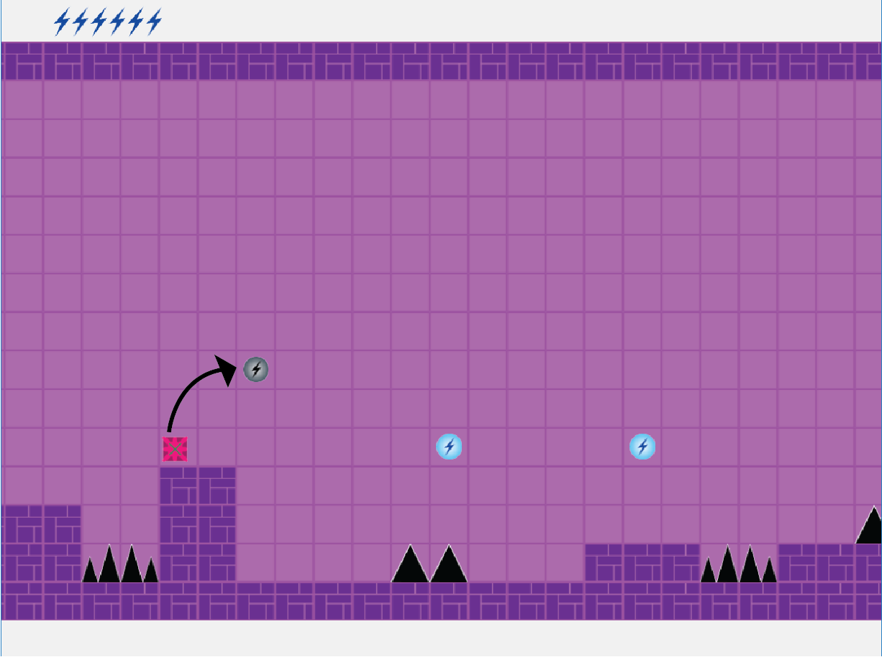

Slide 10
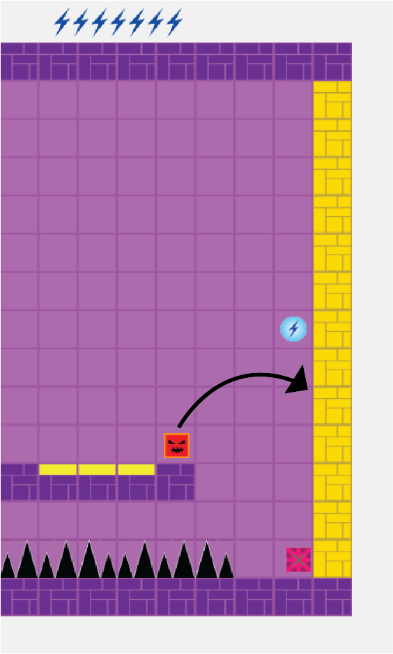

Slide 11
Gameplay video- Learn from the pros

Slide 12
Future Scope

