Slide 1
Course Project
Control of Autonomous Underwater Vehicle(AUV) by comparison between different control techniques
Non Linear Control
EE651A
IIT KANPUR
Submitted by:
Puneet Shrivastava (21104075)
Krishnadas K M (21104045)
Agrim Saharia (190072)
Sirivella Hemanth Pavan Kumar (21104099)

Slide 2
Introduction
The applications of various controllers like proportional, PID, PDA and fractional order PID controllers in the depth and motion control of AUV are being discussed with the help of two transaction papers named “AUV Buoyancy Control with Hard and Soft Actuators” and “Fractional-Order PID Motion Control for AUV Using Cloud-Model-Based Quantum Genetic Algorithm”.
Simulations are carried out to compare and verify the performance of the above mentioned controllers

Slide 3
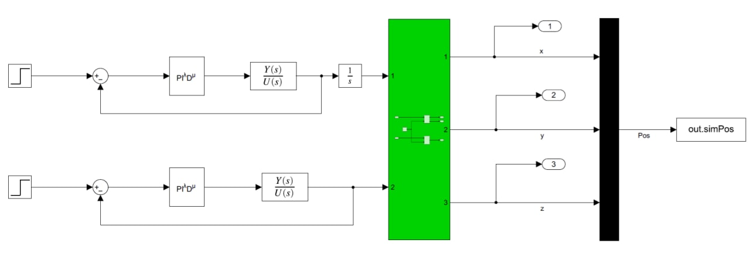
AUV Modelling

Slide 4
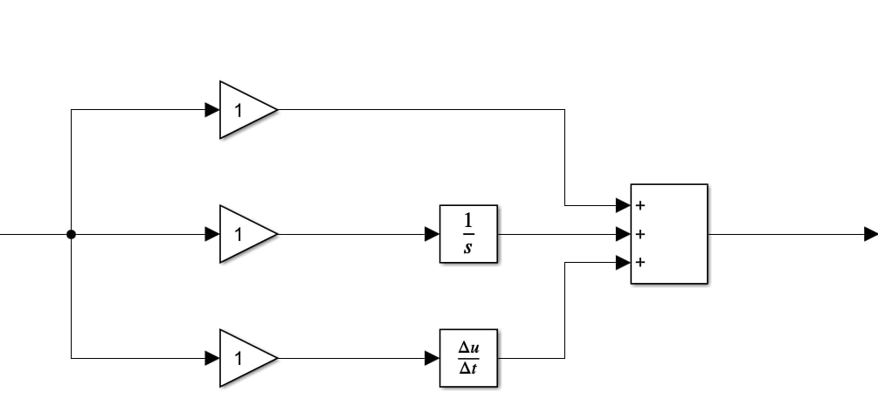

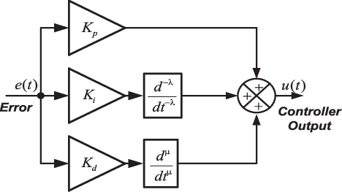

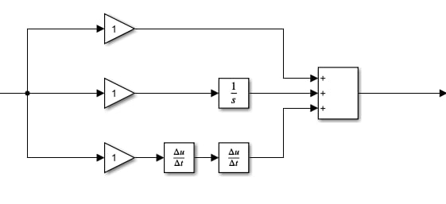


Controllers
The time domain description of PID controller is given by
The time domain description of fractional-order PID controller is given by
The time domain description of PDA controller is given by

Slide 5
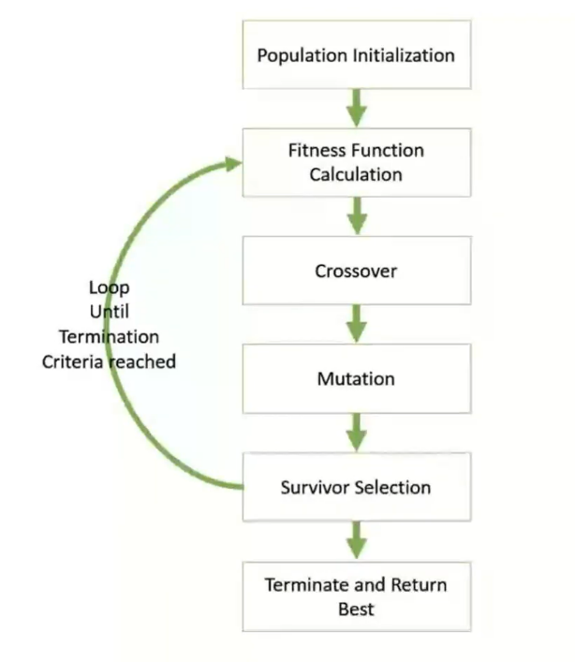
Genetic Algorithm
Genetic Algorithms (GA) is global optimizing ones, based on natural selection and genetics mechanisms.
They use a parallel procedure and structured strategy, but random, aiming to reinforce searching of high aptitude points.

Slide 6
Hard and Soft Actuators
Hard actuators include either the use of complex adjustable thrusters and propellers, design systems with larger bodies to incorporate control surfaces or at least one actuator for each DOF.
And also, it is very difficult to achieve accurate depth control using purely HAs
These are primarily used for adjusting system buoyancy. Buoyancy adjustments are achieved by varying the volume of fluid displaced via a compressed storage tank

Slide 7
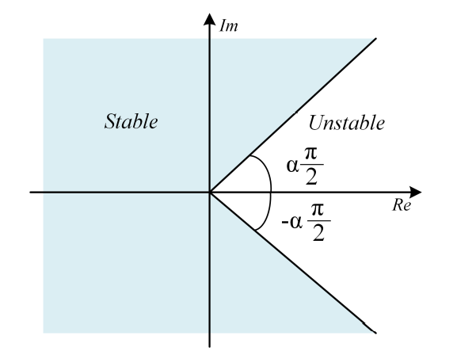
Stability
For PID Controller
In the integer-order system, it is well known from the theory of stability that all the roots of Q(s) = 0 have negative real parts. It means that they are located on the left half of the complex plane.
For Fractional-order PID Controller
The stability of fractional-order system differs from the integer case. It is interesting that a stable fractional system may have roots in the right half of complex plane. The stable region of fractional-order system is given by

Slide 8
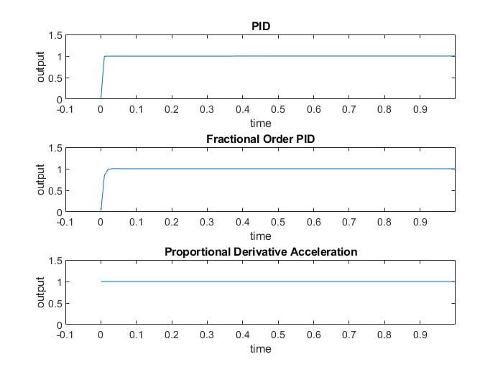
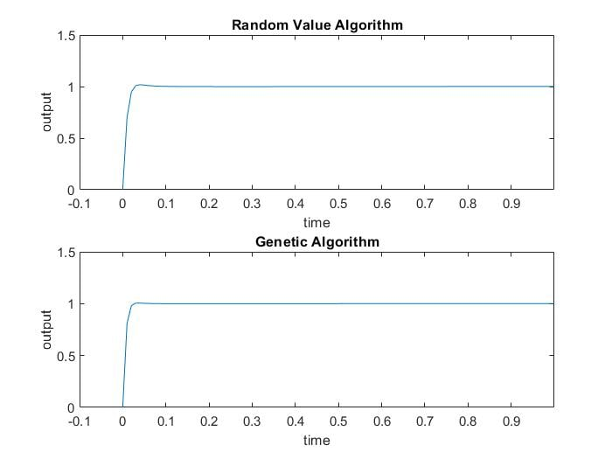
Simulation and Results

Slide 9
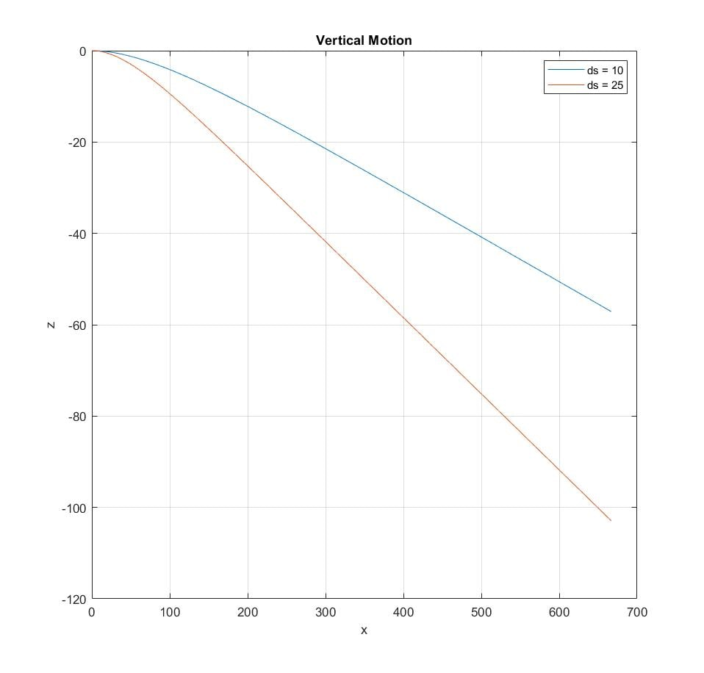
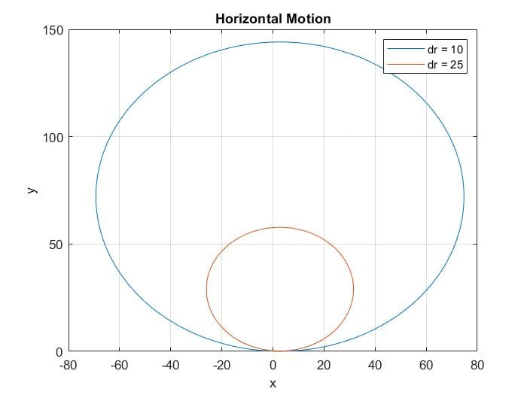
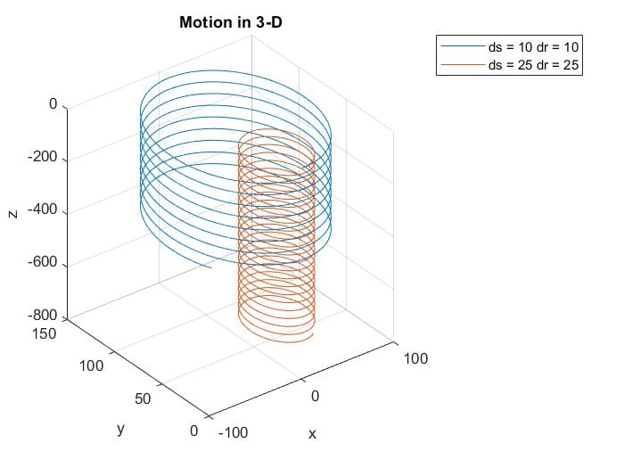
Simulation and Results

Slide 10
THANK YOU

