Slide 1
Course Project
Fuzzy identification of systems and its Application to modeling and Control by Michio Sugeno and Tomohiro Takagi
Submitted by:
Puneet Shrivastava (21104075)
EE658A
IIT KANPUR

Slide 2
Introduction
The primary goal of the study is to propose a mathematical technique for creating a fuzzy system model. In earlier studies, the attempt was made to form a fuzzy implication containing fuzzy variable function in unimodal form. These variables were called linguistic variables as they were linguistically understood. But there was the difficulty in modeling using these linguistic variables as we may have to use multiple variables.
In this study, we tried to reduce these linguistic variables. In order to do that we must consider multidimensional fuzzy thinking as we are dealing with a multi-variable system. We know that in general, building a model using input-output data must have two factors: technique for identification of the system and the mathematical tool for expressing it. As a result, we proposed a simple yet extensive mathematical tool as well as fuzzy implications based on fuzzy space partition. Also the method for identification of the system using its input-output data is shown.

Slide 3
FORMAT OF FUZZY IMPLICATION
Format of Fuzzy variables
The membership function of a fuzzy set A can be denoted as A(x), (x∈X). The fuzzy variables are assumed to be linear with minimum value of ‘0’ and maximum value of ‘1’. As a result, the truth table for the statement |x is A and y is B| may be reduced to – A(x) ^ B(y).
here,
^ : min operation.
X : universe of discourse

Slide 4
Format of Implication
We have defined implication R as follows:
R : If x1 is A1 and ……. and xk is Ak Or f( x1 is A1,⋯,xk is Ak)
then y = g(x1,⋯,xk ) Or y = p0+p1.x1+⋯+ pk.xk
here,
y : Consequence variable f : Logical function
x1 – xk : Premise variables g : Output function of y with x1 – xk
A1 - Ak : Membership function p0,⋯,pk : Consequence parameters

Slide 5



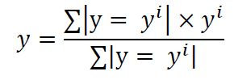
Algorithm of Reasoning
Let’s assume we have ‘n’ implications R (I = 1, … ,n) as shown in above and also, we have
For every Ri, y is given by
Now, weights for y = yi is given by
Let |𝑅𝑖|=1 for simplicity. Thus, the final output y is calculated by finding weighted mean as shown below:

Slide 6
Algorithm of Identification
This algorithm is divided into three parts:
1. Choice of Premise Variables: Out of given possible inputs premise variables are chosen then optimum consequence parameters are found using it. We then calculate errors in the output and find performance index, which is root mean square value of errors. Thus, premise variables are improved in each step choosing least performance index among different choices. To choose premise variables a heuristic search method is used. This method is further explained later.
2. Premise Parameter Identification: In this step optimum premise parameters are found with respect to the above premise variables. This is done by dividing fuzzy variables into different fuzzy sub-spaces like “small, big etc.”

Slide 7

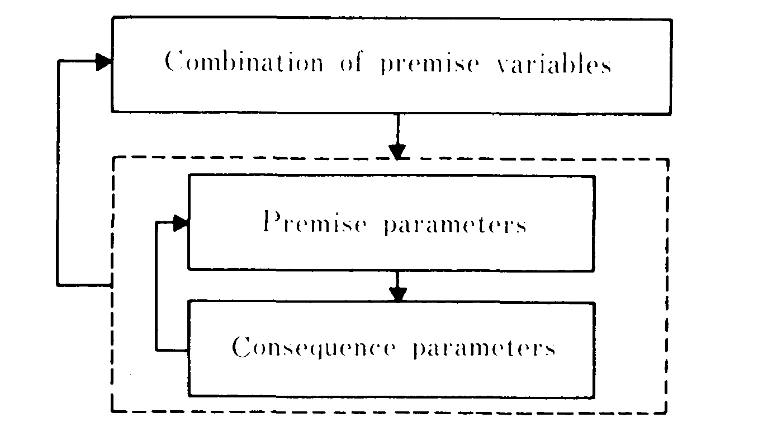
Consequence Parameter Identification: Now using these parameters the consequences are calculated using the least square method.

Slide 8
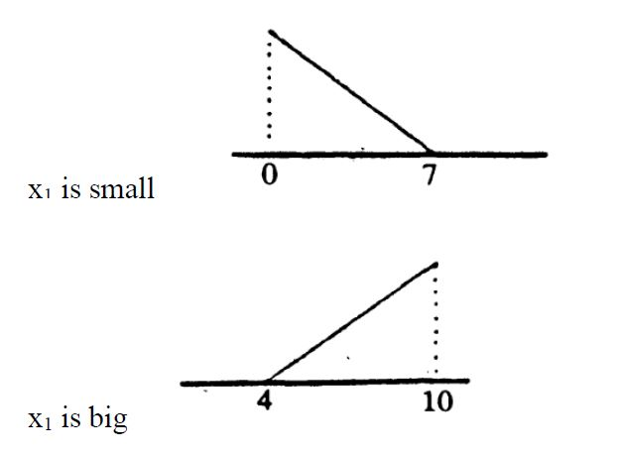
Stepwise Algorithm of Identification
Step 1: A premise parameter is chosen and is divided into subspaces like “small, big etc.” Let’s assume x1 is chosen and is divided into two fuzzy subspaces. Further we will choose x2, x3…….etc.

Slide 9
Step 2: Now we will find consequence parameters using least square method for every combination of subspaces calculated in step 1. This is done using the mathematical equations as stated below.
Step 3: Now for each rule or combination a performance index is found, which is root mean square value of the error. Then the model with least performance index is chosen and rest are discarded. This model is called as stable form.
Step 4: After finding stable model we will move to further divide variables in model 2-k, model 3-k etc. Let’s now have two inputs in the input premise arguments. Then all the xi – xj combination will be covered under the step and for each variable of xi and xj the subspace will be divided in two fuzzy subspaces which are generally ‘big’ and ‘small’. For model xi - xi the ranges will be divided into four subspaces namely ‘small’, ‘big’, ‘medium small’ and ‘medium big’. So, we for each implication we will get model 2-j. Then we will again go with the model having least performance index.

Slide 10
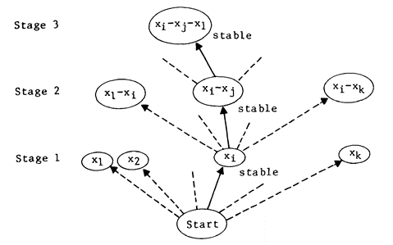
Step 5: Now, we will repeat the process starting from step 2 until one of the following conditions are fulfilled.
1. The final performance index value is less than desired value.
2. Number of premise variables exceeds the maximum permissible number of rules.

Slide 11
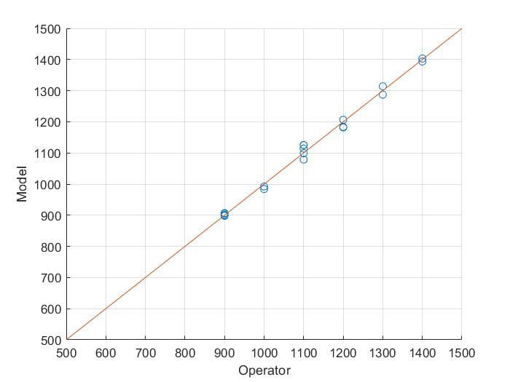
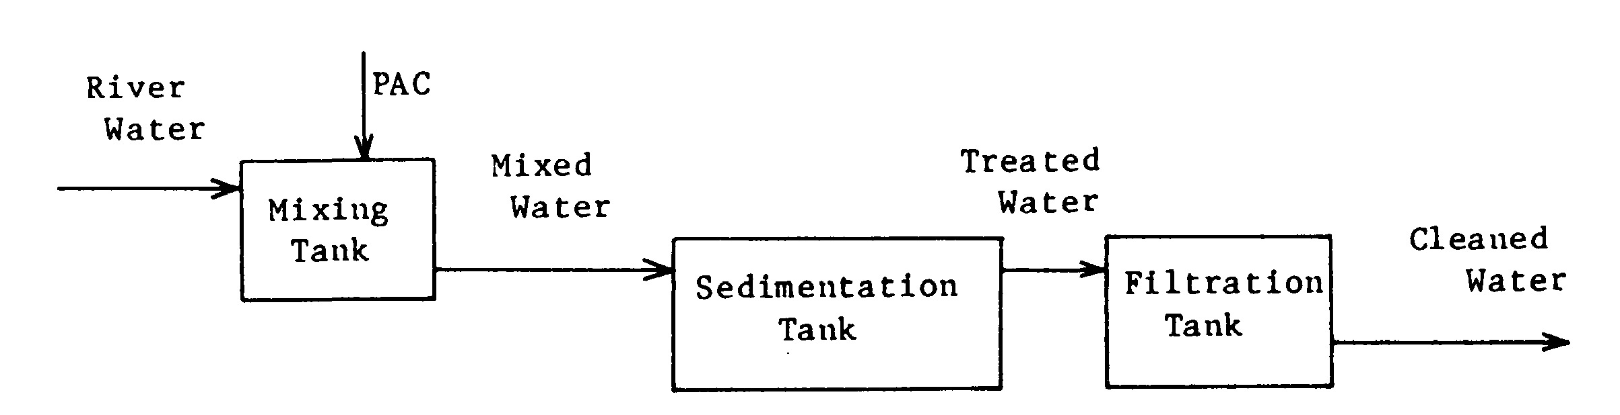
Simulation and Results
Water Cleaning Process
Variation of model output from ideal value in Water Cleaning Process

Slide 12
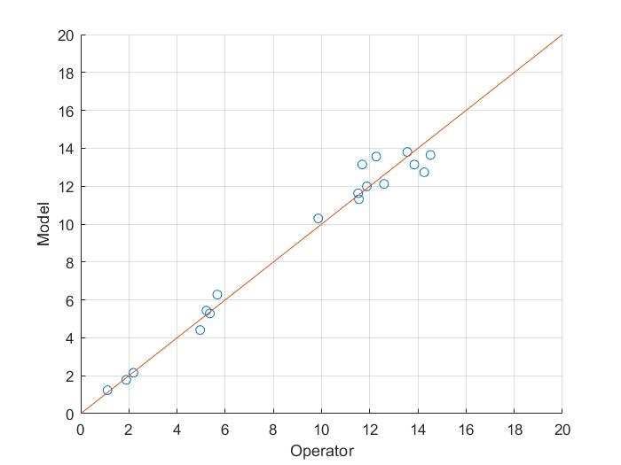
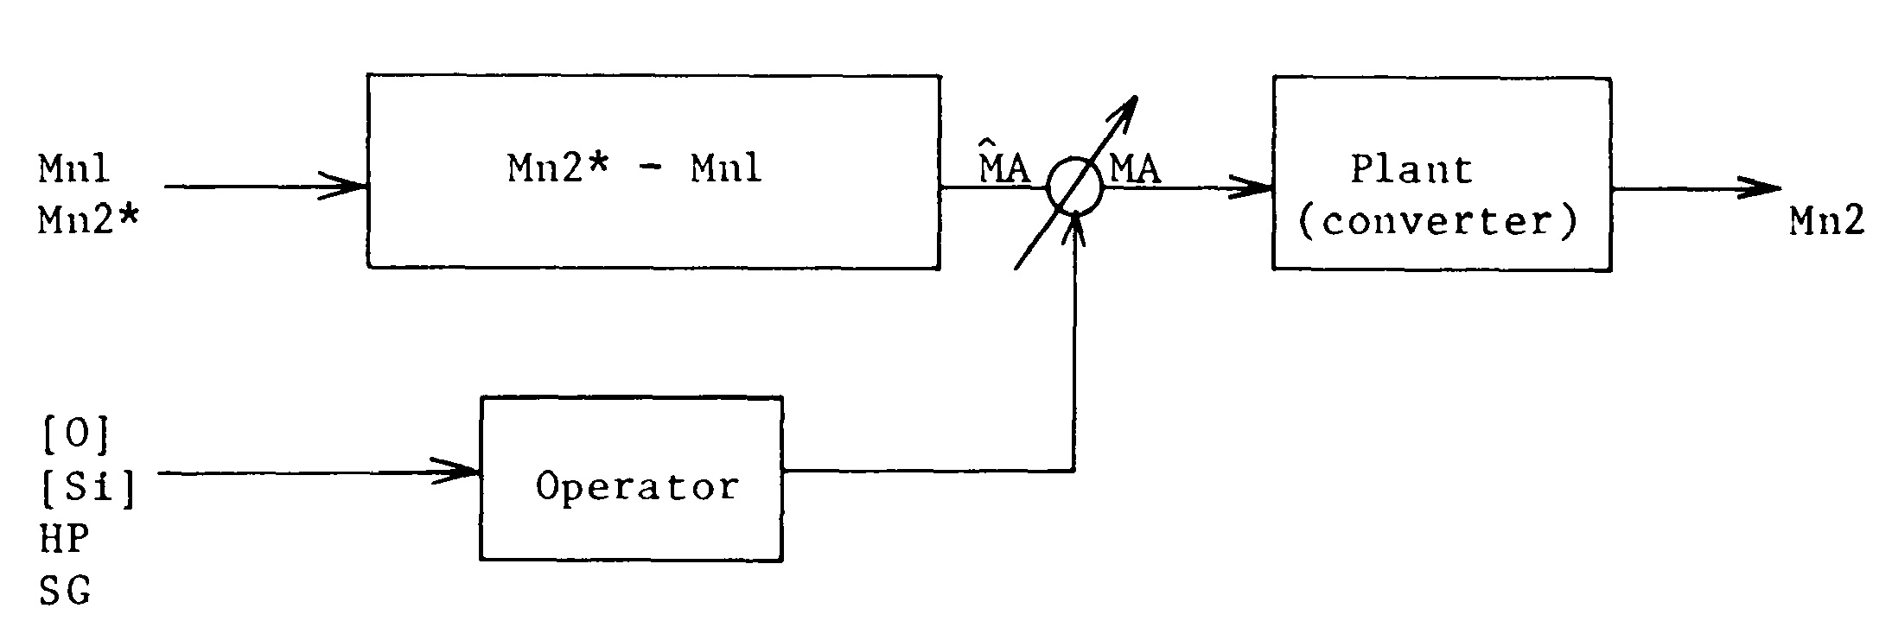
Simulation and Results
Steel Making Process
Variation of model output from ideal value in Steel Making Process

Slide 13
THANK YOU

