Slide 1
Advance Encryption Standard
(AES)

Slide 2
Contents
Introduction
AES Evaluation
The Origins of AES
The AES Cipher Parameters
AES Encryption and Decryption Algorithm
AES Data Structures
AES Encryption Round
AES Key Expansion
Conclusion
References

Slide 3
Introduction
AES is a block cipher intended to replace DES for commercial applications.
It uses a 128-bits block size and a key size of 128, 192, or 256 bits with 10, 12 or 14 rounds respectively.
AES does not use a Feistel structure. Instead, each full round consists of four separate functions: byte substitution, permutation, arithmetic operations over a finite field, and XOR with a key.
The AES ciphers have been analyzed extensively and are now used worldwide, as was the case with its predecessor, i.e. DES.

Slide 4
AES Evaluation
When NIST issued its original request for candidate algorithm nominations in 1997 , the request stated that candidate algorithms would be compared based on the following factors-
Security- This refers to the effort required to cryptanalyze an algorithm.
Cost- NIST intends AES to be practical in a wide range of applications.
Algorithm and implementation characteristics: This category includes a variety of considerations, including flexibility; suitability for a variety of hardware and software implementations; and simplicity.

Slide 5
The Origins of AES
In 1999, NIST issued a new version of its DES standard that indicated that DES should only be used for traditional systems and that triple DES (3DES) be used.
The principal drawback of 3DES is that the algorithm is relatively sluggish in software.
A secondary drawback is that both DES and 3DES use a 64-bit block size. For reasons of both efficiency and security, a larger block size is desirable.
Because of these drawbacks-, 3DES is not a reasonable candidate for long-term use.
And then The Advanced Encryption Standard (AES) was published by NIST (National Institute of Standards and Technology) on November 26, in 2001.
It became effective as a Federal government standard on May 26, 2002 after approval by the Secretary of Commerce.

Slide 6
The AES Cipher Parameters
AES Parameter
1 word= 4 Byte
In the description of this section, we assume a key length of 128 bits, which is likely to be the one most commonly implemented.
Key size (words/bytes/bits) | 4/16/128 | 6/24/192 | 8/32/256
Plaintext block size (words/bytes/bits) | 4/16/128 | 4/16/128 | 4/16/128
Number of rounds | 10 | 12 | 14
Round key size (words/bytes/bits) | 4/16/128 | 4/16/128 | 4/16/128
Expanded key size (words/bytes) | 44/176 | 52/208 | 60/240

Slide 7
AES Encryption and Decryption Algorithm
Initial Round
Initialize the State matrix to plaintext and perform AddRoundKey operation.
Rounds( For N_{r-1} Rounds)
SubBytes—Uses an S-box to perform a byte-by-byte substitution of the block.
ShiftRows—A simple permutation.
MixColumns—A substitution that makes use of arithmetic over GF(2⁸).
AddRoundKey—A simple bitwise XOR of the current block (State) with a portion of the expanded key.
Final Round (No MixColumns)
SubBytes
ShiftRows
AddRoundKey
KeyExpansion—round keys are derived from the cipher key using Rijndael’s key schedule.

Slide 8
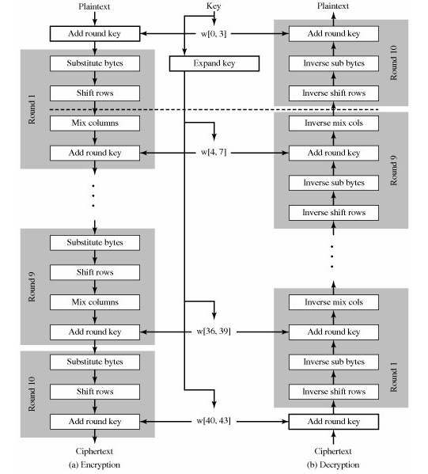
AES Encryption and Decryption

Slide 9
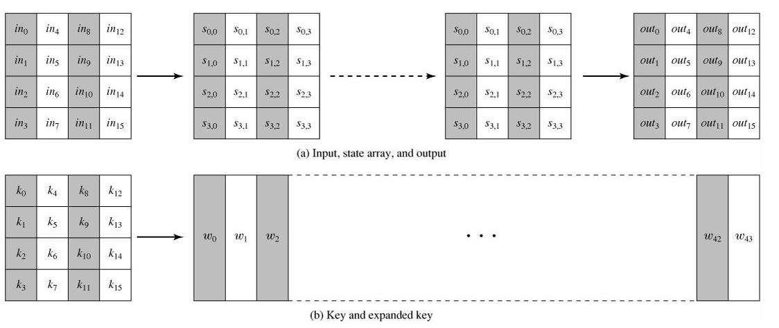
AES Data Structures

Slide 10
AES Encryption Round
Four different stages or operations are used for each round, one of permutation and three of substitution.
Substitute bytes: a non-linear substitution step where each byte is replaced with another according to a S-box.
ShiftRows: a permutation step where each row of the state is shifted cyclically a certain number of steps.
MixColumns: a mixing operation which operates on the columns of the state, combining the four bytes in each column.
AddRoundKey: each byte of the state is combined with the round key using bitwise XOR.

Slide 11
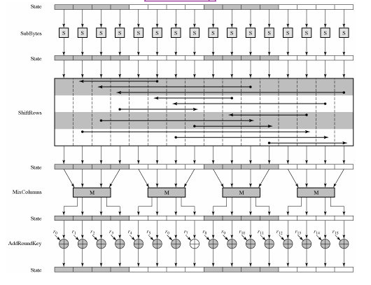
AES Encryption Round

Slide 12
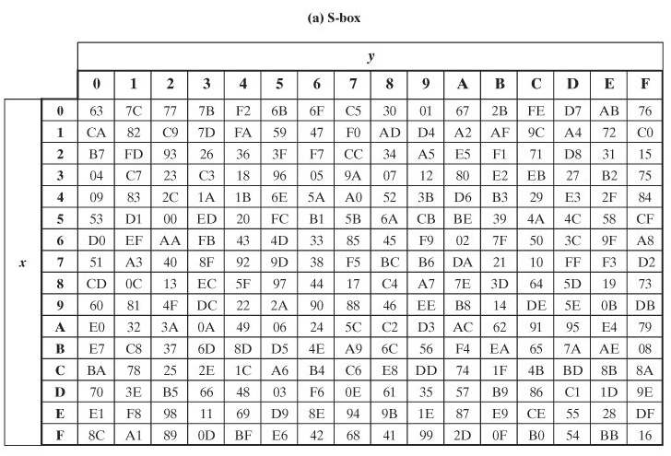
AES S-Boxes

Slide 13
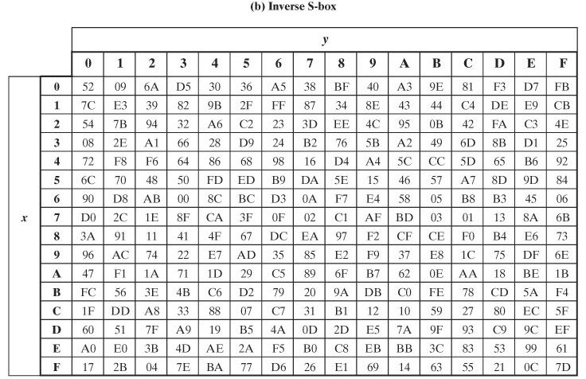
AES S-Boxes

Slide 14
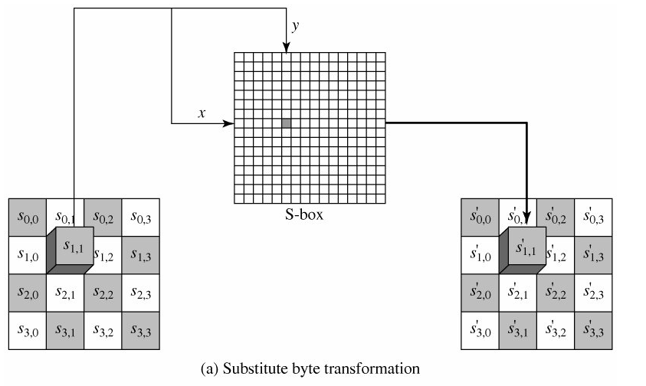
SubBytes operation
The forward substitute byte transformation, called SubBytes, is a simple table lookup.
Each individual byte of State is mapped into a new byte in the following way: The leftmost 4 bits of the byte are used as a row value and the rightmost 4 bits are used as a column value. These row and column values serve as indexes into the S-box to select a unique 8-bit output value.

Slide 15
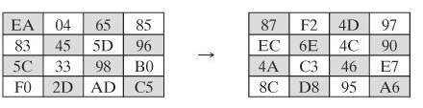
SubBytes operation Example
For example, the hexadecimal value {95} references row 9, column 5 of the S-box, which contains the value {2A}. Accordingly, the value {95} is mapped into the value {2A}.
Here is an example of the SubBytes transformation:
The inverse substitute byte transformation, called InvSubBytes, makes use of the inverse S-box shown above. Note, for example, that the input {2A} produces the output {95} and the input {95} to the S-box produces {2A}.

Slide 16
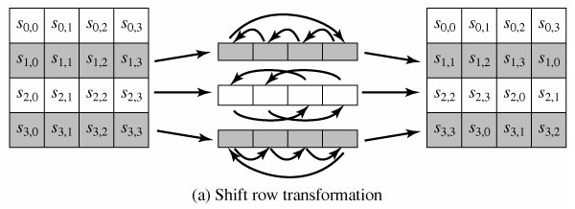
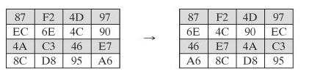
ShiftRows operation
The forward shift row transformation, called ShiftRows.
The first row of State is not altered. For the second row, a 1-byte circular left shift is performed. For the third row, a 2-byte circular left shift is performed. For the fourth row, a 3-byte circular left shift is performed.
The following is an example of ShiftRows:
The inverse shift row transformation, called InvShiftRows, performs the circular shifts in the opposite direction for each of the last three rows, with a one-byte circular right shift for the second row, and so on.

Slide 17

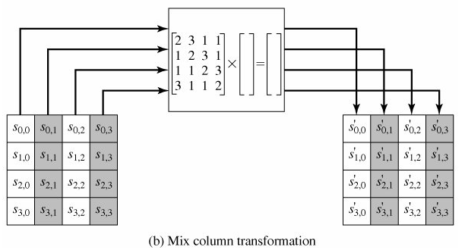
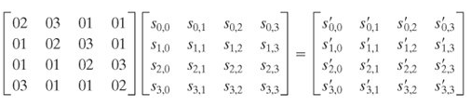
MixColumns operation
In the MixColumns step, each column of the state is multiplied with a fixed polynomial c(x). During this operation, each column is multiplied by the known matrix that for the 128 bit key is-
Transformation shown as given below-
---equation(1)

Slide 18
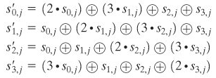

MixColumns operation
In this case, the individual additions and multiplications are performed in GF(2⁸). The MixColumns transformation on a single column j(0<= j<=3) of State can be expressed as:
The following is an example of MixColumns:
The multiplication operation is defined as : multiplication by 1 means leaving unchanged, multiplication by 2 means 1-bit left shift followed by a conditional bitwise XOR with 1B(0001 1011) if the leftmost bit of the original value (prior to the shift) is 1 and multiplication by 3 means perform multiplication by 2 and then performing XOR with the initial unshifted value.

Slide 19
MixColumns operation Example-
From the above we get the first column of the new state matrix as:
{02}.{87} XOR {03}.{6E} XOR {46} XOR {A6} = {47}-----equation(2)
{87} XOR {02}.{6E} XOR {03}.{46} XOR {A6} = {37}-----equation(3)
{87} XOR {6E} XOR {02}.{46} XOR {03}.{A6} = {34}-----equation(4)
{03}.{87} XOR {6E} XOR {46} XOR {02}.{A6} = {94}-----equation(5)
For the above first equation, we have
{02} · {87} = (0000 1110) XOR (0001 1011) = (0001 0101); and
{03} · {6E} = {6E} XOR ({02} · {6E}) = (0110 1110) XOR (1101 1100) = (1011 0010). Then
{02} · {87} = 0001 0101
{03} · {6E} = 1011 0010
{46} = 0100 0110
{A6} = 1010 0110
0100 0111 = {47}
The other equations can be similarly verified.

Slide 20
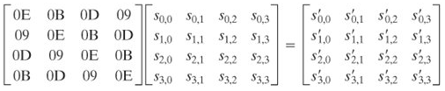
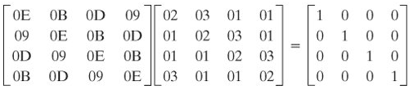
InvMixColumns operation
The inverse mix column transformation, called InvMixColumns, is defined by the following matrix multiplication:
-----equation(6)
It is not immediately clear that Equation (1) is the inverse of Equation (6). We need to show that:
({0E} · {02}) {0B} {0D} ({09} · {03}) = {01}
({09} · {02}) {0E} {0B} ({0D} · {03}) = {00}
({0D} · {02}) {09} {0E} ({0B} · {03}) = {00}
({0B} · {02}) {0D} {09} ({0E} · {03}) = {00}
The other equations can be similarly verified.

Slide 21
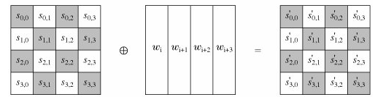

AddRoundKey operation
In the AddRoundKey step, each byte of the state is combined with a byte of the round subkey using the XOR operation (⊕).the operation is viewed as a column wise operation between the 4 bytes of a State column and one word of the round key;
The following is an example of AddRoundKey:
The inverse add round key transformation is identical to the forward add round key transformation, because the XOR operation is its own inverse.
Such as: B ⊕ A ⊕ A = B

Slide 22
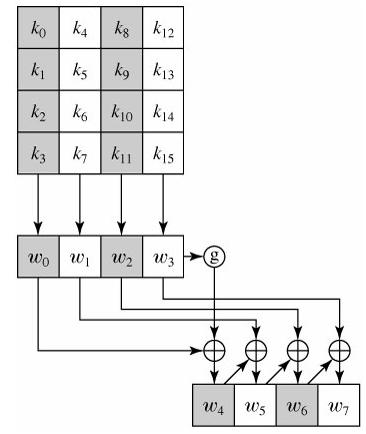
AES Key Expansion operation
The AES key expansion algorithm takes as input a 4-word (16-byte) key and produces a linear array of 44 words (176 bytes).
The key is copied into the first four words
of the expanded key.
The function g consists of the following
subfunctions:
RotWord performs a one-byte circular left
shift on a word. This means that an input
word [b0, b1, b2, b3] is transformed into
[b1, b2, b3, b0].
SubWord performs a byte substitution on
each byte of its input word, using the S-box
The result of steps 1 and 2 is XORed with a
round constant, Rcon[j].

Slide 23

Round Constant
The round constant is a word in which the three rightmost bytes are always 0. The round constant is different for each round and is defined as Rcon[j] = (RC[j], 0, 0, 0), with RC[1] = 1, RC[j] = 2 · RC[j - 1] and with multiplication defined over the field GF(2⁸).
The values of RC[j] in hexadecimal are-
For example, suppose that the round key for round 8 is
EA D2 73 21 B5 8D BA D2 31 2B F5 60 7F 8D 29 2F
Then the first 4 bytes (first column) of the round key for round 9 are calculated as follows:

Slide 24
Conclusion
After the above discussion we have concluded the following points about the AES:
Resistance against all known attacks.
Speed and code compactness on wide range of platforms.
Design simplicity.

Slide 25
References
Cryptography and Network Security Principles and Practices, Fourth Edition By William Stallings.

Slide 26

Thank you

Slide 27
Any Queries
???

