Slide 1
Data Encryption standard
(DES)

Slide 2
Data Encryption Standard (DES)
DES is the most widely used block cipher in the world.
It is based on the Feistel cipher structure with 16 rounds of processing.
DES having 64-bit block size and 56-bit key size and algorithm itself is referred to as the Data Encryption Algorithm (DEA).
Design Principles of DES:
To achieve high degree of diffusion and confusion.

Slide 3
Claude Shannon Principles - Confusion and Diffusion
Two basic building blocks for block cipher. Ideally achieved by arbitrary substitution cipher
Diffusion:
The mechanism of diffusion is to make the statistical relationship between the plaintext and ciphertext as complex as possible.
diffusion can be achieved by repeatedly performing some permutation on the data followed by applying a function to that permutation.
Confusion :
On the other hand, confusion is to make the relationship between the statistics of the ciphertext and the value of the encryption key as complex as possible.
This is achieved by the use of a complex substitution algorithms.

Slide 4
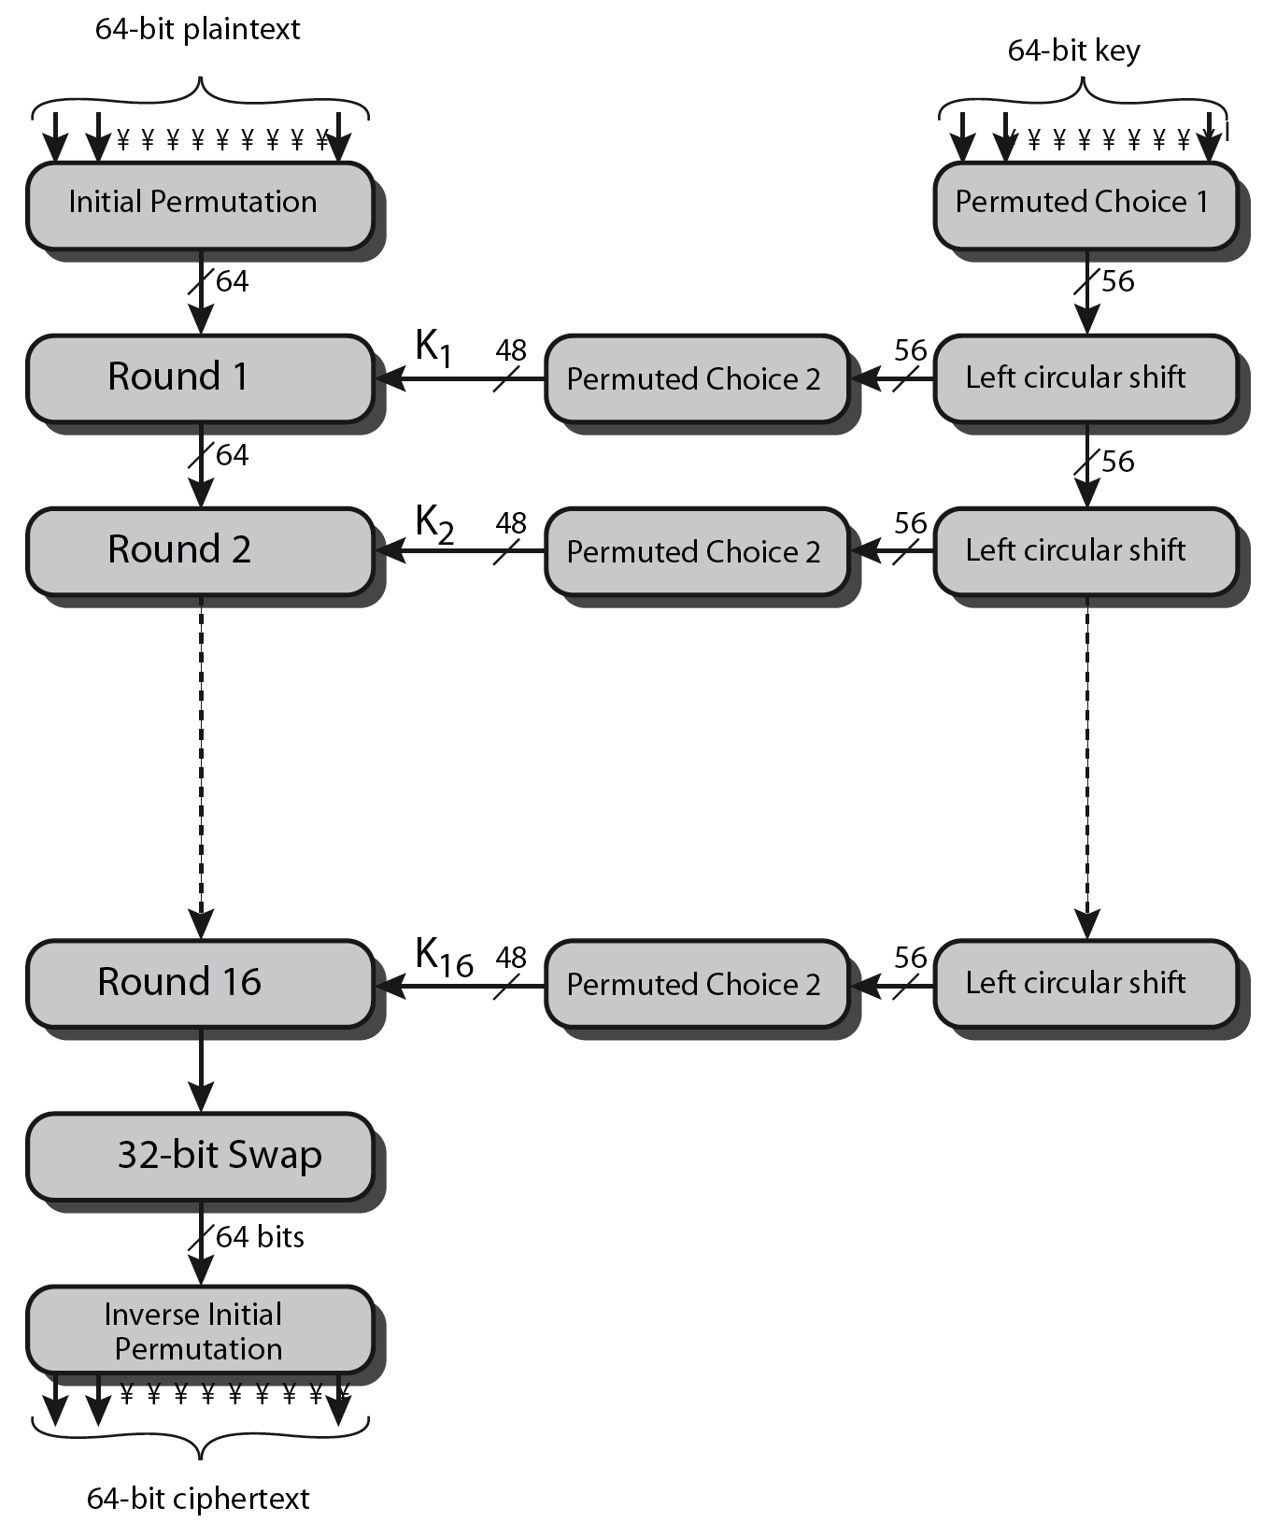
DES Encryption Overview

Slide 5
DES Encryption - Three Phases
In the first phase, 64-bit plaintext passes through an initial permutation (IP) that rearranges the bits to produce the permuted input.
Followed by 16 rounds of same function
Which involve both permutation & substitution functions.
The output of the last (sixteenth) round consists of 64 bits that are a function of the input plaintext and the key.
The left and right halves of the output are swapped to produce the preoutput.
Finally, the preoutput is passed through a permutation (IP⁻¹) that is the inverse of the initial permutation function, to produce the 64-bit ciphertext.

Slide 6
DES Encryption Overview

Slide 7
Initial Permutation (IP)
The initial permutation and its inverse are defined by tables.
The tables are to be interpreted as follows:
The input to a table consists of 64 bits numbered from 1 to 64.
The 64 entries in the permutation table contain a permutation of the numbers from 1 to 64.
Each entry in the permutation table indicates the position of a numbered input bit in the output, which also consists of 64 bits.
Consider the 64-bit input M, then the permutation X = IP(M) and the inverse permutation Y = IP⁻¹(X) = IP⁻¹(IP(M)).
It can be seen that the original ordering of the bits is restored.

Slide 8
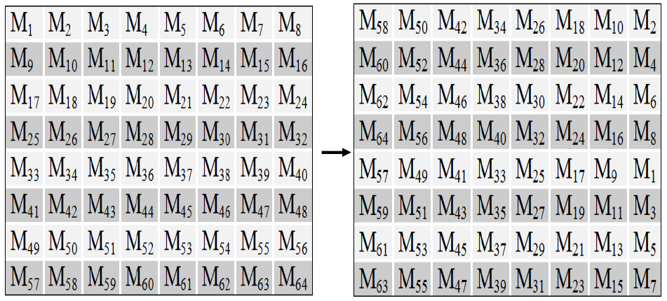
Initial Permutation (IP)

Slide 9
DES Encryption Overview

Slide 10
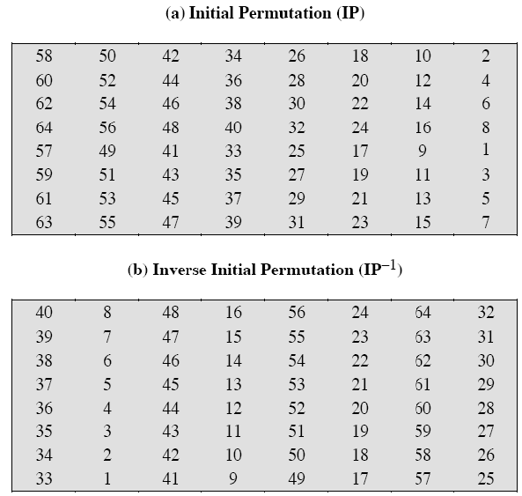
Initial and Inverse Permutation (IP)

Slide 11
DES Encryption Overview

Slide 12
Details of Single Round
Left and right halves of 64 bits are separated into two 32-bit parts, labeled L (left) and R (right).
Overall processing at each round will be:
L_{i} = R_{i-1}
R_{i} = L_{i-1} ⊕ F(R_{i-1}, K_{i})
The round key K_{i} is 48 bits. The R input is 32 bits. This R input is first expanded to 48 bits by using a table that defines a permutation plus an expansion (E) that involves duplication of 16 of the R bits.
The resulting 48 bits are XORed with K_{i}.
This 48-bit result passes through a substitution function F (8 S-Boxes) that produces a 32-bit output.
Output is permuted using permutation function P.

Slide 13
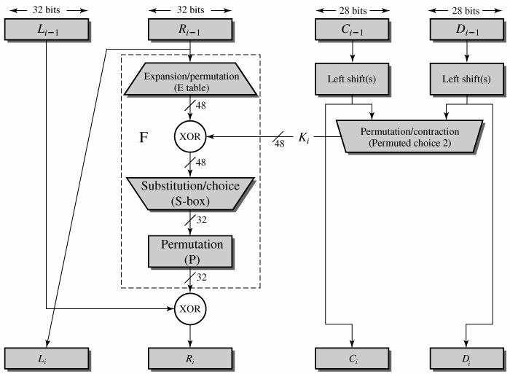
Details of Single Round

Slide 14
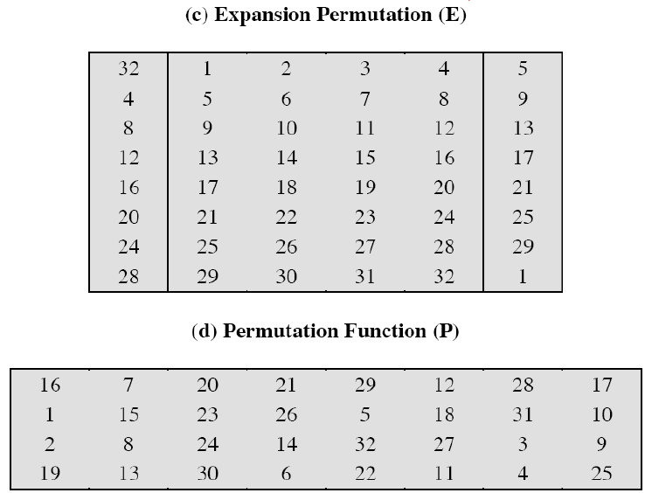
Permutation Tables E, P
48 Bits
32 Bits

Slide 15
Role of S-Boxes
The substitution consists of a set of eight S-boxes, each of which accepts 6 bits as input and produces 4 bits as output.
The first and last bits (outer 2 bits) of the input to box S_{i} form a 2-bit binary number to select one of four substitutions defined by the four rows in the table for S_{i}.
The middle four bits select one of the sixteen columns.
The decimal value in the cell selected by the row and column is then converted to its 4-bit representation to produce the output.
8, 4-bit groups produce 32 bit output.

Slide 16
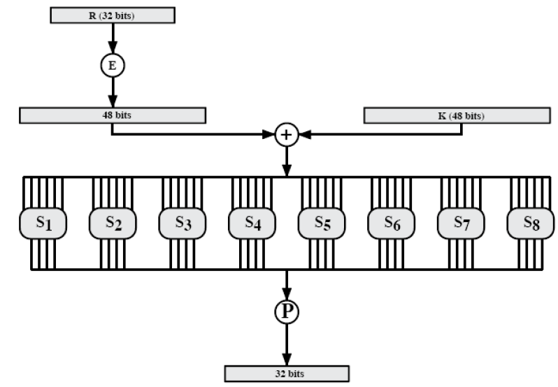
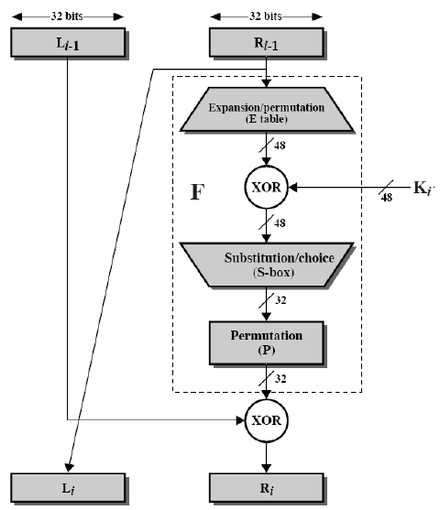
Role of S-Boxes
For example, in S₁ for input 011001, the row is 01 (row 1) and the column is 1100 (column 12). The value in row 1, column 12 is 9, so the output is 1001.

Slide 17
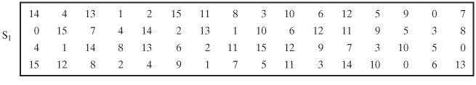
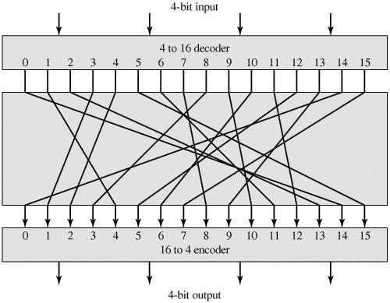

Slide 18
DES Encryption Overview

Slide 19
Key Generation
64-bit key used as input (8 × 8 table).
8th bit in each row is ignored → produces 56 bits.
Key is permuted using table Permuted Choice One PC-1
Resulting 56 bits separated into two 28-bit parts C0, D0
At each round:
C_{i-1} and D_{i-1} are separately subjected to a circular left shift, or rotation, of 1 or 2 bits, as governed by the Table.
These shifted values serve as input to the next round.
They also serve as input to Permuted Choice Two PC-2.
PC-2 produces a 48-bit output that serves as input to the function F(R_{i-1}, K_{i}).

Slide 20
Key Generation

Slide 21
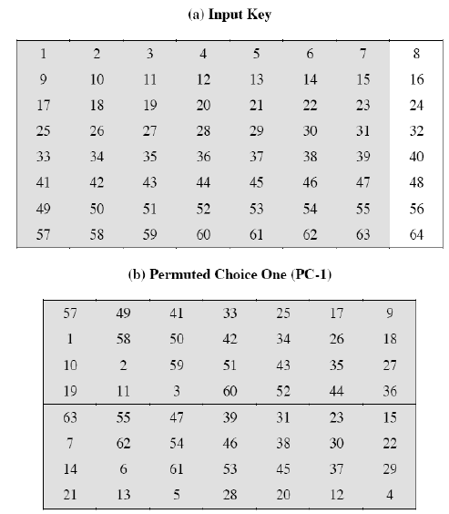
Key Generation
64 Bits
56 Bits

Slide 22
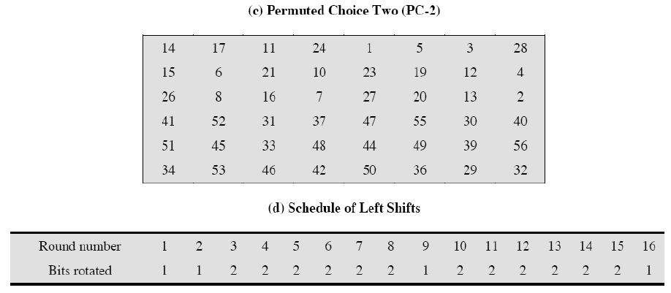
Key Generation
48 Bits

Slide 23
Avalanche Effect
Avalanche effect:
A small change in the plaintext or in the key results in a significant change in the ciphertext.
an evidence of high degree of diffusion and confusion
a desirable property of any encryption algorithm
DES exhibits a strong avalanche effect
Changing 1 bit in the plaintext affects 34 bits in the ciphertext on average.
1-bit change in the key affects 35 bits in the ciphertext on average.

Slide 24
Strength of DES
Key Size:
56-bit keys have 2⁵⁶ = 7.2 x 10¹⁶ values
brute force search looks hard
Timing Attacks:
a timing attack is one in which information about the key or the plaintext is obtained by observing how long it takes a given implementation to perform decryptions on various ciphertexts.
This is a long way from knowing the actual key.

Slide 25
Refrences
Cryptography and Network Security Principles and Practices, Fourth Edition By William Stallings.

Slide 26


